Slide 1
AWS relevant regulatory and non-regulatory material
(Dr I. Zahumensky, WIGOS-PO)

Slide 2
Observations
Compliant with
WMO Technical Regulations

Slide 3
WIGOS Framework
The WIGOS framework, at its simplest, is about:
  Timely delivery of observations that:
    meet user needs, in a way
    they can use them
    (delivery of the fit-for-purpose reliable & trusted observations),
  Documenting and implementing practices and procedures in making and sharing observations,
  … … …
Notes:
Interoperability: Ability to access, combine or compare observations from one source or system with those from another

Slide 4
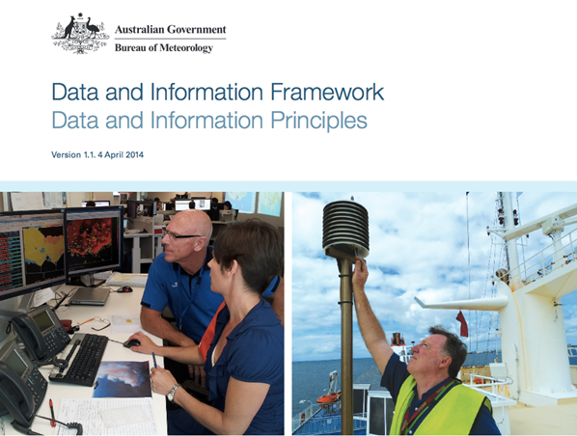
Trusted & reliable Observations
Quality assured,
Quality controlled,
Well documented (i.e. WIGOS Metadata available),
Compatible,
Discoverable, accessible and usable,
Delivering value, i.e. meeting the needs of government, the community, industry and stakeholders
Notes:
4

Slide 5
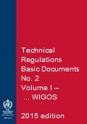
Observations
Compliant with WMO Regulations
(Basic Documents No. 2, WMO-No. 49)
Notes:
5

Slide 6
WMO Technical Regulations
(WMO-No. 49)

Slide 7
WMO Technical Regulations (WMO-No. 49)
TRs
(Vol. I – IV)
Manuals
(Annex 1 – 9)
Guides
Other reference docs
(e.g. WMO-No.9, 100, 134, 168, …, Guidelines, etc.)
Regulations
Basic Provisions
Mostly requirements-driven
Relatively Conservative
“Shall”
and “Should”
have specific
meaning
More detailed Provisions
Mostly technology-driven
Relatively Dynamic
Best procedures and practices, implementation guidance, explanations, examples on
how to implement and operate observing systems
Non-Regulations
“Should”
has ordinary
meaning
Notes:
on how to implement and operate national observing systems in accordance with TR

Slide 8
WMO-No. 49 Provisions (practices and procedures)
Standard practices and procedures
Recommended practices and procedures
Notes:
ARTICLE 9
Execution of Congress decisions
(a) All Members shall do their utmost to implement the decisions of Congress;
(b) If, however, any Member finds it impracticable to give effect to some requirement in a technical resolution adopted by Congress, such
Member shall inform the Secretary-General of the Organization whether its inability to give effect to it is provisional or final, and state its reasons
therefor.

Slide 9
WMO-No. 49 - Standards
The standard practices and procedures:
Are those practices and procedures which it is necessary that Members follow or implement;
Are distinguished by the use of the term shall in the English text and by suitable equivalent terms in the French, Russian and Spanish texts.
Notes:
ARTICLE 9
Execution of Congress decisions
(a) All Members shall do their utmost to implement the decisions of Congress;
(b) If, however, any Member finds it impracticable to give effect to some requirement in a technical resolution adopted by Congress, such
Member shall inform the Secretary-General of the Organization whether its inability to give effect to it is provisional or final, and state its reasons
therefor.

Slide 10
WMO-No. 49 - Recommendations
The recommended practices and procedures:
Are those practices and procedures which it is desirable that Members follow or implement;
Are distinguished by the use of the term should in the English text and by suitable equivalent terms in the French, Russian and Spanish texts.

Slide 11
WIGOS relevant
WMO Technical Regulations

Slide 12
(WMO-No. 49) Volume I – General Standards and Recommended Practices (2015 edition)
PART I. WMO Integrated Global Observing System (WIGOS); Date of effect: 1 July 2016
PART II. WMO Information System (WIS)
PART III. Data Processing and Forecasting
PART IV. Meteorological, hydrological and climatological applications and services
PART V. Education and training
PART VI. Competence of meteorological, hydrological and climatological personnel

Slide 13
Vol. I, Part I – WIGOS & Manual on WIGOS
Introduction to WIGOS
Common attributes of WIGOS component systems
Attributes specific to the surface-based sub-system of WIGOS
Attributes specific to the space-based sub-system of WIGOS
Attributes specific to the global observing system of WWW
Attributes specific to the global observing system of GAW
Attributes specific to the global observing system of WHOS
Attributes specific to the global observing system of GCW
Notes:
http://library.wmo.int/pmb_ged/wmo_1157_en.pdf; Resolutions 25 and 26 (Cg-17)

Slide 14
Vol. I, Part I – WIGOS & Manual on WIGOS
2. Common attributes of WIGOS component
systems
2.1 Requirements
2.2 Design, Planning and Evolution
2.3 Instrumentation and Methods of Observation
2.4 Operations
2.5 Observational Metadata
2.6 Quality Management
2.7 Capacity Development

Slide 15
Manual on WIGOS
2. Common attributes of WIGOS component systems
2.1 Requirements
2.2 Design, Planning and Evolution
Appendices 2.1 - 2.3 (OND Principles; GCOS CMP; RRR)
2.3 Instrumentation and Methods of Observation
2.4 Operations
Attachment 2.1 (WIGOS Station Identifier)
2.5 Observational Metadata
Appendix 2.4 (WIGOS Metadata Standard)
Attachment to Appendix 2.4
Attachment 2.2 (WIR)
2.6 Quality Management
Appendix 2.5
2.7 Capacity Development
Notes:
In Section 2 the standard and recommended practices and procedures relevant to each WIGOS process can be found in the following sub-sections:
Determination of user requirements: 2.1, 2.2
Design, planning and evolution of WIGOS: 2.2
Development and documentation of standard and recommended practices and procedures for observing systems: 2.3
Implementation of observing system by owners and operators: 2.3, 2.4
Observing system operation and maintenance including fault management and audit: 2.4
Observation quality control: 2.4, 2.6
Observations and observational metadata delivery: 2.4, 2.5
Performance monitoring: 2.4, 2.6
User feedback and review of requirements: 2.2, 2.6
Capacity development (including training): 2.7

Slide 16
WIGOS Metadata Standard – Content
I - Purpose and Scope of WIGOS Metadata
II - WIGOS Metadata Categories
III - A Note on Space and Time
IV - Reporting Obligations for WIGOS Metadata
V - Technical Implementation and Use of Standard
VI - Adoption through a Phased Approach
VII - Detailed specification of WIGOS metadata elements
Category 1
…
Category 10
VIII - References
ANNEX – Code Tables

Slide 17
WIGOS Metadata Standard - Categories
Category 1: Observed variable
Category 2: Purpose of Observation
Category 3: Station/Platform
Category 4: Environment
Category 5: Instruments and Methods of Observation
Category 6: Sampling
Category 7: Data Processing and Reporting
Category 8: Data Quality
Category 9: Ownership & Data Policy
Category 10: Contact

Slide 18
Purpose and Scope of WIGOS Tech. Regs
Designed to:
  Specify obligations of Members in the implementation and operation of the WIGOS component observing systems; and
  Facilitate cooperation in WIGOS observations between Members.

Slide 19
Purpose and Scope of WIGOS Tech. Regs.
Vol. I, Part I – WIGOS:
  It specifies WIGOS institutional and system requirements (standards) and recommendations
Manual on WIGOS
  It specifies WIGOS technical standards and recommendations of an operational nature

Slide 20
Purpose and Scope of WIGOS Tech. Regs.
For:
  Establishment of global, regional and national networks and facilities;
  Establishment of an authority or a responsible body;
  Human resources requirements (including education and training, competences, qualifications, etc.);

Slide 21
Vol. I, Part I – WIGOS
2.4.4 Quality Control
2.4.4.1 Members shall implement quality control for all observations for which they are responsible.
Manual on WIGOS
2.4.3 Quality Control
2.4.3.1 Members shall ensure observations provided through their WIGOS component observing systems are quality controlled.
2.4.3.2 Members shall implement real-time quality control prior to exchange of observations via the WMO Information System.

Slide 22
2.4.3 Quality Control
2.4.3.2 Members shall implement real-time quality control prior to exchange of observations via the WMO Information System.
Note 1: Quality control of observations consists of examination of observations at stations and at data centres to detect errors so that observations may be either corrected or flagged. A quality control system should include procedures for returning to the source of observations to verify them and to prevent recurrence of errors. Quality control is applied in real time, but it also operates in non-real-time, as delayed quality control. Observations quality depends on the quality control procedures applied during observations acquisition and processing and during preparation of messages, in order to eliminate the main sources of errors and ensure the highest possible standard of accuracy for the optimum use of these observations by all possible users.
Notes 2: Quality control on a real-time basis also takes place in the Global Data-Processing and Forecasting System, prior to the use of the meteorological and climatological observations in data processing (i.e. objective analysis and forecasting).
Note 3: Recommended minimum standards of quality control of the meteorological and climatological observations at the level of the National Meteorological Centre are given in the Manual on the Global Data-processing and Forecasting System (WMO-No. 485), Volume I – Global Aspects, Appendix II-1, Table I. The Guide on the Global Data-processing System (WMO-No. 305) should be consulted for more detailed guidance.
Notes:
WIGOS DQC processes should be developed and implemented in order to meet data quality standards or as specified within the Manual on WIGOS and should include (but not necessarily be limited to) where and as necessary the following processes or activities:
Testing of the validity of a data value against a standard reference value;
Testing of the validity of a data value against an alternative and representative data value;
Testing of the validity of a data value against scientifically derived data sample bounds;
Testing of the validity of a data value for temporal and spatial consistency;
Testing of the validity of metadata associated with data values;
Documentation of the results of tests applied to data values through the use of data flags, metadata parameters or other documentation; or
The removal of invalid data from data products or messages.
Further guidance:
WMO‑No. 485, Part II, 2.1.3 – Minimum standards;
WMO‑No. 305, Chapter 6;
WMO-No. 100, 2.6.3, 2.6.8, 3.4;
WMO-No. 305, Chapter 6;
WMO-No. 488 Chapter VI and VII;
WMO-No. 958, Chapter 6;
Marine observations: WMO‑No. 781, 3.1.4, Appendix I; WMO‑No. 471, 3.2.9, Annex 3E; WMO‑No. 558, Volume I, 5.6.3; Data, Manuals and Guides, No. 26, UNESCO.

Slide 23
Examples
2.1.1 Members shall establish, operate and maintain their national observing systems to address observational requirements in an integrated, coordinated and sustainable manner.
2.2.1.2 Members shall plan and operate their networks in a sustainable and reliable manner utilizing WIGOS standard and recommended practices and procedures, and tools.

Slide 24
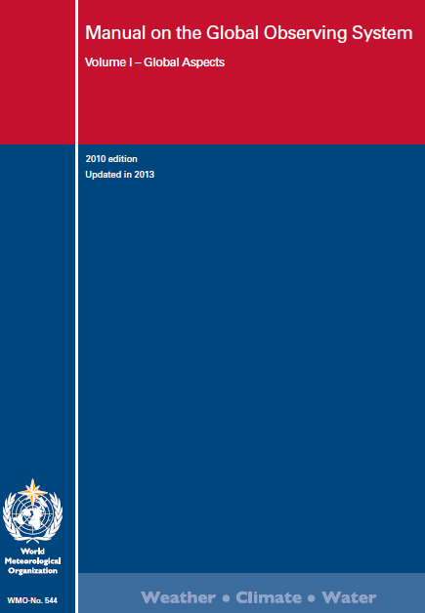
Manual on WIGOS
It should be read in conjunction with Volumes I-IV of WMO-No. 49 and the set of observation relevant Manuals, specifically the Manual on the GOS (WMO-No. 544) (2015 Edition)

Slide 25
  Two groups of provisions
Provisions that have been already specified in TR;
Provisions that specify new requirements, mainly related to:
  WIGOS Information Resource, including OSCAR/Surface,
  WIGOS Metadata and WIGOS Station Identifier,
  Observing Network Design Principles,
  Performance monitoring,
  Quality monitoring,
  Incident management.
WMO

Slide 26
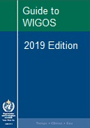
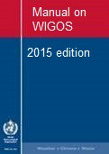
New WIGOS TR and WIGOS Guidance Material
more detailed information, best practices and procedures, explanation and examples on how to implement and operated national observing systems in accordance with TR
WMO
Notes:
Request for sharing by Members those best practices, procedures to be used by others at the Regional / Global levels
The Guide should provide more detailed information, best practices and procedures, explanation and examples on how to implement standard and recommended practices and procedures specified in the Volume I, Part I – WIGOS of the WMO Technical Regulations (WMO-No. 49) and Manual on WIGOS into day-to-day operations.
The Guide is intended to be used by managers/supervisors and other technical staff of NMHSs responsible for planning, implementation, performance and operation of national observing systems/networks. These individuals are the target audience.

Slide 27
AWS Guidance

Slide 28
Guidance for transition to AWS/AWOS
Apparent lack of single guidance on AWS (e.g. handbook or a dedicated chapter/part in the WMO guide) with best practices and procedures on entire life cycle of AWS
Notes:
More and more WMO Members are migrating from manual to automatic observations. Regrettably, there is an apparent lack of single guidance on AWS (e.g. handbook or a dedicated chapter/part in the WMO guide), providing Members with best practices and procedures on entire life cycle of AWS

Slide 29
AWS Guidance
Entire life cycle of AWS:
  Initial consideration
  High-level planning
  Detailed planning
  Procurement
  Field Implementation
  Operations
Notes:
initial consideration and planning through defining a network design, basic functional and technical requirements and specifications; procurement; installation; operations, incl. maintenance, performance and quality monitoring; just to mention some of them.

Slide 30
High-level planning
Challenges and consequences of automation (implementation of a network of AWSs)
User requirements
Sustainability
Lifetime cost and return on investment consideration
Working with Partners
Business arrangement(s) / working with Partners
Dealing with donors
Network design (high-level consideration)
Strategy for automation

Slide 31
Detailed planning
Observing network requirements and considerations (basic requirements; operations requirements; technical infrastructure requirements)
Network design (more details consideration)
Selection of proper sites (purpose, observing programme, accessibility, protection/security, power supply, telecommunications, staffing; present and future environment; sharing of platforms)
System architecture (incl. processing model)
Functional specification and Technical specification
…

Slide 32
Detailed planning
…
Installation cost
Operational cost
Expertise requirements and Staffing
Training / refreshment courses
Budgeting/Life cycle resourcing
Tender

Slide 33
AWS Web Portal
on Development, Maintenance and Operation of Instruments, Observing Methods and Automatic Weather Stations:
www.wmo.int/pages/prog/www/IMOP/WebPortal-AWS/Index.html
Notes:
33

Slide 34
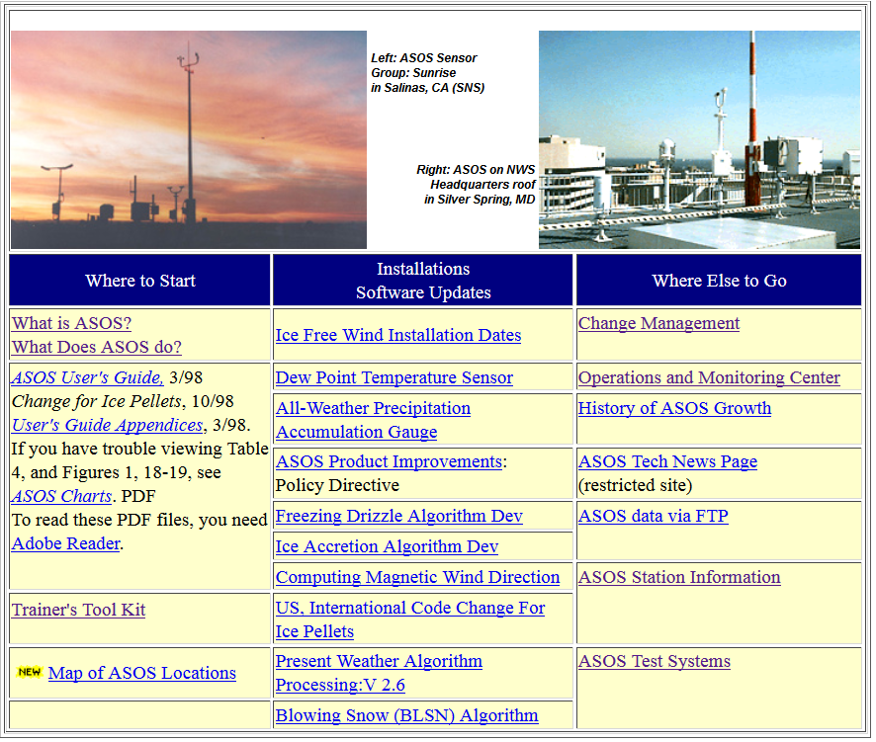
http://www.nws.noaa.gov/asos/index.html
Notes:
34

Slide 35
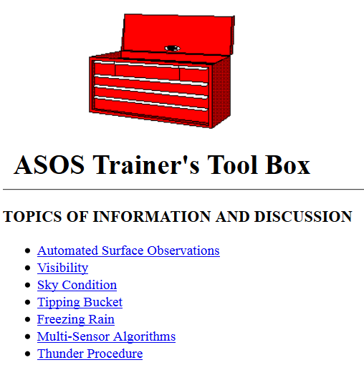
http://www.nws.noaa.gov/asos/toolkt.htm
Notes:
35

Slide 36
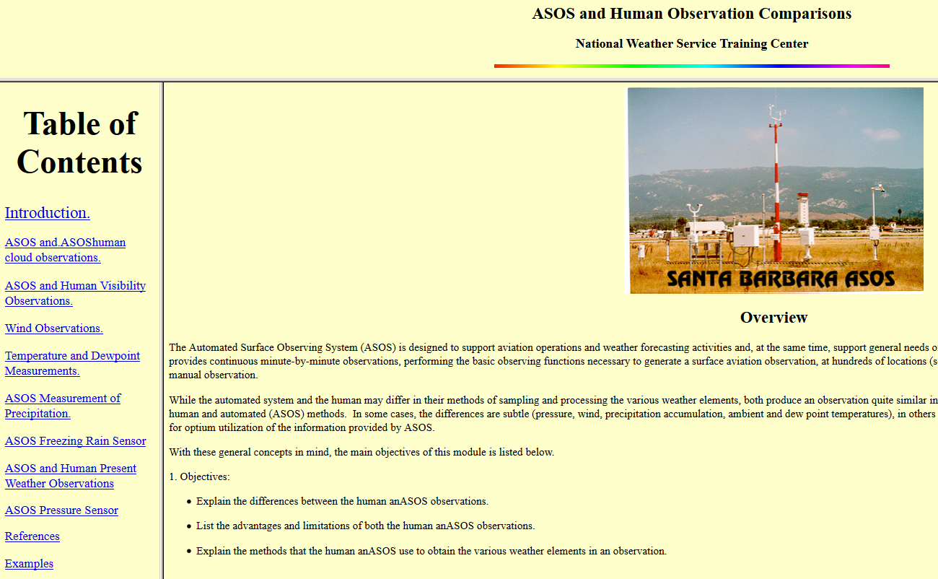
http://www.nwstc.noaa.gov/DATAACQ/d.ASOShuman/ASOSHome.htm
Notes:
36

Slide 37
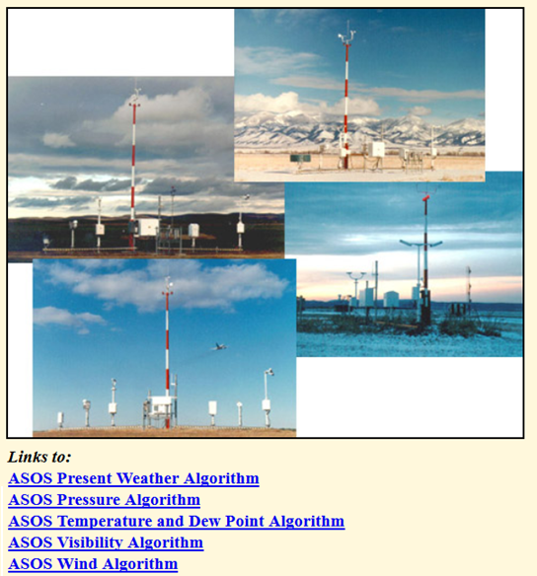
http://www.nwstc.noaa.gov/DATAACQ/d.ALGOR/d.BASIC/BASICalgoMenu.html
Notes:
37

Slide 38
AWS Guidance – Initial Steps
Draft Table of Content with
Initial list of references to various WMO and non-WMO publications, documents, papers, and web pages relevant to AWS: www.wmo.int/pages/prog/www/wigos/WGM.html
The aim: to help NMHSs and their Partners to find guidance on best practice and procedures for planning, establishing and sustainable operations of AWS

Slide 39
AWS Guidance – Draft Table of Content
“Missing” topics - could/should be added, for example:
  Infrastructure requirements
  Installation and operational costs
  Special requirements for extreme climate conditions
  Long-term sustainability
  Expected changes of AWS environment
  Life-cycle requirements
  Installation procedures and practices
  Sensors shelters;
  Sensors protection,
  etc. …

Slide 40
AWS Guidance – References
[1] WMO-No. 49; Volume II
[2] WMO-No. 8
[3] WMO-No. 488
[4] WMO-No. 100
[5] WMO-No. 134
[6] WMO-No. 168, Volume I
[7] WMO-No. 188
[8] WMO-No. 305
[9] WMO-No. 544
[9a] WMO-No. 731
Notes:
References to Automatic Weather Station (AWS) relevant guidance material

Slide 41
AWS Guidance – References
[10] WMO/TD-No. 862
[11] WMO/TD-No. 872
[12] WMO/TD-No. 1074
[13] WMO/TD-No. 1185
[14] WMO/TD-No. 1307
[15] WMO/TD-No. 1504
[16] WMO/TD-No. 1544
Notes:
References to Automatic Weather Station (AWS) relevant guidance material

Slide 42
AWS Guidance – References
[17] BoM Observation Specification No. 2013.1.
[18] ASOS User’s Guide (aum-toc.pdf)
[19] A Guide to the Siting, Exposure and Calibration of Automatic Weather Stations for Synoptic and Climatological Observations
[20] Handbook for the Meteorological Observation
[21] Manual on Automatic Meteorological Observing Systems at Aerodromes (ICAO, Doc. 9837)
[22] Quality Assurance Procedures in the Oklahoma Mesonetwork (Journal of Atmospheric and Oceanic Technology, Volume 17, Issue 4 (April 2000))
Notes:
References to Automatic Weather Station (AWS) relevant guidance material

Slide 43
AWS Guidance – References
[23] Quality Assurance Procedures for Mesoscale Meteorological Data (Journal of Atmospheric and Oceanic Technology, Volume 27 (April 2010))
[24] Automatic Weather Stations for Agricultural and Other Applications
[25] Lecture Notes on WMO Training Workshop for Instrument Specialist of RA II (Japan, 1998)
Notes:
References to Automatic Weather Station (AWS) relevant guidance material

Slide 44
AWS Guidance – References
[26] Expert Team on Requirements of Data from Automatic Weather Stations, Fifth Session, Geneva, 2008
[27] Expert Team on Requirements and Implementation AWS Platforms, Sixth Session, Geneva, 2010
[28] Expert Team on Requirements and Implementation AWS Platforms (ET-AWS), Seventh Session, Geneva, 2012
Notes:
References to Automatic Weather Station (AWS) relevant guidance material

Slide 45
AWS Guidance – References
[29] ASOS and Human Observation Comparisons
[30] ASOS Algorithms
[31] ASOS Trainer's Tool Box
[32] UNDP Procurement
[33] Request for Proposal (RFP) Document for Procurement of 484 GSM/GPRS based Automatic Weather Stations (AWS)
[34] Integrated Hydrometeorological Monitoring Solutions and Network Management
[35] Quality Control of Meteorological Observations; Automatic Methods Used in the Nordic Countries
[36] MeteoSwiss acceptance procedure for automatic weather stations
Notes:
References to Automatic Weather Station (AWS) relevant guidance material

Slide 46
Thank you for your attention
www.wmo.int/wigos
izahumensky@wmo.int

