Slide 1
The Caribbean Institute
for
Meteorology and Hydrology
Regional AWS Issues For RA-IV
by
Marvin Forde
Technical Officer(I)
WMO RA IV WIGOS Implementation Workshop (English)
(Willemstad, Curaçao, 1–3 December, 2015)
Notes:
1

Slide 2
Mission Statement
To assist in improving and developing the Meteorological and Hydrological Services as well as providing the awareness of the benefits of Meteorology and Hydrology for the economic well-being of the CIMH member states. This is achieved through training, research, investigations, and the provision of related specialised services and advice.
Notes:
2

Slide 3
The Caribbean Meteorological Organization
Membership
Anguilla
Antigua and Barbuda
Barbados
Belize
British Virgin Islands
Cayman Islands
Dominica
Grenada
Guyana
Jamaica
Montserrat
St. Kitts/Nevis
St. Lucia
St. Vincent and the Grenadines
Trinidad and Tobago
Turks and Caicos Islands
Notes:
3

Slide 4
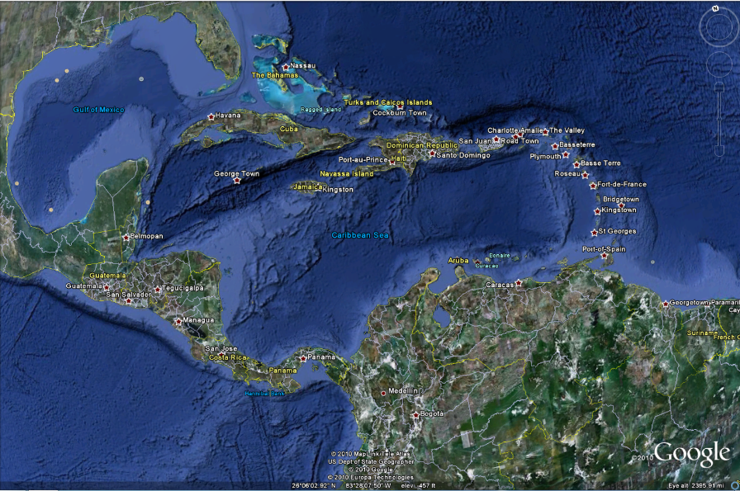
The Caribbean Meteorological Organization

Slide 5
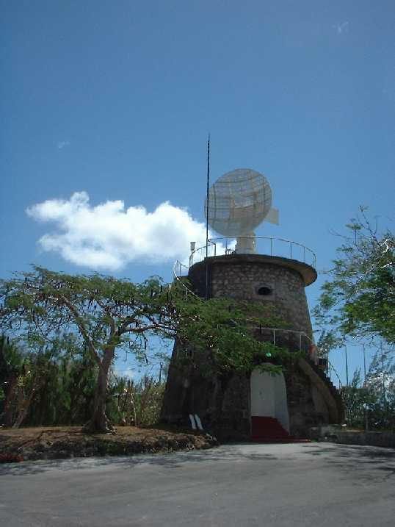
Functions of the Caribbean Institute for Meteorology & Hydrology
WMO Regional Training Centre - Train various categories of meteorological and hydrological personnel
Operate as a centre of research in meteorology, hydrology and associated sciences
Regional Climate Data Centre - Data collection, storage, & dissemination
Regional Instrument Centre – Develop, maintain, repair, and calibrate meteorological & hydrological instruments
Regional Centre of Excellence for Satellite Meteorology
WMO Regional Climate Centre (Demonstration Phase)
Caribbean Centre for Climate and Environmental Simulations CCCES)
Advisor to regional governments on matters related to meteorology, climate & hydrology
Provide specialized services to industry
Notes:
5

Slide 6
DATA
Products and Services
Notes:
6

Slide 7
How is this Data Collected
Meteorological Offices (Airports)
Official manned Sites
Automatic Weather Stations (AWS)
Notes:
7

Slide 8
Suitable Siting of AWS
Physical siting space
Location with respect to critical locations
Security
Theft
Notes:
8

Slide 9
Cost of AWS
Fully functional AWS USD $20,000 – $30,000
Procurement is project oriented
Notes:
9

Slide 10
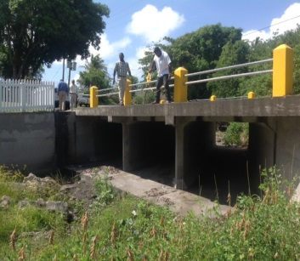
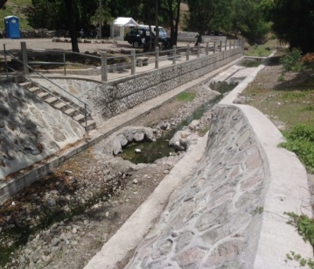
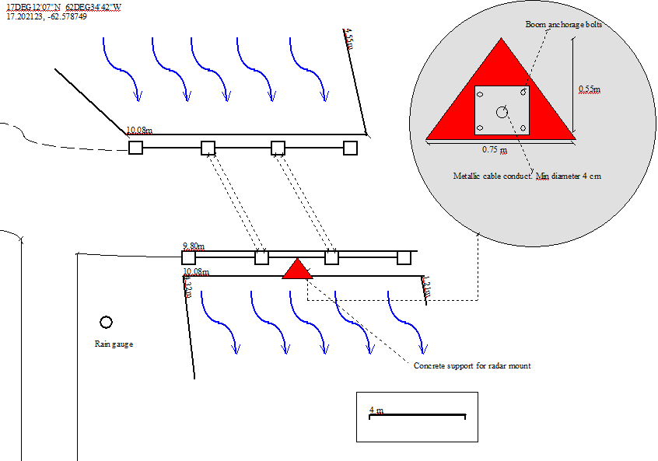
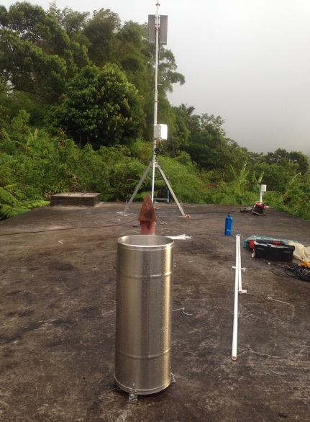
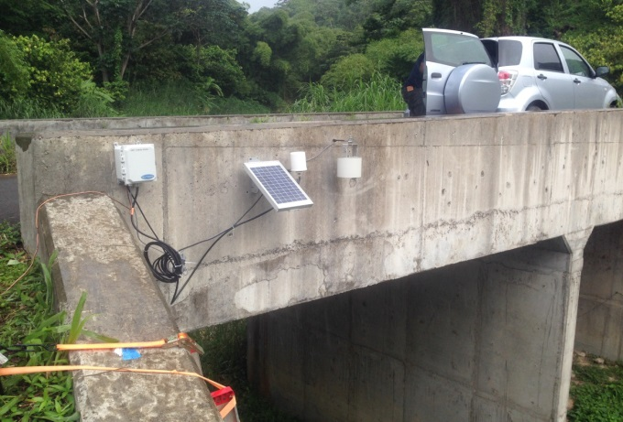
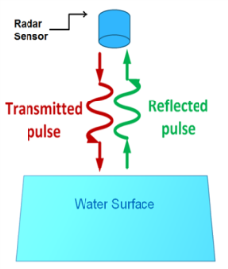
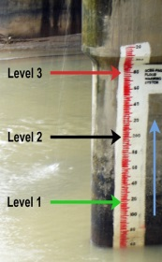
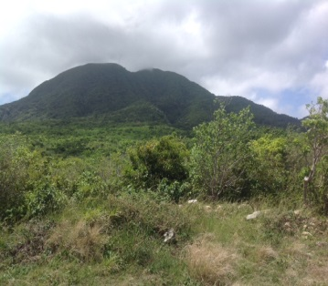
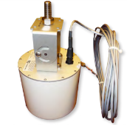
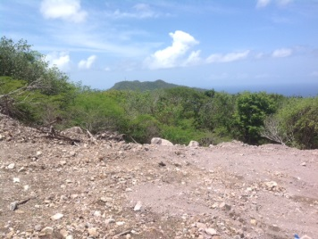
Phase I - Nevis Flood Mitigation Project:
Develop and Implement Hydrological Data Collection, Monitoring, and Early Warning System
Nesbit Plantation
The island of Nevis is susceptible to occasional flooding and flood damage. To mitigate this, the Caribbean Institute for Meteorology and Hydrology with HALCROW have designed a flood mitigation early warning system which will provide early flood warning and additionally make available high quality long term hydro-meteorological data to compliment registers from the numerous manual networks on the island. In phase I, four sites will be installed; two rain gauges and two water level sensors.
Stoney Grove Bath
Spring Hill
Detail of the installations proposed.
Morgan Estate
Data saved from the proposed system will be utilized to obtain a clearer understanding of precipitation episodes and their temporal evolution, coupled with improved flood warning forecasts and damage mitigation measures.

Slide 11
Data Dissemination
Radio Frequency
Topography
Telecommunication Technologies
Internet
Satellite
GSM/GPRS
Notes:
11

Slide 12
Personnel Training
Continued Training of Technical Personnel
Builds capacity within service
Reduces down time
Notes:
12

Slide 13
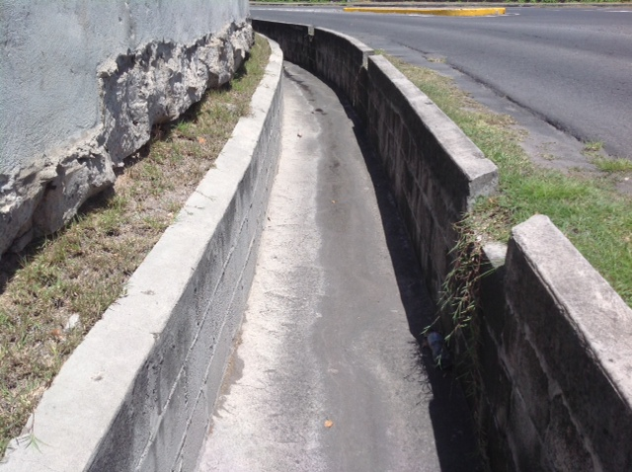
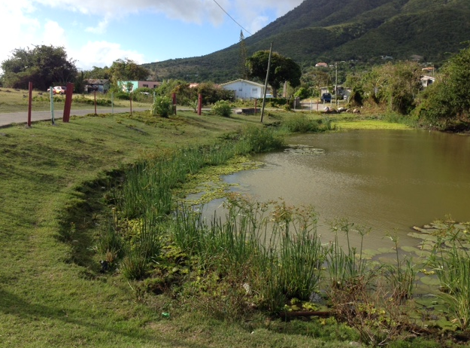
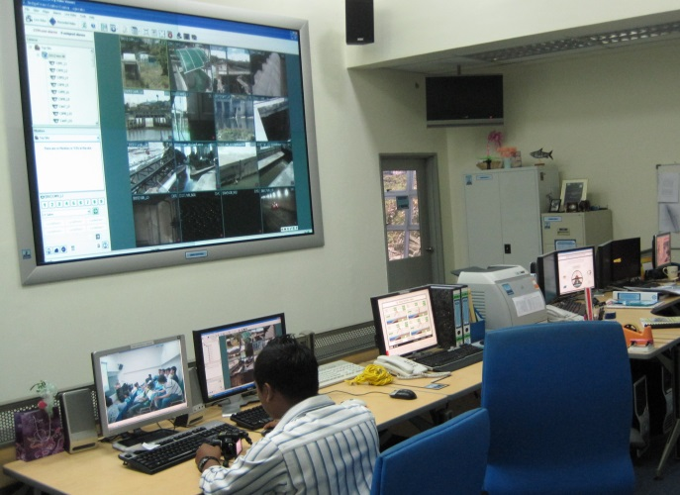
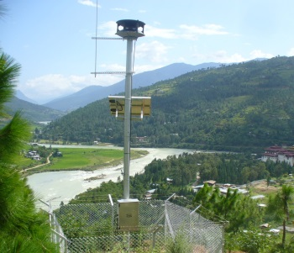
Phase II - Nevis Flood Mitigation Project:
Develop and Implement Hydrological Data Collection, Monitoring, and Early Warning System
Phase II of the project involves the installation of two additional stations together with a Central Control Room to facilitate the effective management of the system under normal and extraordinary circumstances.
Stoney Grove Siren
Pond Hill Siren
Central Control Room
The control room will be located in a secure installation and will be provided with an independent back-up power supply, radio communication and dedicated phone lines. Two operator posts will be established together with facilities aimed towards presenting information in a clear concise fashion.
In addition the Nevis Authority will be provided with on site training together with a residential Hydrological Technician training course in Barbados.
A 4 x 4 pick-up vehicle will also be supplied to facilitate field maintenance duties.

Slide 14
Acts of God
Hurricanes
Severe Flooding
Notes:
14

Slide 15
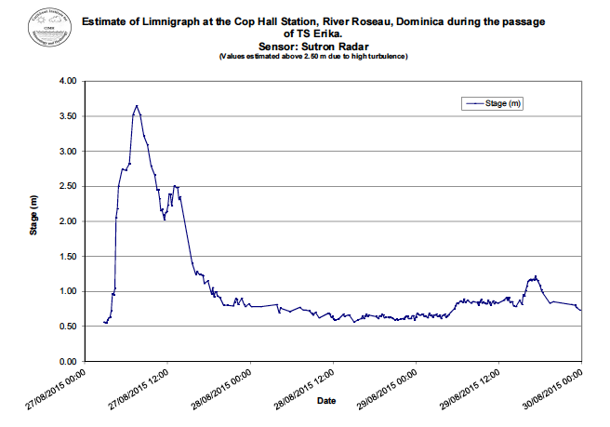
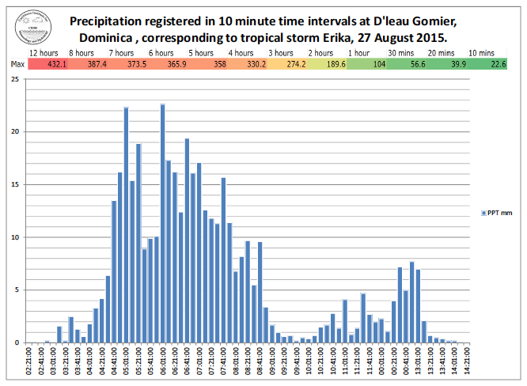
Support to Dominica Post Erika
CIMH reached out to Dominica immediately after the event through CDEMA, ODPM and the Meteorological Service
Dr. Farrell and Mr. Marvin Forde traveled to Dominica carrying a replacement AWS for the Douglas Charles Airport with the assistance of the Barbados Coast Guard
Mr Forde was tasked to work with the technicians at the Met Service to replace the AWS at the end of the runway and to ensure that all other meteorological equipment at both airports were functioning properly and relaying data accurately, as well as looking at other parts of the observation network.

Slide 16
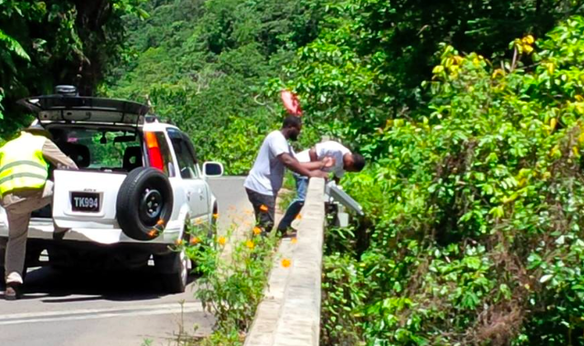
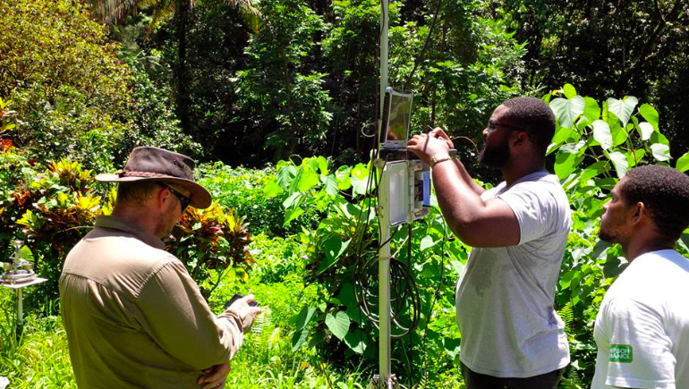
Support to Dominica Post Erika
Dr. Farrell led a follow up mission comprised of Dr. Jonathan Cox, Mr. Damien Prescod and Mr. Courtney Forde to Dominica to assess the geological stability of several watersheds and the status of the instruments in the early warning system. The mission also downloaded data from the various stations visited. Key findings:
Many of the stations in the early warning network survived the event but were subsequently vandalized. Where this occurred the stations were dismantled and stored.
Good data records were downloaded from the remaining stations and the stations reset.
Following discussions with the CDB, the bank has agreed to replace the stations it originally funded and will consider funding a top to bottom assessment of the early network in the near future

Slide 17
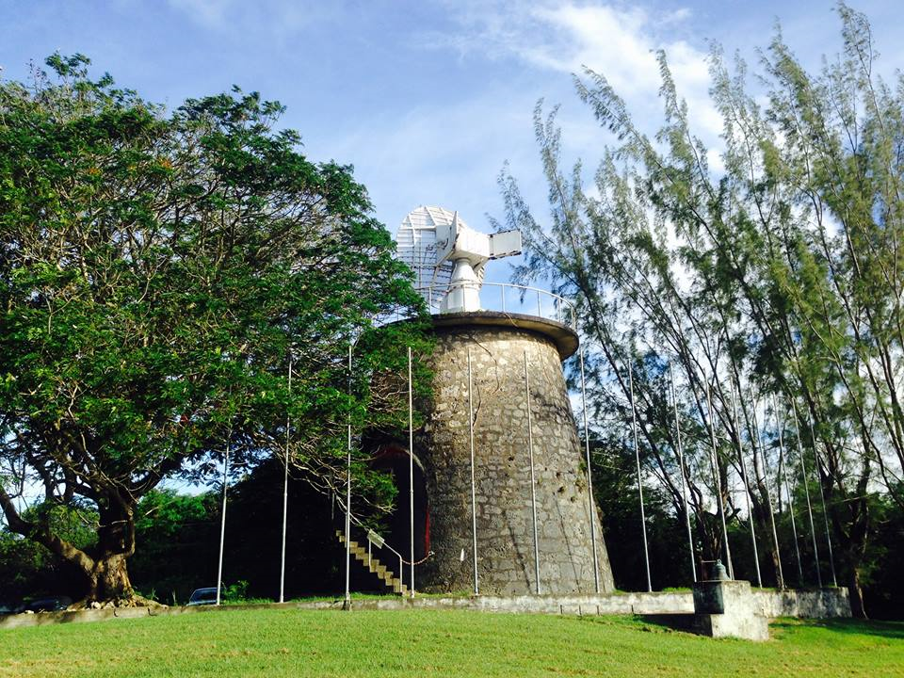
Thank You
Notes:
17

