Slide 1
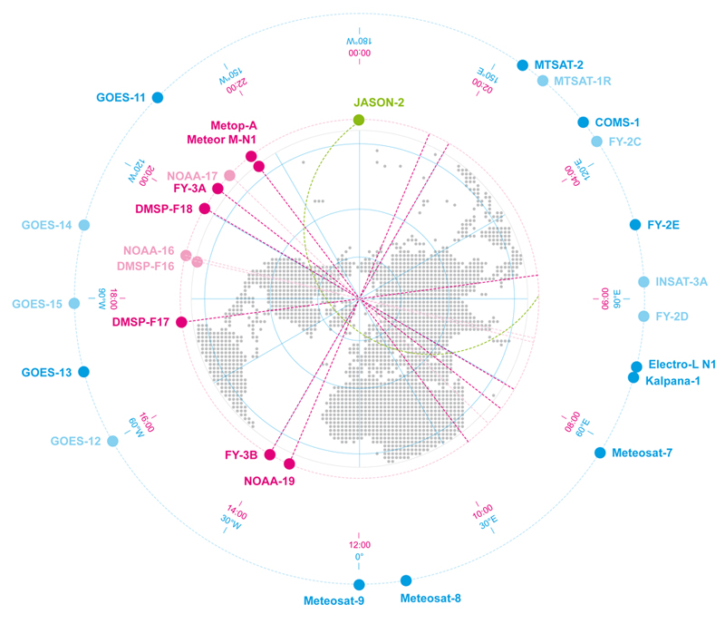
Progress Report on the RA II WIGOS Project to Develop Support for NMHSs in Satellite Data, Products and Training Co-coordinator, KMA and JMA RAII Expert Group on WIGOS 31 October 2016, Abu Dhabi, United Arab Emirates

Slide 2
I-1 History of RA II WIGOS Project
“Pilot Project to Develop Support for NMHSs in Satellite Data, Products and Training”
Adopted in the 14th session of WMO Regional Association II (XIV-RA II), held in Tashkent, Uzbekistan in December 2008
Procession to a WMO RA-II WIGOS Project
Agreed in the 2nd Coordination Group Meeting at Jeju, Republic of Korea on 8 October 2012
“RA II WIGOS Project to Develop Support for NMHSs in Satellite Data, Products and Training from 2013”
Decided at the 15th session of WMO RA II （RA II-15) at Doha, Qatar on 13-19 December 2012

Slide 3
I-2 Coordinating Group Members
WMO
Coordinating Group
Space Programme
Regional Office for
Asia and South-West Pacific
(13 countries as of 30 November 2012)
Viet Nam
Bahrain
Uzbekistan
China
Co-coordinators
Japan
Republic of Korea
Hong Kong, China
Russian Federation
publishing Newsletters
sharing information through Web and Mailing List
user requirement survey
providing information on satellite products, trainings from operators to satellite users
Pakistan
India
Oman
Kyrgyzstan
Maldives
EUMETSAT
(Observer)
Satellite Operators & NMHSs
(in alphabetically clockwise order)
Notes:
After the session, the WMO Secretariat invited WMO Members to join the Pilot Project Coordinating Group, whose members as of 30 September 2009 are Japan (Co-coordinator), the Republic of Korea (Co-coordinator), Bahrain, China, Hong Kong – China, India, Kyrgyzstan, Oman, Pakistan, the Russian Federation, Uzbekistan, Vietnam and, as an observer, EUMETSAT.

Slide 4
I-3 Terms of Reference of the Coordinating Group
To identify the requirements of NMHSs of WMO Members participating in the “Joint RA-II/RA-V WIGOS Satellite Data Project” regarding satellite imagery, data and products in support of their weather services, including forecasts and warnings;
To develop an inventory of the capabilities of the NMHSs listed under (a), in particular those from developing Members, in the areas of (i) satellite data reception, (ii) satellite data processing, (iii) satellite data interpretation and utilisation;
To provide a gap analysis in which the capabilities under (b) are matched against the requirements under (a); To develop an action plan to close the gap identified under (c);
To devise a protocol under which individual Members can request event-driven rapid-scan satellite data covering their national area of interest for Disaster Risk Reduction;
To report progress on this project to the RA-II and RA-V Management Groups

Slide 5
II. First to Fourth-Phase Accomplishment in RA II Pilot Project
1st: Sep. 2009 – Aug. 2010
2nd: Sep. 2010 – Aug. 2011
3rd: Sep. 2011 – Aug. 2012
4th: Sep. 2012 – Aug. 2013
Quarterly newsletters for RA II Members
Establishment of RA II Pilot Project Webpage on the WMO Space Programme (WMOSP) website (hosted by WMOSP)
Establishment of Portal Site for accessing satellite imagery, data and products as well as training on the Webpage
Conducting RA II Pilot Project questionnaire on the web to understand the needs of satellite data users in RA II
Operating on-site “Training Program” of satellite data processing, utilization and application as part of VLab

Slide 6
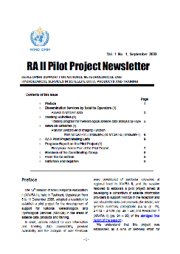
II-1 Quarterly Newsletters
Contents
Information on access to satellite imagery, data and products, including application products
News on meteorological satellites and new services
Progress in the Pilot Project
Introduction to the activities of other RAs and WMO VLab activities
Information on training activities and satellite related meetings
Issued Date
News letters have been issued almost quarterly.
Newsletter Vol. 1 No. 1, Sep. 2009 Newsletter Vol. 1 No. 2, Apr. 2010 ………
Newsletter Vol. 3 No. 3, Jul. 2012 Newsletter Vol. 3 No. 4, Sep. 2012

Slide 7
II-2 Coordinating Group Meeting
The 1st Meeting in Tokyo, Japan, 21–23 February 2011
Agreed to clarify satellite users’ needs and determine the status of utilization through the RA II Pilot Project questionnaire system;
Agreed to share information on access to satellite imagery, data, products and training information through the RA II Pilot Project portal site; and
Shared an understanding that cultivating human resources is essential in promoting the utilization of satellite products.
The 2nd Meeting in Jeju, Korea, 8 October 2012
4th phase action plan agreed to continue and extend on-going activities
Agreed to proceed to a WMO RA-II WIGOS project

Slide 8
III. Progress and Plan of the RA II WIGOS Project
RA II WIGOS Project webpage
http://www.jma.go.jp/jma/jma-eng/satellite/ra2wigosproject/ra2wigosproject-intro_en_jma.html

Slide 9
III-1 Accomplishments in the First to Forth-Phase
1st: Sep. 2013 – Aug. 2014
2nd: Sep. 2014 – Aug. 2015
3rd: Sep. 2015 – Aug. 2016
4th: Sep. 2016 – Aug. 2017
Quarterly Newsletters to RA II Members
Issued Date
- Vol. 4/No. 1, April 2013
- Vol. 4/No. 2, June 2013
- Vol. 4/No. 3, November 2013
- Vol. 4/No. 4, December 2013
- Vol. 5/No. 1, March 2014
- Vol. 5/No. 2, August 2014
- Vol. 5 No. 3, October 2014
- Vol. 5 No. 4, December 2014
- Vol. 6 No. 1, March 2015
- Vol. 6 No. 2, June 2015
- Vol. 6 No. 3, October 2015
- Vol. 6 No. 4, December 2015
- Vol. 7 No. 1, March 2016
- Vol. 7 No. 2, June 2016
- Vol. 7 No. 3, October 2016

Slide 10
III-1 Accomplishments (cont.)
4th Asia/Oceania Meteorological Satellite Users’ Conference
The conference was held in Melbourne, Australia from 9-11 October 2013.
The conference was hosted and sponsored by the Australian Bureau of Meteorology (AuBOM) and was co-sponsored by CMA, JMA, KMA and WMO
The conference was preceded by a two day training event at the AuBOM training facilities and brought together participants from Region II and V.
5th Asia/Oceania Meteorological Satellite Users’ Conference
CMA hosted the fifth AOMSUC in Shanghai in October of 2014.
Like as AOMSUC-3 and AOMSUC-4, the RA II WIGOS Project cooperated.
6th Asia/Oceania Meteorological Satellite Users’ Conference
JMA hosted the sixth AOMSUC in Tokyo in November of 2015.
A training event using new satellite data was also held in conjunction with AOMSUC-6 Plenary.
7th Asia/Oceania Meteorological Satellite Users’ Conference
KMA hosted the seventh AOMSUC in Songdo in October of 2016.
A training event at NMSC/KMA, and 4th Coordination Group meeting at Songdo were also held

Slide 11
III-1 Accomplishments (cont.)
The 3rd Meeting in Tokyo, Japan, 14 November 2015
The results of a questionnaire survey on the utilization of data from the new-generation geostationary meteorological satellites were presented.
Activities relating to SCOPE-Nowcasting were also reported.
Attendees at the first meeting of the SCOPE-Nowcasting Team in November 2013 established four pilot projects covering the areas of:
RGB composites for basic nowcasting
volcanic ash products
a combination of satellite global precipitation products (GEO + LEO) for advanced nowcasting
products for sand and dust forecasting
The following future steps in SCOPE-Nowcasting were also highlighted:
- Continuation of current pilot projects until 2016
- Ongoing team meetings via three-monthly teleconferences
- Project review at IPET-SUP in February 2016 (consideration of additional pilot projects)

Slide 12
III-1 Accomplishments (cont.)
Support users for smooth transition to the new generation geostationary meteorological satellites
Data distribution/dissemination methods of Himawari-8
HimawariCloud (via Internet)
Full Specification (temporal and spatial) of Imagery
HimawariCast (via communication satellite)
JMA’s Baseline for Imagery Dissemination
14 bands (1 Vis. And 13 IR) every 10 minutes for Full Disk
HimawariCast receiving systems
Some countries install by their own fund
Other countries install by the donation of WMO or Government of Japan

Slide 13
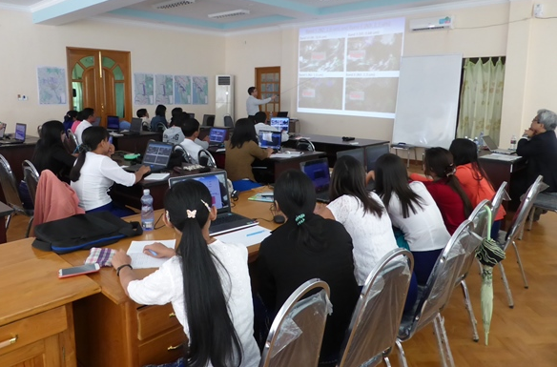
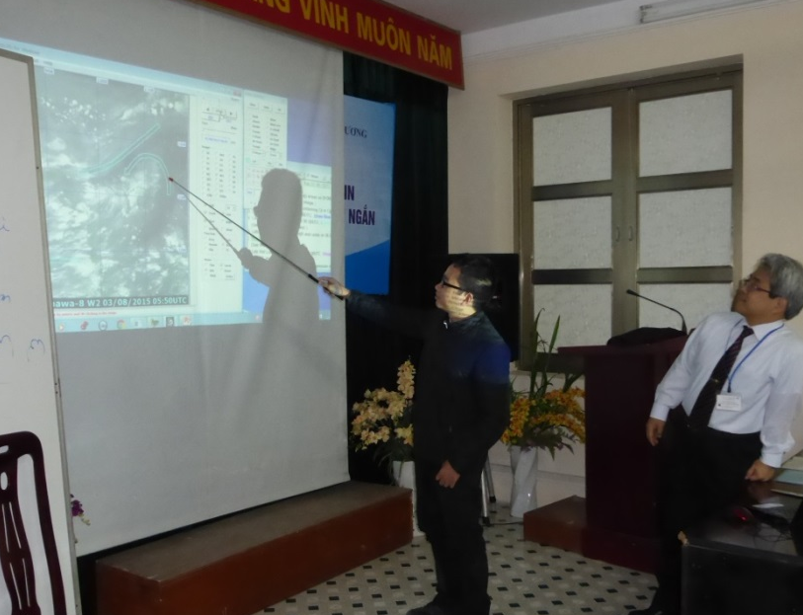
III-1 Accomplishments (cont.)
Training programs for users in Asia Oceania to facilitate efficient use of Himawari-8
Dispatching experts on satellite data utilization
Visited more than 15 NMHSs in the Asia Oceania region
More seminars are planned
Practical training with SATAID
Training program in Myanmar
Training program in Vietnam

Slide 14
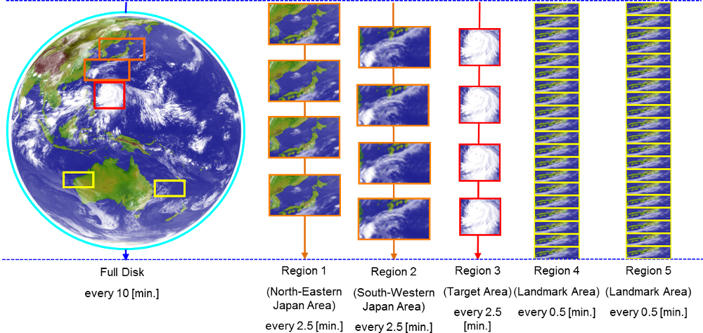
III-1 Accomplishments (cont.)
Feasibility study on Himawari-8 event-driven rapid-scan with AuBoM
AHI (Advanced Himawari Imager) on Himawari-8 has the ability of various scans during 10 minutes Full Disk observation.
AHI can flexibly change the scan range of “Target Area” for observation of phenomena such as typhoons and active volcanoes.
Essentially, the Himawari-8 rapid scan target area observation is focused on tropical cyclones in the RSMC Tokyo - Typhoon Center's area of responsibility and on volcanic eruptions for the Tokyo Volcanic Ash Advisory Center (VAAC Tokyo).
In case a typhoon occurs in Western North Pacific, JMA operates the tracking observation of the typhoon in constantly shifted scan range of the Target Area.

Slide 15
III-1 Accomplishments (cont.)
Feasibility study on Himawari-8 event-driven rapid-scan with AuBoM (cont.)
In October 2015, the Joint RA-II/RA-V Workshop on WIGOS for Disaster Risk Reduction adopted the Jakarta Declaration, and one of its goals is aimed at developing a protocol for NMHSs of the countries in the region to request event-driven rapid scan imagery.
Based on the Declaration, JMA and Australian Bureau of Meteorology (AuBoM) conducted a joint feasibility study toward the development of a protocol for the request of Himawari-8 Rapid Scan observation between February and March 2016.
JMA collaborates with AuBoM to create the cyclone tracking system by “Target Area” observation during high season for cyclone whereas low season for typhoon.
Observation area of Himawari-8

Slide 16
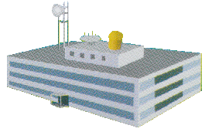
III-1 Accomplishments (cont.)
Feasibility study on Himawari-8 event-driven rapid-scan with AuBoM (cont.)
AuBoM creates the reservation file which specifies the duration and coordinates of observation.
AuBoM uploads the file on the dedicated web page.
JMA constantly surveils this web page.
When AuBM renews the reservation file, JMA “wget”s the file from the web page and makes a new command of “Target Area” determined by the file.
JMA checks format, duration and coordinate of the reservation file (automatically).
In case of conflict between JMA’s observation and AuBoM’s one, the schedule coordinate system in JMA adjusts each reservation in order of priority. ( e.g. set higher priority to typhoon observation than that of cyclone)
Observation Command File
AuBOM
Himawari-8
New Command
wget
JMA

Slide 17
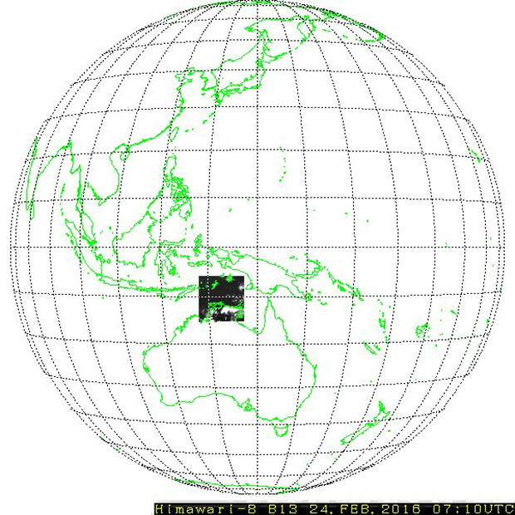
III-1 Accomplishments (cont.)
Feasibility study on Himawari-8 event-driven rapid-scan with AuBoM (cont.)
The test observation was operated six days.
There was no cyclone within the area of responsibility of AuBoM.
The test itself were conducted and the observation successfully operated as AuBoM had expected.
07:10UTC 24 Feb. 2016

Slide 18
III-1 Accomplishments (cont.)
Feasibility study on Himawari-8 event-driven rapid-scan with AuBoM (cont.)
Example : 09 May 2015
21UTC 09 – 10UTC 10 May 2015 (typhoon Noul)

Slide 19
III-1 Accomplishments (cont.)
Feasibility study on Himawari-8 event-driven rapid-scan with AuBoM (Summary)
Based on the Jakarta declaration, JMA and AuBoM successfully conducted the feasibility study during high season for cyclone whereas low season for typhoon from Feb. to Mar. 2016.
The request-based Target Area observation can be one option of rapid scan observation.
Essentially, the Himawari-8 rapid scan target area observation is focused on tropical cyclones in the RSMC Tokyo - Typhoon Center's area of responsibility and on volcanic eruptions for the Tokyo Volcanic Ash Advisory Center (VAAC Tokyo).
Basicalｌy, it is necessary for users to be ready to fully utilize the new 10-min high-resolution 16-band routine observations for their disaster risk reduction activities.
JMA will support NMHSs in their establishing the capabilities of accessing and using the Target Area observation data, and in making special observations using the Target Area observation according to the request of NMHSs in support of disaster risk reduction.

Slide 20
III-2 Future Plan
Supportive activities for preparation of satellite data users to the new generation of geostationary meteorological satellites
The new generation geostationary meteorological satellites such as Himawari-8, FY-4A, GEO-KOMPSAT-2A are planning to be sequentially operated after 2015.
The RA II WIGOS Project will support for preparation of the NMHSs in RA II especially developing countries including LDCs to the new satellites.
It will involve user training, guidance to upgrade processing software and hardware, information and tools.
8th Asia/Oceania Meteorological Satellite Users’ Conference
ROSHYDROMET will host the eighth AOMSUC at Vladivostok in 2017
It is suggested to continue such a cooperative training event in conjunction with AOMSUC-8 and follow-ons.
New host after Memorandum June 2016 during WMO EC-68 , and Indonesia will join the host of AOMSUC-9
Issuance of quarterly newsletters is also continued.

Slide 21
Thank You !!

