Slide 1
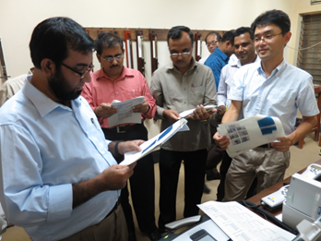
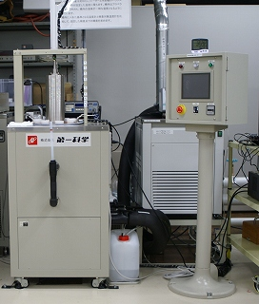
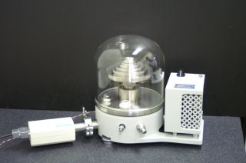
Review of RA-II WIGOS Projects Status
IV. Enhance the Availability and Quality Management Support for NMHSs in Surface, Climate and Upper-air Observations
Nobuyuki TANAKA
Observation Department
Japan Meteorological Agency (JMA)
Email: ntanaka@met.kishou.go.jp
WMO RAII Expert Group on WIGOS
(Abu Dhabi, UAE, Oct-Nov 2016)
Notes:
Hello everyone.
My name is Nobuyuki TANAKA from Japan Meteorological Agency.
Thank you for providing me with an opportunity to make a presentation in this meeting.
I would like to provide the project assessment as a theme leader of project No. 4.

Slide 2
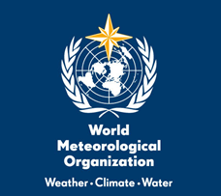
Summary
Eight activities out of ten are implemented or on going according to the plan
Revealed current status and problems through the survey and workshop
Effectiveness of package-type cooperation on instrument calibration
This project makes a steady progress and should be continued in next period
Notes:
This is the summary of my presentation.
Eight activities are implemented or on going according to the plan
Survey and Workshop revealed current status and problems on meteorological observation and instruments
Comprehensive technical cooperation was formulated by RIC-Tsukuba and it is so effective that some NMHS are now introduced
This project makes a steady progress and should be continued in next period

Slide 3
WMO RA II WIGOS Implementation Projects
No. I
Monitor and review the Implementation of EGOS- IP in RA II
No. II
Standard and best practise Portal
No. III-1
Integration of Surface-based Remote Sensing Data in the East Asia
No. III-2
Capacity Building in Radar Techniques in the Southeast Asia
No. IV
Enhance the Availability and Quality Management Support for NMHSs in Surface, Climate and Upper-air Observations
No. V
Develop a Sand and Dust Storm Warning Advisory and Assessment System (SDS-WAS) in Asia Node
No. VI
Develop Support for NMHSs in Satellite Data, Products and Training
Notes:
You know the RA II WIGOS implementation project has seven projects
I am theme leader of Project No. IV, and I am going review this project.

Slide 4
Overview of project No. IV
1. Improvements of data quality at RBCN/RBSN stations (a) Monitoring Data Quality The Coordinator checks data quality of RA II stations and identifies and requests RA II Members to identify technical issues, based on the following results: Questionnaire on the Surface, Climate, and Upper-air Observations and Quality Management in Regional Association II (Asia) (conducted in July 2010), Questionnaire on meteorological instruments, calibration and training in Regional Association II (Asia) (conducted in January 2012), 6-monthly monitoring reports by the Lead Centre for monitoring the quality of land surface observations in Region II. (b) Survey on status on QA/QC procedures and site managements for the network of RBCN/RBSN stations, and report the results. Based on requests from the Coordinator, the following Members will consider the possibility of technical support if funds are available, and share the summary of the technical missions with RA II Members: - CMA, HKO, JMA, and KMA for Southeast Asia, - IMD for South Asia, - Roshydromet for Central Asia, - Kuwait for Middle East.
2. Enhancement of RIC’s Services RICs plan to implement the following action items for further enhancement of their services in capacity building and calibration during the project: (a) Organization of a training workshop to improve understanding of calibration and maintenance of meteorological instruments according to needs of RA II Members to be identified by the “Questionnaire on Meteorological Instruments, Calibration and Training in Regional Association II (Asia)”, (b) Development of training materials on calibration and maintenance of instruments (to be prepared for publication as an Instruments and Methods of Observation Programme (IMOP) technical document), (c) Obtaining the International Standard ISO/IEC 17025 – General requirements for the competence of testing and calibration laboratories – certification for air pressure, temperature, and humidity, (d) Development of RIC’s Websites, (e) Intercomparison between RIC-Tsukuba and RIC-Beijing, (f) Reports on status on calibration instruments for surface-based observations in RA II (to be prepared for publication as an Instruments and Methods of Observation Programme (IMOP) technical document).
Assurance and Management of Data Quality
Calibration of Instruments
Notes:
This is the activities of this project written in the Regional WIGOS Implementation Plan (R-WIP) .
In this project, activities are divided into two parts, one is on Assurance and Management of Data Quality, and the other is on Calibration of Instruments.

Slide 5
Implementation of activities
Three pronged approach
Identifying current status and gap analysis by Survey
Discussions and training by Workshop
Sharing the results of survey and workshop through WMO/IOM Report
<Round 1>
RA II Survey on Surface, Climate and Upper-air Observations and QM (2010)
JMA/WMO Workshop on Quality Management in Surface, Climate and Upper-air Observations in RA II (Tokyo, Japan, 27-30 July 2010)
WMO/IOM Report No. 111 (June 2011)
<Round 2>
Survey on Meteorological Instruments, Calibration and Training (RA II) (2011-2012)
JMA/WMO Training Workshop on Calibration and Maintenance of Meteorological Instruments in RA II (Tokyo&Tsukuba, Japan, 19-22 February 2013)
WMO/IOM Report No. 122 (June 2015)
<Round 3>
RA II Survey on Quality Management for Surface Meteorological Observations (2016~)
Workshop (TBD)
WMO/IOM Report (TBD)
Notes:
To implement fore mentioned activities, coordinating group has taken the three pronged approach, to put in another way, comprehensive activities which are composed from Survey, Workshop, and Documentation by Report.
And we also divided into three stages, Round 1 to Round 3.

Slide 6
Implementation of activities (1)
Three pronged approach
Identifying current status and gap analysis by Survey
Discussions and training by Workshop
Sharing the results of survey and workshop through WMO/IOM Report
<Round 1>
RA II Survey on Surface, Climate and Upper-air Observations and QM (2010)
JMA/WMO Workshop on Quality Management in Surface, Climate and Upper-air Observations in RA II (Tokyo, Japan, 27-30 July 2010)
WMO/IOM Report No. 111 (June 2011)
Survey on:
Current Status of operation and capability of Members in RA II;
Requirements of MNHSs;
Gap Analysis between requirements and current status;
Measurements to solve the problems.
<Round 2>
Survey on Meteorological Instruments, Calibration and Training (RA II) (2011-2012)
JMA/WMO Training Workshop on Calibration and Maintenance of Meteorological Instruments in RA II (Tokyo&Tsukuba, Japan, 19-22 February 2013)
WMO/IOM Report No. 122 (June 2015)
<Round 3>
RA II Survey on Quality Management for Surface Meteorological Observations (2016~)
Workshop (TBD)
WMO/IOM Report (TBD)
Notes:
I will explain each steps in details.
At each stages, firstly, Survey was conducted by the coordinator through the questionnaire to figure out following issues:
Current status of operation and capability of Members in RA II;
Requirements of NMHSs;
Gap analysis between requirements and current status;
Measurements to solve the problems.

Slide 7
Implementation of activities (2)
Three pronged approach
Identifying current status and gap analysis by Survey
Discussions and training by Workshop
Sharing the results of survey and workshop through WMO/IOM Report
<Round 1>
RA II Survey on Surface, Climate and Upper-air Observations and QM (2010)
JMA/WMO Workshop on Quality Management in Surface, Climate and Upper-air Observations in RA II (Tokyo, Japan, 27-30 July 2010)
WMO/IOM Report No. 111 (June 2011)
Workshops are organized for:
Recognizing the challenges;
Discussion in order to solve the problems.
<Round 2>
Survey on Meteorological Instruments, Calibration and Training (RA II) (2011-2012)
JMA/WMO Training Workshop on Calibration and Maintenance of Meteorological Instruments in RA II (Tokyo&Tsukuba, Japan, 19-22 February 2013)
WMO/IOM Report No. 122 (June 2015)
<Round 3>
RA II Survey on Quality Management for Surface Meteorological Observations (2016~)
Workshop (TBD)
WMO/IOM Report (TBD)
Notes:
In the next step, the coordinator organized technical workshop for
Recognizing the challenges;
Discussion in order to solve the problems.
Training events were also held in the workshop as necessary.

Slide 8
Implementation of activities (3)
Three pronged approach
Identifying current status and gap analysis by Survey
Discussions and training by Workshop
Sharing the results of survey and workshop through WMO/IOM Report
<Round 1>
RA II Survey on Surface, Climate and Upper-air Observations and QM (2010)
JMA/WMO Workshop on Quality Management in Surface, Climate and Upper-air Observations in RA II (Tokyo, Japan, 27-30 July 2010)
WMO/IOM Report No. 111 (June 2011)
<Round 2>
Survey on Meteorological Instruments, Calibration and Training (RA II) (2011-2012)
JMA/WMO Training Workshop on Calibration and Maintenance of Meteorological Instruments in RA II (Tokyo&Tsukuba, Japan, 19-22 February 2013)
WMO/IOM Report No. 122 (June 2015)
<Round 3>
RA II Survey on Quality Management for Surface Meteorological Observations (2016~)
Workshop (TBD)
WMO/IOM Report (TBD)
Notes:
The results of survey and workshop were compiled WMO/IOM reports and published on the internet through WMO website.

Slide 9
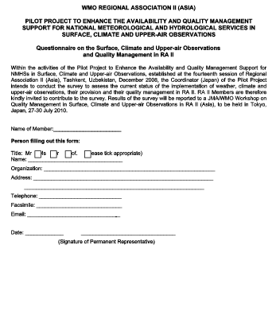
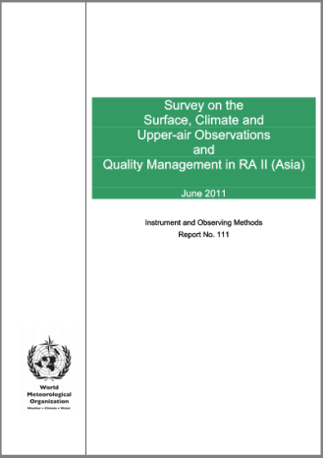
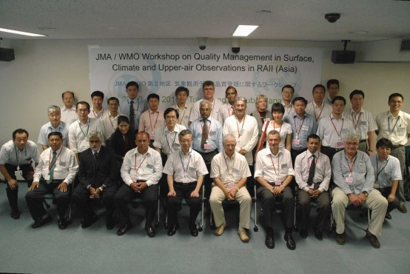
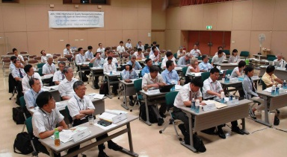
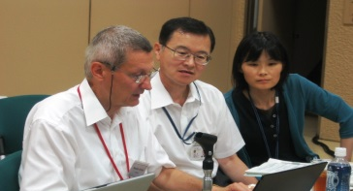
Round one (Observations and QM)
<Round 1>
RA II Survey on Surface, Climate and Upper-air Observations and QM (2010)
JMA/WMO Workshop on Quality Management in Surface, Climate and Upper-air Observations in RA II (Tokyo, Japan, 27-30 July 2010)
WMO/IOM Report No. 111 (June 2011)
Questionnaire
IOM No. 111
http://www.wmo.int/pages/prog/www/IMOP/publications-IOM-series.html
Workshop
Notes:
I will explain the each stages.
Round one is about Investigation on current status and Identifying the common challenges on Surface, Climate, and Upper-air Observation and Quality Management in RAII.

Slide 10
Results of Survey and WS (Round one)
The major conclusions drawn by the survey and workshop are:
Problems with surface observations are due to the lack of appropriately calibrated instruments and maintenance support
Problems with observational reports are due to the insufficient data quality and missing and irregular reports
Improvement of QC methods are needed at different levels from maintenance and calibration of instrument to data availability
Several NMHSs don’t have any operational systems for QC
Metadata are not updated with enough frequency
Notes:
Through the Survey and Discussions in Workshop, these major conclusion are revealed at that time.
Problems due to the lack of calibrated instruments and maintenance support
Problems due to the insufficient data quality and missing and irregular reports
Improvement of Quality Control method are needed
Several NMHS don’t have operational QC system
And, Metadata are not updated

Slide 11
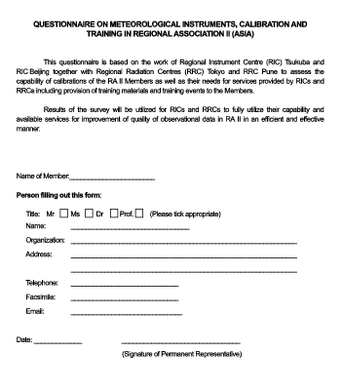
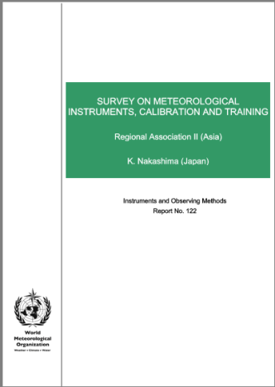
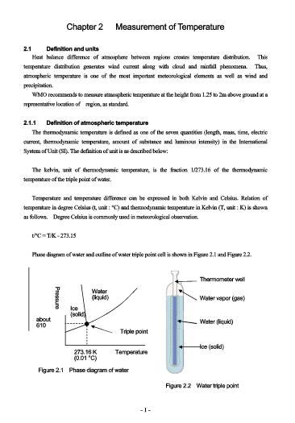
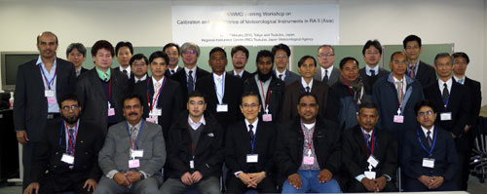
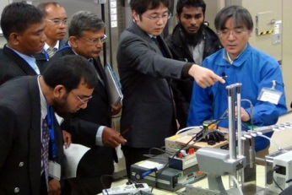
Round two (Instrument Calibration)
<Round 2>
Survey on Meteorological Instruments, Calibration and Training (RA II) (2011-2012)
JMA/WMO Training Workshop on Calibration and Maintenance of Meteorological Instruments in RA II (Tokyo&Tsukuba, Japan, 19-22 February 2013)
WMO/IOM Report No. 122 (June 2015)
Questionnaire
Training Materials
IOM No. 122
http://www.wmo.int/pages/prog/www/IMOP/publications-IOM-series.html
Workshop
Notes:
Round two focused Calibration of Meteorological Instruments.

Slide 12
Results of Survey and WS (Round two)
The Survey revealed that not a few Members of RA II;
obviously lack for international traceability of meteorological instruments.
do not perform regular inspection of meteorological instruments.
are still using mercury instruments.
JMA/WMO workshops and international activities of RIC Tsukuba also identified some countries who have:
No calibration equipment
No manual of calibration
No experience of calibration
Urgent need to establish the international traceability of meteorological instruments was emphasized.
Notes:
As well as round one, these problems are revealed by the round two activities.
Survey indicated that not a few Members has:
lack for international traceability of instruments,
do not perform regular inspection, and
are still using mercury instruments.
The workshop identified that there are Members who have:
No calibration equipment
No manuals of calibration
No experience of calibration
Through this project, we realized that there is urgent need to establish the international traceability in some Member countries.

Slide 13
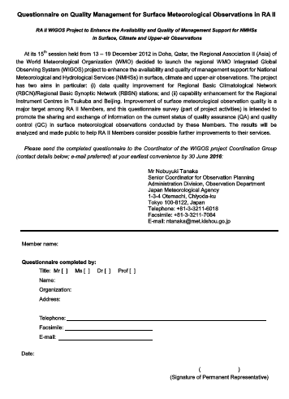
Round three (QM on surface observation)
<Round 3>
RA II Survey on Quality Management for Surface Meteorological Observations (2016~)
Workshop (TBD)
WMO/IOM Report (TBD)
Questionnaire
Notes:
Round three focuses Quality Management on Surface Observation in detail, and now on going.

Slide 14
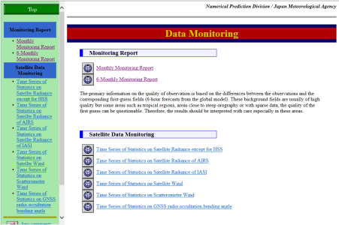
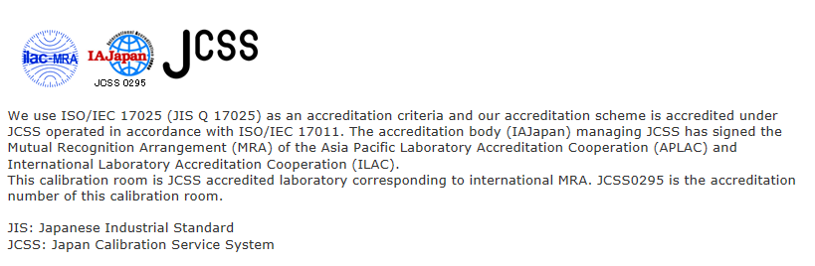

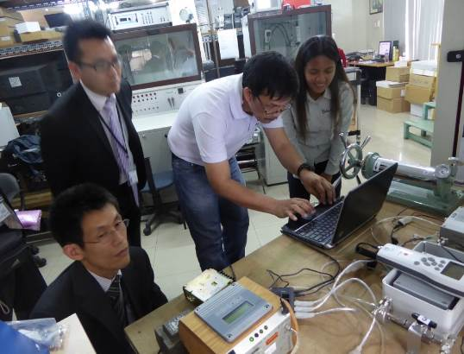
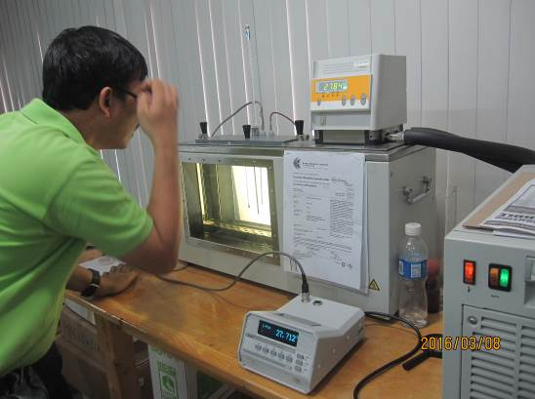
Other activities
< Others >
6-monthly monitoring report
http://qc.kishou.go.jp/
ISO 17025 Certification
RIC Tsukuba Website ( now under renewal!)
http://www.jma.go.jp/jma/jma-eng/jma-center/ric/RIC_HP.html
Intercomparison between RIC Tsukuba (RA II) and RIC Manila (RA V) (March 2017)
Notes:
There are some activities achieved, except Round one to Round three.
6-monthly monitoring report on land surface observation and report the results through the website.
Obtaining the International Standard ISO 17025
Development of RIC Homepage
As for the Intercomparison between two RICs, experimental comparison were conducted RIC-Tsukuba and RA V’s RIC Manila, in March 2016

Slide 15
Results of Survey and WS (Round two)
The Survey revealed that not a few Members of RA II;
obviously lack for international traceability of meteorological instruments.
do not perform regular inspection of meteorological instruments.
are still using mercury instruments.
JMA/WMO workshops and international activities of RIC Tsukuba also identified some countries who have:
No calibration equipment
No manual of calibration
No experience of calibration
Urgent need to establish the international traceability of meteorological instruments was emphasized.
Notes:
As I previously mentioned, through the activities of Round two found the urgent need to establish the international traceability of meteorological instruments.
In order to correspond this problem, RIC-Tsukuba has formulated effective cooperation scheme.
This scheme called “RIC-Tsukuba package”, and I would like to introduce this RIC-Tsukuba package and their effort.

Slide 16



RIC Tsukuba Package
JMA
JICA
Survey
Provision
Training
Follow-up
Preliminary survey of calibration capacity
Provision of standard instruments and/or inspection equipment
Training sessions
Follow up activities
Calibration
Technology
Bilateral
Assistance
Improvement of technical capacity of NMHS
To ensure traceability of meteorological instruments.
To improve quality of surface observation.
Notes:
RIC Tsukuba Package is a synergy of the expertise of RIC Tsukuba and the international assistance mechanism of Japan International Cooperation Agency (JICA), which is Japanese donner agency.
The Package is comprehensive technical cooperation scheme, and it takes 4-step approach.
It starts with a field survey as the 1st step to examine the Member’s capacity in calibration.
Secondly, necessary standards and calibration equipment are provided as the hard component of cooperation.
Thirdly, trainings are carried out for the Member’s staff in charge, including the training in Japan and the in-country training to make the staff fully skilled in the use of calibration equipment.
The final step is to do follow-up activities, and this is the most important part of the Package in order to ensure the self-sustainability.

Slide 17
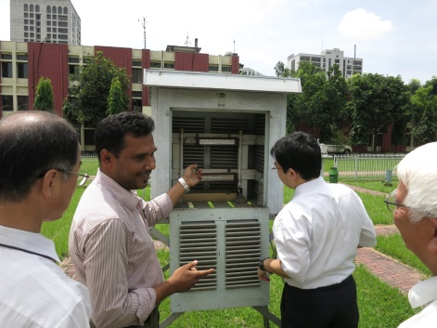
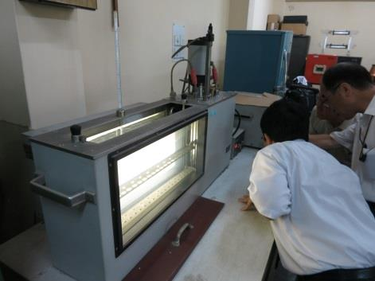
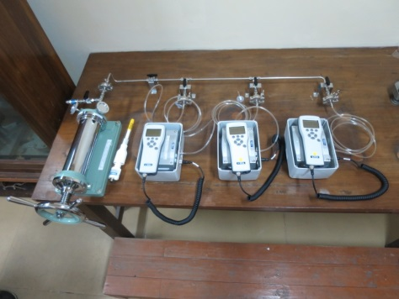
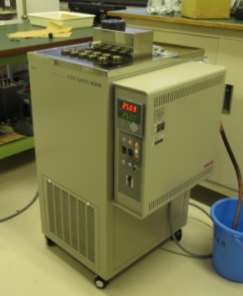

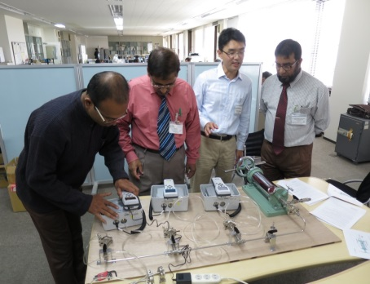
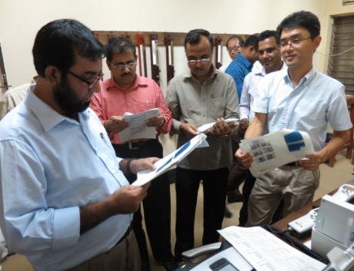



RIC Tsukuba Package for Bangladesh in 2013
RIC Tsukuba Package Improves Quality of Surface Observation
Survey
Provision
Follow-up
Training
(in Japan and Bangladesh)
Notes:
Let me show you an examples of the RIC Tsukuba Package performance.
Bangladesh is the country where the RIC Tsukuba Package was first applied.
The field survey was carried out in August 2013 at Bangladesh Meteorological Department (BMD).
According to the recommendation of the survey, JICA provided meteorological standards and calibration equipment to Bangladesh in October 2013.
In November 2013, three staff members of BMD were invited to RIC Tsukuba, and on-the-job-training was carried out for the overall skills of calibration and the operation of equipment.
The training of BMD staff in Japan was followed up by the advisory and Q&A program in distant communication between BMD and the RIC Tsukuba.
The follow-up program was conducted mainly on an email basis and is still maintained even now.
Now, the operational calibration of meteorological instruments in Bangladesh are implemented by BMD, and I hope it contributes the improvement of the quality of surface observation.

Slide 18





Achievements of RIC Tsukuba Package
Month/year | Country/region |  | Standard instruments calibrated | Training
Oct 2013 |  | Bangladesh | Barometer, thermometer, hygrometer | Barometer, thermometer, hygrometer
Jun 2015 |  | Fiji | Barometer, thermometer, hygrometer | Barometer, thermometer,
Dec 2015 |  | Philippines | Barometer | Barometer
Feb 2016 |  | Mozambique | Barometer, thermometer | Barometer, thermometer
Feb 2016 |  | Sri Lanka | Barometer | Barometer, thermometer
Jul 2016 |  | Fiji | Barometer, thermometer, hygrometer | Rain gauge, hygrometer
Note: Red characters show the ISO17025 (General requirements for the competence of testing and calibration laboratories) calibration
Notes:
This slide shows the achievements of RIC Tsukuba Package during the years from 2013 to 2016.
For the four years, a total of five countries have got the standards with ISO17025 which are shown in red.

Slide 19
Summary
Eight activities out of ten are implemented or on going according to the plan
Revealed current status and problems through the survey and workshop
Effectiveness of package-type cooperation on instrument calibration
This project makes a steady progress and should be continued in next period
Notes:
This is the same slide at the top of my presentation.

Slide 20
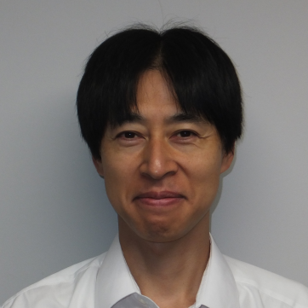

Thank you for your attention.
Thank you for your listening. For further information …
http://www.jma.go.jp/jma/indexe.html
Nobuyuki TANAKA
Observation Department
Japan Meteorological Agency
ntanaka@met.kishou.go.jp (Tanaka)
JMA’s Mascot: Harerun
Notes:
This is the end of my presentation.
Thank you for your attention.

