Slide 1

Integrated Observing System & WIGOS-IP in CMA
WANG Jiankai / Department of integrated observation / CMA

Slide 2

III
Status summary
III
China WIGOS-IP
CONTENTS
III
Emphases 2018-2020
2018 Beijing 北京- WIGOS in RA2

Slide 3



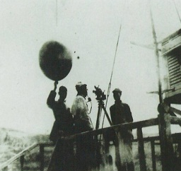
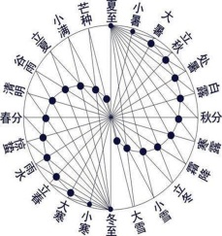

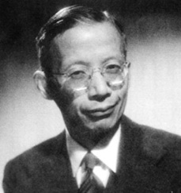
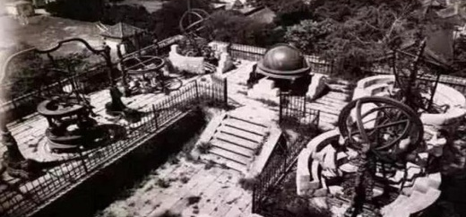
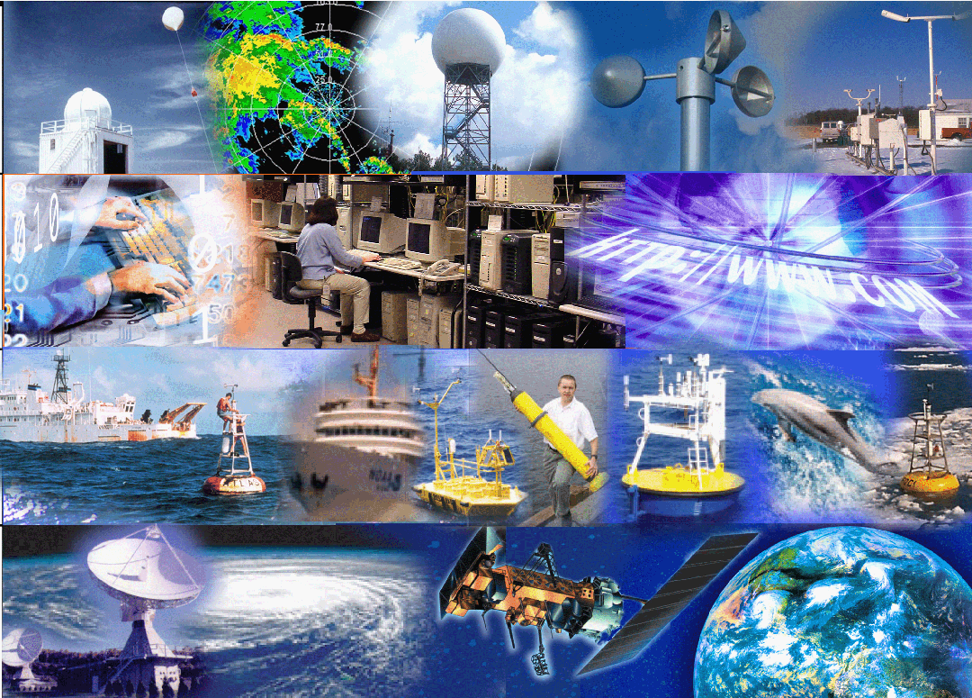
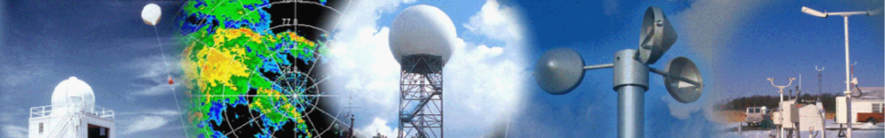




III
Status summary
Capabilities / Requirements / Gaps
As the most important operational system,
IOS, the integration of surface-, air- and space-based measurements,
plays key roles in weather / climate / disaster prevention & mitigation.
2018 Beijing 北京 - WIGOS in RA2

Slide 4
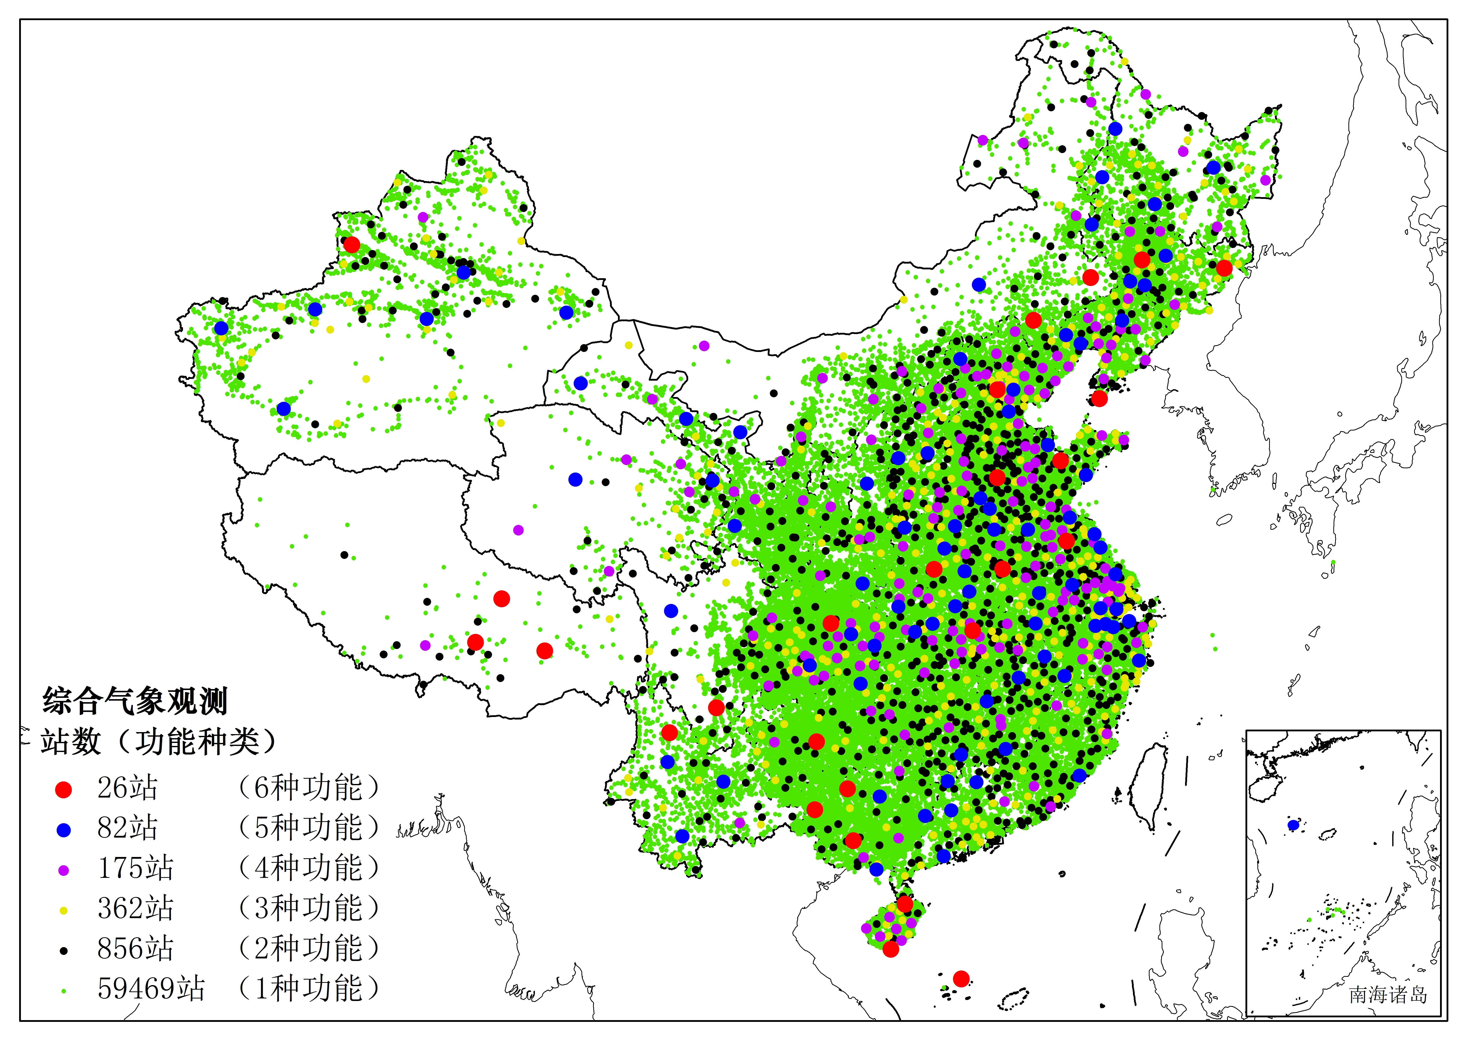
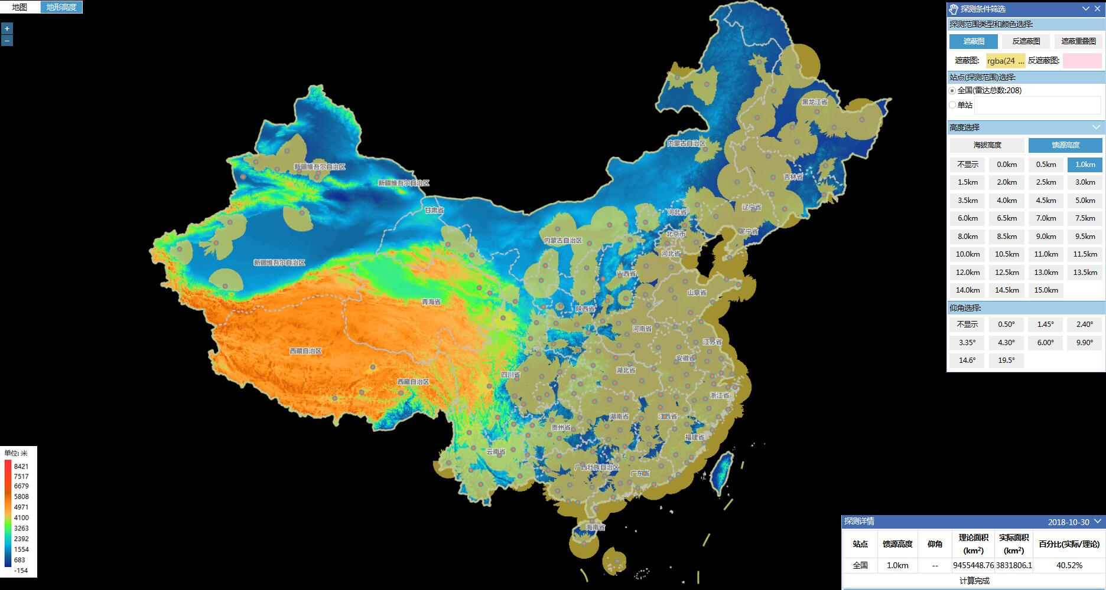
III
Status summary
Capabilities / Requirements / Gaps
Main features :
3 levels = Developed + Developing + Underdeveloped level
Determined by Landforms / economic conditions / population density
2018 Beijing 北京 - WIGOS in RA2

Slide 5
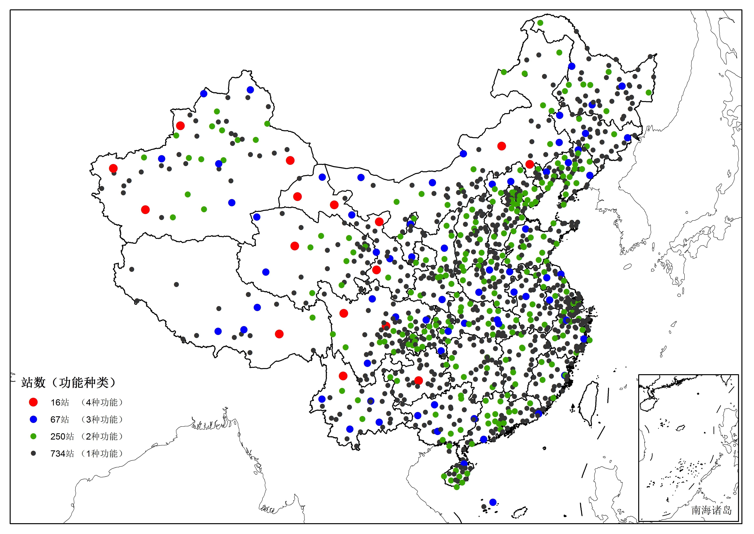
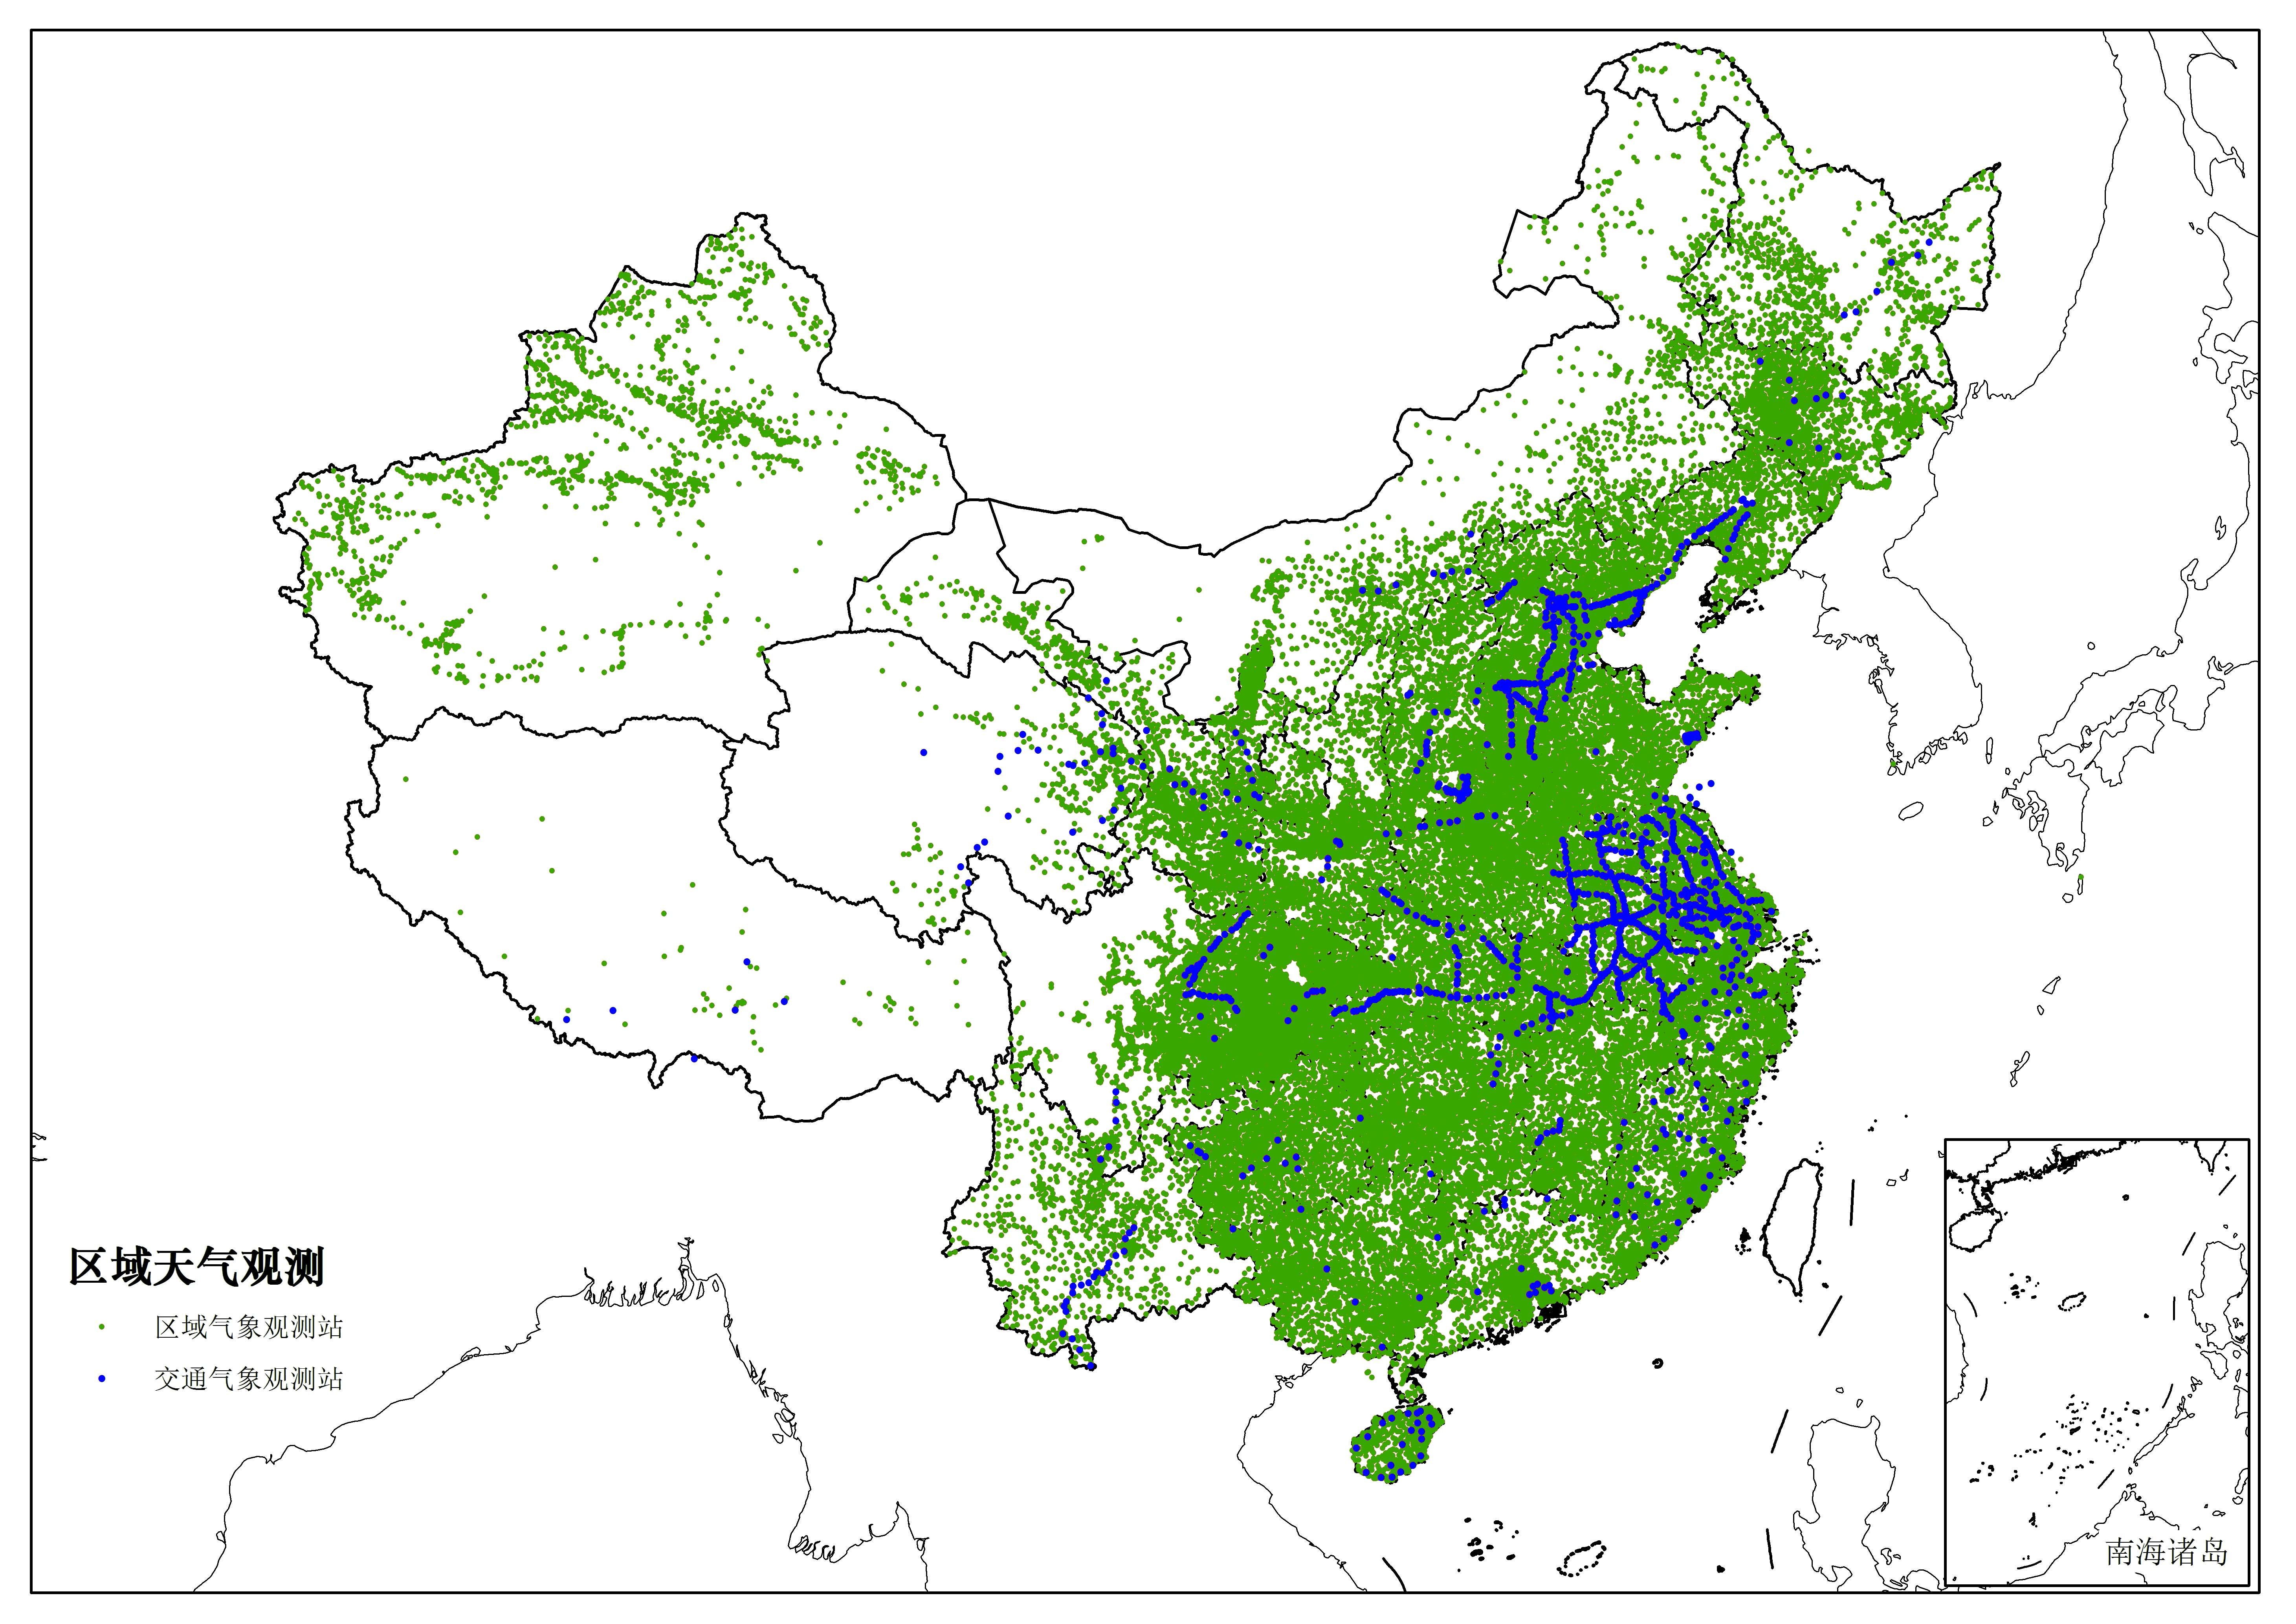
III
Status summary
Capabilities / Requirements / Gaps
（constructing）
5 types sub-networks
classified according to the main usages
Climate | Weather | Disaster | Ecology | Volunteer
2018 Beijing 北京 - WIGOS in RA2

Slide 6
III
Status summary
Capabilities / Requirements / Gaps
main types of stations | Num. | Climate | Weather | Disaster | Ecology | Volunteer
Atmospheric background station | 7
National climate observatory | 5
National Reference Climatological Station | 212
National Basic Met. Station | 633
National Met. Station Weather Station (AWS) | 1580 60332
Applied Met. Obs. Station | >1000
Volunteers’ Obs. Station | (forming)
National test base | 3
upper-air sounding station | 120
new-generation weather radar | 204
FY serial meteorological satellite | 2p+4s
space weather station | >90
2018 Beijing 北京 - WIGOS in RA2

Slide 7
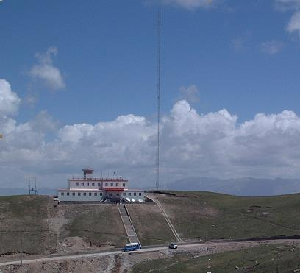
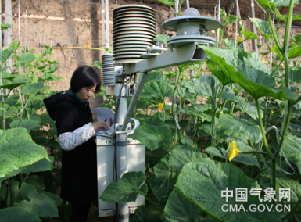

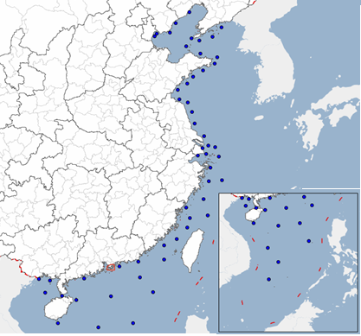
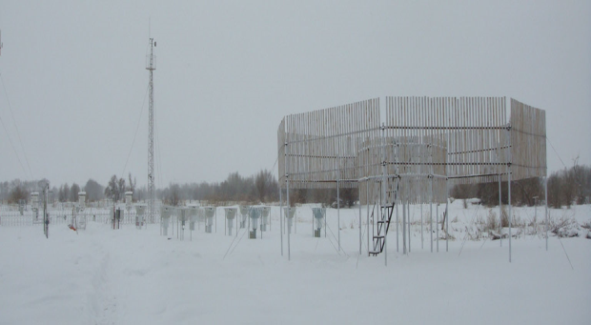

III
Status summary
Capabilities / Requirements / Gaps
More integrated Obs. system
Enlarge the Obs. areas
ecology / offshore / cryosphere / air quality / space
Realize GOS in China
RBON / GAW / GCW / Marian etc.
Multi-sphere Obs. into one big network
One station with more functions
Apply for the TPRCC ( regional GCW
Center )
2018 Beijing 北京 - WIGOS in RA2

Slide 8
III
Status summary
Capabilities / Requirements / Gaps
I
II
III
IV
V
XII
VI
VII
VIII
IX
X
XI
Requirements Review
RRR from WMO
Analysis :
12 Application areas
5D ：variables \ Obs. height \ space resolution \ frequency \ accuracy
variables
accuracy
height
resolution
frequency
CMA focus on 12 areas in 15 areas in OSCAR (web)
Nowcasting – VSRF – SSLP / Climate Monitoring (GCOS) / High Res NWP /
Agricultural Met. / Space Weather / Aeronautical Met. / Atmospheric Composition / Climate Science /
Forecasting Atmospheric Composition / Climate applications / Hydrology / Ocean Applications
2018 Beijing 北京 - WIGOS in RA2

Slide 9
III
Status summary
Capabilities / Requirements / Gaps
Basic Obs. Requirements
(12 application areas)
A very huge martrix
Cover almost everything (physics and chemistry) including the atmosphere and sea and the skin of the Earth
ECVs（GCOS-138 WMO 2010）
Domain | Essential Climate Variables
Atmospheric (over land, sea and ice) | Surface: | Air temperature, Wind speed and direction, Water vapor, Pressure, Precipitation, Surface radiation budget
 | Upper-air: | Temperature, Wind speed and direction, Water vapor, Cloud properties, Earth radiation budget (including solar irradiance)
 | Composition: | Carbon dioxide, Methane and other long-lived greenhouse gases, Ozone and Aerosol supported by their precursors
Oceanic | Surface: | Sea-surface temperature, Sea-surface salinity, Sea level, Sea state, Sea ice, Surface current, Ocean color, Carbon dioxide partial pressure, Ocean acidity, Phytoplankton
 | Sub-surface: | Temperature, Salinity, Current, Nutrients, Carbon dioxide partial pressure, Ocean acidity, Oxygen, Tracers
Terrestrial | Hydrological: | River discharge, Water use, Ground water, Lakes, Soil moisture
 | Cryospheric: | Snow cover, Glaciers and ice caps, Ice sheets, Permafrost
 | Biological Ecological Other: | Land cover, FAPAR, Leaf area index, Soil carbon, Albedo, Above ground biomass, Fire disturbance
Special Service Requirements
Super high resolution Obs. (e.g. <1km)
Special place
Be changing all the time
2018 Beijing 北京 - WIGOS in RA2

Slide 10
III
Status summary
Capabilities / Requirements / Gaps
Design networks
2012-2017
Climate observatories
2014-2016
National surface Obs.
2018-2019
IOS in Tibet
Useful !
Design network / select Obs. projects
2018 Beijing 北京 - WIGOS in RA2

Slide 11
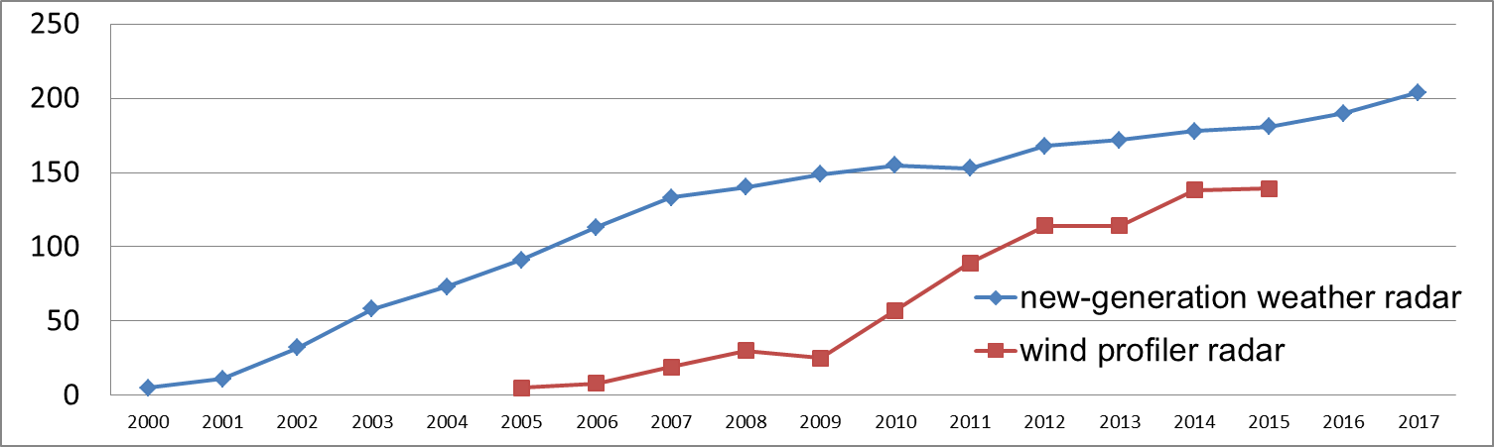
III
Status summary
Capabilities / Requirements / Gaps
Gaps = Requirements – Capability
Capability = Obs. + products ( data / assimilation ) + applying method
It will be more and more difficult to maintain the big Obs. Networks.
We have to look for other solutions.
2018 Beijing 北京 - WIGOS in RA2

Slide 12
III
Status summary
Capabilities / Requirements / Gaps
Critical gaps in China
Derivate disasters : landslide / mud-rock flow
Smart city services : traffic / heavy wind / pollution transmission & alleviation …...
How to get enough information to meet the requirements?
Efficient ways : Enlarge the Obs. Networks / develop the new technology to apply the existing data / improve data assimilation methods
e.g. big data / sensors in mobile phone / small smart AWS...
The right order:
To improve the technology to assimilate new products using IOS
The last way is to build new stations
It’s a real challenge !
2018 Beijing 北京 - WIGOS in RA2

Slide 13
III
Status summary
III
China WIGOS-IP
CONTENTS
III
Emphases 2018-2020
2018 Beijing - WIGOS in RA2

Slide 14

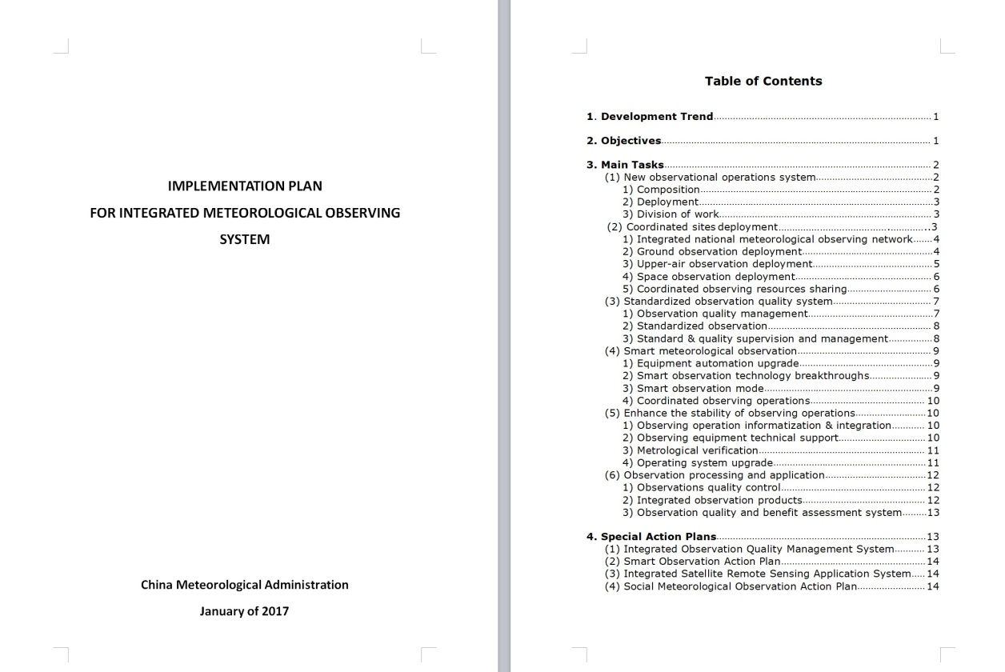
III
China WIGOS-IP
Introduction / Tasks / Particular actions
Jan. 2017
CMA published the IMPLEMENTATION PLAN FOR INTEGRATED METEOROLOGICAL OBSERVING SYSTEM
2018 Beijing 北京 - WIGOS in RA2

Slide 15
III
China WIGOS-IP
Introduction / Tasks / Particular actions
3 Main reference documents
The 13th Five-Year Plan for National Meteorological Development,
The National Meteorological Modernization Development Outlines for 2015-2030
The Integrated Meteorological Observing System Implementation Plan for 2014-2020
According to the 3 doc.
A guidance document as well as general outlines for the nationwide meteorological observation development during the 13th Five-Year-Plan period (2016-2020)
6 main tasks and 4 particular actions
2018 Beijing 北京 - WIGOS in RA2

Slide 16
III
China WIGOS-IP
Introduction / Tasks / Particular actions
6 Tasks | specification
Reform the structure of Obs. operation system | Optimize four components: technology & equipment / observation / data processing / maintenance
Design the coordinated Obs. networks | Design the networks with RRR method Including surface / up-air / space Obs. networks Data sharing
Create the standized Obs. quality system | Enhance Obs. quality management / Standize the process of the Obs. / enhance the supervision and management
Improve the capability of smart Met. Obs. | Upgrade equipment automation / break through smart observation technology / create smart Obs. modes
Enhance the stability of Obs. operations | Realize Obs. operation informatization and integration / improve the capability of maintenance / upgrade the Met. verification system
Improve the technology in Obs. processing and application | Establish the completed Obs. quality control / improve the Integration of Obs. products / create Obs. quality and benefit assessment system
2018 Beijing 北京 - WIGOS in RA2

Slide 17
III
China WIGOS-IP
Introduction / Tasks / Particular actions
4 Particular Actions | specification
Establish Integrated Obs. Quality Management System | in line with the basic requirements of the International Organization for Standardization (IOS) and the World Meteorological Organization (WMO) Implement The Integrated Observation Standardization Work Plan for 2015-2017
Develop Smart Obs. system | Establish open and collaborative mechanisms for technology innovation Advance the research and development of smart observing technologies/techniques
Create Integrated Satellite Remote Sensing Application System | Establish an integrated remote sensing application service system, a data sharing platform and a standardized products system
Implement Social and volunteer Met. Obs. | Encourage the public, companies and organizations to be volunteers to take part in the Obs. Use mobile phone, offshore platform, ship, tower
2018 Beijing 北京 - WIGOS in RA2

Slide 18
III
Status summary
III
China WIGOS-IP
CONTENTS
III
Emphases 2018-2020
2018 Beijing 北京 - WIGOS in RA2

Slide 19
III
Emphases 2018-2020
Implement: IP / RWC / EGOS-IP
Implement the national Obs. plan
The Implementation Plan For Integrated Meteorological Observing System (2016-2020)
The tasks and particular actions in this plan contains most of the China’s tasks in WIGOS-IP
e.g. the metadata / RWC / GCW / upgrade the upper-air sounding system / RRR & Oscar
2018 Beijing 北京 - WIGOS in RA2

Slide 20
III
Emphases 2018-2020
Implement: IP / RWC / EGOS-IP
Implement the regional WIGOS center
Establish Co-operation mechanism in CMA
plan : create multi-center workgroup / establish the mechanism to work together efficiently / improve the methods and the technologies of QC
Update the system and the website of CMA RWC established in 2018 by Met. Obs. Center ( the project was approved in EC-70th and RA2-13rd in 2018 )
2018 Beijing 北京 - WIGOS in RA2

Slide 21
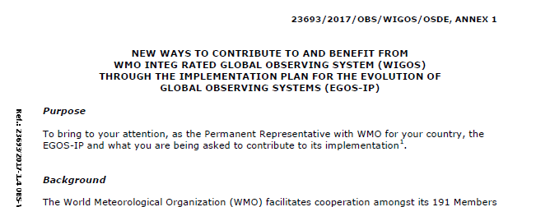
III
Emphases 2018-2020
Implement: IP / RWC / EGOS-IP
Fulfill the EGOS-IP
organizations | Key action No.
National Met. Information center | C3,C7,C8,G2,G7,G17,G18,G40
Met. Obs. Center | C4,C7,C12, G4,G7,G13,G14,G40,G45,G47
National satellite Met. center | C12
The tasks have been started last year
2018 Beijing 北京 - WIGOS in RA2

Slide 22
Thanks for your attention!
wjkaoc@cma.gov.cn

