Slide 1
BANGLADESH
Submitted by
Afruza Sultana
Assistant Meteorologist
Bangladesh Meteorological Department (BMD)
RA II WIGOS Workshop
6-8 November 2018, Beijing, China

Slide 2
Outline
Introduction to the country and the NMHS
Physical context of the country
National requirements for observations
Summary of national observing capabilities
Status of National implementation of WIGOS

Slide 3
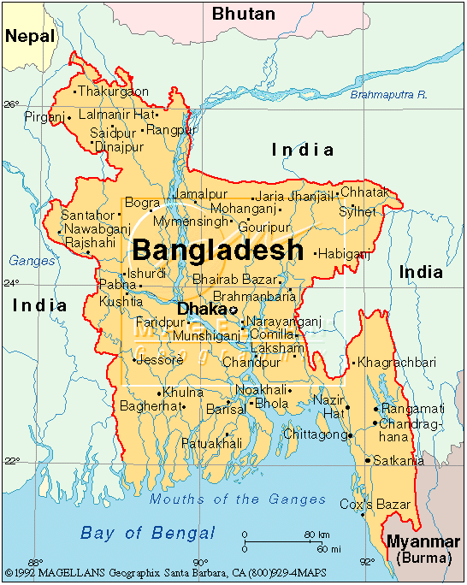
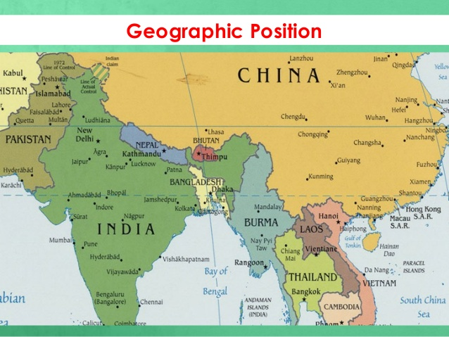
Introduction to the Country and the NMHS
Government Name: People's Republic of Bangladesh
Location of Bangladesh: 20.57ºN to 26.63ºN and 88.02ºE to 92.68E
Capital: Dhaka
Total Area: 1,47,570 Sq-Km (92nd)
Population: 16,29,51,560 (8th)
Population Density: 1106/Sq-km
National Income: $1660 (Per Capita)
Population Growth Rate: 1.20

Slide 4
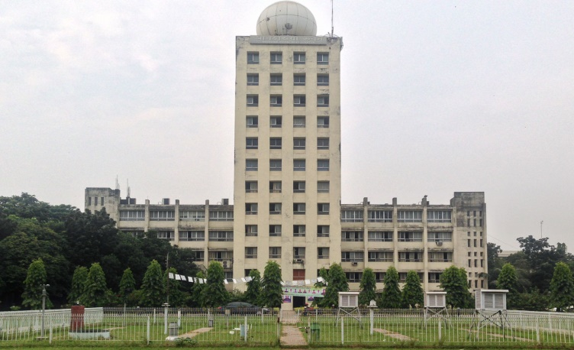
Bangladesh Meteorological Department
(BMD)
The meteorological activities started in this country in 1877 through the establishment of one observatory in Satkhira during the British rule. In 1947, the service was renamed as Pakistan Meteorological Services. After the independence in 1971, it became Bangladesh Meteorological Department (BMD).
Bangladesh Meteorological Department is a government organization under the administrative control of the Ministry of Defence. BMD is mainly responsible for recording the meteorological observations and providing forecast and warnings for disaster management and all social economic activities.

Slide 5
Organizational structure of BMD
BMD Head Quarters has the following divisions:
i. Director’s Office
ii. National Weather Forecasting Centre (Storm Warning Centre)
iii. Meteorological & Geo-physical Centre (M&GC), Chittagong
iv. Meteorological Training Institute
v. Climate Division
vi. Agromet Division
vii. Forecasting Division
viii. Synoptic Division
ix. Planning Division
x. International Meteorological Division
xi. Communication Division
xii. Electronic and Instruments Division
Workshop and Laboratory
Staff:
Administrative, Operational, Planning and Other Meteorologicial activities of BMD is completed by more than 1200 personnel.

Slide 6
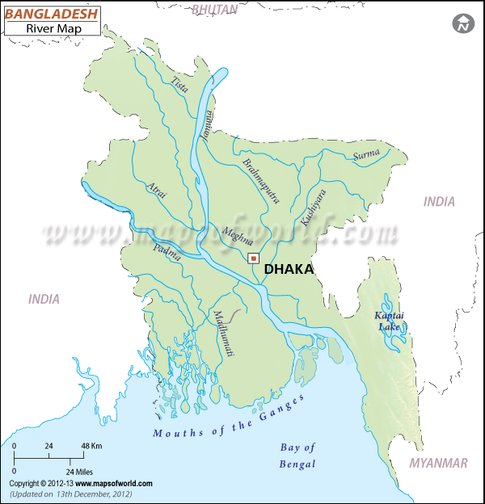
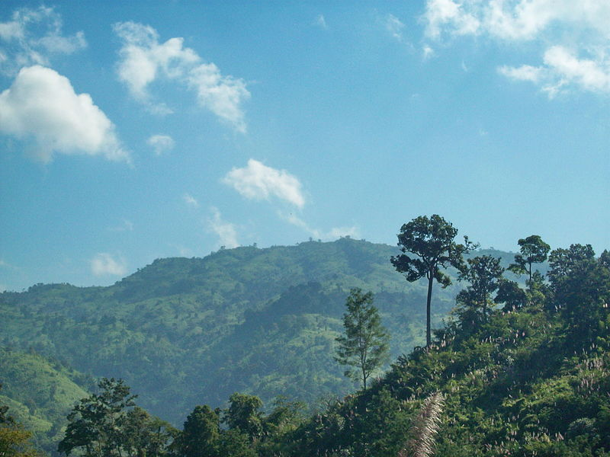
Physical context of Bangladesh
Surface Area of Bangladesh: 1,47,570 sqkm
Mountains: Less or more 75 such mountains have been identified and mapped in the Hill Tracts of Bangladesh
River: There are 230 rivers in Bangladesh out of which 57 originate from outside country.
Coast: The coastline of Bangladesh is about 720 km long along the continental shelf which has shallow bathymetry .
The total area of forest land is 2.53 million hectares representing about 17.5% of the country's area. Bangladesh Forest Department manages 1.53 million hectares of forest land.
Cultivable land: Agricultural land (% of land area) in Bangladesh was reported at 70.63 % in 2015, according to the World Bank collection of development indicators, compiled from officially recognized sources. Agricultural land refers to the share of land area that is arable, under permanent crops, and under permanent pastures.

Slide 7
Weather and Climate of Bangladesh
Winter or North-East Monsoon : Average rainfall is about 2% of the total annual rainfall. Mean temperature is 18-21 ͦC .
Average Temperature in Winter Monsoon: 18-22 ͦC .
Average Minimum Temperature: 8-10 ͦC .
Summer or Pre-Monsoon : Mean temp. is 23-30 ͦC and average rain fall is 19%.
Average Maximum Temperature: 36-40 ͦC .
South-West Monsoon or Monsoon : Average rainfall of this season is about 71% of the total annual rainfall.
Autumn or Post-Monsoon : Average rainfall receives in this season is about 8%. The lowest temperature remain above 10 ͦC.

Slide 8
National Requirements for Observations
Bangladesh Meteorological Department (BMD) is the only Government Authorized Organization that provides the Meteorological & Climatological aspects to the other relevant organization as per their need.
1. National priority application areas:
Agriculture: BMD provides Agro - meteorological forecasts for the development of agriculture sector which contributes widely in the socio economic development of Bangladesh. Overall all sector of agriculture research and the farmers are now-a-days using this forecasts are being used at the end to end level to facilitate the agriculture production and processing activities.
Aviation: Aviation forecasts of BMD is used by the pilots for safely transportation. It is provided according to the International Civil Aviation Organization (ICAO).
River and Sea Transports: To save the lives and properties from unexpected casualities and safe transportation through river and sea BMD issues Inland warnings and Marine forecasts. Besides, during the severe weather disasters such as cyclones havoc, tornado, tsunami BMD provides special weather bulletin. In some cases hourly forecasts also disbursed through electronics and other media.

Slide 9
Hydrology: Flood Forecasting Warning Centre (FFWC) of Bangladesh Water Development Board (BWDB) issues flood warning. BMD only provides the meteorological data as per their need to prepare flood warning.
Health: Due to varied seasons difference kinds of diseases sometimes appears with regards to temperature, humidity and coldness and heat wave. Meteorological parameters temperature and humidity & other relevant regards to disease is observed by the health sector i.e. is provided from BMD .

Slide 10
2. Most relevant measurements:
Temperature
Wind
Pressure
Humidity
Precipitation
Radiation
Cloud

Slide 11
Observing capabilities of Bangladesh Meteorological Department (BMD)
Bangladesh Meteorological Department is the authorized government organization for all meteorological activities in the country. It maintains a network of-
-Surface and upper air observatories
-Radar and satellite receiving stations
-Agro-meteorological observatories
-Seismological Observatories
-Meteorological Telecommunication System
Total Observatories: 60 ( 43 Operation)
Pilot Balloon Observatories: 10
Rawinsonde Observatories: 4
Agromet Observatories : 20
Radar Station: 5
Automatic Weather Station: 25
Seismic Observatories: 10
Hydrogen Plant: 1
Thunderstorm & Lightening
Detection system : 8
Workshop and Laboratory : 1
Instrumentation Lab: 1
Aviation forecast facilities: 7

Slide 12
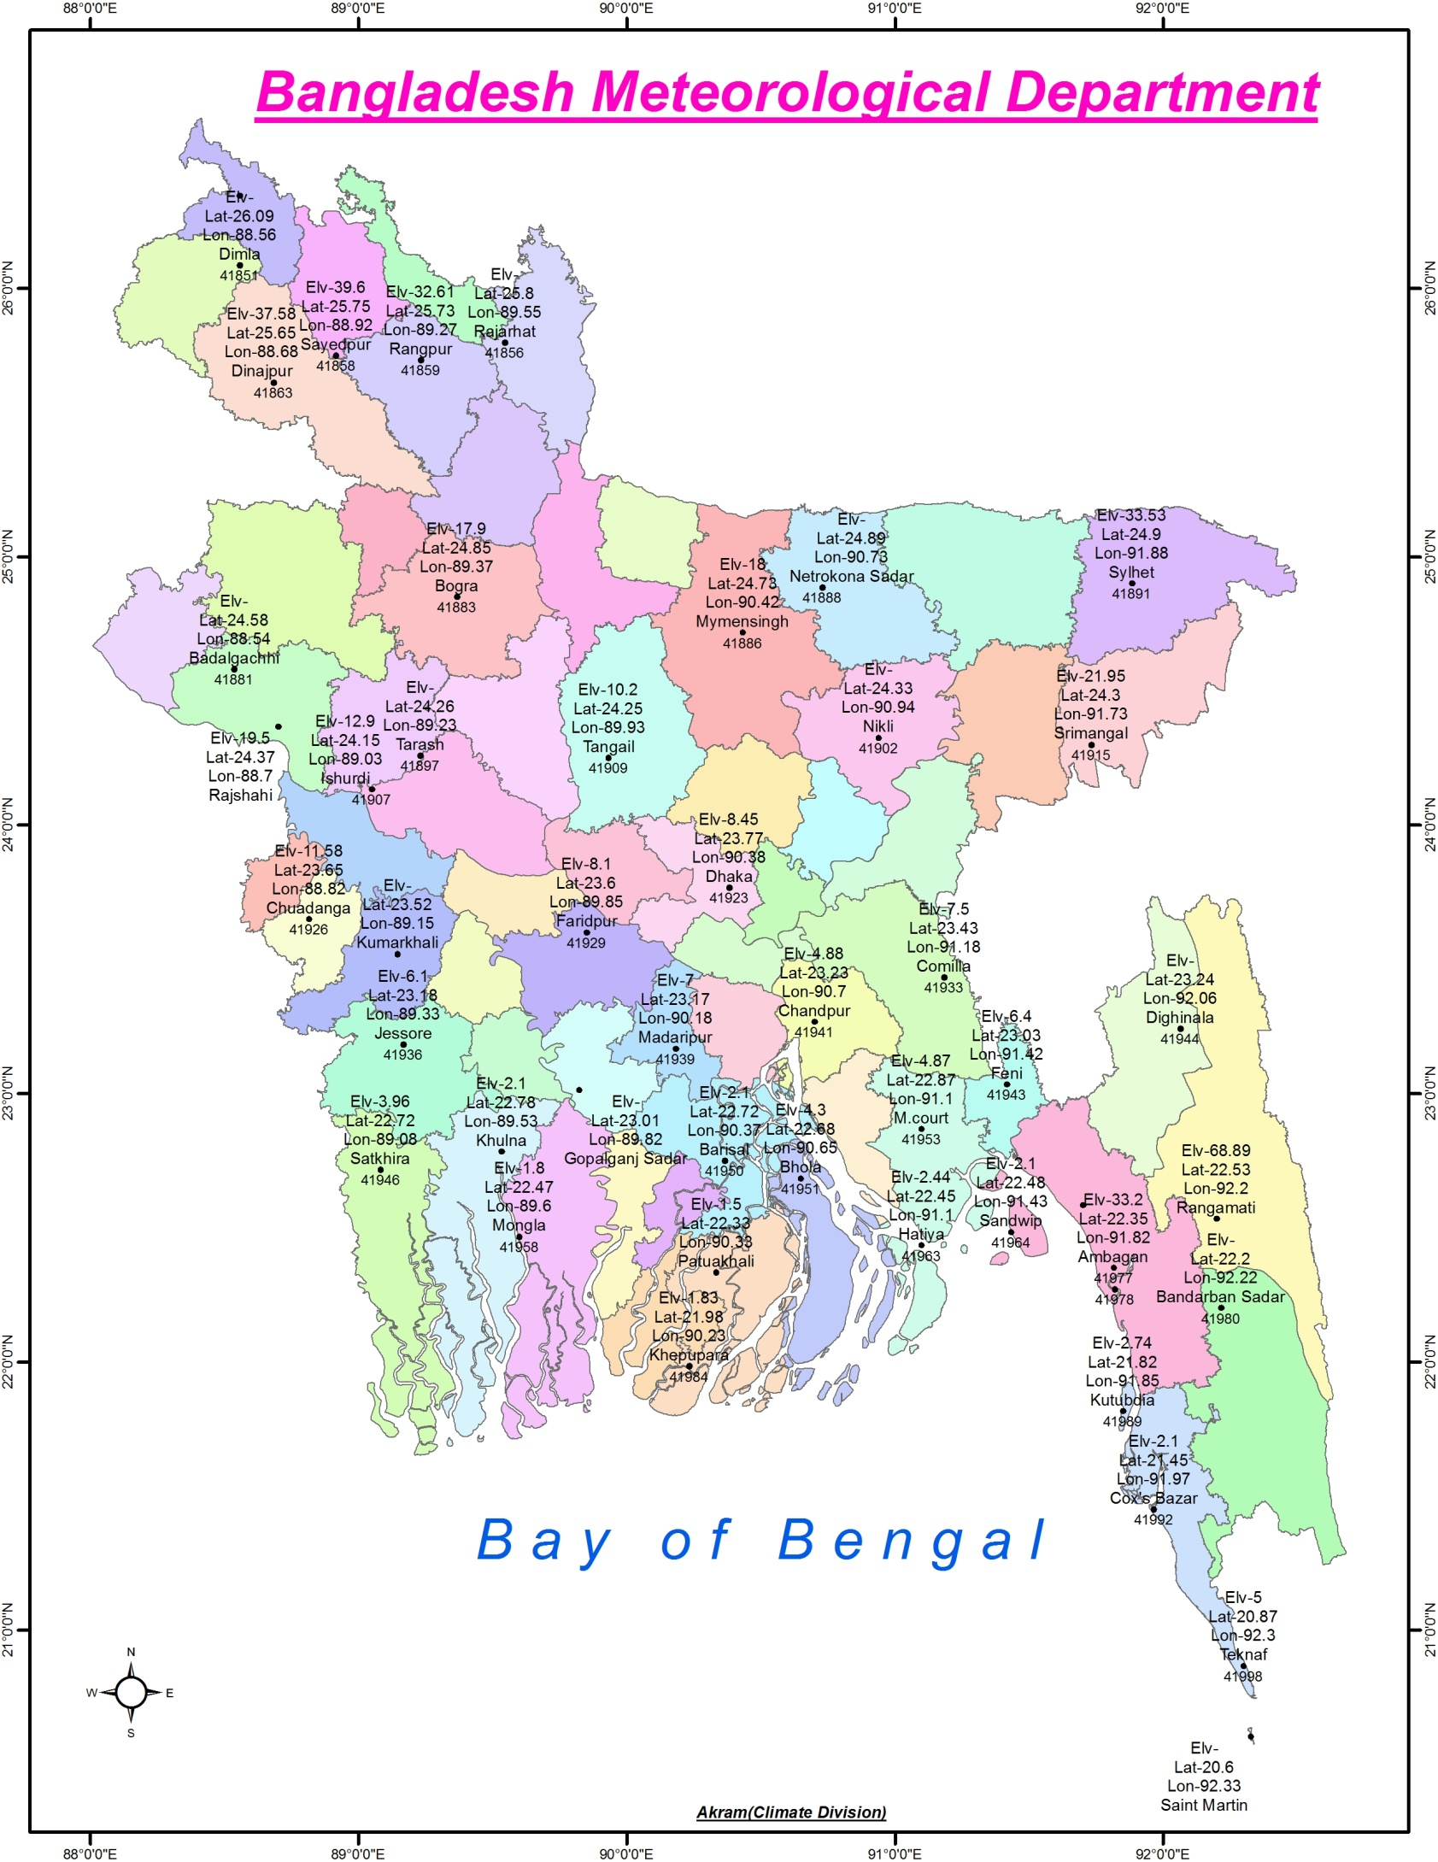
Map of Bangladesh Meteorological stations

Slide 13
Radar Networks in BMD
At this moment BMD has Five Radar Station. These are-
Dhaka
Rangpur
Moulvibazar (Doppler)
Cox’sbazaar(Doppler)
Khepupara (Doppler)
Rangpur
Moulvibazar
Dhaka
Khepupara
Coxsbazar

Slide 14
RADAR Networks
Data Reception at SWC
APSTAR-V Communication Satellite
Data Dissemination by SWC
Cox’s Bazar
VSAT Communication
Rangpur
BTV
128 Kbps
Moulvibazar
64 Kbps
PMO
Khepupara
Storm Warning
Center (SWC)
BMD, Dhaka
128 Kbps
AIR
PORT
FFWC
DDN Link
Microwave Link
Dhaka

Slide 15
Status of National implementation of WIGOS
National Observing Strategy : 03 Hourly observations are taken from 47 Observatories, 12 hourly observations are taken from 11 Observatories and also under process to take observations every three hourly.
National WIGOS Implementation Plan: Quality Control of rainfall data already started by double mass analysis.
National WIGOS governance mechanism: National Meteorological Communication Centre (NMCC), Dhaka
National WIGOS partnership agreements for integration and open-sharing of observations from NMHSs and non-NMHSs sources:National Meteorological Communication Centre (NMCC), Dhaka
WIGOS Station Identifiers: under process
WIGOS Data Quality Monitoring System (WDQMS): NMCC, Dhaka
National focal points nominated (WIGOS NFP = Mr. Md. Mizanur Rahman Khan Chowdhory, Meteorologist, BMD and OSCAR NFP= Mr. Md. Abdul Matin, Senior Communication Engineer, BMD)

Slide 16
Recommendation for Future Development
Establishment of Buoy based Automatic Weather Station to collect sea and river data in Bangladesh.
Human Resources Development to meet the future requirements of
-Establishment of WMO Information System (WIS) and WMO Integrated Global Observing System (WIGOS)
- Establishment of Thunderstorm & Lightening Detection system over Bangladesh.
-Establishment of Numerical Weather prediction (NWP)
-Establishment of Weather Studio.
-Establishment of Direct to Home (DTH) System.
For more information please visit website of BMD
http://www.bmd.gov.bd

Slide 17
Expectation from this workshop
BMD is on the way of WIGOS implementation and in the coming days we hope with the kind assistant and direction of WMO.
Hopefully we will be able to gather knowledge from this workshop that will be helpful for implementation of all WIGOS plan.
WMO will provide logistic support to BMD and also arrange some training program for BMD officers and staffs for capacity building on OSCAR/Surface with WIGOS.

Slide 18
Thank you
afruza.sultana.ju@gmail.com

