Slide 1
National Center for Hydrology & Meteorology(NCHM)
Bhutan
Trashi Namgyal
Dy. Exe. Engineer
Hydro-met Operations & Infrastructures Division
tnamgyal@nchm.gov.bt
RA II WIGOS Workshop
6-8 November 2018, Beijing, China

Slide 2
Outline…….
Introduction to Kingdom of Bhutan and the NCHM
Physical context of Bhutan
National requirements for observations
Summary of national observing capabilities
Status of National implementation of WIGOS
Other remarks

Slide 3
Introduction to the Kingdom Of Bhutan
Overview of the Country/ Land of Thunder Dragon
landlocked country in South Asia.
Located in the Eastern Himalayas bordered with China in the north, India in the west, south and east.
Rugged land of steep mountains and deep valleys
Elevation: 200 m (660 ft) in the southern foothills to more than 7,000 m (23,000 ft).
Total land Area: 38,394 km²
Total Population: 735,553
Government: Constitutional Monarchy
Capital city: Thimphu
National Dress: Gho & Kira

Slide 4
Climate & extreme weather events in Bhutan
Bhutan has a wide range of altitudinal zones and micro-climatic conditions which have created highly diverse ecosystems and a complex pattern of climatic conditions.
Three main Climatic zones:
Southern belt has a hot, humid climate, with temperatures remaining fairly even throughout the year—between 15°C and 30°C - and rainfall ranging between 2,500 and 5,000 millimeters (mm).
Central inner Himalayas have a cool, temperate climate, with annual average rainfall of about 1,000mm.
The higher and more northern region has an alpine climate, with annual rainfall of around 400mm

Slide 5
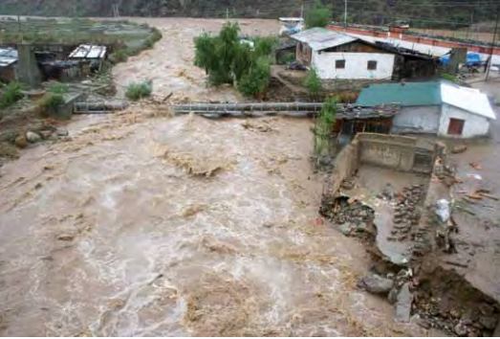
Climate & extreme weather events in Bhutan
Glacial Lake Outburst Flood (GLOF):
Glacial lakes have formed in many places in the area left at the foot of retreating valley glaciers.
A major proportion of Bhutan's population is settled in fertile valleys along a number of river systems.
GLOF that took place in Bhutan in 1994 along the Puna Tsang Chu valley. Lives and property were damaged but also important infrastructure such as hydroelectric dams that are situated along these rivers.
Notes:
Glacial Lake Outburst Flood (GLOF): Glacial lakes have formed in many places in the area left at the foot of retreating valley glaciers. A major proportion of Bhutan's population is settled in fertile valleys along a number of river systems. GLOF that took place in Bhutan in 1994 along the Puna Tsang Chu valley. Lives and property were endangered but also important infrastructure such as hydroelectric dams that are situated along these rivers.
Flash floods and landslides: Bhutan is prone to flash floods, especially in the eastern and southern foothill regions, due to the steep terrain and fragile geology. These flash floods have become more frequent and intensified in the last decade due to increasing intensity of rainfall, and untimely start and end of monsoons. Landslides are a recurrent phenomenon in Bhutan and closely linked with flooding events.
In May 2009, cyclone Aila, originating in the Bay of Bengal, resulted in incessant rainfall causing one of the worst disasters in Bhutan. Record breaking rainfall, measuring up to 76mm over a 24 hour period, was recorded as one of the highest in the last five years. Subsequently, the rainfall also led to swelling of rivers and streams to dangerous flood levels. These rivers and streams were never recorded to have such volumes of water in the past forty years; in fact, river-gauging stations in the Punatsangchhu show that the water flow in the river during cyclone Aila exceeded the water flows during the 1994 GLOF.
In 2010, landslides and flash floods damaged more than 2000 acres of agricultural land, affecting some 4165 households over 20 dzongkhags, and damaged farm roads and irrigation channels affecting 529 households.
Windstorms have been recorded every year. However, the severity and frequency of windstorms in Bhutan have increased over the past few years, especially in the pre-monsoon season. Example: In April 2008, windstorms damaged 249 rural houses in lower Trashigang. Eight school buildings, four lhakhangs and one forest office were also damaged by the windstorm.
Farmers have had to deal with increasing frequency of hail and windstorms. Eg: In 2010 alone, more than 5000 acres of agriculture crops were affected by hail and windstorms, damaging a wide range of staple crops, such as maize, rice, potato, chili, buckwheat and others.

Slide 6
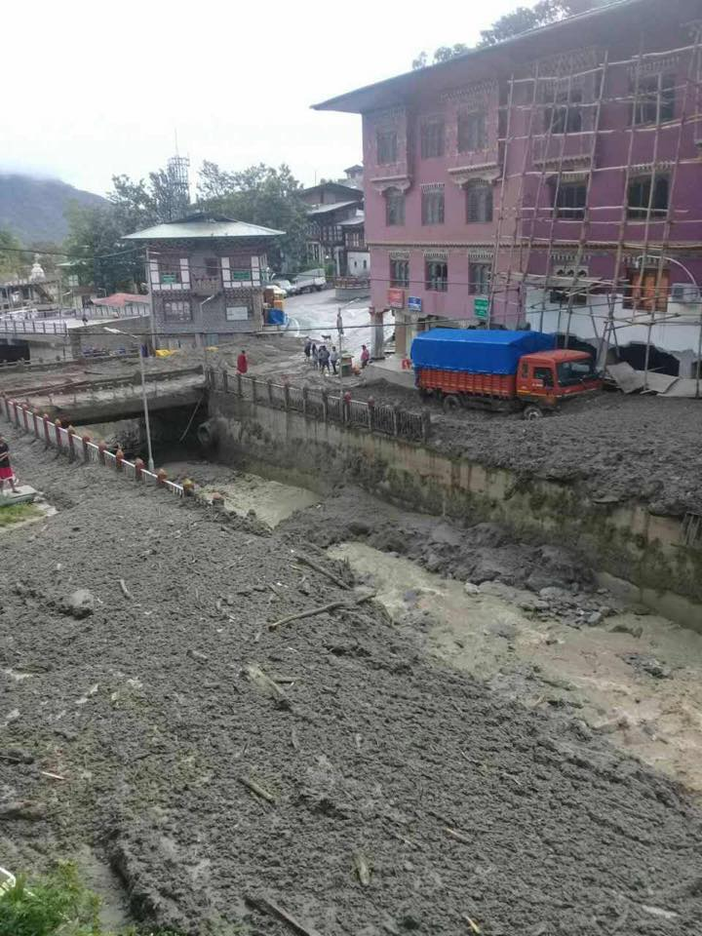
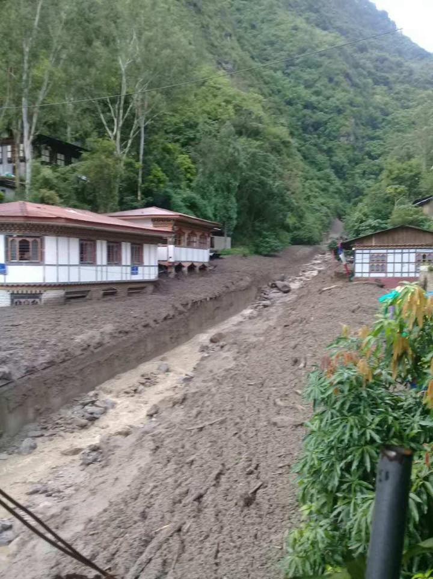
Climate & extreme weather events in Bhutan
Flash floods and landslides:
Bhutan is prone to flash floods & Land slides due to the steep terrains.
The flash floods have become more frequent over the last decade due to increasing intensity of rainfall
In May 2009 cyclone Aila caused worst disasters in Bhutan
2010 flash floods damaged more than 2000 acres of agricultural land, affecting some 4165 households damaged farm roads and irrigation channels affecting 529 households
The Recent flash flood occurred in 23rd July 2018. Happened all of a sudden and it was massive and no loss of life/significant damage to properties.

Slide 7
Climate & extreme weather events in Bhutan
Windstorm:
Windstorms have been recorded every year.
The severity and frequency of windstorms in Bhutan have increased over the past few years, especially in the pre-monsoon season.
In April 2008, windstorms damaged 249 rural houses in lower Trashigang. Eight school buildings, four lhakhangs and one forest office were also damaged by the windstorm.
Farmers have had to deal with increasing frequency of hail and windstorms. In 2010, more than 5000 acres of agriculture crops were affected by hail and windstorms, damaging a wide range of staple crops, such as maize, rice, potato, chili, buckwheat and others
Notes:
Windstorms have been recorded every year. However, the severity and frequency of windstorms in Bhutan have increased over the past few years, especially in the pre-monsoon season. Example: In April 2008, windstorms damaged 249 rural houses in lower Trashigang. Eight school buildings, four lhakhangs and one forest office were also damaged by the windstorm.
Farmers have had to deal with increasing frequency of hail and windstorms. Eg: In 2010 alone, more than 5000 acres of agriculture crops were affected by hail and windstorms, damaging a wide range of staple crops, such as maize, rice, potato, chili, buckwheat and others.

Slide 8
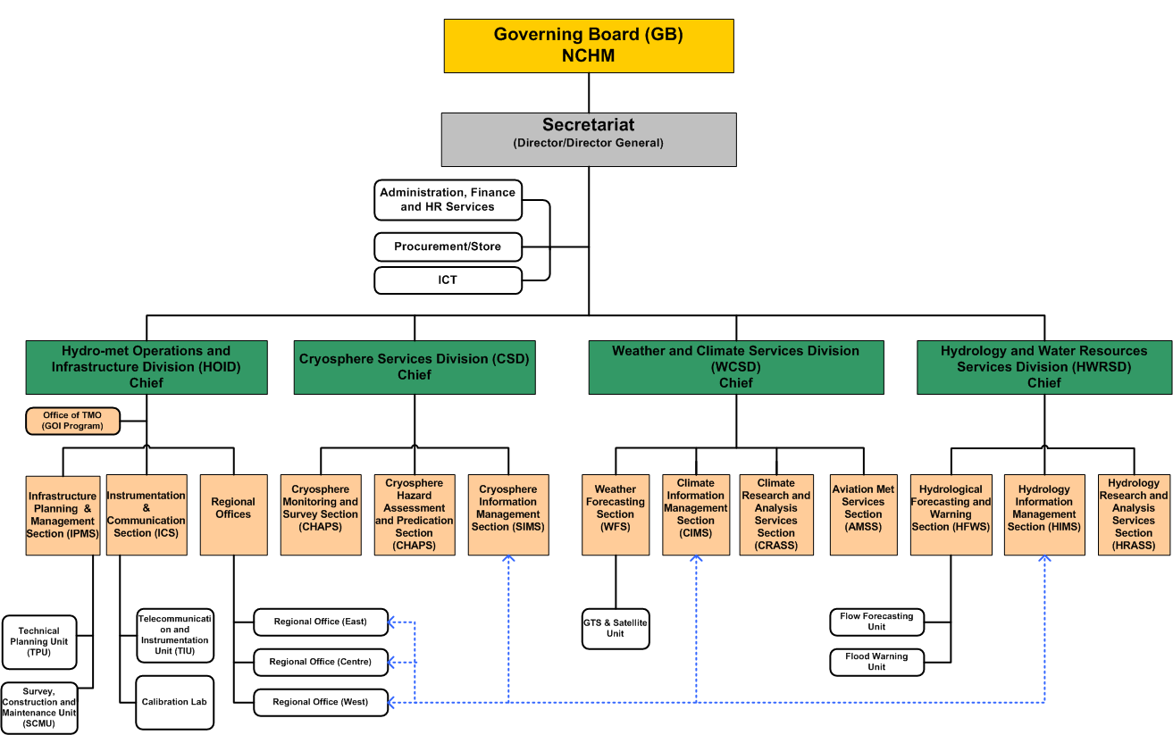
National Center for Hydrology & Meteorology(NCHM)

Slide 9
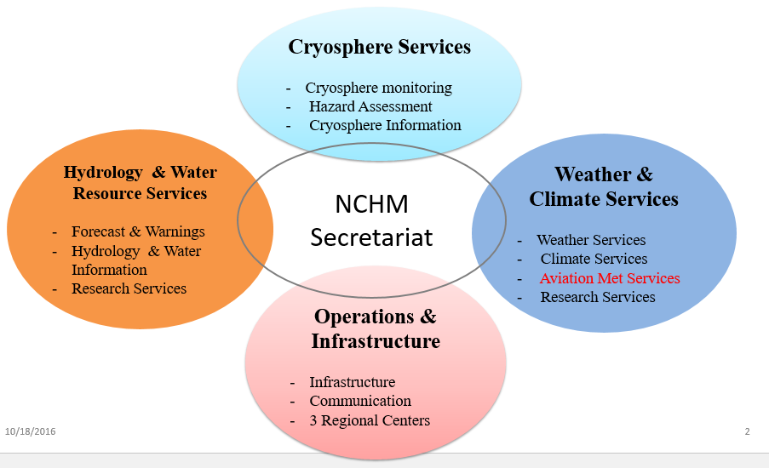
National Center for Hydrology & Meteorology(NCHM)
NCHM by Functions
Agro-Met Services

Slide 10
National Center for Hydrology & Meteorology
NCHM Staffs by Profession
Meteorologist (1)
Communication/Electroniucs Engineer (2)
Hydrologist (1)
ICT Personel (1)
Glaciologist (2)
Statistician (2)
Electrical engineer (7)
Civil Engineer (15)
Geologist (1)
Technicians (149)
3
Administration and Finance (8)
Total Strenght (189)

Slide 11
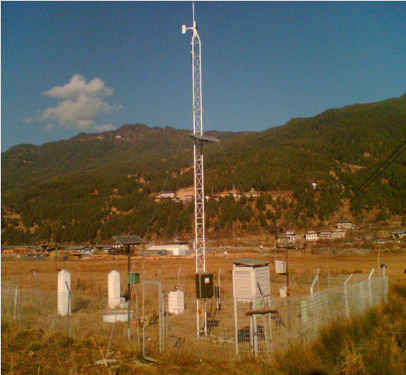
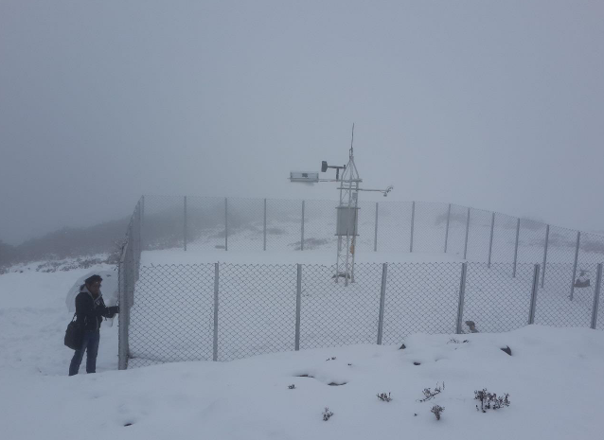
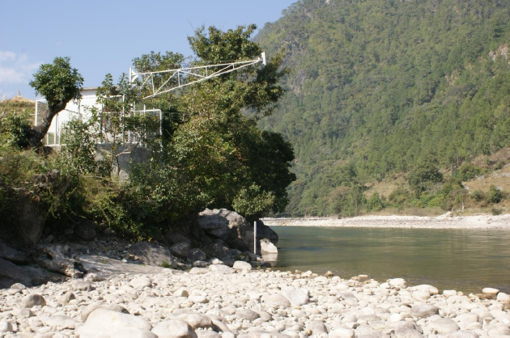
National Center for Hydrology & Meteorology
Mandate:
To establish & operates the national hydro-met observational network and associated facilities required for monitoring & data collection to understand weather, climate & water resources.
Surface observations
Meteorological Stations:
80 AWS
20 Class A
60 Class C
Hydrological Stations:
17 Principal
10 Secondary
10 Sediments
46 AWLS
Cryosphere stations:
18 Manual Stations
2 ASS

Slide 12
National Center for Hydrology & Meteorology
Process of data collection & Products
Weather station
Data
Warnings
Hydrology station
Modelling
Analysis
Monitoring
Research
Forecast
Data Collection
Data Processing
Data Quality
Data Reception
Dissemination
Snow Station
Advisories
Hazard Maps
GLOF/Flood stations
Climate Services
Water resource
Satellite/GTS
Source
Development
Product

Slide 13
Physical context of the Bhutan
Surface area: 38,394 km²
Rugged land of steep mountains crisscrossed by a network of swift rivers, which form deep valleys.
71 % of the country is under forest cover. (Constitution mandates keep a minimum of 60% of country’s land area under forest cover for all times to come.)
Glacier Lakes & Snow capped Mountains

Slide 14
National requirements for observations
National priority application areas
Hydro power generation Plants,
Agriculture
Tourism &Transports
Disaster
Aviation Industries
Most relevant measurements:
Temperature, humidity, precipitation, wind
Pressure, radiation

Slide 15
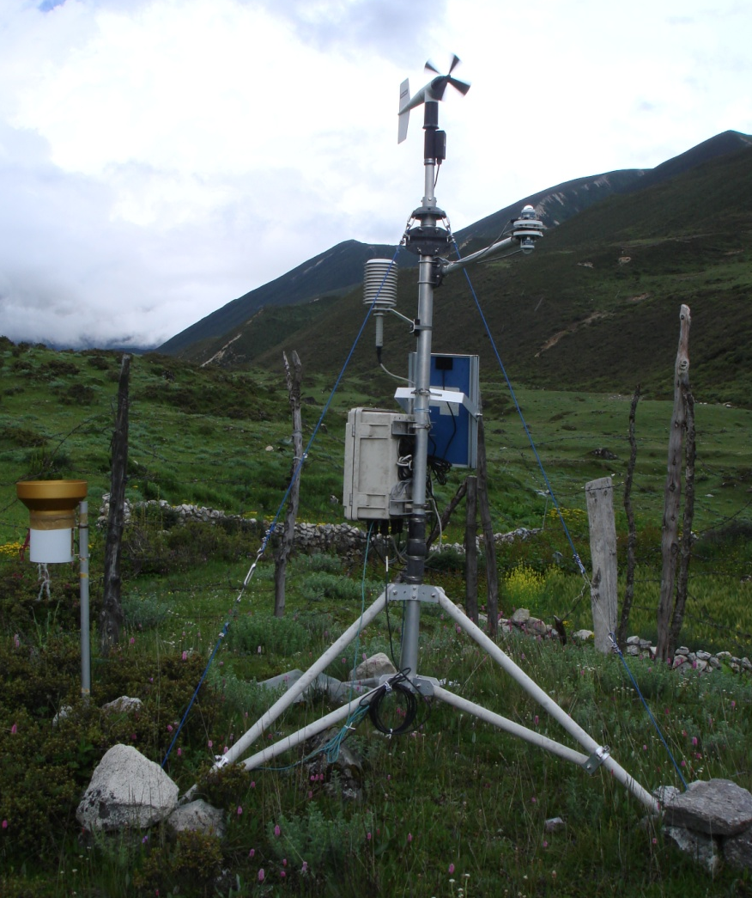
1. Meteorological Observing Stations..
Summary of national observing capabilities & Status
Rainfall
Temperature
Humidity
Pressure
Sunshine Hour
Evaporation
Wind speed and direction
Snow
Class C
Class A
Weather Forecasting
Weather/Climate trend
Planning and Development
5

Slide 16
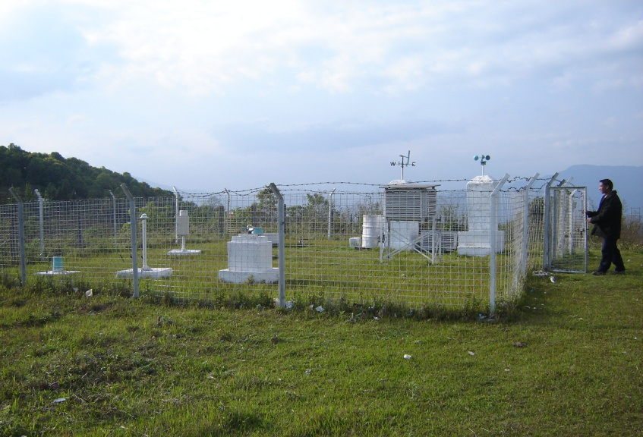
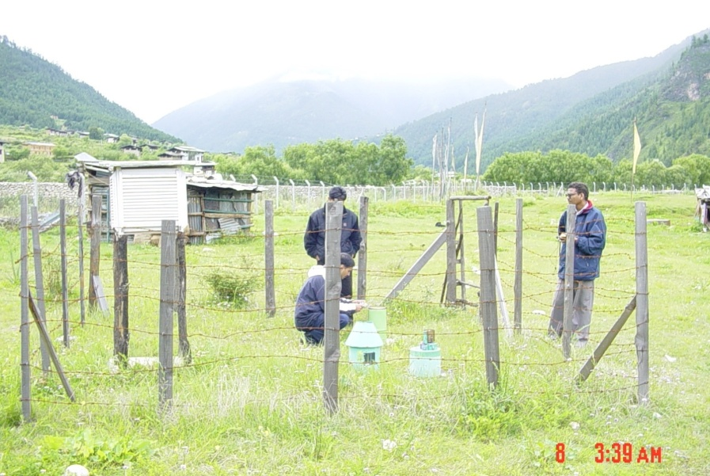
Meteorological Stations
Summary of national observing capabilities & Status
Automatic Weather Station(21 stations)
Class A
Class C
AWS=80
Class-A=20
Class-C=60
6

Slide 17
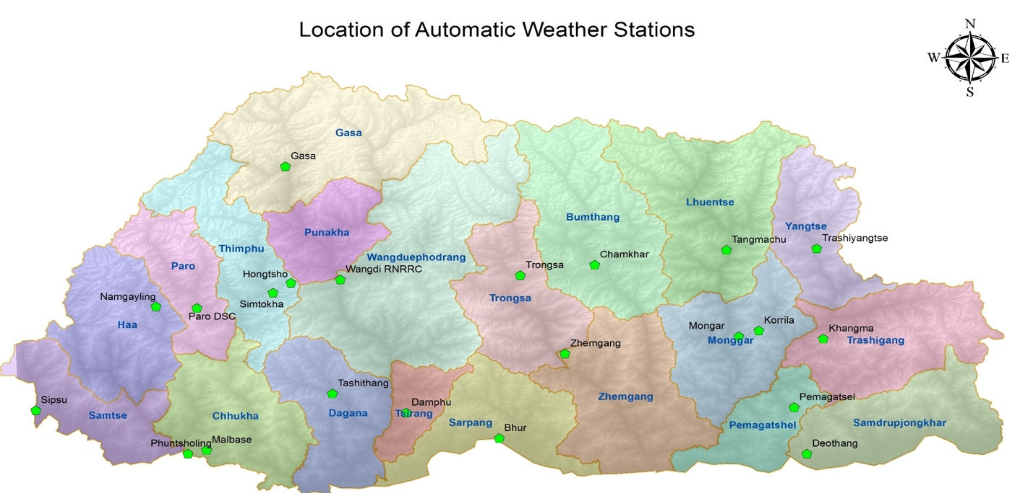
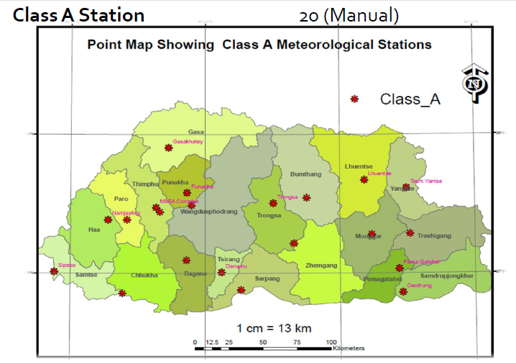
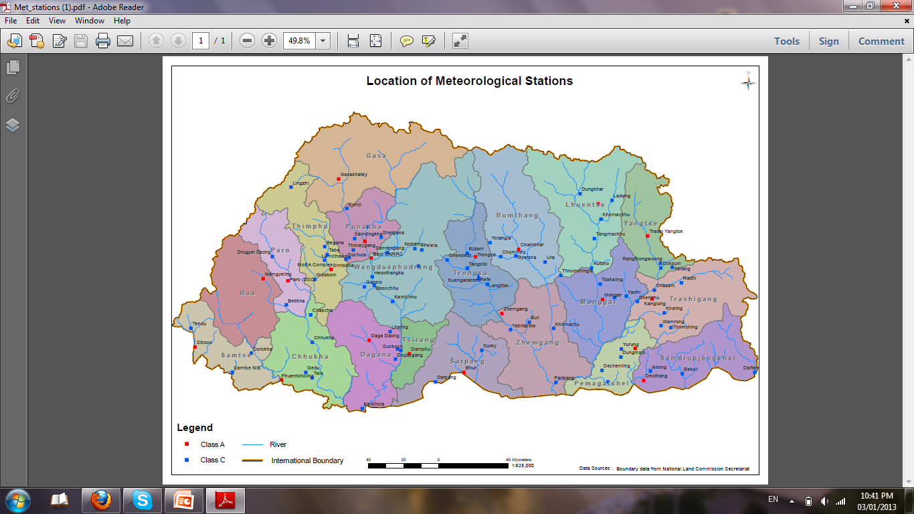
Summary of national observing capabilities & Status
AWS=80
Class-A=20
Class-C=60
6

Slide 18
Status of National implementation of WIGOS
The NCHM first installed the display software visualizing Satellite Animation and Interactive Diagnosis, SATAID where data was downloaded from the HimawariCloud in August, 2015. However later in March 2016, an independent reception antenna was installed which now enables the Center to download the images directly from the satellite.
2015: GTS was installed in Center (DHMS)
Project for Capacity Development of GLOF and Rainstorm Flood Forecasting and Early Warning in the Kingdom of Bhutan, 2013-2016: 1 AWS (WMO station ID: 44517, and 4 AWLS ( Station ID: 44516,44513, 44512, 44511 )were registered. However with the GTS, only one station 44517 is transmiited to data.
One METAR data ( Paro International Airport ) is shared to the WIS.

Slide 19
Challeges, Gaps & Plan
Limitted Techical HR Capacity
Integregation of different observation systems
Complex Geography of country
Weather Radar

Slide 20
???.
Thank You & Tashi Delek!

