Slide 1
Implementation of the Rolling Review of Requirements (RRR) process in China
WMO RA II WIGOS Workshop
Dr. JIANXIA GUO
Meteorological Observation Center of CMA
06/11/2018
Beijing, China

Slide 2
CONTENTS
The Rolling Review of Requirements (RRR) Process
The Practices of RRR Process by CMA
The Recommendations for the Implementation of RRR Process in RA II

Slide 3
The Rolling Review of Requirements (RRR) Process
/01

Slide 4
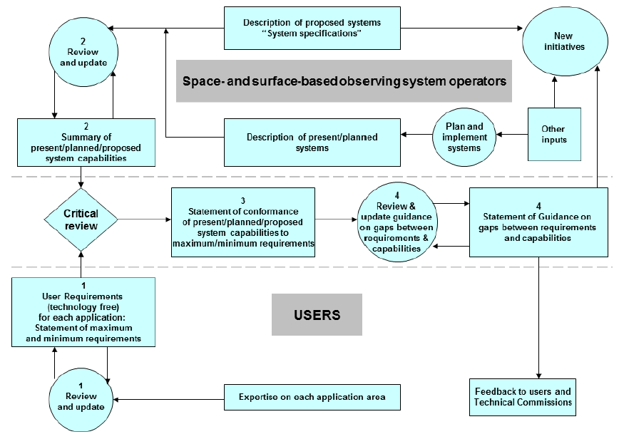
The Conception of the RRR Process
The RRR process provide a method to improve the quality of the observation system, to design, redesign or optimize the system, to promote the data using level by the application area.

Slide 5
Five Criteria Connecting Requirements and Capabilities
Global NWP
variables
SYNOP
High Resolution NWP
Horizontal resolution
Vertical resolution
Frequency(observation cycle);
Timeliness(delay in availability);
uncertainty (acceptable RMS error and any limitations on bias)
Nowcasting and Very Short Range Forecasting
Wind Profiler
Sub-seasonal to longer predictions
Aeronautical Meteorology
Forecasting Atmospheric Composition
Radar
Monitoring Atmospheric Composition
Providing Atmospheric Composition information to support services in urban and populated areas
Sounding
Ocean Applications
Agricultural Meteorology
AMDAR
∙∙∙∙∙∙
Hydrology
GCOS
Space Weather
Climate Science

Slide 6
The Critical Review (Gaps analysis between capacities and requirements )
The process must be as objective as possible.
OSEs
Observing System Experiments.
Representative analysis
FSO
Balanced coverage analysis
Forecasts Sensitive to observations.
OSSEs
Homogeneity analysis
Observing System Simulation Experiments.
Where?
Which?
How Many?

Slide 7
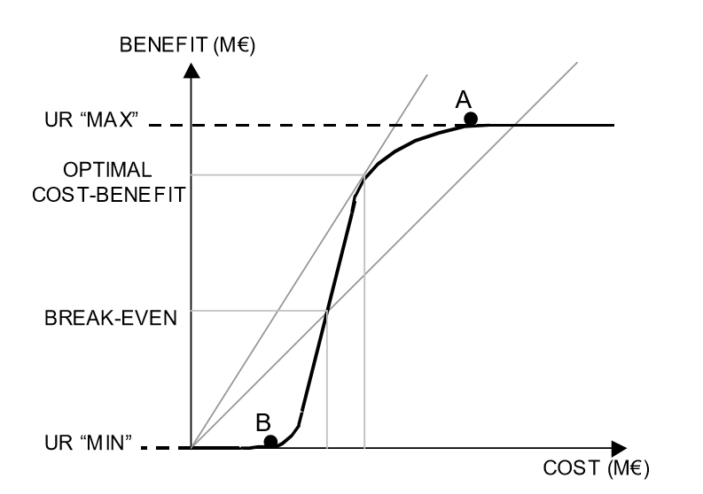
Statements of Guidance ( SoG) ---- Cost-effective
Text here
Goal: maximum requirement. The cost of improving the observations beyond the goal would not be matched by a corresponding benefit.
Text
Breakthrough: if achieved, would result in a significant improvement for the targeted application.
Text
Text
Text
Threshold: minimum requirement. Below this minimum, the benefit derived does not compensate for the additional cost involved in using the observation.
Terminology: Marginal, Acceptable, Good

Slide 8
The Practices of RRR Process by CMA
/02

Slide 9
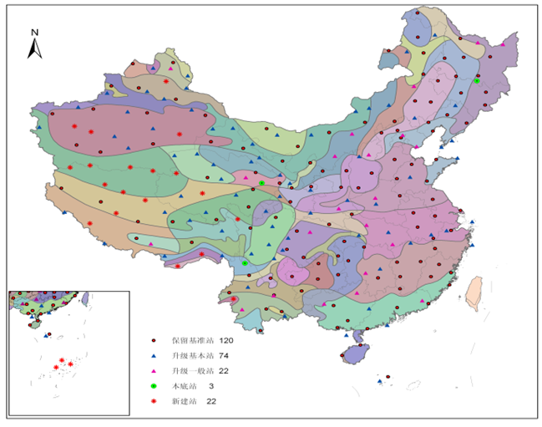
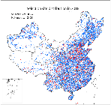
The Practices of RRR Process by CMA
Optimization of the Reference Climate observation Network
2009-2012
A comprehensive evaluation was conducted for the National Reference Climate observation;
A new optimization scheme of RCN was proposed by experts team and was approved by CMA.
Optimization of the Surface AWS network
2014-2016
A comprehensive evaluation was conducted for the AWS network.
Some AWS were selected from the regional AWS network and were upgraded to the national AWS network.

Slide 10
The Practices of RRR Process by CMA
Optimization of the Reference Climate observation Network
2009-2012
A comprehensive evaluation was conducted for the National Reference Climate observation;
A new optimization scheme of RCN was proposed by experts team and was approved by CMA.
Optimization of the Surface AWS network
2014-2016
A comprehensive evaluation was conducted for the AWS network.
Some AWS were selected from the regional AWS network and were upgraded to the national AWS network.

Slide 11
Optimization of the Reference Climate observation Network
Step 1: State the requirements to the observation system by the experts from the area of climate science.
1
Representativeness
Away from the local influence.
2
Sustainable
Lasting for a long time without interference.
3
Uncertainty (Accuracy )
Meet the GCOS requirements.
4
The coverage
The network should cover the whole country.

Slide 12
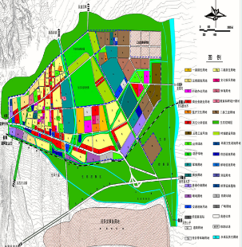
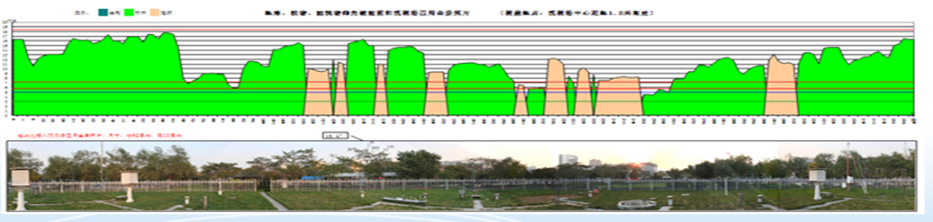
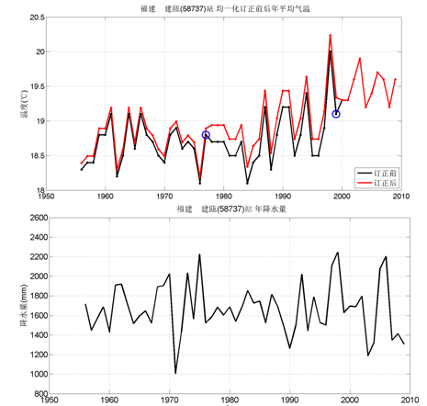
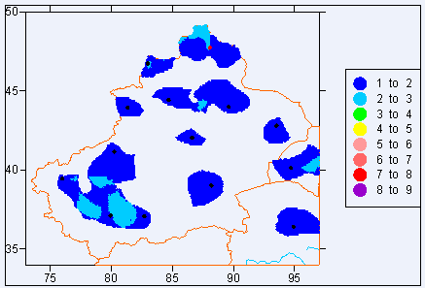
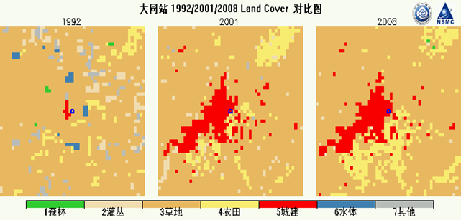
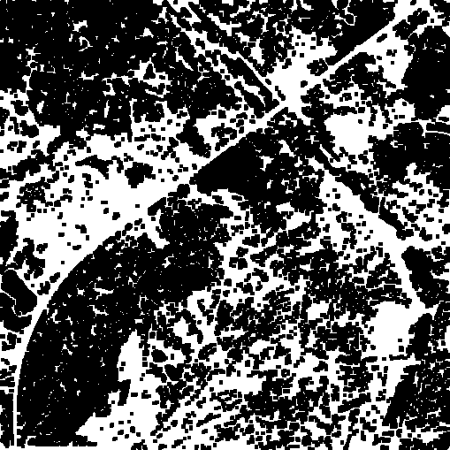
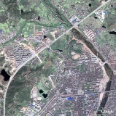
Optimization of the Reference Climate observation Network
Step 2: A review of the existing observing system according to the requirements
City developing plan
Make sure the site is stable
Field Survey
To estimate the influence of the surrounding environment
Data and metadata
To analysis the representative, homogeneity, and uncertainty.
Satellite images and land use
To estimate the influence of the urbanization.

Slide 13
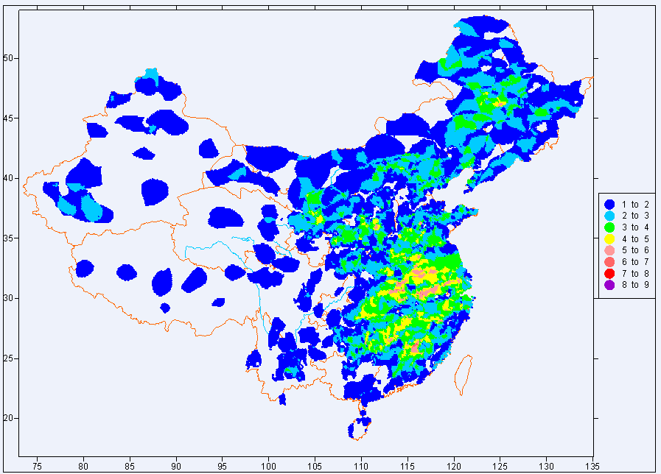
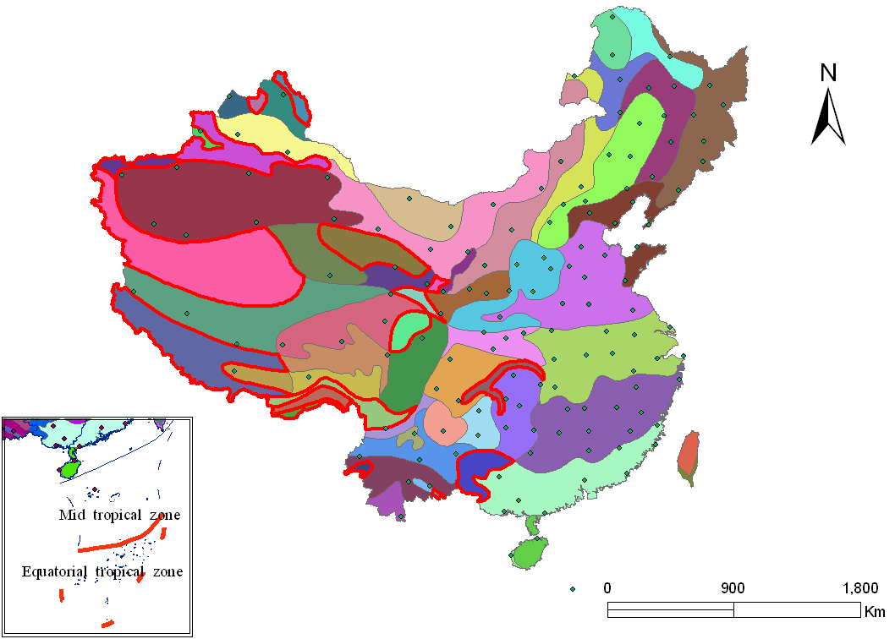
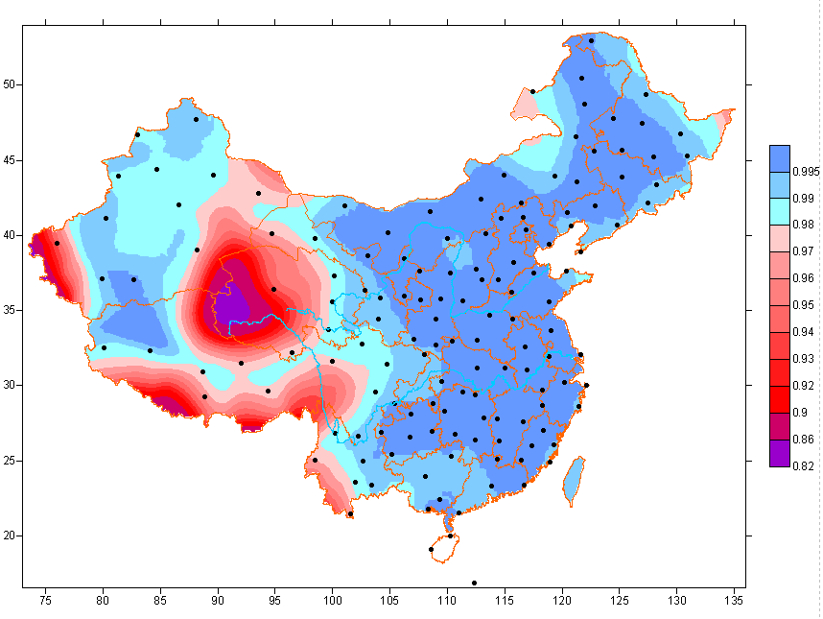
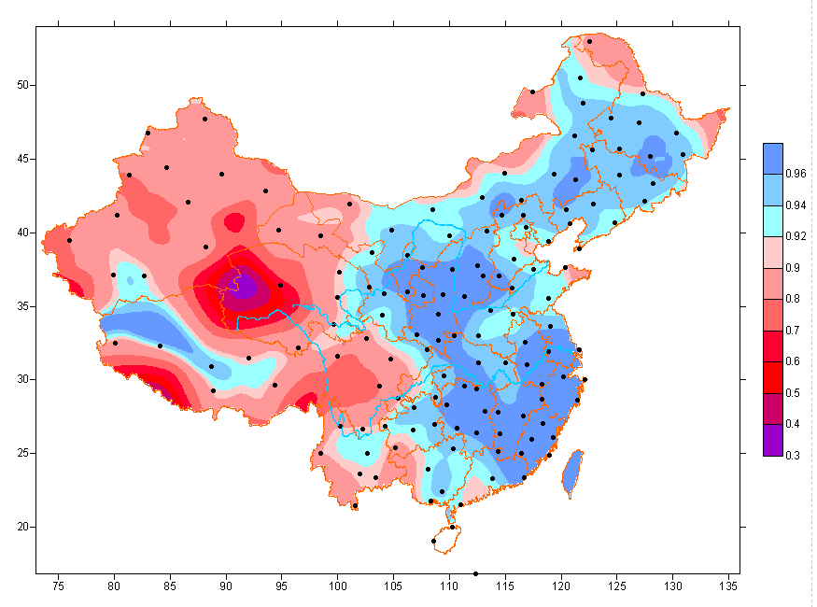
The Critical Review (Gaps analysis)
Capabilities to monitor
temperature and precipitation
Coverage analysis

Slide 14

Statements of Guidance ( SoG)
Degraded some stations from the density area.
Upgraded some good stations from the sparse region.
Established some new stations at the west part of china
Ratio of coverage
Station number
Optimization scheme
The coverage cost curve

Slide 15
Validation of the optimized scheme
The temperature monitoring capability of 81% area reach to 98% ;
The precipitation monitoring capability of 62% area reach to 90%;

Slide 16
The Practices of RRR Process by CMA
Optimization of the Reference Climate observation Network
2009-2012
A comprehensive evaluation was conducted for the National Reference Climate observation;
A new optimization scheme of RCN was proposed by experts team and was approved by CMA.
Optimization of the Surface AWS network
2014-2016
. A comprehensive evaluation was conducted for the AWS network.
Some AWS were selected from the regional AWS network and were upgraded to the national AWS network.

Slide 17
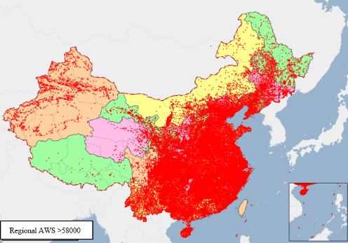
Optimization of the Surface AWS network
Motivation
Aim
The density of the national AWS network was not enough to meet the increased needs of high-resolution numerical forecast system and the small and medium severe weather capture. Need to be improved
Improve the capacity of monitoring and forecasting of the 20-50km weather system.

Slide 18
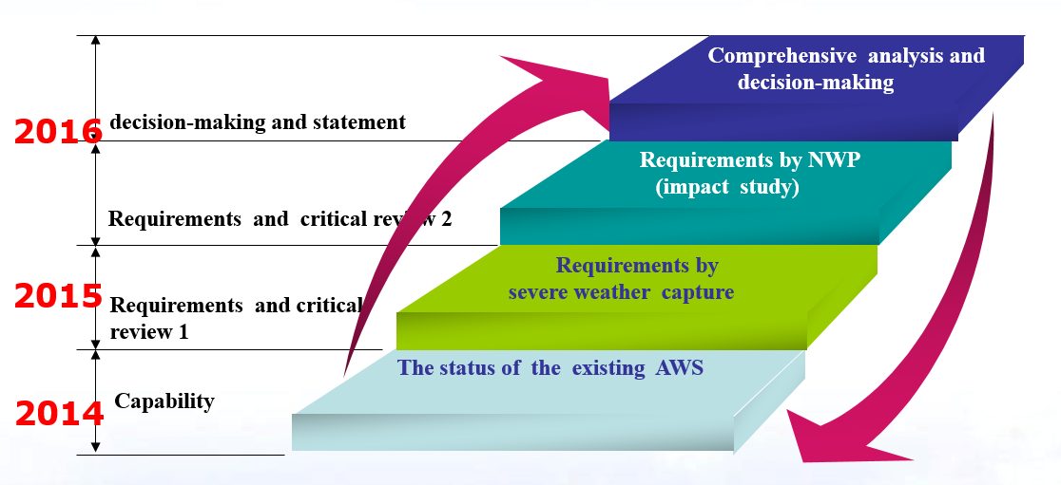
Optimization of the Surface AWS network
  The RRR cycle of the optimization AWS network activities.
How many?
Where?
Which?

Slide 19
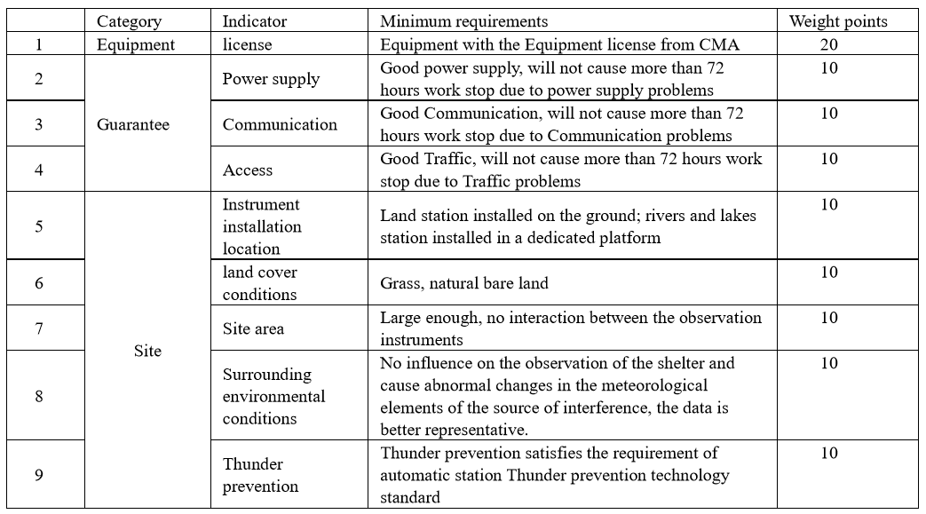
Optimization of the Surface AWS network
Capabilities evaluation---Step 1 (2014)
Provincial and local meteorological services all over the country participated in the work. Greatly contribute to the judgment of site credible.

Slide 20
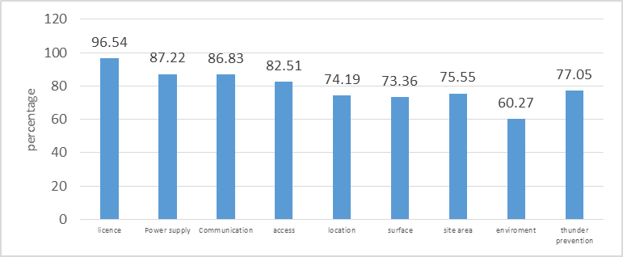
Optimization of the Surface AWS network
The situation of the regional AWS
There are more than 30,000 regional AWS is reliable for selection.

Slide 21
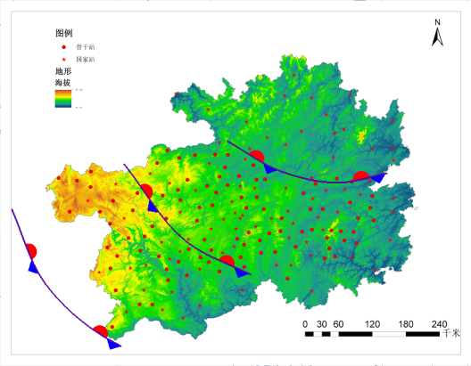
Optimization of the Surface AWS network
Requirements statement 1---- Step 2 for application area 1(2015)
  Weather systems analysis
    Focus on 7 types of weather systems that may induce the severe weather.(low pressure ,convergence line, low vortex, low trough, front, shear line, the subtropical high)
  High-impact /severe weather analysis
    Focus on 4 kinds of high-impact /severe weather (heavy rain, wind, hail and thunderstorm)
    Critical review 1---- Step 3 for application area 1 (2015)
      Scale, activity area
      Occurrence source, developing and weakening area, moving route and other sensitive areas.

Slide 22
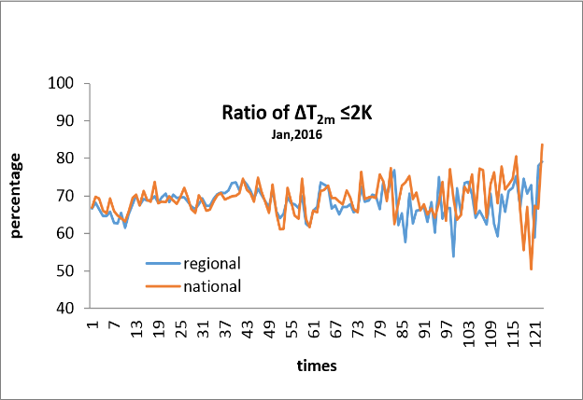
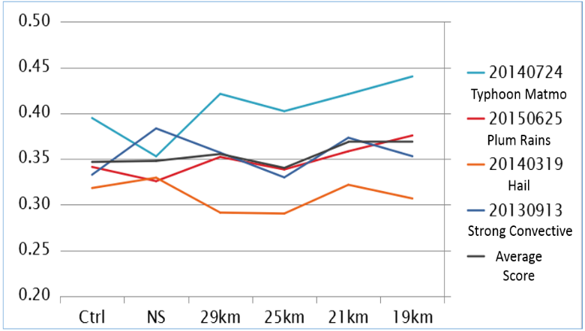
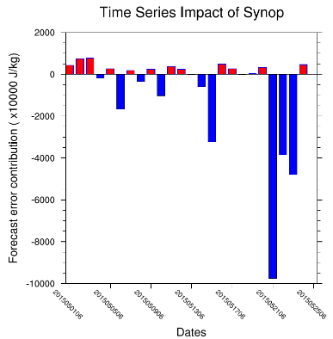
Optimization of the Surface AWS network
Requirements statement 2---- Step 2 for application area 2(2016)
  The horizontal resolution of National NWP model is 15km
  The assimilation rate of AWS is lower than 50%.
    Critical review 2---- Step 3 for application area 2(2016)
      Data quality check.
      The method for improving the assimilation rate of AWS.
      OSEs, OSSEs experiments for density variation of AWS.
      FSOs experiments for AWS contribution investigation.

Slide 23
Optimization of the Surface AWS Network
Density control
15km for the whole country and 10km for the key area.
Fist priority
Step 4:
SOG
To the AWS with positive contributions to the NWP.
Second priority
To the AWS by synoptic analysis needs.
Station selection
The observation condition is the basic reference to choose the AWS.

Slide 24
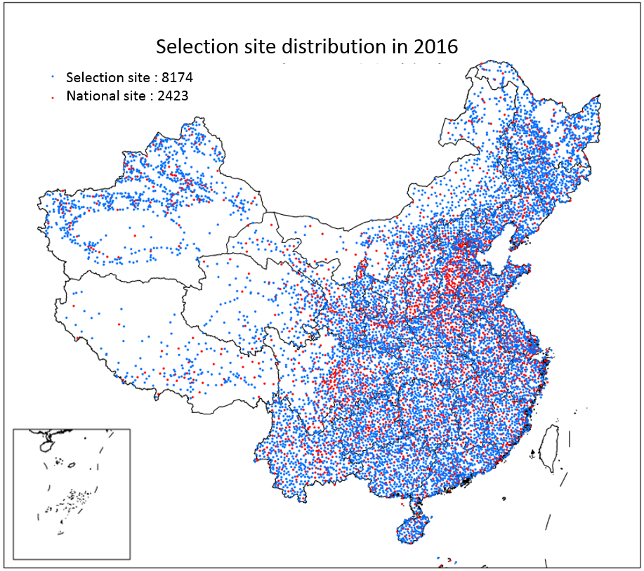
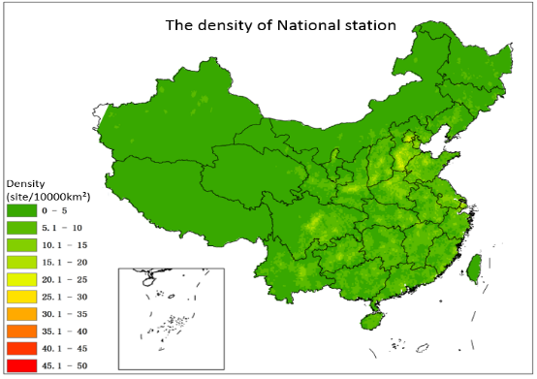
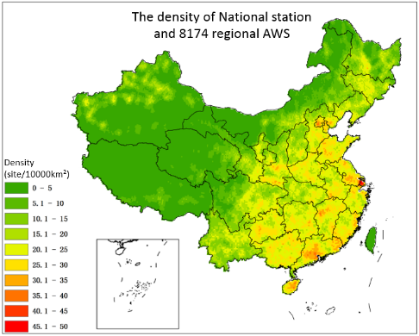
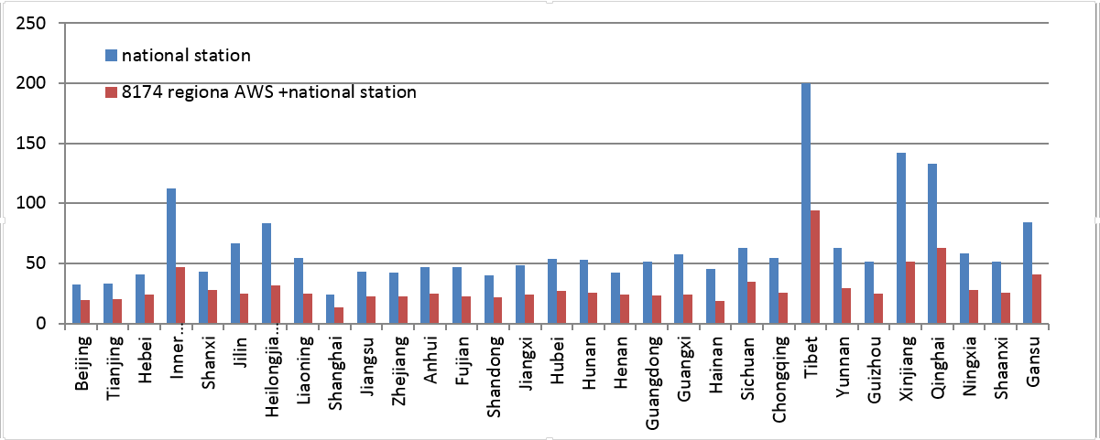
Optimization of the Surface AWS Network
The variation of AWS density
Optimization scheme

Slide 25
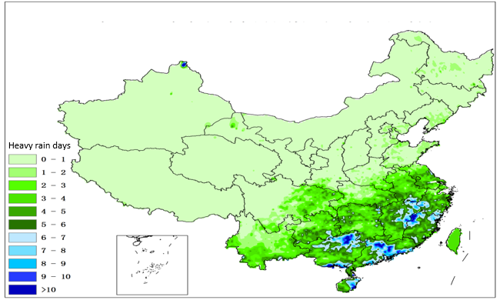
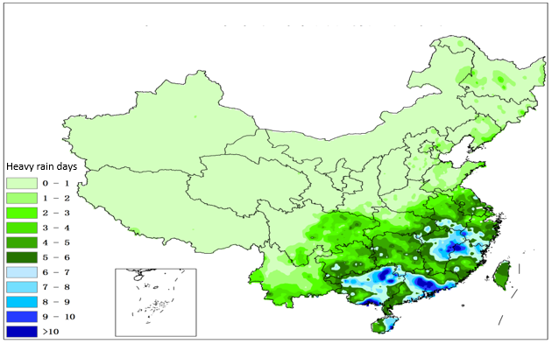
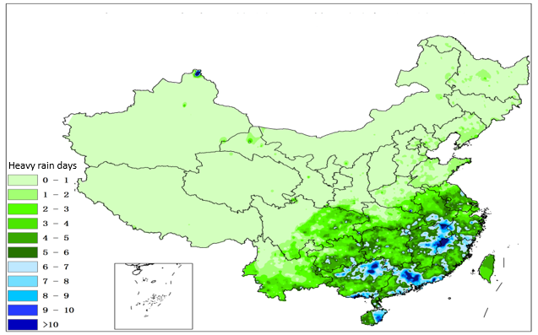
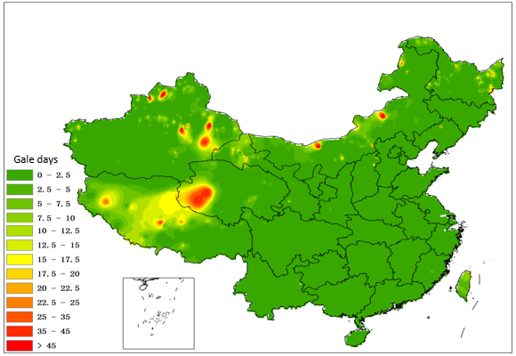
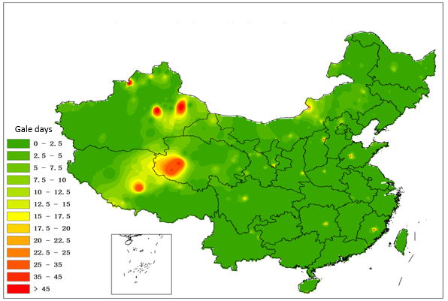
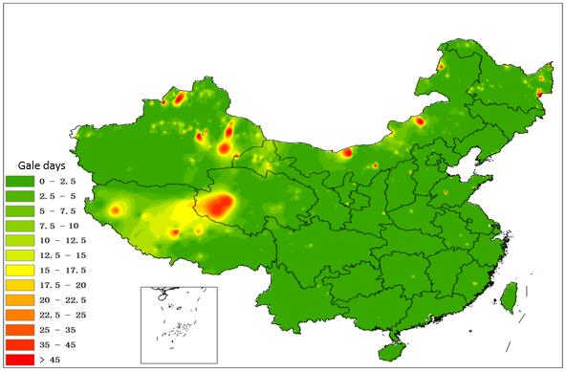
Validation of the optimized scheme
All AWS
National AWS
Final scheme
Heavy rain days
Gale days

Slide 26
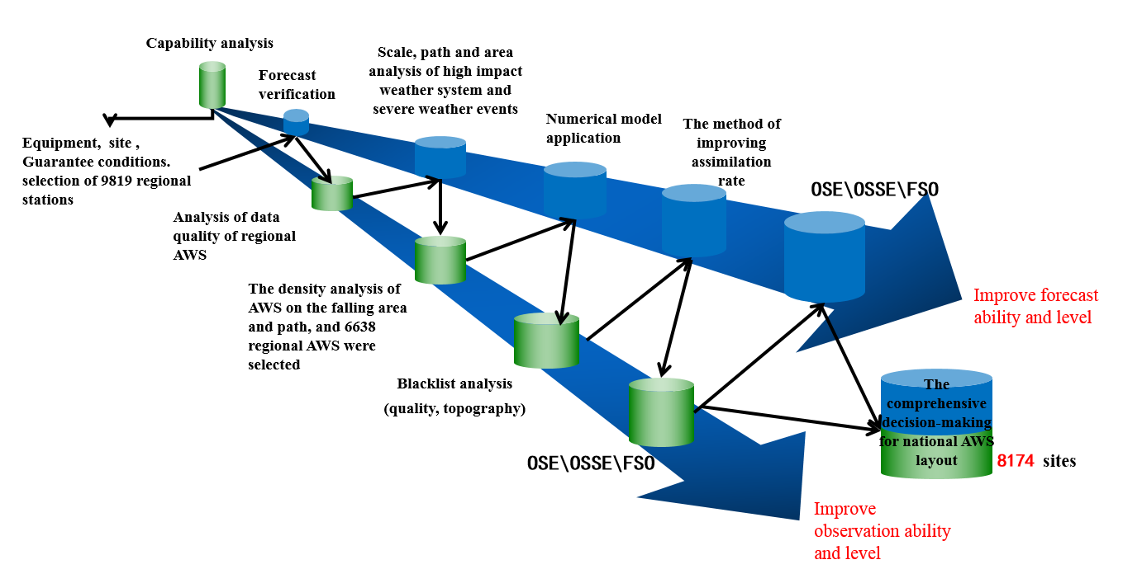
Conclusion and experience
RRR is a process with combining the science and engineering process of the system.
Both the observation systems and the application systems benefit from the RRR process.

Slide 27
The Recommendations for the Implementation of RRR Process in RA II
/03

Slide 28
The Recommendations for the Implementation of RRR Process in RA II
Establish a group of experts to study the scientific implementation of the RRR process in RA II……
More than 10 actions
C4,G8
Design RBON according to the RRR principle.
G9,G10
G15,G16,G17
G19,G28,G29…
Encourage members of RA II to evaluate and optimize their own observation systems in line with the RRR principle.

Slide 29
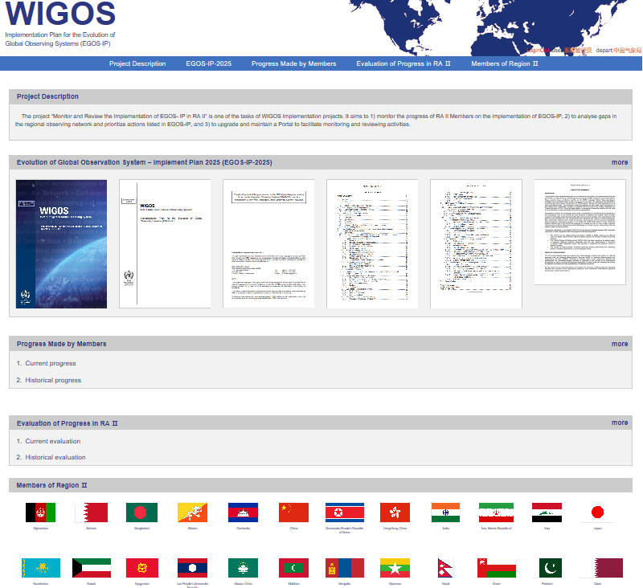
Monitor and review the Implementation of EGOS- IP in RA II
EGOS-IP website are divided to 5 sections, in which “Progress Made by Members” section is designed to investigate the progress made by WMO members in a manner of questionnaire.

Slide 30
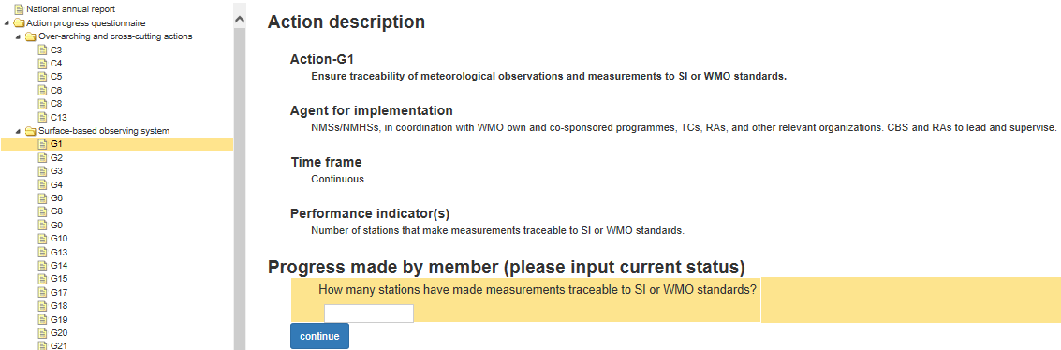
There are 105 actions in EGOS-IP, and they cover 4 areas: cross-cutting (C), space weather (W), and surface-based observing system (G/S). 49 of them are leaded by WMO members and should be evaluated on this website, while the rest 56 actions that are leaded by global organization and technical commission are not shown here.

Slide 31
Each action has some questions related to “Performance indicator(s)” to evaluate its progress.

Slide 32
Thanks for Your Attention!

