Slide 1
Regional WIGOS Centre Tokyo
Submitted by
Yoshihiko TAHARA
RA II WIGOS Workshop
6-8 November 2018, Beijing, China

Slide 2
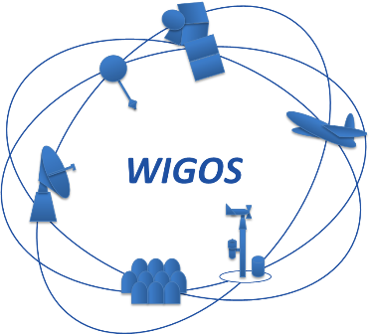
Outline
JMA’s current activities - RWC Tokyo’s backbone –
RWC Tokyo’s activity plan
RWC Tokyo’s Milestones

Slide 3
JMA’s current activities - RWC Tokyo’s backbone -
Regional Instrument Centre (RIC) Tsukuba
Conducts technical cooperation with Members to support regional capacity development activities.
Runs the “RIC Tsukuba Package” as a comprehensive support approach encompassing the following activities.
Calibration of national standard instruments
Transfer of calibration technology
Preparation of instruments for national standards where necessary
RIC Tsukuba Package
Survey
Provision
Training
Follow-up
Preliminary survey of calibration capacity
Provision of standard instruments and/or inspection equipment
Training sessions
Follow up activities

Slide 4
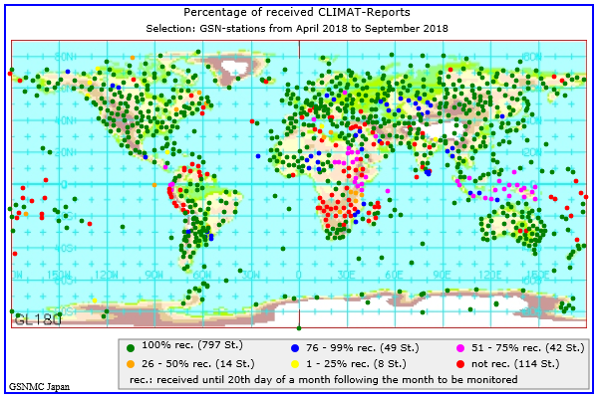
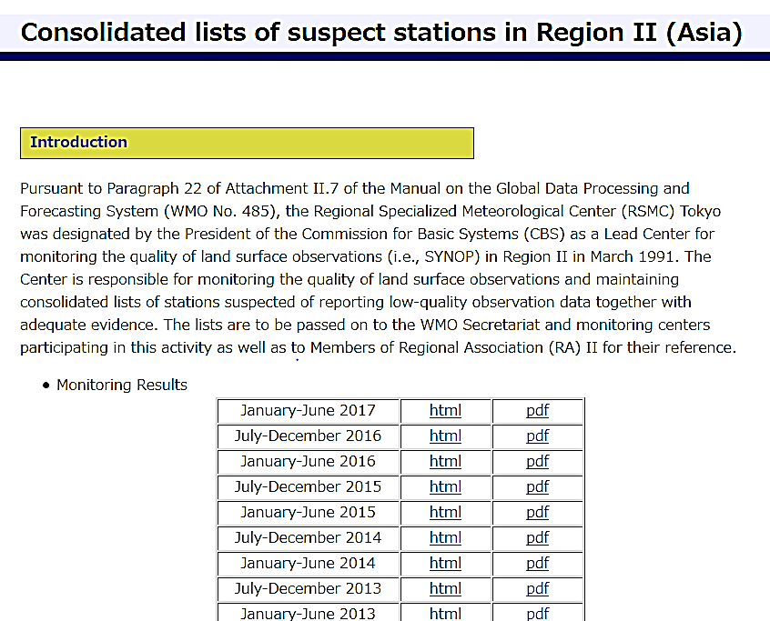
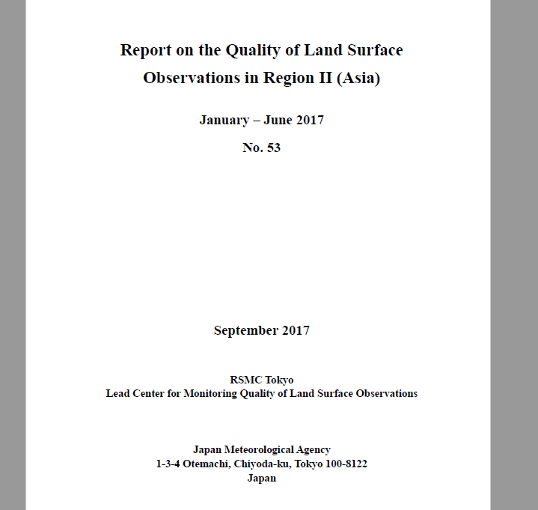
JMA’s current activities - RWC Tokyo’s backbone -
JMA Numerical Weather Prediction (NWP) enables monitoring land/sea surface and upper-air observations in the World
GSN Monitoring Center for climate data
CBS Lead Centre monitoring for land surface observations
https://www.dwd.de/EN/ourservices/gsnmc/gsnmc.html
http://qc.kishou.go.jp/

Slide 5
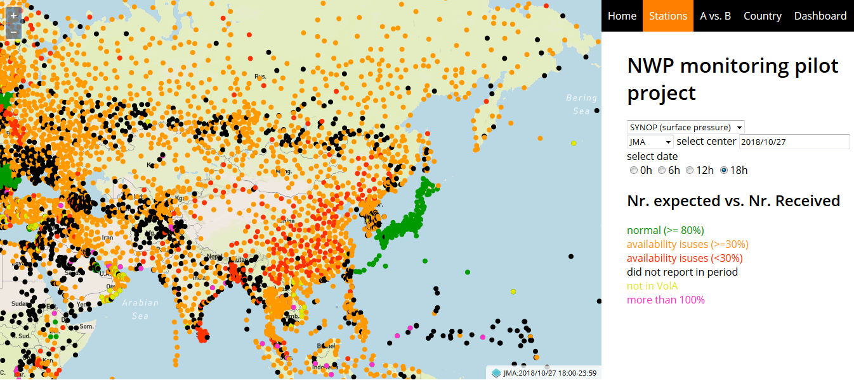
JMA’s current activities - RWC Tokyo’s backbone -
TT-WDQMS (WIGOS Data Quality Monitoring System)
JMA Participates in the NWP Quality Monitoring Pilot Project on WDQMS with ECMWF, NCEP and DWD, and
The Project collects (shows) availability and quality information on surface observations in the World
Surface pressure observation availability map developed by WIGOS Project Office

Slide 6
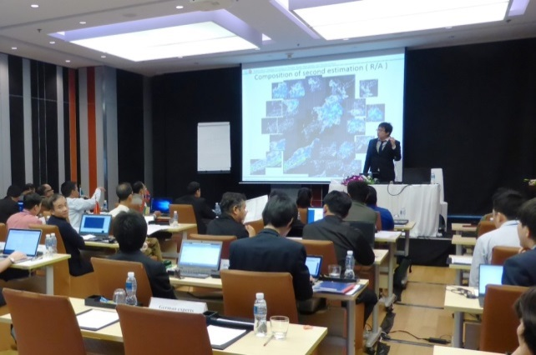
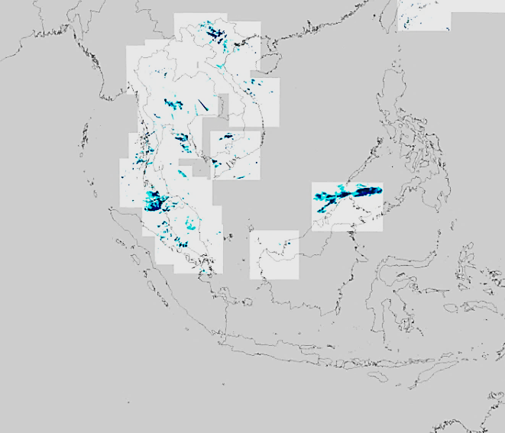
JMA’s current activities - RWC Tokyo’s backbone -
RA II WIGOS Implementation Project No. III Capacity Building in Radar Techniques in the Southeast Asia
ASEAN Regional Training Workshop on Weather Radar Basis and Routine Maintenance and Real-Time Radar Rainfall Estimation and Forecasting (Bangkok, Thailand, 24 February - 7 March 2014)
WMO/ASEAN Training Workshop on Weather Radar Quality and Standardization (Bangkok, Thailand, 5 - 13 February 2018)
Technical cooperation for Lao PDR, Malaysia, Thailand and Vietnam on development of regional radar network in Southeast Asia under the ESCAP/WMO Typhoon Committee
Bilateral cooperation with Indonesia

Slide 7
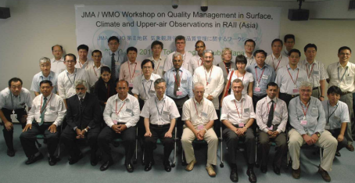
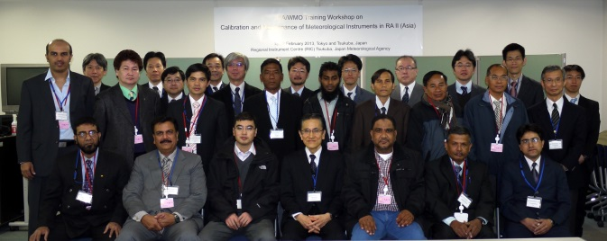
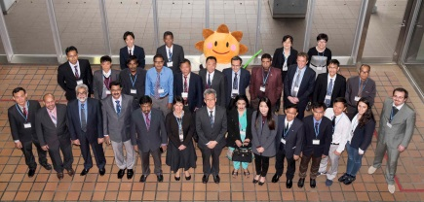
JMA’s current activities - RWC Tokyo’s backbone -
RA II WIGOS Implementation Project No. IV Enhance the Availability and Quality Management Support for NMHSs in Surface, Climate and Upper-air Observations and Project
Survey
Workshop
Report
Actions
Round 1
Gap-analysis between user requirements and current status in NMHSs in RA II
(27-30 July 2010, Tokyo, Japan)
Round 2
Improvement of understanding of and skills in traceability of measurements in NMHSs in RA II
(19-22 February 2013, Tsukuba, Japan)
Round 3
Capacity building on Quality Management techniques in rainfall observation in NMHSs in RA II
(19-23 March 2018, Tokyo, Japan)

Slide 8
JMA’s current activities - RWC Tokyo’s backbone -
RA II WIGOS Implementation Project No. VI Develop Support for NMHSs in Satellite Data, Products and Training
Support for the preparation of satellite data users in relation to the new generation of geostationary meteorological satellites
Establishment of close coordination between the RA II WIGOS Project and the RA-V Task Team on Satellite Utilization
Establishment of the new webpage of the RA II WIGOS Project (hosted by JMA)
Convening the series of Asia/Oceania Meteorological Satellite Users’ Conference (AOMSUC)
Conducting the trainings and questionnaires on the utilization of new generation of geostationary meteorological satellites through the AOMSUCs
Quarterly newsletters for RA II Members

Slide 9
RWC Tokyo’s activity plan
RWC Tokyo will cover both mandatory and optional functions.
Mandatory Functions:
Regional WIGOS metadata management (work with data providers to facilitate collecting, updating and providing quality control of WIGOS metadata in OSCAR/Surface);
Regional WIGOS performance monitoring and incident management (WIGOS Data Quality Monitoring System) and follow-up with data providers in case of data availability or data quality issues.
Optional functions:
assistance with the coordination of regional/sub-regional and national WIGOS projects;
assistance with regional and national observing network management;
support for regional capacity development activities.

Slide 10
RWC Tokyo’s activity plan
1. Regional WIGOS metadata management
Provide support for introducing OSCAR/Surface in each country through activities such as workshops.
Review the registration status of WIGOS metadata in OSCAR/Surface of each Member.
Notify the National Focal Points of the relevant Members when there are unregistered stations or doubts about the registered data to encourage improvement.
OSCAR/Surface
Each Member
RWC Tokyo
Register
Review
Notify & Support

Slide 11
RWC Tokyo’s activity plan
2. Regional WIGOS performance monitoring and incident management (WDQMS)
CBS Lead Centre
Quality monitoring: To monitor availability, immediacy and quality of observation data (idea: by JMA and/or other NWPs)
Evaluation: To evaluate the monitor results and specify problematic stations
Quality monitoring
Linked work
Evaluation
Incident management
Existing Regional Centres （RIC, RCC, RRC, WCC, QA/SAC）
Follow-up
Collaboration

Slide 12
RWC Tokyo’s activity plan
2. Regional WIGOS performance monitoring and incident management (WDQMS)
Incident management: To notify the problem to Members and keep track of recovering progress
Follow-up: To assist Members in solving problems in collaboration with relevant Regional Centres, e.g. RIC Tsukuba, GISC Tokyo, Tokyo Climate Center (TCC)
Quality monitoring
Evaluation
Incident management
Existing Regional Centres （RIC, RCC, RRC, WCC, QA/SAC）
Follow-up
Collaboration

Slide 13
RWC Tokyo’s activity plan
JMA will continue the regional activities as “RWC Tokyo’s Optional Functions” in collaboration with existing WMO Centres.
Assistance with the coordination of regional/sub-regional and national WIGOS projects
Coordinating the RA II WIGOS Implementation Projects as the Project Leaders/Coordinators, and advising national WIGOS projects in each Member.
Assistance with regional and national observing network management
Providing advices on management of regional and national observing networks in collaboration with existing WMO Centres (RIC, RCC, RRC, WCC and QA/SAC).
Support for regional capacity development activities
Supporting regional capacity development activities through technical cooperation in collaboration with existing WMO Centres (RIC and RCC).

Slide 14
RWC Tokyo’s Milestones
June 2018: Designated as a RWC in pilot mode
Early 2019: Develop tools for regional WIGOS metadata management and the WDQMS
March 2019: WIGOS Workshop in Tokyo
2019: Begin pilot RWC activities
2020: Begin operational RWC activities

Slide 15
RA II WIGOS Workshop in Tokyo
Date: 6 - 9 March 2019
Venue: JMA HQ in Tokyo, Japan
Participants: Technical officers in surface observation implementation
Purpose:
To understand keys of WIGOS (incl. OSCAR/Surface and WDQMS)
To make practical discussion about collaboration between RWC and Members to improve observation using WDQMS
To share RWC Tokyo’s services with Members
PLAN

Slide 16
Thank you
y-tahara@met.kishou.go.jp

Slide 17
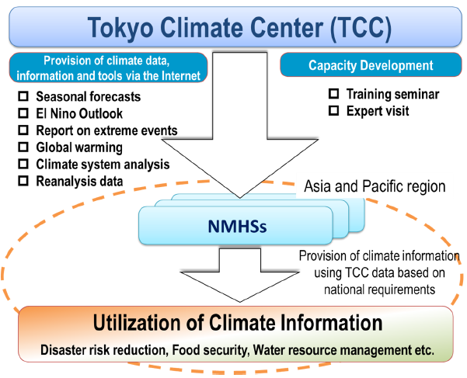
JMA’s current activities - RWC Tokyo’s backbone -
Tokyo Climate Center (TCC)
TCC serves as a WMO Regional Climate Center in the RA II.
TCC supports NMHSs through data/information provision and capacity development activities.

