Slide 1

Regional WIGOS Center in RA-II
CMA Proposal and capabilities
China Meteorological Adminstration
07 Nov. 2018
RA II WIGOS Workshop
6-8 November 2018, Beijing, China
Notes:
Good morning, delegates, my name is WU Lei. I am very glad to introduce CMA proposal and capabilities of Regional WIGOS Center in RA-II here.

Slide 2
Outline
Background Introduction
Progress on the RWC Pilot Project of CMA
Future Work Arrangements
Notes:
The content of the report consists of three parts, firstly the background introduction, and then I will introduce the progress on the RWC Pilot Project of CMA , including the process, technology and system. Finally, I’ll talk about CMA's arrangement for future work.

Slide 3
Background Introduction
Notes:
First, the background introduction.

Slide 4
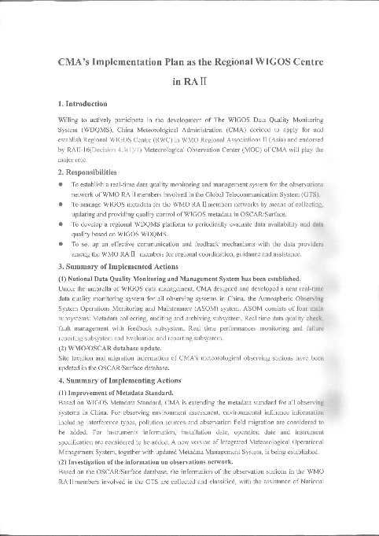
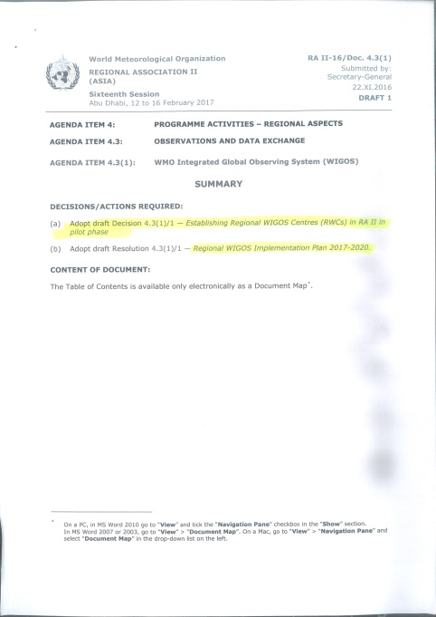

WMO (Cg-17) agreed to develop and establish a Regional WIGOS Center (RWC) to undertake regional WIGOS metadata maintenance and data quality management responsibilities.
In January 2017, CMA applied to establish the Regional WIGOS Center (RWC) and fulfilled the WIGOS regional data quality management function.
In accordance with the spirit of the resolutions and decisions of the 68th Executive Committee of the 17th World Meteorological Organization Conference, CMA deployed relevant work to promote the pilot of the Regional WIGOS Center (RWC).
In 2018, CMA invested about $500,000 to support the RWC pilot project.
Notes:
As we know, WMO agreed to develop and establish RWC to undertake regional WIGOS metadata maintenance and data quality management responsibilities.
In January 2017, CMA applied to establish the RWC.
Then CMA deployed relevant work to promote the pilot of the RWC.
In 2018, CMA invested about $500,000 to support the RWC pilot project;
In 2019, CMA will continue to improve the work.

Slide 5
II. Progress on the RWC Pilot Project of CMA
Notes:
Secondly, I will introduce the progress on the RWC Pilot Project of CMA .

Slide 6
Work Goal ：
To establish a mature operational RA II observation data quality monitoring center
Technical routes ：
Based on China GRAPES Mode Forecast Products
Monitoring and evaluation algorithms and systems are consistent with WMO requirements
Comprehensive diagnostic analysis of various means (WDQMS, OSCAR, etc.)
Work effectiveness ：
Complete the implementation of the Regional WIGOS Center of RA II
Complete the development of land surface observation and sounding evaluation algorithms
Complete the design and development of the Regional WIGOS Center Quality Monitoring System
Complete evaluation report of AWS in the first half of 2018
Notes:
Our goal is to establish a mature operational RA II observation data quality monitoring center.
Our technical routes as follows: the comparison is based on the Forecast Products of Chinese GRAPES mode, monitoring and evaluation algorithms and operational systems are consistent with WMO requirements, and using various means (such as WDQMS, OSCAR, etc.) to comprehensively diagnose and analyze the observation data quality.
Now we have Completed the land surface observation and radiosounde evaluation algorithms,the RWC Quality Monitoring System and the evaluation report of land surface observation in the first half of 2018 which has been sent to everyone as the meeting material.

Slide 7
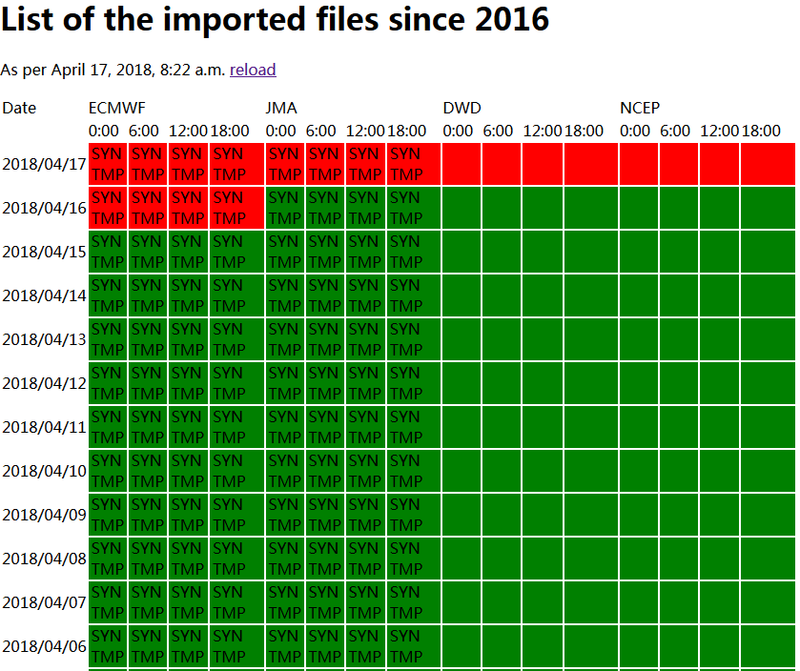
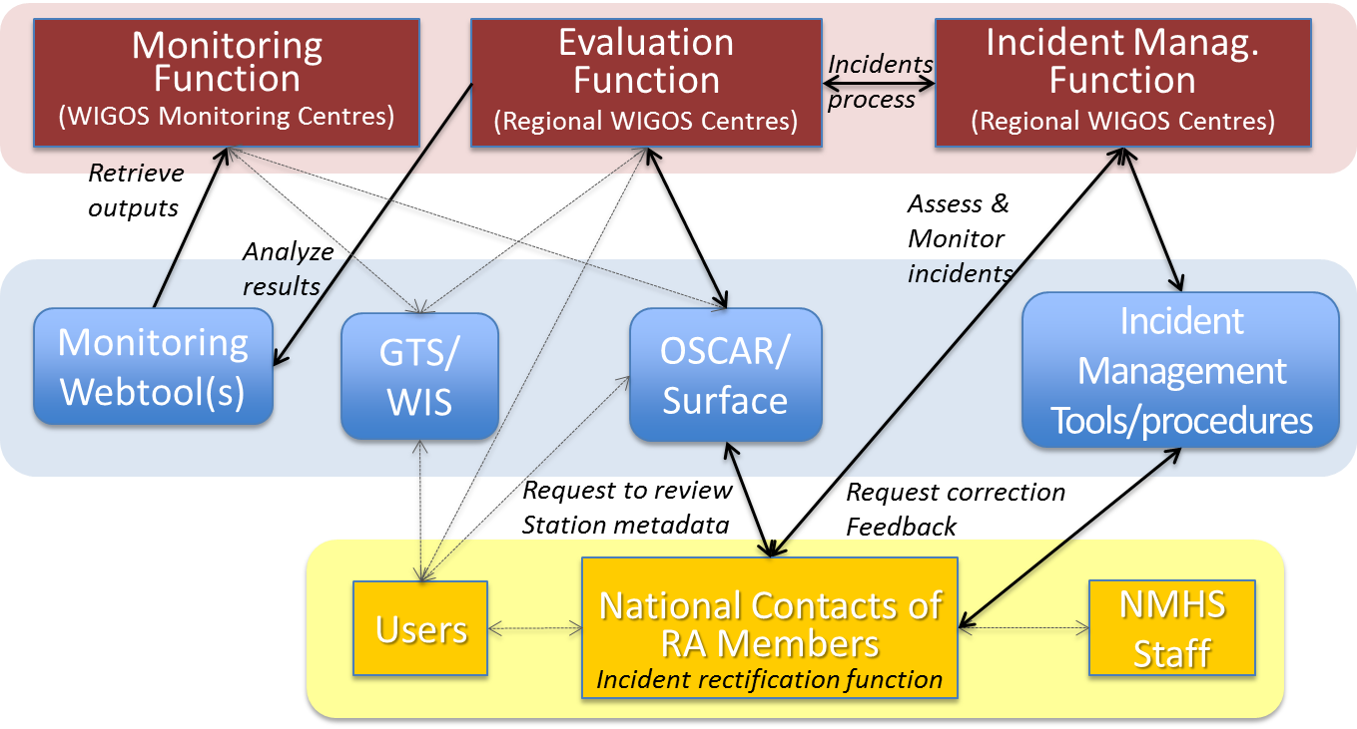
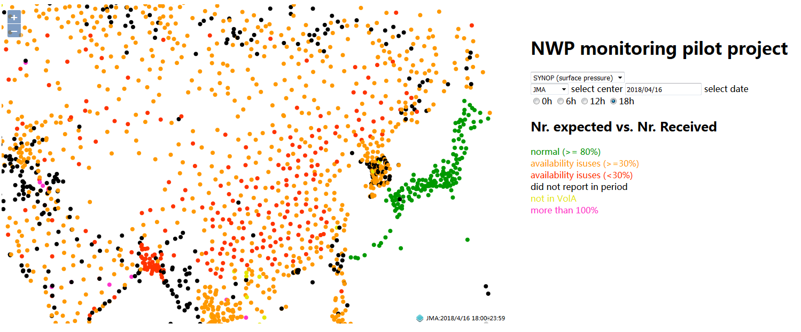
Previous Research - System Construction
WMO organized to develop WIGOS Data Quality Monitoring System (WDQMS)
Integrated evaluation results of four NWPs of ECMWF, JMA, DWD, and NCEP
With data quality monitoring, evaluation, and event management functions
Real-time output of monitoring results (by 6 hours)
Notes:
In order to carry out the RWC pilot project of RA II, and to exercise the RWC duties, we have done in-depth research on relevant foreign situations. In terms of operational system, WMO organized to develop WIGOS Data Quality Monitoring System (WDQMS), which integrates the evaluation results of four NWPs of ECMWF, JMA, DWD and NCEP, and has three functions: data quality monitoring, data quality evaluation and incident management. The first two functions are easily understood, and about the incident management function, my understanding is to track and help improve data quality issues.
The system monitoring results are output in real time and output every 6 hours. In fact, when I took over this work, I just wondered why using the forecast field for comparison. Through in-depth research, I understand that it is for data monitoring, improving timeliness, quickly finding problems, and solving problems as early as possible, instead of letting the problem exist for one month or even six months then found through evaluation. Of course, the evaluation is also useful.

Slide 8
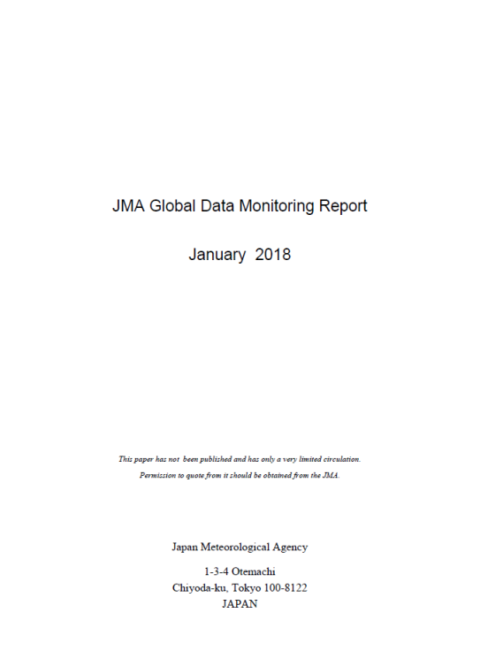
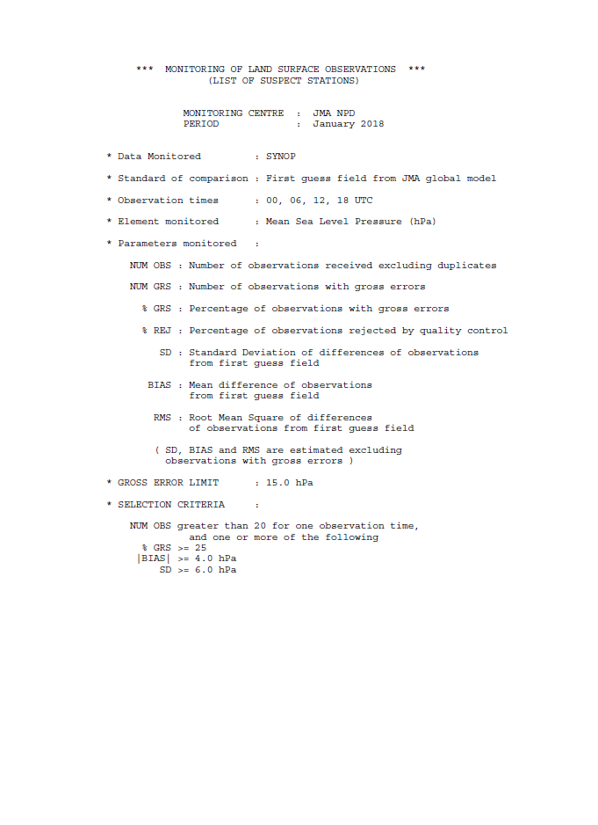
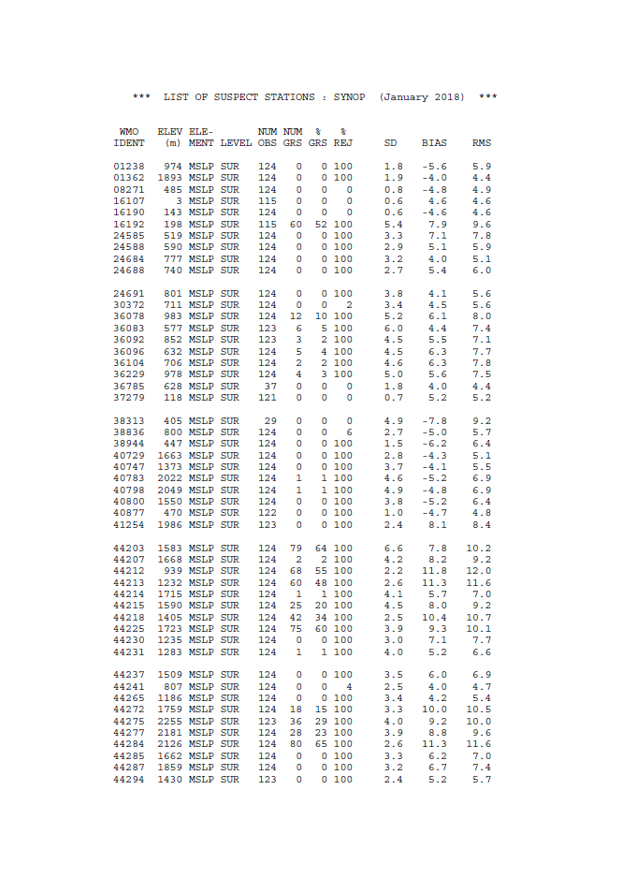
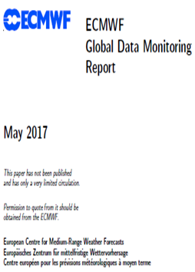
Previous Research – Evaluation Report
organization | Comparison benchmark | Evaluation Report
ECMWF | Numerical Forecast Product | Monthly report
JMA |  | Monthly report Half year report
DWD |  | Weekly statistics Monthly statistics
NCEP |  | Monthly statistics
Notes:
The survey also includes evalutation reports.

Slide 9
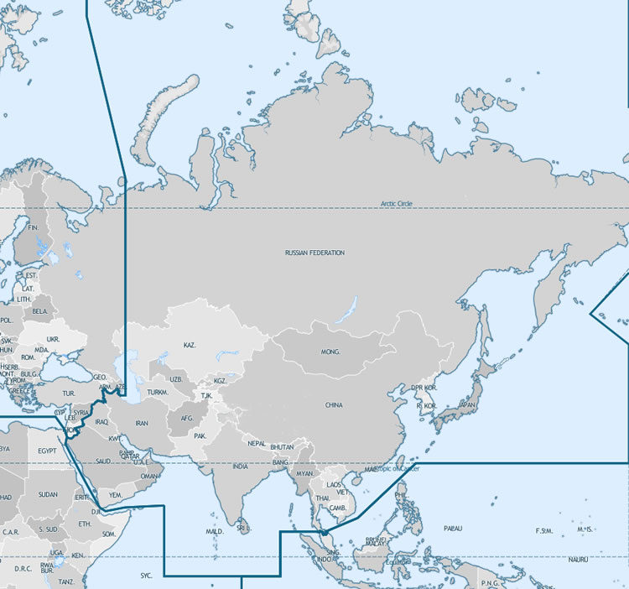
Implementation Plan of The RWC Pilot Project of CMA
Overall objectives: In accordance with the relevant WMO resolutions and operational requirements, the functional design of RWC operation in RA-II will be proposed, the technical methods for monitoring observation data quality in RA-II will be standardized, and the R &D of the quality monitoring system for the observation data in RA-II will be completed to provide the Regional WIGOS Center the ability to manage observation data quality in RA-II.
Goals in 2018: Standardize the quality monitoring technology of land surface observation data, complete the research and development of the quality monitoring system for land surface observation data in RA-II; research and develop the technical methods for quality monitoring of sounding data.
Notes:
Now I will give a brief introduction of the implementation plan for RWC Pilot project of CMA.
The overall objectives is as follows: In accordance with the relevant WMO resolutions and operational requirements, the detail functional design of RWC operation in RAII will be proposed, the technical methods for monitoring observation data will be standardized, and the research and development of the quality monitoring system for the observation data will be completed to provide the RWC the ability to manage observation data quality in RAII.
In 2018, we will work on the quality monitoring technology of land surface observation data, completing the R&D of the quality monitoring system for land surface observation data in RAII and to develop the technical methods for quality monitoring of radiosound data.

Slide 10
Implementation Plan of The RWC Pilot Project of CMA
Tasks
Managing the metadata of the International Exchange Station of RA II.
Real-time monitoring and abnormal data management of the data of the International Exchange Station of RA II by WDQMS.
Real-time monitoring and suspicious data management of the data of the International Exchange Station of RA II by using the data quality monitoring system based on GRAPES mode.
The monitoring results of the above two methods are used for comprehensive analysis, and abnormal data (metadata, observation data) are managed, and relevant evaluation reports are regularly formed and released.
Plan
In 2018, the development of the land surface observation data quality monitoring system was completed, and the RA II assessment-feedback-improvement mechanism was initially established.
In the following 2-3 years, the development of observation data quality monitoring systems for sounding, weather radar, wind profile radar, aircraft and ocean will be completed step by step, and the evaluation-feedback-improvement mechanism will be improved.
Notes:
The tasks including 4 aspects. First, manage the metadata of the International Exchange Station of RA II, promote the collection, update and quality control of metadata on the OSCAR/surface website with data providers.
Second, using WDQMS to do real-time monitoring and data management in RA II.
Third, using the data quality monitoring system based on GRAPES mode to do real-time monitoring in RA II.
Forth, using the monitoring results of the above two methods for comprehensive analysis, and manage suspicious data (metadata, observation data) to form and release the relevant evaluation reports regularly. , and communicate with data providers for data availability and data quality issues.
Regarding the plan, in 2018, the development of the land surface observation data quality monitoring system will be completed, and the RA II evaluation-feedback-improvement mechanism will be initially established. In the following 2-3 years, the development of observation data quality monitoring systems for sounding, weather radar, wind profile radar, aircraft and ocean will be completed step by step, and the evaluation-feedback-improvement mechanism will be improved.

Slide 11
Implementation Plan of The RWC Pilot Project of CMA
Content
Development of Regional WIGOS Center (RWC) Observation Data Quality Monitoring System
Establishing the coordination mechanism for RA II observation data quality
Establish a regular release mechanism for RA II observation data quality monitoring report
Notes:
The content include three parts:First is the development of the RWC observation data quality monitoring system. This system is mainly to improve the monitoring technology, timely discover and solve data quality problem as soon as possible, improve the basic operation based on data quality control, and provide more reliable data for applications.
Secondly, it triggers the corresponding data management activities for the suspicious data, and release the reports for relevant data providers and help them to improve data quality, effectively fulfills responsibilities of data management.
Finally, the mechanism for the regular release of the RA II regional observation data quality report will be established.

Slide 12
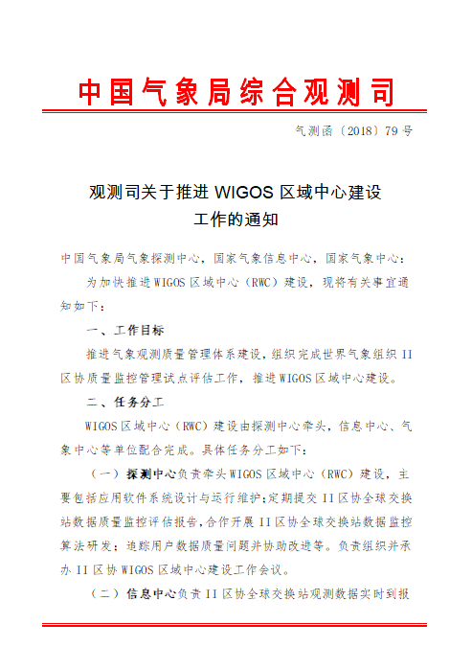



Implementation Plan of The RWC Pilot Project of CMA
Meteorological Observation Center (MOC) is responsible for leading the RWC pilot project, which mainly includes the research and development on data quality monitoring and evaluation technology and operational systems, releasing reports, and incident management.
National Meteorological Information Center (NMIC) is responsible for the data transmission and provides a unified data environment and hardware platform support.
National Meteorological Center (NMC) is responsible for technical support of NWPs.
Notes:
CMA established a joint working group and established a multi-department joint working mechanism. Meteorological Observation Center (MOC) is responsible for leading the RWC pilot project, which mainly includes the research and development on data quality monitoring and evaluation technology and operational systems, releasing reports, and incident management.
National Meteorological Information Center (NMIC) is responsible for the data transmission and provides a unified data environment and hardware platform support.
National Meteorological Center (NMC) is responsible for technical support of NWPs.

Slide 13
Domestic Land Surface Observation Data Quality Monitoring And Evaluation
    Based on the data which MDOS quality control identification is trusted, identify low-quality land surface observation suspicious site problematic data, analyze and verify and trigger relevant quality improvement activities
Quality Control
Quality Assesment
GOAL
Quality Improvement
Subsequent application
    Establish a closed loop of operational processes, timely discover and solve data quality problems from the source, and provide trusted data support for back-end applications
    Using the WIGOS assessment technology method, combined with the domestic operational system, select the GRAPES numerical forecasting operation product as a comparison benchmark, construct an observation and mode deviation assessment model, and quantitatively monitor and evaluate the quality of observation data of the national ground automatic station.
Elements: P, T
Indicator: standard deviation of deviation
ALGORITHM
Standard ：P≤4hPa,T≤6 ˚C
Notes:
Now I would like to introduce the land surface and sounding data quality evaluation techniques. First, we carried out the monitoring and evaluation of the land surface observation data quality in China. The goal is to identify low-quality land surface observation site and its problematic data, analyze and verify them ,then trigger the relevant quality improvement activities, and establish a closed-loop operational process. We refer to the WIGOS data quality management evaluation technology, combined with the domestic operational system, select the GRAPES product as the benchmark, and quantitatively monitor and evaluate the quality of the AWS data. In China, the elements we evaluated are air pressure and temperature. The threshold of O minus B is P less than or equal to 4 hPa and T less than or equal to 6 degrees.

Slide 14
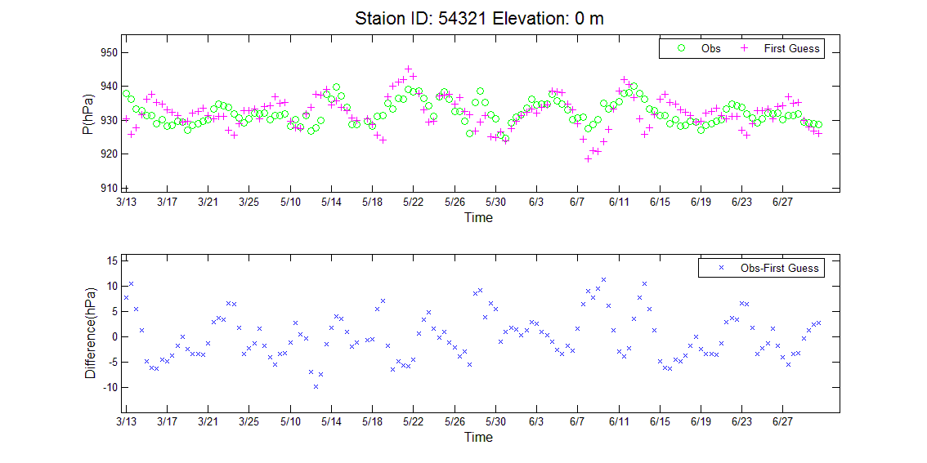
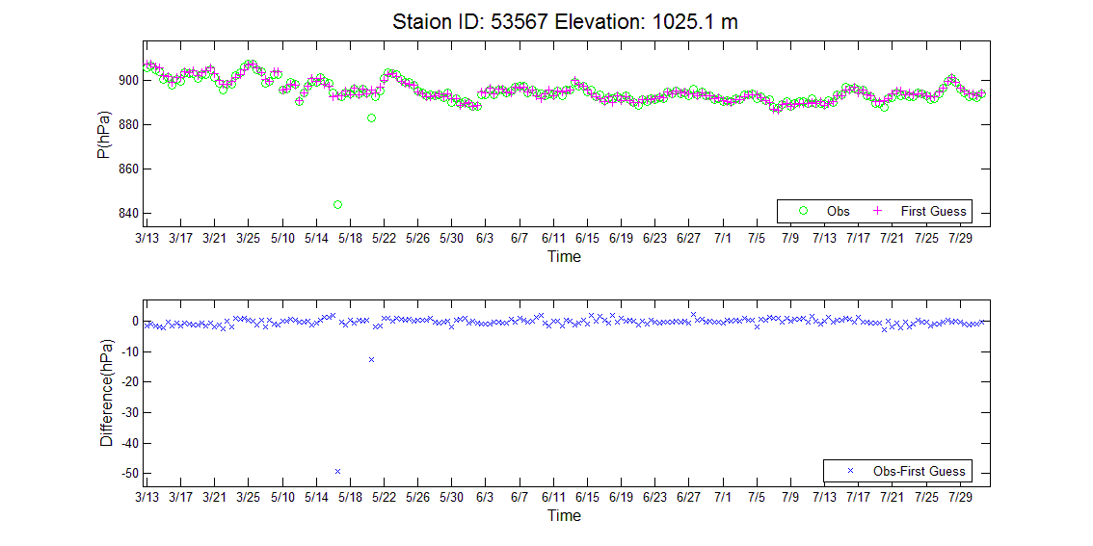
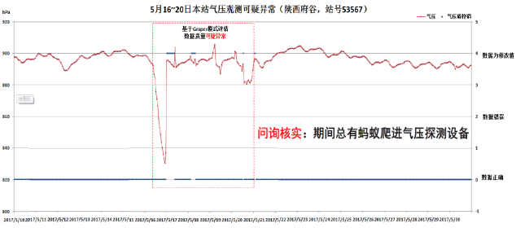
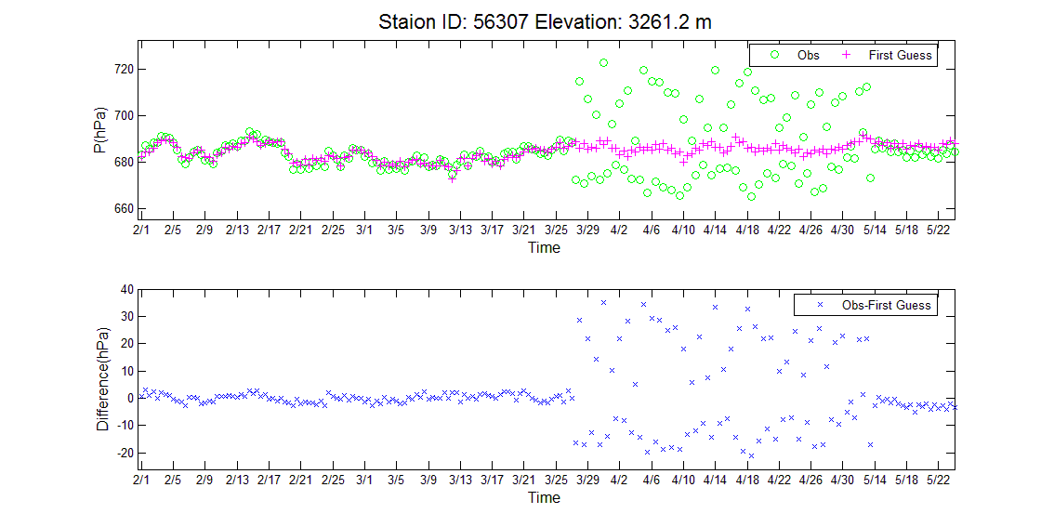
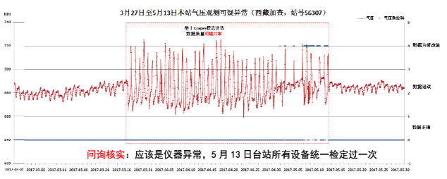
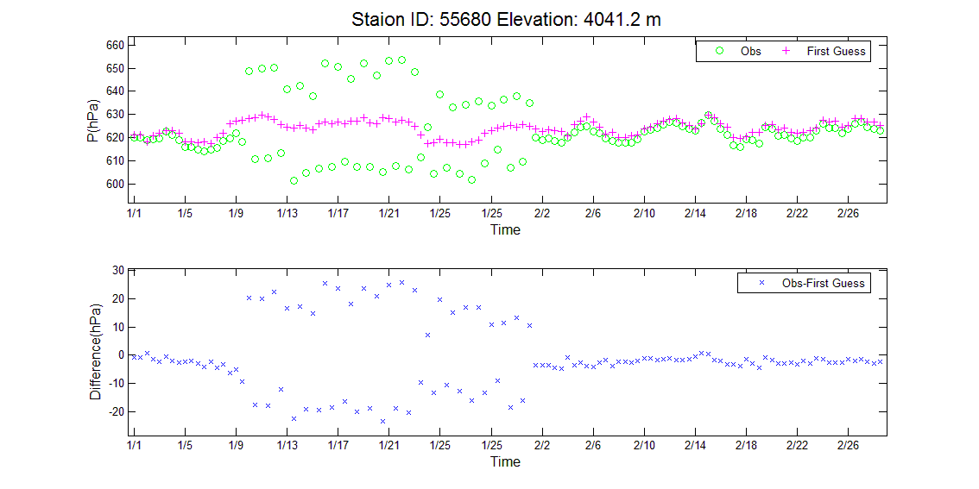
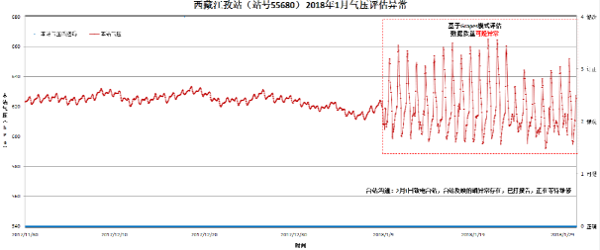
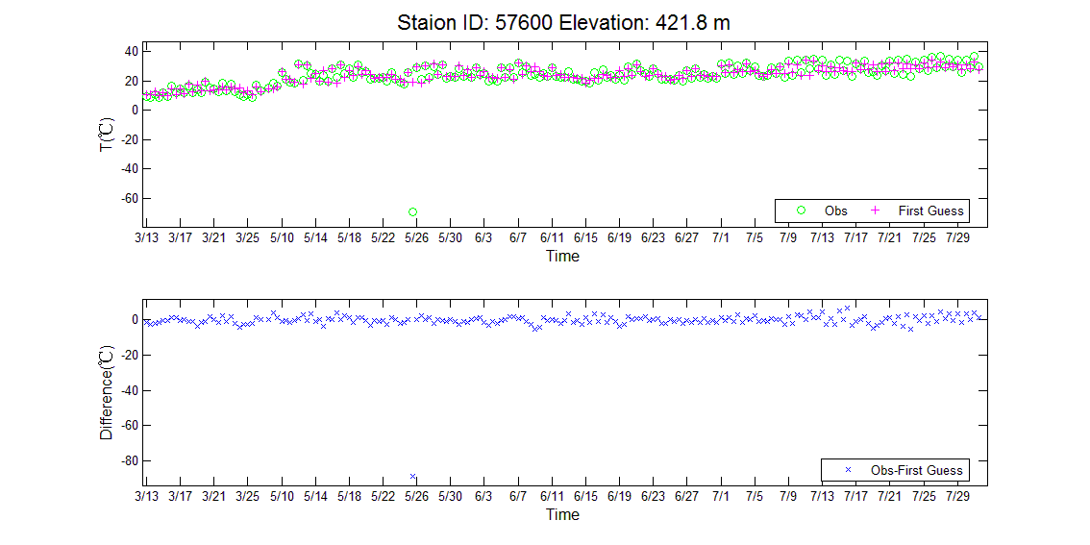
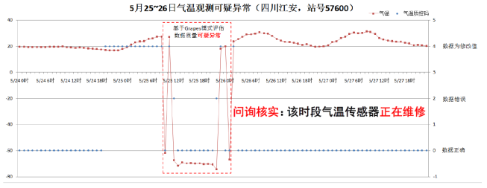
Land Surface Observation Data Quality Evaluation
Observation / Background: Every 6 hours
Observation: every 1 hour
    Latitude and longitude error
Short-term abnormality of air pressure
(The device is subject to external biological interference)
Evaluate
Suspicious
Station
Abnormal air pressure sensor
Temperature equipment maintenance
Notes:
通过对中国地面观测数据质量的评估我们发现并改进的数据质量问题主要有4类：经纬度错误、气压短期异常（设备受外界生物干扰）、气压设备异常、气温设备维修。
Through the evaluation of the quality of Chinese AWS data, we found that there are four main types of data quality problems: latitude and longitude errors, short-term abnormal air pressure (devices are subject to external biological interference), abnormal air pressure sensor, and temperature equipment maintenance.

Slide 15
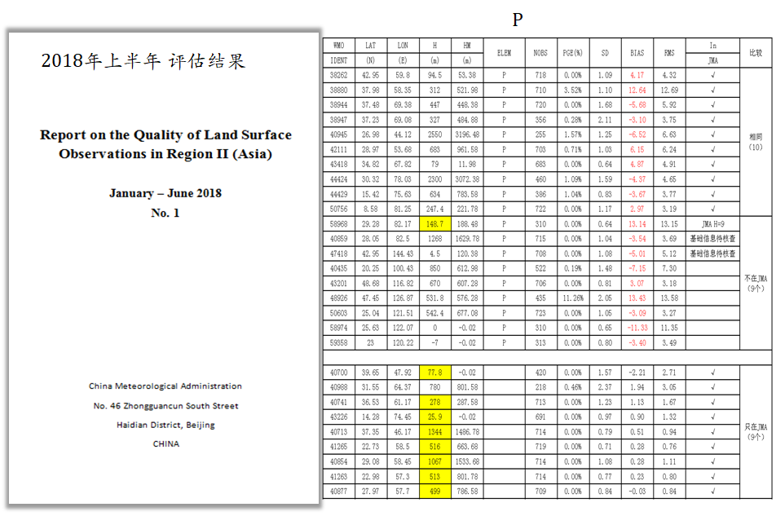
Notes:
We completed the evaluation report of the land surface observation data of RA II in the first half of 2018. Some suspicious data was found.

Slide 16
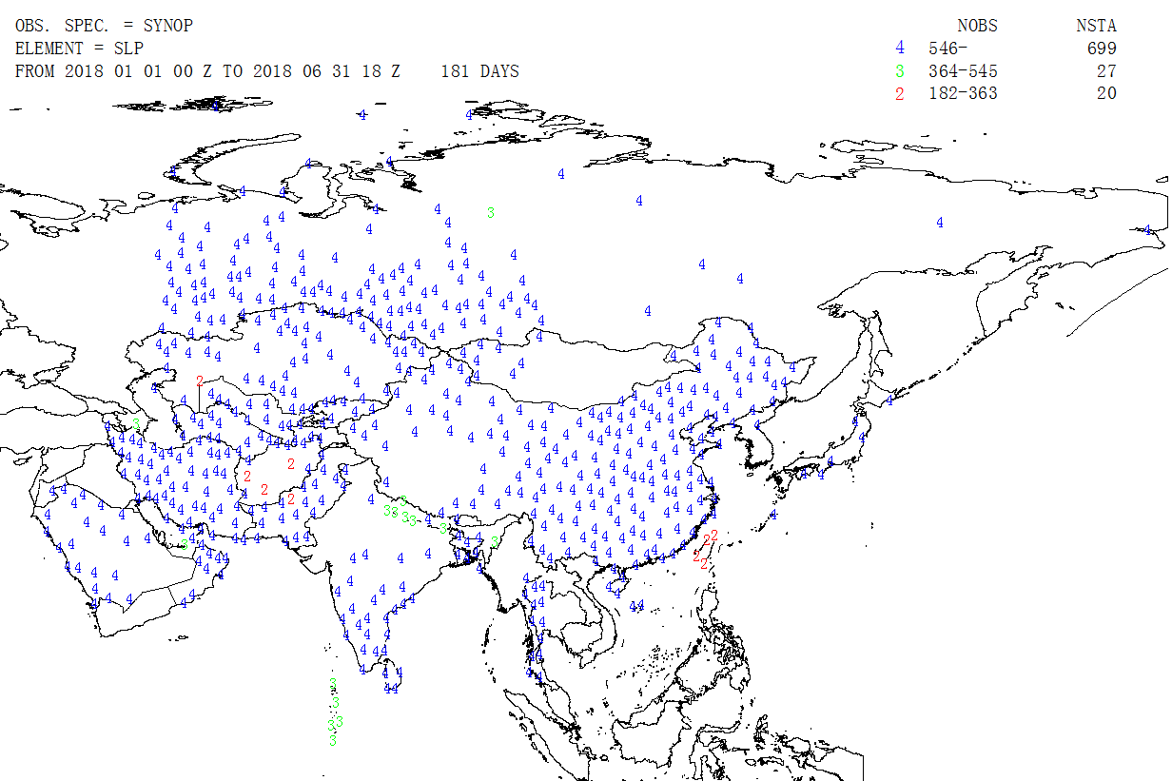
The numbers of stations in Region II：937
Location of all land surface stations reporting station level pressure (SLP) observations in Region II over the six-month period from January to June 2018
Notes:
We evaluated the data of 937 land surface stations received from January to June 2018. This is a distribution map.

Slide 17
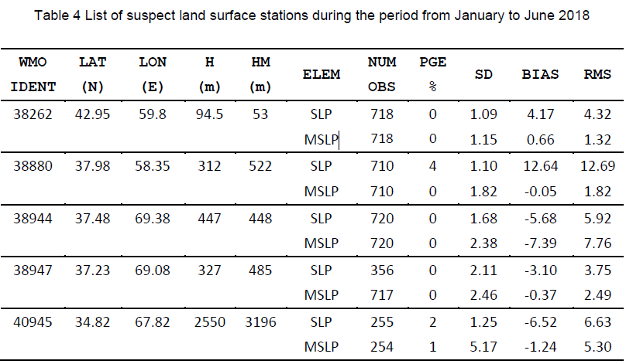
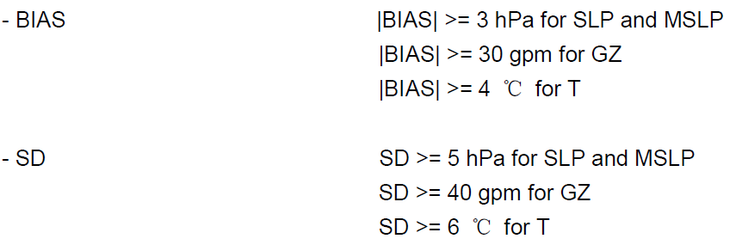
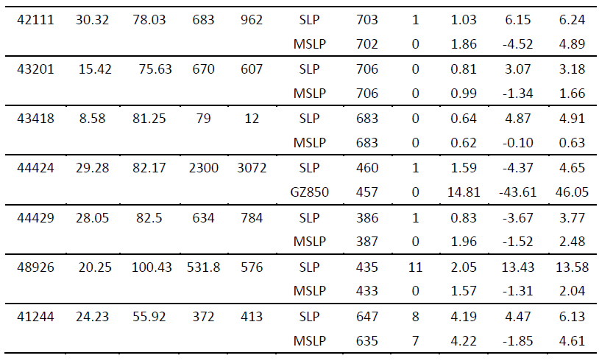
The numbers of suspect stations ：12
Notes:
Through evaluation, we found that there are 12 stations, which have data quality problems.

Slide 18
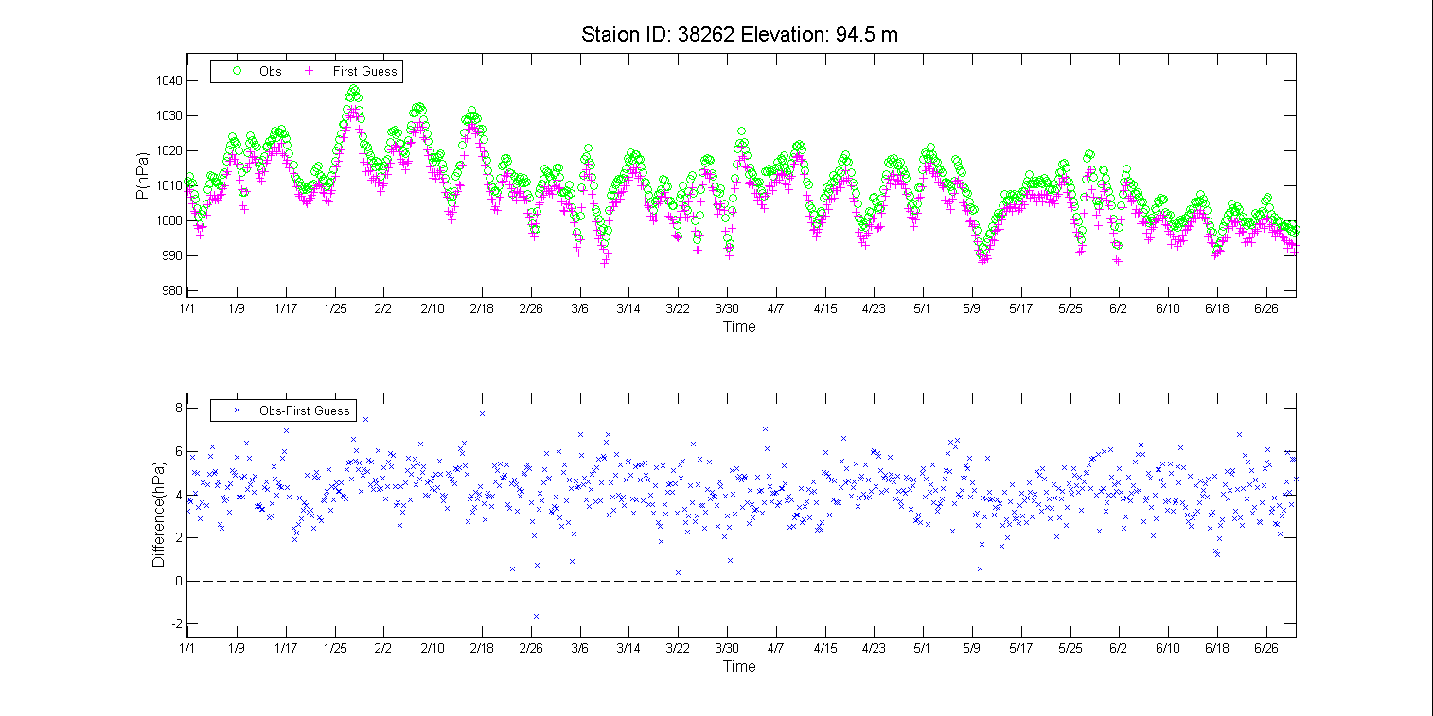
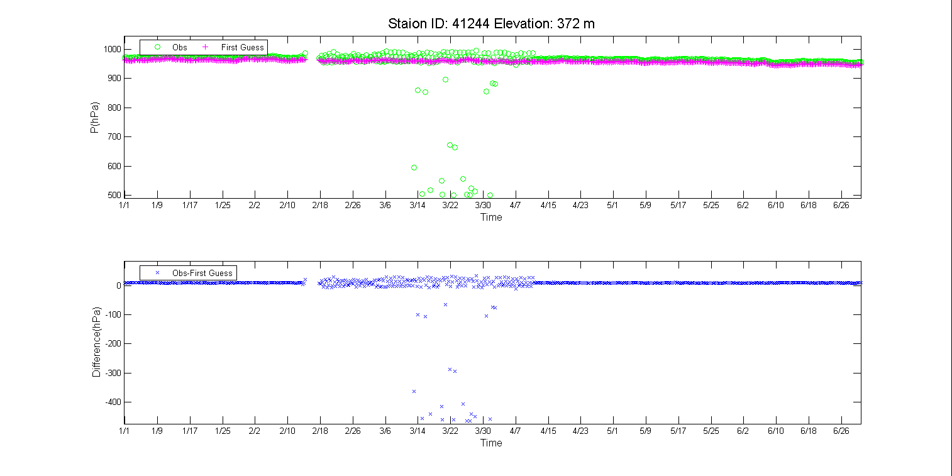
Abnormal pressure deviation
COUNTRT： Uzbekistan
STATION ： CHIMBAJ
Air pressure sensor is abnormal
COUNTRY： Oman
STATION ：BURAIMI
Notes:
比如乌兹别克斯坦某站的气压异常偏差，观测比背景场高4hPa以上。阿曼某站的一段时间的气压传感器异常
For example, the abnormal pressure deviation of a station in Uzbekistan is 4hPa higher than the background field. Anomalous pressure sensor at a station in Oman continued for a period of time.

Slide 19
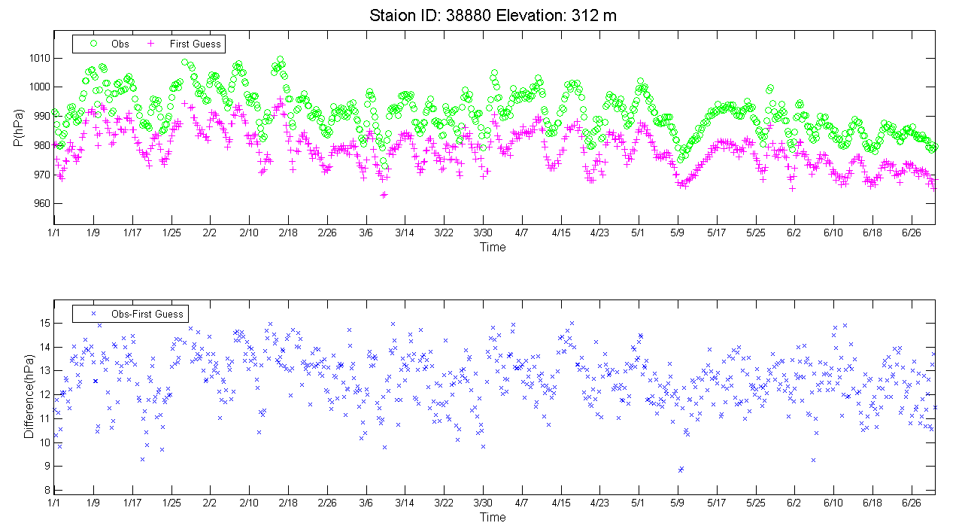
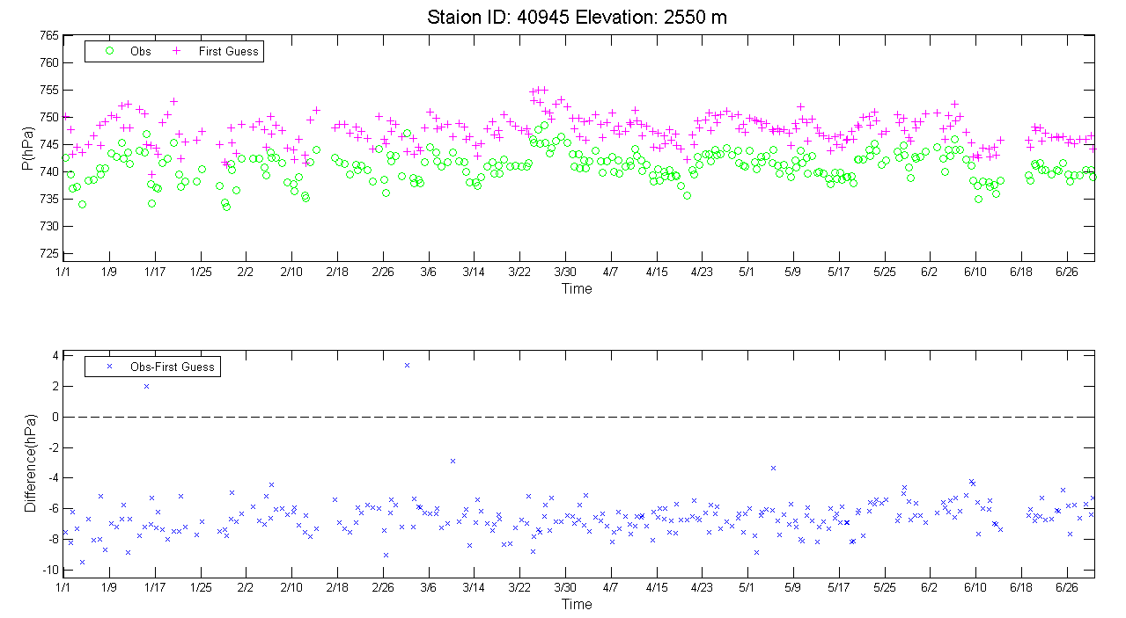
Abnormal pressure deviation
COUNTRY：Turkmenistan
STATION ： ASHGABAT
Abnormal pressure deviation
COUNTRY：Afghanistan
STATION ： BAMIYAN
Notes:
Turkmennistan的某站的气压异常偏差，观测比背景场偏高10hPa以上。Afghanistan某站的气压异常偏差，观测比背景场偏低6hPa以上。
The abnormal pressure deviation of a station in Turkmennistan is 10hPa higher than the background field. The abnormal pressure deviation of a station in Afghanistan is 6hPa lower than the background field.

Slide 20
Tracking & Improvement of Abnormal Pressure Data
1. Communicate with the station and repair the air pressure sensor.
56307、55680 station
2. Communicate with the station and check the surrounding environment of the air pressure sensor.
53567station
3. Communicate with the data transmission department and check the data transmission operation software.
54321station
Notes:
我们在中国国内还开展了跟踪改进业务，通过与台站沟通，维修气压传感器和检查气压传感器周边探测环境。通过与数据传输部门沟通，检查数据传输业务软件。通过这些工作，达到实时数据监控并快速解决问题的目的。
We have carried out tracking and improvement in China. In my understanding, it is incident management. Through communicating with the station, we repair the air pressure sensor and checking the surrounding. Check the data transmission operation software by communicating with the data transmission department. Through these tasks, real-time data monitoring is achieved and the problem is solved quickly.

Slide 21
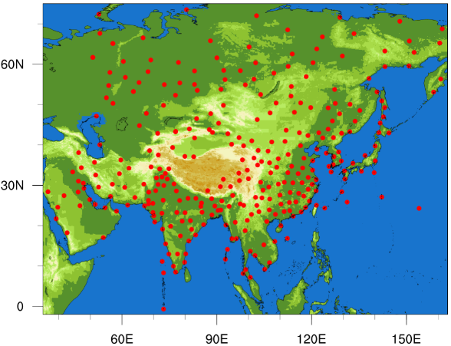
Radiosonde Data Quality Evaluation
Comparing the data quality evaluation methods of WMO, ECMWF and JMA, we can quantitatively evaluate and monitor data quality of radiosonde, find and solve the problem of data quality in time, improve the data service quality, and fully support the new requirements of the World Meteorological Center for global meteorological data service.
begin
Reading observation data and mode data
|BIASi |>a？
Calculation deviation ：BIASi=O-B
Average deviation, standard deviation and root mean square error are calculated.
Gross error percentage calculated
According to the
respective thresholds of mean deviation, standard deviation and root mean square error, whether
the data is suspicious or not.
Output gross error percentage
Output mean deviation, standard deviation and root mean square error.
end
286 radiosonde stations of WIGOS II
Quality evaluation method of O-B
Notes:
We have also researched and developed radiosonde data quality evaluation method. HereWe give the flow chart of the quality evaluation method.

Slide 22
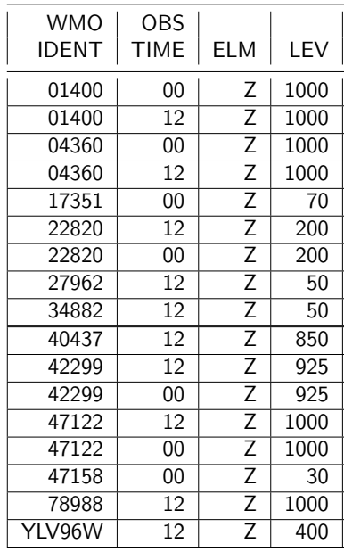
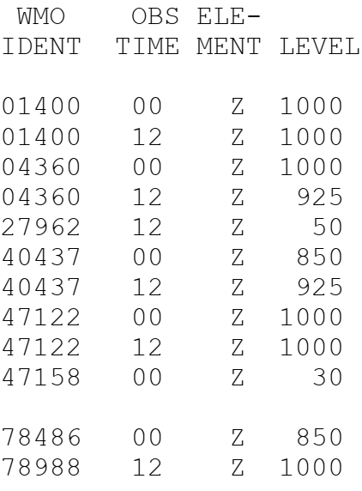
Comparison of evaluation (height)
China
EC
JMA
June
Coincidence rate: 34%
Coincidence rate: 84%
China has the ability to assess the height, but there is still a gap with the international level.
Notes:
红框代表我们评估到的，黄框代表二区协的站点，JMA和EC的结果是全球站点的
This is the evaluation result of height. We compared the results between the NWPs from China, EC and JMA. We found more problems than EC and JMA. In the future we will do deep research on these suspicious data.

Slide 23
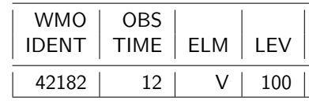
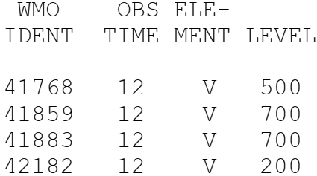
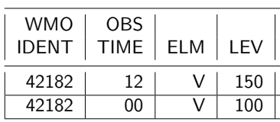
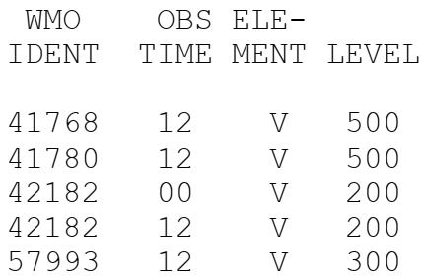
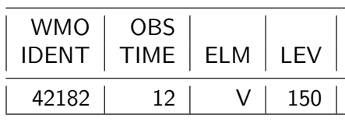
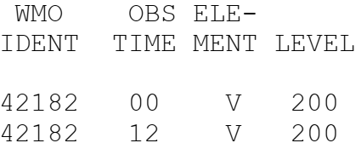
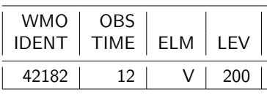
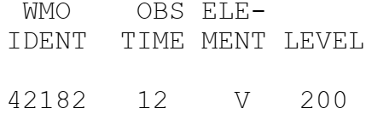
Comparison of evaluation （wind speed）
China
EC
JMA
January
February
March
April
May
NO
NO
June
NO
NO
China has the ability to assess the wind speed, but there is still a gap with the international level.
Notes:
红框代表我们评估到的，黄框代表二区协的站点，JMA和EC的结果是全球站点的
This is the evaluation result of wind speed. Same as above, we found more problems than EC and JMA.

Slide 24
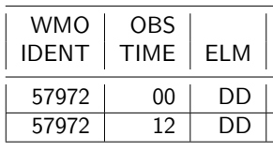
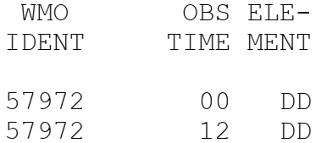
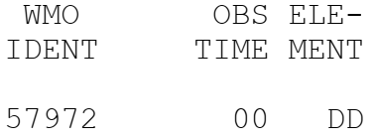
Comparison of evaluation results——wind direction
China
EC
JMA
April
May
NO
China has the ability to assess the wind direction, but there is still a gap with the international level.
Notes:
红框代表我们评估到的，黄框代表二区协的站点，JMA和EC的结果是全球站点的
This is the evaluation result of wind direction.

Slide 25
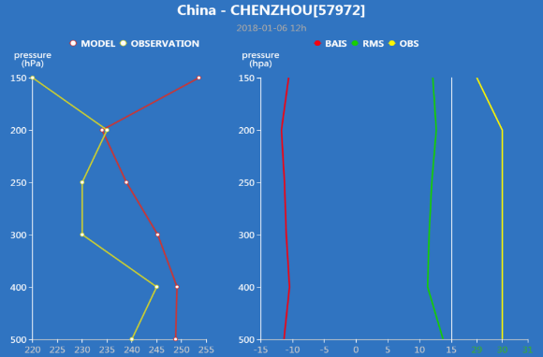
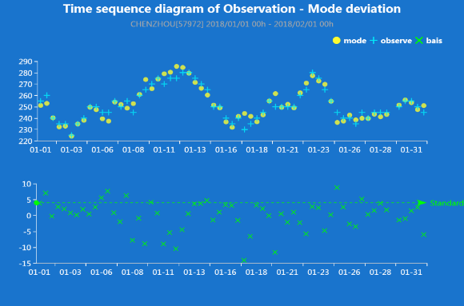
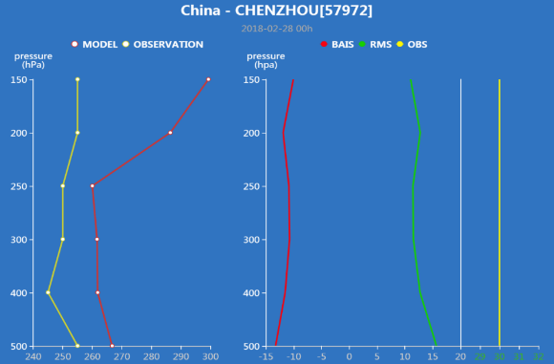
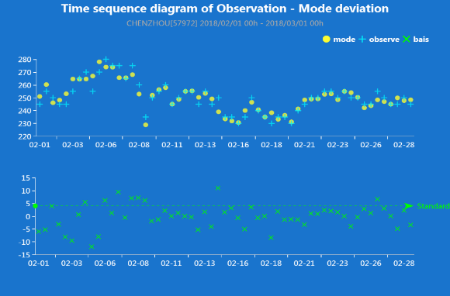
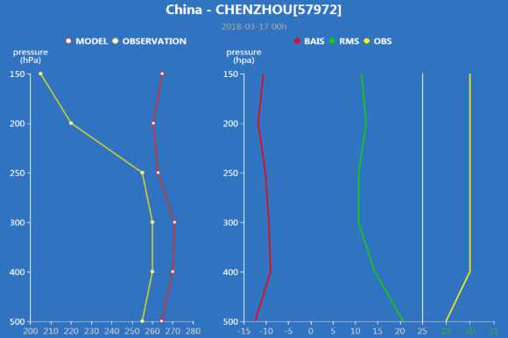
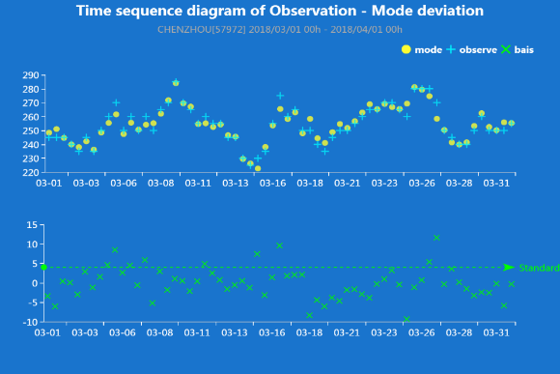
Tracking & Improvement of Abnormal Wind Direction Data
Jan
Feb
Mar
Suspicious station
Station id：57972（China）
Notes:
We have also carried out tracking and improvement for radiosonde data in China. the station id of the suspicious wind direction is 57972.
Suspicious wind direction data appeared at 500-150hpa . We communicated with the technical staff of the station and confirmed that the l-band radar maintenance and calibration have been carried out, and the equipment operated normally.
This situation gradually reduced after May ,so we analyzed that it was due to the reversal of wind direction at high altitudes.

Slide 26
RA II Observation Monitoring & Analysis System
Basic Function
Portal Application System
Monitoring&Evaluation Results
Monitoring&Evaluation Reports
Operational Function
Task Scheduling
Quality Monitoring&Evaluation
Data Management
Automatic Task Scheduling
Manual Task Scheduling
Task Scheduling Configure
Metadata Configure
Data Analysis&Matching
Quality Monitoring&Evaluation
Diagnosis&Analysis
Multi source Comprehensive
Quality control results released
Data Input Configure
Data Output Configure
Notes:
为了实现区域中心对于观测数据的监视、评估和质量管理功能，我们设计开发了观测数据监视分析系统，基本功能是展示监视评估结果和发布评估报告，核心是业务功能，包括任务调度、质量监视评估和数据管理。
In order to realize the monitoring, evaluation and quality management functions of the observation data in the regional center, we designed and developed the RA II Observation Monitoring & Analysis System. The basic function is to display the monitoring evaluation results and release the evaluation report. The core is the operational function, including task scheduling, quality monitoring evaluation and data management.

Slide 27
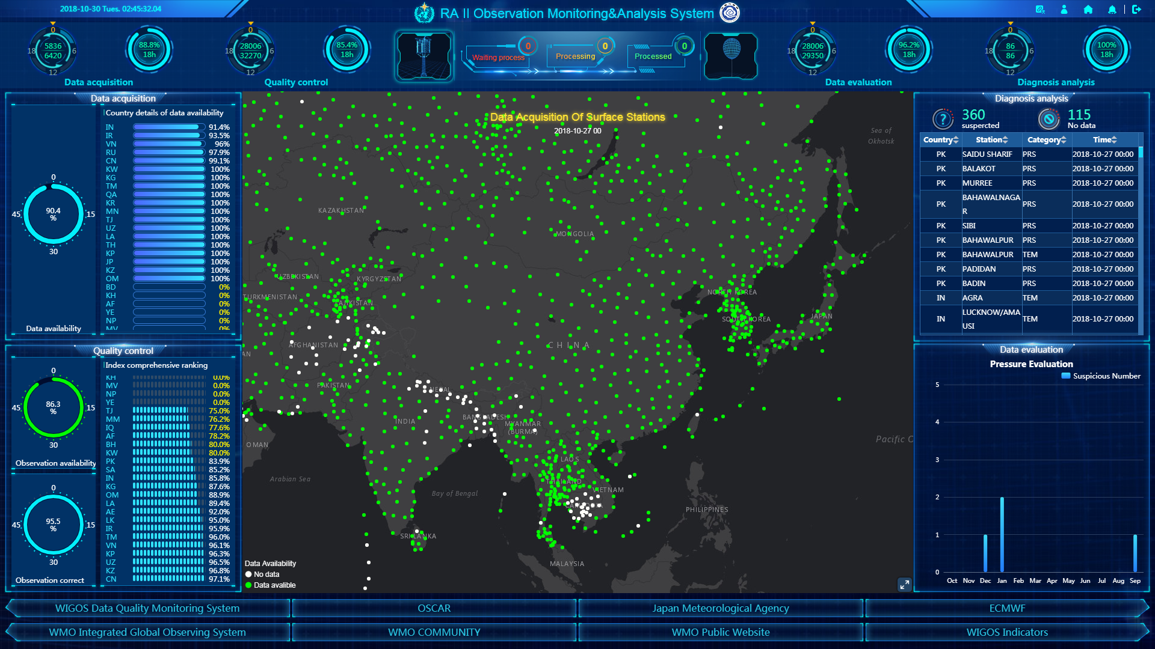
Four operational links: data acquisition、quality control、data examination、diagnosis analysis
Objective evaluation indicators
Data of surface observation and sounding have been monitored in the system.
Notes:
This is the system interface. Consistent with the domestic observation data quality management system, we divide the regional center operation into four parts: data acquisition, quality control, data examination, and diagnostic & analysis. Both the data of land surface observation and radiosounde have been monitored. The situation of each observation and each operational chain can be seen at a glance at this interface.

Slide 28



Data Acquisition
Have we got the data yet?
And if not, when?
Notes:
This is the display of data acquisition. From these pages, we can know:
Have we got the data yet? And if not, when?
Through analyzing the acquisition rate and punctuality rate from multiple dimensions such as type, region and time, we can monitor the data acquisition situation, and release the abnormal alarm.

Slide 29



Quality Control
Right or Wrong？
Good or Bad？
Notes:
This is the display of the results of quality control. From these pages we can know:
“Right or Wrong？”、“Good or Bad？”
Based on mature quality control algorithm, comprehensively analyze the data availability rate from types, regions, time, etc., so we can monitor data and improve observation data availability .

Slide 30



Data Examination
Check the data quality in one map.
Notes:
Through the pages of data examination, we can“Check the data quality in one map” . We give the deviation distribution between observation and background on the map.

Slide 31


Diagnosis & Analysis
Discover Problems
Solve Problems
Notes:
These are pages of diagnosis an analysis. Through these pages we can Discover and Solve Problems”: Based on quality control results and observation data timing, using human-computer interaction we can analyze and diagnosis the suspicious data. In the future maybe we can realize manual correction.

Slide 32
III. Future Work Arrangements
Notes:
首先背景介绍。
Finally, the future work arrangement of CMA.

Slide 33
CMA will continue to invest in supporting the RWC pilot project. We hope to work together with all member states to promote the improvement of the quality of the integrated observation data in RA II and to maximize the benefits of WIGOS.
Notes:
CMA will continue to invest in supporting the RWC pilot project and improve the work of data management including releasing reports, improving operational system and building the mechanism of incident management in RAII.
We hope to work together with all member states to promote the improvement of the quality of the integrated observation data in RA II and to maximize the benefits of WIGOS.

Slide 34

Thank you
wlaoc@cma.gov.com

