Slide 1
Regional WIGOS Centers (RWC)
and WIGOS technical Systems
(OSCAR/Surface and WDQMS)
Lars Peter Riishojgaard and Luis Nunes
WMO Secretariat, Geneva

Slide 2
Outline
WMO
Introduction to Regional WIGOS Centers
OSCAR/Surface
WIGOS Data Quality Monitoring System (WDQMS)
Conclusions
RA-II Workshop on WIGOS, Beijing, November 6-8 2018

Slide 3
Outline
WMO
Introduction to Regional WIGOS Centers
OSCAR/Surface
WIGOS Data Quality Monitoring System (WDQMS)
Conclusions
RA-II Workshop on WIGOS, Beijing, November 6-8 2018

Slide 4
Introduction to RWCs
Regional WIGOS Centres (RWCs) will play a critical role in advancing operation of WIGOS.
The overall purpose of the RWCs is to provide support and assistance to WMO Members and Regions for their national and regional WIGOS implementation efforts.
The RWCs will work closely with:
WMO Regional Offices
RICs, RRCs, RMICs
RTCs
RA I MG & WG-OTI
Members
WIGOS-PO

Slide 5
Mandatory functions
Regional WIGOS metadata management
work with data providers to facilitate collecting, updating and providing quality control of WIGOS metadata in OSCAR/Surface;
Regional WIGOS performance monitoring and incident management (WIGOS Data Quality Monitoring System)
and follow-up with data providers in case of data availability or data quality issues (WDQMS);

Slide 6
Optional Functions
Assistance with the coordination of regional/sub-regional and national WIGOS projects;
Assistance with regional and national observing network management; and
Support for regional capacity development activities.
…

Slide 7
Implementation Options
Each RA (i.e. Members of the Region) must decides on its own way to address specific needs, priorities, challenges and available technical and human resources of the Region;
Member or group of Members can establish RWC in sub-region, taking into account the natural geographic / linguistic / economic conditions/circumstances of the sub region.

Slide 8
Establishing a Regional WIGOS Centre in pilot mode (Annex to Decision 30, EC-69)
Introduction
Rationale for the project and its relevance to WMO
Project description
Resourcing
Implementation stages
Risk assessment/management
Governance, management and execution
Monitoring and evaluation
Annex 1 - Concept note on establishment of WMO Regional WIGOS Centres
Annex 2 - Application template for a RWC candidate

Slide 9
Current status of RWCs
Region I: Many indications of national interest (e.g. Morocco, Kenya, Tanzania, …; limited national resources. RWC pilot to be initiated in East Africa on DFID (UK) project funding, centered in Kenya and Tanzania
Region II: on a sub-regional basis: China and Japan have both formally addressed P/RA-II to request recognition of RWCs in pilot mode in Beijing and in Tokyo, respectively; Indications of interest also from Saudi Arabia and India.
Region III: Plans for Virtual RWC maturing, with distributed functions involving 3/4 Members, decision to be made at RA-III-17 later this month;
Region IV: No clear path yet; USA may be willing to help;
Region V: Indications of interest from Australia, Fiji, Indonesia, Singapore; was discussed at RA-V-17 in October;
Region VI: successful RWC operating in pilot mode at DWD thanks to EUTMETNET engagement; see presentation by Stefan Klink; tentative plans for RWCs also in Belarus (Russian-speaking countries in RA-II and RA-VI) and Croatia (specifically for marine observing systems).
RA-II Workshop on WIGOS, Beijing, November 6-8 2018

Slide 10
Outline
WMO
Introduction to Regional WIGOS Centers
OSCAR/Surface
WIGOS Data Quality Monitoring System (WDQMS)
Conclusions
RA-II Workshop on WIGOS, Beijing, November 6-8 2018

Slide 11
OSCAR/Surface
(“What is WIGOS?”)
Implementation layer of the WIGOS Metadata Standard: Modern, electronic, searchable inventory of metadata for all observing stations/platforms under WIGOS
OSCAR/Surface will replace WMO Pub. 9, Volume A, but will also include information from similar inventories for other (non-GOS) components of WIGOS
Developed jointly by WMO and MeteoSwiss, with the Swiss government providing the major part of the funding
Operational since May 2016
Education and training Members in populating, editing and using OSCAR/Surface is a major priority for 2016-2019 financial period; Training delivered in
RA I (English);
RA III (Spanish);
RA IV (Spanish and English);
RA V (English);
RA VI (English)

Slide 12
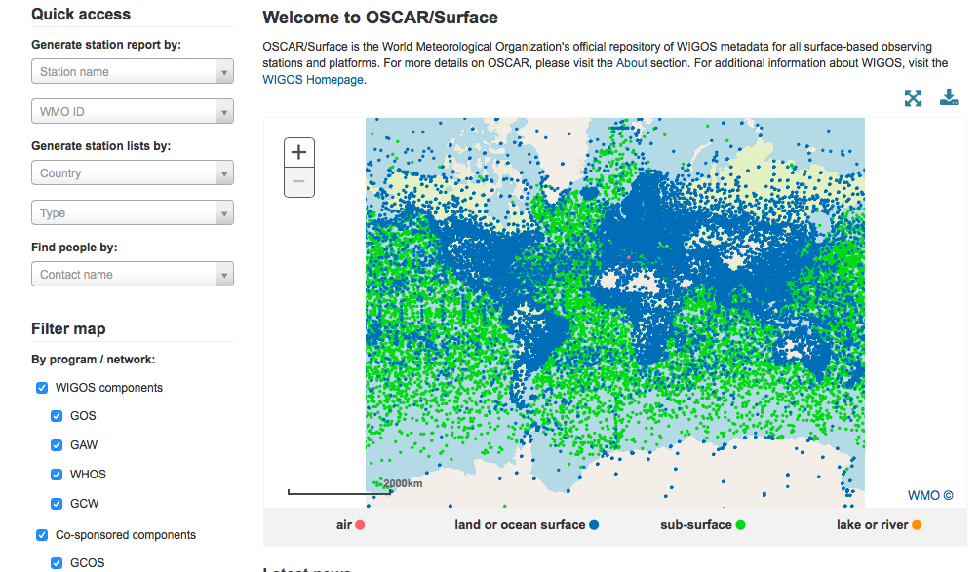
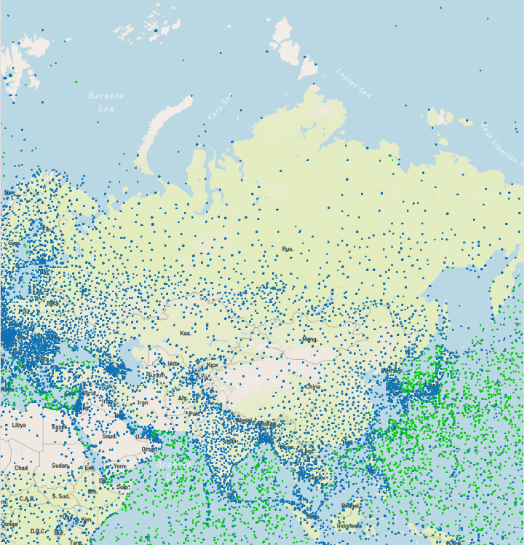
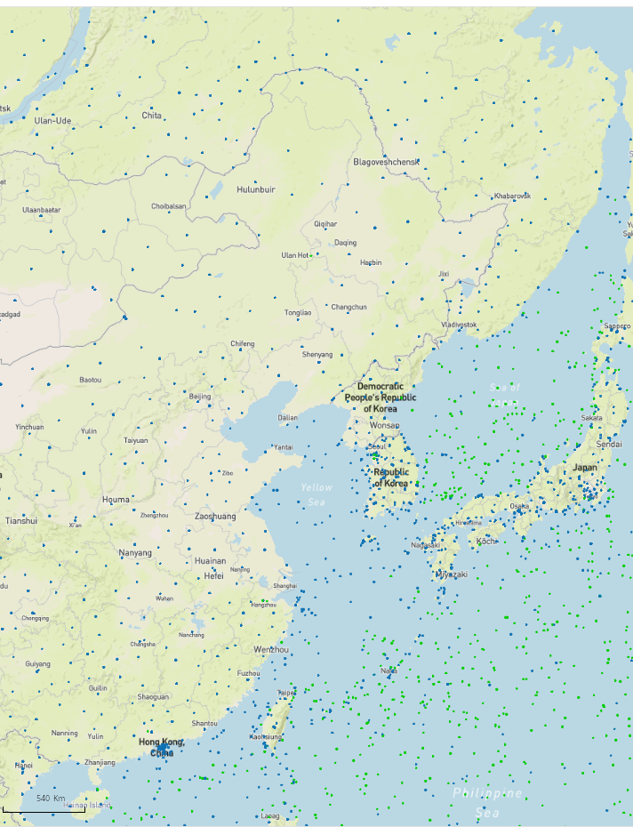
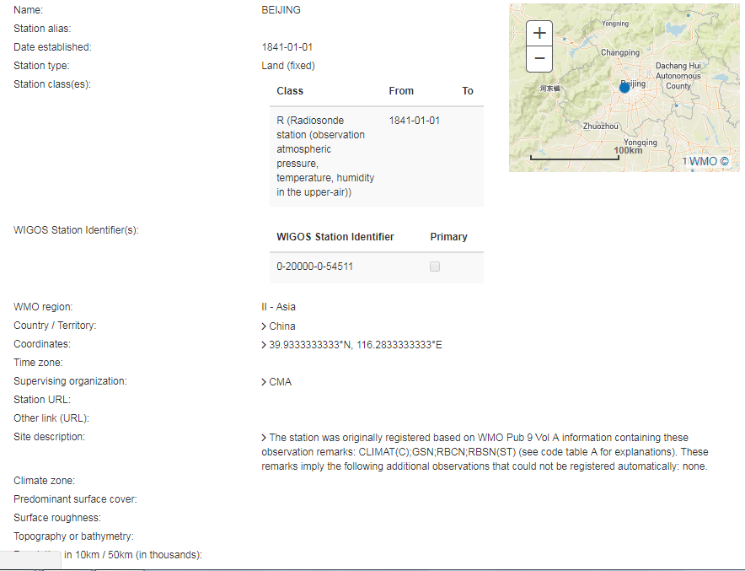
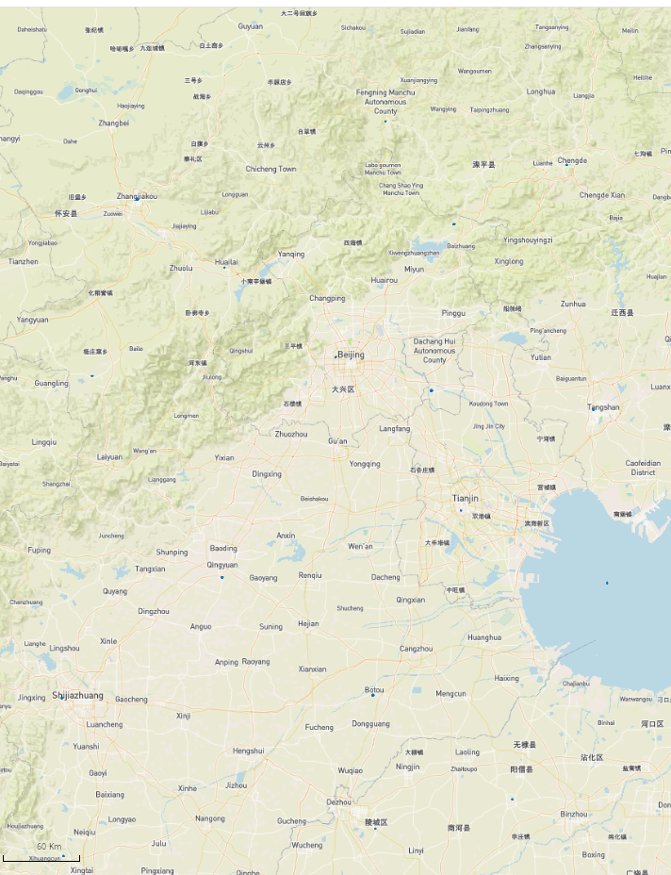

Slide 13
The OSCAR/Surface webinar
Monthly webinar with varying topic, since Sept 2018
Audience is OSCAR/Surface Focal Points and users
Always on the first Monday of the month 11 UTC
Hosted on the WMO Webex platform
More info and recordings of past webinars on OSCAR/Surface Resources Portal
We are open for suggestions on topics!

Slide 14
The OSCAR/Surface API (Application Programming Interface); Machine to Machine (M2M) updating of OSCAR
Release 1.4.1 (September 2018) first version of API
Manual upload only
Based on 1.0RC9 WMD schema
Release 1.4.2 (October 2018) brought additional features
Authentication token
Upload to proper REST API endpoint
XML download

Slide 15
The OSCAR/Surface API (II – Usage)
Obtain access to OSCAR/Surface API
NFPs can create machine user and obtain security token
Security token needed to access API
Encode station fully or partly in WMD XML
Send WMD XML file (and token) to the API endpoint
XML is first validated, only valid XML files are processed
New station is created if station does not exist yet (WIGOS ID)
Station is updated if already existing
Add information if it does not exist already (gml id)
Correct information if it exists already (gml id)
Process status code to know if update succeeded

Slide 16
The OSCAR/Surface API (III - Use cases)
Synchronize OSCAR/Surface with a local database
Regular process
For countries with existing station database
Integrate into data warehouse workflow
Upload list of stations to OSCAR/Surface
Initial seeding
Import stations from Excel etc. lists
One-time action
Interactive and semi-automatic batch changes
Make batch correctionss
adding observations
Correcting schedules
Semi-automatic and interactive usage

Slide 17
API documentation
the OSCAR/Surface Resources Portal
Formal model and XML schema are on http://schemas.wmo.int
Current version: 1.0RC9 (http://schemas.wmo.int/wmdr/1.0RC9/)
Codelist entries for XML elements are important
http://test.wmocodes.info/wmdr/
More code lists on gdrive
OSCAR/Surface User Manual (soon)

Slide 18
Outline
WMO
Introduction to Regional WIGOS Centers
OSCAR/Surface
WIGOS Data Quality Monitoring System (WDQMS)
Conclusions
RA-II Workshop on WIGOS, Beijing, November 6-8 2018

Slide 19
The WIGOS Data Quality Monitoring System (“How is WIGOS performing?”)
One of the five priority areas of WIGOS Pre-operational phase: Describes how well WIGOS is functioning
Real-time monitoring of performance
data availability (implemented) and quality (under development),
searchable by region, country, station type, period, etc.
for all WIGOS components (GOS, GAW, WHOS, GCW, GCOS),
Evaluation of monitoring results
Incident management component for mitigation of issues
Current/recent activities:
Pilot project on NWP-based monitoring: ECMWF, NCEP, DWD, JMA
RA-I Demonstration Project of monitoring and incident management involving Kenya and Tanzania running through Jun.2016-Jun.2017

Slide 20
The Pilot project with Global NWP Centres (1)
Four NWP centers, ECMWF, NCEP, JMA, DWD, are providing monitoring output in real time (every six hours) to WMO Secretariat;
Started with surface pressure, now including also surface humidity, wind, temperature and upper air soundings
Simple ASCII files in commonly agreed format contain the following information for each individual observing station:
Observation received within operational data cut-off (yes/no)
Observation used in assimilation (yes/no)
If not used, why not (flag)
Observation minus background residual (value)
The Task Team on WDQMS and NWP centres are working to expand the monitoring to other observation types (marine, aircraft, climate)

Slide 21
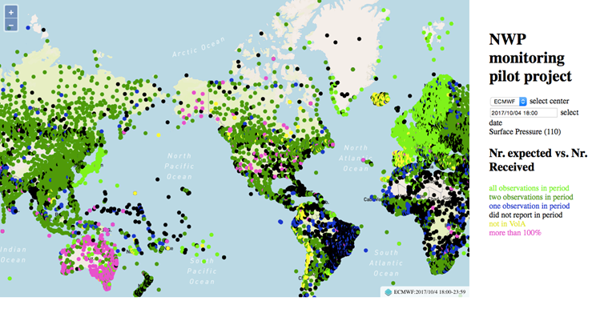
The Pilot project with Global NWP Centres (2)
A prototype of a Webtool for displaying the monitoring outputs from the NWP Centres was developed at Secretariat (WIGOS PO)
Interactive geographic display
Interactive time series graphics
Data quality:
Data quality monitoring is being developed to compare with O-B values
Implementation of data quality monitoring in the Webtool not ready
ECMWF agreed to
host, to further
develop and to
implement the
operationally

Slide 22
Technical Guidelines for RWCs on the WDQMS for surface land stations of the GOS (part of Guide to WIGOS)
1. Functions of a WDQMS for surface-based system of GOS
2. WDQMS Quality Monitoring Practices
3. Data quality monitoring and evaluation
4. Incident Management Procedure
4.1 Responsibilities
4.2 Steps of the Incident Management Procedure
4.2.1 Issue Identification (A)
4.2.2 Issue Raised as Incident (Process Initiation) (B)
4.2.3 Receipt Confirmation (C)
4.2.4 Action Proposal (D)
4.2.5 Incident Status (E)
4.2.6 Confirmation of Successful Incident Rectification (F)
4.2.7 Incident Escalation Procedures
5. Quality Performance Reports

Slide 23
Summary and Conclusions
WIGOS Pre-operational Phase 70% completed; main technical systems implemented/under implementation;
Already providing powerful diagnostics of the workings of WIGOS/WIS and the compliance of WMO Members with WMO regulatory and guidance material;
Room for very substantial improvement!
This is a limiting factor in the quality of monitoring, forecast and warning products;
Regional WIGOS Centers are a key element in supporting Members in the implementation of WIGOS and in improving the overall performance of WIGOS;
RA-VI pioneered the RWC implementation, but is still looking for a way forward to make this operational
RA-II Workshop on WIGOS, Beijing, November 6-8 2018

Slide 24
Thank you
lfnunes@wmo.int
www.wmo.int/wigos

