Slide 1

RA II WIGOS Workshop
Sri Lanka
Preethika Madhawee Jayakody
RA II WIGOS Workshop
6-8 November 2018, Beijing, China

Slide 2

Outline
Introduction to the country and the NMHS
Physical context of the country
National requirements for observations
Summary of national observing capabilities
Status of National implementation of WIGOS
Other remarks

Slide 3
1.1Introduction to the country and the NMHS
Mean Temperature: 27.5 C (lowlands)
.Lower Temperatures in the highlands
Tropical climate
Population ~20 million
Languages – Sinhala, Tamil, English
Religions – Buddhism -70%, Hinduism 15%
Christianity 8% , Islam 7%
Source:Shutterstock

Slide 4
I.I.Cont;Climate
Introduction to the country and the NMHS
Northeast monsoon Dec-Feb
Southwest monsoon
May-Sep
26%
30%
Average Rainfall – 556.0 mm
Varies between 100 to over 3000 mm
Average Rainfall – 479.0 mm
Higher falls receive in Eastern slopes of the Central hills

Slide 5
I.I.Cont;Climate
Introduction to the country and the NMHS
1st Inter monsoon
March-April
2nd Inter monsoon
Oct-Nov
14%
30%
Average rainfall = 558.0 mm
SW slopes of hills 750-1200 mm
Average Rainfall = 268.0 mm

Slide 6
I.I.Cont;Climate
Introduction to the country and the NMHS
Extreme events
1.Flood
2.Land slide
3.Drought

Slide 7
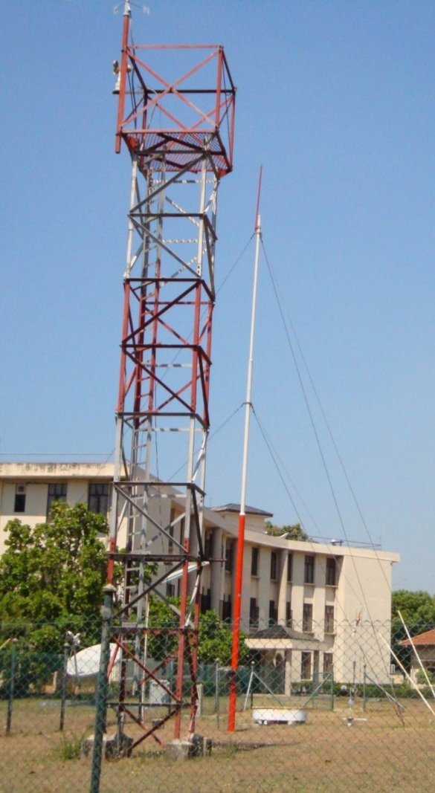
I.II. NMHS Activity
Introduction to the country and the NMHS
Our Vision
A Centre of Excellence in weather and climate related services
Our Mission
To provide services pertaining to Meteorology, Aeronautical Meteorology, Ocean Meteorology, Hydro Meteorology, Agricultural Meteorology, Climatology and Astronomy to government agencies, private sector and the general public in keeping with national interest and international standards.

Slide 8
Introduction to the country and the NMHS
I.II. NMHS Activity
Weather forecasts for general public
Three times per day
2. Weather forecasts for fishery and shipping
Two times per day(for sea areas around the island/International sea) once a day for Multiday Boats(3 days forecast-Indian ocean)
once a day for -10 day forecast
3. Bad Weather Warnings
    Heavy Rain, Cyclone Warnings, Tsunami, Storm Surge Warnings,
    Strong Wind Warnings.
4. Aeronautical meteorological services
Terminal Aerodrome Forecasts (TAF)
Significant Weather Analysis Charts
SIGMET (for Colombo FIR )
AIRMET /Lightning alert/Aerodrome Warning
5. Climatological and Agro meteorological services

Slide 9
Organization Structure
Introduction to the country and the NMHS
Director General
Director
(observation Network
and Instrument)
Director
(Data Processing
and Archival)
Director
(Forecasting and
Decision support)
Director
(Research and
development)
Director
(Human resource
And management
Accountant
DD
(Conventional
Instruments
and
observation
Management)
Electronic
engineer- 01
(class I)
DD
(Forecasting
and
decision
support)
DD
(Aviation)
DD
Research
AD
Development
AD
Administration
DD
Quality
management
and Archival
DD
Data
assimilation
and Process
Civil
Engineer
(SLES)
M-1
Training
Awareness
&
Publications
(SLSS)
AO
Draft
man1
FA-1
BA-1
Electronic
Engineer
-02
M-1
(SLSS)
MIC
M-9
(SLSS)
MIC
M-4
MRIA
(SLSS)
MIC
M-4
BIA
(SLSS)
M-1
RMA
(SLSS)
M-4
Research
(SLSS)
M-2
CCCS
(SLSS)
Librarian
M-3
(SLSS)
M-1
computer
(SLSS)
M-1
DBMS &
GIS
(SLSS)
MA
17
OIC
Instruments
SLTS-S
OIC
Comm.
OIC
SBO
OIC
com
OIC
SLTS-S
RA
4
RA
2
SLTS-S
-01
MO
2
OIC
Met &
climat
OIC
SLTS-S
ICT
Officers
2
OIC
Outstation
SLTS-S
SLTS-S
-01
MO
1
OIC
NMC
OIC
SBO
Translator
2
OIC
Upper air
SLTS-S
OIC
Agro
Met.
DD- Deputy Director
AD- Assistant Director
OIC- Officer in Charge
M- Meteorologist
MO- Meteorological officer
AO-Administrative officer
FA-
BA-
SBO-
Comm- communication
RMA- Rathmalana Domestic Airport
BIA- Bandaranayke International Airport
MRIA- Mattala Rajapaksha International Airport
SLTS-
NMC-National Meteorological center

Slide 10
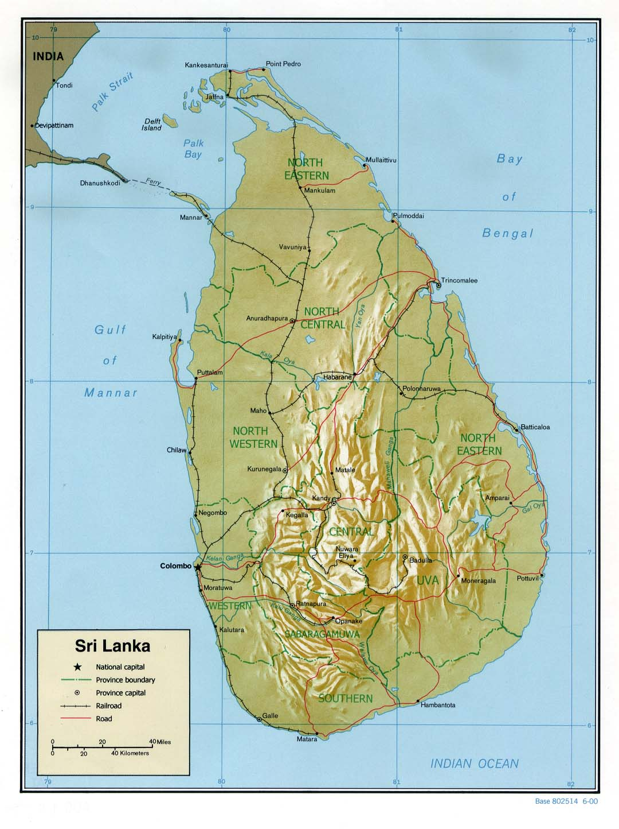
II.Physical context of the country
Topography:
Sri Lanka Locates Between (5 to 10) N and (79 to 82) E
Surface:65,525 sq km
Central parts:hilly areas and water falls
Many rivers :starts in Central parts
Irrigation systems

Slide 11
III.National requirements for observations
National priority application areas
  Agriculture (two rice cultivation season starts with intermonsoon)
  Hydrology (Power basically depend on hydrology)
  Health (some deseases spread with heavy rainfall)
Most relevant measurements:
  Pressure
  Wind
  Precipitation (flood/land slide…)
  Temperature
  Humidity

Slide 12
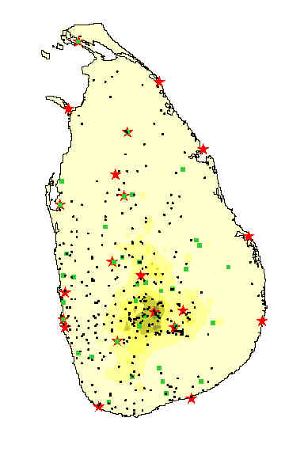
IV. Summary of national observing capabilities
Surface observations

Slide 13
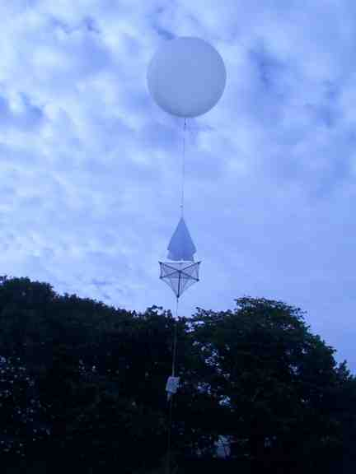
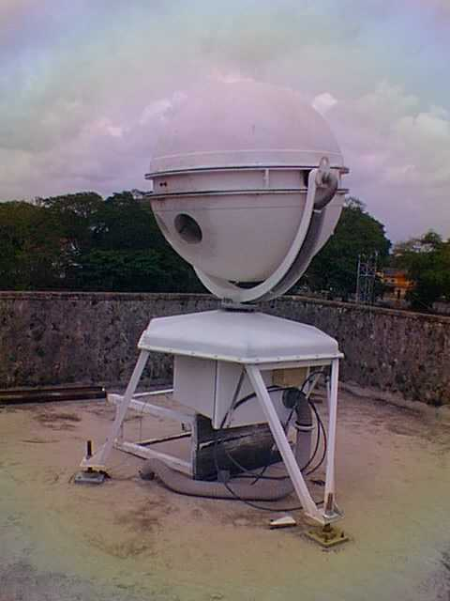
IV. Cont;Upper Air Observations
Summary of national observing capabilities
Pilot ballon observation everyday 0000z,0600z and 1200z
Radiosonde observation
3 days per week (Mon/Wed/Fri)

Slide 14
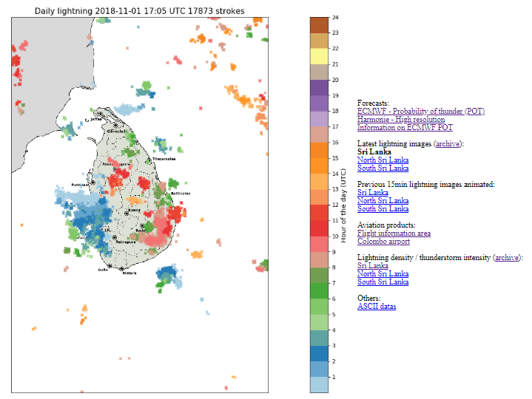
    IV.Lightning detection networks
Summary of national observing capabilities
2017-2018 TRAIL PERIOD
Update every 10min

Slide 15
V. Status of National implementation of WIGOS
National Meteorological Center
Start marine division & NWP UNIT: issue several types of weather forecast (improve out puts)
Seasonal forecasting division: issue seasonal prediction
Implement Standard Operational Procedures For:
          Heavy rainfall
Strong winds
Cyclone
Tsunami
Aviation :
Documentation has done for QMS 2018
Implement to USE SIGMET TOOL SINCE July 2018 (China training)

Slide 16
V.Cont;
V.National WIGOS Implementation
Instrument
Conventional rainfall net work has upgrated to telemeter rain gauge(20 installed & proposed 100)
Thermometer has changing as digital
For calibration using new instruments (before comparison, now digital)
Ongoing training for technical staff

Slide 17
Traceability of Standards
V.National WIGOS Implementation
Universal Standards
WMO Standards
National Standards
Sri Lanka
Regional Standards
RIC - India
Regional Standards
RIC/RRC-Japan
Thermometers Calibration
Barometer Calibration
After JICA Training calibration
National Meteorological Standards
Instrument Division of DOM
Traveling Standards
Instrument Division of DOM
Operational Instruments
Observation Sites

Slide 18
V.National WIGOS Implementation
V. Cont;Satellite Products
(SATAID (JMA) as an analysis Tool)
Himawaree cast donated by JICA

Slide 19
V. Cont; Weather Radar
V.National WIGOS Implementation
Two Doppler radars will be granted by JICA
Sri Lanka has no Radar observation yet

Slide 20
VI.Other remarks
Develop capacity building
NWP improve to do with high resolution
Implement verification methods
iv. Enhance internet and computer speed particularly at Airport
Recruit new meteorologist

Slide 21

Thank you
madhaweej@yahoo.com

