Slide 1
Implementation of WIGOS in Singapore
RA-II Workshop on WIGOS
6-8 NOV 2018

Slide 2
Outline
Introduction and background
National requirements for observations
Summary of national observing capabilities
Status of National implementation of WIGOS

Slide 3
Urbanised environment
Main meteorological/environmental hazards:
Heavy rain/flash floods;
Lightning* ; strong winds (from thunderstorms)
Transboundary haze
*Annual average of 168 thunderstorm days
Singapore
Located deep in the tropics (about 1ºN of the equator)
710.3 sq km (49 km E-W; 26 km N-S)
Population of 5.6 million

Slide 4
Singapore Climate
Northeast Monsoon
(Dec – Mar)
1st Inter-Monsoon
(Apr – May)
2nd Inter-Monsoon
(Oct – Nov)
Southwest Monsoon
(Jun – Sep)
Climatological Statistics
Average Annual Rainfall -2166 mm
Highest Annual Rainfall - 3452 mm (1913)
Highest Monthly Rainfall - 819 mm (Jan 1893)
Highest one-day Rainfall - 512 mm (Dec 1978)
Highest one-hour intensity - 147 mm (Nov 1995)
Significant heavy rainfall events in recent years
16 July 2010 (Highest one-day rainfall) : 250 mm
17 June 2016 (Highest one-day rainfall) : 217 mm
8 November 2014 (Highest one-day rainfall) : 161 mm
26 February 2013 (Highest one-day rainfall) : 155 mm
Notes:
17 jun 2016 - 217mm
8 nov 2014 - 160.8mm
26 Feb 2013 - 154.8mm
16 jul 2010 - 250.2mm
5 Feb 2013 - 151.8mm
31 DEc 2017 - 149.6mm

Slide 5
Background on MSS
Meteorological Service Singapore (MSS) is the national meteorological authority for weather and climate with a key remit of providing :
Weather Forecast and Warning Services
Monitoring and Early Warning of Hazards
Climate Information Services
Civil Aviation
Public
Government Agencies / Whole-of-Government
Business (shipping, recreation, construction etc)
Key Stakeholder / Customer Groups

Slide 6
Background on MSS
Staff Composition
Meteorologists
Number of Staff performing observations/ Implementation of met observing systems:
Observations : 1 Meteorologist / 32 Observers (across 5 stations)
Implementation / Maintenance of Meteorological Systems : 3 Meteorologists / 1 Systems Analyst / 2 Technical Support Officers
Meteorologists / Observers are trained in accordance with WMO BIP requirements; Observers are trained in-house.

Slide 7
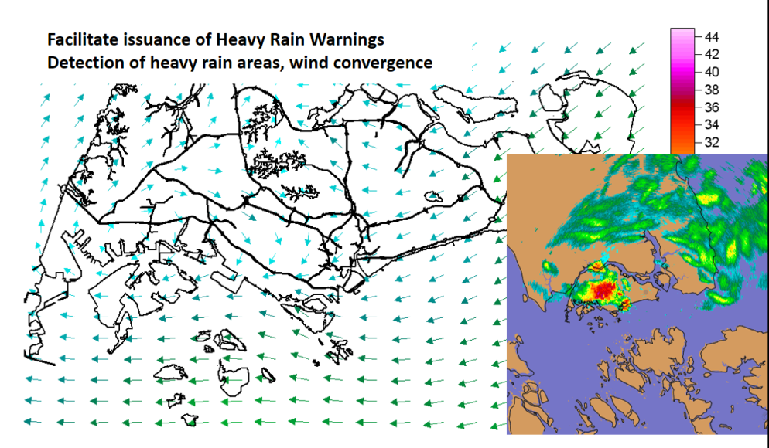
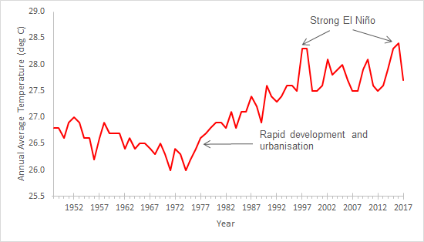
National requirements for observations
Nowcasting and short range forecasting
High-resolution regional Numerical Weather Prediction
Climate monitoring and services
Specific application areas (such as Aeronautical Meteorology)

Slide 8
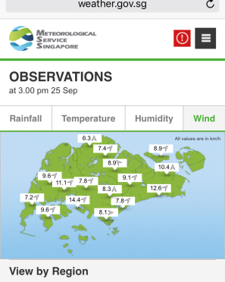
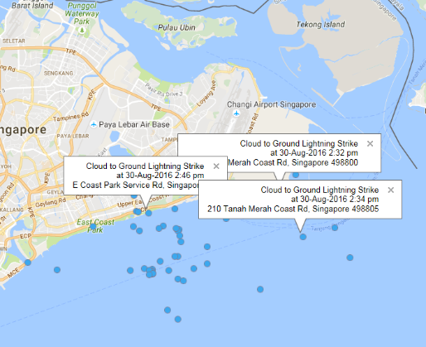
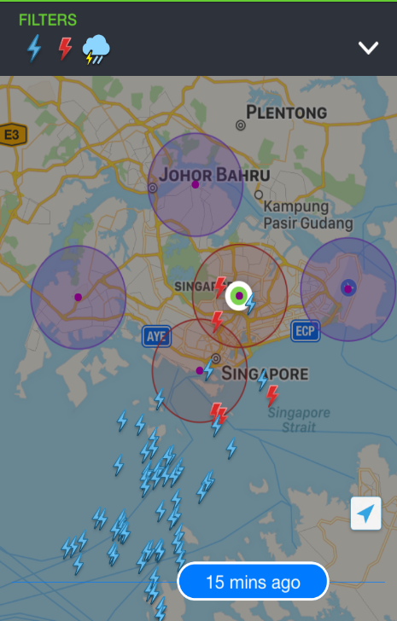
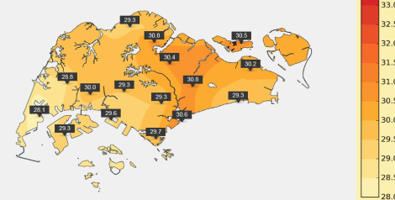
National requirements for observations
Delivery of Services
Observational data is made available on website/app
Increasing demands from public and government agencies for data at high spatial and temporal resolution
myENV app
Most relevant observed variables:
Rainfall and rain locations – for flood and water resource management and climate monitoring
Detected lightning locations – for alerting of lightning risk
Temperature/ humidity/ wind etc – for indication of current conditions, climate monitoring

Slide 9
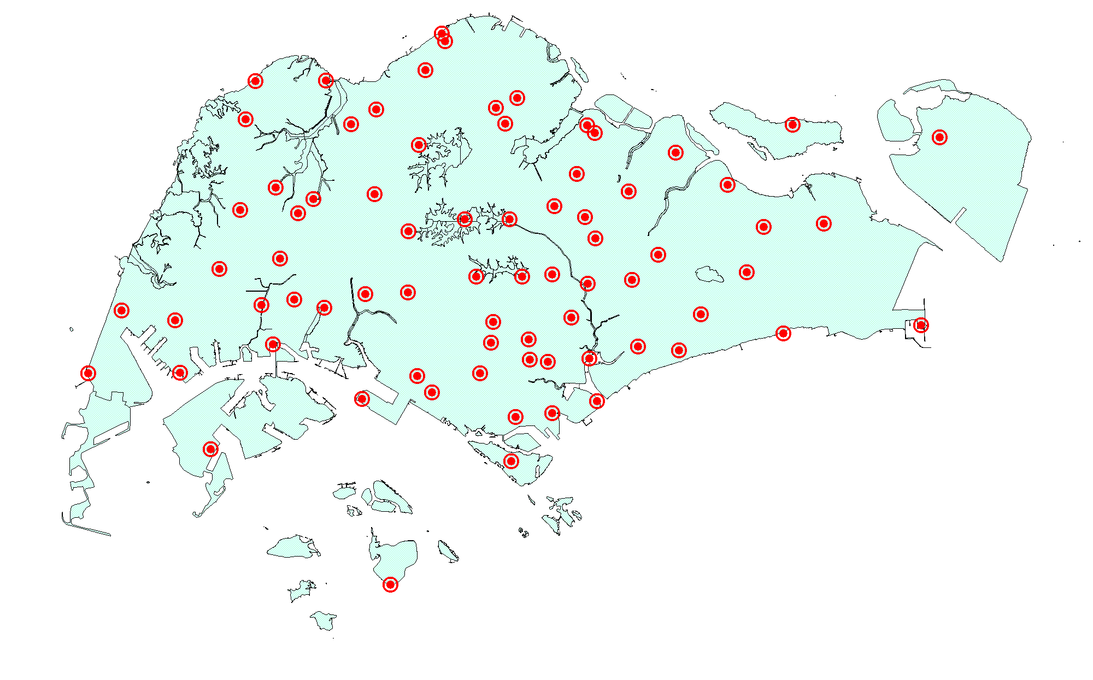
Singapore’s Meteorological Sensor Network Singapore
Aeronautical Met station
WMO Synoptic/ Climate station (RBSN/RBCN)
SYNOPS reported at standard/ intermediate hours
06/18Z PILOT reports
Wind Profiler
Brewer Spectrophotometer
Various Satellite Reception Systems
Manned observation stations
Upper Air Station
(00/12Z TEMP)
Weather Radar
Lightning detector
Aerosol LIDAR
Wind LIDAR
Automatic Weather Station
Wind/Aerosol LIDARs
Wind Profiler
Lightning Detection System
Automatic Weather Stations
Weather Radar
Satellite Reception Systems
Others:
AMDAR reports from selected European airlines landing in Singapore
Upper Air Sounding System
WBGT (AWS)
LDS

Slide 10
Meteorological Sensor Network
Summary of observing systems:
1 synoptic / climate station (Aeronautical/ RBSN/RBCN)
4 other manned observing stations
Aeronautical and local climatological reports
1 upper air station (RBSN/GUAN)
2 Doppler Weather Radars
100 Automatic Weather Stations (as of Nov 2018)
Lightning Detection Network (4 sensors), 1 wind profiler
1 wind LIDAR, 1 aerosol LIDAR
Various Satellite Reception and Processing Systems
Ongoing initiatives:
Further enhancement to lightning detection and rainfall network in progress
Ensuring the quality of systems
Improving resilience of systems

Slide 11
Status of National Implementation of WIGOS
National Observing Strategy
MSS is in the process of developing the NOS, focusing on areas such as staffing, processes, infrastructure, technology integration
National WIGOS Implementation Plan;
In progress, will build on the NOS; need to strengthen the planning/ engagement particularly with non-NMHS contributors
At the same time, to enhance existing internal practices to better meet WIGOS requirements
National WIGOS partnership agreements for integration and open-sharing of observations from NMHSs and non-NMHSs sources:
Service agreements with key user agencies for provision of services (including observational systems/ data);
In selected cases, MSS manages observing system on behalf of other agencies (e.g. automatic weather stations/ rain gauges)
MSS has arrangements in place to receive data from other agencies (e.g., tide data from the Maritime and Port Authority, air quality data from the National Environment Agency etc)
On-going process to formalize approach

Slide 12
Status of National Implementation of WIGOS
Metadata of stations used for international exchange have been updated in OSCAR/Surface
Planning is in process for use of new WIGOS Station Identifiers – existing stations were migrated from Vol A, though there will be a need to create new stations
Processes are in place to routinely monitor data disseminated internationally, and to act on quality issues if identified from the WDQMS
WIGOS NFP has been nominated; OSCAR/Surface FP has been nominated and trained

