Slide 1
WIGOS regulatory and guidance material
RA II WIGOS Workshop
(Beijing, China, 6-8 November 2018)
Presented by: Luis F. Nunes
Based on slides by: Igor Zahumensky
(WIGOS Project Office, WMO Secretariat)

Slide 2
Outline
Introduction
WIGOS Technical Regulations
The Guide to WIGOS
Final Remarks
Notes:
ARTICLE 9
Execution of Congress decisions
(a) All Members shall do their utmost to implement the decisions of Congress;
(b) If, however, any Member finds it impracticable to give effect to some requirement in a technical resolution adopted by Congress, such
Member shall inform the Secretary-General of the Organization whether its inability to give effect to it is provisional or final, and state its reasons
therefor.

Slide 3
Outline
Introduction
WIGOS Technical Regulations
The Guide to WIGOS
Final Remarks
Notes:
ARTICLE 9
Execution of Congress decisions
(a) All Members shall do their utmost to implement the decisions of Congress;
(b) If, however, any Member finds it impracticable to give effect to some requirement in a technical resolution adopted by Congress, such
Member shall inform the Secretary-General of the Organization whether its inability to give effect to it is provisional or final, and state its reasons
therefor.

Slide 4
WMO Technical Regulations and Guides
TRs
(Vol. I – III)
Manuals
(Annexes to TRs)
Guides
(e.g. WMO-No. 8, 100, 134, 168, …; Guidelines, other reference docs., etc.)
Regulations
Basic “high level” Provisions
Mostly requirements-driven
Relatively Conservative
“Shall”
and “Should”
have specific
meaning
More detailed Provisions
Mostly technology-driven
Relatively Dynamic
Non-Regulations
“Should”
has ordinary
meaning
Best procedures and practices, implementation guidance, explanations, examples on
how to implement and
operate observing systems

Slide 5
Technical Regulations (WMO-No. 49) Vol. I General Standards and Recommended Practices
PART I. WMO Integrated Global Observing System (WIGOS) – Date of effect: 1 July 2016
PART II. WMO Information System (WIS)
PART III. Data Processing and Forecasting
PART IV. Meteorological, hydrological and climatological applications and services
PART V. Education and training
PART VI. Competence of meteorological, hydrological and climatological personnel
Notes:
ARTICLE 9
Execution of Congress decisions
(a) All Members shall do their utmost to implement the decisions of Congress;
(b) If, however, any Member finds it impracticable to give effect to some requirement in a technical resolution adopted by Congress, such
Member shall inform the Secretary-General of the Organization whether its inability to give effect to it is provisional or final, and state its reasons
therefor.

Slide 6
Technical Regulations WMO-No. 49 (Standards and Recommendations)
The standard practices and procedures:
It is necessary that Members follow or implement;
Are distinguished by the use of the term shall in the English text and by suitable equivalent terms in the other WMO language versions.
Notes:
ARTICLE 9
Execution of Congress decisions
(a) All Members shall do their utmost to implement the decisions of Congress;
(b) If, however, any Member finds it impracticable to give effect to some requirement in a technical resolution adopted by Congress, such
Member shall inform the Secretary-General of the Organization whether its inability to give effect to it is provisional or final, and state its reasons
therefor.

Slide 7
Technical Regulations WMO-No. 49 (Standards and Recommendations)
The recommended practices and procedures:
It is desirable that Members follow or implement;
Are distinguished by the use of the term should in the English text and by suitable equivalent terms in the other WMO language versions.
Notes:
ARTICLE 9
Execution of Congress decisions
(a) All Members shall do their utmost to implement the decisions of Congress;
(b) If, however, any Member finds it impracticable to give effect to some requirement in a technical resolution adopted by Congress, such
Member shall inform the Secretary-General of the Organization whether its inability to give effect to it is provisional or final, and state its reasons
therefor.

Slide 8
Examples of provisions in the WIGOS Technical Regulations
2.2.1.2 Members shall plan and operate their networks in a sustainable and reliable manner utilizing WIGOS standard and recommended practices and procedures, and tools.
2.2.2.1.1 Members should follow the principles specified in Appendix 2.1 when designing and developing their observing networks.

Slide 9
Outline
Introduction
WIGOS Technical Regulations
The Guide to WIGOS
Final Remarks
Notes:
ARTICLE 9
Execution of Congress decisions
(a) All Members shall do their utmost to implement the decisions of Congress;
(b) If, however, any Member finds it impracticable to give effect to some requirement in a technical resolution adopted by Congress, such
Member shall inform the Secretary-General of the Organization whether its inability to give effect to it is provisional or final, and state its reasons
therefor.

Slide 10
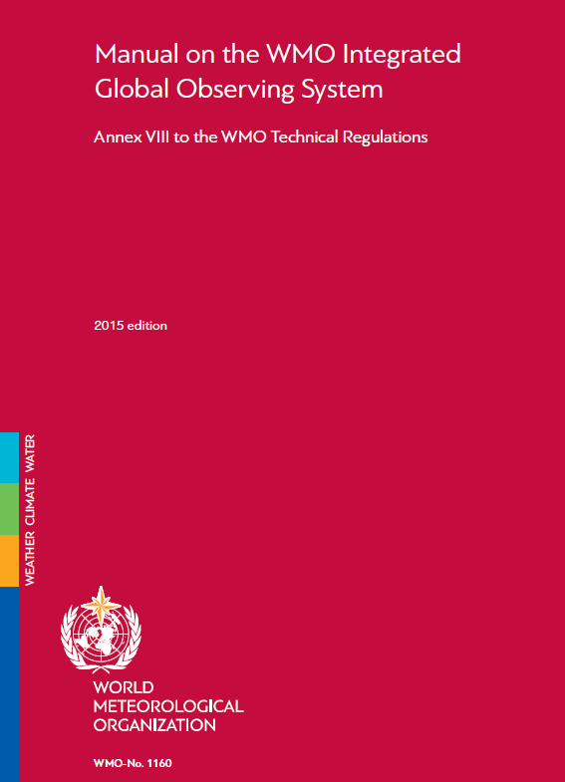
WIGOS Technical Regulations and Manual
Technical Regulations Manual on WIGOS
Vol. I, Part I – WIGOS

Slide 11
Purpose and Scope of WIGOS Technical Regulations
Vol. I, Part I – WIGOS
It specifies WIGOS institutional and system requirements/standards and recommendations
Manual on WIGOS
It specifies WIGOS technical requirements/standards and recommendations of an operational nature

Slide 12
Purpose and Scope (Cont.) of WIGOS Technical Regulations
For:
Establishment of global, regional and national networks and facilities;
Establishment of an authority or a responsible body;
Human resources requirements (including education and training, competences, qualifications, etc.);

Slide 13
Chapters of WIGOS Technical Regulations Vol. I, Part I – WIGOS & Manual on WIGOS
Introduction to WIGOS
Common attributes of WIGOS component systems
Attributes specific to the surface-based sub-system
Attributes specific to the space-based sub-system
Attributes specific to the global observing system of WWW
Attributes specific to the observing component of GAW
Attributes specific to the WMO Hydrological Observing System
Attributes specific to the observing component of GCW

Slide 14
Vol. I, Part I – WIGOS & Manual on WIGOS
2. Common attributes of WIGOS component
systems
2.1 Requirements
2.2 Design, Planning and Evolution
2.3 Instrumentation and Methods of Observation
2.4 Operations
2.5 Observational Metadata
2.6 Quality Management
2.7 Capacity Development

Slide 15
Manual on WIGOS
2. Common attributes of WIGOS component systems
2.1 Requirements
2.2 Design, Planning and Evolution
2.3 Instrumentation and Methods of Observation
2.4 Operations
2.5 Observational Metadata
2.6 Quality Management
2.7 Capacity Development
Notes:
In Section 2 the standard and recommended practices and procedures relevant to each WIGOS process can be found in the following sub-sections:
Determination of user requirements: 2.1, 2.2
Design, planning and evolution of WIGOS: 2.2
Development and documentation of standard and recommended practices and procedures for observing systems: 2.3
Implementation of observing system by owners and operators: 2.3, 2.4
Observing system operation and maintenance including fault management and audit: 2.4
Observation quality control: 2.4, 2.6
Observations and observational metadata delivery: 2.4, 2.5
Performance monitoring: 2.4, 2.6
User feedback and review of requirements: 2.2, 2.6
Capacity development (including training): 2.7

Slide 16
New draft Edition of WIGOS Technical Regulations
This draft new edition is a result of a collaborative effort involving many experts, national focal points and the Secretariat Staff, and marks a very important milestone on our way toward the WIGOS operational phase.
Manual on WIGOS – to be updated in 2019 with new chapter on:
Global Basic Observing Network (GBON),
Regional Basic Observing Network (RBON),
The Global Observing System (GOS) (Manual on the GOS, WMO-No. 544
being integrated into the Manual on WIGOS)

Slide 17
Outline
Introduction
WIGOS Technical Regulations
The Guide to WIGOS
Final Remarks
Notes:
ARTICLE 9
Execution of Congress decisions
(a) All Members shall do their utmost to implement the decisions of Congress;
(b) If, however, any Member finds it impracticable to give effect to some requirement in a technical resolution adopted by Congress, such
Member shall inform the Secretary-General of the Organization whether its inability to give effect to it is provisional or final, and state its reasons
therefor.

Slide 18
Guide to WIGOS (WMO-No. 1165)
It provides more detailed information, best practices and procedures, explanation and examples on how to implement standard and recommended practices and procedures specified in the Volume I, Part I – WIGOS of the WMO Technical Regulations (WMO-No. 49) and in the Manual on WIGOS into day-to-day operations.
It is intended to be used by managers/supervisors and other technical staff of NMHSs responsible for planning, implementation, performance and operation of national observing systems/networks. These individuals are the target audience.
WMO

Slide 19
Guide to WIGOS (WMO-No. 1165) – Cont.
Initial version of the Guide to WIGOS (2017 edition) with guidance material on:
WIGOS Station Identifiers (WSI),
WIGOS Metadata,
OSCAR/Surface,
Observing Network Design principles

Slide 20
Guide to WIGOS (WMO-No. 1165) – Cont.
2017 edition, updated in 2018 (approved by EC-70):
New Chapter 6:
Guidance on National WIGOS Implementation
New Chapter 7:
Guidance on WIGOS Data Partnerships - Part 1
New Chapter 8:
Establishing a Regional WIGOS Centre in pilot mode
New Chapter 9:
Technical Guidelines for Regional WIGOS Centres (RWCs) on the WIGOS Data Quality Monitoring System (WDQMS) for surface land stations of the GOS

Slide 21
Outline
Introduction
WIGOS Technical Regulations
The Guide to WIGOS
Final Remarks
Notes:
ARTICLE 9
Execution of Congress decisions
(a) All Members shall do their utmost to implement the decisions of Congress;
(b) If, however, any Member finds it impracticable to give effect to some requirement in a technical resolution adopted by Congress, such
Member shall inform the Secretary-General of the Organization whether its inability to give effect to it is provisional or final, and state its reasons
therefor.

Slide 22
WMO Technical Regulations (WMO-No. 49)
TRs
(Vol. I – III)
Manuals
(Annexes to TRs)
Guides
(e.g. WMO-No. 8, 100, 134, 168, …; Guidelines, other reference docs., etc.)
Regulations
WHAT TO DO (“Shall” and “Should”)
Non-Regulations
HOW TO DO

Slide 23
New draft Edition of WIGOS Technical Regulations
The Volume I, Part I is already available on the WIGOS page www.wmo.int/pages/prog/www/wigos/WRM.html
The Manual on WIGOS will also be available soon at the same webpage.
The official letter by the Secretary General to all Permanent Representatives (PRs) of Members with WMO will be distributed by the end of November. A review period will extend over two months (December 2018 and January 2019).

Slide 24
New draft Edition of WIGOS Technical Regulations
The draft amendments are accessible from the following table:
(updated on 1 October 2018)
WMO-No. 49, Volume I, Part I - WIGOS
English | French | Arabic | Chinese | Russian | Spanish
Manual on WIGOS (WMO-No.1160)
English | French | Arabic | Chinese | Russian | Spanish
WIGOS Metadata Standard (WMO-No.1192)
English | French | Arabic | Chinese | Russian | Spanish

Slide 25
Thank you
谢谢
www.wmo.int/wigos

