Slide 1
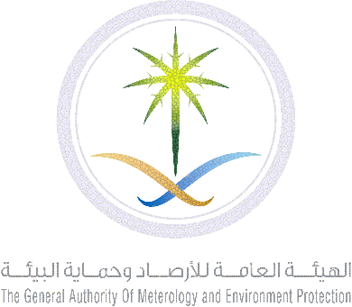
General Authority of Meteorology and Environmental Protection (GAMEP)
Status and Plan of Regional WIGOS Center (West Asia) in
Saud Arabia
By:
Mohammed BABIDHAN
WNFP GAMEP SAUDI ARABIA
WMO RA II WIGOS Workshop
(Beijing, 6-8 November 2018)

Slide 2
General Authority of Meteorology and Environmental Protection (GAMEP)
Introduction
Saudi Arabia has formally indicated its interest to host RWC in RA-II (West Asia).
Recognizing the important role of WIGOS as one of the priorities of WMO
GAMEP is supporting WMO programmes by hosting WMO centers such as GISC Jeddah and planning to host SDS-WAS Center for West Asia.
GAMEP is an authority under the auspices of Ministry of Environment, Water and Agriculture

Slide 3
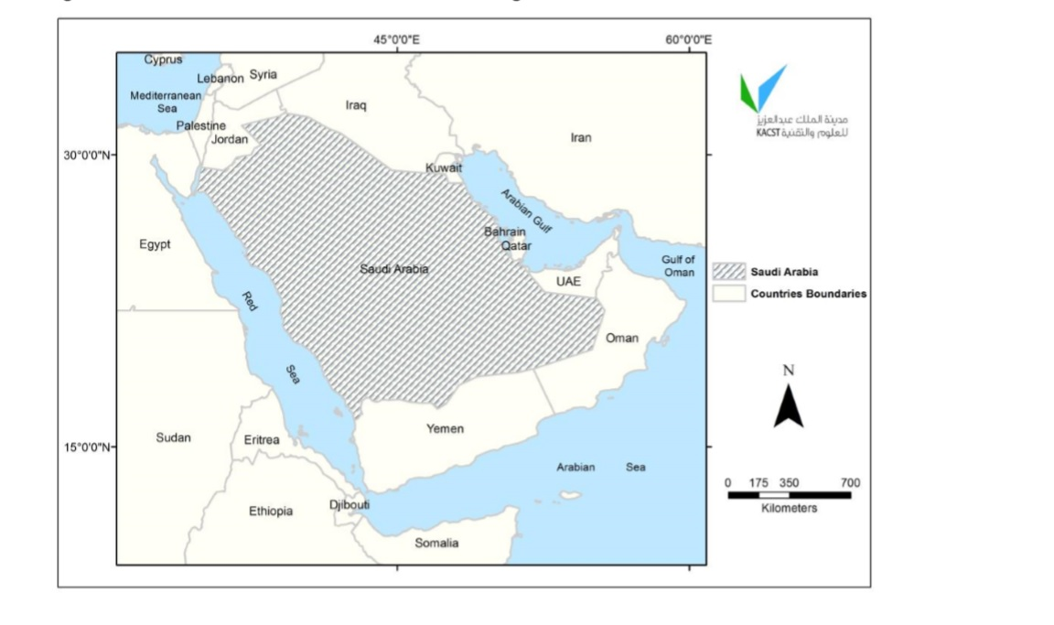
General Authority of Meteorology and Environmental Protection (GAMEP)
Saudi Arabia occupies about 80% of the Arabian Peninsula (the world's largest peninsula), lying between latitudes 16° and 33° N, and longitudes 34° and 56° E. the total area is 2,149,690 km2 and population is about 33 million.

Slide 4
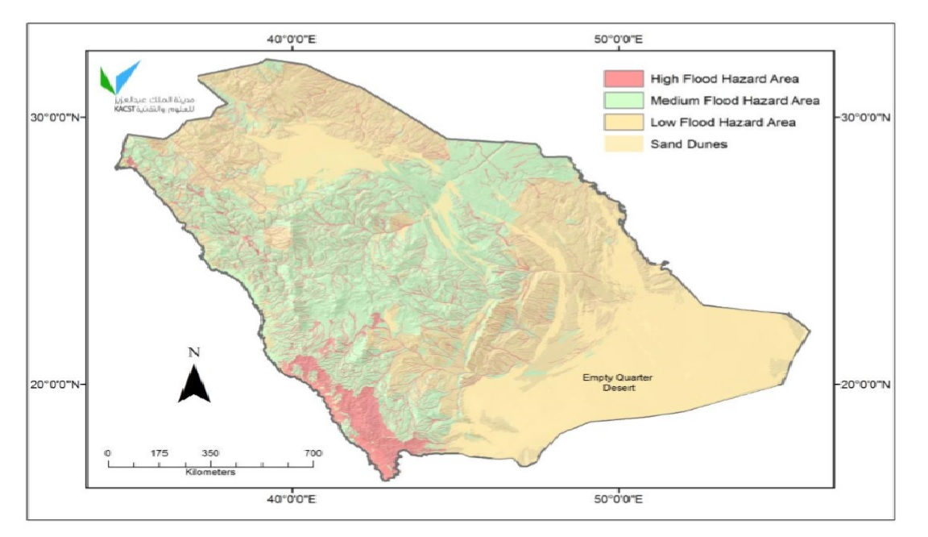
General Authority of Meteorology and Environmental Protection (GAMEP)
Weather and Climate Hazards
Thunderstorms
Heavy rain
Flash Floods
Dust and Sand storms
Heat Waves
Cold Waves
Drought
Tropical Cyclone

Slide 5
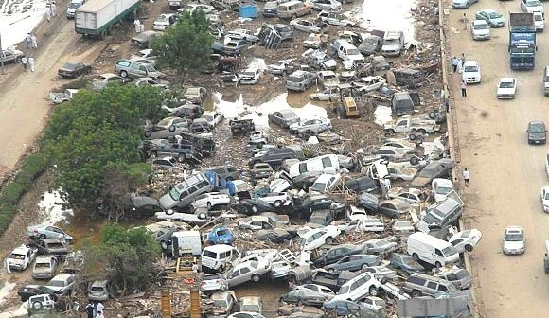
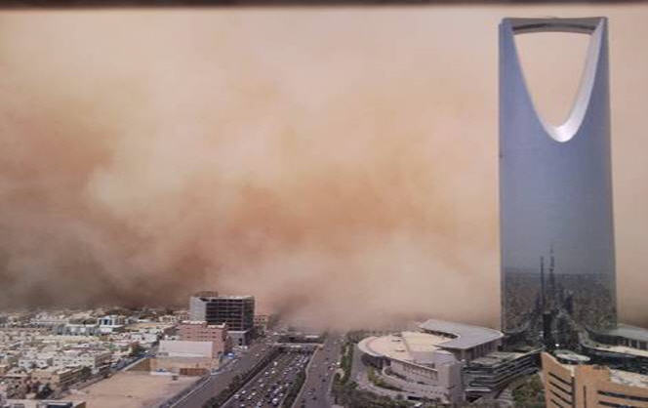
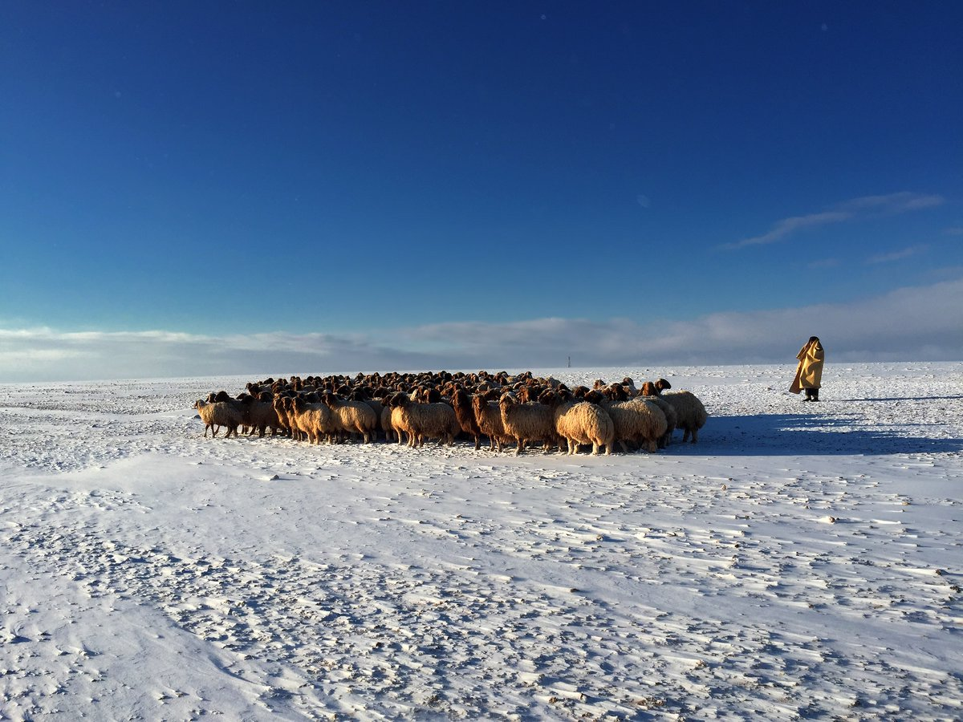
General Authority of Meteorology and Environmental Protection (GAMEP)

Slide 6
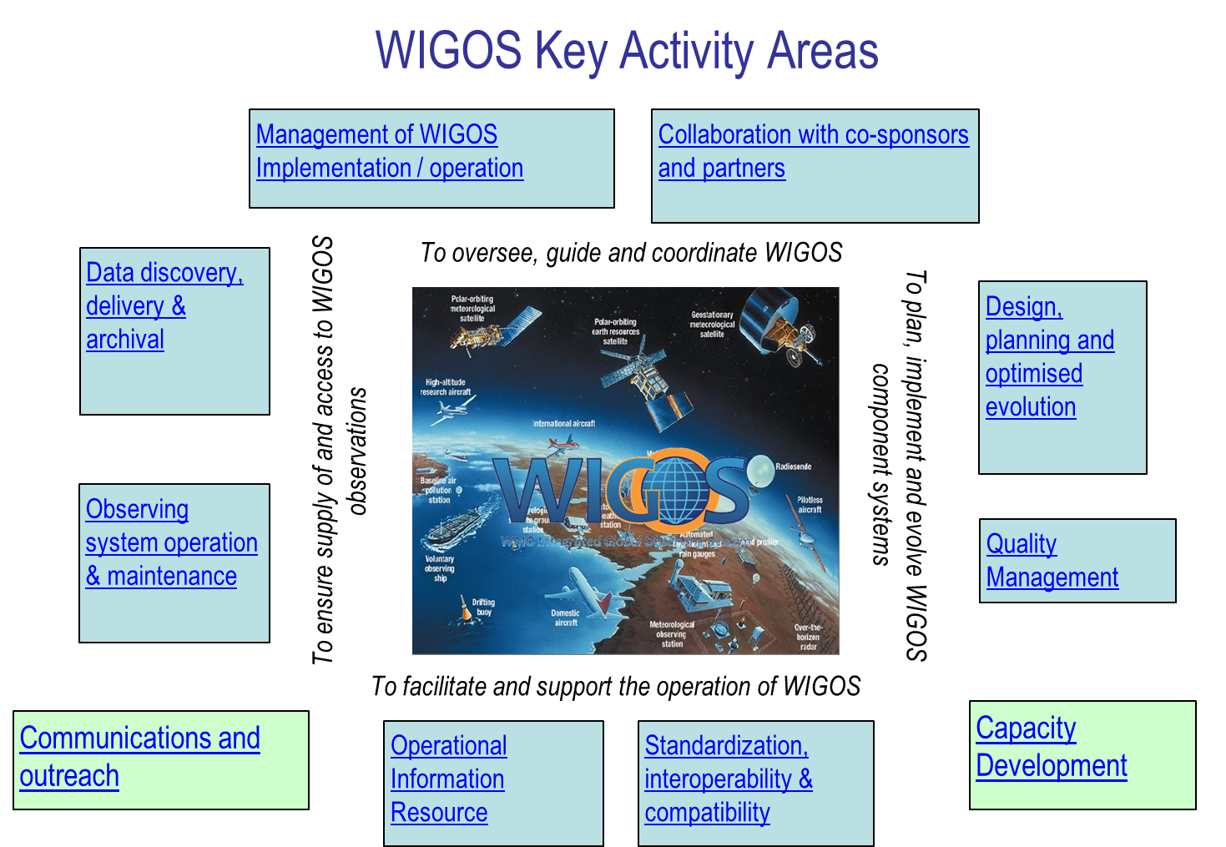

Slide 7
General Authority of Meteorology and Environmental Protection (GAMEP)
Key Activity Areas/ Saudi Arabia
1. Mmanagement of WIGOS implementation
GAMEP is the authority and responsible for making the meteorological observations
Assessment of observing systems in Saudi Arabia with support of WMO
Ongoing Programme for redesign and establishment of integrated national observing network (Initiatives of Saudi Vision 2030)
Inclusion of WIGOS concept in line with GAMEP strategic plan
Developing the N-WIP in accordance with WIP and R-WIP-II
Cooperating with universities, research institutions, private sector and other governmental agencies
A proposal for the protection of observing sites as a part of meteorological low
Supporting RA-II, Technical Commissions, working groups, expert teams and task teams

Slide 8
General Authority of Meteorology and Environmental Protection (GAMEP)
Key Activity Areas/ Saudi Arabia
2. Collaboration with the WMO co-sponsored observing systems and international partner organizations and programmes
Supporting WMO co-sponsored observing systems and international partner organizations and programmes
Making coordination between these organizations/programmes with national agencies
Initiatives for participation in AMDAR programme in cooperation with national airlines
Implementing a project in cooperation with WMO providing observing systems for capacity development in Yemen.

Slide 9
General Authority of Meteorology and Environmental Protection (GAMEP)
Key Activity Areas/ Saudi Arabia
3. Design, planning and optimized evolution of WIGOS component observing systems
Implementing a process for determining the national requirements for observations
Considering the regional and global observational data requirement
Taking into account the WMO regulations and recommendations, WMO application areas, all related technical documents, guidance material.
Making regular consultation with internal and external users to review and to meet their observational data requirements
Following and implementing the technological development as well as international regulations at observing network
Establishment of integrated observing network with different observing system

Slide 10
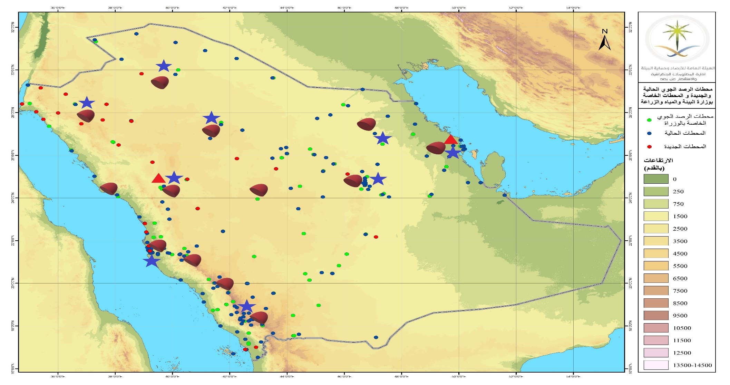
General Authority of Meteorology and Environmental Protection (GAMEP)

Slide 11
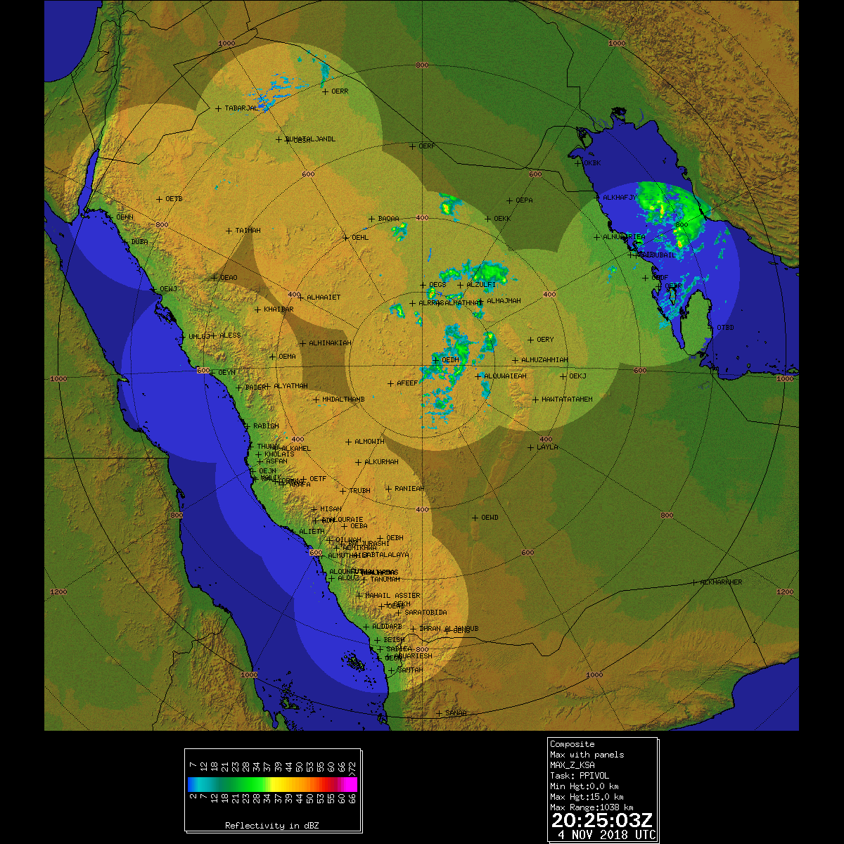
General Authority of Meteorology and Environmental Protection (GAMEP)

Slide 12
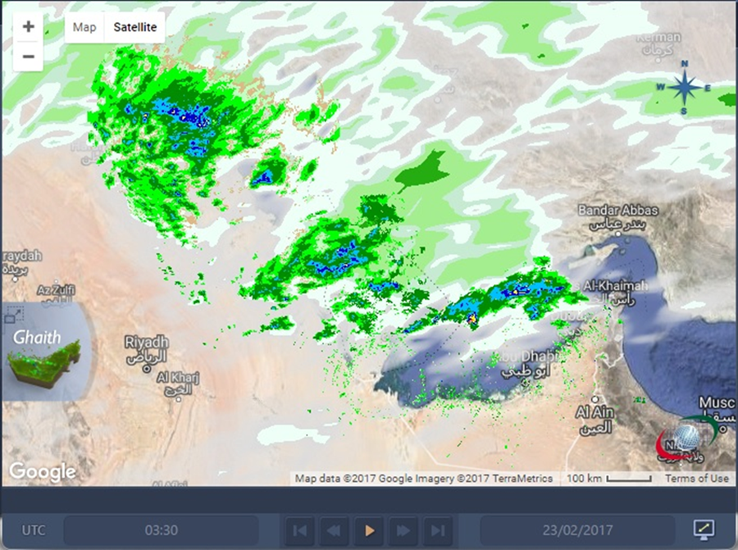
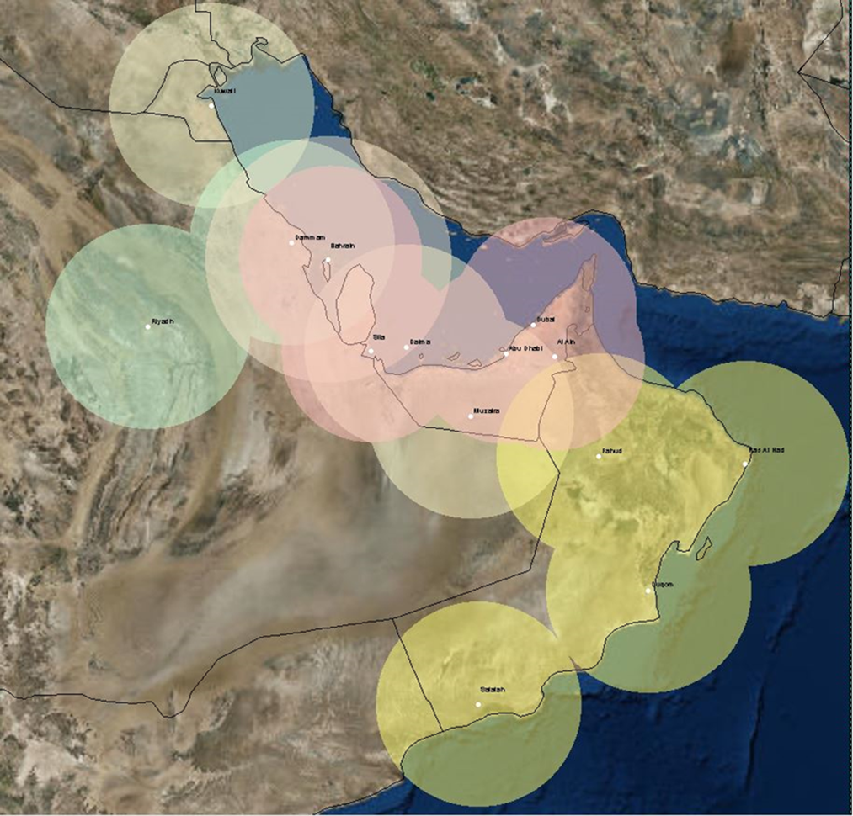
General Authority of Meteorology and Environmental Protection (GAMEP)

Slide 13
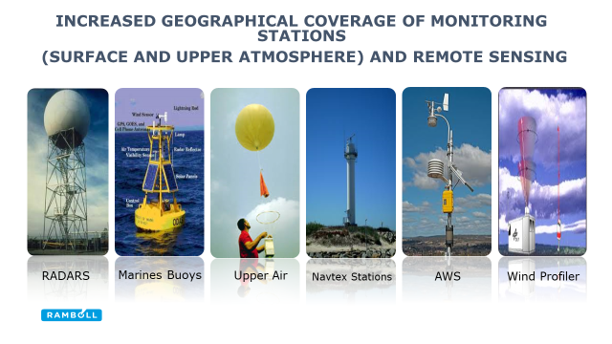
General Authority of Meteorology and Environmental Protection (GAMEP)
Deployment of new observing systems based on user needs

Slide 14
General Authority of Meteorology and Environmental Protection (GAMEP)
Key Activity Areas/ Saudi Arabia
4. Observing System Operation and Maintenance
Performing operation and maintenance routine procedures
Making preventive and corrective maintenance
Making calibration at certain interval for each particular observing system
A plan for development of national database for metadata
A web based real time status and maintenance monitoring tool for observing network
Carrying out regular training activities for GAMEP O&M staff.

Slide 15
General Authority of Meteorology and Environmental Protection (GAMEP)
Key Activity Areas/ Saudi Arabia
5. Quality Management
Quality Management System (QMS) (ISO 9001:2015)
Developing and implementing a Quality Control process for all observational data
Making documentation of the operation and maintenance processes of observing systems in accordance with QMS
Monitoring all activities in a web based programme

Slide 16
General Authority of Meteorology and Environmental Protection (GAMEP)
Key Activity Areas/ Saudi Arabia
6. Standardization and interoperability
Complying with WMO standard and recommended practices and procedures for instruments and methods of observation.
Having a process for the classification of the observing stations according to WMO/CIMO Guidance
Fulfilling obligations, standards and applications, and hosting GISC recognized by WMO
Managing a central database for processing, archiving and disseminating the all observational data

Slide 17
General Authority of Meteorology and Environmental Protection (GAMEP)
Key Activity Areas/ Saudi Arabia
7. WIGOS Information Resource
Reviewing all meteorological data inventory, and updating metadata records
8. Data discovery and availability (data and metadata)
GAMEP is hosting GISC Jeddah which provides exchange of data, interpretation metadata, and management of related discovery metadata

Slide 18
General Authority of Meteorology and Environmental Protection (GAMEP)
Key Activity Areas/ Saudi Arabia
9. Capacity development
Organizing national and Regional training courses on observing systems
Cooperation with WMO and Members (consultancy service, etc.)
Providing assistance to enable effective implementation, operation and management of observing systems;
10. Communications and outreach
A plan to provide details on WIGOS benefits, increased effectiveness, and efficiency, and impact on the activities of the Members of the Region, as well as on the socio-economic benefits of WIGOS data.

Slide 19
General Authority of Meteorology and Environmental Protection (GAMEP)
Conclusion
Strong support from Members, RA II, and the WMO Secretariat
Strengthen regional cooperation for full implementation of WIGOS at regional and sub-regional level
Resources to develop and implement management and operational WIGOS and partnerships will be needed
Lack of sufficient human resources

Slide 20
Thank you

