Slide 1
Status of WIGOS implementation
in Russian Federation
Submitted by Alexander Gusev
WIGOS national coordinator
Russian Federation
RA II WIGOS Workshop
6-8 November 2018, Beijing, China

Slide 2
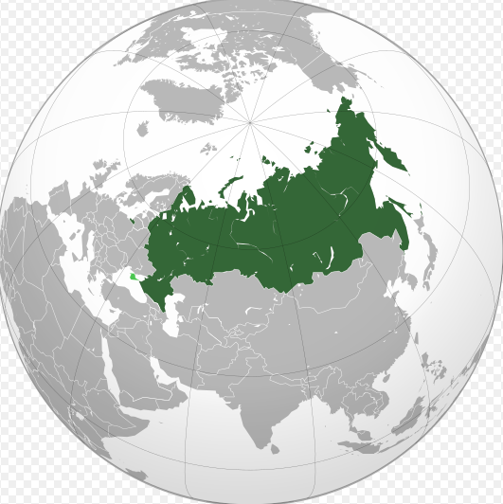
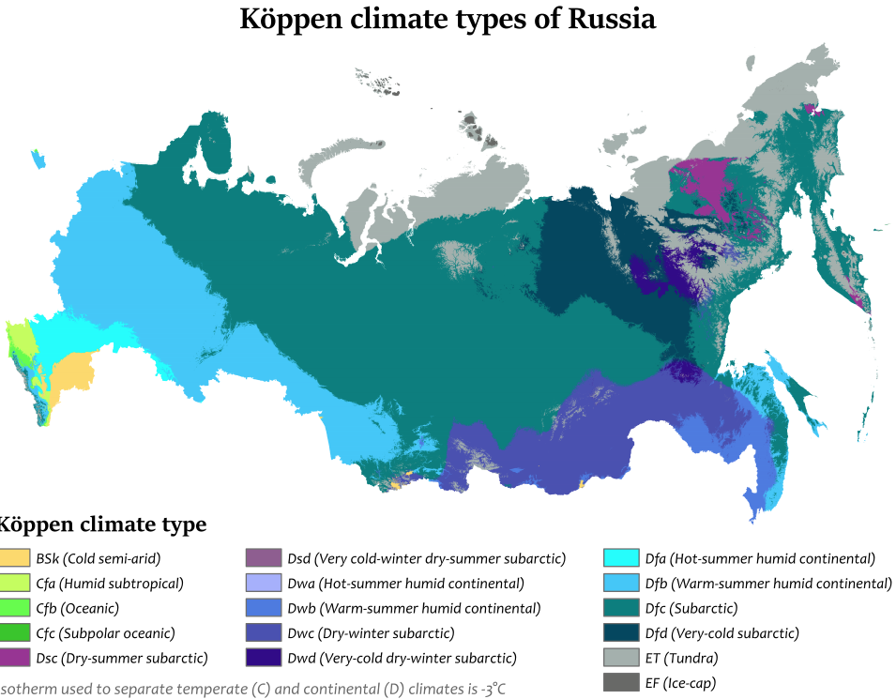
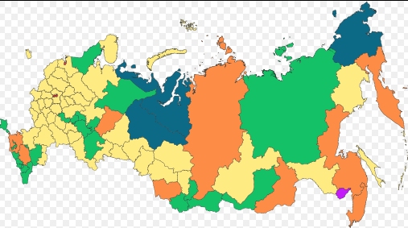
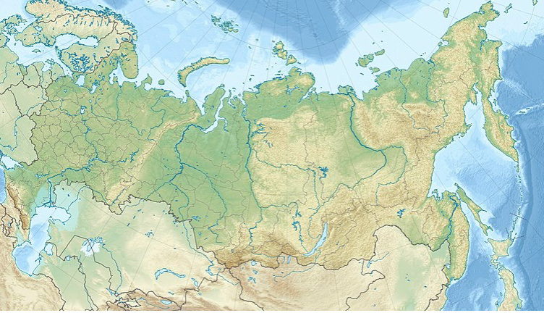
Introduction to the country and the NMHS
17 125 191 square kilometres (6,612,100 sq mi);
about 146.8 million people (2018).

Slide 3
Introduction to the country and the NMHS
Russian meteorological service
has been established in 1849
Historically Roshydromet developed as national hydrometeorological service with the inherent integration of observational networks.
Currently, the observation network performs
about 30 types of different observations
(meteorology, hydrology, agrometeorology, aviation meteorology, oceanography, geophysics, environmental monitoring….)
STAFF – about 30K
16 research institutes

Slide 4
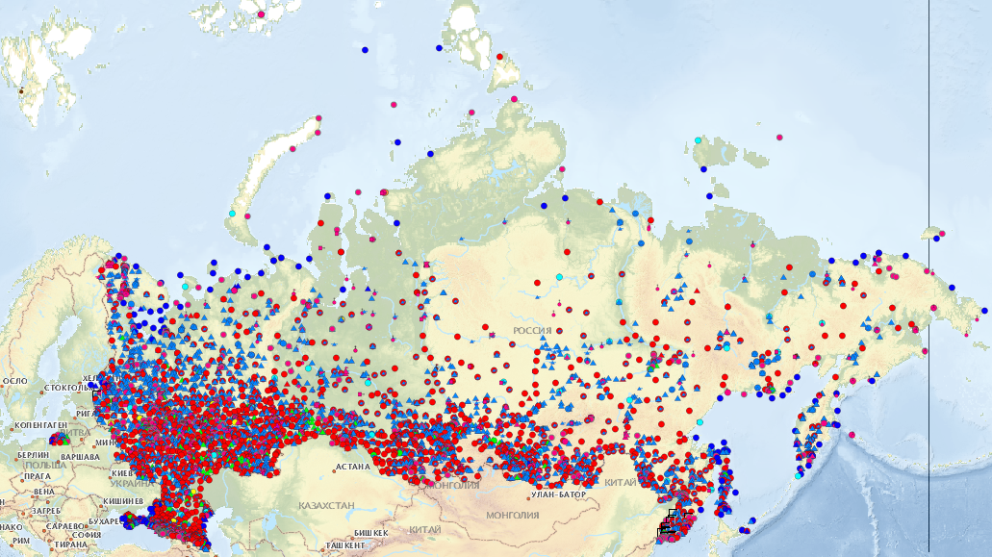
Roshydromet observation networks
> 6,700 hydrometeorological stations and posts;
~ 14,000 observation programs.
networks need to be managed from the point of view of optimizing and reducing the costs of producing observations.
аutomated accounting system for keeping record of observation units (AASOU) are developing

Slide 5
Main observation networks
meteo
upper-air

Slide 6
Main observation networks (2)
hydrology
Doppler radars

Slide 7
Main observation networks (3)
lightning detection
tsunami

Slide 8
Main observation networks (4)
Antarctic
satellite

Slide 9
National automated accounting system
asunp.meteo.ru
The most important element of management of such an integrated observation network is the system of accounting of its quantitative composition (OSCAR or OSCAR-like systems).
For this purpose, the national automated accounting system for observation units (AASOU), functionally close to the OSCAR system, containing, inter alia, a significant amount of diverse metadata, is used.

Slide 10
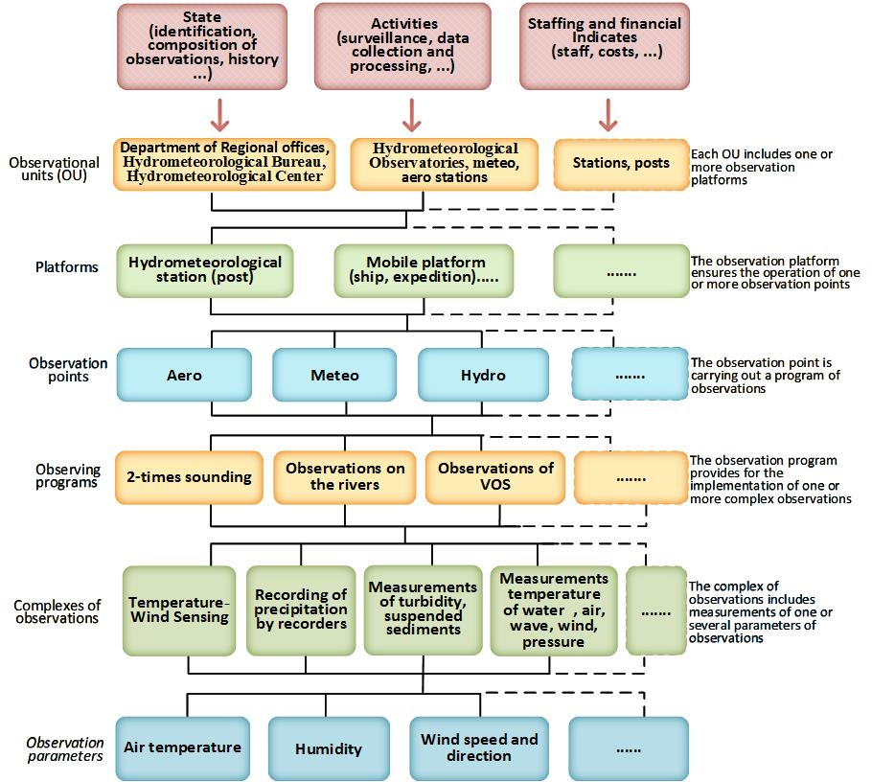
As an elementary object in the system, the "observation unit" is used as an object of accounting linked to a particular type of observation. Meteorological and hydrological stations, posts, observatories are described, thus, as a superposition of various "observation points".

Slide 11
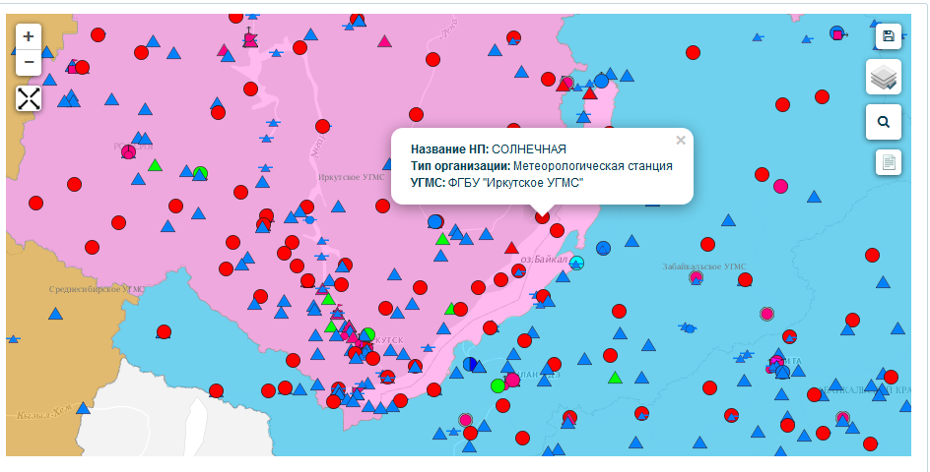
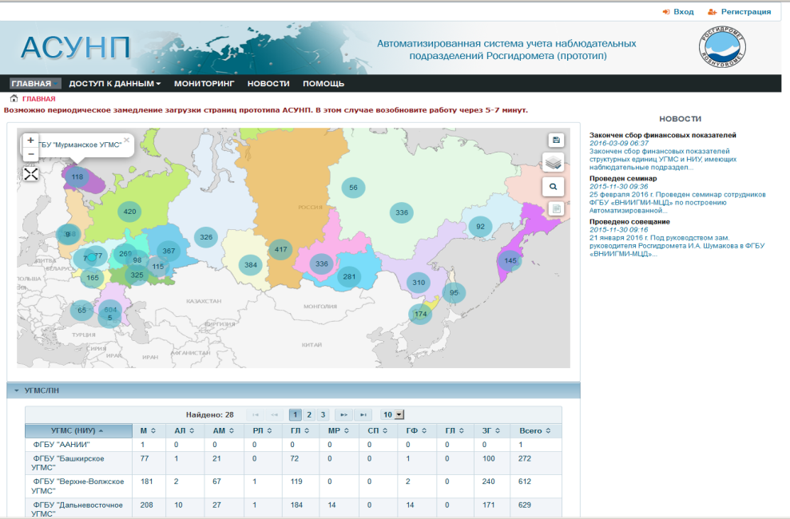
Basic features
Using ”observation units» as elementary object
Inclusion of staff and financial information
Remote web-input of information for different users
Standardized reporting on established forms of reports and indicators
Assessment of the state and dynamics of changes in network indicators
Access to standardized reporting and execution of user requests

Slide 12
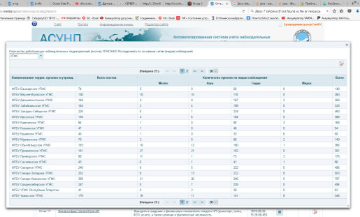
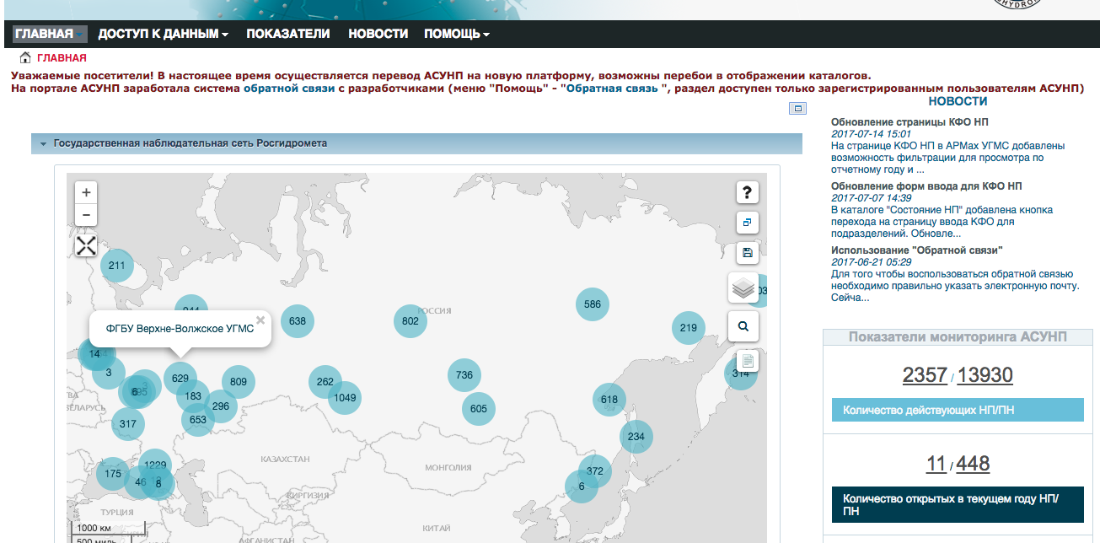
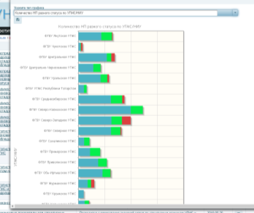
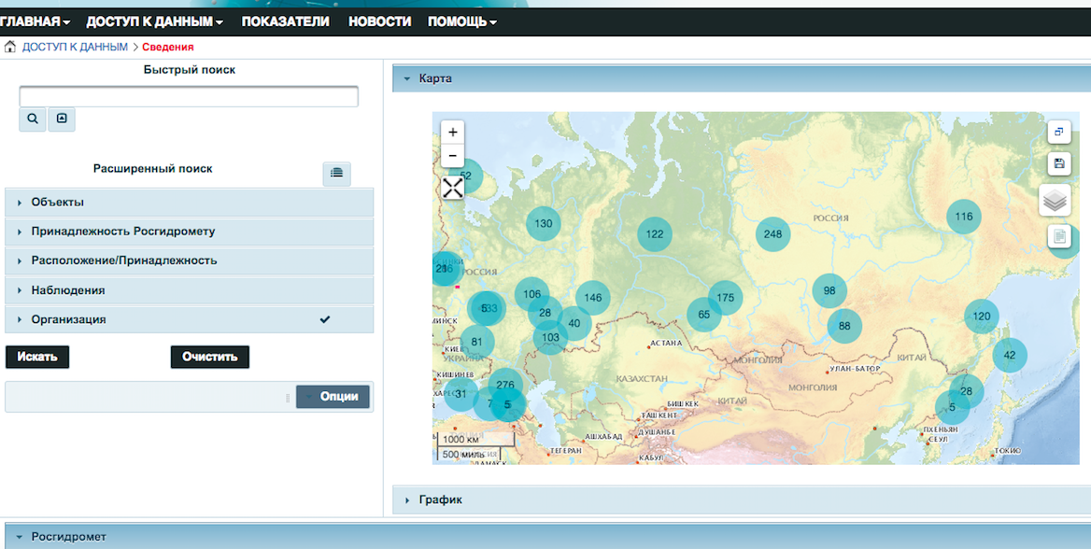
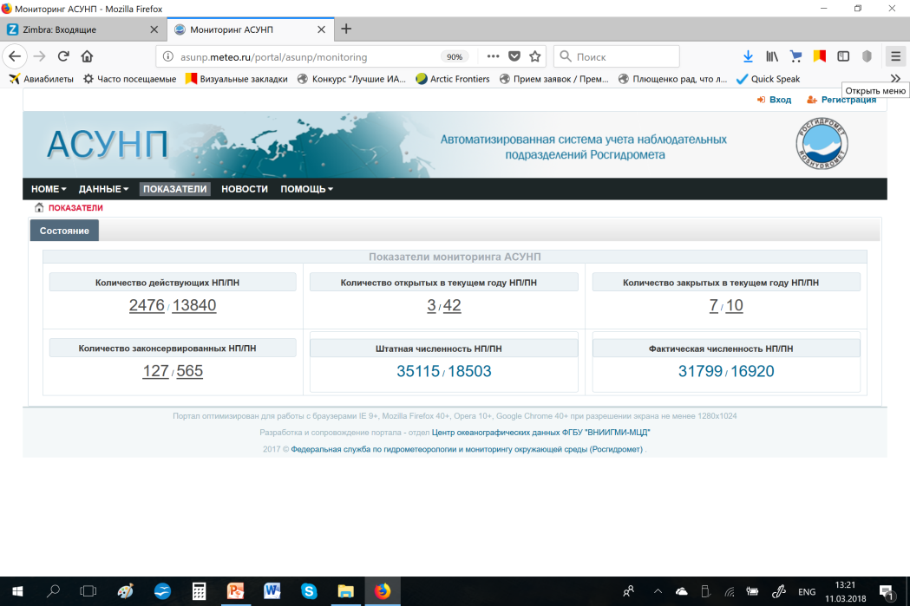
AASOU

Slide 13
System interaction (M2M)
Through machine-to-machine interface is planned to provide a pair of AASOU with the OSCAR system.
The system will be important elements of a plan for Russian-speaking countries of the Regional WIGOS centre.

Slide 14
Problems, perspectives
M2M - problem of metadata overlapping
WDQMS
Future evolution -
(CIS country, Regional WIGOS centre for Russian speaking countries, private and other partners …)
Motivation to participate in WIGOS project is a key problem

Slide 15
Status of National implementation of WIGOS
National Observing Strategy adopted/approved
National WIGOS Implementation Plan adopted/approved
National WIGOS governance mechanism: in place
National WIGOS partnership agreements for integration and open-sharing of observations from NMHSs and non-NMHSs sources: in place ;
OSCAR/Surface being populated and updated with WIGOS metadata for which observations are exchanged internationally
WIGOS Station Identifiers: implemented
WIGOS Data Quality Monitoring System (WDQMS): national process in place, for acting on quality problem information received from WDQMS;
National focal points nominated (WIGOS NFP and OSCAR/Surface NFP)

Slide 16
Thank you!
gusev_ai@mail.ru
aggusev@mail.ru

Slide 17
Financial for the main networks and programs observations for Roshydromet and regional offices
Indicators | Meteo | Hydro | Marine | Agro | Special | Aero | MRL | Geophysics | Pollution
Number PO | 3683 | 3321 | 273 | 1080 | 181 | 116 | 10 | 233 | 4482
Times | 7886920 | 5848760 | 388360 | 538010 | 109500 | 80300 | 29200 | 765770 | 4288428
Measurement | 89005980 | 53795525 | 9949900 | 10760200 | 2287820 | 399675 | 146000 | 11155860 | 60314406
Volume (Mb) | 424 | 256 | 47 | 51 | 11 | 2 | 0.7 | 53 | 287.60
Cost, total (thousand rubles) | 1368544 | 993592 | 282470 | 990948 | 79960 | 534110 | 4936 | 238051 | 798175
-Transport | 50828 | 27126 | 37876 | 15378 | 503 | 25521 | 8 | 19609 | 27502
-Communi cate | 28727 | 11349 | 3166.54 | 14782 | 738 | 4978 | 37 | 2626 | 9790
-Salary | 876096 | 639081 | 128845 | 731658 | 59878 | 254688 | 2677 | 122099 | 511978
Average cost for one measurement (rubles) | 17.23 | 56.96 | 45.16 | 126.03 | 219.67 | 1550 | 67.62 | 29.21 | 54.64
In general, for Roshydromet: The number of OU - 2739, PO - 13299, the total cost - 5.698 billion rubles, the average cost of one measurement of one parameter is 73.57 rubles.

Slide 18
CliWare – инструмент (система) представления результатов работы наблюдательных сетей, обеспечение доступа к данным наблюдений
CliWare версии 2.0; новый интерфейс системы; удобный ввод для представления и расчётов;
добавлено ведение базы данных аэрологической информации;
добавлены оперативные данные, в том числе в коде BUFR;
добавлено ведение базы климатических характеристик;
новые виды представления данных в табличном и графическом форматах.
свободно распространяемое ПО, включая OS Linux, реляционная СУБД; использование Web –технологий,
разделение пользователей на группы по уровням доступа к функциям и информации.

Slide 19
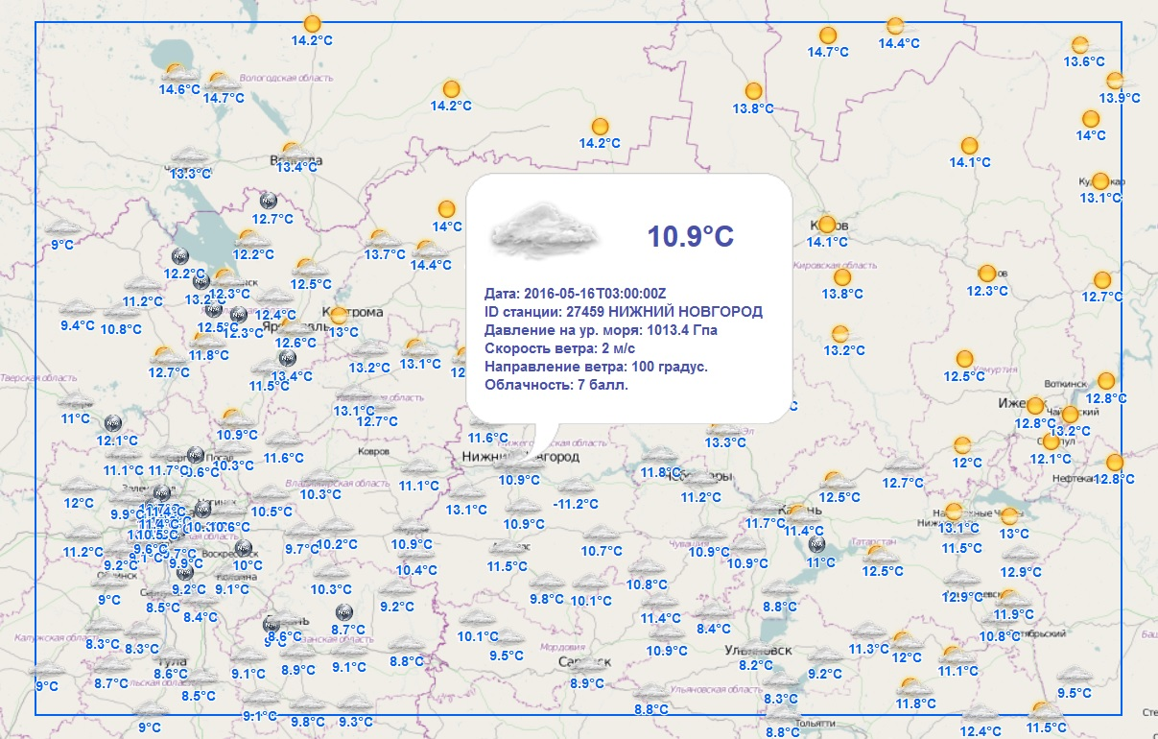
Картографическое представление (карта погоды)

Slide 20
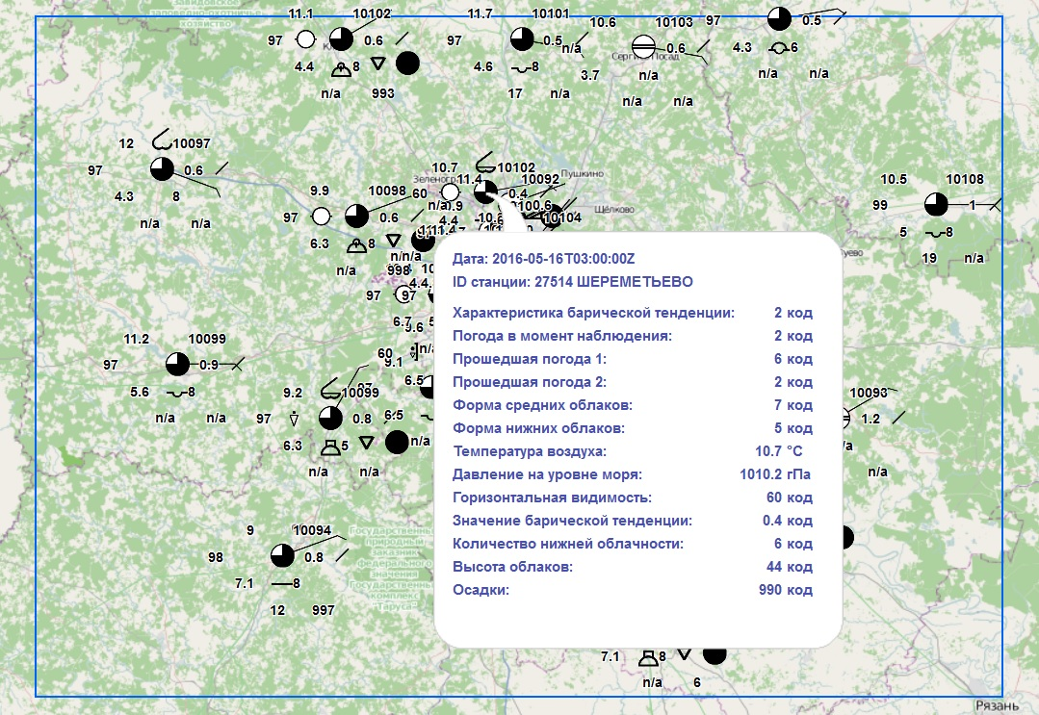
Картографическое представление. (карта кольцовка)

Slide 21
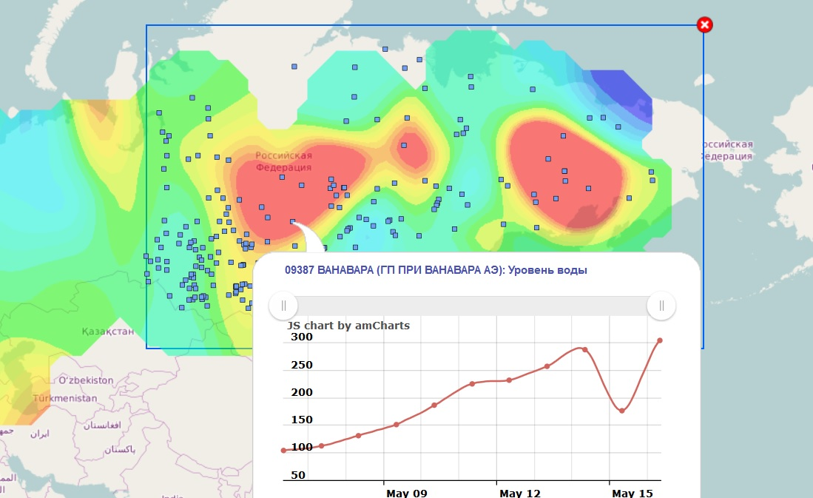
Картографическое представление. (гидрология)
Цвет отражает изменение уровня за сутки

Slide 22
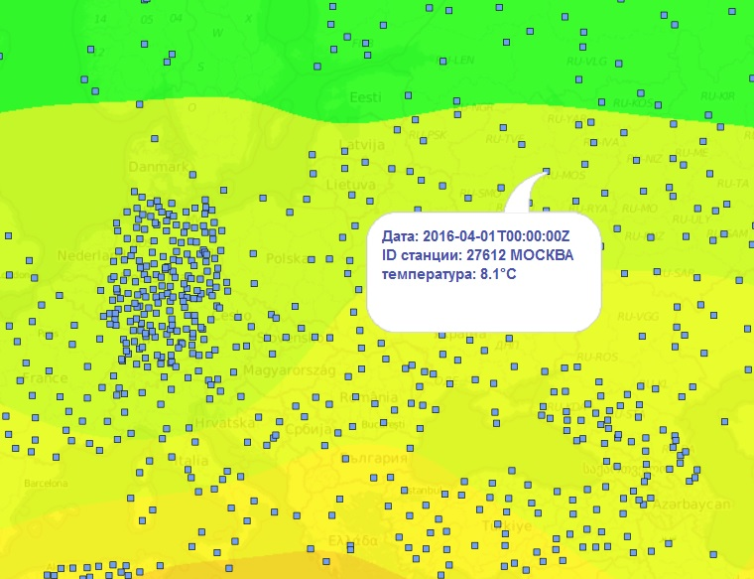
Картографическое представление. (карта средней температуры по телеграммам CLIMAT)
Цвет отражает среднюю температуру воздуха за месяц

