Slide 1
Lao PDR
Dr. Mayphou MAHACHALEUN
Deputy of Climate and Agro-meteorological Division
Mobile phone: +856(20) 5566 2565
Email: mayphou@gmail.com,
mayphou66@yahoo.com
RA II WIGOS Workshop
6-8 November 2018, Beijing, China

Slide 2
Outline
Introduction to the country and the NMHS
Current status of DMH’s Facilities
National requirements for observations
Summary

Slide 3
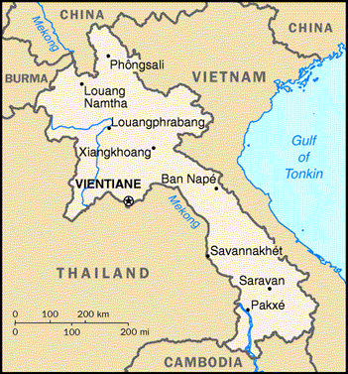
Introduction to the country and the NMHS
overview of the country:
The Lao People’s Democratic Republic
(Lao PDR) is the only landlocked
country in Southeast Asia. The capital is Vientiane (Lao: Viangchan), located on the Mekong River in the northern portion of the country.
The land area covers 236 800 km2,
of which more than 80 percent is mountainous.
Population: 6.758 million (2016).
The Lao PDR is border stretches:
Myanmar 235 km, Cambodia 541 km, the PR China 423 km, Thailand 1,754 km, Vietnam 2,130 km

Slide 4
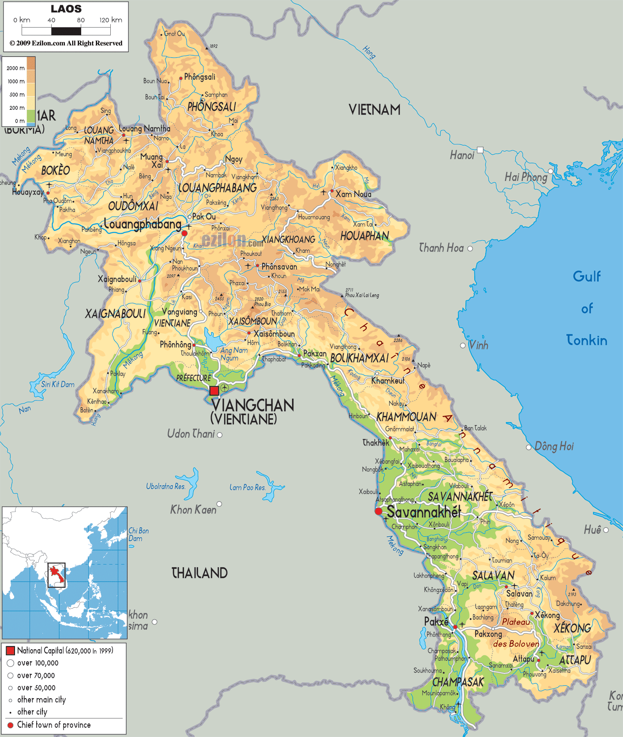
Introduction to the country and the NMHS
Area: total: 236,800 km² land: 230,800 km² water: 6,000 km²
Elevation extremes: lowest point: Mekong River 70 m highest point: Phou Bia 2,817 m
List of mountains in Laos
Phou Bia, 2,817 m
Phu Xai Lai Leng, 2,720 m
Rao Co, 2,286 m
Phu Soi Dao, 2,120 m
Phou Khe, 2,079 m
Shiceng Dashan, 1,830 m
Dong Ap Bia, 937 m

Slide 5
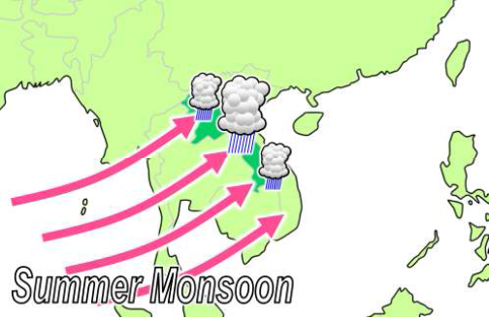
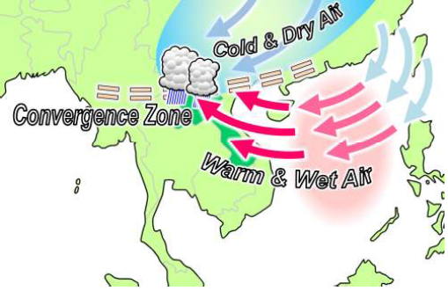
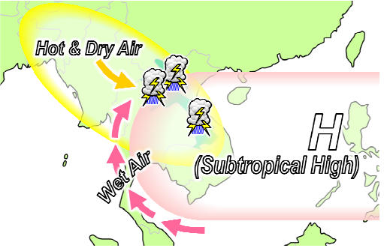
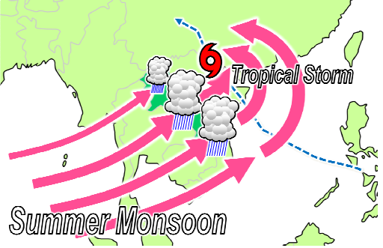
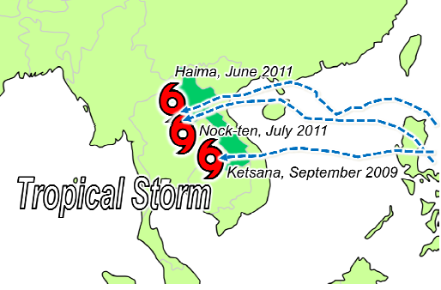
Introduction to the country and the NMHS
Climate characteristics in Lao PDR
Laos has the typical tropical monsoon (wet-dry) climate of the region, though the mountains provide some variations in temperature. During the rainy season (May to October), the winds of the southwest monsoon deposit an average rainfall of 1,300 to 2,300 mm, with totals reaching some 4,100 mm on the Bolovens Plateau. The dry season November to April is dominated by the northeast monsoon. Minimum temperatures average between 16 and 21 °C in the cool months of December through February, increasing to highs of more than (32 °C) in March and April, just before the start of the rains. In the wet season the average temperature is (27 °C).
Mar, Apr
May, Jun, Jul, Aug, Sep, Oct
Jan, Feb, Nov, Dec
Indirect impact
Direct impact

Slide 6
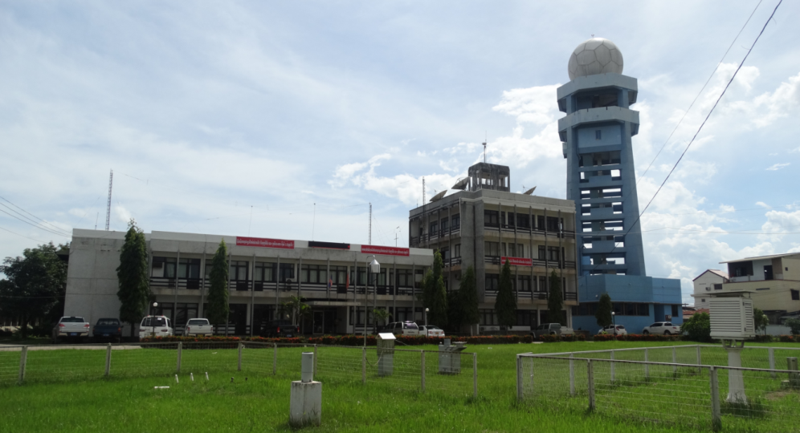
introduction to the NMHS
The Department of Meteorology and Hydrology of Lao PDR (DMH) is a governmental department under Ministry of Natural Resources and Environment (MONRE), it is responsible for the collection and analysis of hydro-meteorological data and the provision of water supply conditions, weather forecasts, and issuing early warnings.

Slide 7
DMH’s Key Functional Services
Governmental Department under Ministry of Natural Resources and Environment (MONRE)
Provide Meteorological services
Permanent Representative (PR) of Lao PDR to WMO
Provide Hydrological Services
Provide Seismological information & Services
Issuing the Early Warning
Develop Curriculum on Hydro-met (Training)
For Protection, mitigation and reduction lost of life and properties of the people from the impacts from disastrous

Slide 8
DMH Structure Chart
Ministry of Natural Resources and Environment (MONRE)
Department of Meteorology and Hydrology
Climate and Agro-met Div
General affairs Div
Provincial Hydro-met Station
Hydrology Div
Staff Member
Meteo-Network and Earthquake Div
Head Quarter: Total 74 prs , woman: 27
Volunteer: 3 prs , woman 1
Weather Forecasting Div
Ph.D: 2, Master: 9, Bachelor: 29, High Diploma: 13, Technician: 18
Aeronautical Div
In 17 Provinces: 162 prs. Woman 114 prs.

Slide 9
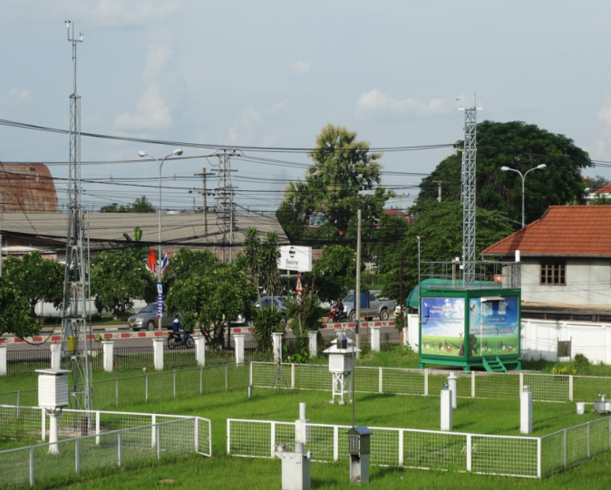
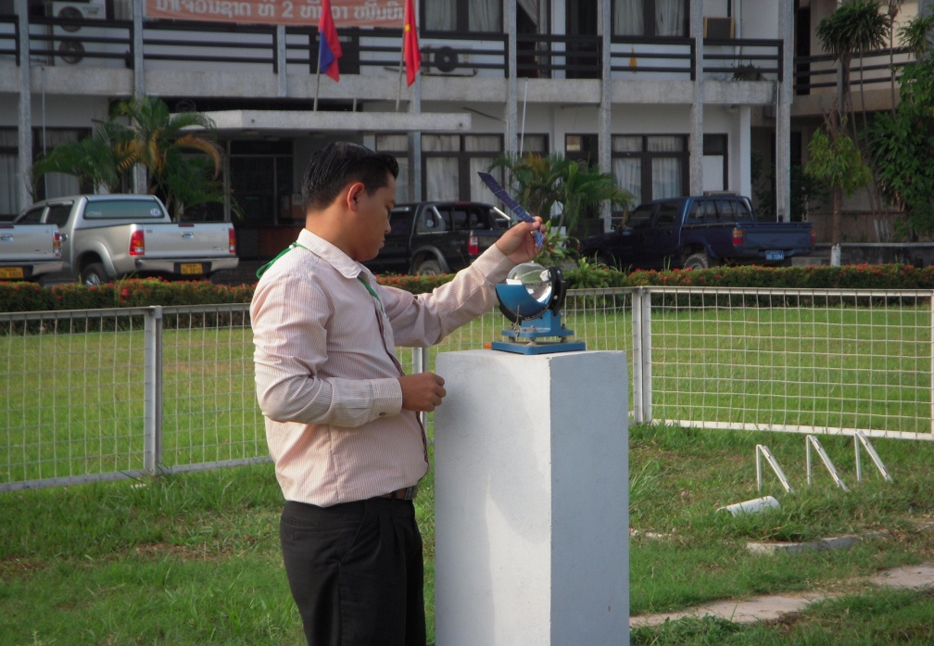
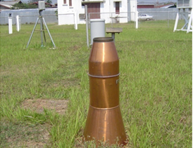
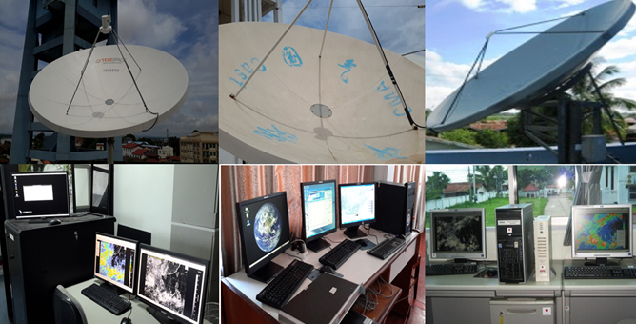
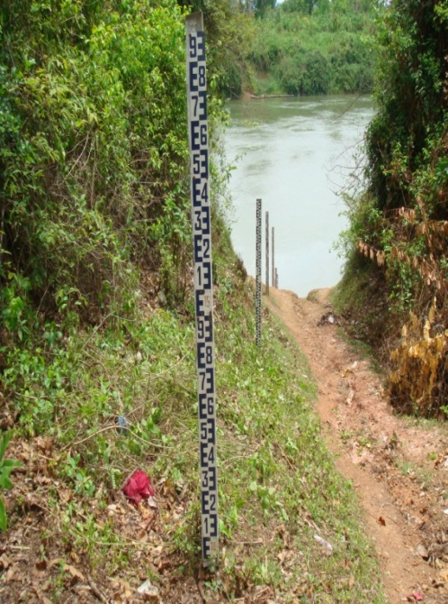
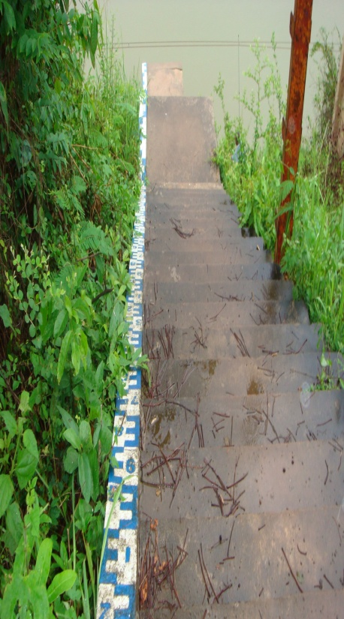
Current status of DMH’s Facilities

Slide 10
DMH’s Vision
Professional in providing meteorological, hydrological, earthquake, environment and climate services in support of safety and sustainable development of the Lao community;
Highly competent in issuing hydro-met warning to reduce the loss of life and property during the severe weather occurred; and
Able to play an effective role in international and regional cooperation in the field of hydro-met services.

Slide 11
DMH’s Vision
Collect and exchange meteorological and hydrological data in accordance with WMO regulations for analysis, forecasting and warnings to the public on hazardous weather;
Provide meteorological and hydrological data, information, forecasts and warnings to support activities of various sectors;
Understanding of the country's weather, climate and hydrological situation; and further strengthen researches for the advancement of meteorological and hydrological sciences;
Engage in international and regional cooperation in the fields of meteorology, including climatology, hydrology and seismology for the benefit of the nation;

Slide 12
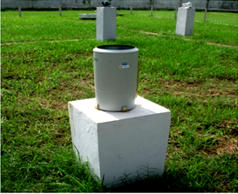
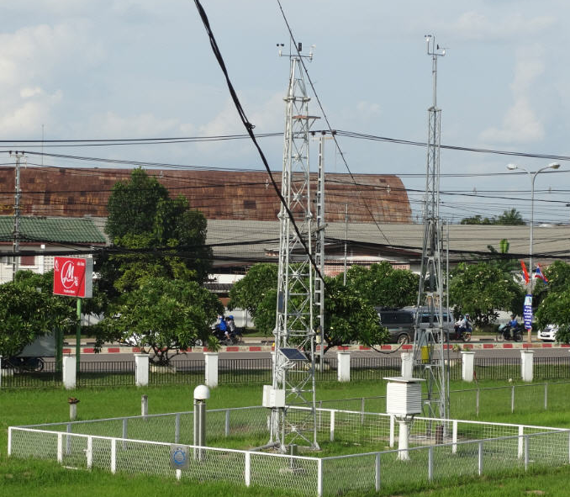
National requirements for observations
Meteorological Network: 51 stations
Hydrology Network: 86 station
Rain Gauge Network: 119 sites
Aero-Meteorological Station Network
10 Stations of the 51 stations are also services to aviation
Since 2016, upgraded to AWS
Projects: JICA: 18, WB: 16, ADB: 9

Slide 13
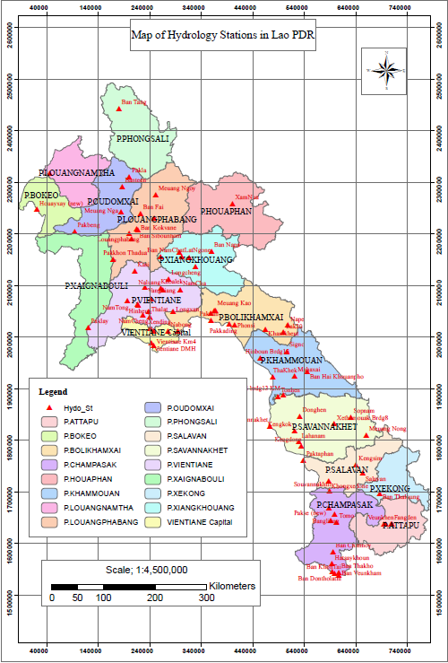
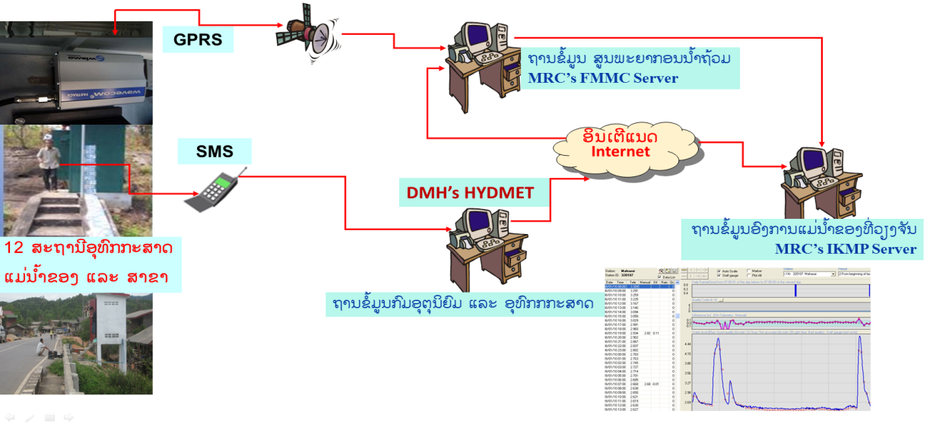
Hydrology Network: 86 station
Manual Type
Upgraded to AWL

Slide 14
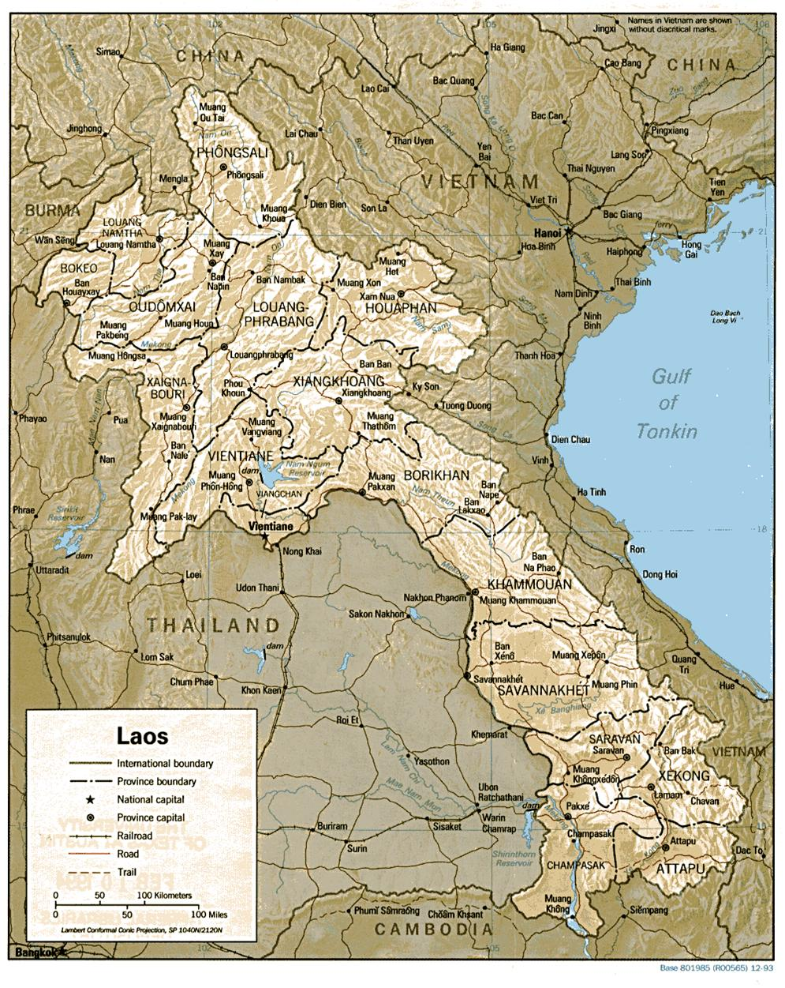
Seismic Station Network
China
Station 1: LuangPrabang
Latitude : Longitude: Elevation
19º54’ N 102º09’ E 305m
Vietnam
Myanmar
Lao P.D.R
V
i
e
t
n
a
m
L
a
o
P
D
R
Station 2: Lak Sao
Latitude : Longitude: Elevation
18º12’ N 104º59’ E 522m
Thailand
Data Center: DMH Vientiane
Latitude : Longitude: Elevation
17º57’ N 102º40’ E 171m
Cambodia

Slide 15
Data management
Data terminal (at the DMH)
Data storage, Databases (HydMet, MC-Excel, HYMOS vers 4.50 ),
Data quality checking
Analyzing and validation
Hydrologic yearbook
Data display

Slide 16
Hydro-Meteorological data collection system
Dial-Up
Via Modem
Phone
Line
GTS Network
R.A. II RTH
Bang Kok
Internet
WMO Centers’ Website,USGS, NOAA
MTSAT; CMACAT, COMS!
Satellite
128kbps FTP
TCP / IP
Provincial Services of Meteorology and Hydrology
DMH’s Telecommunication Center
Doppler
Weather
RADAR
SSB Radio
SMS
Early Warning center Weather Forecast Division
District Meteorological and Hydrological Stations
Hydrological Division(Flood Forecasting Unit)

Slide 17
Forecast information & Early Warning Dissemination system
Department of Meteorology & Hydrology
http://www.dmh.gov.la
WMO TC,NOAA
GTS Network
MRC
LNMC
Prime Minister’s Office
MAF
Mass Media TV Radio News Paper
Provincial Hydro – Meteo Stations
Provincial TV Radio
MoNRE
Aviation.
Intl. Airport
NDMC ( NDMO) Line ministries concerned
Local Authorities
Electricity Hydro– power
Provincial Agriculture and Forestry Services
PDMC
People in affecting areas
MEM
DDMC
Districts & villages affected areas
Line Ministry Concern
Village Disaster Prevention

Slide 18
Summary of national observing capabilities
DMH 2016-2020 Priorities
Training and capacity building in support of the modernization actions and human resource renewal of DMH.
Continued modernization of the observing network for remaining river basins.
Improved models for forecasting of serve weather and floods.
Strengthened capacity for longer term prediction of droughts and extreme weather related to climate change.
Continued operation of the observing and forecast services in support of the aviation, hydropower, and resource sectors.

Slide 19
Urgent needs
To fulfil its mandates and to respond the increasing national demands for services delivery as well as to cope with WMO strategic thrust and recommended framework, DMH Lao PDR has to rely on external resources , such as ODA from funding organizations, bilateral assistance from development partners and neighboring countries, to upgrade technical facilities :
Data Communication Link via satellite for sharing data and early warnings with other neighboring countries;
Assistance and Lesson learnt from internationalities on techniques and setting-up National Early Warning Systems, including floods, drought, extreme weather and seasonal climate prediction and longer-term projection;

Slide 20
Thank you for your attention
maypou@gmail.com

