Slide 1

Japan
Submitted by
Yoshihiko TAHARA
RA II WIGOS Workshop
6-8 November 2018, Beijing, China

Slide 2
Outline
Introduction of Japan and JMA
National requirements for observations
Summary of national observing capabilities
Status of national implementation of WIGOS

Slide 3




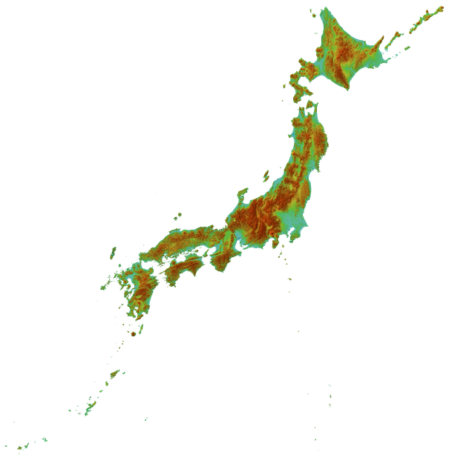
Introduction of Japan
Population: ~126,000,000
Physical context: 378,000 km²
  Four main islands,
  more than 6,000 small islands
  About three-fourths of Japan
  is covered by mountains
  111 active volcanoes
Climate:
  Four distinct seasons with a climate ranging from subarctic in the north to subtropical in the south.
  The rainy season “Baiu” in Early summer
  Tropical cyclones “Typhoon” approaching Japan from Aug. to Oct
  Heavy snow on the Sea of Japan side in winter

Slide 4
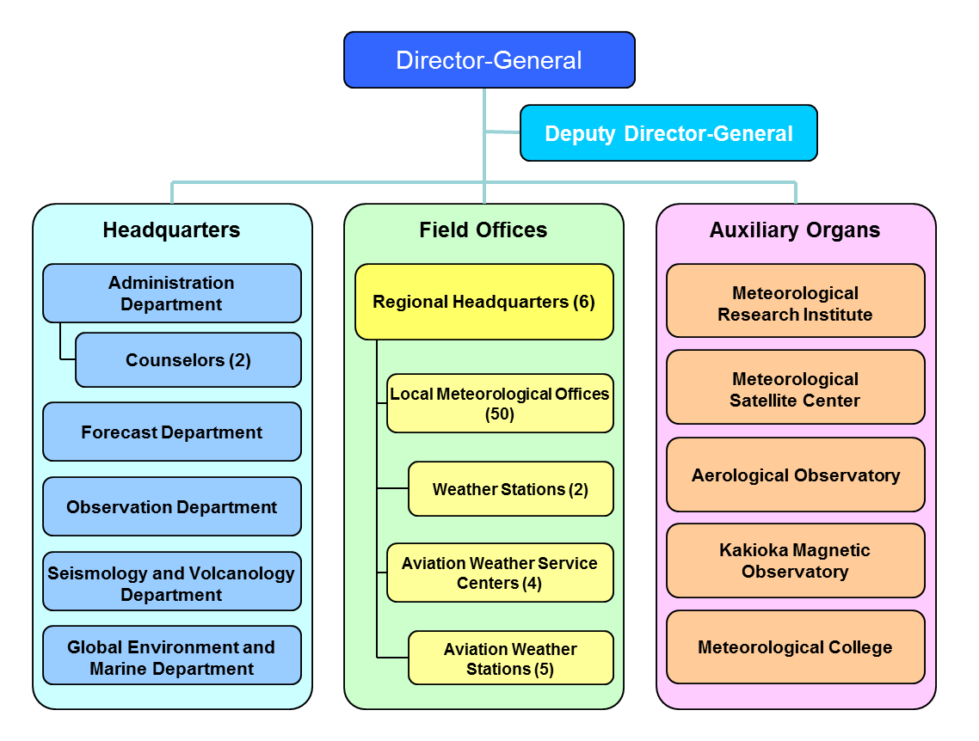


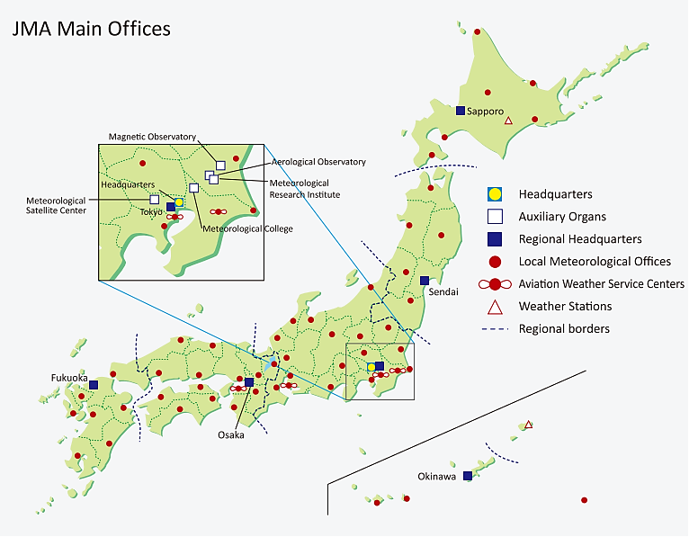
Intro. of JMA
Staff: ~5000
Mascot “Harerun”

Slide 5



National Requirements for Observations
In compliance with “the Meteorological Service Act”, JMA implements its services with the following ultimate goals (Article 1).
Prevention and mitigation
of natural disasters
Safety of transportation
Provide daily/monthly forecasts and warnings/Advisories for
- Preparation for disasters
- Evacuation
- Risk management
Provide meteorological information to
- Pilot and airline companies
- Road administrators
- Train companies
Development and prosperity of industry
International cooperation
Provide weather forecasts and climatological data to
- Energy companies
- Agriculture
- Other industries
- International data exchange
- Technical support
- Sharing disaster information
- Collaboration to develop technics
Article 3 The Director-General of JMA shall, … , endeavor to carry out the following:
Establishing and maintaining observation networks concerning meteorological phenomena, earthquakes, and volcanic phenomena;
Article 4 JMA shall, when performing observations of meteorological phenomena, …, and hydrological phenomena, do so in compliance with the methods specified by Ordinance of the Ministry of Land, Infrastructure, Transport and Tourism.

Slide 6
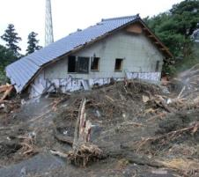
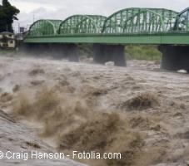
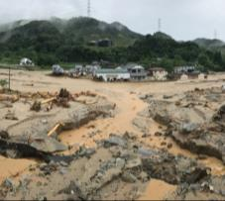
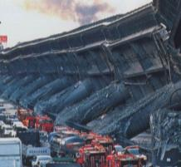
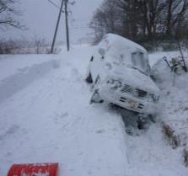
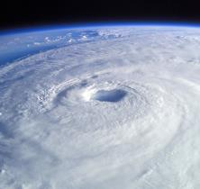
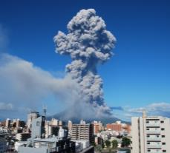
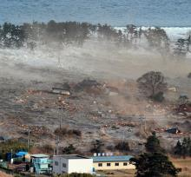
National Requirements for Observations
Diversity of Disasters in Japan
Japan is exposed to the risk of various disasters.
Even recently, there are still many disasters that cause serious damages.
The possibility of increase in frequency and intensity of extreme precipitation is indicated in mid-latitudes because of global warming.
Heavy Rain
Flood
Landslide
Earthquake
Lightning
Tornado
Multi-hazard
in Japan
Tsunami
Heavy Snow
Volcano
Typhoon
High Wave
Storm Surge

Slide 7
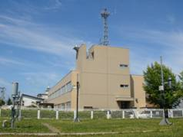
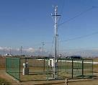

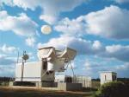

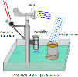
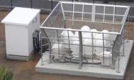

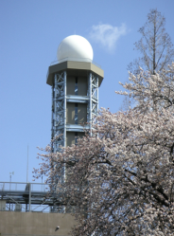

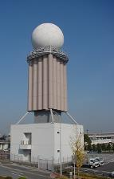

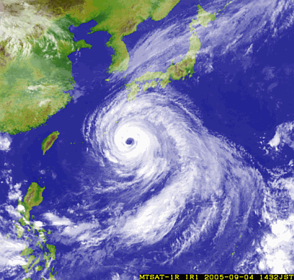

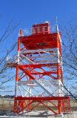


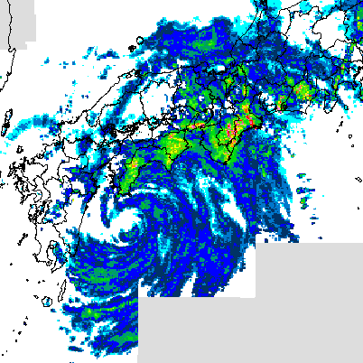
Summary of National Observing Capabilities
Weather Observation Systems of JMA
Surface Observation
at Observatories and Automated Weather Stations
Upper-air Observation
using Radiosondes and Wind Profilers
Weather Radar Observation
Geostationary Satellite Observation
Observation for Civil Aviation

Slide 8
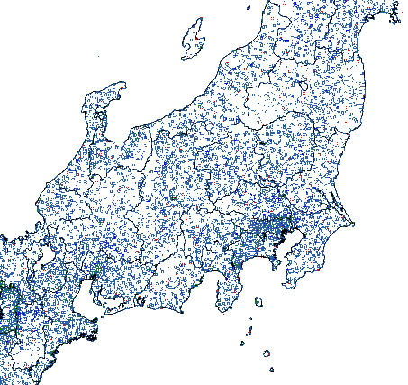
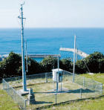
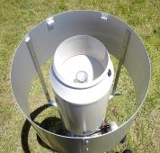
Nationwide Rain-gauge Network
JMA actively exchanges observational data with relevant central governmental and local authorities on a real-time basis.
□ Approx. 1,300 JMA
□ Approx. 3,500 MLIT (Ministry of Land, Infrastructure, Transport and Tourism)
□ Approx. 5,800 Local Government
400 km
Notes:
JMA collect rain gauge data from Government, and local government.
MLIT is one of the Ministries of government. The initial of Ministry of Land , Infrastructure, Transport and Tourism.
MLIT has about 3500 rain gauge station.
Local Governments have about 5800 rain gauge stations totally.

Slide 9
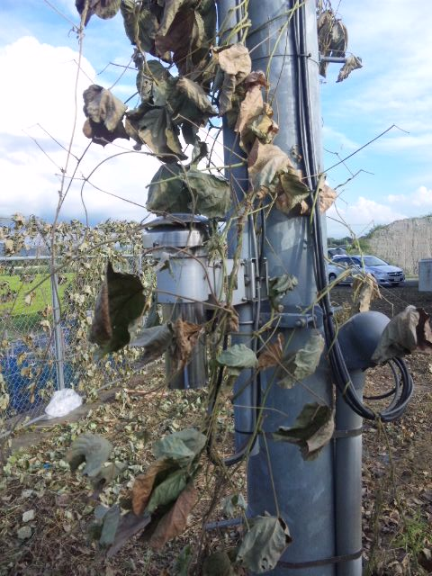
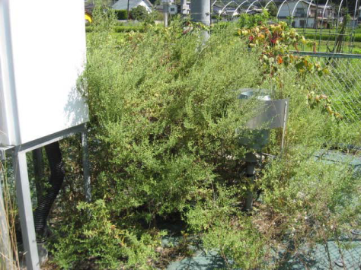
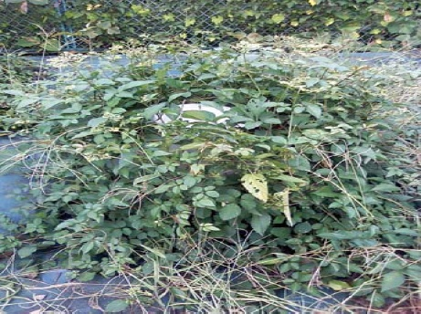
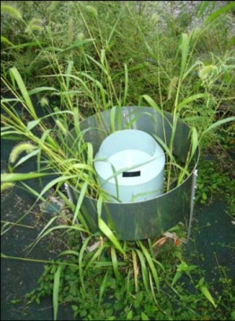
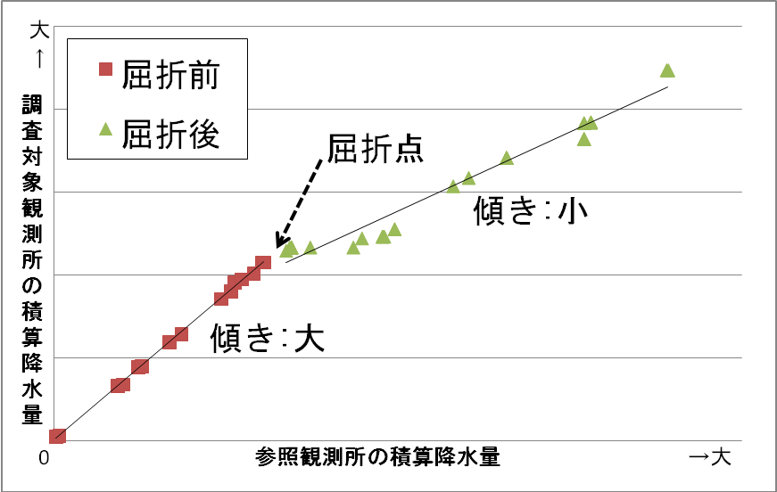
Summary of National Observing Capabilities
Yomiuri Shimbun Newspaper (9 September 2010)
Ivied thermometer
The daily highest temperature
Rain-gauges covered with weed
Before
Difference from regional average
After
Breakpoint
Total rainfall at examined station
Gradient: Small
Ave. 1.68
Ave. 0.32
Gradient: Large
Date
Total rainfall at reference station
rain-gauge examination

Slide 10
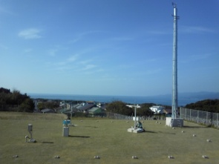
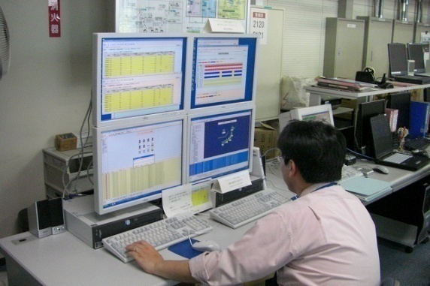
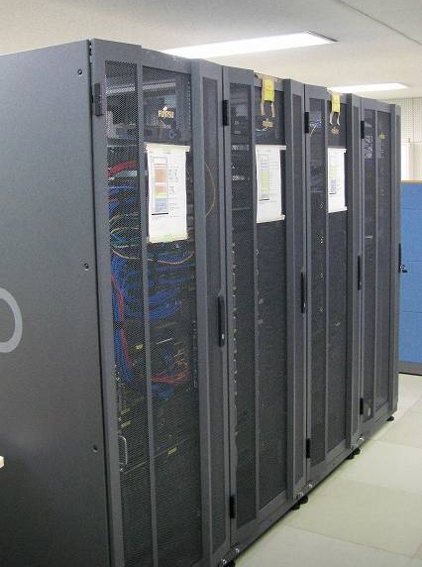
Summary of National Observing Capabilities
AWS（Instruments）
Trouble shooting !
AQC
DATA
QC information
(House Keeping information)
Center Systems（Servers）
QC information
Basic AQC
Advanced AQC
OPERATORS
HQC
OPERATION
DATA
USERS

Slide 11

Summary of National Observing Capabilities
Organizational frameworks of Quality Control (QC) in JMA
JMA Headquarter
Project overall strategy
Develop and improve AQC/HQC system
Give guidance to Regional Headquarters
Regional Headquarters
Evaluate results of AQC/HQC by LMOs
Give guidance to LMOs
Local Meteorological Offices (LMO)
Conduct HQC
Trouble-shoot based on AQC, HQC and HK results
Conduct periodical maintenance
Maintain observation environment
Give guidance to partner organizations
HK (House Keeping) information: operational status of instrument
Partner organizations

Slide 12
Status of National Implementation of WIGOS
Regular maintenance at manned meteorological observatory
Interval | Check Items for manned station
Daily | checking data quality inspecting the condition of observation fields and instruments
Weekly | checking hardware clocks cleaning the glass shield of pyranometer
Monthly | checking silica gel (desiccant) of pyranometer
Three months | cleaning sensors and the covers of instruments checking DC power supplies checking silica gel (desiccant) of sunshine recorder
Six months | changing precipitation gauge, changing the filters of humidity sensors checking snow cover meter, checking inverter batteries
Annual | calibration for barometers and visibility sensors changing the sensors of wind vane and propeller anemometers checking for cables and anti-icing system
Five years | changing the motors and the rubber packings of shelter changing the lightning arresters changing the batteries

Slide 13





Status of National Implementation of WIGOS
Management of observation metadata
JMA
WMO
Meteorological
Satellites
OSCAR/Space
Weather Radars
WMO Radar Database
Wind Profilers
Radiosondes
OSCAR/Surface
Observatories &
Special AWSs
Marine Observation
JCOMMOPS
GAW Stations
GAWSIS

Slide 14

Thank you
y-tahara@met.kishou.go.jp

Slide 15
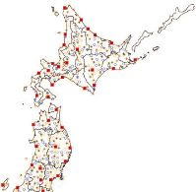
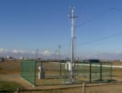

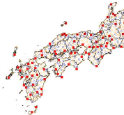



Summary of National Observing Capabilities
Automated Weather Station “AMeDAS”
AMeDAS (Automated Meteorological Data Acquisition System)
■ Observatories, Special AWS 156
〇 rainfall, temperature, wind, sunshine 686
〇 rainfall, temperature, wind 87
〇 rainfall 371
＋ snowfall 323
average interval (rain gauges): 17 km
About 1300
rain gauges
Automated Weather Station
Observatory
Backup System
(Osaka)
AMeDAS Center System
(System Op. Center, Kiyose)
TCP/IP
Each observatory and station link AMeDAS center system on TCP/IP network.
Data is collected on real-time, and quality controlled.
Rain gauges monitored by JMA:
Approx. 1,300 JMA
Approx. 3,500 MLIT (Ministry of Land, Infrastructure, Transport and Tourism)
Approx. 5,800 Local Governments
0
AMeDAS Center System
100
300km
Main System
(System Op. Center, Kiyose)
Backup System
(Osaka)

Slide 16
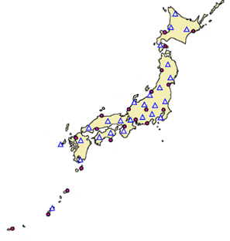
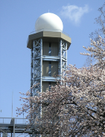

Summary of national observing capabilities
Weather Radar Network
C-band Radars
● JMA C-Band: 20
△ MLIT C-Band: 26
Precipitation and Wind
Observation
Every 5 min.
Sapporo
Kushiro
Hakodate
Doppler Radars (20)
Radar Coverage
Akita
Niigata
Sendai
Fukui
Nagano
Tokyo
Matsue
Nagoya
Hiroshima
Shizuoka
Fukuoka
Osaka
C-band Radar echo data (JMA, MLIT) are collected to the center system and integrated into a nationwide echo intensity composite map
( every 5 minutes )
Murotomisaki
Tanegashima
Naze
Tokyo Radar
Domestic Core Network
(TCP/IP)
Okinawa
Operation Center
(HQ, Tokyo)
Ishigakijima
Backup System
(Osaka)

Slide 17
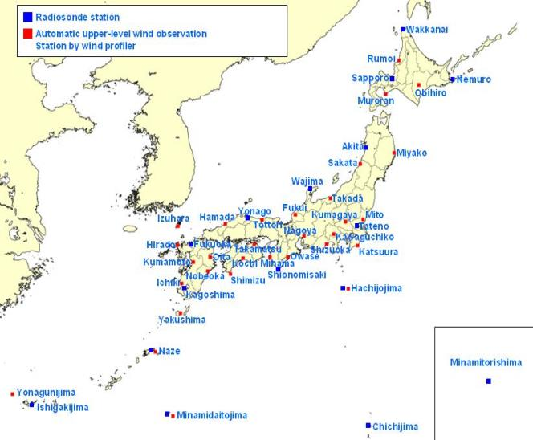

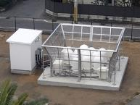
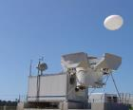
Summary of national observing capabilities
Upper-air Observation Network
■ Radiosonde Station 16
Temperature, Humidity, Wind, Pressure observation twice a day.
Average interval: 350 km
Half of them are ABL (Automatic Balloon Launcher) stations
■ Wind Profiler 33
Automated upper-level wind observation every 10 min.
Average interval: 110 km
Kushiro
■
Radiosonde
■Sendai
■Wakamatsu
Matsue
0
100
300km
L-band Wind Profiler Radar Every 10 min.
Automatic Balloon Launcher (8)

Slide 18
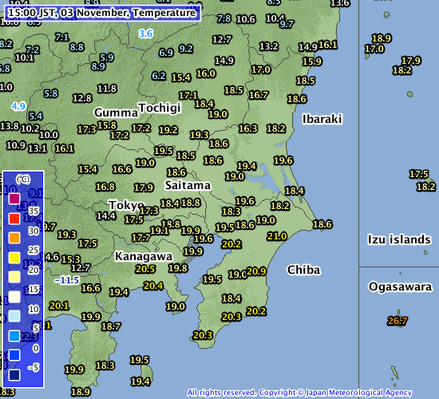
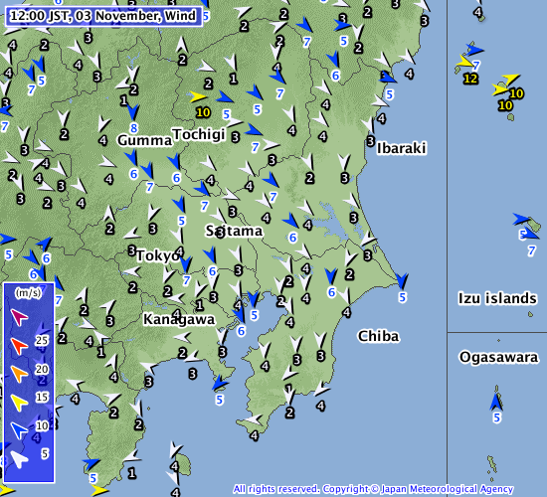
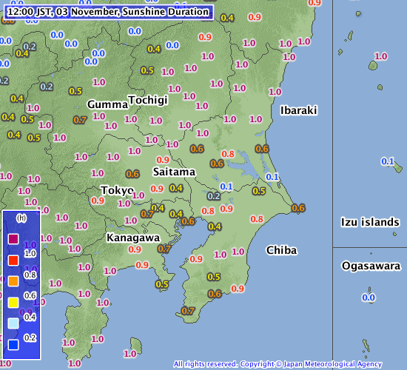
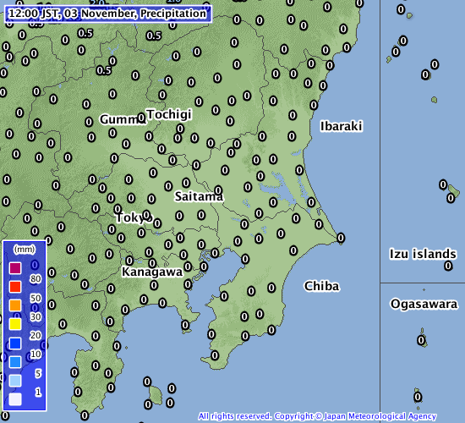
Real-time Data Browse via JMA Website
Temperature
Wind
Tokyo
0
20
40
60
80
100km
Sunshine duration
Precipitation
(JMA Website)
http://www.jma.go.jp/en/amedas

Slide 19
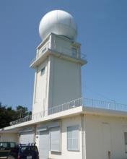
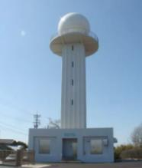
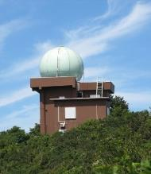
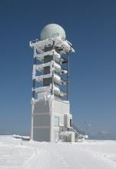
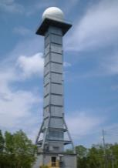
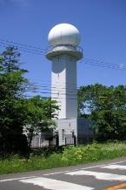














Matsue
Fukui
Niigata
Hakodate
Sapporo
Kushiro
Weather Radar Observation
Fukuoka
Osaka
Hiroshima
Nagoya
Nagano
Sendai
Akita
Ishigakijima
Okinawa
Naze
Tanegashima
Murotomisaki
Shizuoka
Tokyo

Slide 20























Nationwide Radar Composite Maps
C-band Radars
● JMA C-Band: 20
△ MLIT C-Band: 26
for Monitoring / Nowcasting
Quantitative Precipitation
Estimation / Forecast (QPE/QPF) etc.
C-band Radar echo data (JMA, MLIT) are collected to the center system and integrated into a nationwide echo intensity composite map
( every 5 minutes )
MLIT: Ministry of Land, Infrastructure, Transport and Tourism

Slide 21





High Resolution Precipitation Nowcasts
short-range precipitation intensity predictions with a spatial resolution of 250 m
derived from weather radar data and other types of meteorological information
JMA radars replaced with units featuring a 250-m radial resolution (offering twice as much detail as before) until 2014 for improved observation of local downpours
Involves the use of data such as rain gauges, wind profilers, radiosondes and MLIT-XRAIN radars
Forecasts of precipitation intensity distribution with a spatial resolution of 250 m covering the period up to 30 minutes ahead
20 JMA Radars (C-band)
High Resolution Precipitation Nowcasts
Provision of effective information for disaster prevention
Rain gauges
38 MLIT-XRAIN Radars (X-band)
(JMA Web page)
http://www.jma.go.jp/en/highresorad/
Rain gauges:
Approx. 1,300 JMA
Approx. 3,500 MLIT (Ministry of Land, Infrastructure, Transport and Tourism)
Approx. 5,800 Local Governments
MLIT: Ministry of Land, Infrastructure, Transport and Tourism

Slide 22





Detection of “meso-cyclones” using Doppler Radars
Radial-wind component
2013/09/02 14:20JST Tokyo-radar
Detection of meso-cyclones
A strongly-localized pair of
receding winds (warm color) and approaching winds (cold color)
Receding winds
Approaching winds
Potentially tornado-generating vortex
(meso-cyclones)
tornadoes
Echo intensity
2013/09/02 14:20JST Tokyo-radar
Doppler Weather Radar
Detection of the potential outbreak area of tornadoes/gusts using radar observation data and numerical prediction results
Provision of effective information on the risk of tornado outbreaks
“Hook”-shaped echo
(JMA Web page)
http://www.jma.go.jp/en/highresorad/

Slide 23
















JMA’s Radiosonde Stations
MBL (Manned Balloon Launching)
MBL (Manned Balloon Launching)
Wakkanai
Sapporo
Akita
Aerological
Observatory
Fukuoka
Kagoshima
Chichijima
ABL (Automatic Balloon Launcher)
Minamitorishima
Kushiro
Shionomisaki
Wajima
Hachijojima
Matsue
Naze
Ishigakijima
Minamidaitojima

Slide 24





Observation by Radar Wind Profilers
Radiated Electric wave is scattered by turbulent density of atmosphere.
Air Flow
Upper Air Wind
Antenna
L-band(1.3GHz) Transceiver
Scattered Electric Wave
Doppler shifted
Radiated Electric Wave
Kumagaya (36.15N, 139.38E) alt.30m
Antenna with snow dome
Altitude (km)
W
N
E
S
1.3 GHz Electric wave (5 beams) radiated from Radar Wind Profiler is scattered by turbulent density of atmosphere.
Air flow (velocity) is calculated from Doppler shifted reflective wave.
Vertical velocity
(upward)
Operation Center
(JMA Headquarters)
Local Time
(downward)

Slide 25


































WINDAS (Wind Profiler Network and Data Acquisition System)
Rumoi
Obihiro
Muroran
Miyako
Sakata
Takada
Sendai
Wakamatsu
Fukui
Kumagaya
Mito
Nagoya
Kawaguchiko
Shizuoka
Operation Center
Owase
Katsuura
Hachijojima
Tottori
Hamada
Mihama
Izuhara
Ohita
Hirado
Kumamoto
Nobeoka
Ichiki
Yakushima
Takamatsu
Kouchi
Shimizu
Naze
Yonagunijima
Minamidaitojima

Slide 26







Weather Observation for Civil Aviation
Observation by
Person and Instruments
JMA provides users
(Airlines, ATC, ATM etc)
with observation data
from 89 airports
on the Internet.
Wind, Temp, Humidity Pressure, Ceiling, RVR, MOR, Rain Intensity etc. are reported as METAR/SPECI and 6sec. real-time data
Observation by JMA : 81 Airports
Observation by JSDF/USFJ: 8 Airports
This Map is issued by Japan Civil Aviation Bureau.

Slide 27






Wakkanai
Aviation Weather Observation Integrated Processing System
(DRAW, LIDAR & LIDEN)
Memanbetsu
Shin-Chitose
Kushiro
Okushiri
Aomori
Akita
Hanamaki
Monitoring Center (H.Q., Tokyo)
Niigata
C-band Transceiver
For Wind and Precipitation
Near Infrared Transceiver
For Wind
VHF, LF Reciever
For Lightning
Fukushima
Toyama
Kiyose
Narita
Backup Center (Osaka)
Tottori
Matsumoto
Yamaguchi-Ube
Osaka
Cyubu
Tokyo Haneda
Takamatsu
Kansai
Oshima
Iki
Fukuoka
Kouchi
Nanki Shirahama
Oshima
Kagoshima
Miyazaki
DRAW+LIDAR 3
DRAW only 6
LIDEN 30
Data Centers
Main Center (Kiyose, Tokyo)
Tanegashima
Amami
Kumejima
DRAW: Doppler Radar for Airport Weather (TDWR)
LIDAR: Light Detection and Ranging
LIDEN: Lightning Detection Network System
Naha
Minamidaitou
Yonaguni
Miyako
Notes:
Finally, let me talk about aviation weather observation integrated processing system.
The system consists of Doppler radars for aviation weather, Doppler lidars, and a lightning detection network.
3 major airports in Japan are equipped with a Doppler radar and a lidar.
Other 6 important airports are equipped with a Doppler radar.
Lightning detection stations are located at 30 airports.
(office)
All these observation stations are controlled from here.
(LIDARの説明）
LIDAR is basically the same as normal weather radars.
But the wavelength is different.
Normal radars use the approximately 5 cm wavelength, while lidars use the approximately 2 μm.
It means that the target is different.
Rader’s taget is water particle, while lidar’s target is aerosol such as dust in the air.
We use the radar when it’s rainy, and we use the lidar when it‘s sunny.

Slide 28






Wind Shear Observation in All Weather Conditions
JMA provides low-level wind shear
and microburst alerts
in all weather conditions.
Cancel Landing
Active Convection
Cloud
Pilots receive Low-level Wind Shear Alerts
from ATC
and cancel Landing
Normal Landing Path
Microburst
Crash
0837 34LA MBA 39kt- 1nm FNL
0837 34LA SLA 25kt+ 3nm FNL
If the airplane could not avoid the microburst,
it would be smashed into the ground
due to the sudden decrease of lifting power.
ATC Tower
Microburst
divergence
Shear Line
convergence
All Weather
Observation
Doppler LIDAR detects
low-level wind shears
in Sunny or Cloudy condition.
DRAW (TDWR) detects low-level wind shears
in Rainy condition.
DRAW: Doppler Radar for Airport Weather (a Japanese version of a TDWR)
LIDAR: Light Detection and Ranging
Notes:
A Doppler radar for aviation weather can detect microbursts and sheer lines.
When it detects such phenomena in arrival or departure areas, it automatically issues an alert message.
The message appears on the display of the air traffic controllers, who immediately the message to the pilots.
A Doppler lidar can detect low-level wind sheer in non-precipitating conditions, while a radar is useful in precipitating area.

