Slide 1
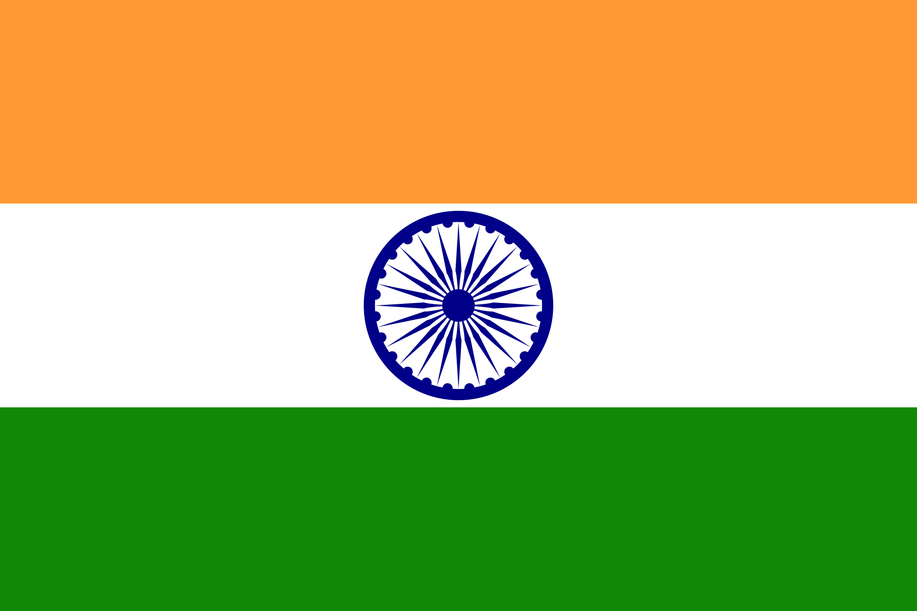
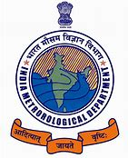
National WIGOS Implementation Plan
by
SANKAR NATH, INDIA
NATIONAL FOCAL POINT FOR OSCAR/SURFACE,
CODES AND DATA RELATED MATTER
RA II WIGOS Workshop
6-8 November 2018, Beijing, China

Slide 2
Outline
Introduction to the country and the NMHS
Physical context of the country
National requirements for observations
Summary of national observing capabilities
Status of National implementation of WIGOS
Challenges

Slide 3
Introduction
India is one of the oldest civilizations in the world with a kaleidoscopic variety and rich cultural heritage. It has achieved all-round socio-economic progress during the last 65 years of its Independence.
India has become self-sufficient in agricultural production and is now one of the top industrialized countries in the world and one of the few nations to have gone into outer space to conquer nature for the benefit of the people.
Bounded by the Great Himalayas in the north, it stretches southwards and at the Tropic of Cancer, tapers off into the Indian Ocean between the Bay of Bengal on the east and the Arabian Sea on the west.
Lying entirely in the northern hemisphere,
the mainland extends between latitudes 8° 4' and 37° 6' north, longitudes 68° 7' and 97° 25' east .

Slide 4
Afghanistan and Pakistan to the north-west; China, Bhutan and Nepal to the north; Myanmar to the east; and Bangladesh to the east of West Bengal. Sri Lanka is separated from India by a narrow channel of sea, formed by Palk Strait and the Gulf of Mannar.
There are 29 states and 7 Union territories in the country. There are 718 Districts in India administered by their respective State/UT.
India's population, as on 1 March 2011 stood at 1,210,193,422 (623.7 million males and 586.4 million females)
The average annual exponential growth rate stands at 1.64 per cent during 2001-2011,
The climate of India can broadly be classified as a tropical monsoon one. But, in spite of much of the northern part of India lying beyond the tropical zone, the entire country has a tropical climate marked by relatively high temperatures and dry winters.

Slide 5
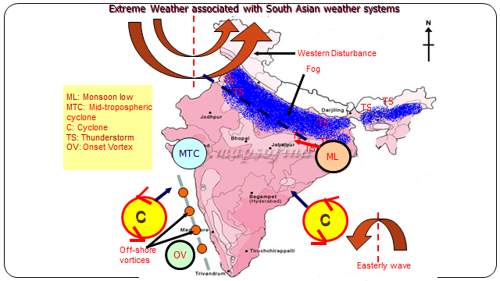
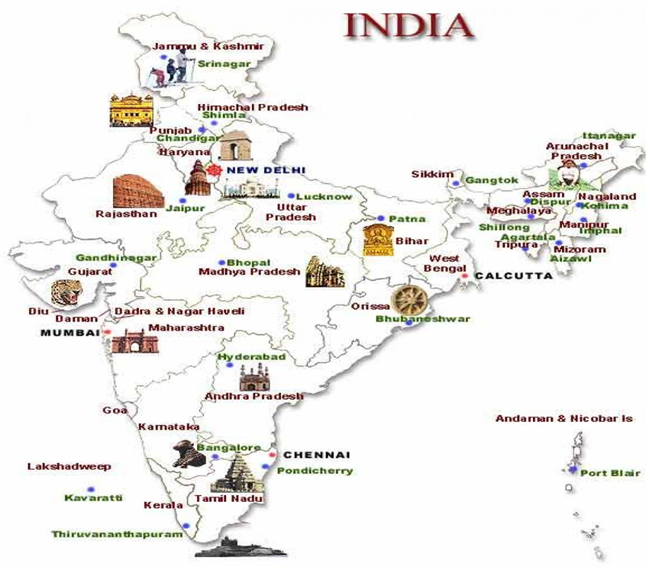
There are four seasons:
Winter (Jan-Feb) Western Disturbance, Cold Wave, Fog
Summer (March-May) Cyclonic Disturbances, Heat Wave, Thunder Storms, Squalls Hail Storm Tornado
South-West Monsoon season (June-September) SouthwestMonsoon Circulation Monsoon Disturbances
Post monsoon season (October-November) Northeast Monsoon Cyclonic Disturbances
India is characterized by strong temperature variations in different seasons ranging from mean temperature of about 10°C in winter to about 32 °C in summer season.
The annual rainfall 1182.8 mm.

Slide 7
INDIA METEOROLOGICAL DEPARTMENT-OVERVIEW
India Meteorological Department, Ministry of Earth Sciences is the National Meteorological Service of the country and the principal Government agency in all matters relating to Meteorology and allied discipline and provides weather and climate services to the public and specialized sectors.
A disastrous tropical cyclone struck Calcutta in 1864 and this was followed by failures of the monsoon rains in 1866 and 1871. In the year 1875, the Government of India established the India Meteorological Department, bringing all meteorological work in the country under a central authority.
From a modest beginning in 1875, IMD has progressively expanded its infrastructure for meteorological observations, communications, forecasting and weather services and it has achieved a parallel scientific growth.
The Director General of Meteorology is the Head of the of the India Meteorological Department, with headquarter at New Delhi. There are four Additional Director Generals.
For the convenience of administrative and technical control there are six Regional Meteorological centers at Delhi, Mumbai, Chennai, Kolkata, Guwahati and Nagpur.
The number of staffs are 4000 .

Slide 8
It’s mandate is:
To take meteorological observations and to provide current and forecast meteorological information for optimum operation of weather-sensitive activities like agriculture, irrigation, shipping, aviation, offshore oil explorations, etc.
To warn against severe weather phenomena like tropical cyclones, norwesters, duststorms, heavy rains and snow, cold and heat waves, etc., which cause destruction of life and property.
To provide meteorological statistics required for agriculture, water resource management, industries, oil exploration and other nation-building activities.
To conduct and promote research in meteorology and allied disciplines.
To detect and locate earthquakes and to evaluate seismicity in different parts of the country for development projects.

Slide 9
It covers an area of 32,87,263 sq. km, extending from the snow-covered Himalayan heights to the tropical rain forests of the south.
The Himalaya Range, Karakoram and Pir Panjal Range, Eastern Mountain Range or The Purvanchal Range, The Satpura and Vindhaya Range, The Aravalli Range, The Western Ghats, The Eastern Ghats.
The rivers of India can be classified into four groups viz., Himalayan rivers, Deccan rivers, Coastal rivers, and Rivers of the inland drainage basin. The main Himalayan river systems are those of the Indus and the Ganga-Brahmaputra-Meghna system.
Dal Lake, Surinsar Lake, Mansar Lake , Nainital Lake, Harirke Lake, Pushkar Lake, Chilika Lake
Coast The total length of the coastline of the mainland, Lakshadweep Islands and Andaman & Nicobar Islands is 7,516.6 km.

Slide 10
National requirements for observations

Slide 11
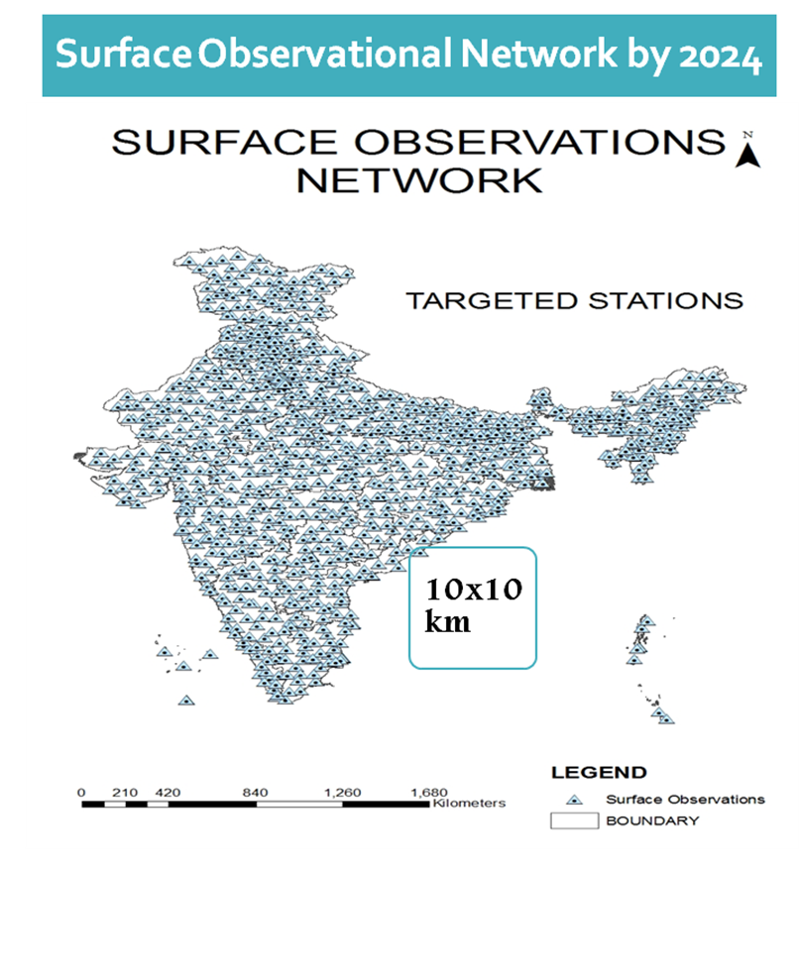
Summary of national observing capabilities

Slide 12
Upper Air Network
GUAN standard compatible RS/RW stations
Other GPS based stations
2018
2019-20 (77 GPS)

Slide 13
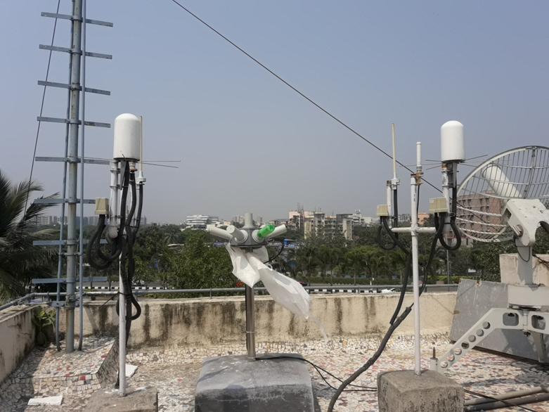

Slide 14
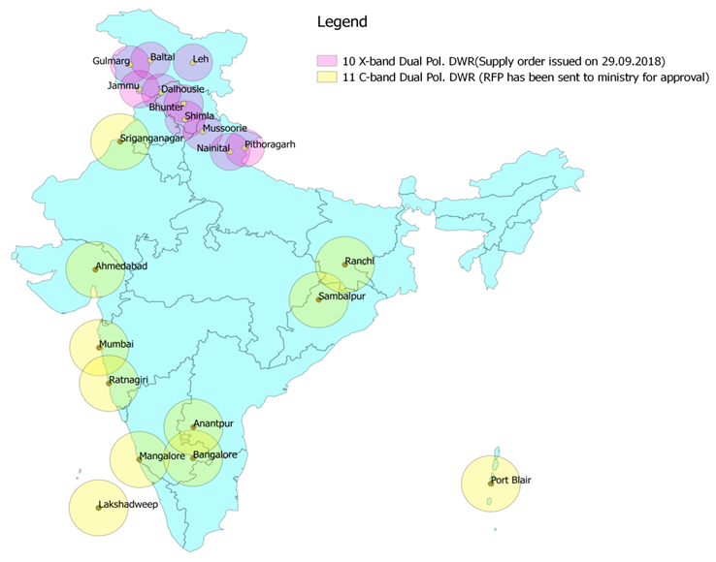
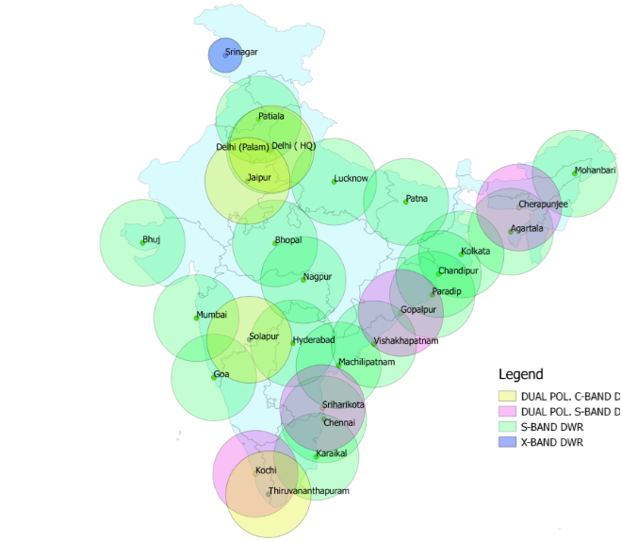
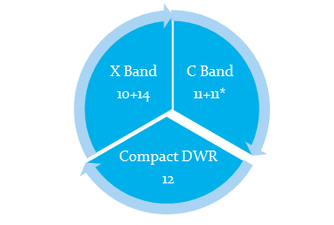
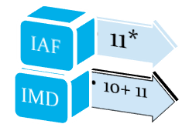
24 Nos. S-Band DWRs
02 Nos. C-Band DRWs
01 No X-Band DWRs
IAF

Slide 15
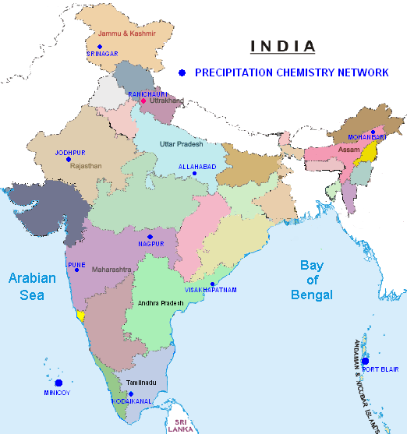
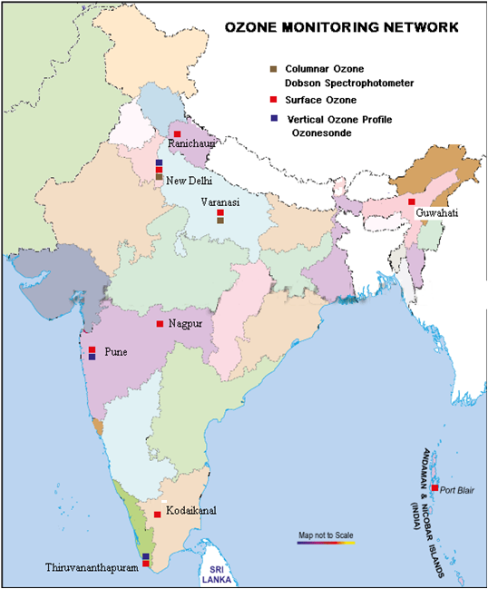
Environmental Monitoring and Research Services
Monitoring of Aerosol Optical Properties & Radiative Effects
Sky radiometer (20)
Black Carbon Monitoring (16+9*)
Nephelometer Stations (12)
Air Quality Modeling & Forecasting: Implementation of SILAM Model by October 2018.
Precipitation and Aerosol Chemistry Monitoring (11*)
Environmental Impact Assessment Project Evaluation
Ozone Monitoring
Total Columnar ozone (2)
Surface Ozone monitoring (7)
Vertical Distribution of Ozone (3)
Maitri and Bharati
*Expansion of network by November 2018.
PROPOSED PROGRAMMES
Climate Monitoring: Trace Gases CO, SO₂, NOx
Augmentation of Surface Ozone Network
Augmentation of Precipitation Chemistry Network (11→20)
Establishment of Fog Chemistry Network
Sky radiometer calibration facility & Infrastructure Development for Kodaikanal & Port Blair

Slide 16
Black Carbon Monitoring Stations (16+9)
Proposed +5 (2018-19)
16
25
30
12
20
30
IMD Sky radiometer Network (12+8*)
Proposed + 10 (2018-19)
* Completed. Presently 20 stations form the Sky Rad. Network

Slide 17
Lightning detection stations 200 (approx).
However, data frequency is every 2-minutes.

Slide 18
Under the network of observatories related to Agrometeorology, at present there are 263 Agromet observatories, 42 Evapotranspiration Stations, 43 Soil Moisture Stations and 76 Dew gauge stations in the country.
AMFUs will established in all districts of the country.
Agro-Meteorological Advisory Services (AAS): Agro Meteorological Advisory Services are disseminated under PPP mode and through Kisan Portal to 21.69 million farmers.
At present, there are two operational meteorological satellites; INSAT-3D & INSAT-3DR carrying 6 channel imager for imaging the earth in visible (0.55-0.75um),SWIR (1.55-1.70um) of resolution 1KmX1 Km, MIR (3.80-4.00um),TIR-1 (10.30-11.30um),TIR2(11.50-12.50um) of resolution 4KmX4Km and WV (6.50-7.10um) of resolution 8KmX 8Km. and 19 channel sounder consisting of 7 channels of LWIR (14.71-12.02um), 5 channels of MWIR (11.03-6.51um), 6 channels of SWIR (4.572-3.74um) and one channel of visible (0.695um) each of resolution 10X10 Km scan the atmosphere for derivation of profiles. INSAT-3D was launched on 26th July, 2013 and located at 82 degree east.
INSAT-3DR was launched on 08th September 2016 and is located at 74 degree east.
At Present 48 nos. of satellite passes are acquired daily from each INSAT-3D and INSAT3DR IMAGER payload, are being used in stager mode so that after every fifteen minutes a new set of images/ product become available to the forecasters

Slide 19
A network of 25 Nos Global Navigation Satellite System (GNSS) to derive Integrated Precipitable Water Vapor (IPWV) at the interval of 15minutes is operational which are made available to forecasters through website as monitoring of IPWV provide a guidance for nowcasting the weather and data generated by GNSS network is assimilated in NWP models.
NOAA/MODIS/ METOP Satellite data receiving and processing system at New Delhi, Chennai and Guwahati are used to receive and process the data of NOAA, METOP-A, Terra, Aqua and FY1 polar orbiting Satellites and derived level-1, level2 products and profiles are made available to forecasters through website for users.
SCATSAT data routed on GTS.
BY 2020-24 Establishments of Processing systems to receive, process, derivation of products from imager and sounder payloads data of INSAT 3DS, SCATSAT, OCEANOSAT-III.

Slide 20
Status of National implementation of WIGOS
India adopted the major satellite and ground based systems for global environmental observation for the atmosphere, the oceans and the land in a framework that delivers maximum benefit and effectiveness in their final use.
Data/Observations are sharing among most of the organization/ Research institute for better decisions in the allocation of their resources to meet their own priorities.
Meeting with Governments to improved the understanding of the need for global observations through the presentation of an overarching view of current system capabilities and limitations.
National WIGOS Implementation Plan adopted. Feedback on EGOG-IP(para C and G) Implementation action national level submitted 2017.
National WIGOS governance mechanism in place.
National WIGOS partnership agreements for integration and open-sharing of observations from NMHSs and non-NMHSs sources in place .

Slide 21
OSCAR/Surface being populated and updated with WIGOS metadata for which observations are exchanged internationally
505 land stations, 43 GPS Sonde, 58 sea (Mobile), 22 DWRs, 71 Aerodrome,21 GAW stations updated in OSCAR/Surface.
Most of the stations with basic metadata of reporting stations updated in OSCAR/Surface with all mandatory metadata.
10 Numbers of staff trained in OSCAR/Surface.
WIGOS Station Identifiers: implemented
WIGOS Data Quality Monitoring System (WDQMS): national process in place, for acting on quality problem information received from WDQMS;
http://www.ncmrwf.gov.in/t574model/obs_monitor/Daily_MR_00.pdf
National focal points nominated for WIGOS NFP and OSCAR/Surface NFP.
Mr. SANKAR NATH is the NFP for OSCAR/Surface

Slide 22
National and International collaboartion
IMD has entered into an agreement with DRDO for development of laser based sensor for meteorological applications for measurement of clouds.
Implementation of INSAT-3D data supply to NOAA through FTP service of RTH.
MoU between IITD & IMD
An EUMETcast terrestrial Satellite data receiving system has been set-up at NCMRWF, Noida through an MOU signed between IMD and EUMETSAT.
ESSO-MoES regularly engages with various international organizations for collaborative research activities which are mutually beneficial. Presently Korea, USA,UK Maurities and Norway.

Slide 23
Challenges
The Metadata updates for 2000 AWS and ARG stations are in the process in coordination with WMO/OSCAR surface team.
Collections and updates of metadata for all types of instruments.
Co-ordination with WMO focal points to update the Hydrological stations metadata.
The updated metadata on radar database is not updated in OSCAR/Surface database.
The guidelines for WIGOS id for Aerodrome stations.
Gap analyses by variable .

Slide 24
Thank you
saulnov07@gmail.com

