Slide 1
Incident Management System
Pilot Project
Dean Lockett, Scientific Officer, Observing Systems Division, WMO
2nd WIGOS Workshop on
Quality Monitoring & Incident Management
Geneva, Switzerland, 15-17 December 2015
WMO; Observing and Information Systems Department

Slide 2
Content
Background on IMS pilot project
Progress
Where to now

Slide 3
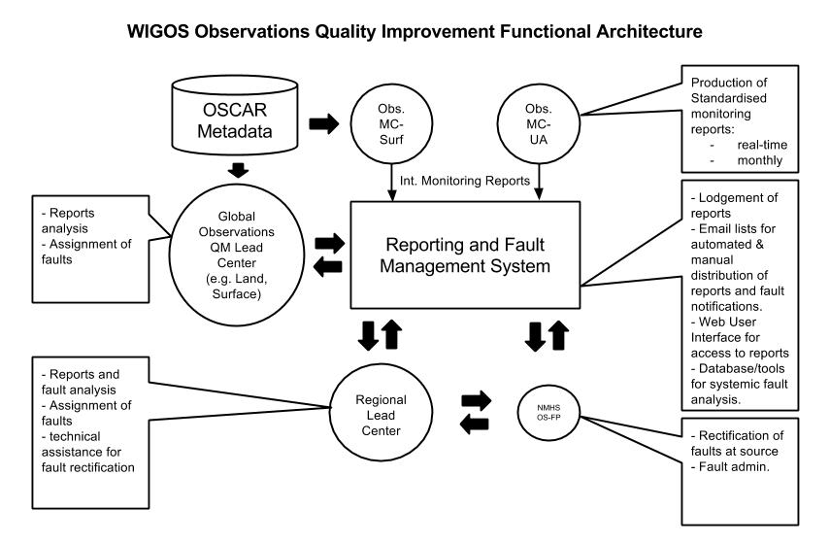
Background on IMS pilot project
From 1st WIGOS Workshop on DQM & Incident Management:
Reporting and Fault (Incident) Management System:
Lodgement of QM reports
Email lists for automated & manual distribution of reports and fault notifications.
Web User Interface for access to reports
Database/tools for systemic fault analysis.
Stefan Klink to elaborate on requirements of the WIGOS IMS.

Slide 4
Background on IMS pilot project
From 1st WIGOS Workshop on DQM & Incident Management:
(ET-SBO to conduct) 2 regional pilot IMS in association with the NWP Quality Monitoring Pilot. The idea:
Test concept of a regional center receiving, analysing and acting on QM information (QM Pilot) in cooperation with several national centres;
IMS to be a devised and likely non-technical system
Use 2 regions in WMO Region I to test usefulness and requirements for developing countries.

Slide 5
Progress on IMS pilot project
Terms of reference were developed Q3 2015.
At ET-SBO Session 2, 5-8 October 2015:
Kenya agreed to participate in PP as PP Regional Lead Center
Suggested other participating countries:
ET-SBO would make a formal approach to the Kenya Meteorological Service to confirm
ET-SBO to approach other countries in the east Africa sub-region
ET-SBO would improve the formulation of the scope and requirements for the pilot project

Slide 6
Where to now?
Should the IMS Pilot Project go ahead?
Will expected outcomes be useful to developing the WIGOS DQMS?
Next steps?

Slide 7
Thank you for your attention
dlockett@wmo.int

