Slide 1
Constituent Body Reform
EC created CBR-Task Force
1st meeting in Sept 2018
Video conf in Dec
2nd meeting next week
SOP planned for March timeframe
Internal structure as per S.N. 02/2019
Change Manage Committee CMC (monthly)
Reform Support Team (weekly)
”How” group

Slide 2
ALIGNMENT OF WMO STRUCTURES
Strategic Plan Long-term Goals | Global Lead/Regional Expertise | Executive Council Policy, Coordination, Integration, Foresight
1
Agile, responsive Secretariat
Services
Services
Commission
Policy Advisory Committee
2
Systems
Infrastructure
Commission
Technical Coordination
Committee
3
Science
Research
Board
Scientific Advisory Panel
4
Support to Members
Regional Associations
5
Smart Organization
■ EC-70 Recommendations to Congress
■ Established by EC-70

Slide 3
REFORM OBJECTIVES
Effectiveness and efficiency
Seamless and integrated approach
Increase value
for society
Engagement of Members and Partners
Earth System
approach
WMO
acting as one
Agile and responsive
to new challenges
Notes:
Agile and responsive to new challenges

Slide 4
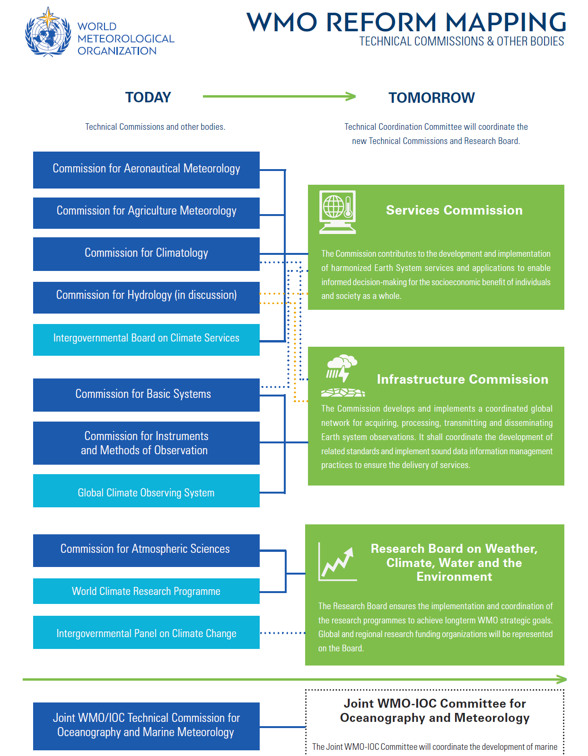
NEW TECHNICAL COMMISSIONS

Slide 5
TECHNICAL COMMISSION STRUCTURES
Management Team
Normative Work
Exploratory Work
Standing Committee
Standing Committee
Standing Committee
Study Group
Study Group
Expert Team
Expert Team
Expert Team
Expert Team
Expert Team
Expert Team
Expert Network

Slide 6
ENHANCED ROLE OF REGIONAL ASSOCIATIONS
Congress / EC
Scientific and technical communities
Political and economic regional groups
Regional requirements, needs and priorities
Technical solutions Standards, guidance
TECHNICAL COMMISSIONS
REGIONAL ASSOCIATIONS
National/regional experts
Expertise, assistance, efficiency, innovation
Implementation Process

Slide 7
TRANSITION PLAN
Finalization of proposals, work on details, mapping,
communication, formation of Communities of Practice (CoP)
Establishing of structures, work programmes, preparation of first session
Kick-off of new TCs
APPROVAL of CBR
2018
2019
2020
More information: public.wmo.int/en/governance-reform

