Slide 1
The WMO Global Basic Observing Network (GBON)
A WIGOS approach to securing observational data for critical global weather and climate applications
Lars Peter Riishojgaard
and
Rob Varley,
WMO Secretariat,
Anthony Rea, Bureau of Meteorology

Slide 2
Overview
Why is it important to have weather and climate observations everywhere on the globe?
What do we need to measure from the surface?
Why and where are we currently missing observations?
What is WMO doing about this problem?
What is the expected impact of GBON on WMO Members?

Slide 3
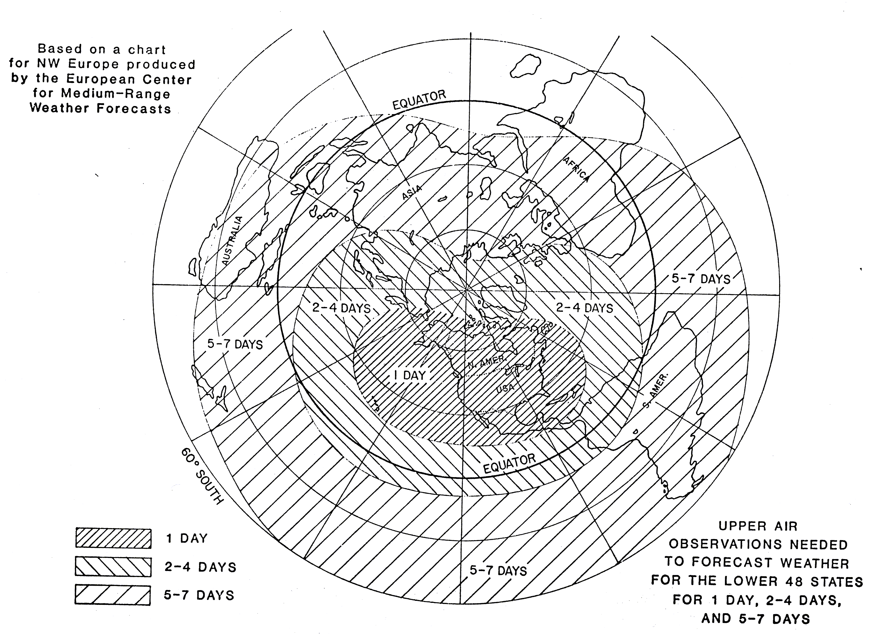
1. Why is it important to have observations everywhere?
Global NWP:
is a foundational capability for weather forecasting climate reanalysis
needs observations everywhere for accurate predictions anywhere
Weather prediction beyond the
3-4 day range essentially requires observations from the whole world
WMO is the only organisation with the mechanisms to provide these observations
1 day
2-4 days
5-7 days

Slide 4
WMO Application Areas listed in the RRR
Global numerical weather prediction
High-resolution numerical weather prediction
Nowcasting and very short range forecasting
Seasonal and inter-annual forecasting
Aeronautical meteorology
Forecasting atmospheric composition
Monitoring atmospheric composition
Atmospheric composition for urban applications
Ocean applications
Agricultural meteorology
Hydrology
Climate monitoring (currently under revision by GCOS and WCRP)
Climate applications (currently under revision by GCOS and WCRP)
Space weather
Foundational capability for nearly all weather and climate applications

Slide 5
Importance of Global NWP
Global observations
Global NWP
Regional NWP
Nowcasting and forecasts
Products and services
Without local observations, NWP guidance will be poor
- Leading in turn to poor services
- This is particular issue in the tropics

Slide 6
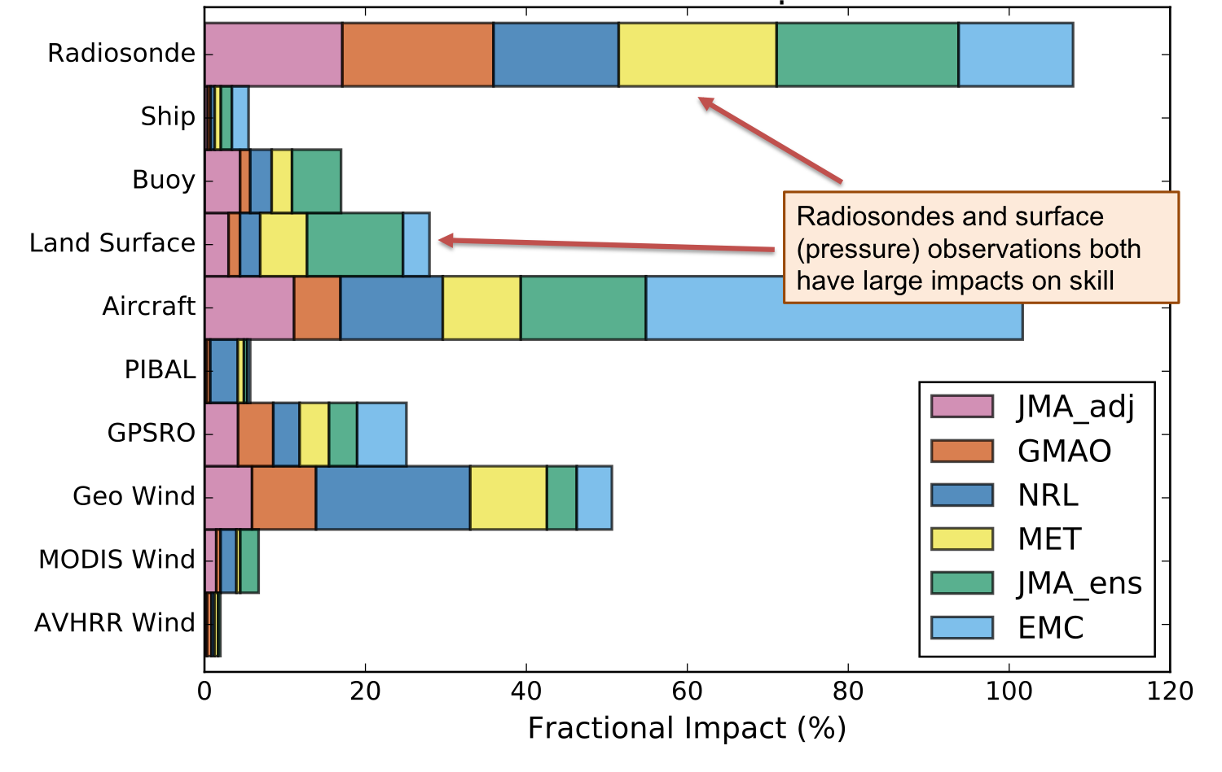
2. What do we need to measure from the surface? (and why not just use satellite data?)
Certain key variables are currently not measured from space - e.g. surface pressure, vertical wind profiles
Some variables are difficult to measure from space - over land, over snow and ice, beneath dense cloud
Reference data for satellite calibration and validation are needed
Evidence from impact studies

Slide 7
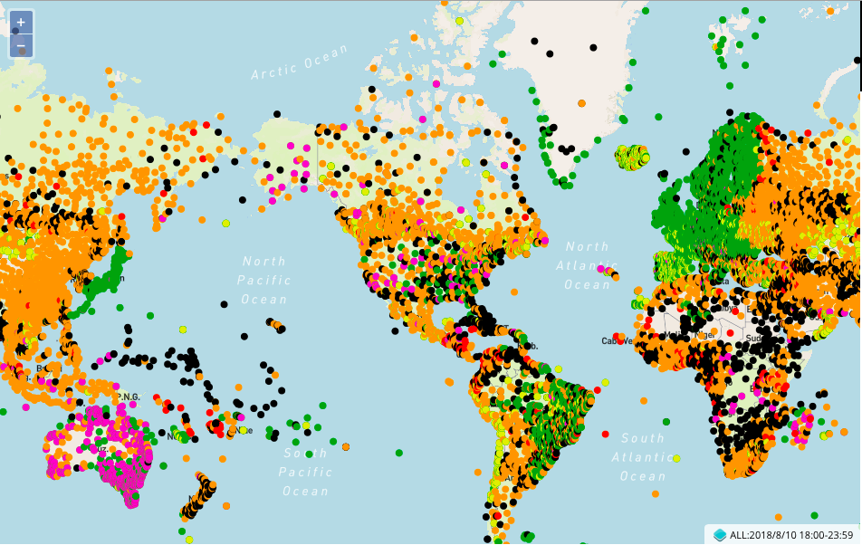
3. Why are we currently missing observations?
Current data exchange based on WMO 540 (Manual on the GOS) - and WMO Resolution 40 (Cg-11)
Resolution 40 was adopted in 1995 - NWP requirements vastly different now - inconsistent implementation by Members
More recent guidance issued - CBS recommendations, implementation plans, etc.
Many Members only follow regulations
Many more observations are being made, but not exchanged
Current WIGOS monitoring shows unacceptable gaps in coverage

Slide 8
3. Where are we currently missing observations?
Green: Fully reporting (hourly)
Orange: Partly reporting (mostly 3-hourly)
Red: Few reports (mostly daytime only)
Black: Silent stations
(Purple or yellow: metadata problems)
Surface pressure obs available to global NWP Centres on 10 August 2018, 18Z

Slide 9
3. Where are we currently missing observations?
Many areas of missing data; black = lost opportunities
Surface pressure obs available to global NWP Centres on 10 August 2018, 18Z

Slide 10
4. What is WMO doing about this problem?
To increase observations for global NWP, EC-70 requested:
CBS to develop an overarching design for the Global Basic Observing Network (GBON) to meet threshold requirements for Global Numerical Weather Prediction and Global Climate Monitoring (Analysis) as established by the Rolling Review of Requirements Process…
the Intercommission Coordination Group on WIGOS to develop relevant provisions of the Manual on WIGOS regarding the implementation of the GBON and propose them to Cg-18 in 2019
By WMO standards, this is an extremely rapid development schedule
Testament to the EC view of the importance of this issue!

Slide 11
Draft GBON provisions: Surface Observations (to be submitted to Cg-18 for approval)
3.2.2.4 Members shall operate a set of surface land observing stations/platforms that observe atmospheric pressure, air temperature, humidity, horizontal wind, precipitation and snow depth, located such that the GBON has a horizontal resolution of 500 kilometres or higher for all of these variables, with an hourly frequency.
3.2.2.5 Members should make available additional surface land observations of atmospheric pressure, air temperature, humidity, horizontal wind, precipitation and snow depth that enable GBON to have a horizontal resolution of 100 kilometres or higher for all of these variables, with an hourly frequency.

Slide 12
Draft GBON provisions: Upper air observations (to be submitted to Cg-18 for approval)
3.2.2.7 Members shall operate a set of upper air stations over land that observe temperature, humidity and horizontal wind profiles, with a vertical resolution of 100 m or higher, twice a day or better, up to a level of 30 hPa or higher, located such that GBON has a horizontal resolution of 500 kilometres or higher for these observations.
3.2.2.8 Members should operate a subset of the selected GBON upper air observing stations that observe temperature, humidity and horizontal wind profiles up to 10 hPa or higher, at least once per day, located such that, where geographical constraints allow, GBON has a horizontal resolution of 1000 kilometres or higher, for these observations.

Slide 13
5. What is the expected impact of GBON on WMO Members?
Access to better NWP and climate analysis products
Four broad categories of implementation impact:
GBON-compliant observations already made and exchanged internationally
GBON-compliant observations currently made, but not all exchanged
GBON-compliant observations are not made, but could conceivably be made with additional resources
Achieving GBON compliance is unrealistic with currently available technology

Slide 14
5. What is the expected impact of GBON on WMO Members?
Four categories of implementation (examples):
Members already complying with the GBON provisions (e.g. Japan, Western Europe) – no further action is needed
GBON observations made, but not currently exchanged (e.g. USA, China); new data exchange practices adopted
Insufficient national resources available (e.g. Africa, South Pacific); use GBON to help steer internationally funded development projects
GBON requirements not met due to geographic constraints (e.g. Indian Ocean, North Pacific) clear role for new or emerging technologies, space-based remote sensing

Slide 15
5. What is the expected impact of GBON on WMO Members?
Many observations available data exchange must be improved
Silent or under-reporting stations; development projects can help , if driven by GBON metrics
Surface pressure obs available to global NWP Centres on 10 August 2018, 18Z

Slide 16
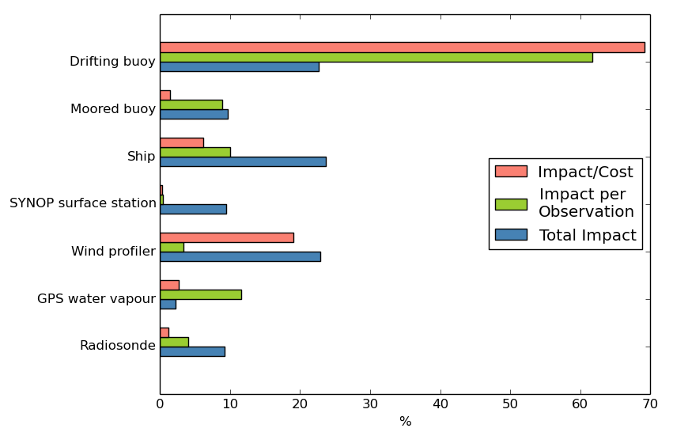
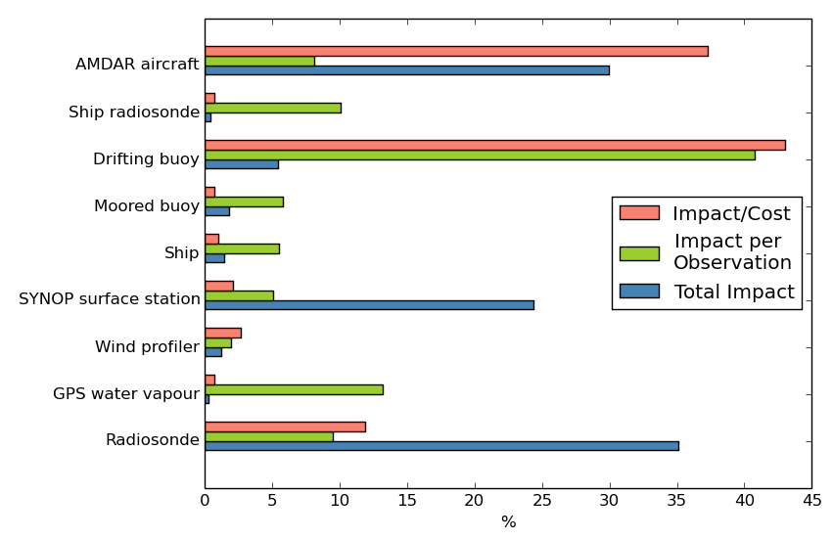
5. What is the expected impact of GBON on WMO Members?
Better global coverage
Massive global multiplier on investment in observations
Like a jigsaw puzzle, the full potential realized only if all the pieces are available
UK radiosondes: modest impact (blue); low cost/benefit ratio (red)
Worldwide radiosondes (no extra cost): highest impact; good C/B
Image source: www.kisspng.com

Slide 17
Summary and Conclusions
Ensuring a continuous real-time supply of observational data from all areas of the globe to critical global NWP and climate analysis systems is vital to product generation and service delivery capabilities of all WMO Members
The current availability of observational data falls well short of agreed requirements, this limits the ability of all WMO Members to predict and understand the atmosphere at all time-scales
The GBON provisions in the Manual on WIGOS will clarify the obligations of the WMO Members in this regard, and can help guide both national WIGOS implementations and internationally funded development projects

Slide 18
Thank you
Merci

