Slide 1
Vision for WMO Integrated Global Observing System (WIGOS) in 2040
Context, purpose, scope, and current status
Lars Peter Riishojgaard, Fernando Belda,
Werner Balogh, Toshi Kurino
WMO Secretariat

Slide 2
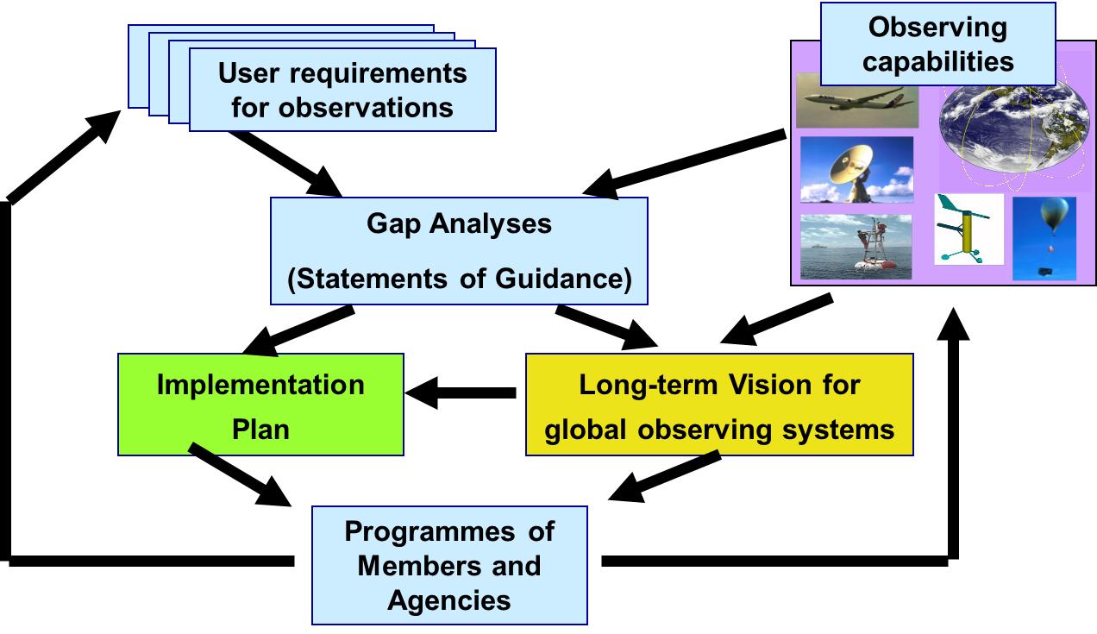
Rolling Review of Requirements (RRR)
WMO Congress: All WMO and WMO co-sponsored observing systems shall use the RRR to design networks, plan evolution and assess performance.
The RRR is the process used by WMO to collect, vet and record user requirements for all WMO application areas and match them against observational capabilities
Rolling Review of Requirements

Slide 3
Why a Vision for WIGOS in 2040?
To serve as reference for WMO Members and other observing system operators, providing context and expected boundary conditions relevant for observing system developments
To inform long-term planning of satellite agencies about expected evolution of WMO user requirements
This drives the 2040 timeline; current 2025 Vision too near-term
To inform planning efforts of users of observations (NHMSs, NWP centers, …) regarding systems development and required computing and communication capabilities

Slide 4
A few of the key drivers behind new Vision
External to the NMHSs:
Climate change; new requirements for information on all time scales;
Support for Paris Agreement, SDGs. Sendai Framework, …;
New application areas, renewed emphasis on existing application areas
Demographic changes (urbanization, mass migration, …);
Increasing overall demand for meteorological information
Internal to the world of meteorology:
Evolving technical capabilities (sensing, telecommunication, computing);
Move toward integrated earth system modeling:
Increasing recognition of economic value of meteorological information;
Private sector increasingly interested in owning and operating observing systems rather than in selling hardward.

Slide 5
Timeline
Timeline
17th World Meteorological Congress (2015) requested ICG-WIGOS to develop a “Vision for WIGOS in 2040” and submit for approval at next session in 2019;
Expert team meetings and user consultation workshops held in 2015-16; ldraft “Visions” for space- and surface-based components, respectively;
ET-SAT led the development of the initial space-based vision document;
Draft material presented and discussed in various contexts (WMO constituent bodies, CGMS-44, 45, GEO-XIV,…;
First draft of an integrated document: ICG-WIGOS-7 in January 2018;
Submitted to CGMS-46 as WMO-WP-01
Endorsed for finalization and submission to the 18th World Meteorological Congress in 2019 by WMO Executive Council in June 2018.

Slide 6
Document Structure
Chapter I; Context, purpose, scope
Why a new vision, what are the main drivers of change; what does the concept of “integration” in WIGOS entail;
Chapter II; Space-based WIGOS components
Trends in Requirements and Capabilities; text and tables introducing the four tiers of space-based systems contributing to WIGOS;
Chapter III; Surface-based WIGOS components
Trends and issues (technology, requirements, private sector involvement, commoditization of sensors, processing, communication, …); tables of available and emerging technologies.

Slide 7
Timeline
Current status and final steps
Draft version 1.6 sent out for comments to all WMO TC’s and Program Areas (GCOS, WCRP, GFCs, CGMS, CEOS, …) on Dec 13 2018;
Feedback received by Jan 17 2019 has been incorporated in draft version 1.7, which is made availaible to ICG-WIGOS-8;
Many of the comments have been very helpful;
Inevitably, some of the comments are in direct contradiction with each other;
Some reviewers would have liked to see a completely different type of document;
A few loose ends still to be cleaned up, and the document could (and should?) be made more graphically appealing before Cg-18;
ICG-WIGOS requested to endorse current version and give the WMO Secretariat the freedom to finalize this before submitting it for translation on March 1 2019

Slide 8
Next steps

