Slide 1
4. STATUS OF THE PRIORITY AREAS IMPLEMENTATION OF THE PLAN FOR THE WIGOS PRE-OPERATIONAL PHASE (PWPP)
4.4 Development and implementation of the
WIGOS Data Quality Monitoring System
ICG-WIGOS-8/Doc 4.4

Slide 2
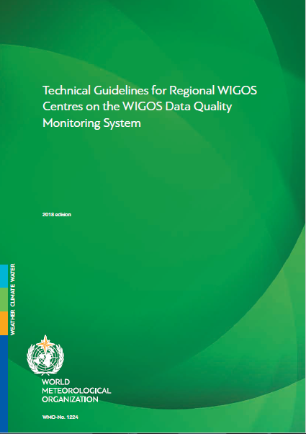
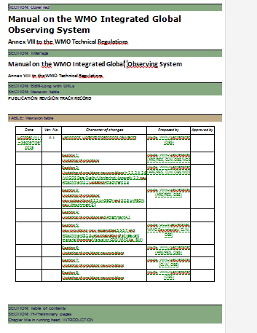
Contributions to Manual & Guide to WIGOS
Guide to WIGOS (WMO-No. 1165, 2018 update)
“Technical Guidelines for Regional WIGOS Centres (RWCs) on the WIGOS Data Quality Monitoring System (WDQMS) for surface-based stations of the Global Observing System (GOS)” was endorsed by EC-70 →Annex to Chapter 9
Manual on WIGOS (WMO-No. 1160)
Contributions to new draft edition of the Manual on WIGOS → generic description of WDQMS, including its functions and the responsibilities at all levels
Development of the GBON concept and its draft provisions for the Manual on WIGOS
endorse the edits to the new draft edition of the Manual on WIGOS and to review some provisions
Notes:
the development of the GBON concept and its draft provisions for the Manual on WIGOS, are already a substantial impact of the project that was based on the experimental results from the WDQMS Webtool prototype,
Output generated by the GNWPC Pilot was shown at the CBS TECO in March 2018, and the relatively poor status of exchange of surface observations led to the CBS MG putting this issue in front of EC-70 as a matter to be urgently addressed by organization.
Similar results were presented at EC-70, and the Council decided to take immediate action to improve this situation. The Council thus requested the Commission for Basic System to develop an overarching design for a Global Basic Observing Network (GBON) that would meet threshold requirements or better for Global NWP and climate analysis, and it requested ICG-WIGOS to develop the relevant provisions reflecting this design and incorporate them in the new draft Manual on WIGOS to be submitted for approval by Cg-18.

Slide 3
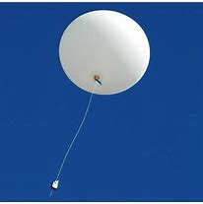
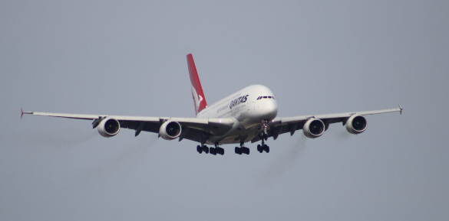
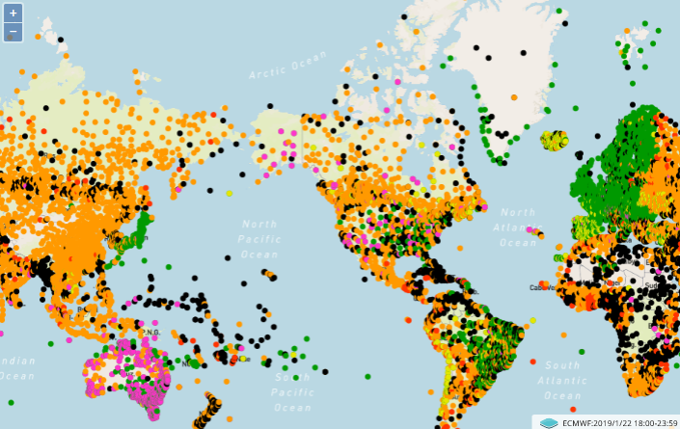
Integration of all WIGOS components
Progress:
Development & implementation of monitoring files for
upper-air observations,
aircraft observations,
Monitoring of satellite observations
Initial discussions for a better alignment of GSICS with WDQMS concept
Not much progress with
monitoring from the marine observations,
monitoring from other WIGOS components
extended membership of the TT needed (representatives from JCOMM, GAW, GCW, WHOS).
need to find a way to cooperate with already existing monitoring systems
huge amount of work for integration of all WIGOS observing components
WDQMS
Notes:
For TT-WDQMS (low priority): to create a template for radars similar to that for radiosondes, to collect results from NWP centres assimilating wind profilers/radars profiles (ECMWF, NCEP, JMA) for both availability & quality (o-b).
For TT-WDQMS: to integrate ASAP observations using the radiosonde template, but availability results won't have any comparison target.

Slide 4
WDQMS Functions
Reviewed and adapted description of 3 WDQMS Functions:
Establishment of RWCs critical for operational activities related to Evaluation and Incident Function!
need for capacity building activities in support of establishing RWCs
RWCs provide input for the development of the WDQMS Webtool
exchange of monitoring information across various RWCs.
Development of auditing process on WDQMS for RWCs
Monitoring Function
Monitoring results
Evaluation Function:
Comparison of results & analysis
Incident Function:
Creates, registers & monitors incidents
GNWPCs
RWCs

Slide 5
Reflexions on the further development of the WDQMS
Overall:
Definition of WDQMS long-term vision, within the context of the whole WIGOS.
complexity of the whole WDQMS → focus on maturing the WDQMS concept in monitoring the GOS observations
data licencing issues have to be considered → publicly availability of results
WDQMS functions:
Beneficial to have more GNWPCs
Experiences with Webtool needed before data quality results can be integrated in OSCAR/Surface → clear description of what monitoring results refer to and how they were computed
Monitoring of timeliness → WIS monitoring needs to be included in future evolution of WDQMS
Comparison of performance results to 2 different baselines → 1) declared status & 2) required status
Map of availability → availability to data assimilation
Combined availability → maximum across centres
Monitoring Function
Evaluation Function
Incident Function

Slide 6
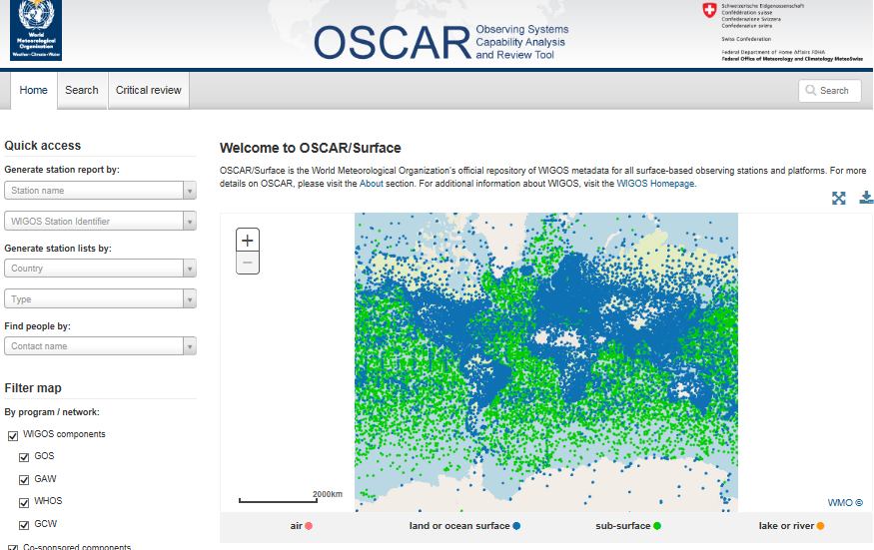
WDQMS Systems
Exchange of information between OSCAR/Surface & WDQMS
monitoring outputs to be recorded in OSCAR/Surface incl. description of their meaning → data availability to start with
Exchange via M2M-Interface of OSCAR/Surface (metadata & monitoring results)
WDQMS Webtool prototype
signed agreement between ECMWF and WMO for development & hosting of operational WDQMS Webtool → project plan agreed with WMO (technical design in Q1, implementation in Q2 (pre-operat. Version ready for Congress-18), available in Q3 2019);
tested for the monitoring of data availability from surface & upper-air stations:
development in two steps → 1. data availability and 2. data quality
Integration of Actions in Workplan (outcome TT-WDQMS-3)

Slide 7
Thank you
Merci

