Slide 1
ICG-WIGOS-8
Co-chair Introduction

Slide 2
ICG-WIGOS-8 Objectives
Review and celebrate progress
Identify gaps, outstanding challenges
Finalisation of WIGOS pre-operational phase
Priority activities to be ‘WIGOS Ready’
Cg18 proposals and outreach
Preparing for post Cg18
WIGOS Operational Plan 2020-23
WIGOS governance and management
Notes:
Short meeting, get down to business quickly

Slide 3
Review priority areas
What is achieved and, more importantly, priority gaps/needs, actions?
National WIGOS Implementation – varied success with NWI Plans; but learnt about needs, gaps and partnership
WIGOS Regulatory Material – solid progress with support of WEdB and TT-WDP, but timelines ambitious
WIGOS Information Resource – solid progress across OSCAR/Requirements and training; maintenance strategy for OSCAR/Space and /Surface; harmonisation, incl with Metadata standard; WSI – solid progress, evolution of implementation process
WDQMS – solid progress on pilot, learnings for RWCs
WIGOS Regional Centres – some progress, more needed
Notes:
Hear reports from Task Teams
OSCAR/R – including non-GOS (GAW, GCOS, GCW) and regional perspectives
Review of application areas needed

Slide 4
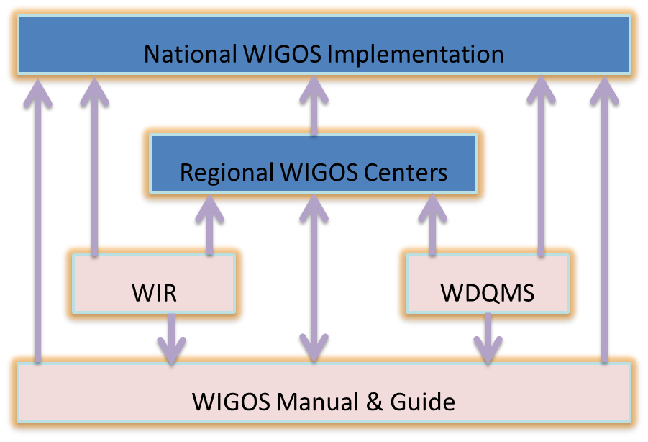
Key issues for ICG-WIGOS-8
RWCs
Critical to national WIGOS implementation
Link together all pillars of WIGOS
WDQMS & incident management
OSCAR/surface & WSI
Plans and governance
Regional collaboration
Capacity priorities

Slide 5
Key issues for ICG-WIGOS-8
GBON
Immediate action on concept post EC70 decision
Global coverage & international exchange critical to effective national application
Regulatory material to Cg18
Vision for WIGOS in 2040
WIGOS Operational Plan 2020-23
WIGOS Governance post Cg-18
Impact of CBR

Slide 6
WIGOS Open
Outreach
to partners
Cg18
WDQMS
Station IDs
WIGOS Ready
WIGOS Metadata
OSCAR/Surface
July 2016
WIGOS Uptake
WHOS
GOS
GCW
GAW

Slide 7
WIGOS Timeline
WIGOS Pre-operational
Phase
Congress 16
Congress 17
Congress 18
ICG-WIGOS
WIGOS strategic priority
WIGOS Ready
WIGOS
Concept
WIGOS
Framework
WIGOS
Operational
Technical Commissions, under leadership of CBS and CIMO,
in collaboration with Regional Associations
Notes:
Arrow goes back further, since integration is not a new concept – the WWW was/is an exemplar in integration, with its end to end view across WMO/NMHS functions, and the GOS has led the way in surface and space-based integration.
Now broaden and embrace, and address the growing challenges and demand on NMHS for more and more observations, with fewerand fewer resoirces, and with increasingly rapid changes in technology on all fronts.
Situational awareness is all about observations, information and interpretation

Slide 8
WIGOS Timeline
WIGOS Pre-operational
Phase
WIGOS Operational
Phase
Congress 16
Congress 17
Congress 18
Congress 19
ICG-WIGOS
WIGOS strategic priority
WIGOS Ready
WIGOS Open
WIGOS
Concept
WIGOS
Framework
WIGOS
Operational
Technical Commissions, under leadership of CBS and CIMO,
in collaboration with Regional Associations
COIIS and RAs
Notes:
Arrow goes back further, since integration is not a new concept – the WWW was/is an exemplar in integration, with its end to end view across WMO/NMHS functions, and the GOS has led the way in surface and space-based integration.
Now broaden and embrace, and address the growing challenges and demand on NMHS for more and more observations, with fewerand fewer resoirces, and with increasingly rapid changes in technology on all fronts.
Situational awareness is all about observations, information and interpretation

Slide 9
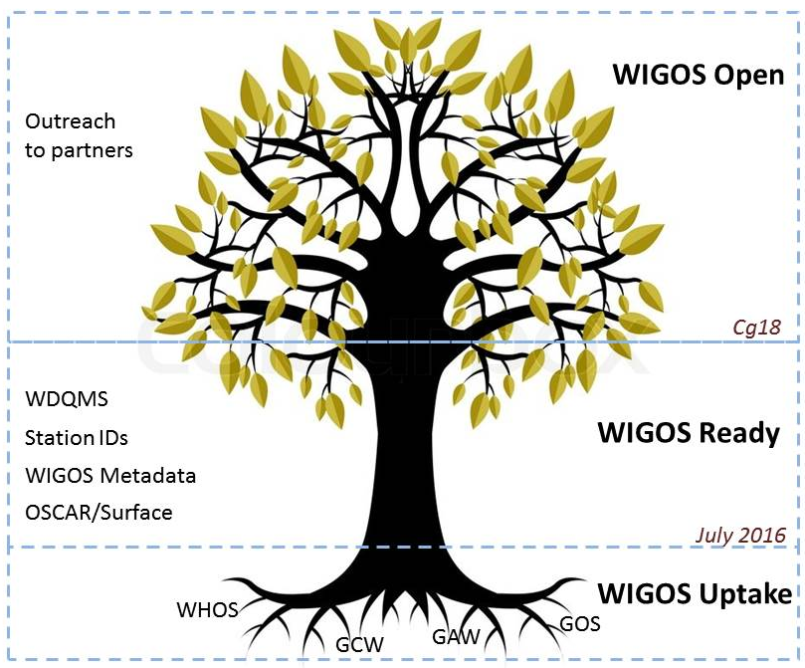
WIGOS Ready by Cg18
By Cg18, we aspired to:
WIGOS Uptake
WIGOS Ready
Progressively:
integrating partners, new partner systems;
supported by Regional WIGOS centres
After Cg18:
WIGOS Open
Implications for future:
RWCs operational
Support for Members
Attracting partners

Slide 10
Thank you
Merci

