Slide 1
COLLABORATION AND ENGAGEMENT WITH CROSS-CUTTING WMO PRIORITIES; WIGOS MAIN OBSERVING COMPONENTS GLOBAL CRYOSPHERE WATCH
25 Jan 2019
Árni Snorrason
Chair, GCW Steering Group
PR Iceland

Slide 2
Summary
GCW status;
GCW Preoperational phase;
Next Steps.

Slide 3
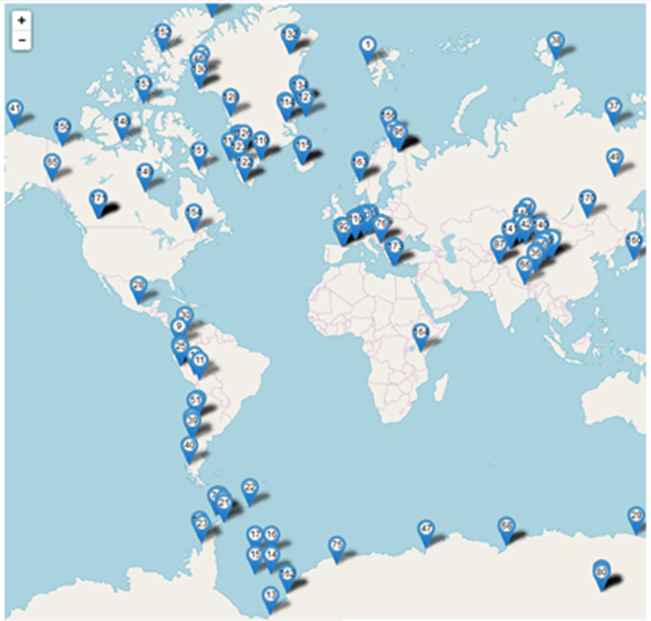
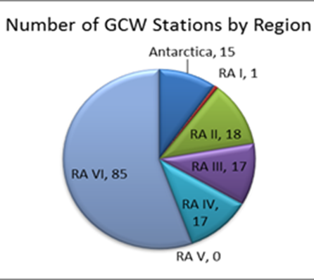
GCW Surface Observing Network (GCW SON)
Approved by Resolution 29 (EC-70);
Regulatory aspects included in Technical Regulations and WIGOS Manual
153 stations → 29 countries→
41 institutions:
15 NMHSs,
9 Universities,
17 other institutions (research, etc).

Slide 4
GCW Preoperational Phase
Modelled after WIGOS Preoperational Phase.
Recommendation 17 (EC-70) to Cg-18, draft Resolution on the Preoperational Phase of GCW.
An end-to-end GCW, as a cross cutting activity, from 2024, onward;
Priorities:
Integrated Cryosphere Information System (Data Portal - backbone);
Facilitating cryosphere information products (trackers, assessment, intercomparisons, links to satellite data);
Further development of the GCW Surface Observing Network;
Increased regional focus (e.g. mountain regions).

Slide 5
Next Steps
There is increasing interest to join the GCW network;
Acceptance of new stations for the GCW network has been paused to address:
Registration of stations in OSCAR Surface:
Allocation of WIGOS IDs;
Availability of metadata.
Achieving interoperability at data level (real time and archived data)

Slide 6
Next Steps
WIGOS IDs:
Currently ~20% of stations have IDs.
Agreement yesterday on an improved process for allocating WIGOS IDs: supported by, and necessary to GCW.
Metadata: more work needs to be done by GCW
Currently ~20% of cryosphere variables already in the WIGOS Metadata Standard;
Priority: harmonize terminology WIGOS/OSCAR/scientific communities;
Collaboration with TT-WMD: greatly appreciated

Slide 7
GCW Best Practices
Measurement of Cryosphere Variables:
New volume of the CIMO Guide, WMO No. 8;
Approved for publication by CIMO-17 in 2018;
Successful collaboration GCW –CIMO;
Documents accepted observing practices;
Currently includes:
Chapters 1 (General),
2 (Measurement of Snow).
Next, focusing on: Glaciers, Sea Ice, Permafrost.
Engagement of respective expert communities.
Information to be used for the WIGOS Metadata Standard (measurement methods).

Slide 8
GCW Regional activities
GCW conducted Asia, South America, Tropical CryoNet workshops;
Recommendation GCW involvement in
WIGOS Regional Workshops;
WIGOS Regional Centres;
Noting the role of GCW in linking with applications e.g. Regional Climate Centres:
E.g. Third Pole Regional Climate Centre Network development: requested that GCW facilitates access to cryosphere data from research observing programs, internationally projects

Slide 9
Interoperability at Data Level
WIGOS IDs: critical to data access;
Data Portal – Integrated Cryosphere Information System:
GCW to address:
variability in capabilities of data centres,
consistency of metadata and data formats used.
Goal to provide functionality as WDQMS; it requires the continued commitment of Members.
Engagements within WIGOS framework for implementing the WDQMS model for cryosphere observations, including through Regional WIGOS Centres

Slide 10
Summary
Accomplishments
Next Steps
Establish GCW Surface Observing Network;
Regulatory framework established;
Guide to Cryosphere Variables – published;
WIGOS Metadata Standard: Input on snow and glacier variables;
Input to WIGOS 2040 Vision.
WIGOS IDs;
Registration in OSCAR;
Further development of WIGOS Metadata Standard;
WDQMS;
Further development of Best Practices;
Interoperability at Data Level.

Slide 11
Thank you
Merci

