Slide 1
WHOS
Silvano Pecora
Vice-President of CHy
ICG-WIGOS-8
Inter-Commission Coordination Group On WIGOS
WMO, Geneva, Switzerland
24-26 January 2019

Slide 2
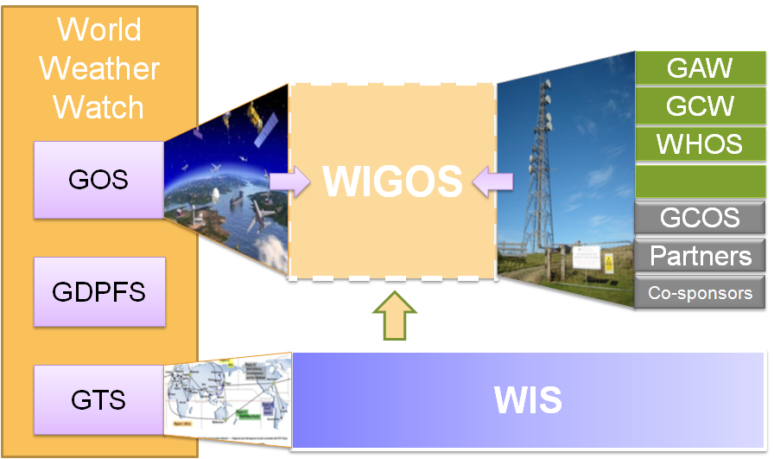
WMO INTEGRATED GLOBAL OBSERVING SYSTEM (WIGOS) and WMO HYDROLOGICAL OBSERVING SYSTEM (WHOS)
In June 2015 the President of CHy informed Cg-17 of CHy proposal to develop WHOS as the CHy contribution to WIGOS
Congress welcomed the effort and urged the president of CHy to continue guiding WHOS to full implementation
Congress urged the promotion of WHOS among NHSs and the hydrological community

Slide 3
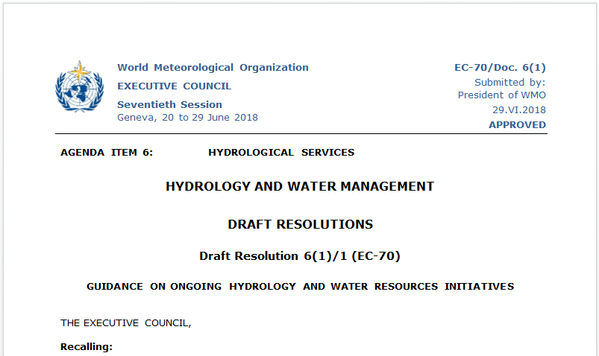
EC-70 ENDORSES THE INITIAL IMPLEMENTATION ON WHOS

Slide 4
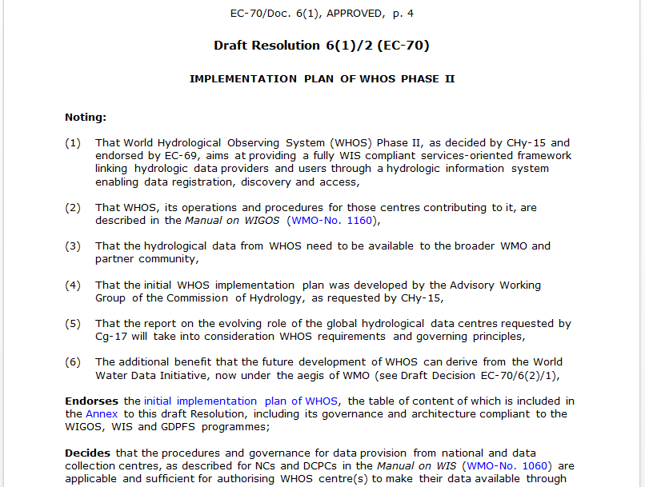

Slide 5
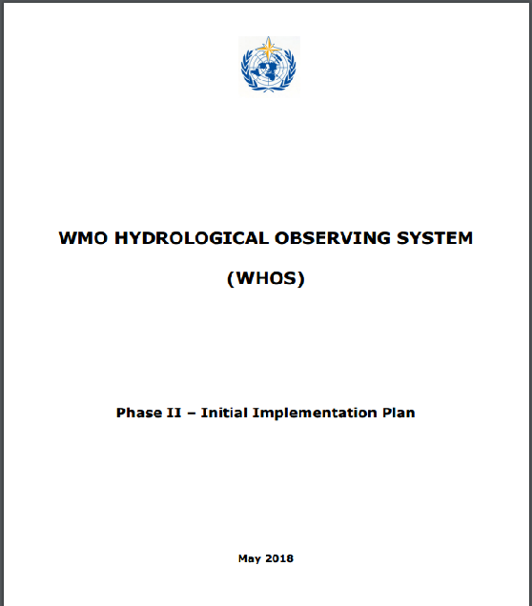
EC-70 DOCUMENT on THE INITIAL IMPLEMENTATION
http://www.wmo.int/pages/prog/hwrp/chy/whos/documents/WHOS_Phase-II_Initial_Implementation_Plan.pdf

Slide 6
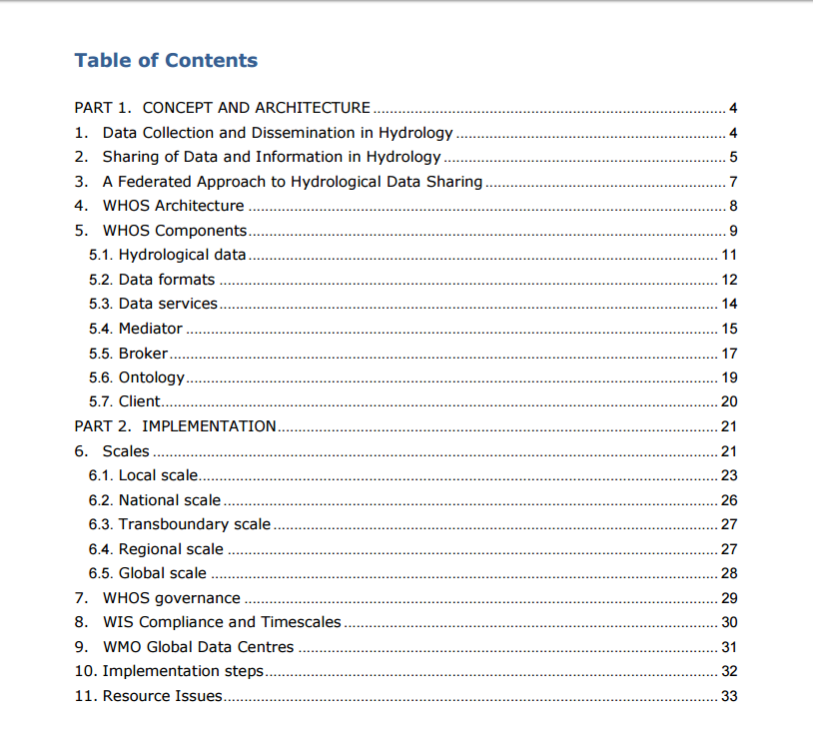

Slide 7
WHOS SUPPLY-CHAIN MODEL
Data/information is the new “oil”

Slide 8
WHOS
FORMAT
BROKER
DATA
CLIENT
MEDIATOR
ONTOLOGY
SERVICE
reshaping data in hydrology

Slide 9
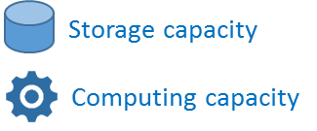
WHOS supply-chain SECO
Human Computer Interface
Harmonization capacity
WMO Programmes
WMO CHy
Projects
Other
Apps
DOWNSTREAM
APIs
APIs
APIs
APIs
Brokering/Mediation Platform
Thematic/International Federation systems
APIs
APIs
APIs
APIs
Workflow/Processing systems
MIDSTREAM
Regional/National Data Nodes
APIs
APIs
APIs
APIs
Data systems
UPSTREAM
Notes:
SECO = Software Ecosystem

Slide 10
WHOS GOVERNANCE
In order to ensure the quality and comparability of observations within the WMO
Integrated Global Observing System (WIGOS), Members making their hydrological
observations available through the WHOS are requested to comply with the provisions
specified within the Manual on the WIGOS (WMO No. 1160), together with predominantly
recommended practices and procedures of the Technical Regulations (WMO No. 49),
Volume III: Hydrology. Members are urged to make their best efforts to implement the
WIGOS standard practices and procedures in the collection and exchange of hydrological
observations and to make such observations available through WHOS.
The WMO Hydrological Observing System shall comprise hydrological observations,
initially focusing on water level and discharge, and it shall expand to include other
elements identified through the Rolling Review of Requirements (RRR).
The procedures and governance for data provision from national and data collection
centres are described for NCs and DCPCs in the Manual on WIS (WMO No. 1060) and
they are applicable and sufficient for authorising WHOS centres to make their data
available through WIS.

Slide 11
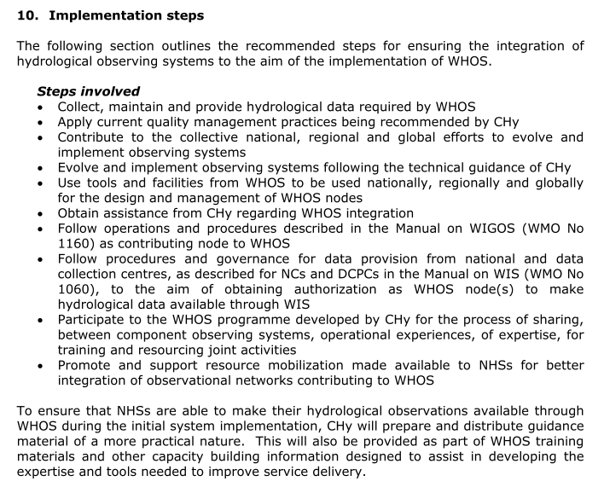
WHOS IMPLEMENTATION STEPS

Slide 12
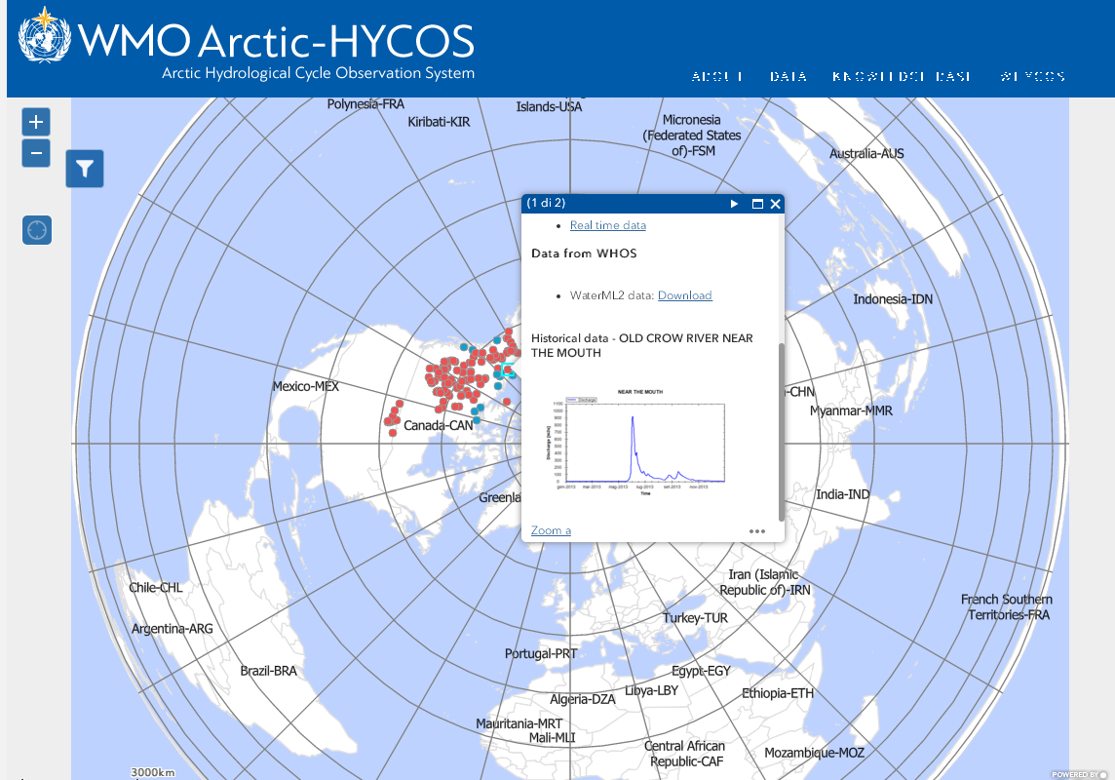
http://www.whycos.org/WMO/arctichycos/index.html

Slide 13
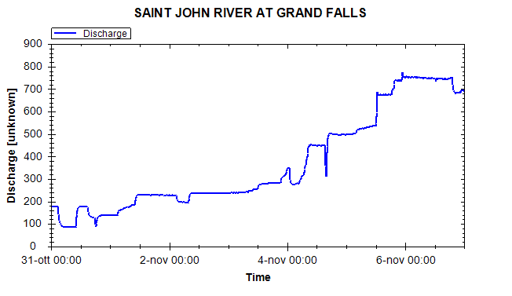
http://hiscentral.ddns.net/graph/handler2.ashx?height=375&width=645&serviceUrl=http%3A%2F%2Farpa-er-axe.geodab.eu%2Fgi-axe-arpa%2Fservices%2Fhis&siteCode=EC%3A01AF002%40794943551&variableCode=Discharge&startDate=2018-10-31&endDate=2018-11-07

Slide 14
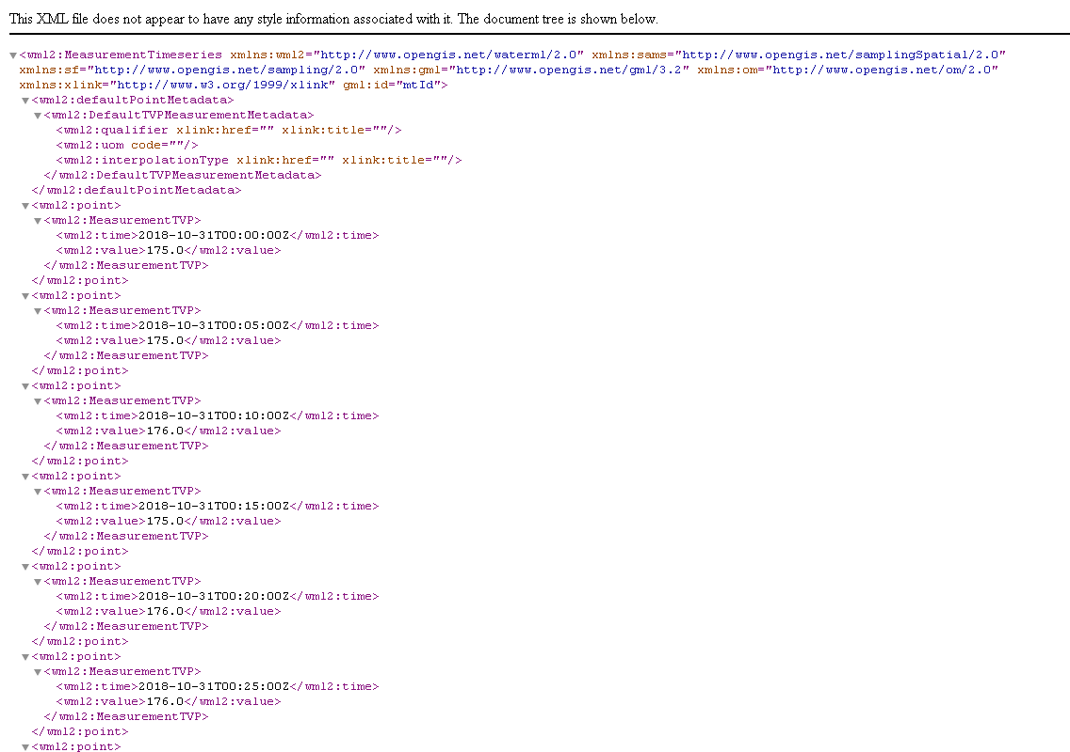
http://arpa-er-axe.geodab.eu/gi-axe-arpa/services/http-get?request=execute&service=WPS&identifier=gi-axe-transform&DataInputs=descriptor=;outputFormat=WML_2_0;outputTemporalBegin=2018-10-31T00%3A00%3A00Z;outputTemporalEnd=2018-11-07T00%3A00%3A00Z&RawDataOutput=resource&protocol=HYDRO&linkage=http%3A%2F%2Farpa-er-axe.geodab.eu%2Fgi-axe-arpa%2Fservices%2Fhis&name=Discharge%40EC%3A01AF002%40794943551

Slide 15
WHOS and OSCAR
OAI-PMH interface endpoint can be used to harvest WHOS content as:
Dublin core
ISO 19139
2006 schema
2007 schema
Wigos Metadata Standard
http://arpa-er.geodab.eu/gi-cat-arpa/services/oaipmh

Slide 16
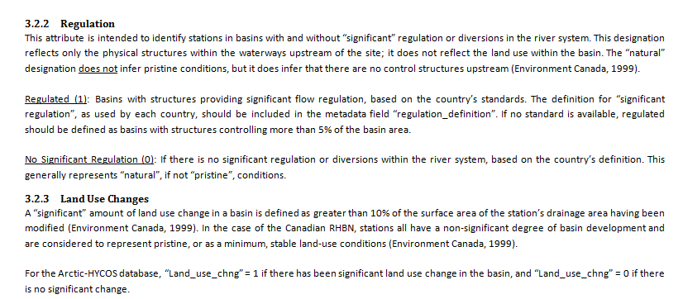
PROPOSED HYDROLOGICAL METADATA FROM ARCTIC-HYCOS
Arctic-HYCOS is defining a proposal for the complete list of metadata attributes to describe each station in the Arctic-HYCOS station list and database.

Slide 17
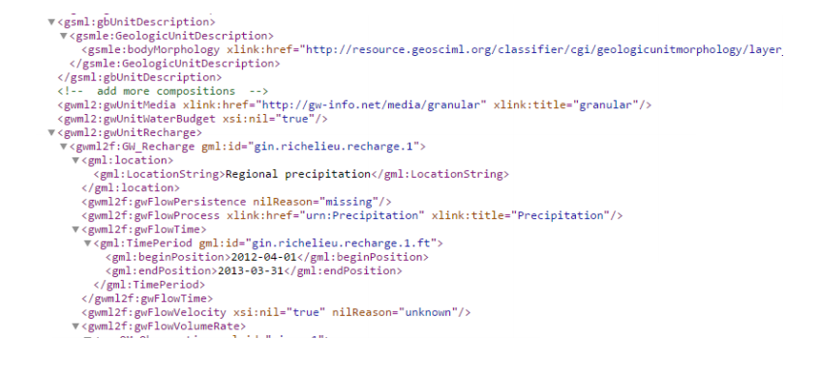
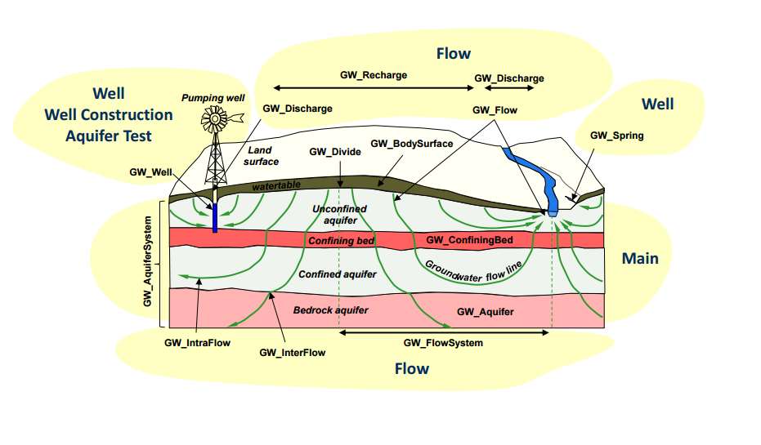
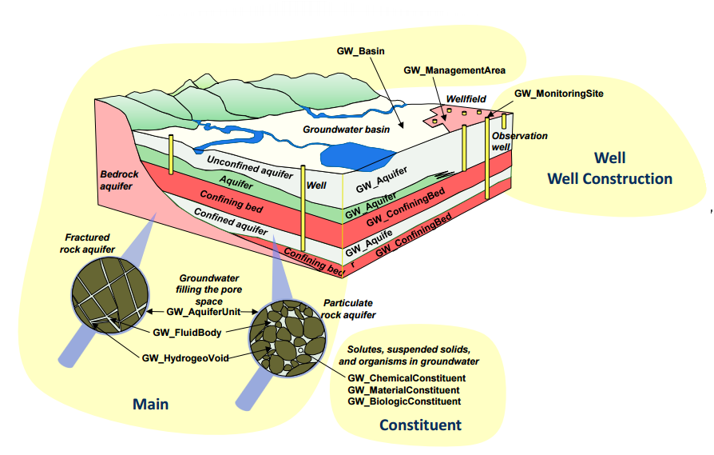
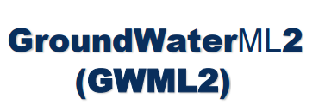
WaterML2 Part3
OGC Standard today -> WMO Standard soon

Slide 18
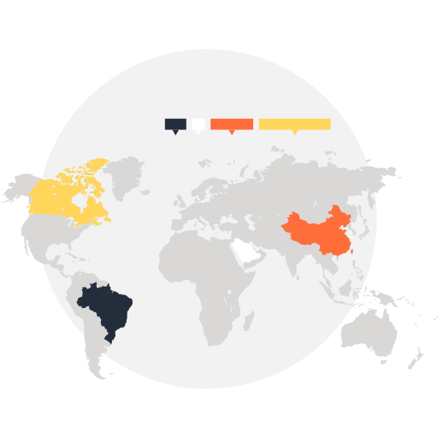
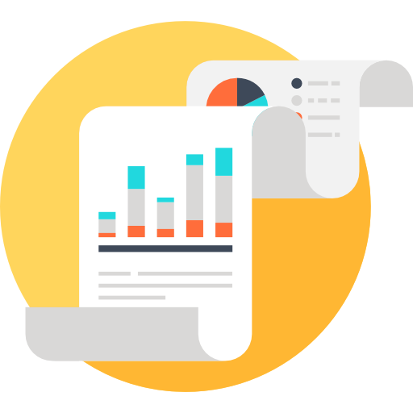
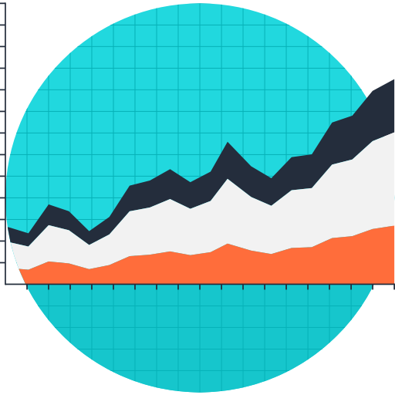
WHOS Plata System Overview
Application
Application
Application
Application
App Icons made by Maxim Basinski from www.flaticon.com is licensed by CC 3.0 BY
WHOS Plata
Data Node
Data Node
Data Node
Data Node

Slide 19
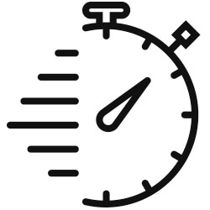
Plata Broker Configuration at INMET
Distributes incoming requests to the node with the lightest workload
Periodically checks health of each node
When a node is found unhealthy, it removed from load balancer
Public DNS
Clusterizing
broker.hisplata.org
Routing Service
Load Balancing Service
Monitoring Service
Unreachable from DNS
IP Address
IP Address
IP Address
GI-suite
GI-suite
GI-suite

Slide 20
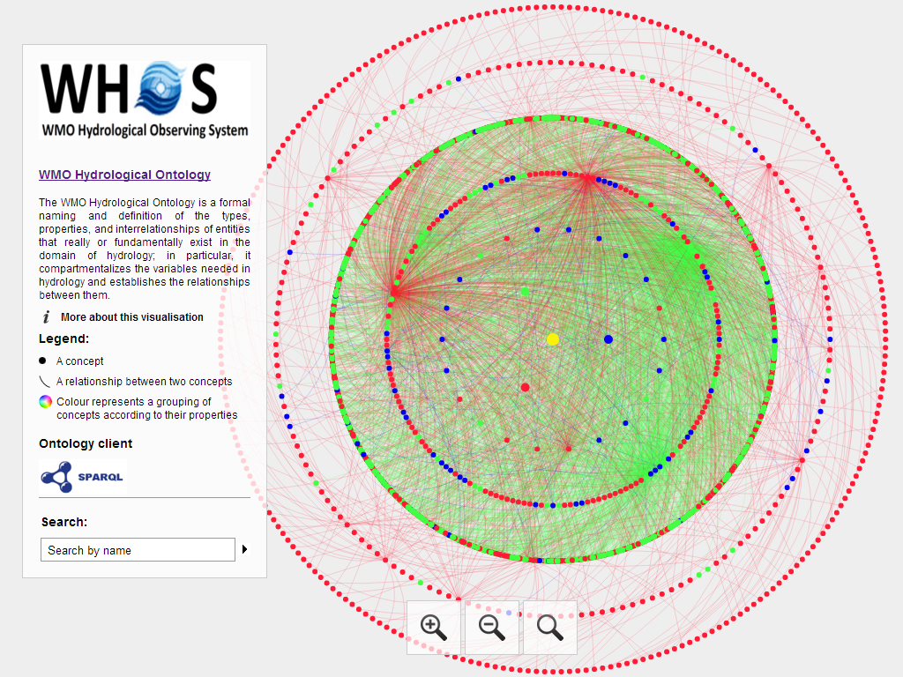
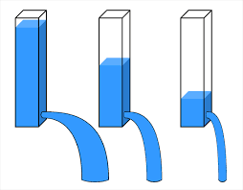
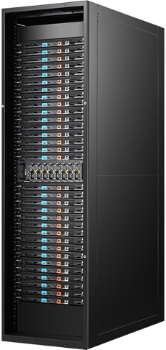
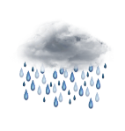
WHOS ontology service
Water level
SPARQL
endpoint
Discharge
Water level
Flowrate
Altura
Nivel
Caudal
Vazao
Precipitation
Precipitation
Chuva
Rain

Slide 21
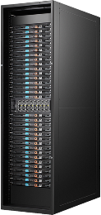
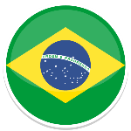
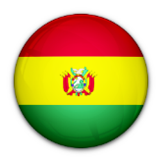
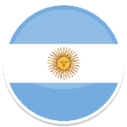
Semantic enhanced search
The ontology provides translations:
“Discharge, stream”
“Caudal”
“Portata”
“Streamflow”
SPARQL
Hydrology ontology service
A query is sent
e.g. “Discharge, stream”
WHOS
Brokering
Framework
CUAHSI
HydroDesktop
Enriched queries
are generated and
executed
CUAHSI
HydroServers
Argentina INA service
Brazil ANA service
Brazil INMET service

Slide 22
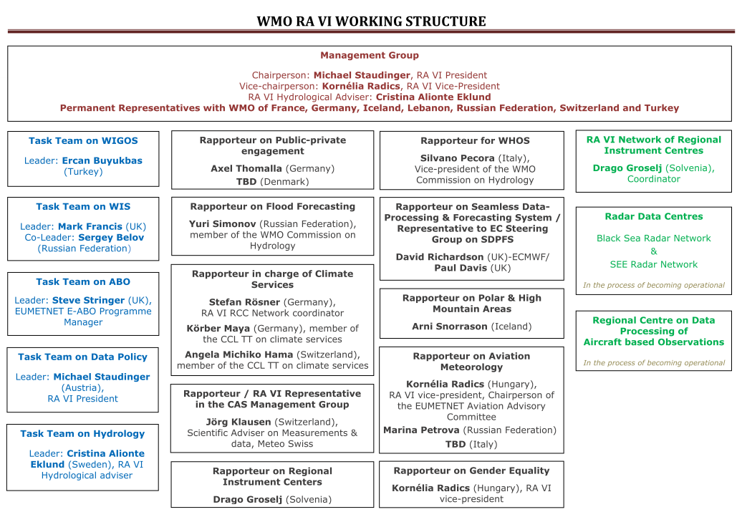

Slide 23
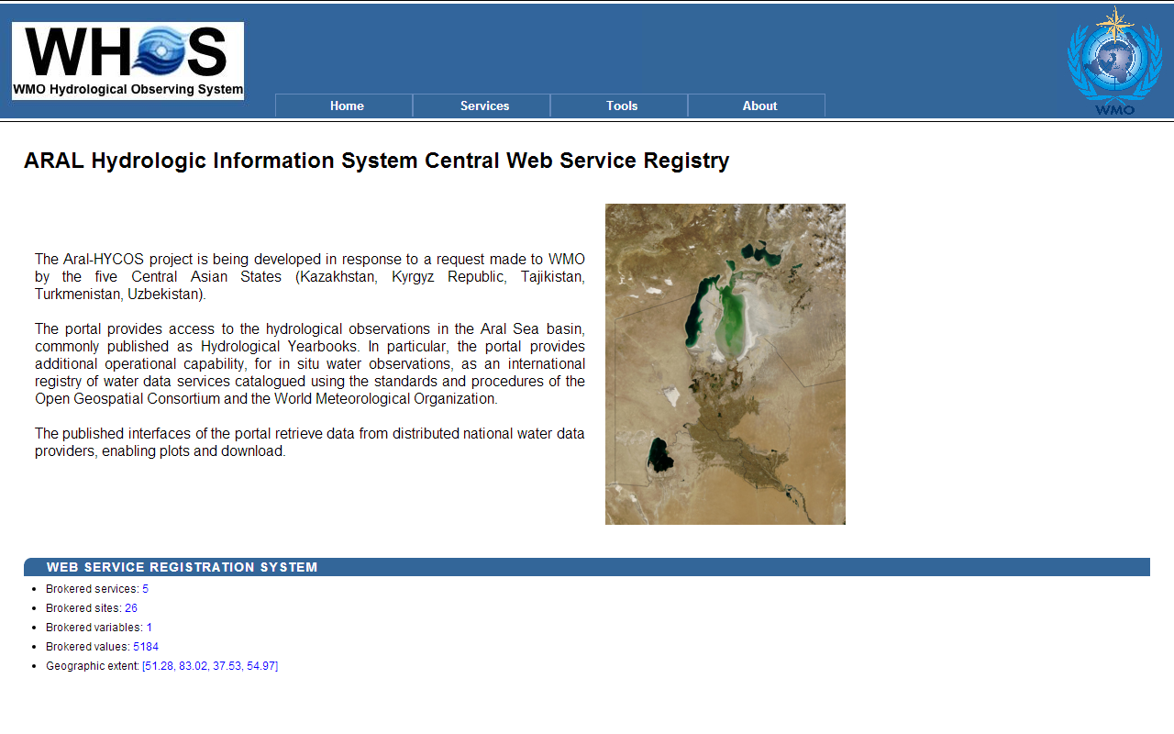
RAVI Rapporteur for WHOS
Terms of Reference
To contribute actively, with the support of the national focal points on WHOS, to the development of WHOS in support of hydrological data exchange, in collaboration with WIS and WIGOS TTs of RA VI.
Report to the RA VI Management Group and the WMO Secretariat on the WHOS implementation in RA VI.
Identification of five pilot cases at the basin scale, namely:
Aral Sea
Danube river
Rhyne river
Sava river
Arctic region

Slide 24
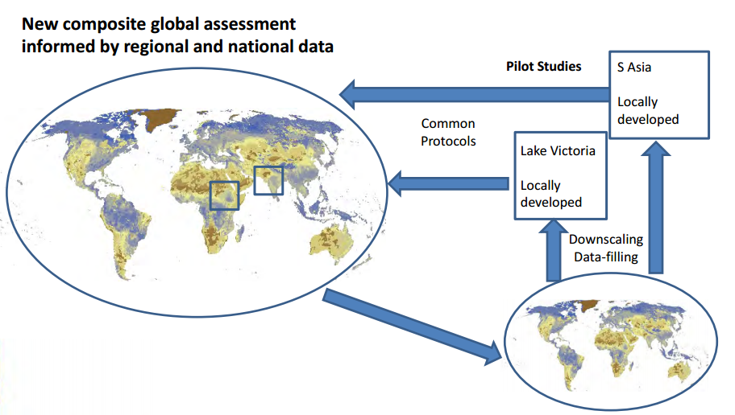
A flagship under construction: HydroSOS
NEEDS
NEEDS
WMO Hydrological Status and Outlook System

Slide 25
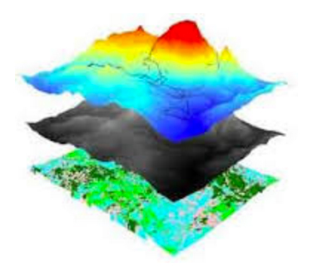
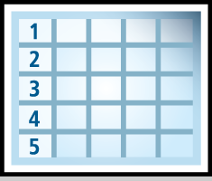
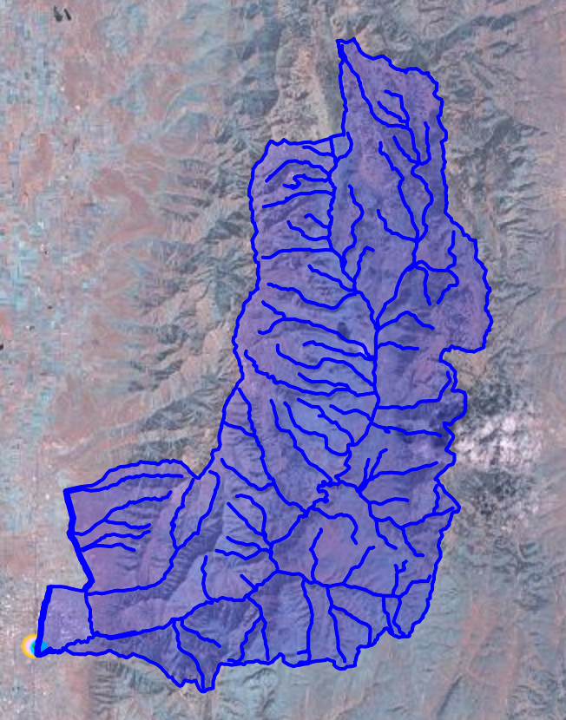
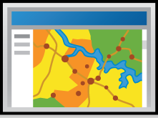
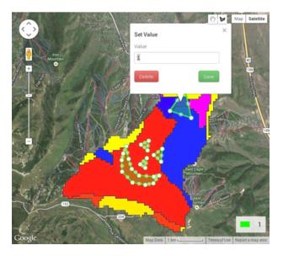
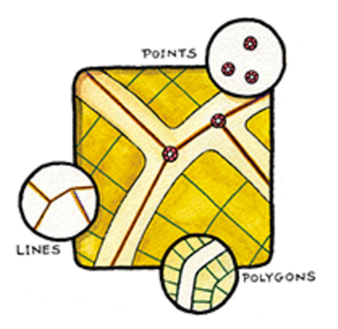
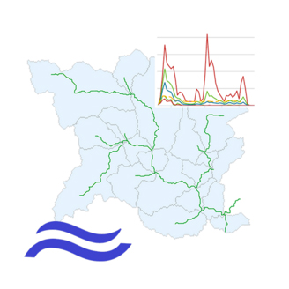
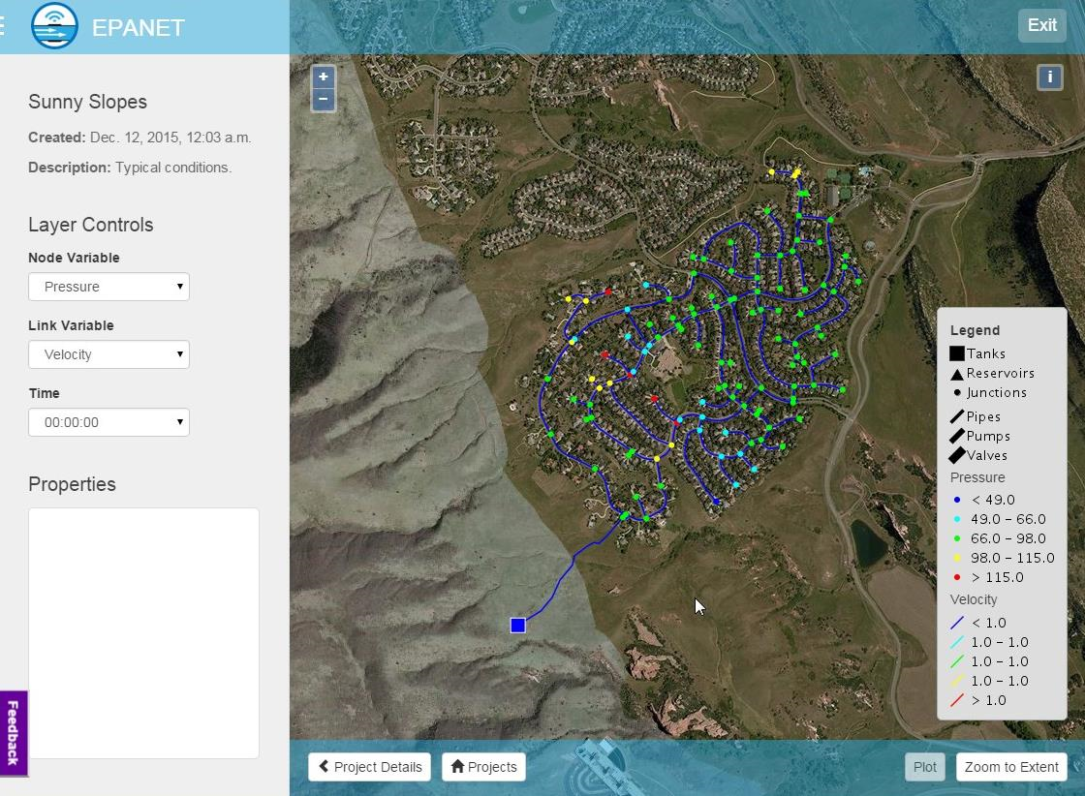
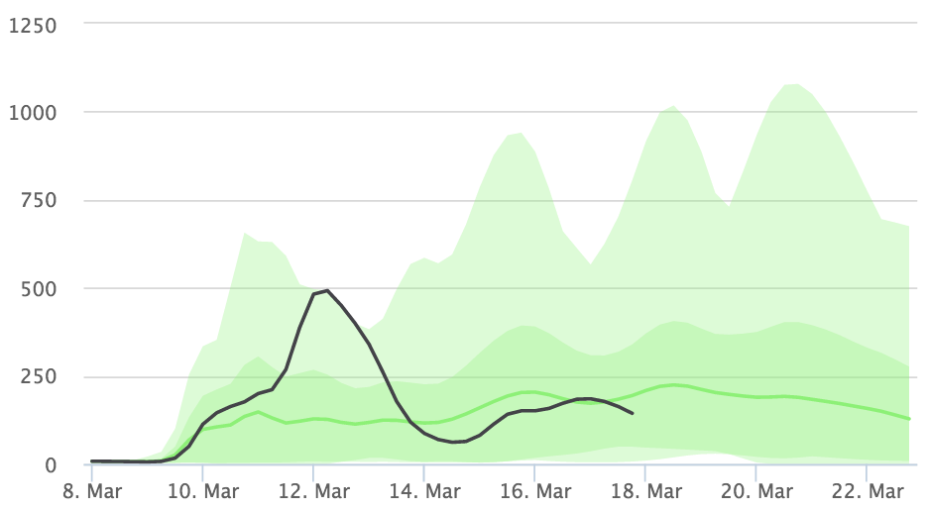
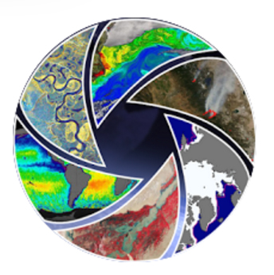
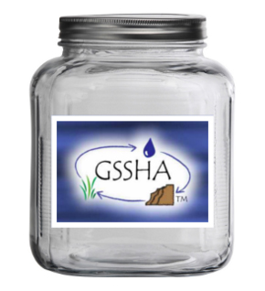
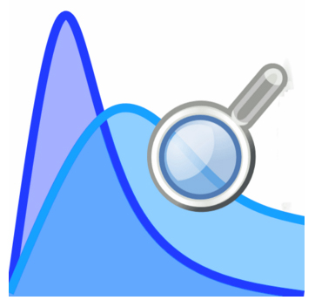
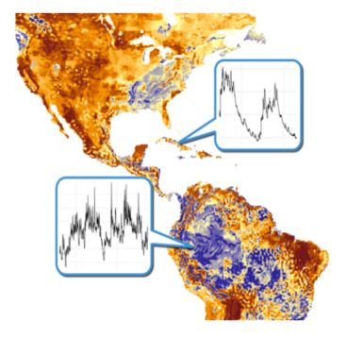
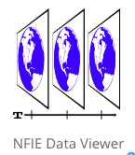
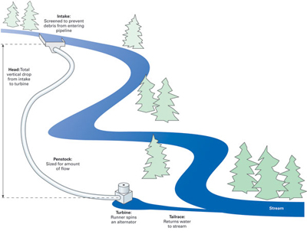
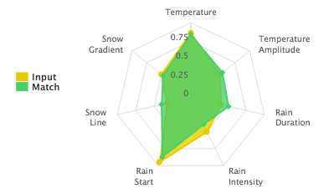
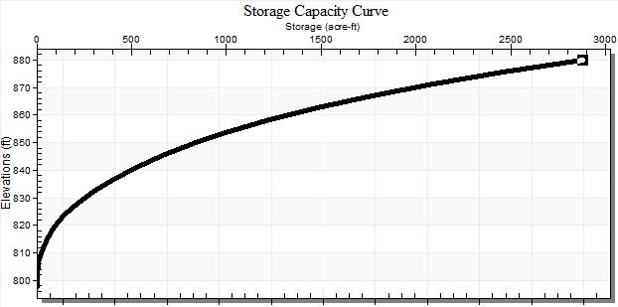
NASA SERVIR PORTAL
ICIMOD NEPAL PORTAL
APP WAREHOUSE
WMO LA PLATA PORTAL

Slide 26
Thank you
Merci

