Slide 1
GEO – WIGOS
Collaboration
Douglas Cripe(GEO Secretariat)
INTER-COMMISSION COORDINATION GROUP ON WIGOS
24-26/01/2019

Slide 2
GEO Strategic Plan
GEO is a coalition of governments and participating organizations having as its mission the implementation of the Global Earth Observation System of Systems (GEOSS) to meet the need for timely, quality long term global information as a basis for sound decision-making.
Earth observations from diverse sources, including satellite, airborne, in-situ platforms, and citizen observatories, when integrated together, provide powerful tools for understanding the past and present conditions of Earth systems, as well as the interplay between them.
(GEO Strategic Plan 2016-2025)

Slide 3
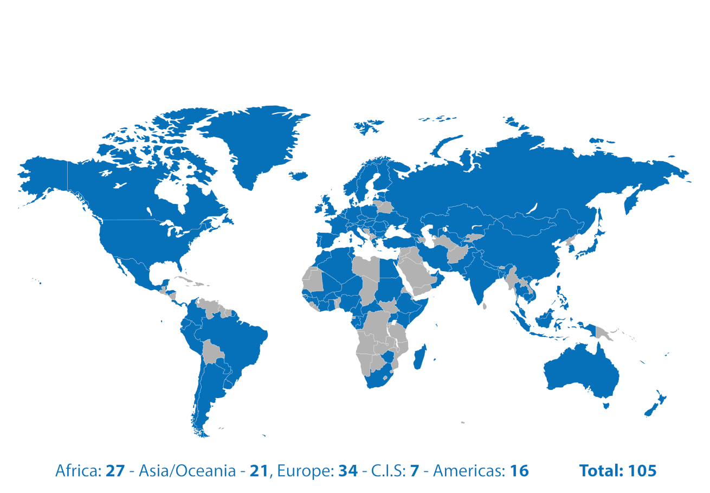
105 MEMBER COUNTRIES

Slide 4
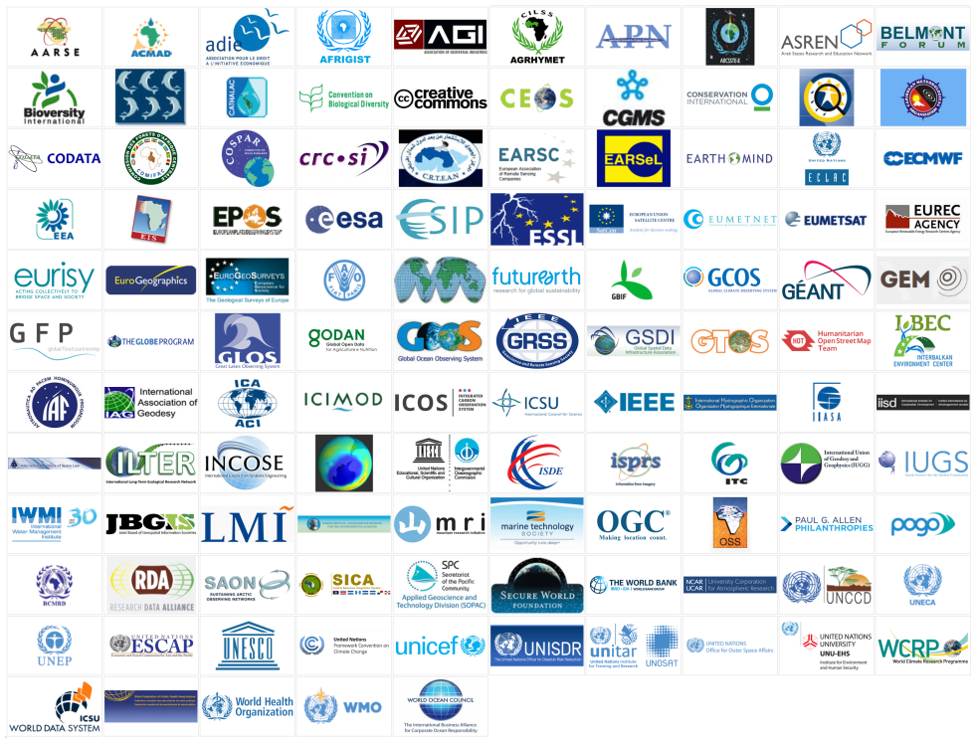
118 PARTICIPATING ORGANIZATIONS

Slide 5
The GEOSS Platform
GEOSS Like
GEOSS API
Status Checker
GEOSS View
Yellow Pages
GEOSS Widget
GEOSS Mirror

Slide 6
The uniqueness of GEO
GEO’s mission is to build the Global Earth Observation System of Systems (GEOSS) to provide global information as a basis for sound decision-making.
GEO is an information technology enabler!
image : shutershock
GEO is the first digital international organization!
Notes:
1

Slide 7
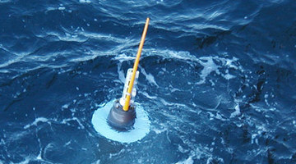
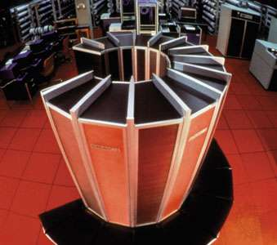
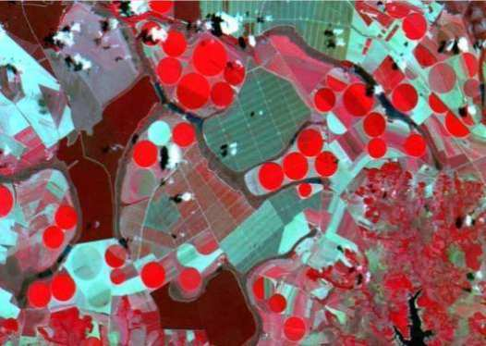
How does GEO work?
data
agreements
community
analysis
Notes:
<number>

Slide 8
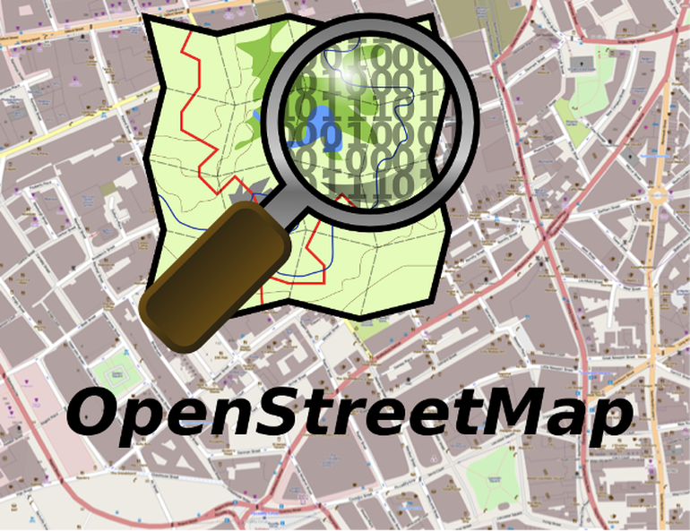
What is the GEO working model?
Commons-based peer production:
the wealth of networks

Slide 9
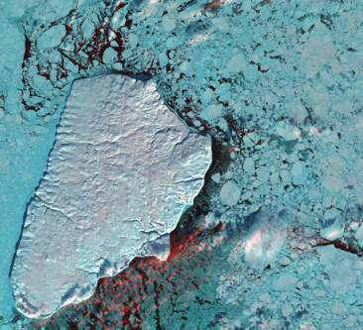
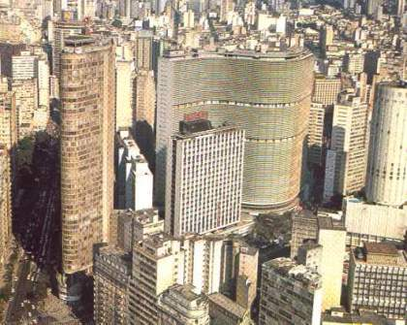
Knowledge and action for sustainable development
Knowledge: informs us about the limits of our planet
Action: societies decide how to use our planet’s resources
Notes:
<number>

Slide 10
Knowledge for sustainable development
Reliable knowledge: communicates its discoveries to society.
Socially robust and reusable knowledge: transdisciplinary, co-designed with stakeholders, open and replicable

Slide 11
The new digital economy
Low access cost
big data
public APIs
massive use
Google, Twitter, Facebook, Spotify, Netflix,…
images: shutterstock

Slide 12
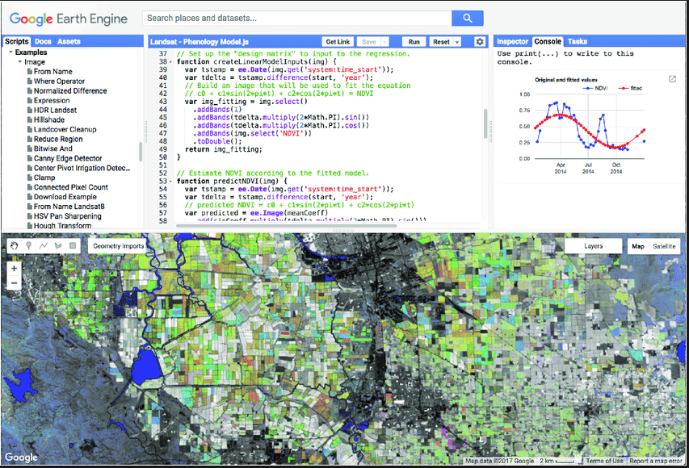
Google Earth Engine: Silicon Valley comes to Earth observations
Global enabler (2.000+ papers): low entry cost to big Earth observation data analysis
but...no public decision on data, no long term guarantee
Notes:
<number>

Slide 13
Why knowledge is becoming easier to share
Using the cloud: focus on mindware, not hardware

Slide 14
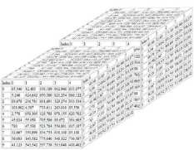
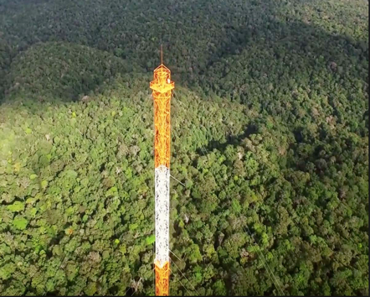
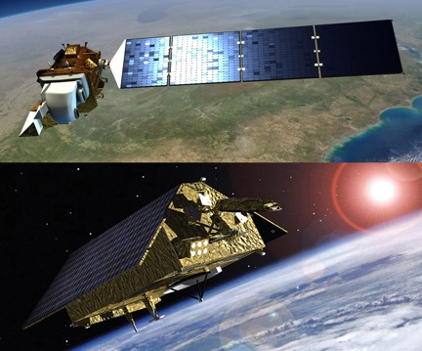
What the global EO community needs
Empowered global experts
Reusable, shared knowledge
Cloud architectures
APIs
APIs
In-situ observations
Multi-satellite data
Notes:
<number>

Slide 15
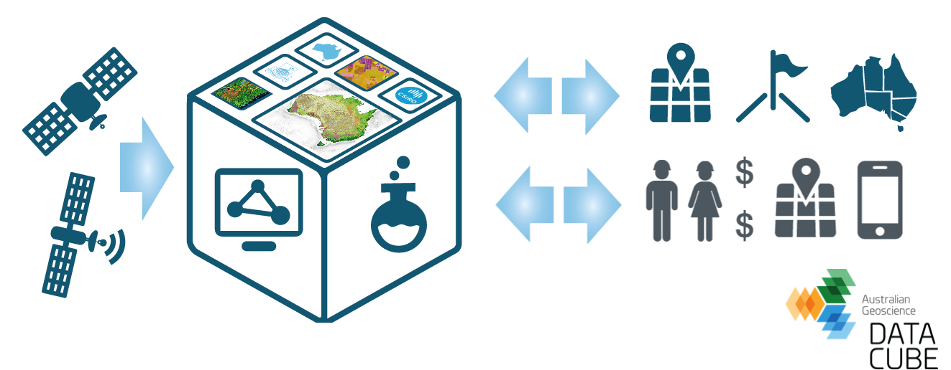
Open data cube: CEOS initiative
Collective effort: build an application library of data analysis methods

Slide 16
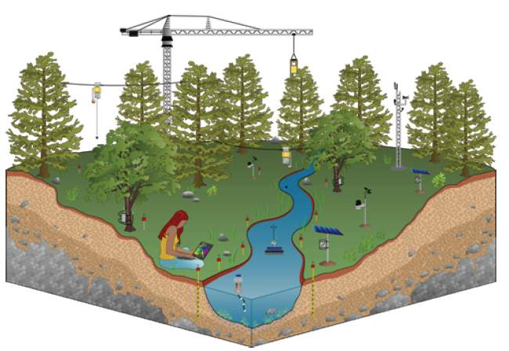
An in-situ EO data repository for GEO
Image: Deborah Estrin (UCSB)
GEO in-situ data cloud
APIs
Notes:
<number>

Slide 17
Where GEOSS is going
metadata hub
Trusted, reproducible, and robust guidance on best use of Earth observation data for decision-making
knowledge hub

Slide 18
The digital economy effect
The Global South will only use EO information which is free at the point of access. How to pay for it?
The Global South will only use EO information which is free at the point of access. Who will pay for it?
Image: Rede Globo (Brazil)

Slide 19
Call for proposals
Governments and research institutions from middle and low income countries (per World Bank)
Proposals should be submitted to GEO with a maximum grant value of US$ 100,000 over three years

Slide 21
WMO-GEO key collaboration areas
1. Development of common protocols and methods to facilitate free and open data access wherever possible;
2.“ Big data” and related emerging issues, e.g. regarding the role of the private sector in Earth observations;
3. Monitoring of greenhouse gases, e.g. through coordination between the GEO Global Carbon Observing and Analysis Systems and the proposed WMO Integrated Global Greenhouse Gases Information System – IG3IS;
4. Promotion of an integrated “Systems of Systems” approach to Earth observations at the regional and national level, e.g. via coordination of regional
5. Radiofrequency coordination, with the aim of protecting frequency bands that are critical to the acquisition and dissemination of Earth observations;
6. Cryosphere activities, as exemplified by GEO Cold Region Activities and the WMO Polar and High Mountain Regions activities, including the Global Cryosphere Watch, Year of Polar Prediction, etc.;
7. Highlighting the role of and strengthening the in situ marine observing systems;
8. Support for the Global Framework for Climate Services priorities: Agriculture and Food Security, Disaster Risk Reduction, Health, Energy and Water;
9. Further exploitation of the synergy of the WMO Information System (WIS) global and national infrastructure (GISCs, DCPCs and NCs) and the GEO Common Infrastructure (GCI);
10. Joint activities to quantify and highlight the socioeconomic benefit of Earth observations;
11. Joint activities to identify and document user needs for information for decision-making and Earth observations.

Slide 22
Based on above-mentioned achievements and recommendations, focusing on the WIGOS contributions to GEOSS in particular its Foundational Tasks, following tasks can be identified with potential collaborations:
Advancing GEOSS Data Sharing principles; Proposed contribution: WIGOS to contribute to the task for sharing the practices in WMO efforts on open data and for making joint efforts on more open data.
GCI Operation; Proposed contribution: WIS through Germany DWD-GISC to contribute to the task for continuing improvement of the WIS and GCI interface.
GCI Development; Proposed contribution: WIS through Germany DWD-GISC to contribute to the task for continuing improvement of the WIS and GCI interface.
Global Observing and Information Systems ; Proposed contribution: WIGOS and WIS to lead the task and start leveraging and promoting WIGOS OSCAR, WIGOS 2040 Space vision activities and WIS to GEO for seeking the way to integrate WIGOS and WIS into GEOSS effectively and also for involving more systems to take part in this task.
GEONETCast: Proposed contribution: EUMETSAT, NOAA and CMA have committed their continuous leading and contributing the task.
GEOSS Satellite Earth Observation Resources; Proposed contribution: CEOS and its member space agencies are leading the task. It would be worthwhile WIGOS and CGMS to participate to the task in order for more systematic coordination between R&D and Operational satellite providers to ensure the long-term availability of the data. WIGOS to seek opportunities to have dialogues with CEOS.
GEOSS in situ Earth Observation Resources; Proposed contribution: WIGOS to contribute to the task and start leveraging and promoting WIGOS activities on in situ for seeking the way to show value of GEO coordination across different in situ systems.
Systematic determination of user needs / observational gaps; Proposed contribution:WIGOS to contribute to the task through leveraging the Rolling Requirement Process.
Radio Frequency Protection; Proposed contribution: WIS to lead the task leveraging through SG-RFC process.

