Slide 1
The Global Observing System for Climate
GCOS Update
Document 10.2
ICG-WIGOS-8, Geneva (Jan 2019)
GCOS Secretariat, WMO
Tim Oakley, GCOS Network Manager

Slide 2
GSN Monitoring (2018)

Slide 3
GUAN Monitoring (2017)

Slide 4
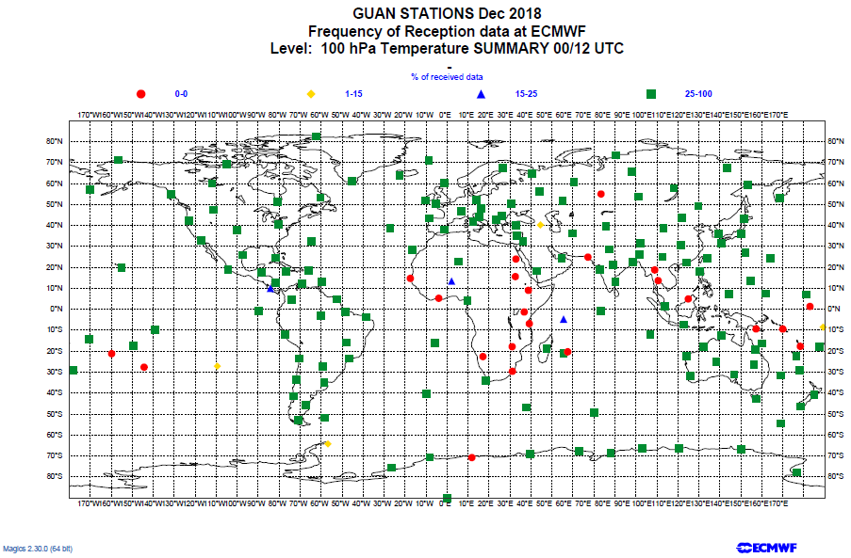
GUAN Monitoring (December 2018)

Slide 5
GCOS Cooperation Mechanism 2018 & 2019
The GCOS Cooperation Mechanism is the system improvement and resource mobilization activity of the GCOS programme. It has been established following a decision by the UNFCCC SBSTA in 2004 (UNFCCC Decision 5/CP.5) in order “to enable developing countries to collect, exchange, and utilize data on a continuing basis in pursuance of the UNFCCC”. Since then, more than 3.5 million USD have been raised over the years to accomplish projects dedicated to improve climate observation systems.
Project to re-establish and upgrade the upper-air stations in Kenya, Tanzania and Uganda.
GCOS working with the HIGHWAY project, as managed through WMO, providing the technical expertise and managing the procurement (through WMO) and the implementation.
400kEuro using HIGHWAY (UK) and GCOS funds
Project to restock the upper-air station in Yerevan, Armenia and Gan, Maldives
GCOS supporting the operations of GUAN stations following the request from Armenia and the Maldives. Providing the technical expertise and managing the procurement (through WMO).
100kEuro using GCOS funds kindly donated by Germany and Japan
Providing technical expertise and working with WMO Members to implement a sustainable system according to WMO regulations and requirements, subject to available funds

Slide 6
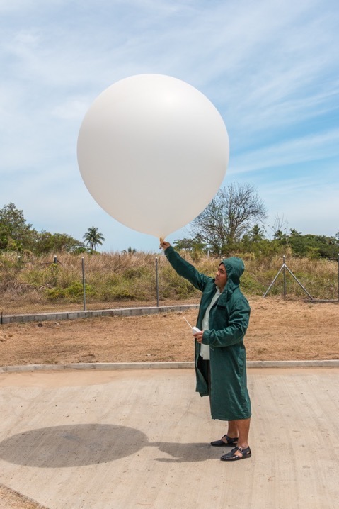
South Pacific – Fiji:
East Africa – Uganda:
Earth Observations: How to support the Paris Agreement goals
Countries cannot afford the consumables needed to operate an upper air station.
Countries cover huge expanses of ocean with poor and slow communications and transport.
Insufficient reporting to meet climate and weather needs.
Lack of planning for sustainable operation.
GCOS Secretariat, WMO
Carolin Richter

Slide 7
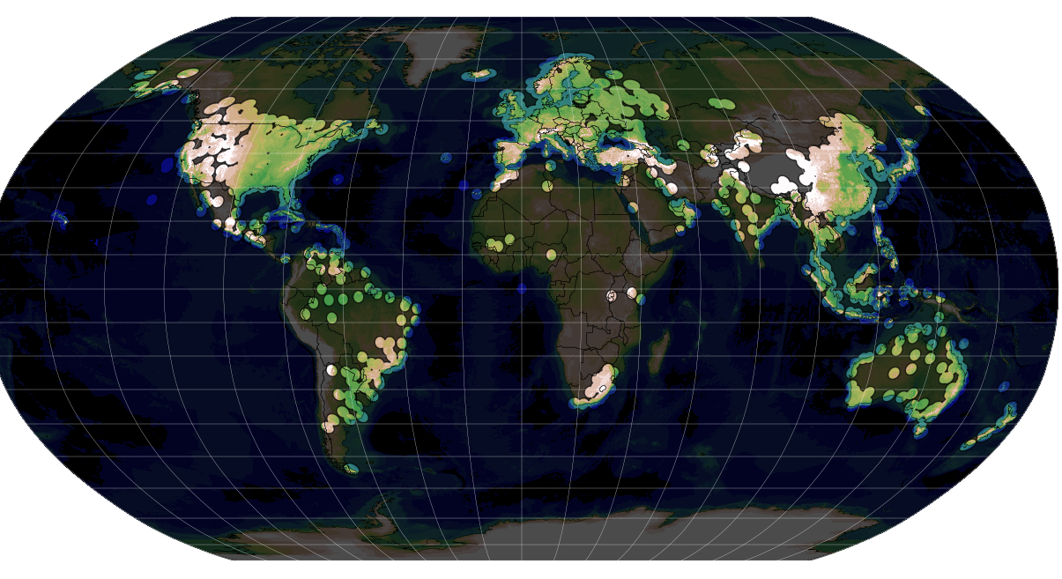
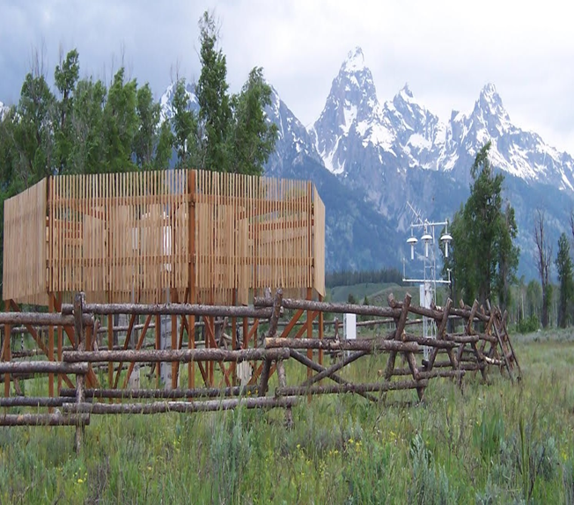
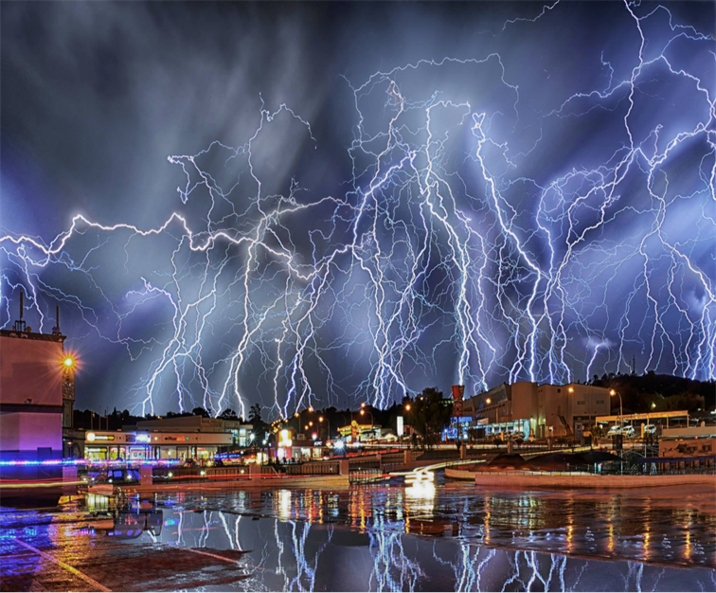
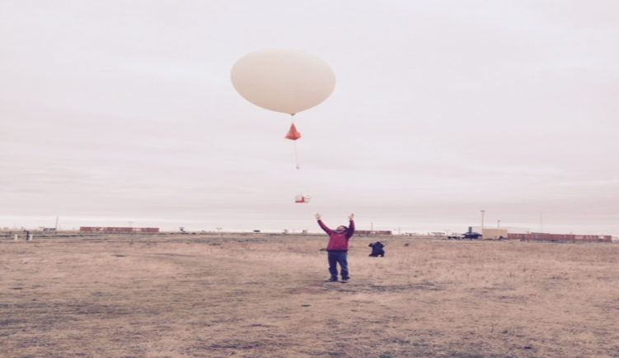
AOPC Task Teams
Radar for Climate
The GCOS Surface Reference Network (GSRN):
Lightning Observations for climate
The GCOS Upper-Air Network Task Team (GUAN TT)

Slide 8
Collaboration with IPET-OSDE for OSCAR/requirements
AOPC has provided input for the updates of the OSCAR/requirements for the climate monitoring application area and participated in the IPET-OSDE workshop December 3-4 2019 on updating OSCAR/requirements.
Outcome:
For surface and upper-air ECV:
Current ECV products mapped to the existing OSCAR variables when possible
New variables added in OSCAR when required
Definitions for the ECV products in OSCAR/variables provided
Next steps work with GAW:
Atmospheric composition: to consolidate list of ECV products to be included in OSCAR/Requirements and relative definitions.
Aerosols: to consolidate ECV products.
Results for Atmospheric composition and aerosol to be discussed with IPET-OSDE.

Slide 9
An Ocean of Opportunity
The OceanObs’19 conference is a community-driven conference that brings people from all over the planet together to communicate the decadal progress of ocean observing networks and to chart innovative solutions to society’s growing needs for ocean information in the coming decade.
September 16-20, 2019
Hawai’i Convention Center
Honolulu, HI, USA
Conference Themes
Program Objectives
Observing System Governance
Information: how do we meet future user needs?
Interoperability: how can we better communicate among observing systems to deliver products for users that follow usability and other best practices across the globe?
Innovation: how can we spur innovation in observing technologies, products, and user services?
Integration: how can we balance user and operator needs, capabilities, and knowledge worldwide?
Data & Information Systems
Observing Technologies & Networks
Discovery
Ecosystem Health & Biodiversity
Climate Change & Variability
Water, Food, & Energy Securities
Pollution & Human Health
Hazards & Maritime Safety
Blue Economy
Input
Attend
140 Community White Papers under review
Open Call for Breakout Sessions and Side Events!
Registration for the conference is now open!
For more info: www.oceanobs19.net or info@oceanobs19.net

Slide 10
Requests to ICG-WIGOS-8
Take note of the work of GCOS particularly that of direct relevance to WIGOS
Take particular note of the further deterioration in the observing networks being monitored by the GCOS Network Manager; and take every opportunity to communicate this to WMO Members and seek ways to resolve this.
Request that ICG-WIGOS advises and supports GCOS in the communication of the observational activities that require WMO members collaboration, in particular that of the proposal for a GCOS Surface Reference Network (GSRN), the redesign of the GCOS Upper Air Network (GUAN) and the further implementation of the GCOS Reference Upper Air Network (GRUAN).
Requests ICG-WIGOS consider how WMO should engage in the OceanObs’19 Decadal Conference, which will set the forward agenda for sustained observations of the ocean. WMO has been invited to sponsor the conference (financially and intellectually), but currently isn’t formally engaged.

Slide 11
The Global Observing System for Climate
Thank you
gcos.wmo.int

