Slide 1
WMO HYDROLOGICAL OBSERVING SYSTEM
architecture and implementation
Action Item no 4.1.8
Silvano Pecora
Vice-President of CHy
INTER-COMMISSION COORDINATION GROUP
ON WIGOS
ICG-WIGOS-7
15-17 January 2018, Geneva

Slide 2
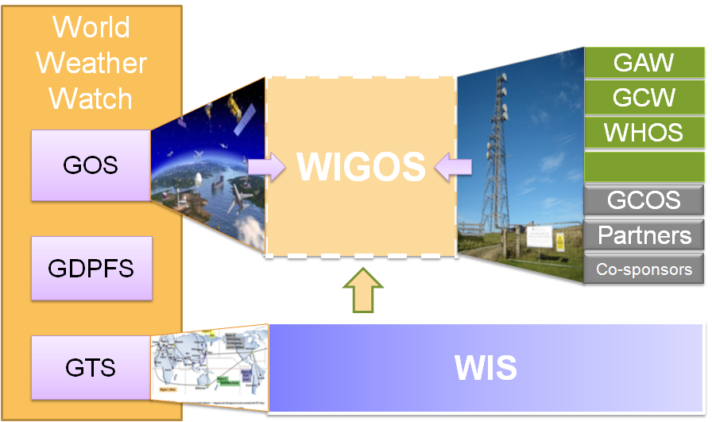
WMO INTEGRATED GLOBAL OBSERVING SYSTEM (WIGOS) and WMO HYDROLOGICAL OBSERVING SYSTEM (WHOS)
In June 2015 the President of CHy informed Cg-17 of CHy proposal to develop WHOS as the CHy contribution to WIGOS
Congress welcomed the effort and urged the president of CHy to continue guiding WHOS to full implementation
Congress urged the promotion of WHOS among NHSs and the hydrological community

Slide 3
WMO Hydrological Observing System (WHOS)
Implementation:
Phase 1:
Map interface with links to those NHSs that make their real-time and historical stage and discharge data available online. implemented in August 2015.
Phase 2:
A fully WIS/WIGOS compliant services-oriented framework linking hydrologic data providers and users through a hydrologic information system enabling data registration, data discovery, and data access.
Beta version for CHy-15 review and endorsement (Dec 2016)
Initial implementation for EC approval (June 2018)

Slide 4
Commission for Hydrology 15th session
Resolution 4.1(3)
WMO
Approves further implementation WHOS Phase I and
initial concept of WHOS Phase II.
Requests AWG, with support of WMO Secretariat,
to develop initial implementation plan encompassing
governance, architecture, relationships with WIGOS
and WIS centres, provision of metadata into OSCAR
and a clear definition of the roles of CHy, the Secretariat,
the global data centres, and the NMHSs, to be presented
to EC-70 in 2018 for endorsement.

Slide 5
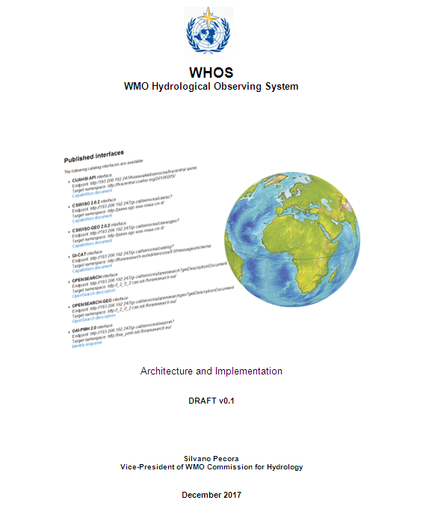

Slide 6
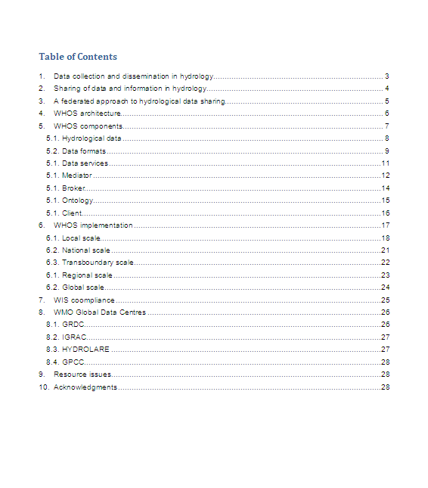

Slide 7
Interoperability and Information Flow
Special Data View
Common Ontology services
Regional nodes synchronization service
Community Nodes
… .
… .
Regional Nodes
… .
National/Local Data Systems
Europe
Africa
Asia

Slide 8
WHOS interfaces
OAI-PMH interface endpoint can be used to harvest WHOS content as:
Dublin core
ISO 19139
2006 schema
2007 schema
Wigos Metadata Standard
http://arpa-er.geodab.eu/gi-cat-arpa/services/oaipmh

Slide 9
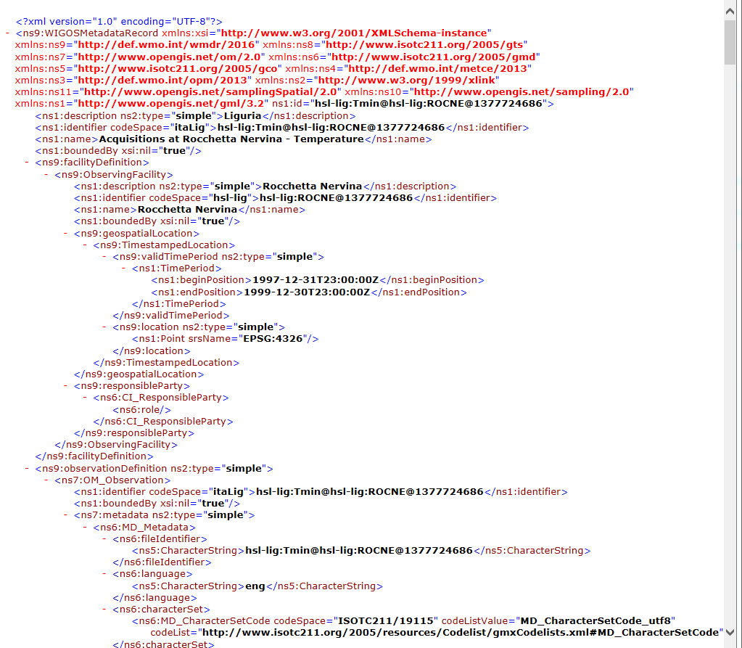
jOAI Harvester – the result
A folder containing about 80.000 records encoded according to Wigos metadata standard
E.g.

Slide 10
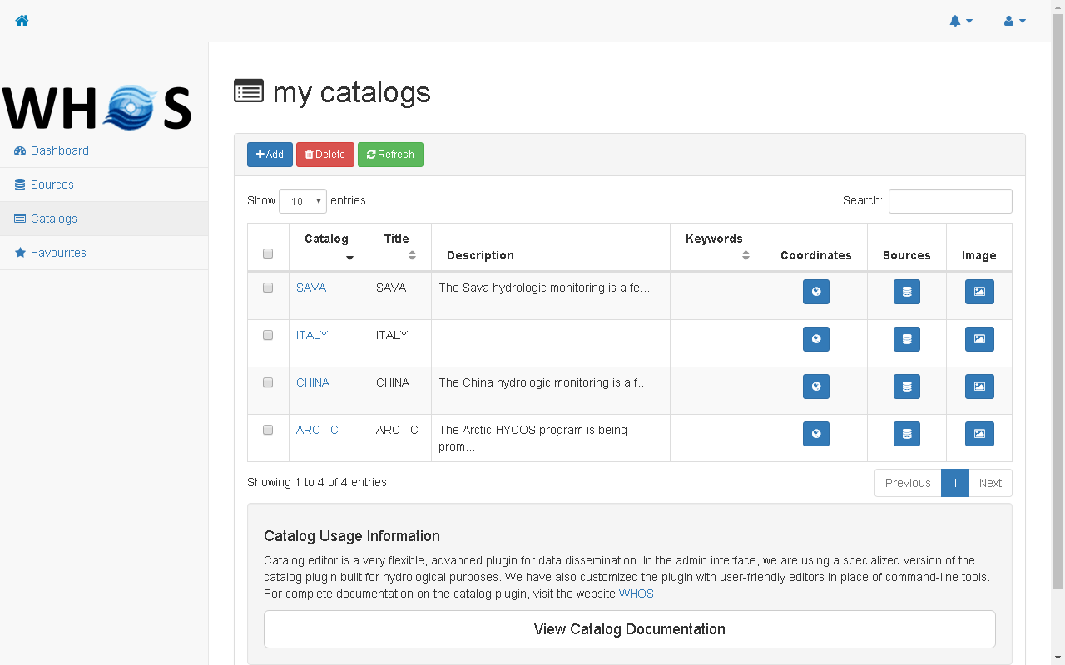

Slide 11
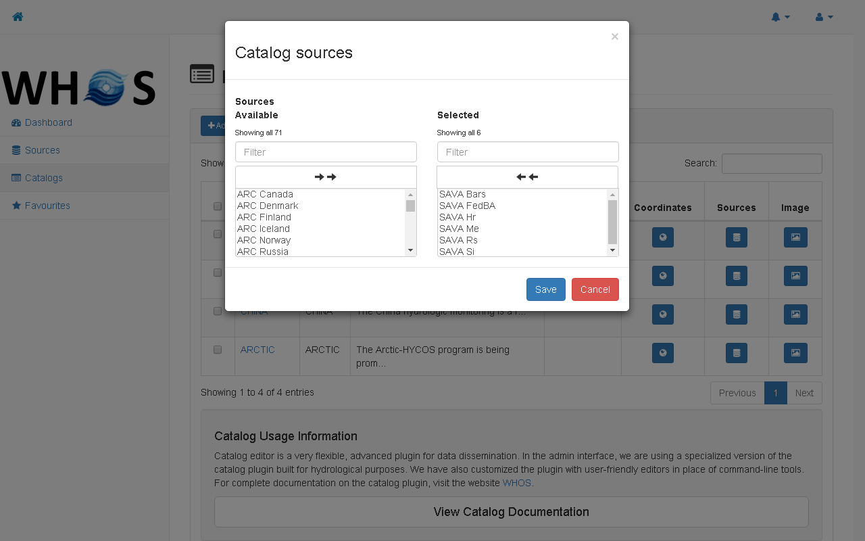

Slide 14
CHy-15 AWG WORKPLAN
Focus Area: Coordination and Implementation Support

Slide 16
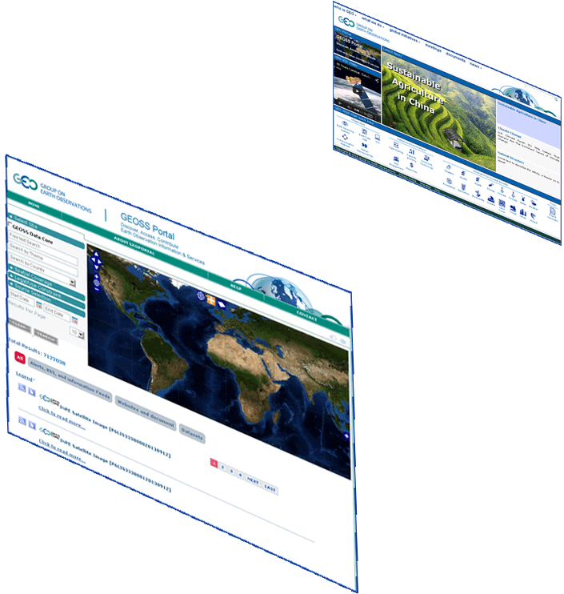
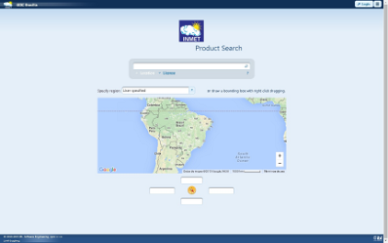
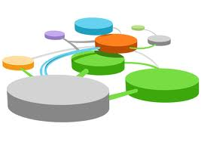
Hydrologic Information System in the Plata basin
CIC
Home Page
GISC Brasilia
Home Page
Argentina
Bolivia
PLATA HIS Portal
5 national
brokered systems
Brasil
Paraguay
Broker
and
Mediator
Systems
Registry
Semantic engines
Uruguay
...
.. .
Brokered Data Providers (capacities, systems, networks, etc.)
.. .
.. .
Hydrologic tools (tested interoperability)

Slide 17
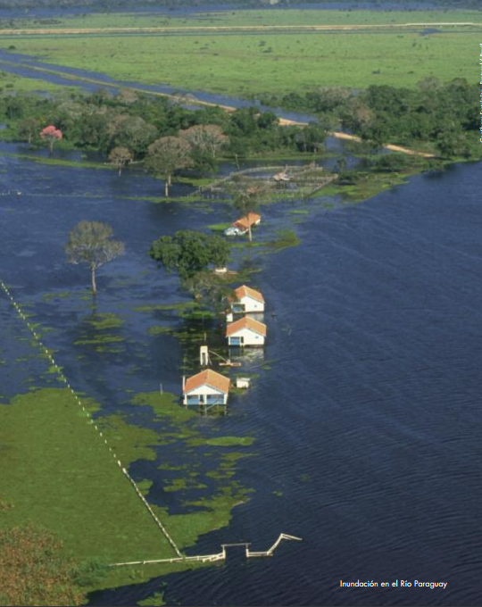
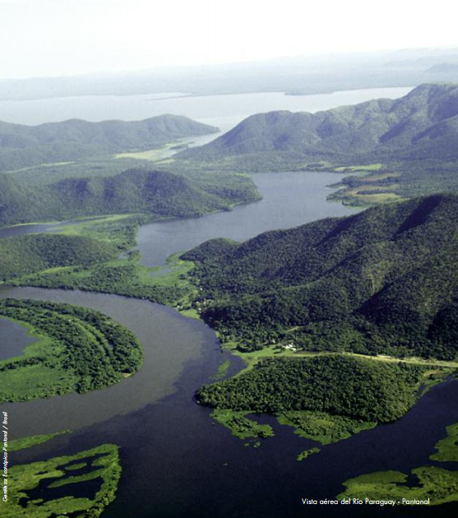
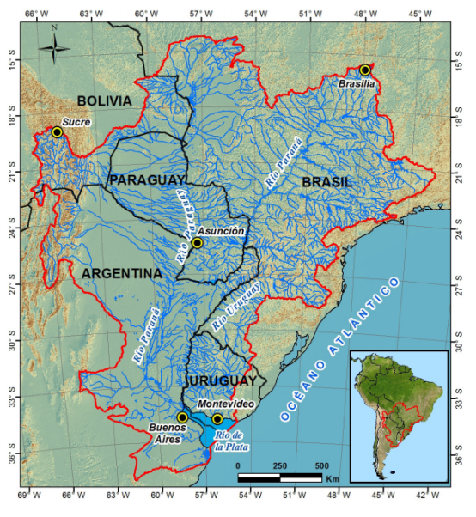
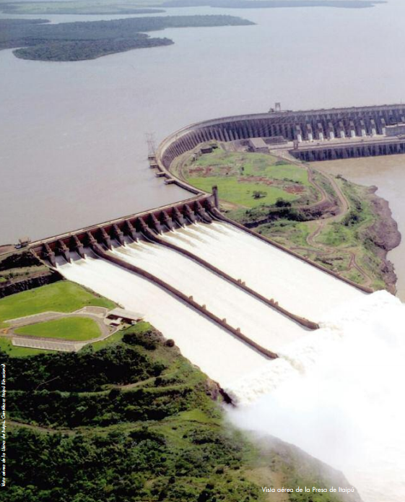
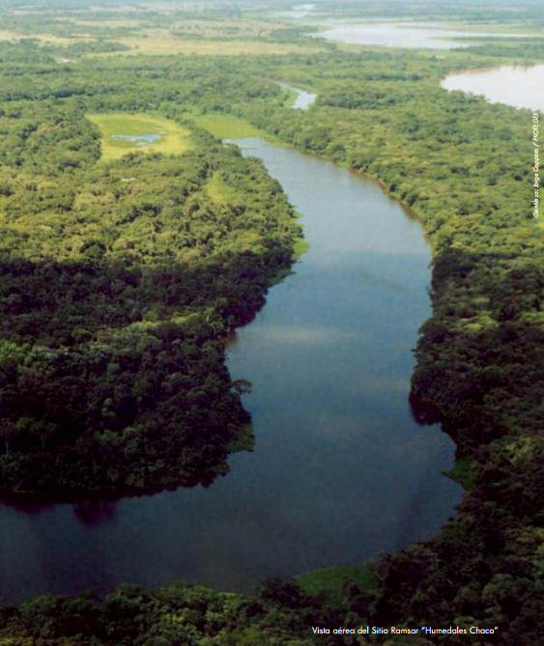
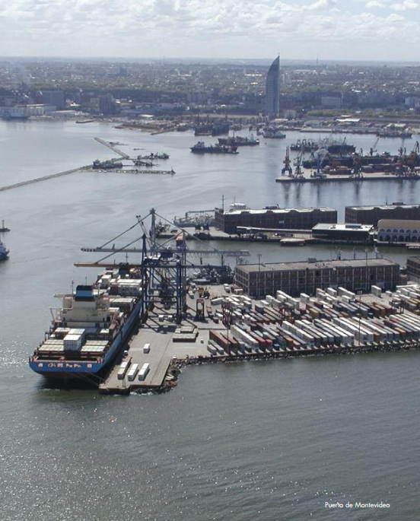

Slide 18
HIS in La Plata Basin

Slide 19
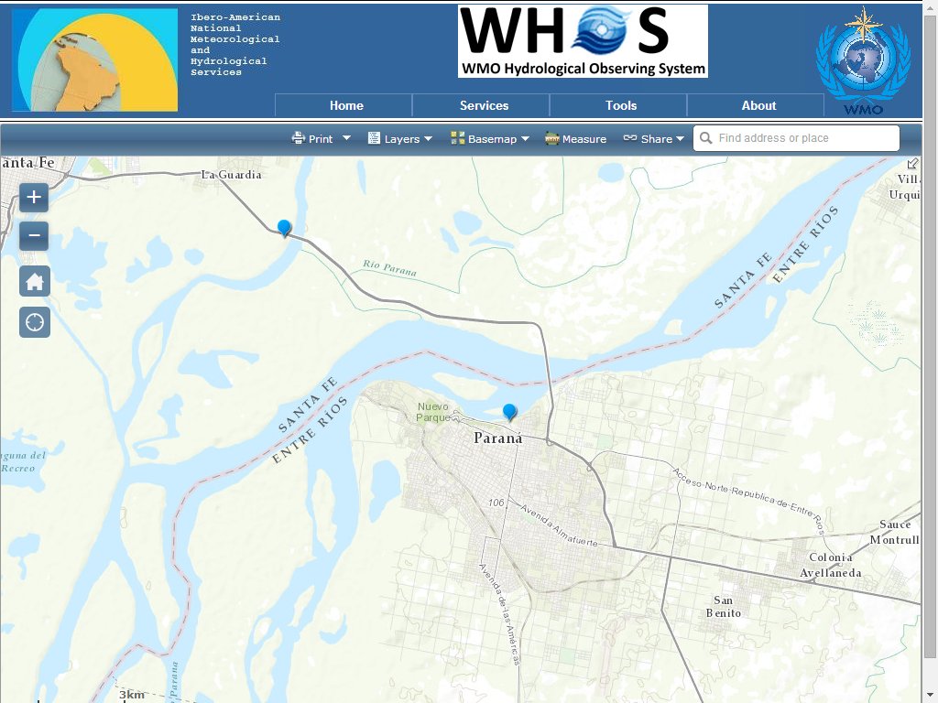
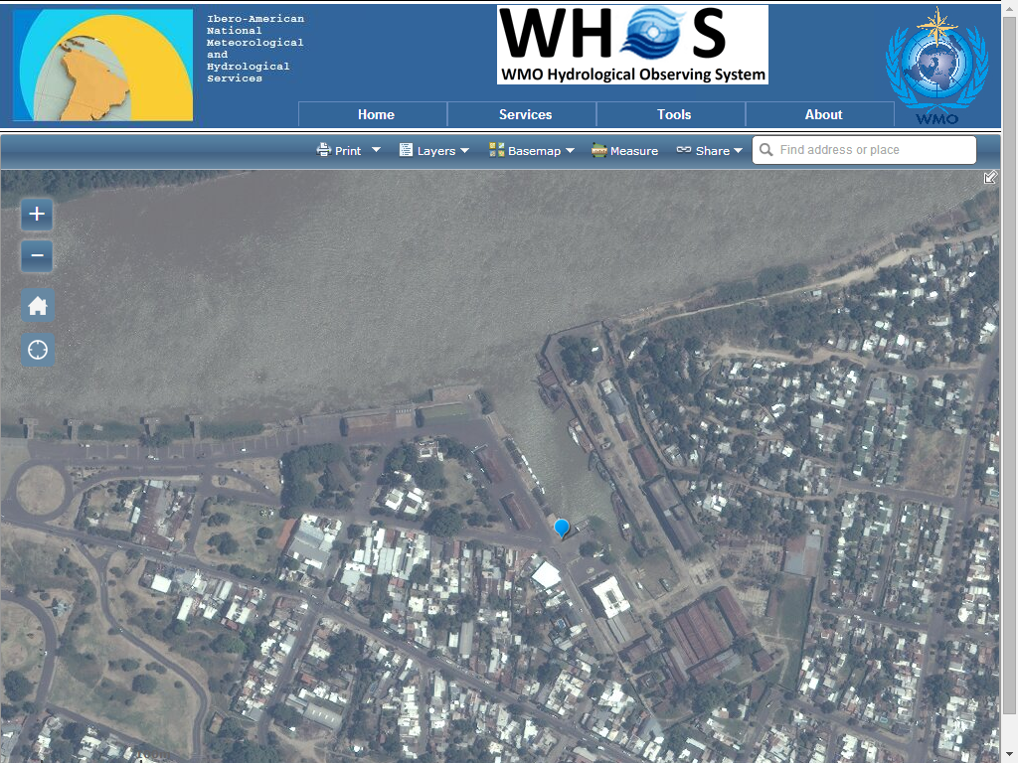
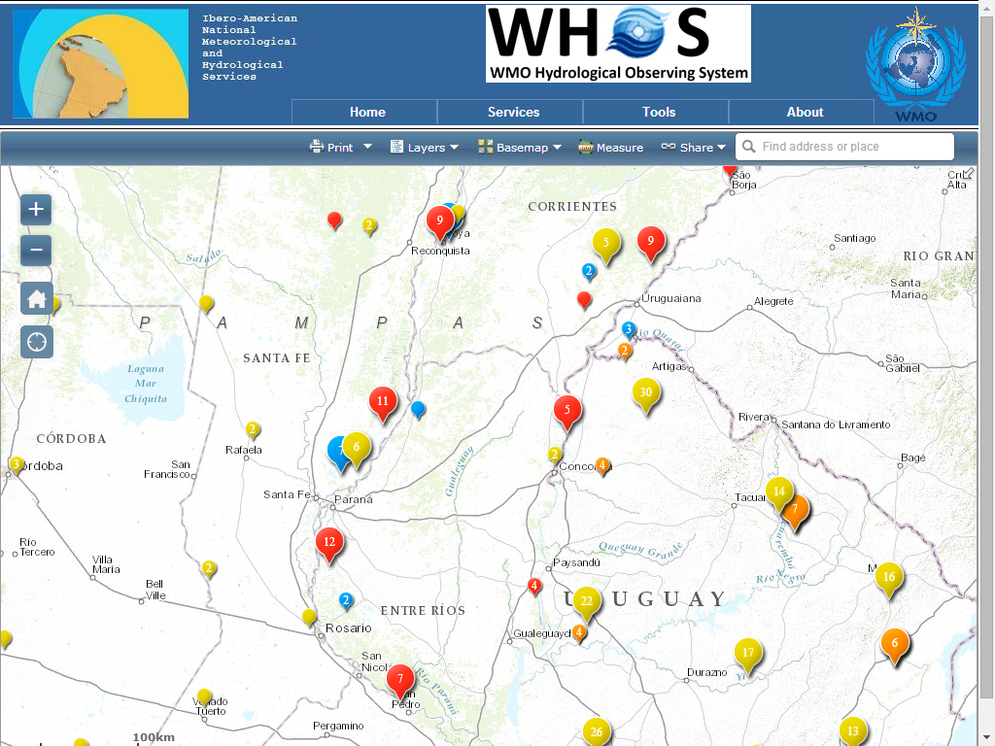
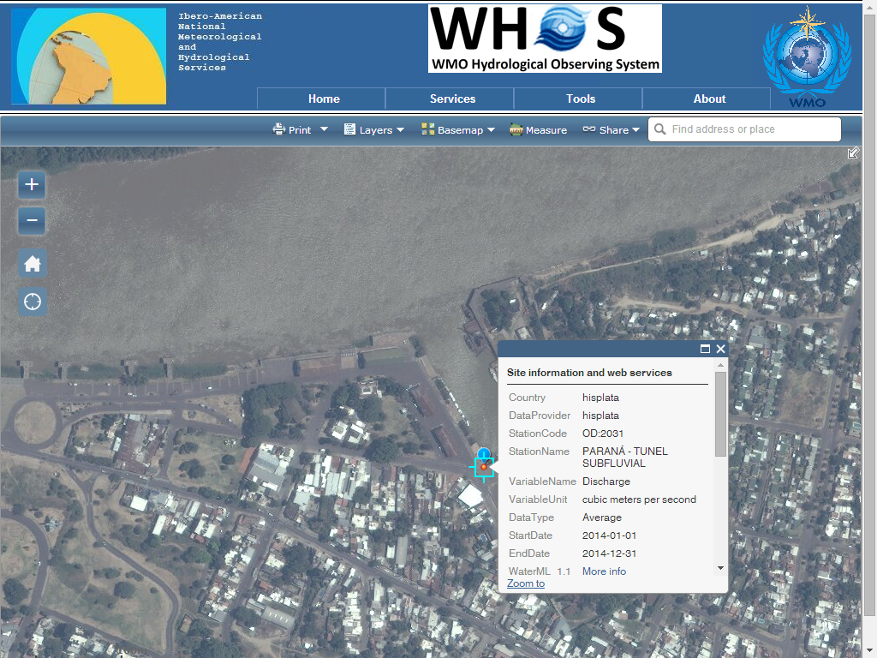
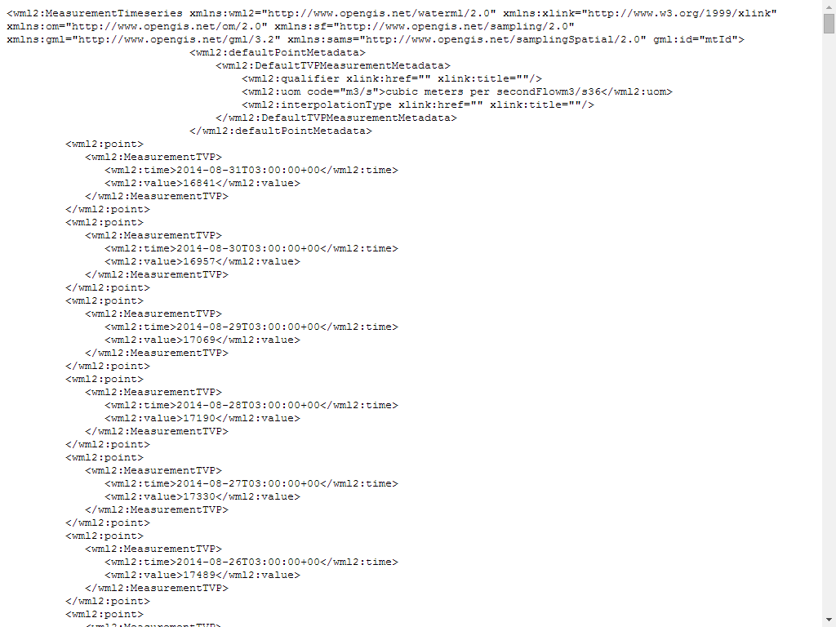
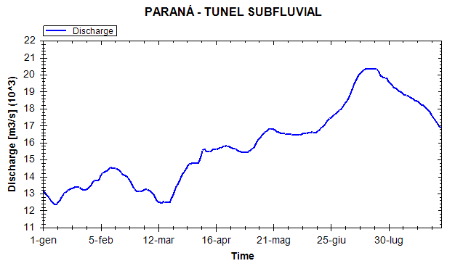

Slide 20
LA PLATA HIS
The system has been successfully used as follows:
definition of a monitoring network of hydrological and meteorological stations maintained by countries belonging to the La Plata basin;
analysis and optimization of the hydrological monitoring network at the basin scale;
increased collaboration between countries to improve network design and lower costs;
collaborative calibration of hydro-meteorological instruments;
free exchange of meteorological and hydrological observations;
common policies to control data quality;
and creation of archives of hydrological data allowing improved services and responses to natural disasters.

Slide 21
ACTIVITIES for THE OPERATIONAL PLATA HIS
Upstrean activities
Porting the current prototype of Plata HIS in the GISC of Brasilia
Porting and evolution of data systems in each country
Midstream activities
Optimisation of the distributed architecture (GISC and NHSs)
Ontology extension
Downstream activities
Development of a Plata web portal as the Plata HIS interface
Training and documentation
Training on the broker and mediator installed in Brasilia (Gi-Suite)
Training on the current data systems (hydroservers in Brasilia), web and desktop clients (hyrodesktop)
Training on new data systems (defined by countries)
Training on the Plata web portal
Production of manuals and user guides

Slide 22
ROADMAP of THE OPERATIONAL PLATA HIS
Mar 2018: Porting of current Plata HIS in Brasilia
Dec 2018: Evolution of Plata HIS as a distributed architecture
Jun 2019: Testing of the distributed architecture of Plata HIS
Dec 2017: Final project technical document
December 2019
Operational
PLATA HIS
D.4, D.5
A.2, B.1, B.2, D.3, D.4
A.1, D.1, D.2, D.4

Slide 23
Thank you
Merci

