Slide 1
Key topics
for WMO Space Programme
in 2017
WMO Space Programme Office
ICG-WIGOS-6, 12-14 January 2017

Slide 2
Contents
User Readiness for New-Generation Meteorological Satellites
Physical Architecture for Climate Monitoring from Space in support of GFCS and DRR
2040 Vision on WIGOS Space, and activities in support of the WMO RRR Process
Exchange and Availability of Satellite Data on WIS
Space Weather Services (Four-year Plan: 2016 - 2019)

Slide 3
User Readiness for New-Generation Meteorological Satellites
Best practices developed, and adopted by CBS-16, for NMHSs on how to achieve user readiness, and for satellite operators in CGMS to support this process.
The CBS Inter-Programme Expert Team on Satellite Utilization and Products (IPET-SUP) has the lead role in WMO to improve user readiness
These need to be promoted and put in place, through:
raising awareness with WMO Members, using the SATURN Portal
RA-based satellite data user groups (focus on RA-II, III, IV, V)
VLab-based training activities
the WMO-CGMS International Science Working Groups

Slide 4
Physical Architecture for Climate Monitoring from Space in support of GFCS and DRR
To optimize the contribution of the space-based WIGOS and derived datasets to climate applications and services (GFCS)
Identify the space-based components of WIGOS in support of climate, including current and future gaps
Foster the coordinated generation of satellite-based ECV records and other climate datasets, and support the assessment of maturity and quality
Address the requirements of RCCs and other operational centres (GPCs etc) for satellite-based climate datasets, and foster their utilization, e.g., for monitoring extreme events

Slide 5
2040 Vision on WIGOS Space, and activities in support of the WMO RRR Process (1/2)
Further consolidating the current draft 1.0 of the “Vision for the WIGOS Space-based components in 2040”, and broadening its ownership by satellite agencies and data user communities.
Collect comments from WMO Members and from additional user groups (including the research community) and from satellite agencies (through CEOS), and incorporate these into a new draft
Combine the new draft Vision WIGOS Space with the equivalent Vision for the surface-based WIGOS components

Slide 6
2040 Vision on WIGOS Space, and activities in support of the WMO RRR Process (2/2)
Establishment of a sustainable framework for managing OSCAR/Space v2 in support of the WMO Rolling Review of Requirements
Seek support of the Satellite Operators and Space Agencies (CGMS and CEOS), and Global Space-based Inter-Calibration System (GSICS) Executive Panel and WGs Members by implementation of OSCAR/Space v2 Support Team and Science and Technical Advisory Team
OSCAR/Space v2 has become the community reference resource for satellite metadata (e.g., launch date, payloads, time lines) and capabilities (e.g., instruments measuring which variables)

Slide 7
Exchange and Availability of Satellite Data on WIS
Foster documentation of global satellite data exchange requirements of global NWP centres (through GODEX-NWP)
Update documentation of regional satellite data requirements, through the Region-based satellite user groups
Implement consistent monitoring of DBNet (Direct Broadcast Network for near real-time relay of low-Earth orbit satellite data) performance, and improve timeliness and implement WIS metadata standard for DBNet products
Promote use of satellite data-specific WIS metadata standard, recently adopted by CBS-16
Initiate prototype for monitoring of global satellite data availability (by ECMWF, GISC Tokyo)

Slide 8
Space Weather Services (Four-year Plan: 2016 - 2019) (1/2)
Objective of developing the WMO’s initiative for worldwide coordination of Space weather services responds to the growing demand of WMO Members for space weather services
Cg-17 requested CAeM and CBS to consider existing responsibilities, working mechanisms, expert teams and integration within relevant WMO Programmes in finalizing a draft “Four-year Plan for WMO Coordination of Space Weather Activities (the Plan)”
EC-68 approved the Plan, and requested CAeM and CBS to establish Inter-Programme Team on Space Weather Information, System and Services (IPT-SWeISS)
WMO Space Programme, Aeronautical Meteorology Division, and Data-processing and Forecasting Division will jointly coordinate and promote Space Weather in WMO.

Slide 9
Space Weather Services (Four-year Plan: 2016 - 2019) (1/2)
An urgent need for accelerated action in 2017 through:
Implementation of a Space weather basic system, including issues related to observation techniques and networks, data management and exchange, data centers, and space climatology
Promoting of Space weather science, including issues related to modelling, model evaluation and verification, interaction with climate, and transition from research to operations
Development of Space weather application, including requirements evaluation, the delivery of services, capacity building and user interaction
Oversee the development and review of OSCAR so that it meets the needs of WIGOS for information concerning user space weather observing system capabilities

Slide 10
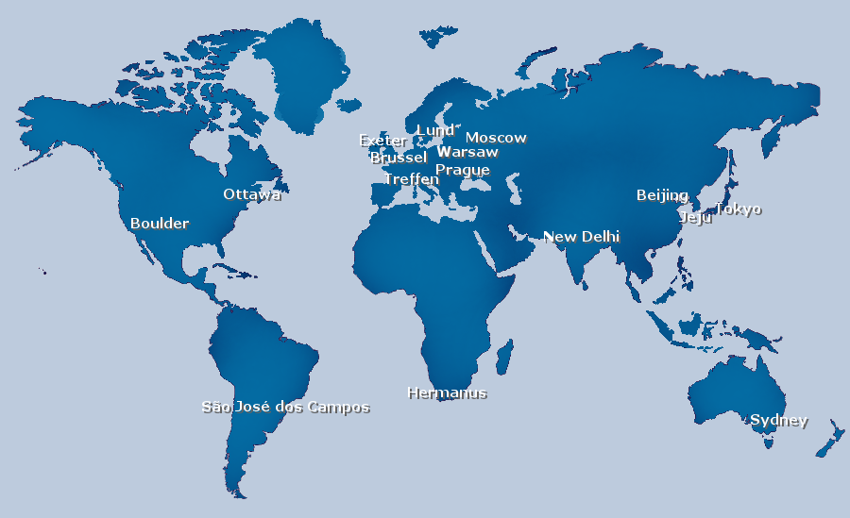
ISES (International Space Environment Services) Members
Eighteen Members distributed around the globe. These centers are located in China (Beijing) , USA (Boulder), Russia (Moscow), India (New Delhi), Canada (Ottawa), Czech Republic (Prague), Japan (Tokyo), Australia (Sydney), Sweden (Lund), Belgium (Brussels), Poland (Warsaw), South Africa (Hermanus), South Korea (Jeju), Brazil (São José dos Campos), Austria (Treffen), UK (Exeter), Mexico and Indonesia. The European Space Agency (Noordwijk) is a collaborative expert center providing a venue for data and product exchange for activities in Europe. In addition, the Associate Warning center in France (Toulouse) provides specialized services to customers, and is affiliated through RWC Belgium.
Morelia
Bandung

Slide 11
IPT-SWeISS Members (Nominated)
Seventeen WMO Members are nominated as of January 2017
Core-member
XiaoXin ZHANG (CMA, China) – Chair (CAeM)
Robert David RUTLEDGE (NOAA, USA) – Co-chair (CBS)
Paul Davis (UK), Yuki HONDA (Japan) – Co-Chairs (OPAG DPFS)
Associate-member
Argentina, Australia, Brazil, Canada, France, Germany, Italy, Japan, Korea, Netherland, New Zealand, Russia, South Africa, Switzerland, UK
UN or Intergovernmental Organization
ESA, ISES, ITU, ICAO, UNOOSA
Anthony Mannucci (US) – Rapporteur of IROWG
Expecting participation from WMO Members: Poland, Indonesia

Slide 12
Thank you

