Slide 1
ICG-WIGOS 6
WIS Status Report
Agenda Item 6.1
David Thomas
Chief Information & Telecommunication System Division. WMO
13 Jan 2017. Geneva

Slide 2
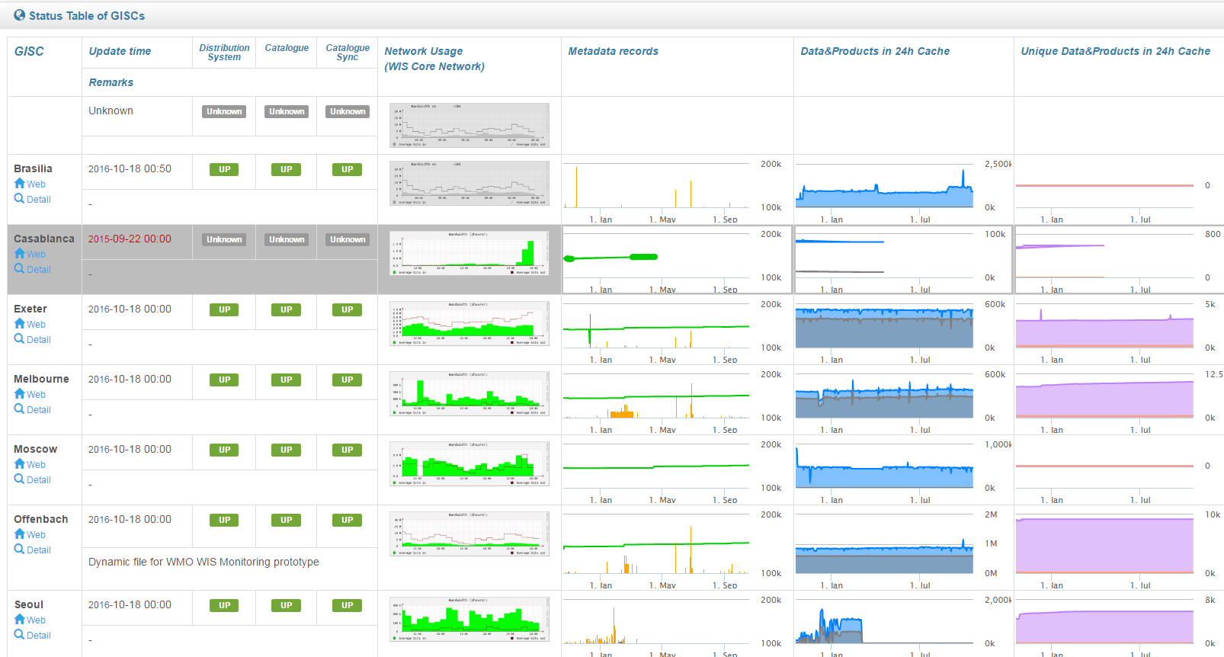
WIS is Operational
https://wiswiki.wmo.int/WIS-Status

Slide 4
WIS Status
Part A: Evolution of the GTS and opening to all programmes (324 centres approved/371 identified).
CAeM(6/9), CAgM(2/3), CAS(3/5), CCl(12/14), CHy(4/5), JCOMM(8/11)
Many potential contributors still not sure how to publish
Part B: New functionality of WIS
Discovery metadata driven
Implemented
Need better and more diverse metadata entries
Knowledge of how to use and benefit from WIS still too low.
Linkage to WIGOS metadata
Part C. Information management
This is for all WMO programmes.
WIS 2.0 and eWIS

Slide 5
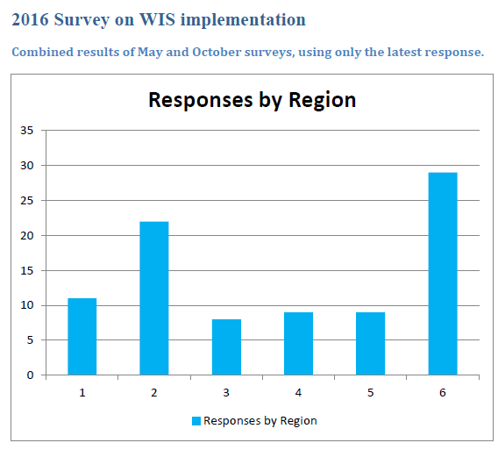
WIS Implementation
National WIS knowledge by Region (Percentage of region responses)
Level of national implementation by region (Percentage of region responses)
1 – Little or no knowledge of WIS
5 – Extensive knowledge of WIS
Notes:
So just how far have Members come. Here we can see that although the Members are showing an increase in WIS understanding across the regions, significant number of Members have little or only some of the new functionality in place. We really need to work on building WIS competencies and assisting Members to get them in place.

Slide 6
WIS support to WIGOS MD
IPET-DD
WIS assisting WIGOS on MD and vocabulary
When to send to EC? (69 or 70)
We have the representation standards but no one has tried it on real data.
Need to hold joint meeting of IPET-DD and ET-WMD
IPET-CM
WIGOS say what needs to be represented.
WIS look after process of development and approval
Seamless linkage between WIGOS and WIS MD
WIS->WIGOS: Yes, providing OSCAR can provide a URL to data record
WIGOS->WIS: Yes, ideally point to P-GISC SRU server
Need to determine what to point to. Ideally Data archive
Could also point to GTS/WIS messages or both message and data archive

Slide 7
Hot issue - Cyber Security
Interconnectivity makes life easier but more vulnerable

Slide 8
Security for WIGOS
WIGOS like WIS is increasingly relying on automated systems connected to open networks
Millions of devices are access points
Difficult to maintain patches across broad observing networks
Vulnerable as likely targets for cyber attack

Slide 9
WIS Status
Part A: Evolution of the GTS and opening to all programmes (324 centres approved/371 identified).
CAeM(6/9), CAgM(2/3), CAS(3/5), CCl(12/14), CHy(4/5), JCOMM(8/11)
Many potential contributors still not sure how to publish
Part B: New functionality of WIS
Discovery metadata driven
Implemented
Need better and more diverse metadata entries
Knowledge of how to use and benefit from WIS still too low.
Linkage to WIGOS metadata
Part C. Information management
This is for all WMO programmes.
WIS 2.0 and eWIS

Slide 10
WIS Part C
Information Lifecycle
Create
Cg-17 tasked CBS to lead in reviewing and documenting all information management practices across WMO
Inter-commission task team on WIS supported TCs participation in achieving this.
Developing guides on information practices will be a key deliverable over next four to six years
Destroy
Store
Information activities
Archive
Share
Use

Slide 11
WIS 2.0 - User Expectation
Easy to access and combine information from different communities
Familiar interfaces, more social interaction, creative presentation using analytics
New “dynamic” ways of making data available
those underlying Twitter and Facebook.
Users’ expectations driven by services provided by large global companies
Eg Google, Amazon, …
Increasingly challenging for Members to deliver services in expected ways
Better to partner than try and match the innovation & development capabilities of Industry

Slide 12
WIS 2.0 - Data Volumes and Complexity
Larger, higher resolution, more frequent, more timely
Satellite, Model output, Radar …
NMHS access to new data sources
Public and private, social networks, crowd sourcing, …
Earth obs and modelling growing faster than telecommunication networks
Challenge for processing, distribution and storage
Fundamental change – take user to the data
Use data sources and services in cloud and only download results

Slide 13
WIS 2.0 - Costs
Reducing budgets
Remove duplication
Adopt rather than adapt or create
Collaboration between NMHSs to share cost if adapting or creating
WIS 2.0 should enable
mechanisms to increase collaborative development, maintenance and support of services,
promote the exchange of best practices, and
enable the uptake of new technologies
Altruistic policies on making data available
NMHS are expected to support data services from projects
Need for an Information Assurance framework
Through out information life cycle.

Slide 14
WIS 2.0 - Technology Trends
Big Data
The 4 Vs: Volume, velocity (Freq), variety and veracity (QA)
Cloud
Remote applications, computing and storage resources that host and process data
Search Engines
Make WIS searchable and accessible via the popular “gates” of the Internet (eg Google)
Messaging and Social Networking
protocols and quickly scale to support many millions of concurrent users sharing information in real time
Internet of Things
WIS should facilitate interactions with IOT that could contribute to or benefit from environmental information
Application Programming Interfaces (APIs) and Web Services
M2M & third party services (eg authentication)
Open data
Free access to information to foster the development of applications and services

Slide 15
WIS 2.0 - Opportunities
Increasing use of the Web as an information sharing platform
Commercial infrastructure providers offer
stable, secure and cost-effective ‘cloud’ hosting of virtualized computing resources
‘content distribution networks’ (CDN)
Search engines (Google, Bing, Yahoo etc.) remain the common entry point for consumer discovery of information
Application Programming Interfaces (APIs) and Web Services are now very common solutions for information exchange
Messaging services and protocols offer new opportunities for sharing meteorological information in real-time based on common industry practices
Use of analytics and user feedback to drive improvement of user experience
Applications such as Dropbox indicate that file distribution services have become commoditized and are no longer the domain of specialized applications such as GTS message switching
Notes:
A content delivery network or content distribution network (CDN) is a globally distributed network of proxy servers deployed in multiple data centers. The goal of a CDN is to serve content to end-users with high availability and high performance.

Slide 16
Thank you
Merci

Slide 17
Accessing and using WIS
Three levels of access
General ad hoc discovery and download
Registered for subscription
Registered for publication
Each level inherits the access of the level above it. i.e. Registered for publication gives general and subscription access
https://wiswiki.wmo.int/wis-pub-sub

Slide 18
General access
Any one can go to a GISC and search and, subject to the data policy, down load products discovered
If it is Res 40 essential or unrestricted GTS traffic and less than 24 hours, it can be obtained from the GISC
Other information is accessed from the information custodian
Normally, but not necessarily a WIS centre
GISCs - www.wmo.int/giscs
All centres - http://wis.wmo.int/WISCentresDb

Slide 19
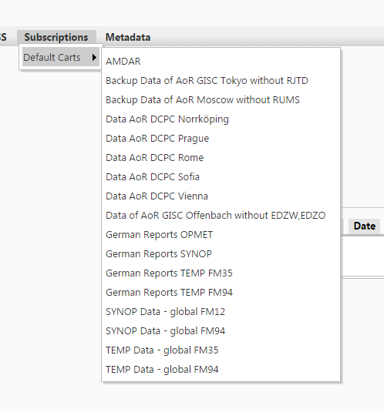
Ability to subscribe (GISC)
Authority to register to subscribe to a GISC service comes from either the GISC or National WIS focal point
http://www.wmo.int/pages/prog/www/CBS/Lists_WorkGroups/CBS/cross-cutting/fp%20wis/members
Not all GISCs offer the same resolution of subscription services
Normally limited to new information, often only GTS traffic
Have to subscribe to a data custodian if not circulated on WIS.

Slide 20
Down loading of information
Downloading methods are described in WIS TechSpecs 10, 11 & 12
See WMO No 1060 Part IV, para 4.11-4.13 & appendix D)
Normally by http, ftp or email
NC/DCPCs often support things like opendap or other web services
Some GISCs require registration to down load data.
Registration necessary if using ftp and email
Always necessary if subscribing.
Can use GTS for downloading via subscription services if connected to GTS (ie an NMHS)
Files can have any format but if GTS then restricted to those in GTS manual
File names normally GTS file naming convention.

Slide 21
Ability to publish
Publishing can only be through a registered data centre (NC or DCPC)
A strict governance process is in place for a publisher to be registered as a data centre (NC or DCPC)
Registration involves PR, TC and RA
Centre must be WIS compliant
WIS centres can publish information on behalf of other contributors but are responsible for compliance as if they were the originator.
Some GISCs may host data centre’s publishing service
i.e. GISCs may accept input from a non-NC or non-DCPC source, where an NC or DCPC has authorized a source to publish direct to the GISC
All information must have a WIS discovery metadata record published before the information can be sent or discovered in WIS
See WIS TechSpec 1 (WMO No 1060 Part IV, para 4.2 & appendix D)

Slide 22
Uploading to publish
Uploaded information is normally a file sent by a method agreed between the provider and uploading WIS centre
See WIS Tech Spec 2 (WMO No 1060 Part IV, para 4.3 & appendix D)
If data is to go on GTS, the file should comply with GTS file naming convention
See GTS Manual, Part II, Attachment II-15
WMO approved format (data representation) is preferred but not compulsory)
Most common or preferred methods are via ftp or email from provider to the uploading WIS centre
If the WIS centre is on GTS, then may use normal GTS publishing.
Receiving centre is required to check existence of WIS discovery metadata
(GISCs will allow a grace period of 2 minutes for metadata to turn up before rejecting the product)

Slide 23
How do users get published information?
Uploading to WIS does not guarantee distribution
WIS and the GTS is subscription based
People must be alerted to new products so that they can subscribe
Process for GTS is Metno with fixed publishing deadlines
For other WIS information, some GISCs support RSS alerting to new products
In most cases, it is up to the publisher to advise the target community that the new product is coming.
Additional users may find the product through search or RSS.

