Slide 1
Vision for WIGOS in 2040
Sue Barrell, Bertrand Calpini
Co-Chairs, ICG-WIGOS
with thanks to
ET-SAT, IPET-OSDE, WIGOS PO

Slide 2
Overview
Why a Vision for WIGOS in 2040?
Drivers for a new Vision
The future of environmental measurements
Vision for WIGOS/Space in 2040
Vision for WIGOS/Surface in 2040
Toward an integrated Vision for WIGOS in 2040

Slide 3
1. Why a Vision for WIGOS in 2040?

Slide 4
Why a "Vision for WIGOS in 2040"?
Serves as a reference for WMO Members and other service providers
Forcing agent for satellite agencies – current 2025 Vision too near-term
Sets frame for future systems deployment, development and integration
Opportunities and options to underpin future services development
Cg-17: Develop a “Vision for WIGOS in 2040”, to be submitted to CG-18
Space-based Vision 2040, well advanced
Surface-based Vision 2040, early stages - different challenges, application, set directions, less specificity
Goal is to develop a coherent over-arching WIGOS Vision, representing integrated approach to future observing system planning

Slide 5
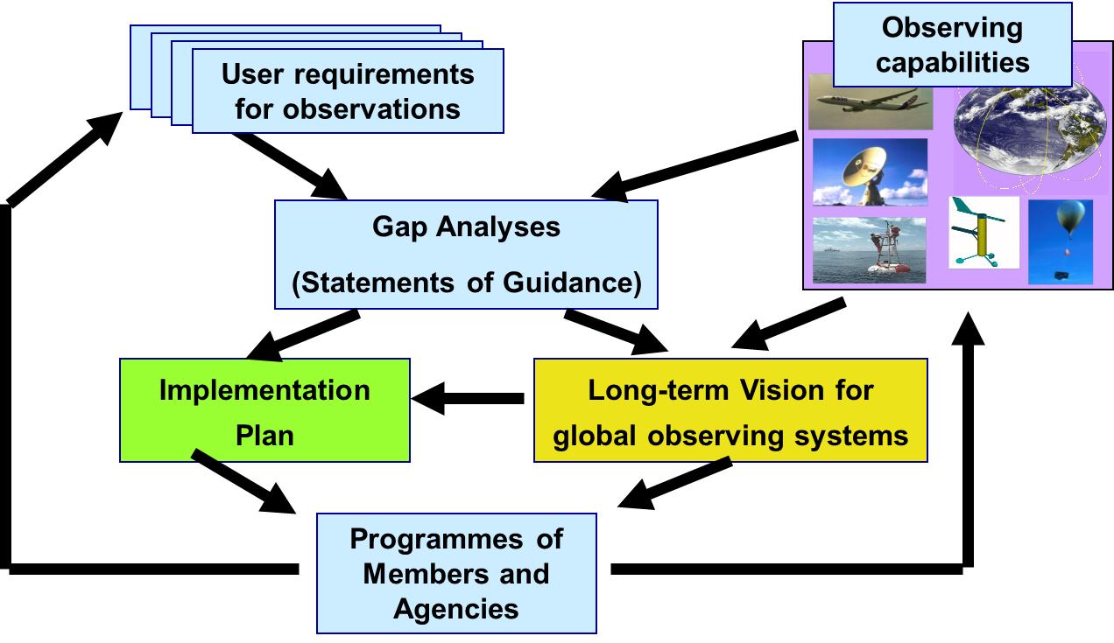
Rolling Review of Requirements
WMO Congress: All WMO and WMO co-sponsored observing systems shall use the RRR to design networks, plan evolution and assess performance.
The RRR is the process used by WMO to collect, vet and record user requirements for all WMO application areas and match them against observational capabilities

Slide 6
2. Drivers for a new long-term Vision

Slide 7
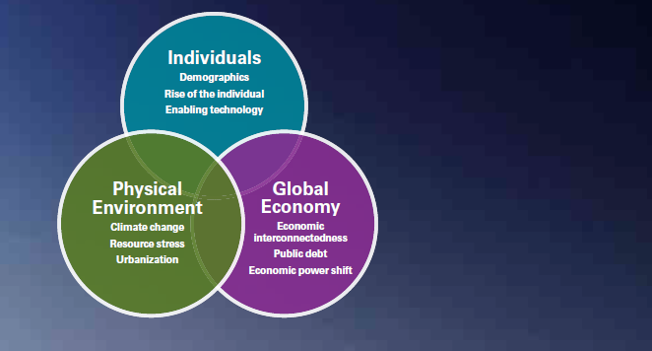
The world in 2040?
Future State 2030 (KPMG, 2015)
Global megatrends impacting governments and citizens
While they are highly interrelated, the megatrends can broadly be grouped into trends reflecting changes in the status and expectations of individuals, changes in the global economy and changes in the physical environment.

Slide 8
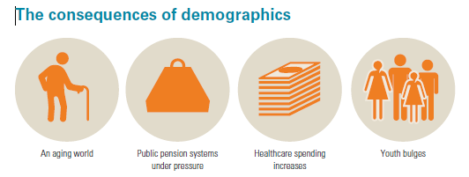
#1 Demographics
Higher life expectancy and falling birth rates are increasing the proportion of elderly people across the world, and challenging the solvency of social welfare systems including pensions and healthcare.
Some regions are also facing the challenge of integrating large youth populations into saturated labor markets.

Slide 9
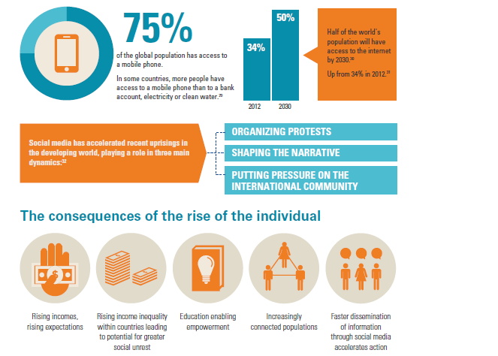
#2 Rise of the individual

Slide 10
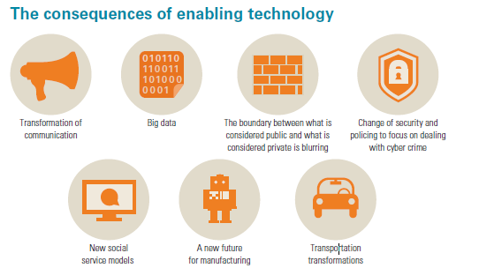
#3 Enabling technology
ICT- based technologies have enabled R&D and growth of technologies in many fields such as applied science, engineering, health and transport.
Exponential growth in the volume and speed of access to information can generate new markets and challenge existing institutions.
Developed countries may have greater access to these technologies now, but many innovations provide ‘leapfrog’ opportunities for less developed countries to capitalize on new and changing markets.

Slide 11
#4 Economic interconnectedness
The interconnected global economy will see a continued increase in the levels of international trade and capital flows, but unless international conventions can be strengthened, progress and optimum economic benefits may not be realized.

Slide 12
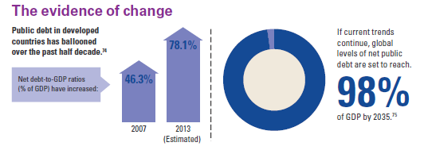
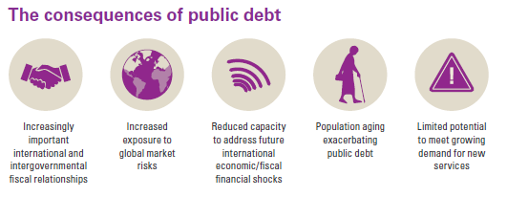
#5 Public debt

Slide 13
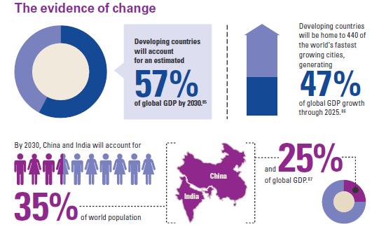
#6 Economic power shift

Slide 14
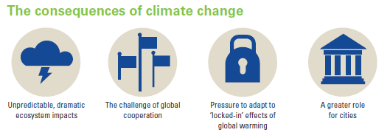
#7 Climate change
By 2050, costs of extreme weather could reach up to 1% of world GDP pa.
With warming of 3-4C, up to 200 M people could become permanently displaced due to rising sea levels, flooding and droughts.

Slide 15
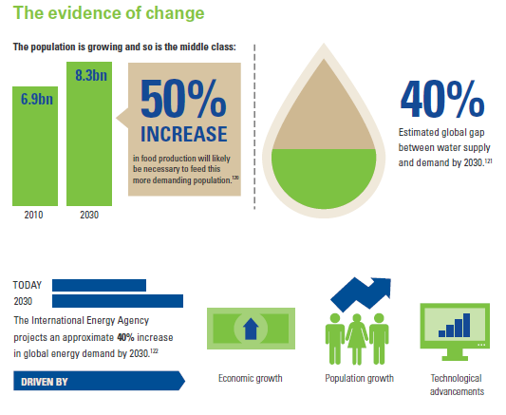
#8 Resource stress

Slide 16
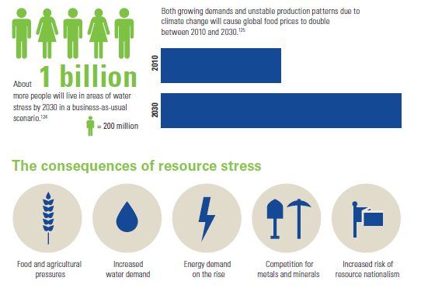
#8 Resource stress/2
"If nothing is done, we will run out of water before we run out of oil"

Slide 17
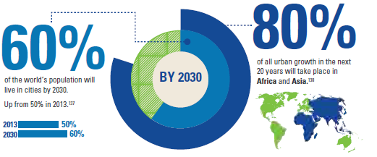
#9 Urbanization
The number of megacities (pop. 10+ million) will increase from 20 today to 35 in 2025

Slide 18
Implications for NMHSs in 2030: Services demand driving WIGOS
Technology and data, capability and uptake – NMHSs and users, ability to access and use information
Technology and information convergence – integration and seamless
Agriculture and food security – demand, integration, agility in use of services and information, planning for reliable and resilient production
Water – quality and quantity, manage/control use, plan/security of supply
Urbanisation – impact of weather, esp. severe weather, heat, air quality, climate change & variability on (e.g.) infrastructure management, transportation, energy demand, construction, tourism, health, well-being…
Communications – more accessible, lower unit cost → easier to transmit/share data, spectrum challenges
Environmental management – measure/monitor to manage
Increased demand for 'short-fuse' services - extreme weather, DRR
International collaboration and connectedness – stronger, improved global balance
Public and private sector – find 'right' balance, data and services, PPP

Slide 19
3. Future of Environmental Measurements

Slide 20
CIMO Proposal: Future of Environmental Measurements
Mission: Members achieve fit-for-purpose environmental measurements through appropriate standards and technologies.
Vision: The WIGOS measurement community is the source of information on the suitability of measurements for specific environmental intelligence (applications).
Desired Outcomes
WIGOS measurement community is a cadre of measurement experts that supports and promotes the gathering & dissemination of knowledge on the quality of relevant environmental measurements and how fit-for-purpose measurements are achieved.
Users and providers understand the importance of the measurement process in the environmental information chain.
Users and providers are committed to traceability of ECV measurements.
The potential quality and uncertainty of emerging measurements are documented in the CIMO Guide and reference material.

Slide 21
Achieving fit-for-purpose environmental measurements through WIGOS
Strategies to achieve the Mission and Vision:
Collaborate effectively with all users and providers of measurements;
Develop and promote the implementation of good measurement practices;
Develop, and provide effective access to, standards and guidance material;
Coordinate the transition from new science and technology to operational implementation;
Characterize the traceability that can be achieved from emerging alternative technologies.

Slide 22
4. Vision for WIGOS/Space in 2040

Slide 23
Vision for WIGOS/Space 2040
Initial draft prepared by WMO/CBS Expert Team on Satellite Systems (ET-SAT), using input from:
the WIGOS Space 2040 workshop, Geneva, 18-20 Nov 2015
the Coordination Group for Meteorological Satellites (CGMS)
the Inter-Programme Coordination Team on Space Weather (ICTSW).
Draft v1.0 based on feedback received from a series of consultations:
WMO Presidents of Technical Commissions meeting (19-20 January 2016)
Consultative Meeting on High Level Policy on Satellite Matters (CM-13, 28-29 January 2016)
WMO CBS Inter-Programme Expert Team on Satellite Utilization and Products (IPET-SUP-2, 23-26 February 2016)
2016 meeting of the Coordination Group for Meteorological Satellites (CGMS).

Slide 24
Initial Assumptions
The current structure of the space-based observing system is a solid foundation
It underpins the success story of the World Weather Watch and is essential to WIGOS
(Ref: Manual on WIGOS endorsed by Cg-17, and CGMS baseline)
Questions raised with respect to the Vision 2025
What should be added ?
What is at risk and should be reinforced ?
What should be improved (performance, coverage) ?
What could be performed differently in the future ?
What are the major challenges?

Slide 25
Main Drivers for the Vision 2040 Space
Evolving and emerging user requirements
Future modelling requires increased resolution (spatial, temporal, spectral..)
Consistent, comprehensive data records (calibration & traceability)
Applications related to atmospheric composition (e.g. air quality), cryosphere, hydrology, space weather, are more mature and should be better addressed
Recent/anticipated advances in technology enable new capabilities
Sensor technology
Orbital concepts
Satellite programme concepts (small satellites, constellations)
Data system architecture
Evolution of satellite programmes
More space faring nations – Vision should promote various cooperation models
Enhanced pressure to provide cost/benefit justification
Increased interest from private sector in providing data

Slide 26
5. Vision for WIGOS/Surface in 2040

Slide 27
Vision 2040 - surface-based component
Vision less developed than Space component, but many drivers the same
Extended timeline is more challenging for surface-based component, but will shape and inform:
Optimising the complementarity of surface and space,
Planning investment in large-scale infrastructure and investment (e.g. radars, field stations, laboratories, ground stations, space weather instrumentation, etc)
Maintaining spectrum protection for the long-term
Integrated (cross application/ domain/ etc) approach of WIGOS.
Supersedes Vision 2025
Reflects broader scope of WIGOS
Updates on observing technologies and their development
Link to WMO Strategic Plan → High level goals to guide evolution of WIGOS

Slide 28
Initial assumptions
Surface-based measurements remain both complementary and unique
Measurement characterisation and traceability
Calibration/validation for space-based measurements
Long-term and unique applications
Exploring and evolving science and service needs
Using existing, new and emerging technologies
Leading to better data, products and services for and from NHMSs
Reflect major changes → science, IT, products, training, …
Rapid changes in implementation agents …
… but principles of sharing observations remain
WMO, working with partners
To be combined with Vision 2040 Space
Notes:
WMO Strategic Plan only 4 years!

Slide 29
6. Toward an integrated Vision for WIGOS in 2040

Slide 30
Integrated Vision for WIGOS in 2040
WIGOS surface-based Vision 2040 Workshop held in Geneva, October 2016
Co-chaired by ICG-WIGOS Co-Chairs
Wide stakeholder, technical commission and regional representation
Reviewed progress of surface and space visions
Considered challenges, drivers and dependencies that will influence services requirements for NMHSs and observing system choices over the next 25 years
Looked backwards and forwards
Change is a constant
Surprises will happen
Disruption is a given
Agreed that WIGOS 2040 Vision cannot/should not be prescriptive, but sets the scene and direction for WIGOS to evolve and respond at all levels
Focus on needs more than solutions, and setting challenging high level goals

Slide 31
Integrated Vision for WIGOS in 2040 (II)
Agreed the approach for developing an integrated Vision for WIGOS in 2040
Integrated vision will address:
Rationale and audience
Themes, needs, environment scan
Drivers, directions, dependencies, user requirements
Trends, possibilities and aspirations
Integration and complementarity of space and surface components
Common and specific space and surface elements of vision
Vision will be approximately 10 pages
with additional detail in space- and surface- annexes
Initial draft under development (Sue Barrell, Bertrand Calpini, Joe Pica (NOAA), Lars Peter Riishojgaard)

Slide 32
Summary and Conclusions
Vision statements for 2040 have been developed for the space-based and surface-based components of WIGOS
more in the case of space, less in the case of surface-based
Draft Decision 5.4.2(1)/1 (CBS-16)
→ ICG-WIGOS to take the lead in integrating these two statements into a common framework as an over-arching Vision for WIGOS in 2040
ICG-WIGOS now taking the lead in developing these into an over-arching coherent Vision for WIGOS in 2040
With support from ET SAT and IPET-OSDE
Consider and finalise at ICG-WIGOS-7
For submission to Cg-18 (2019) for its approval

Slide 33
Thanks to ET-SAT, IPET-OSDE, and to all participants in the two Workshops
WIGOS Space 2040 (2015)
WIGOS Surface 2040 (2016)

