Slide 1
Review on WIGOS Activities Regional Association - V Report for ICG-WIGOS-6

Slide 2
WIGOS IMPLEMENTATION LEAD BY WORKING GROUP ON INFRASTRUCTURE
The objective of the Working Group on Infrastructure (WG-INFR) is to contribute to the improvement of infrastructure (data and information services) for weather, climate and water in Region V through implementation of the WMO Integrated Global Observing System (WIGOS) and WMO Information System (WIS).
Chair: Karl Monnik (BoM)

Slide 3
REGIONAL WIGOS IMPLEMENTATION PLAN FOR RA V 2016 – 2019
Key Implementation Activities have been identified as part of the R-WIP-RA-V
Management of WIGOS Implementation in Region V
Develop the Regional WIGOS Implementation Plan for Region V – Complete;
Compile information for a “stock-take” of existing WMO observing systems in RA-V;
Assess the EGOS-IP to identify actions relevant to RA-V and Member countries; assign priorities to these actions;
Provide an effective RA-V focal point to liaise with CBS about the implementation of EGOS-IP in RA-V;
Additional activities have been identified which align with:
Pacific Islands Meteorological Strategy 2012 – 2021 (http://www.sprep.org/publications/pacific-islands-meteorological-strategy-2012 - 2021)
Notes:
EGOS – IP: Evolution of Global Observation System – Implementation Plan;

Slide 4
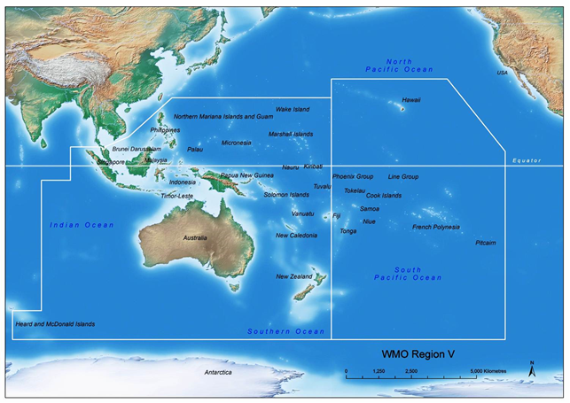
Specific Priorities in R-WIP-V
Radar mosaics for SE Asia (for convective weather and aviation safety) – Joint activity with RA-II
Improved operational uptake of satellite data (especially Pacific part of the Region)
(Ref: Jakarta Declaration, 2014)
Guidance on network design – supported by OSCAR/Surface and EGOS-IP
Strengthening/rehabilitating the conventional network especially in the Pacific part of the Region;
AMDAR implementation;
Development of Regional WIGOS centres

Slide 5
WIGOS Pre-Operational Phase (2016-2019)
Increased emphasis on regional and national activities;
Five (5) main priority areas:
WIGOS Regulatory Material, supplemented with necessary guidance material
WIGOS Information Resource, especially the Observing Systems Capabilities Analysis and Review tool (OSCAR) / Surface
WIGOS Data Quality Monitoring System (WDQMS)
Regional Structure, Regional WIGOS Centers
National WIGOS Implementation, coordination and governance mechanisms
Notes:
RWC will be discussed under WG Infracstrture and brought to RA Session next 2018;

Slide 6
Recent WG-INFR Activities related with WIGOS
Activities of CBS Lead Centre for GCOS for the WMO RA V in the year 2015. Report prepared for GCOS Network Meeting (AGG & CBS Lead-Centres GCOS), Cambridge UK, 7th -9th September 2016;
Attended WIGOS 2040 Vision workshop to represent RA V, Geneva, 18-20 Oct 2016;
Becoming WIGOS Ready members:
Held 2 WebEx meetings (07/09/16, 05/10/16) with members of WG-INFR to update on progress;
Demonstrated OSCAR/Surface web interface.
Facilitated proposal of a Aircraft Based Operations workshop for RA V members in Indonesia during May 2017.
BMKG will host the meeting
Excellent opportunity to encourage greater participation with Garuda Airlines, Jet Star Asia and Malaysian Airlines.
Notes:
AGG – Advisory Group on GSN (Global Surface Network);

Slide 7
Thank you

