Slide 1
ICG –WIGOS
Report of the President of
RAII Abdulla Mohammed Al Mannai

Slide 2
RWC in RA II
CONTENTS
WIGOS until 2016
2016 Key survey findings on WIGOS
RA II Key strategy & WG -Recommendations
Governance -
Future structure of RA II – EG- WIGOS
TOR RBON-
Planned Activities 2016-2019
Notes:
In response to the request made by the co-chair of ICG-WIGOS and PR of Australia , on behalf of RA II , I am honored to present our RA II position now on the ongoing pre operational phase of WIGOS.

Slide 3
2013-2016
RA II Regional WIS Implementation Plan
First version: approved by the President of RA-II in December, 2013, available at: http://wis.wmo.int/file=653
Updates to be submitted to RA II and WMO secretariat by the end of 2016
A new structure to be proposed to RA II-16.

Slide 4
Progressing through - RA II WIGOS Implementation Projects
No. | Project title | Key regional players
I | Monitor and review the Implementation of EGOS- IP in RA II | China; Hong Kong, China
II | Standard and best practise Portal, including technical documents with necessary details in English from all RA II Members | Republic of Korea
III.1 | Observing systems integration for supporting disaster risk reduction - Integration of Surface-based Remote Sensing Data in the | China, Japan, Republic of Korea
III.2 | Observing systems integration for supporting disaster risk reduction - in Radar Techniques in the | ASEAN (Thailand, Malaysia)
IV | Enhance the Availability and Quality Management Support for NMHSs in Surface, Climate and Upper-air Observations | Japan
V | Developing a Sand and Dust Storm Warning Advisory and Assessment System (SDS-WAS) in Node | China, Japan, Republic of Korea
VI | Develop Support for NMHSs in Satellite Data, Products and Training | Japan, Republic of Korea

Slide 5
Project. I Monitor and review the Implementation of EGOS- IP in RA II Key Regional Players: China; Hong Kong, China
Aim(s)
To identify gaps and prioritize actions listed in the EGOS-IP through reviewing the progress of the Evolution of Global Observing Systems (EGOS),
The progress and experiences are shared by RA II members when implementing the EGOS-IP.
Achievements
A portal for sharing the national progress of EGOS-IP implementation was established by CMA.
A report template has been prepared.
The technical scheme of assessing the progress was drafted.

Slide 6
Project. II Standard and Practical Portal, including Technical Documents with Necessary Details in English from all RA II Members Key Regional Players: Republic of Korea
Aim(s)
To develop a Standard and Best Practise Portal
To establish regional standard and best practices documentation (regional practices database) for enhanced observational data/products utilization, including data/metadata management
To specify mechanisms, procedures for regular monitoring and updating of the portal.
Achievements
KMA’s domestic project for standardization of met observations finished 1st phase (2013).
By 2015, more than 3,600 sites data from 28 agencies (including local gov.) were collected into one system. 85% of the data are collected in real time.
QC-ed data are open for domestic agencies for DRR, public broadcast and local governments.
Notes:
KMA did their exercise and their knowledge share from this project will benefit all our members.

Slide 7
Project. III-1 RA II WIGOS Project for Observing Systems Integration for Supporting Disaster Risk Reduction -Integration of Surface-based Remote Sensing Data in the East Asia Key Regional Players: Japan, Republic of Korea, China
Aim
to develop a feasible and optimal draft design of integrated surface-based remote sensing observations toward operational assimilation of those data in meso-scale NWP model of the participating organs at the sub-regional level, as well as real-time quality-assured radar composite maps.
Achievements
Real-time exchange of radar CAPPI products and automated weather station data between Japan and Korea
Evaluation of Impact of assimilation of QPE over Korea on NWP over Japan
Notes:
Similar exercise have to carried over to other sub regions also.

Slide 8
Project. III-2 RA II WIGOS Project for Observing Systems Integration for Supporting Disaster Risk Reduction -Capacity Building in Radar Techniques in the Southeast Asia Key Regional Players: ASEAN (Thailand, Malaysia)
Aim
To develop effective early warning systems building on radar data in Southeast Asia.
Achievements
ASEAN Regional Training Workshop on Weather Radar Maintenance, QPE and Forecast (Bangkok, 2014) with 20 participants from 7 ASEAN members.
National reports on usage of weather radar (Thailand and Malaysia submitted to 35th ASEAN/SCMG, 2013)
TMD – JMA technical meetings on radar issues started in 2011 and followed by 2012, 2013, 2014, 2015 meetings as activities of WMO/ESCAP Typhoon Committee.
MMD – JMA technical meetings on radar issues started in 2014.
BMKG – JMA technical meetings on remote-sensing technology started in 2015.

Slide 9
Project. IV Enhance the Availability and Quality Management Support for NMHSs in Surface, Climate and Upper-air Observations Key Regional Players: Japan
Aim
Improvement of data quality at RBCN/RBSN stations and enhancement of services of RA II RICs.
Achievements
WMO/JMA Survey on met. instruments, calibration and training in RA II was implemented, and the consolidated report was issued as WMO/IOM No. 122 (available on RIC Tsukuba website) http://www.jma.go.jp/jma/jma-eng/jma-center/ric/material.html
The users’ needs were clarified (i.e. lack of standard instruments, SI tractability etc.)
So-called “RIC-Tsukuba Package”, combination of cooperative activities;
Preliminary survey
Provision of standard instruments and/or inspection equipment
On-the-job training
Follow-up
successfully implemented in some NMHSs (i.e. Bangladesh, Sri Lanka etc.)
Notes:
JMA assisted and ready to assist more NMHSs in future.

Slide 10
Project. V Develop a Sand and Dust Storm Warning Advisory and Assessment System (SDS-WAS) in Asia Node Key Regional Players: China, Japan, Republic of Korea
Aim
Mitigation of risks in many affected areas in the Asia Node countries through enhancement of systematic NRT monitoring of sand and dust storm.
Achievements
The three dust forecast models (from CMA JMA and KMA) have been continuously operated.
A web portal to display in real time all SDS models including ECMWF and NCEP forecast products was developed. http://eng.weather.gov.cn/dust/
Dust forecast model products verification has been carried out. Data –exchanged list has been identified.

Slide 11
Project. VI Develop Support for NMHSs in Satellite Data, Products and Training Key Regional Players: Japan, Republic of Korea
Aim
To encourage NMHSs in RA II to make a kind of self-help effort to improve the flow of satellite-derived information,
To improve the knowledge and techniques to use satellite data and products.
Achievements
Establishment of the Project website http://www.jma.go.jp/jma/jma-eng/satellite/ra2wigosproject/ra2wigosproject-intro_en_jma.html
RA II WIGOS Project Newsletters (quarterly)
Asia/Oceania Meteorological Satellite Users’ Conference (AOMSUC):
4th Conference, Melbourne, Australia (Oct 2013)
5th Conference, Shanghai, China (Nov 2014)
6th Conference, Tokyo, Japan (Nov 2015)
7th Conference, Incheon, Republic of Korea (Oct 2016)
Russia, India and Indonesia newly joined.
Memorandum signed by PR from sponsors (WMO EC-68, 2016)
Coordination Group meetings:
3rd meeting, Tokyo, Japan (Nov 2015)
4th meeting, Incheon, Republic of Korea (Oct 2016)
Held training seminars on meteorological satellite data for NMHSs in Asia and Pacific region along with AOMSUC.
Support users for smooth transition to the new generation satellites.
Tutor programs (dispatching experts on satellite data utilization) for users in Asia and Pacific to facilitate efficient use of Himawari-8.
Feasibility study on Himawari-8 event-driven rapid-scan with AuBoM.

Slide 12
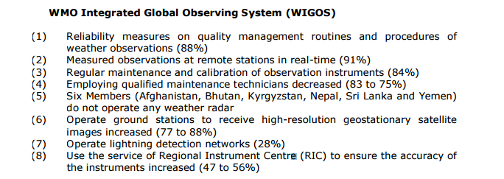
2016 Key Survey Findings
Notes:
A survey on the basic capability on NMHSs was done in 2016. 32 out of 35 member countries responded.

Slide 13
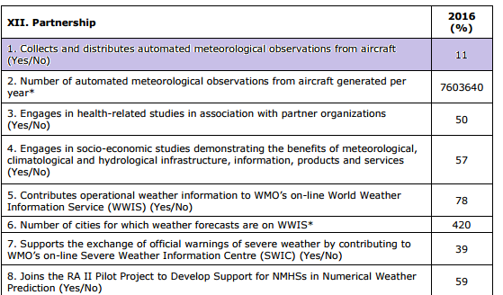
AMDAR

Slide 14
Key Strategy
Recommendation from EG-WIGOS (Abu Dhabi, Oct 2016) to consider the establishment of specific thematic RWCs for sub-regions of RA II, e.g. for Weather Radar data processing, AMDAR data processing;
Resulting in Draft Decision & Resolution in the coming RA II 16 , 2017
Recommendation from RA-II Workshop on WIGOS (Abu Dhabi, Oct. 2016) to take into account the existing infrastructures of GISCs as a basis for sub-regional RWC
In the draft R-WIP-II, under "2.5 Integrated Quality Management”, new text is being proposed regarding RWCs

Slide 15
Additional Focus – Inter regional Projects (RA V Jakarta Declaration)
The Joint RA-II/RA-V Workshop on WIGOS for Disaster Risk
Joint RA-II/RA-V WIGOS Satellite Data Project
Strengthening the capabilities of all Members to use geostationary satellite images and derived products in support of Disaster Risk Reduction
Developing a protocol for the NMHSs in the project countries to request event-driven rapid-scan imagery for their respective national areas of interest
Joint RA-II/RA-V WIGOS Radar Data Project
Improvement of data quality of existing radars
Development and expansion of national radar networks
Near real time international exchange of radar data, and
Development of «sub-regional» radar data centre

Slide 16
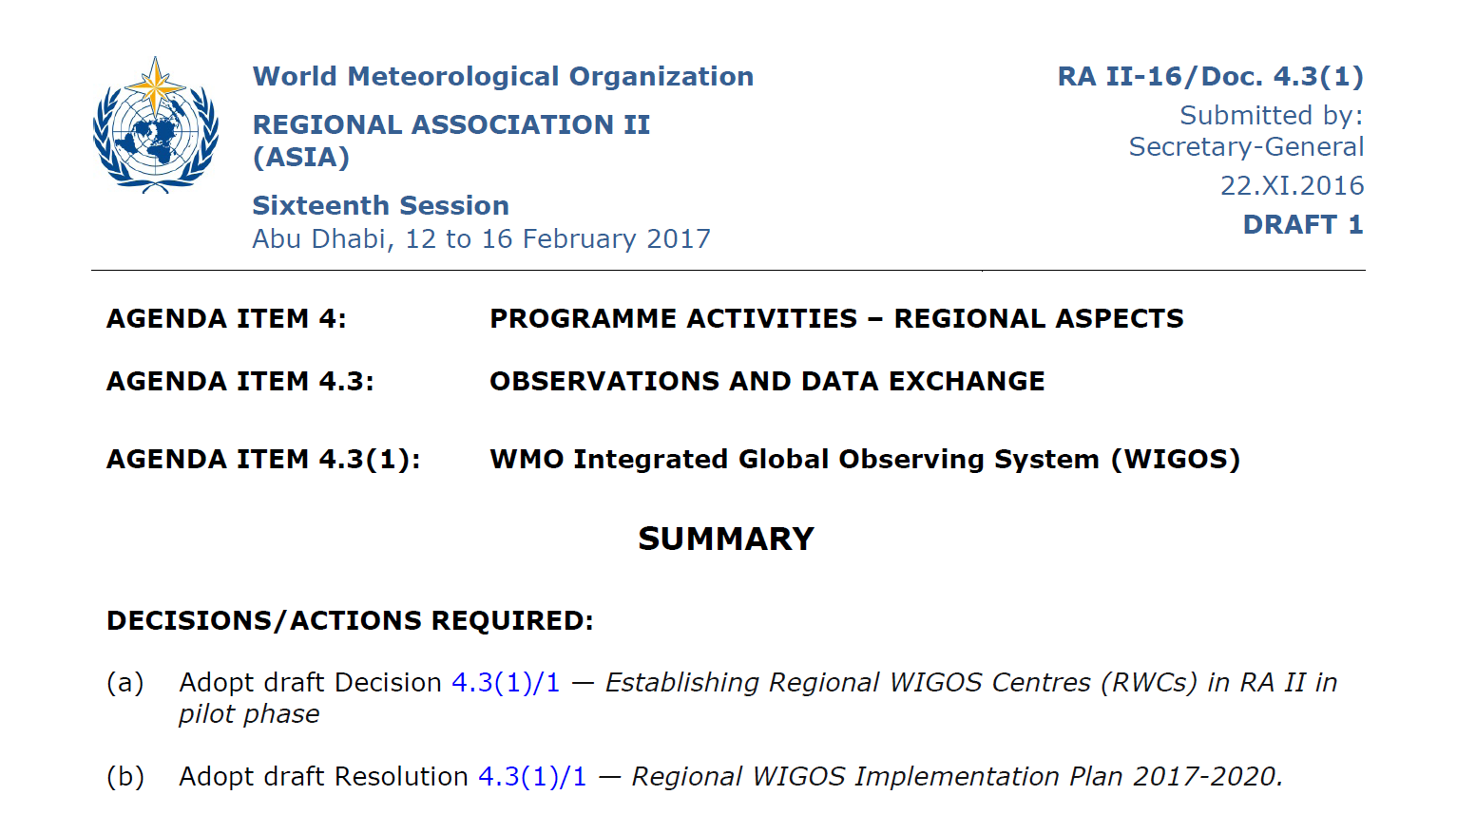
Proposal- RA II 16 -2017

Slide 17
Recommendation 1: The Continuation of WIGOS Projects
EG-WIGOS recommended that 6(5) of 7 Projects should continue in the next four years and should be updated in accordance with the new requirement of pre-operational phase of WIGOS

Slide 18
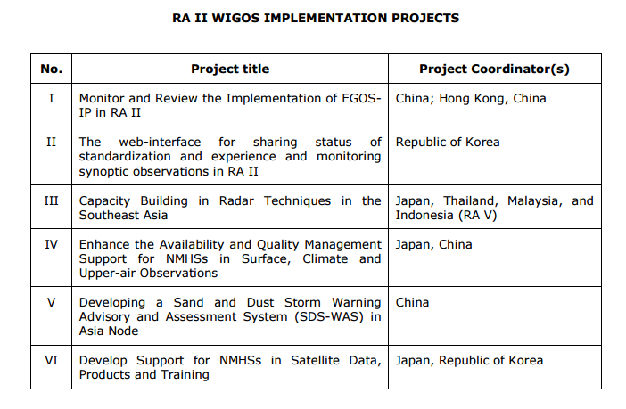
2016-2019 Pilot projects

Slide 19
Recommendation 2: WIGOS Centers
WIGOS Centers should be established in pilot mode in the next RA II session.
The WIGOS Centers should cover west and east Parts of Region II
Unlike WIS, RWCs do not have responsible countries to take care of
The function of WIGOS Data Quality Monitoring System should be included in RWC
A proposal paper will be prepared

Slide 20
Recommendation 3: RBON-Regional Observing Network
A Task Team on developing the RBON in RA II is proposed to be established by RA-II-16.
TOR with a roadmap for the implementation of RBON in RA II is also submitted to RA II MG for consideration.

Slide 21
Terms of Reference TT-RBON
Develop the proposal for the Regional Basic Observing Network in RA II:
Prioritize the WMO application areas relevant to the Region;
Define the RA II specific criteria for the selection of stations/platforms into RBON of RA II;
Select the RBON stations/platforms in accordance with the RBON concept and RA II specific criteria;
Identify gaps and develop a draft action plan to deal with them;
Develop the Roadmap for, and coordinate the activities on the implementation of the RBON in RA II;
Work with RA II EG-WIGOS and WIGOS-PO on the further elaboration of the RBON concept

Slide 22
Roadmap for the implementation of the RBON in RA II
February 2017, establishment of TT-RBON;
April 2017, RA II specific criteria for the selection of stations/platforms into RBON;
June 2017, a draft pilot RBON;
July 2017 to June 2018, the pilot RBON testing;
September 2018, evaluation for the pilot RBON
December 2018, the draft RBON
January 2019, submission of the draft RBON to president of RA II

Slide 23
Recommendation 4: Updating of R-WIP-II
The R-WIP-II should be updated taking into account the Plan for the WIGOS pre-operational phase 2016-2019.
The updated R-WIP-II is submitted to RA II MG for consideration.

Slide 24
Recommendation 5: Updating of RBSN/RBCN
The current RBSN/RBCN should continue to be operational until the new RBON is formally implemented based on the approval by P-RA/MG or the RA session.
The RBSN/RBCN lists should be updated and be submitted to the 16th session of RA II for approval.
When the RBSN/RBCN lists are being updated, the RBON concept, specifically the key attributes and criteria for the selection of stations/platforms into RBON should be taken into account.

Slide 25
Recommendation 6: Future Structure of EG-WIGOS
The term “Theme Leader” should be changed to “Project Leader”
The name of the Project Leaders should be identical to those listed in the R-WIP-II Projects.
Task Team leader should be a member of EG-WIGOS

Slide 26
Governance
Expert Working Group on WIGOS:
Proposal to RA II 16
Terms of Reference (TOR)
Planned Activities

Slide 27
EG-WIGOS
Title | Name | Country
Co-Coordinators
Project Leader in Monitoring and Reviewing the Implementation of EGOS IP in RA II
Project Leader in The web-interface for sharing status of standardization and experience and monitoring synoptic observations in RA II
Project Leader in Capacity Building in Radar Techniques in the Southeast Asia
Project Leader in Enhancing the Availability and Quality Management Support for NMHSs in Surface, Climate and Upper-air Observations
Project Leader in Developing a Sand and Dust Storm Warning Advisory and Assessment System (SDS-WAS) in Asia Node
Project Leader in Developing Support for NMHSs in Satellite Data, Products and Training
Chair of Task Team on RBON

Slide 28
EG-WIGOS _ TOR(1/2)
To coordinate the planning and implementation of WIGOS in the Region in accordance with the Regional WIGOS Implementation Plan (R-WIP-II), in accordance with decisions and guidance from Cg-17, the follow-up EC sessions, RA II Management Group, and the RA II Strategic and Operating Plan;
To provide support and assistance to RA II Members in accordance with the R-WIP-II and in a response to their requests (subject to availability of resources/funds);
To assist RA II Members to develop their National WIGOS Implementation Plans (N-WIPs);
To monitor the progress in the implementation and operations of WIGOS in the Region; advise on possible improvements and priorities for appropriate actions and the need for external support, where required, according to the technical guidance from the technical commissions, specified in the GFCS-IP, EGOS-IP, GCOS-IP and other observing system implementation plans in order to evolve and implement WIGOS in the Region;

Slide 29
EG-WIGOS _ TOR(2/2)
To support the implementation and improvement of OSCAR/Surface in the Region;
To collaborate with related bodies on the implementation of WDQMS in the Region;
To collaborate with the RWC candidates, RA II management group and WIGOS-PO on the establishment of the Regional WIGOS Centers in the Region;
To coordinate relevant activities with the regional groupings involved in observations to ensure consistency of approach and synergy;
To advise the President of the Regional Association and the chair of the WIGOS relevant Working Group on the proposed composition and changes to the Regional Basic Synoptic Network and Regional Basic Climatological Network;
To collaborate with TT-RBON on the implementation of the Regional Basic Observing Network in the Region.
To advise RA-II/MG on WIGOS implementation in the Region.

Slide 31
Thank you

