Slide 1


Global Cryosphere Watch (GCW)
ICG-WIGOS
Geneva, 12-14 January 2017
(Barry Goodison¹, Arni Snorrason², Jeff Key³, Rodica Nitu⁴
¹Vice-chair, GCW Steering Group (Canada)
²Chair, GCW Steering Group (PR Iceland)
³Senior Science Advisor, GCW (USA)
⁴ GCW Project Office Manager (Geneva)
(http:/globalcryospherewatch.org)

Slide 2
WMO Priorities 2016-2019 include…
WMO Integrated Global Observing System
Polar and High-mountain Regions:
  Improve meteorological and hydrological monitoring, prediction and services in polar and high-mountain regions and beyond, by:
  (i) operationalizing the Global Cryosphere Watch;
  (ii) better understanding the implications of changes in these regions on the global weather and climate patterns, and
  (iii) advancing the polar prediction under the Global Integrated Polar Prediction System
GCW is a cross-cutting activity dependent on partnerships
Robust, sustained surface and space-based observing system is essential for GCW to achieve its mission

Slide 3
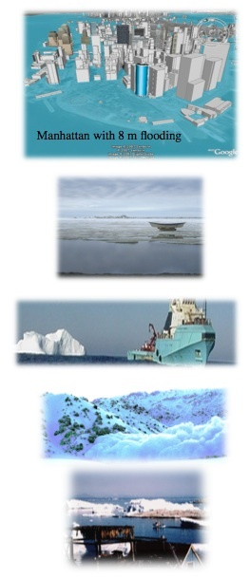
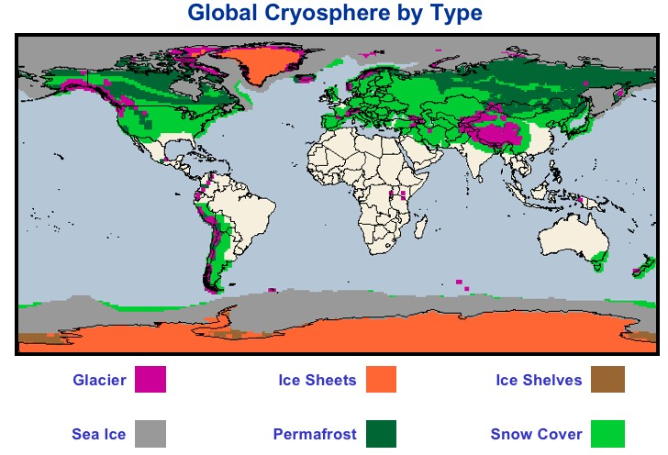
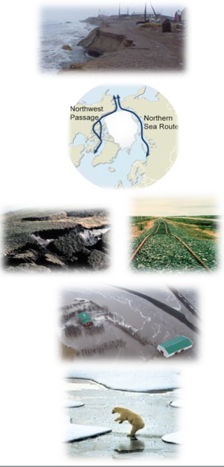
Cryosphere: solid precipitation*, snow cover*, sea ice*, lake and river ice, glaciers*, ice caps*, ice sheets*, ice shelves, permafrost* and seasonally frozen ground (*GCOS ECV)
Many of these areas are:
Remote
Sparse networks
Harsh operating conditions
Expensive to operate
Very vulnerable to a changing climate
Currently not required observations under GOS
Notes:
Manhattan figure from http://freegeographytools.com/2007/high-resolution-sea-level-rise-effects-in-google-earth

Slide 4
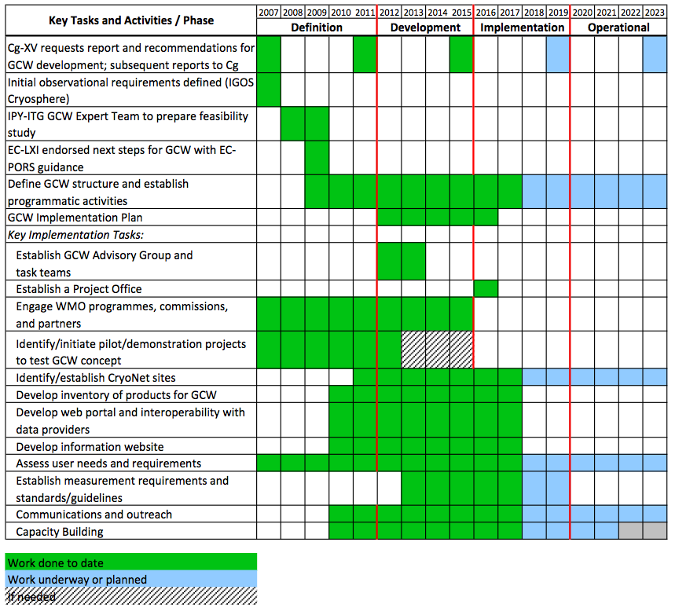
GCW Mission: GCW will provide authoritative, understandable, and useable data, information, and analyses on the past, current and future state of the cryosphere to meet the needs of WMO Members and partners in delivering services to users, the media, public, decision and policy makers.

Slide 5
GCW Activities
(what is GCW doing, or what’s happening that wouldn’t otherwise happen)
developing a network of surface observations, with "CryoNet“ at the core, which builds on existing networks;
collating/establishing measurement guidelines and best practices;
refining observational requirements for WIGOS OSCAR ;
engaging in and supporting intercomparisons of instruments and products, e.g., the GCW Snow Watch project (and SnowPEx); SPICE
enhanced near real-time snow depth observation on the GTS/WIS and reporting of zero snow depth (with modelling centres and CBS);
        contributing to WMO’s space-based capabilities database (with PSTG);
        evaluation/intercomparison of satellite snow products initiated with ESA (e.g. SnowPEX);

Slide 6
GCW Activities …2
        producing unique hemispheric products, e.g., “snow anomaly trackers” for SCE and SWE in collaboration with partners;
engaging in historical data rescue (e.g., snow depth);
building a glossary of cryospheric terms;
developing international training, outreach materials; co-sponsoring workshops
providing up-to-date information on the state of the cryosphere;
providing access to data and metadata through GCW portal;
These activities are essential for GCW to meet user requirements for cryospheric data and information in the future

Slide 7
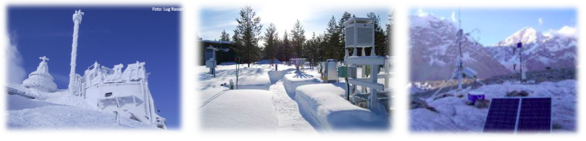
GCW Surface Network – A Tiered Network
an immediate GCW priority is to establish the core network of GCW surface measurement stations/sites – CryoNet, one part of the whole GCW observing system.
GCW/CryoNet is an observing component of WIGOS
CryoNet stations/sites must meet a minimum set of requirements
CryoNet covers all components of the through an extensive approach of surface-based observations.
CryoNet is initially comprised of existing stations/sites, rather than creating new sites; some SEARCH and AON sites are already part of CryoNet
Synoptic, climatological, GSN, agromet, third party networks are to be identified in GCW surface network if measure cryosphere variable(s)
GCW Contributing Stations provide useful measurements of the cryosphere, but whose data records may be shorter or with large gaps, or do not provide the quality and consistency of data required of CryoNet stations; may be in remote, hard to access regions where cryospheric observations are scarce.
Notes:
7

Slide 8
CryoNet Station
All CryoNet stations will be either Primary or Reference.
Primary - Have a target (intent) of long-term operation and have at least a 4-year initial commitment.
Reference - Have a long-term operational commitment and long-term (more than 10 years) data records.
CryoNet stations may also have one or more additional attributes:
Cal/val - the station is being used for calibration and/or validation of satellite products and/or (earth system) models, or it has been used for such purposes in the past and it still provides the needed facilities.
Research - the station has a broader research focus related to the cryosphere.
43 stations approved; 29 new applications

Slide 9
CryoNet Site
A GCW CryoNet site generally encompasses an area greater than a conventional observing station, and has two or more active GCW surface-based stations with varying capabilities that are operated as a coordinated unit. At least one station has to be a CryoNet station. A site may comprise several micro-climatological regions or extend over larger altitudinal gradients.
Potential attributes:
  Basic: monitor single or multiple components of the cryosphere
  Integrated: monitor at least two components of the cryosphere and at least one other component of the earth system. Integrated sites are particularly important for the study of feedbacks and complex interactions between these components.
Minimum requirements:
- A site comprises at least one GCW CryoNet station
- Integrated sites have technical supporting staff
- Integrated sites have training capability
- has a long-term financial commitment
- Data are made freely available, and whenever possible, in (near-)real time.
16 sites approved; 20 new applications

Slide 10
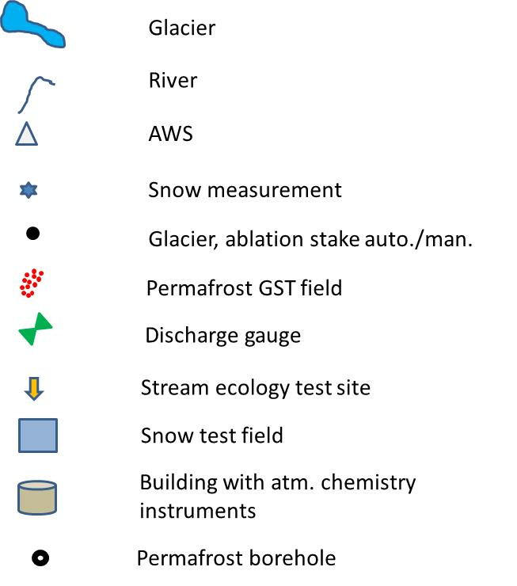
Cryospheric surface observations have complex structure
CryoNet Stations in a Site

Slide 11
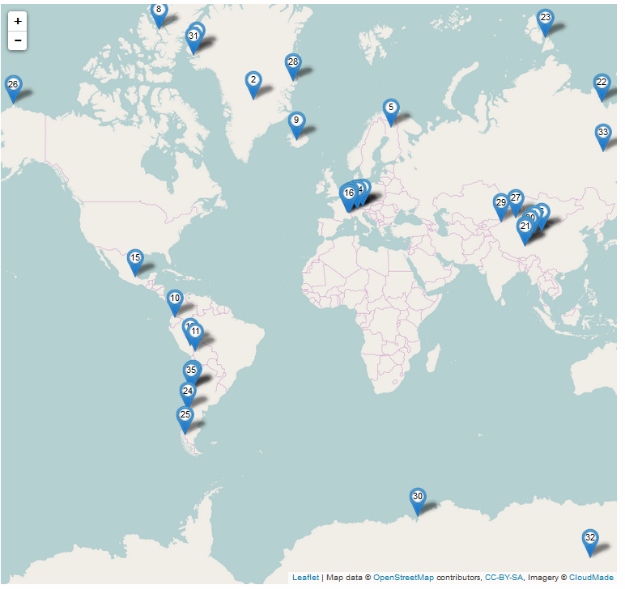
Observations: CryoNet
Pre-operational testing of CryoNet is in progress with the set of 36 sites initially approved by Cg-17
Regional Activities:
Latin America: stations added to the CryoNet network
Support training of experts in Latin America, focusing on glacier monitoring and science, in conjunction with UNESCO, in 2017.
CryoNet Asia: Specific projects were proposed, including AHECO: Asia High Elevation Cryosphere Observations.
GCW Tropical cryosphere: Workshop being planned for July 2017 focusing on topics related to the cryosphere in tropical areas.

Slide 12
Minimum program at CryoNet stations – sites
Defining expected minimum frequency of observations
SNOW/SOLID PRECIPITATION | Recommended minimum frequency of observations at CryoNet stations
Variables recommended to be measured
 | Timescale
Variable | hourly | daily | weekly | bi-weekly | monthly | half-yearly | yearly | multi-year
Snow on the ground (According to WMO code 0975: State of ground with snow or measurable ice cover.) |  | M
Snow depth (including stake farms and snow courses) | A | M |  | M(S, SI, LI) |  |  | M(G, IS)
Snow water equivalent | A |  |  | M |  |  | M(G, IS)
Solid precipitation (Requires both amount and type of precipitation to be measured) | A
Depth of snowfall |  | M
Water equivalent of snowfall |  | M
Snow cover extent |  |  |  | M(SI, LI)
Snow profiles |  |  |  | M
Snow profiles |  |  |  | M(SI, LI)
Snow chemistry |  |  |  | M |  |  | M
Snow surface temperature | A
Snow temperature | A
Drifting snow | A | M
Specific surface area |  |  |  | M |  |  | M
Plus, hourly auto measurements of: air temperature, humidity, wind speed and direction, incoming and reflected shortwave radiation. Incoming and outgoing longwave radiation

Slide 13
Measurement Standards and Best Practices:
Roadmap to GCW Guide Approval
GCW is drawing on existing measurement methods where possible and where a scientific consensus has been or can be reached.
The approval of CryoNet network is expected to be done by EC-69 (May 2017).
As the CryoNet is a core GCW network that applies GCW agreed practices, it is required that the GCW Guide is endorsed by EC-PHORS and EC-69 informed of that fact.
Therefore, the critical stages of the Road map to GCW Guide are:
  First outline and assignment of work must be available for GSG-4 (16-20 January 2017)
  Final outline must be available for EC-PHORS-7 (end of March 2017)
  GCW Guide must be published end of 2017

Slide 14
Measurement Standards and Best Practices:
Roadmap to GCW Manual Approval
GCW/CryoNet is one of the four components of WIGOS and all mandatory practices relevant to GCW/CryoNet must be documented in the WIGOS Manual.
The approval of the major revision of the WIGOS Manual will be done by Cg-18 (May/June 2019). This revision must contain appropriate provisions specified in the GCW Manual.
Note: The 2019 List of CryoNet stations will be submitted to Cg-18 for approval and reference should be made from the Resolution on CryoNet to the GCW Manual, which need to be approved prior to the Cg-18.
Therefore, the critical stages of the Road map to GCW Manual are:
  First draft ready for ICG-WIGOS (1 Q. 2018)
  Final draft ready for CBS-Ext.(2018??) ; otherwise through written consultation of CBS in writing and approval at CBS 2020
  Goal is to publish GCW Manual by the end of 2018

Slide 15
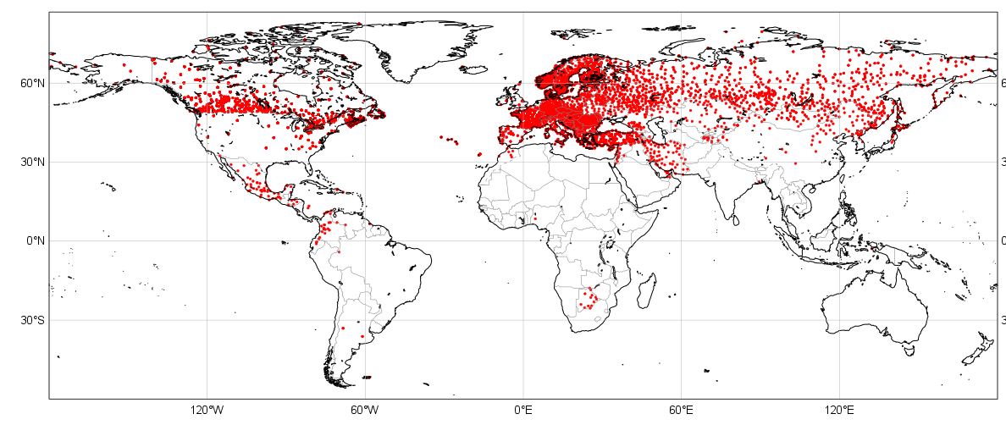
Snow Observations
GTS Snow depth availability
SYNOP TAC + SYNOP BUFR + national BUFR data
Status on 7 January 2017
- Gap in USA, China and southern hemisphere
- NRT data exist and is available (more than 20000 station in the US), but it is not on the GTS for NWP applications.
- However, we note an improvement in China (since status in de Rosnay et al, ECMWF NL article 143, 2015), related to TAC to BUFR transition (new reports in China are all BUFR SYNOP)

Slide 16
Timeline for Zero Snow Depth Reporting
Dr. Samantha Pullen (Snow Watch Team)
Where we are now
Gain support from international community, make representations to WMO
Official WMO guideline change (CBS)
Regional guidelines change (RA Sessions)
Adoption of changed practices by nations
Uptake of new data by users
Representations made through IPET-DRMM, Surface Obs ET (2014)
Approved by CBS Ext (2014):
“The commission agreed to facilitate reporting zero snow depth by suggesting that those Members using TAC nationally might consider using the unallocated entry 000 of code table 3889 to indicate zero snow depth, so that the information would be available when national reports are converted to TDCF.”
Sign-off Sep 2016
Proposal to be submitted to RA Sessions – regional guideline changes (Atsushi Shimazaki, Miroslav Ondras, recent communication)

Slide 17
CBS 16 – Snow Depth Reporting and Exchange
THE COMMISSION FOR BASIC SYSTEMS,
Noting Resolution 60 (Cg-17) –WMO policy for the international exchange of climate data and products to support the implementation of the Global Framework for Climate Services, that includes climate relevant cryospheric data, in particular snow cover and snow depth,
Noting further Decision 50 (EC-68), urging Members to exchange in situ snow measurements in real-time,
Having considered the positive impact of snow depth data collected in Europe on NWP, using the BUFR template 3 07 101 (Snow observation), adopted by CBS-Ext.(2014),
Having considered further a need for real-time access to in situ snow measurements to support future Polar and High Mountain Regional Climate Centres, a tool of GFCS services provision,
Recommends to the Executive Council:
To approve amendment to the Manual on the Global Observing System, Volume I: Global Aspects (WMO–No. 544) by adding new provisions as follows:
  Members shall should report snow cover and snow depth from all stations where snow is experienced, four times a day, namely 00, 06, 12 and 18 UTC;
  Members shall should report values of zero snow depth (0 cm) from the above stations when snow is not present, for the entire period during which snow can be expected. This period shall be defined for each location by the relevant Region;
To request Members to exchange in situ snow measurements in real-time in BUFR through GTS/WIS in accordance with the Manual on the GOS (WMO-No. 544);
Requests the CBS OPAG-ISS to review and harmonize practices for reporting snow cover and snow depth in the Manual on Codes (WMO-No. 306).
GCW needs feedback from CBS and Members on the issues wrt this recommendation
Where does GCW fit in with respect to GOS and WIGOS – how will GCW observing requirements be met within WIGOS and WMO?

Slide 18
GCW DATA PORTAL
The GCW Data Portal will exchange cryosphere data, metadata, information and analyses among a distributed network of providers and users in support of informed decision-making. The GCW Data Portal is part of WIS, a Data Collection and Production Centre (under development), and is interoperable with data centres.
Data quality, sharing and access are fundamental principles
improve access to, and utilization of observations and products from WMO and other observing systems and national and international data centres, built using the principles developed for IPY2007-2008.
facilitates the interaction between users and providers of the products
YOPP data management builds on GCW data management (both principles and solution)
gcw.met.no

Slide 19
Information and Services: Data Accessibility and Sharing
Initiated integration of data from CryoNet sites into the GCW Data Portal, tests conducted with three CryoNet sites: Weissfluhjoch-Davos (Switzerland); Sonnblick (Austria); Sodankylä (Finland)
Based on the experience from working with these stations, have produced first versions of:
- GCW Portal Interoperability Guidelines
- GCW Portal Operations Manual
Two recommendations being discussed by GSG for EC-PHORS and EC:
1) NMHSs to provide support to their national organizations in contributing to the GCW Observing Network, with the implementation of recommended formatting of data and metadata, and allow their distribution in [near] real time, though the GTS/WIS (for data), and to OSCAR/Surface (for instrument/platform metadata)
2) GCW Observing Network data from contributing organizations could use NetCDF as an alternative formatting system, which could be automatically translated into BUFR through the GCW Data Portal .

Slide 20
Linking to WIGOS Priorities 2016-2019
(1) National WIGOS Implementation
=> covered through GCW efforts and its implementation plan (CryoNet, Data Portal ...)
(2) WIGOS Regulatory material complemented with necessary Guidance material
=> covered through GCW efforts to develop Manual & Guide and best practices
(3) Further development of the WIGOS Information Resource (WIR) with special emphasis on operational deployment of OSCAR;
=> Efforts are underway to link the station/site metadata to the data portal, and then to be provided to OSCAR via Machine to Machine interface.
(4) Development of the WIGOS Data Quality Monitoring System (WDQMS);
=> Discussion ongoing on the issue of quality management for GCW
(5) Concept development and initial establishment of Regional WIGOS Centres (RWCs).
=> There are two aspects to consider (i) how the RWCs once established will be covering cryospheric observations, and (ii) whether there is a need to promote specific centres focusing on cryospheric observations.

Slide 21
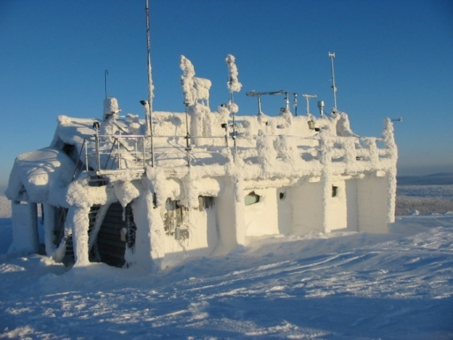
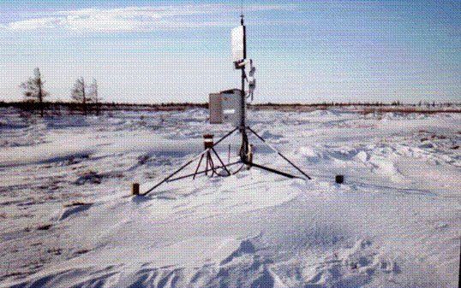
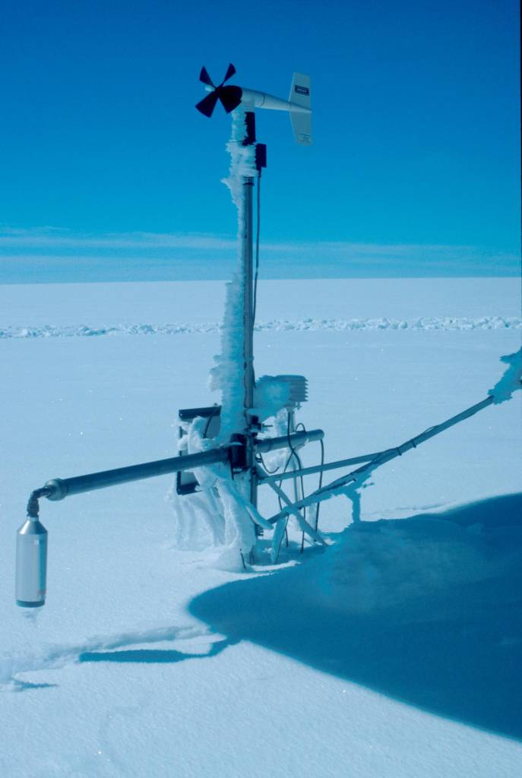
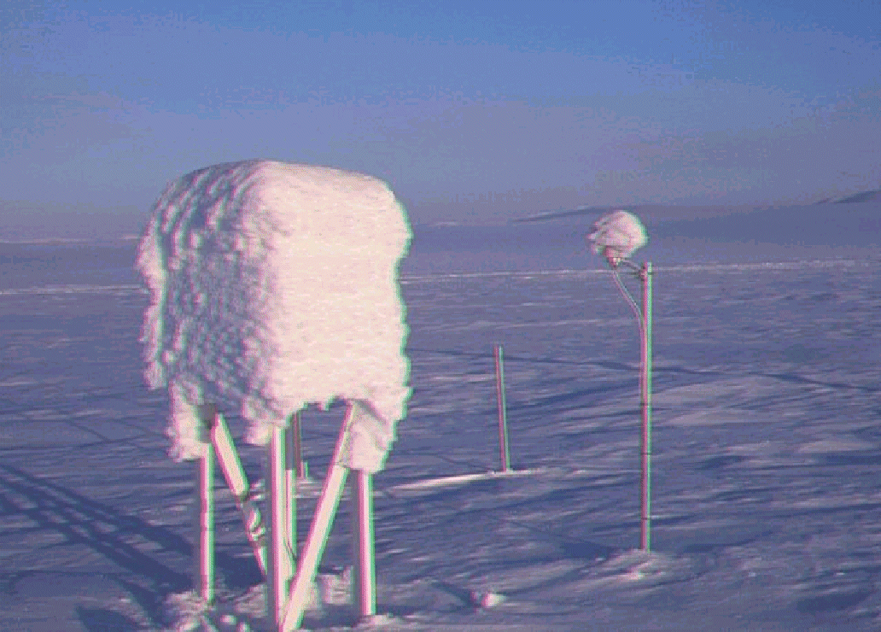
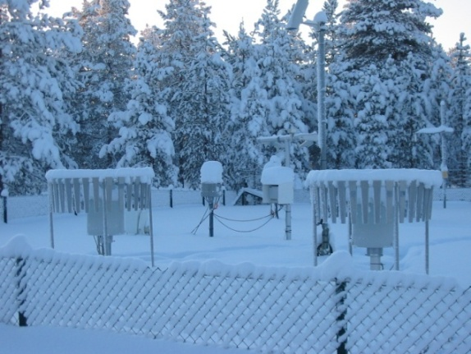
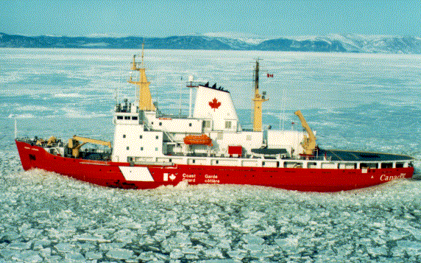
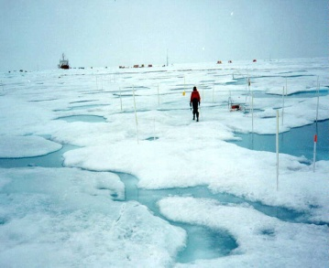
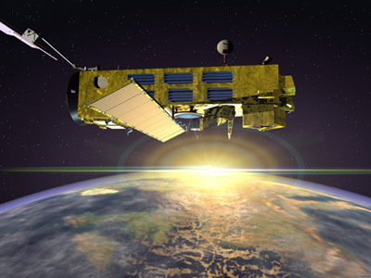
Moving Forward…
A host of geographical, physical, technical, economic, political, bureaucratic challenges
Notes:
This is the environment we are doing this in – challenges include geographical, physical, technical, economic, political etc

Slide 22
Cryosphere Information in a Changing Environment
An “integrated” surface and space-based observing system will be essential to provide data, information, and integrated products with higher spatial resolution and in near-real time for all regions of the world
Cryosphere observation and monitoring will be a key element of “environmental observing” which will serve a multitude of user communities
  “water” is key issue and will be even more important in the future, in all its aspects (supply, risk, economic resource …). and the cryosphere has a large impact on its amount/quantity in cold climate and alpine regions.
  Sea level rise is a significant threat, and continuing cryospheric measuring and monitoring of the loss of ice globally will be essential
  in high latitude regions where warming is occurring at a faster rate, changes in sea ice and snow cover, melting of glaciers and ice sheets , thawing of permafrost will have significant physical and socio-economic impacts locally, regionally, globally.
  cryospheric related hazards (thin ice (lake, river and sea), avalanches, glacier lake outburst floods, active layer detachments, spring flooding, etc) may increase in response to warming requiring high resolution driving data for high resolution process/forecast models.

Slide 23

Challenges Moving FORWARD
There are many challenges in implementing GCW and meeting expectations:
GCW is interdisciplinary and cross-cutting - national, regional and global in scope, addresses all time scales, requires collaboration among government, academia, private sector - How do we garner the commitments needed from WMO and different institutions and harness the expertise and resources that each community can offer – more than just NMHSs
Need to address the challenges in enabling interoperability between data centres, including WIS, especially for non-NMHS data centres
Overcoming the “strategic” or “commercial” designation of some cryosphere data, hence limiting sharing of data -publicly available data and databases are key to ensuring full usefulness of observations that are collected by the future system
How does WIGOS see the integration of GCW and cryosphere obs/products as one of the 4 networks that makes WIGOS a whole system?
The focus for WMO obs is weather, climate, water. How best can we include cryosphere observations?

Slide 24
GCW…a key component in visioning an integrated observing system
GCW Website: http://globalcryospherewatch.org/
GCW Portal: http://gcw.met.no/

Slide 25
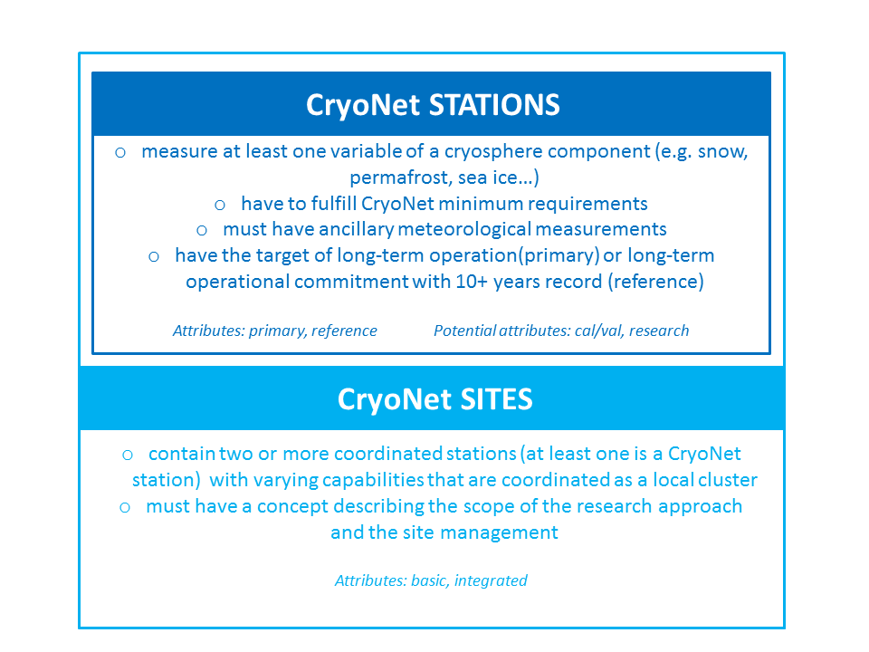
CryoNet Station and Site concepts
A CryoNet station must meet the minimum set of requirements, which includes providing ancillary meteorological measurements.

Slide 26
GCW contributing station
Measure at least one variable of at least one cryosphere component (e.g. snow, permafrost, sea ice…).
Provide useful measurements of the cryosphere but do not fulfil all CryoNet minimum requirements. These stations may be in remote, hard to access regions where cryospheric observations are scarce or in regions where they complement other cryospheric measurements.
Potential attributes:
Reference: have a long-term operational commitment and/or long-term (more than 10 years) data records.
Mobile platforms such as ships, drifting stations and buoys may also be contributing stations. Synoptic/climate stations of the NMHSs measuring cryospheric variables to WMO standards, and providing their metadata and data via WIS and WIGOS, could fulfill the necessary requirements

Slide 27
Minimum requirements of a CryoNet Station
Meeting Core CryoNet Measurement Requirements: The station shall measure at least one of the variables of one of the cryosphere components (i.e. snow, solid precipitation, lake and river ice, sea ice, glaciers, frozen ground and permafrost). The station location is chosen such that cryospheric measurements are representative of the surrounding region, and such representativeness needs to be clearly described.
Commitment of Operational Continuity: The station must be active. The responsible agencies are committed, to the extent reasonable, to sustaining long-term observations of at least one cryosphere component. There must be a commitment to continue measurements for a minimum of four (4) years.
Metadata Up to Date and Available: The station metadata, including all metadata describing the station characteristics and observational programme, are kept up-to-date and available in the GCW Portal as the interface to the WIGOS OSCAR
Compliance with Agreed Regulatory Practice: The station observational procedures, the instruments and method of observations, quality control practices, etc., should follow GCW endorsed regulations, manuals, guides and, to the extent possible, the recommended best practices.
Data and Ancillary Data Freely Available: Data are made freely available, and whenever possible in near real-time. In situ ancillary meteorological observations, as required by CryoNet best practices, should also be available with documented quality.
Competency of Staff: Personnel must be trained in the operation and maintenance of the station.

Slide 28
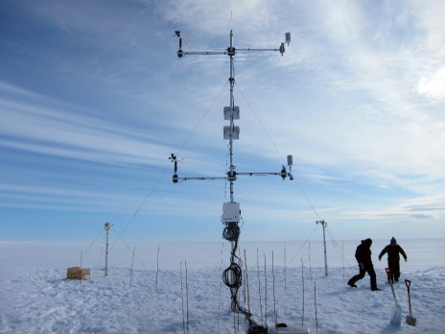
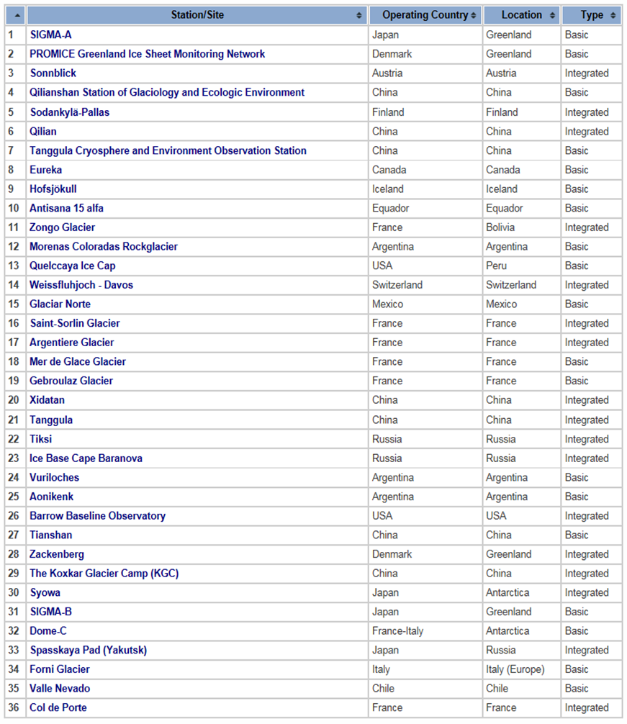
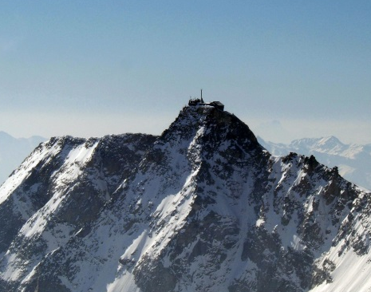
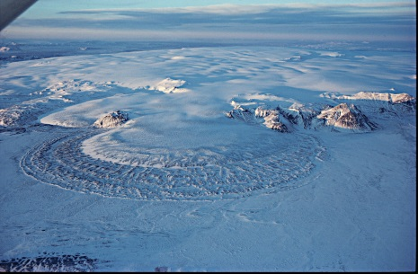
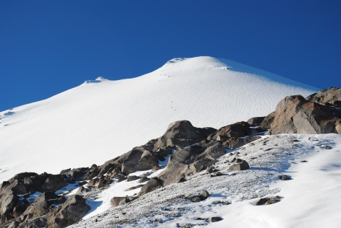
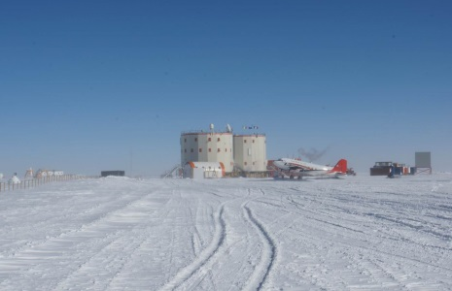
1
3
9
15
32

Slide 29
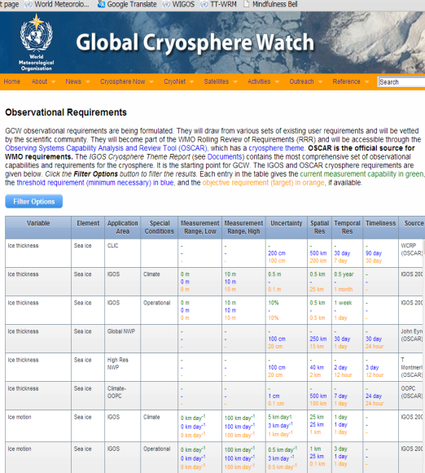
Requirements and Capability for observations
(ongoing)
GCW Requirements are being formulated and documented
on the GCW website;
They will draw from various sets of existing user requirements and will be vetted by the scientific community;
Those requirements will become part of the WMO Rolling Review of Requirements (RRR);
Will be accessible through the Observing Systems Capability Analysis and Review Tool (OSCAR), the official source for WMO requirements, which has a cryosphere theme;
GCW may engage the cryosphere community to update the IGOS Cryosphere requirements. This would be a major endeavour.

Slide 30
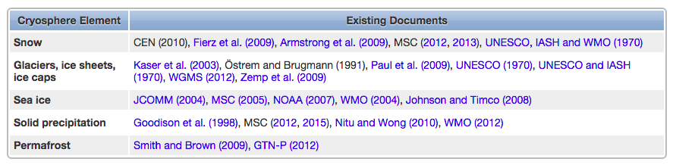
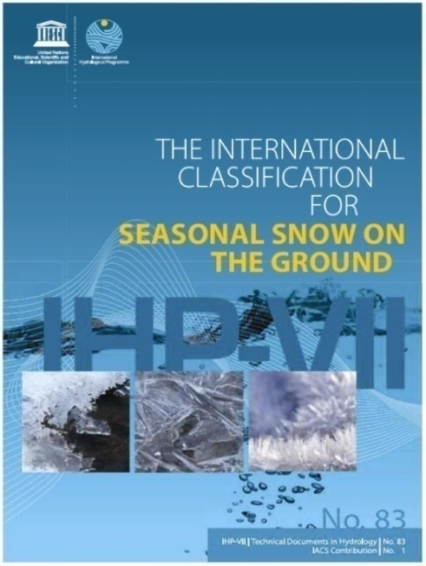
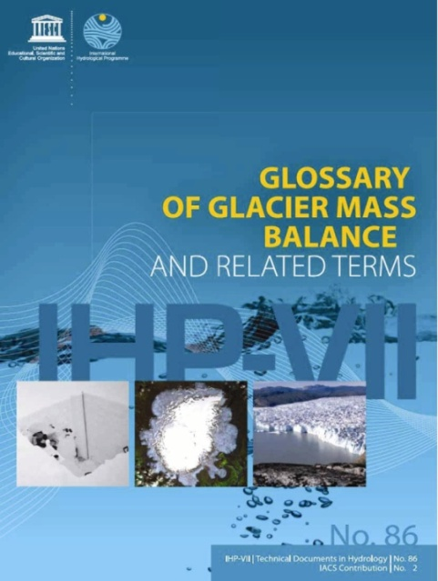
Measurement Standards and Best Practices
GCW is drawing on existing measurement methods where possible and where a scientific consensus has been or can be reached.
Step 1: Inventory of existing guidelines:
Step 2: GCW works through these documents, engages the community (WMO and beyond), and reaches a consensus on best practices for each variable.
GCW Guide: early 2017 (draft)
GCW Manual: Cg-18 in 2019
JOINT with UNESCO?? In all WMO languages??

Slide 31
Cryosphere Information in a Changing Environment
GCW surface-based observing component in the long term should be:
  - a consolidated (standardized from guidelines/best practices, high quality, sustainable) network of cryo-observations capable of providing essential information for cryosphere products to support various services offered by NHMSs and others
  - a technologically advanced and more complex, automated system allowing measurement of more cryospheric variables in all environments,
  - enabling significantly easier access to cryo-data
  - (one of) the first places people go to for data on the cryosphere (for various purposes like model validation, satellite cal/val, …)
  - a “trademark” helping its members of the network to sustain over the long term
GCW observing network will assess the role of community based observing, volunteer networks (e.g. CoCoRAHS), crowd sourcing (crowd funding…)
GCW (and WIGOS) needs to support and influence WMO priorities as they change over the next 25 years) providing authoritative global and regional data, information and products, for NWP, PRCC, HWRP, GFCS …….

