Slide 1
JCOMM activities in support of the WMO Integrated Global Observing System (WIGOS)
ICG-WIGOS-6
(12-14 January 2017)
Jon Turton (JCOMM OCG Vice-Chair)

Slide 2
JCOMM
WMO-IOC Joint Commission for Marine Meteorology and Oceanography
Observations Programme Area (including JCOMMOPS)
Data Management Programme Area
Services and Forecasting Systems Programme Area
Participants include National Meteorological and Hydrological Services (NMHS), oceanographic and marine institutions and laboratories

Slide 3
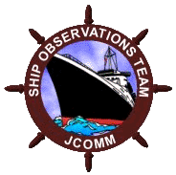
JCOMM in situ Observations Programme Support centre – Champika to present

Slide 4
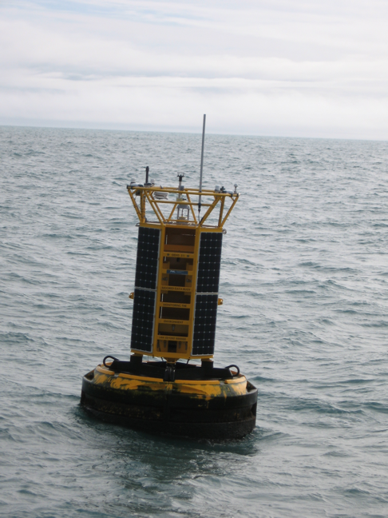
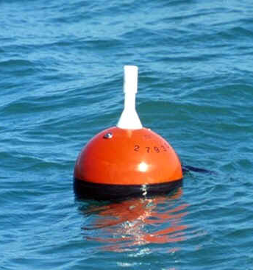
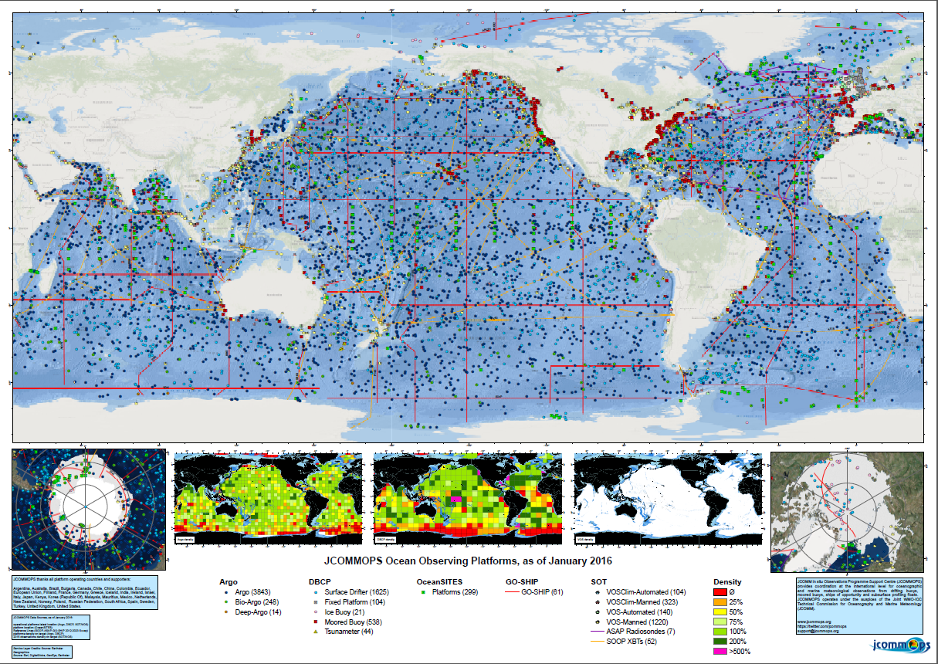
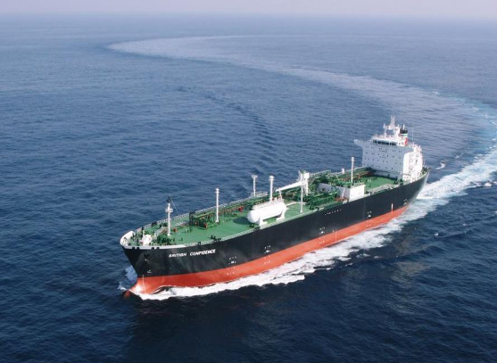
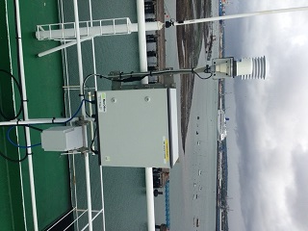
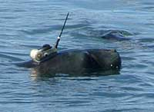
JCOMM observing networks

Slide 5
Marine/ocean observing networks
JCOMM ‘owned’
Ship observations (VOS, SOOP, ASAP) under SOT
Data Buoy observations (global drifter array, tropical moored buoy array, national/coastal moored buoy networks, high latitude (Arctic/Antarctic) buoys, tsunami buoys) under DBCP
GLOSS global tide gauge network

Slide 6
Marine/ocean observing networks
‘Partner’ networks associated with JCOMM
Argo (global profiling float array)
OceanSITES network of fixed point reference sites
GO-SHIP repeat hydrography programme
Future ‘partner’ networks
Sub-surface glider observations under the EGO (Everyone’s Gliding Observatories) network
Coastal HF radar networks
Coastal networks (e.g. links with GOOS Regional Alliances)
Animal-borne sensors (e.g. marine mammals at high latitudes)
Carbon observations under the IOCCP (International Ocean Carbon Coordination Project)

Slide 7
Marine/ocean observing network metrics
Networks have been encouraged to develop clearer missions and targets (performance indicators)
These will be used by JCOMMOPS to provide regular reports on the status of the observing networks
Variable based metrics (across the whole observing system) are a priority for the Ocean Observations Panel for Climate and will be developed by OCG and OOPC

Slide 8
Standards and best practices
Juliet Hermes (SAON) appointed as a OCG Vice Chair for Standards and Best Practices
JCOMM standards and practices have been submitted to the repository of community practices at www.oceanpractices.net
Individual network specification sheets have been developed that include details of the Standards and Best Practices documentation used by the observing networks
Need to look across these documents as a package; identify gaps, synergies, and opportunities to better connect them

Slide 9
WIGOS
Limited appreciation of what WIGOS is within the (mainly oceanographic) community
following OCG-7 in April 2016 members now aware that national focal points for WIGOS exist (but not who they are !) and on the future use of unique WIGOS numbers for marine/ocean platforms
A key aspect will be the interfaces between WIGOS and the (non JCOMM-owned) partner observing networks (e.g. Argo and OceanSITES), where JCOMMOPS and TT-MOWIS will have key roles

Slide 10
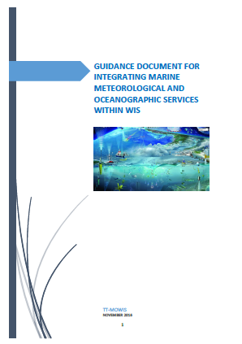
TT-MOWIS
JCOMM Task Team for Integrated Marine Meteorology and Oceanographic Services within WIS
Have recently developed a Guidance Document for Integrating Marine Meteorological and Oceanographic Services within WIS

Slide 11
WIGOS data exchange issues
Data can only be exchanged on WIS/GTS using agreed WMO formats, e.g. BUFR which is replacing the legacy TAC
Opportunity for platform/network specific messages that include new variables (e.g. bio-geochemical) and quality flags
BUFR templates for new data types/platforms have still to be developed (TT-TDC)
BUFR not used by the research community who use netCDF (hence need to develop netCDF to BUFR conversion tools)

Slide 12
WIGOS data exchange issues
Only NMHSs have direct access to GTS, the marine/oceanographic partners within JCOMM do not
Open Access GTS Pilot Project (improve access to the GTS and to GTS data for JCOMM partners) – plan to demo at JCOMM-V
OCG is encouraging the use of ERDDAP for data integration http://osmc.noaa.gov/erddap/tabledap

Slide 13
Data quality monitoring
For ‘traditional’ surface marine meteorological data from VOS and buoys – routine near real-time comparison against NWP background fields
WMO lead centre for monitoring the quality of surface marine observations at UK Met Office (monthly reports)
EUMETNET QC tools and monitoring statistics provided by Meteo-France

Slide 14
Oceanographic data quality monitoring
For sub-surface data, the data are used to validate the models rather than the models to validate the data
Real-time QC of T&S profile data (Argo, OceanSITES, gliders) is carried out at national DACs following community agreed automated tests (and now oxygen)
For Argo T&S profiles CLS check for anomalies against satellite altimetry and feedback to DACs every 4 months
QC of other bgc variables (chlorophyll, nitrate etc.) is still an area of active development

Slide 15
Delayed-mode data
Marine Climate Data System (MCDS)
VOS Global Collecting Centres (UK, Germany) to be designated as VOS Global Data Assembly centres (GDACs)
Trial GDACs for drifting buoys (France, Canada)
Well established GDACs for Argo and OceanSITES in France and US
Well specified delayed-mode QC systems in place for T&S profile data

Slide 16
JCOMM Data Management
Over the years the individual JCOMM networks have developed their own data processing and management systems with differing levels of capability (QC, data access, metadata etc.)
Argo is providing the model for the newer and emerging networks (e.g. OceanSITES, gliders)
Need to bring all networks up to the ‘gold’ (Argo) standard

Slide 17
Metadata
Will be covered by Champika
WMO-owned networks (e.g. VOS) will need to comply with the WIGOS metadata standard, but unrealistic to expect partner networks (e.g. Argo, OceanSITES) to fully comply
Marine/oceanographic community likely to continue to use network-based GDACs and JCOMMOPS to collect and access metadata
JCOMMOPS forwarding metadata to OSCAR, but urgently need machine-to-machine interface between JCOMMOPS and OSCAR for upload

Slide 18
Regional WIGOS centres
Two Regional Marine Instrumentation Centres (RMICs) established: NMDIS, Tianjin, China and NDBC, Gulfport, US
RMIC-RA-IV-2 (Feb 2016, Gulfport, USA): recommendation to promote Quality Assurance of Real Time Ocean Data (QARTOD) best practices and standards by the US IOOS via a JCOMM Technical Report
First CMOC/China Workshop (28 Aug - 1 Sep 2016, Tianjin, China): pilot study on integrating the DBCP drifter data with metadata was discussed

Slide 19
Capacity Development
RMIC workshop for RA IV with focus on wave measurement technology - NDBC, US, Feb 2016
DBCP (North Pacific Ocean and Marginal Seas – Busan, Republic of Korea) NPOMS-4 and (Pacific Islands - Noumea, New Caledonia) PI-2 workshops during 2016
WIGOS RA VI workshop on marine meteorological and oceanographic observing requirements – Croatia, Sep 2016

Slide 20
Summary
JCOMMOPS has a fundamental role in providing a single consolidated interface for marine/ocean observing related information (e.g. metadata) to be provided to WIGOS
Are we delivering everything that WIGOS wants ?
TT-MOWIS and TT-TDC will have a key role in developing the interfaces for data exchange between WIGOS and JCOMM partner observing network data centres (TT-MOWIS work plan to be approved by JCOMM-MAN)

