Slide 1
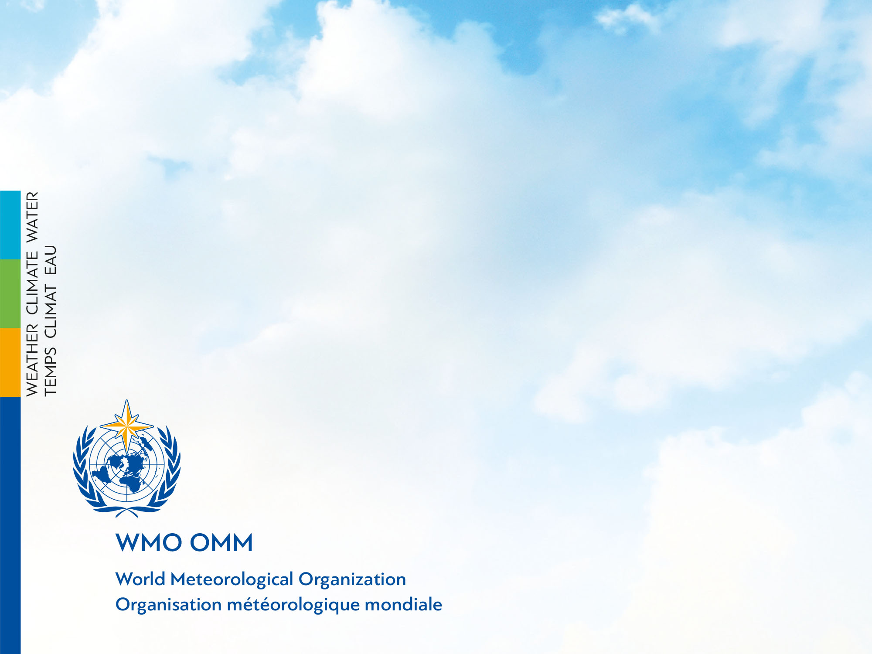
Report to ICG-WIGOS-6 on Status and Perspectives from CAgM
12-14 Jan. 2017
Byong Lyol LEE
Commission for Agricultural Meteorology

Slide 2
Development of Service Lifecycle by CAgM
Goal : Active engagement in implementation of pre-operational WIGOS
for enhanced Impact-based forecast & Risk-based Early Warning
along with AGMP and CAgM activities, especially through GIAM
  In-situ observations : RG, GHG, SM, Phenology
  Service implications : EW with NWPs / DS
  - Crop status monitoring & prediction :
  3) Capacity development & partnerships
  - MetAgri & SMAPVEX16/AAFC, GEOGLAM, ISB,
  - CIMO/CAS/CCl/CHy/CBS/JCOMM
  ICT Infrastructure for CAgM with WIGOS
  - WIS2.0 compatible, Cloud, Big-data, GIS-online,
  - GDPFS centres : GAMEOS – Global AgMet EW & Outlook Service
  GIAM Governance through GRIAM
  - ICO in Global Research Institute of Applied Meteorology at NUIST

Slide 3
3-Tiers Approach for AGMP
CAgM
FOCUSF AREAS (FA)
for efficient, effective & on-time supports to emerging
requirements from UN, WMO, Members, Partners
through Synergy build-up by leveraging available
resources and legacy systems
FA 1
Operational
Agricultural
Meteorology
Chair: N. Chattophday
(India-RA II)
Co-chair: D. Diarra
(Mali-RA I)
FA 2
Science and
Technology for
Agricultural
Meteorology
Chair: O. Brunini
(Brazil-RA III)
Co-chair: H. Shannon
(USA-RA IV)
FA 3
Natural Hazards
and Climate
Change/Variability
In Agriculture
Chair: R. Stone
(Australia-RA V)
Co-chair: R. Desjardins
(Canada-RA IV)
FA 4
Capacity
Development in
Agricultural
Meteorology
Chair: E. Mateescu
(Romania-RA VI)
Co-chair: J. Ukeje
(Nigeria-RA I)
T3
GIAM
T2
CAgM
T1
AGMP
Project Implementation & Management for the Members
Current issues (ToR), Fixed & Key Strategic plans
Emerging/Future issues, Flexible & Supplementary Scheme

Slide 4
CAgM/GIAM with GFCS-AgFS
Global Initiatives in AgroMeteorology
Climate Services
Information Systems
(CSIS)
WAMIS II
Climate User Interface
Programme
(UIP)
Capacity
Development
(CD)
GAMPP
GFAMS
GCREAM
Research,
Modeling and
Prediction
(RMP)
GAMOS
Observations &
Monitoring
(OBS)
Global Federation of AgMet Society (GFAMS) UIP, RMP
Global Center of Research, Excellency in AgMet (GCREAM) CD
Global AgMet Pilot Projects (GAMPP) RMP, CD
Global AgMet Outlook System (GAMOS) GAPON OBS, RMP
WAMIS next phase (WAMIS II) CSIS, UIP
- World AgroMeteorological Information Service

Slide 5
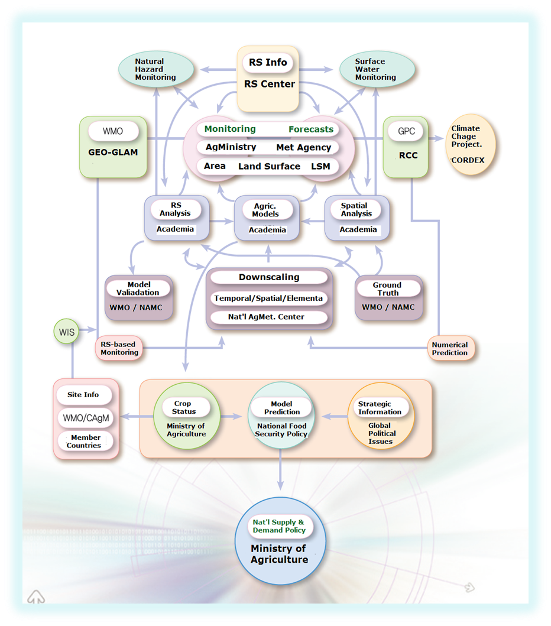
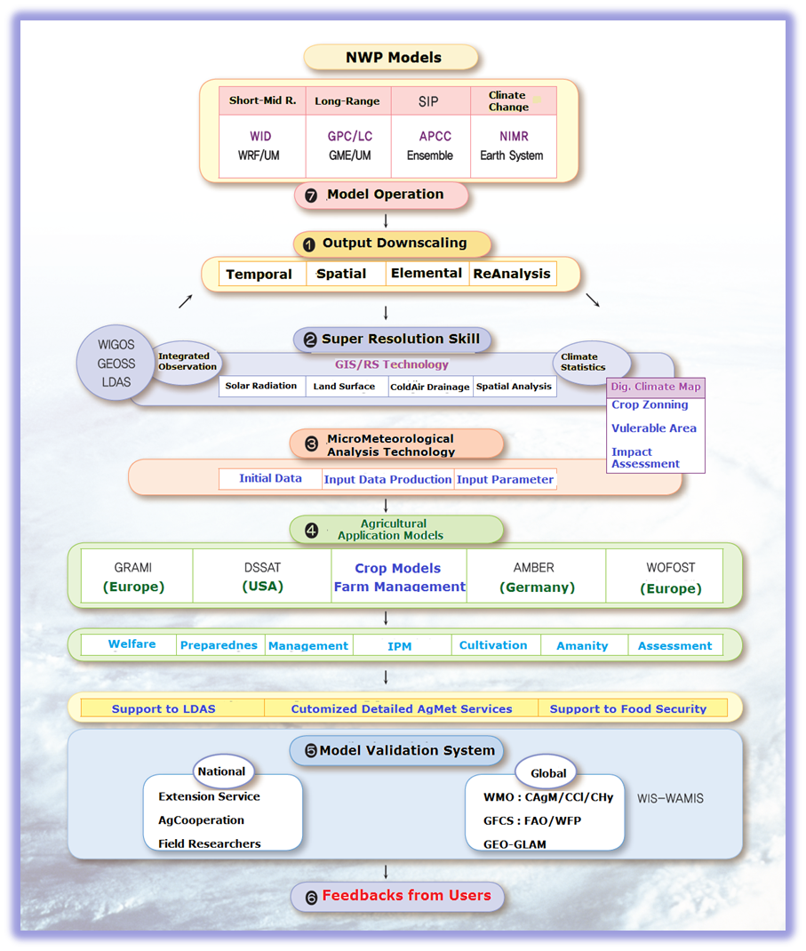
WIGOS
From Risk-based Early Warnings
To Impact-based Forecasts

Slide 6




WIGOS/S2S-based
CAgM-GEOGLAM : World AgroMet Early-Warning & Outlook System
S2S
WWRP/THORPEX-WCRP
GAMOS
GDEWS
GLUMS
GWHAS
GAPON
Downscaling
AgModels
ICT platform
ChiNAMOS
NWPs based
In-situ based
RS based
CAMS
CMA
NUIST
Members
GAMOS
WIGOS
GEOGLAM
Crop Watch
JECAM

Slide 7
Grand Technology Challenges
Establishment of Technology Consortium
on Downscaling Skills for Applied Meteorology
Diverse challenges in developing downscaling technologies for in-situ, monitoring, RS, predictions over the world have been made to meet the user requirements for higher resolutions in time, space and element in the disciplines of Applied Meteorology.
Potential Partners
[Phase 1 : 2015~2016]
GridMET (NUIST, China) : Xinfa QIU
Real-time Downscaling : Grid-RD (PKNU, Korea), Jaiho OH
Digital Climate Map (SNU/NCAM, Korea), Byong LEE
HR-AgMet : KLAPS (KMA/NIMR, Korea) Kyurang KIM
[Phase 2 : 2017~2018]
Uncoupled Surface Model (Nanowx，USA）Matt Haugland
Synthetic Observations (EC, Canada) (TBD)
(TBD) (ASU, USA) Ben RUDDELL
WMO Demonstration project (AGMP/CAgM, WWRP/S2S)

Slide 8
Grand Science Challenge
Development of Life Cycle Analysis Framework (LCAF) on GHG/water (resource) footprints for national policy decision on best Environment performance of AgroEcosystem under present and future climate conditions
Focusing on
Climate Variability issues: S2S
System integration : Process Network Analysis
Coupling of AgroEcosystem to Atmospheric System
Synchronization of Mitigation/Adaptation strategies
Operation supporting ICT infrastructures
Partnerships with AAFC, Canada

Slide 9

WAMIS II as Service Platform
Data Grid
GRID
Computing • Data • Access
Cloud
Computing
GTS/WIS
GISC
WAMIS
ICT Infrastructure
DCPC
NCAR
NCDC
TIGGE
(Joint)GISC
UNIDAT
Computation • Research
KMA/KISTI
Data Broker
OpenWIS
GDS
Climate Projection
SIP
GDAPS / GME
RDAPS / GME : WRF
Mesoscale model
Nowcasting
Historical (Legacy) data
Non-Meteorological Data
WAMIS Grid Portal
User Interface
GridSphere
END-USERS
NWP Outputs
LAS
Pilot Projects
WAMIS
.
.
.
.
MME
AMBER
DSSAT
GIS RS
AgModels
LDAS/LIS
Flux, GHG
Surface Flux
Vegetation
Soil Profile
Services
(WAMISs)
Applied
Meteorology
DCPC-WAMIS : KMA
Cloud Computing-KISTI
NWP Models - PKNU
AgModels - NCAM

Slide 10
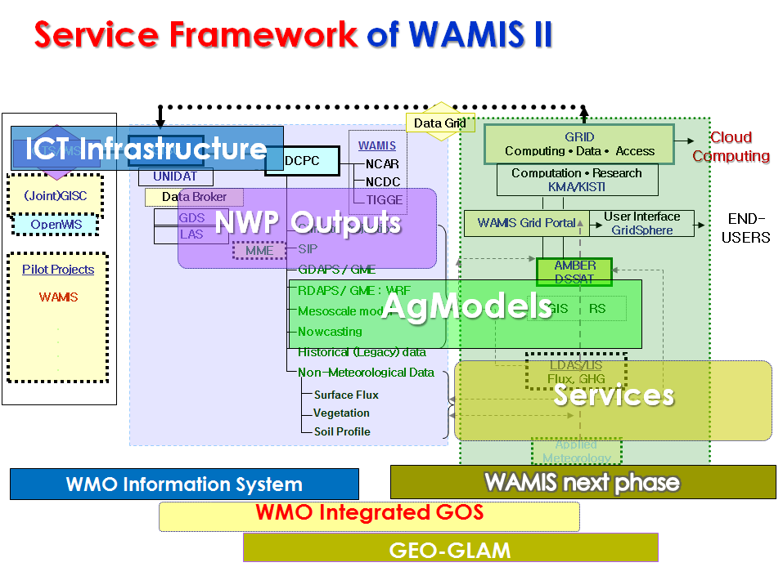
WAMIS II System Architecture

Slide 11

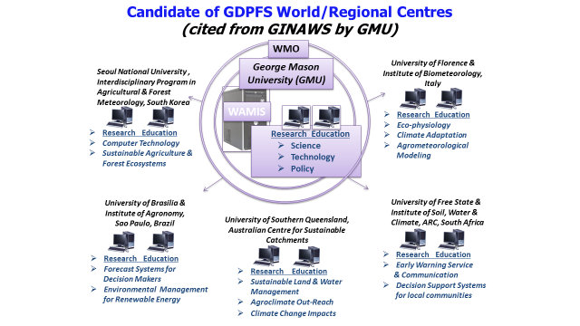
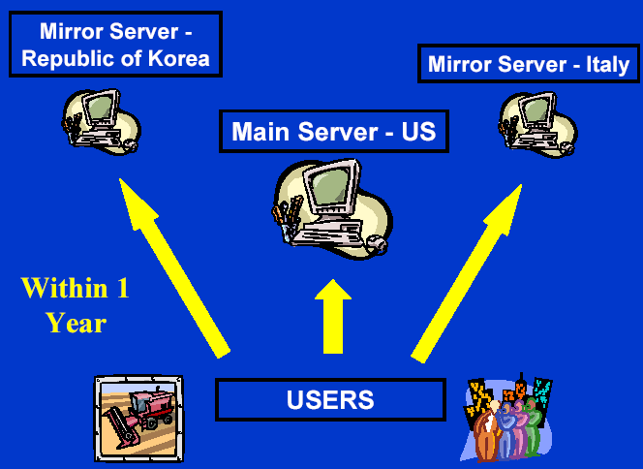

AgMet Platform : ICT Sharable Platform of WAMIS II
KISTI
Science DMZ
WAMIS
DWD
KMA
INMET
QMD
NCAR
NUIST
KMA-KISTI
Science DMZ
WAMIS
GISC
Seoul (KMA) : Offenbach (DWD)
Mutual Backup
DCPC
-WAMIS
GRID /
Cloud
DCPC
-GMC
WAMIS Portal
Australia, Brazil

Slide 12



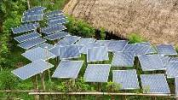
Global Project : IKI
International Climate Initiative

Slide 13
GIAM Governance for CD with GRIAM
Agro
Met
Center
ICO-GIAM
Urban
Met
Center
ICO-HIW
Service
Innovation
Center
WMC-GDPFS
Eco
Met
Center
IPO-GCR
ICO-GIAM
GRIAM/China
GCREAM
Korea/India+8
GFAMS
Italy/Brazil/India+9
GAMPP
Australia/Korea+
GAMOS
China/Canada+8
WAMIS II
USA/Italy/Korea+2
GRIAM at NUIST, China
-Global Research Institute of Applied Meteorology
-targeting WMO endorsements through contributions to GFCS implementation

Slide 14
CAgM
WIS
GFCS
GISC-Seoul
GIS-OnLine : ESRI
Cloud Computing – KISTI/PLSI
AGMIP
Crop Models
WAMIS DCPC
Agric
WMO
AgModels
DSSAT/AMBER
NWP models
WAMIS II
3+3+?
CSIS
UIP
GPC LC
LRF MME
CD
GAMPP
6+?
GFAMS
11+?
GCREAM
8+?
Candidates :
1~3 regional pilot projects
in each RA
RMP
S2S : CAS/KMA (APCC)
GAMOS
Phenoloy
GHG Flux
Soil moisture
OBS
NASNET
Phenology Monitoring
Ground truth information
ISB/CP
Fluxnet/AsiaFlux
FAO, IRI, EU, USA
NASA -NEX
WIGOS
GTOS
GLAM

Slide 15
External Partnerships beyond WMO
ESSP
IHDP DIVERSITA IGBP WCRP
FAO GCP GEON GEOSS IPCC THORPEX TIGGIE CEOP
FluxNet | Phenology | GCOS | WIGOS | Models | Hydrology
GAMOS(Global AgroMeteorogical Outlook System)
GDEWS(Global Drought Early Warning System)
GLUMS(Global Land Use Monitoring System)
GWHAS (Global Weather Hazard Assessment System )
GPPON(Global Plant Phenology Observation Network)
Monitoring
with CAgM
Supporting NWPs available : WRF/MM5 GME/UM MME
Services
via WAMIS
NOAA/KMA
DWD/UK GPC-/RCC/APCC
Climate services expected
CC Scenario Climate Monitoring Short R. Med R, Monthly, Seasonal, decadal
NCAR/ESSP JAWF/MET-BROKER NCAM/NWS RCC COLA

Slide 16

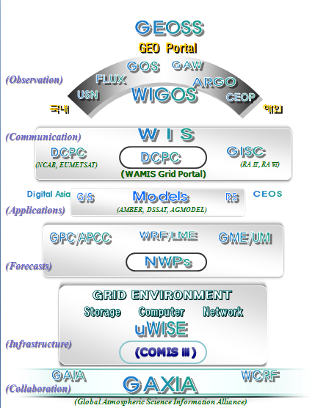
WIS-anchored
System Architecture
of CAgM
WMO CAgM

Slide 17
Matrix of R-based framework from CAgM perspectives
GFCS | CAgM | Requirements | Objectives/Input | Activities/Deliverables
OBS |  | Ground truth/in-situ | Exp.Pj1– joint projects | GEOSS/GAPON/SMDP
 | GAMOS | Outlook/flux/phenology | O1-AI-5) Tr, O2-AI-6) Tw | S2S/RS based Outlook Sys
RMP |  | Mitig/Adapt/Sustain. | Exp.Pj2–Global Challenge | S2S/Downscaling
 | GAMPP | Global challenge research | O2-AI-5) Re, O4-A!-1) Pc | NWP based LCA tool
CSIS |  | Service platform | Exp.Pj3-ICT platform | Cloud/ScienceDMZ
 | WAMIS II | On-line, ICT infra, tools | O3-AI-2) Sv, O2-AI-2) Pf | Sharable ICT platform
UIP |  | Off-line interfaces | Exp.Pj4-Global Soc. Mtng | GIS-Online/CyberGIS
 | GFAMS | Expertise transfer | O1, O2 | Consultations
CD |  | Human/Infra/Instit/Proc. | All-Virtuous CD cycle | RTC/Global Campus
 | GCREAM | E/T/R, Think-tank | O1-AI-5) Tr, O2-AI-4) Ts | Graduate program
Coordinate | ICO/IPO | In/ex-ternal partners | O5-A!-3) Rs | GIAM ICO with GRIAM
Resources | Donors | Trust fund, in-kinds, .. | O4-A!-2) Rs | ICO/GRIAM, GCF/GCR
Governance | AGMP | FAO/WFP/GEO/GACSA .. | O5 | PAC/TAC, GFCS focal point
Note : Green Color – Key projects in AgFS Exemplar, Red Color – Global partners/programmes

Slide 18
WMO
Structural
Schematics with partnerships from CAgM Perspective

Slide 19
Development of Service Lifecycle by CAgM
Goal : Active engagement in implementation of pre-operational WIGOS
for enhanced Impact-based forecast & Risk-based Early Warning
along with AGMP and CAgM activities, especially through GIAM
  In-situ observations : RG, GHG, SM, Phenology
  Service implications : EW with NWPs / DS
  - Crop status monitoring & prediction :
  3) Capacity development & partnerships
  - MetAgri & SMAPVEX16/AAFC, GEOGLAM, ISB,
  - CIMO/CAS/CCl/CHy/CBS/JCOMM
  ICT Infrastructure for CAgM with WIGOS
  - WIS2.0 compatible, Cloud, Big-data, GIS-online,
  - GDPFS centres : GAMEOS – Global AgMet EW & Outlook Service
  GIAM Governance through GRIAM
  - ICO in Global Research Institute of Applied Meteorology at NUIST

Slide 20
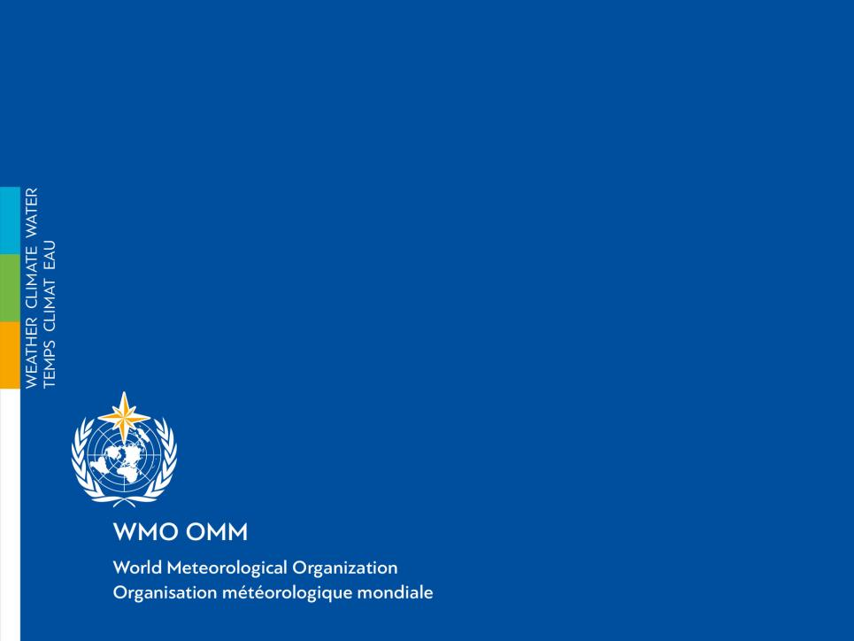
Thank you
lle
Climate Change
c
r

