Slide 1
ICG-WIGOS-6
Co-chairs' Report
Sue Barrell, Bertrand Calpini
Co-Chairs, ICG-WIGOS

Slide 2
Overview
Since last we met….
Objectives for this session

Slide 3
Since last we met at ICG-WIGOS-5 ….
Operational release of OSCAR/Surface – over 12,000 page views in first 2 months
Pilot RWC in Region VI
Regional WIGOS events in every region
EC-68 adopted the Plan for the WIGOS Pre-operational Phase, endorsed Regional WIGOS Centre concept and updated ICG-WIGOS terms of reference
CBS-16 endorsed the Guide to WIGOS, RBON concept, GCW, ...
TT-WMD continued its work
TT-WDP, TT-WDQMS, WEdB commenced their work

Slide 4
Since last we met at ICG-WIGOS-5 ….
Sixth WMO Impact Workshop, Shanghai, China
WIGOS Newsletter – 4 editions

Slide 5
ICG-WIGOS Task Teams
Before ICG-WIGOS-5 | After ICG-WIGOS-5 | Comment
ICG-WIGOS | ICG-WIGOS
TT-WRM (Reg. Material) | WIGOS Editorial Board | Small (3)
TT-WDQM (Data Quality Management) | TT-WDQMS (.. Quality Monitoring ..) | New focus on quality monitoring
TT-WMD (Metadata) | TT-WMD/OD | Focus to transition, from MD to OD
 | TT-WDP (Data & Partnerships) | New
IPET-WIFI | Relevant TCs
SG-RM |  | Integrated
SG-QM |  | into
SG-MD |  | ICG-WIGOS TTs
SG-OD (OSCAR Development)

Slide 6
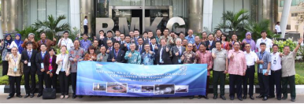
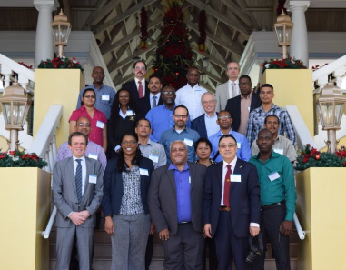
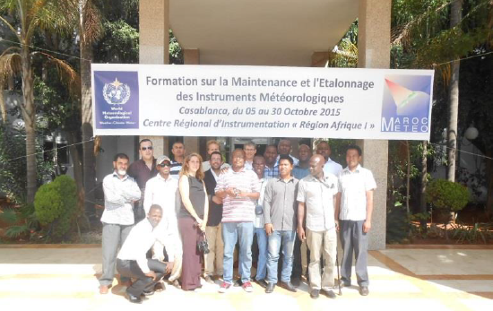
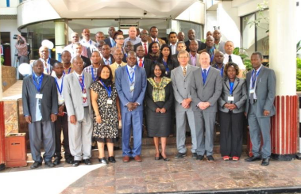
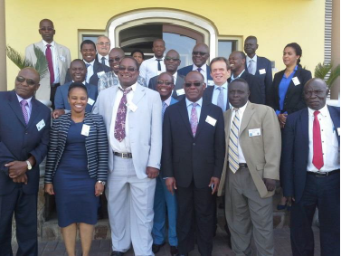
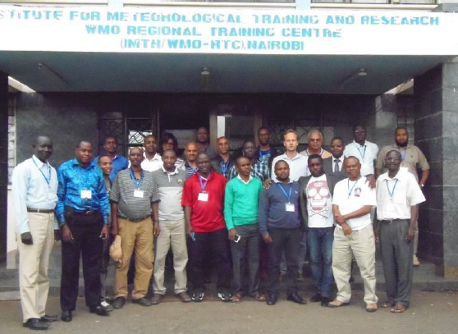
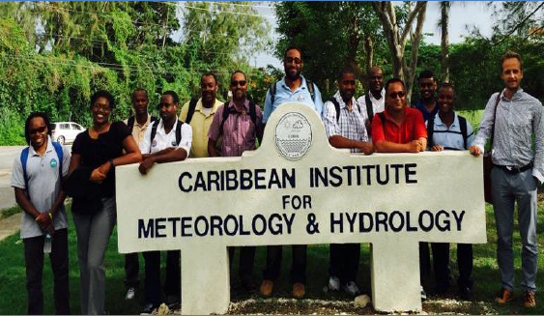
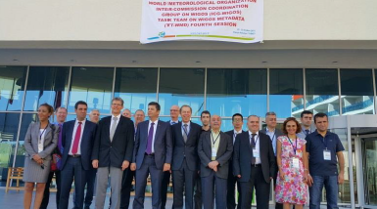
Regional WIGOS events in every region

Slide 7
Objectives of ICG-WIGOS-6
Review activities and outcomes of RAs, TCs and guests
Including JCOMMOPS, TPOS and WIGOS-SAS
Review progress of TTs, PO and advise on next steps
Review status of WPP priority activities
With special focus on RWC concept and PRA homework
Consider development plan and membership of TT-OD
Consider development plan for TT-WDQMS
Provide guidance on update of regulatory material and draft WIGOS Data Partnerships
Consider deliverables/requests to EC69
Indicators of WIGOS 'readiness'
WIGOS future status and governance

Slide 8
Wishing you all a productive meeting!

