Slide 1
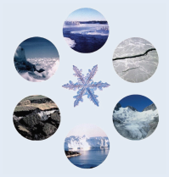
Global Cryosphere Watch (GCW) achievements
GCW Working Structure completed, and implementation phase (2016-2019) started
Steering Group: Chair: A. Snorrason, vice-Chair: B. Goodison
Working Groups: Observations, Information and Services, and Integrated Products (Chair: TBD)
Initial inventory of the Snow Watch products developed & available on GCW website. SnowPEx intercomparison of satellite products (supported by ESA)
Cryonet (component of WIGOS)
Design Principles developed (consistent with WIGOS)
Sites/Stations concept updated
Procedure for site selection proposed (incl. evaluation criteria)
Minimum requirements for Cryonet Sites developed
36 Sites identified under evaluation
Notes:
The change management process can allow stakeholders to buy into WIGOS concept and its implementation

Slide 2
Global Cryosphere Watch (GCW) achievements
GCW Portal progressing
Metadata from 6 sites routinely harvested
GCW Portal Interoperability Guidelines drafted
GCW Portal Operations Manual drafted
Terminology
GCW Glossary developed
Routinely updated with new terms (over 2900 terms, with 1700 being unique, from 21 different sources)
Website completed, includes comprehensive information on GCW http://globalcryospherewatch.org/
Notes:
The change management process can allow stakeholders to buy into WIGOS concept and its implementation

Slide 3
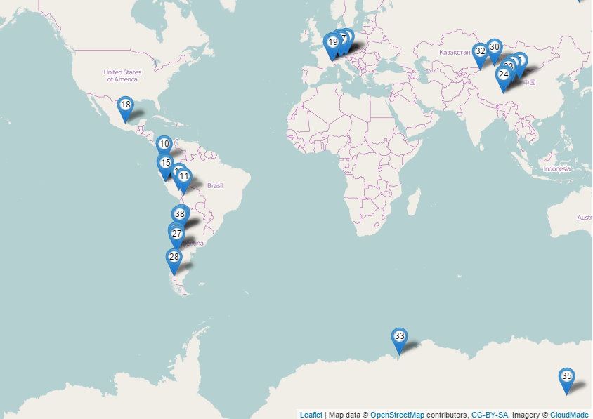
Global Cryosphere Watch (GCW) pending work
Regulatory Materials (update WIGOS Manual, include minimum requirements)
Refine Site/Station selection criteria, and complete assessment and Site/Station selection
Side meeting on GCW at EC-68

Slide 4
Global Cryosphere Watch (GCW) challenges
Develop regional working structure
Operationalizing GCW and establishing closer links between the operational and research communities
Refine terminology, tier structure
GCW Portal: access to data (not just metadata), starting with Davos, Sonnblick and Sodankylä
Provision of Cryonet Sites/Stations metadata to OSCAR/Surface
GCW contribution to the WIGOS Quality monitoring system

