Slide 1
GFCS linkages with WIGOS 26 January 2016
www.gfcs-climate.org

Slide 2
PAC Membership
Burkina Faso, Bhutan, Dominica, Moldova, Papua New Guinea, Tanzania

Slide 3
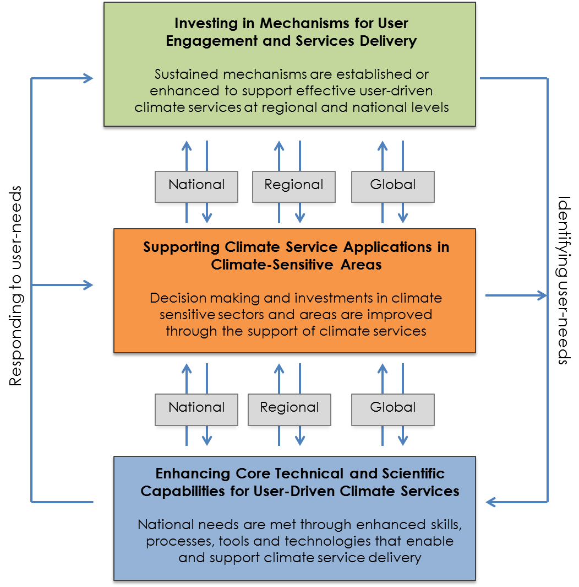
Strategic Objectives of the GFCS Operational Plan
Notes:
The Operational and Resource Plan will address the needs under the pillars of the GFCS to enable development and application of tailored climate services in the five priority areas of the GFCS, through the following strategic objectives:
Objective 1.
Enhance mechanisms for user engagement and service delivery through strengthening and sustaining national, regional, and global coordination and delivery mechanisms. Activities under Objective 1 are focused on establishing and supporting user-interface-platforms (UIP) mechanisms, such as National Frameworks for Climate Services, and coordination functions of Regional Climate Centers. These activities led by the GFCS Office at the global level, in partnership with members and partners, will develop structured mechanisms, policies, and functional processes that create opportunities for users and providers to meaningfully engage and work together to develop and deliver climate services. The expected outcome is sustained or enhanced mechanisms to support effective user-driven climate services at regional and national levels.
Objective 2.
Support the application of climate services for decision-making in the five climate-sensitive GFCS priority areas. The five GFCS priority areas are Food Security and Agriculture, Water Resources, Human Health, Disaster Risk Reduction, and Energy. Activities to support Objective 2 include those that provide technical advisory, planning, and coordination to improve management of climate related risks in these areas, such as establishing help desks, coordination offices, and technical support units. Activities will enable more effective dialogue and partnership that fosters co-production and application of new and innovative climate services tailored to meet user needs. Sector specific activities will be led by, or closely coordinated with, the GFCS Partners representing the priority sectors. The expected outcome of Objective 2 is that decision making and investments in the five climate- sensitive sectors are improved the support of climate services.
Objective 3.
Enhance core technical and scientific capabilities for user-driven climate services. This Objective focuses on actions to enable climate service providers to better serve society with effective climate knowledge, through improvements in the core technical and scientific capacities necessary to deliver climate services. This will require coordination, and technical and scientific support across and within the core GFCS Pillars -- Observations and monitoring (OBS); the Climate Service Information System (CSIS); Research, Prediction, and Modeling (RES); and Capacity Development (CD). Activities will be implemented principally by WMO programmes, including joint programmes, through the work of WMO technical commissions and Regional Climate Centres and partner institutions. The expected outcome of Objective 3 is that national needs are met through enhanced skills, processes, tools, and technologies that enable and support climate service delivery.

Slide 4
Developing a Proof of Concept
National consultations
Burkina Faso, Belize, Bhutan, Chad, Cameroon, Dominica, Malawi, Mali, Niger, Papua New Guinea, Senegal, Suriname, Trinidad and Tobago, Tanzania, South Africa
Regional Consultations
Central Asia, Bishkek, Kyrgyz Republic
North-Eurasian Countries, Sochi, Russian Federation
Least Developed Countries in Asia, Thailand
Caribbean, Trinidad and Tobago
Pacific Small Island Developing States (SIDS), Cook Islands
Latin America, Costa Rica
South Eastern Europe, Turkey
North Africa and the Middle East (dates to be decided).
Capacity Development through implementation of projects
Climate Services Adaptation Programme
Programme for Implementation of the GFCS at Regional and national levels

Slide 5
Systematic approach for supporting countries
Step 1: Conduct Comprehensive Country Baseline Capacity Assessment for the Development of Climate Services
Step 2: Support NHMS to Engage in a National Consultation process for Climate Services & Develop Action Plan
Step 4: Organize Action Plan endorsement by government and partners
Step 5: Begin Implementation of Action Plan; Launch National Framework for Climate Services; Monitor & Evaluate Impact
Step 3: Develop National Action Plan
Map needs against existing initiatives at national/regional level

Slide 6
Support needs
Data access
Standards
Data rescue, quality control , data management system, data processing (Integration of station and satellite data)
Observational network, especially for marine areas (Indian Ocean coastline, Lake Victoria, Lake Tanganyika and Lake Malawi)
Training on methodologies and tools
Facilitation of institutional cooperation (legal frameworks or institutional mechanisms).

Slide 7
Thank you for your attention
www.wmo.int/gfcs

