Slide 1

World Meteorological Organization
Working together in weather, climate and water
WMO
Joint WMO-IOC Technical Commission for Oceanography and Marine Meteorology Contributions to
WMO Integrated Observing System
WMO Technical Commission for Oceanography and Marine Meteorology (JCOMM)
25-28 January, 2016

Slide 2
JCOMM WIGOS related activities and contributions to WIGOS since ICG-WIGOS-4 (January 2015)
Ocean Observing Systems
Marine Climate Data System (MCDS)
Task Team for Integrated Marine Meteorological and Oceanographic Services within WIS (TT-MOWIS)
Capacity Development Workshops
Pilot Projects
Contribution to WIGOS priority activities for Pre-Operational Phase (2016-2019)
ICG-WIGOS V - JCOMM – Geneva - 25-28 Jan 16

Slide 3
Ocean Observing Systems Development in cooperation with OOPC
New ocean observing network targets
Performance metrics
Risk assessment
    Consistent with
  GCOS Implementation Plan
  WMO Rolling Review of Requirements
  Additional requirements to GOCS for marine services & forecasting
ICG-WIGOS V - JCOMM – Geneva - 25-28 Jan 16
Notes:
JCOMM is developing new ocean observing network targets, performance metrics, and risk assessment in cooperation with OOPC. This will be consistent with new GCOS IP under development, and the WMO Rolling Review of Requirements (RRR), taking into account addition requirements to GCOS (e.g. marine services, ocean forecasting)

Slide 4
Marine Climate Data System
(flow of delayed mode data, integrated products)
CMOC/China (Cg-17)
Negotiations for establishing ICOADS & WOD as CMOC(s)
New Technical Regulations to update WMO No.558, 471 (by JCOMM-5, Oct 2017)
MCSS VOS Global Collecting Centres of UK and Germany to be re-established as VOS Global Data Assembly Centres (GDACs)
Formalization of trial GDACs for Drifting Buoys of France and Canada
Expecting more candidate DACs and GDACs
ICG-WIGOS V - JCOMM – Geneva - 25-28 Jan 16
Notes:
JCOMM continues developing the Marine Climate Data System (MCDS) (assuring the flow of delayed mode marine data from various sources to CMOCs, which will provide integrated marine climate products). CMOC/China was established by Cg-17. New Technical Regulations will be proposed for adoption by JCOMM-5 (WMO No. 558, 471). The existing Marine Climatological Summaries Scheme (MCSS) VOS Global Collecting Centres (GCCs) of UK and Germany will be re-established as VOS Global Data Assembly Centres (GDACs); the trial GDACs for Drifting Buoys of France and Canada will be formalized. We are looking for other candidate Data Acquisition Centres (DACs) and GDACs (e.g, moored buoys, Argo).

Slide 5
TT-MOWIS (interoperability with WIS)
Build and activate the interfaces between Marine Meteorological and Oceanographic services and the WMO Information System (WIS)
JCOMM Focal point for the interface with WIS for the Management Committee, OPA, DMPA and SFSPA coordination groups, and Teams
Contribute to Delayed Mode Data Archives of the Marine Climate Data System (MCDS), the IODE network, and the Global Framework for Climate Services
Design and promote the oceanographic components of the Data Collection and Production Centres (DCPCs) of WIS for both observations and forecasting services
Partner Organizations access to WIS data & metadata
ICG-WIGOS V - JCOMM – Geneva - 25-28 Jan 16
Notes:
Cross-cutting Task Team for Integrated Marine Meteorological and Oceanographic Services within WIS
The terms of reference, draft membership and objectives of the TT-MOWIS were adopted by JCOMM MAN-11 in October 2014
Address the WIS related legacy of the JCOMM Pilot Project for the “Integration or Marine and other Appropriate Oceanographic Observations into WIGOS” and further develop it toward the 2013-2016 JCOMM Strategic goals, building on the IOC Strategic Plan for Oceanographic Data and Information Management (2013-2016) (IOC Manuals and Guides No. 66) and the JCOMM-4 approved long-term strategy for the DMPA

Slide 6
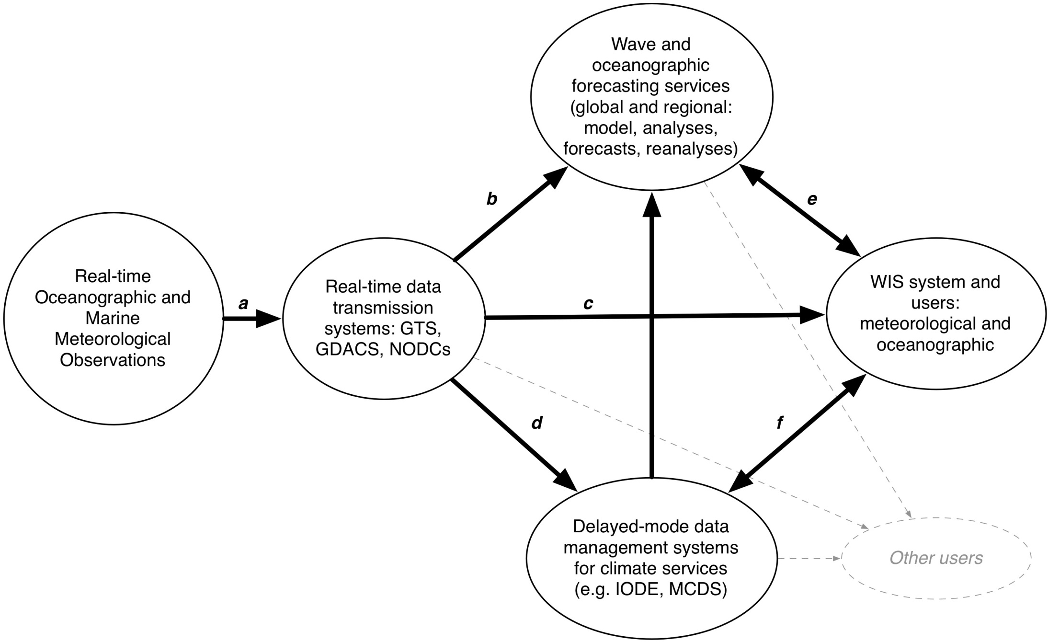
TT-MOWIS
ICG-WIGOS V - JCOMM – Geneva - 25-28 Jan 16

Slide 7

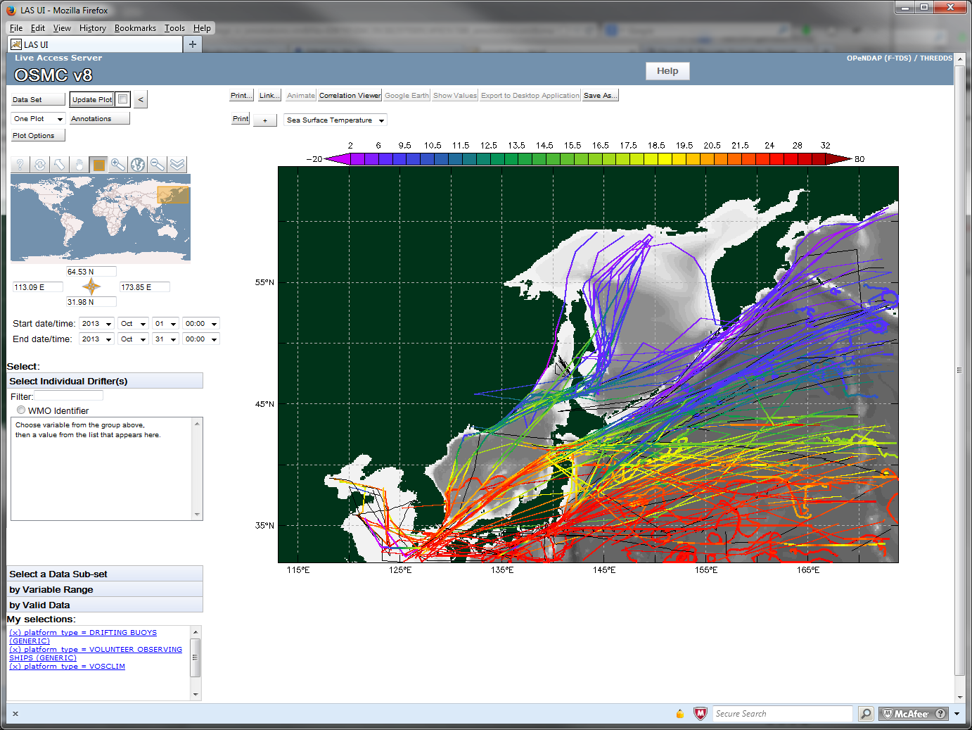
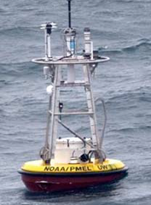
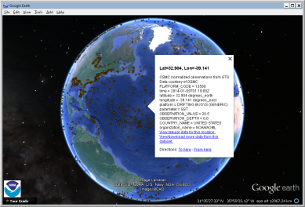
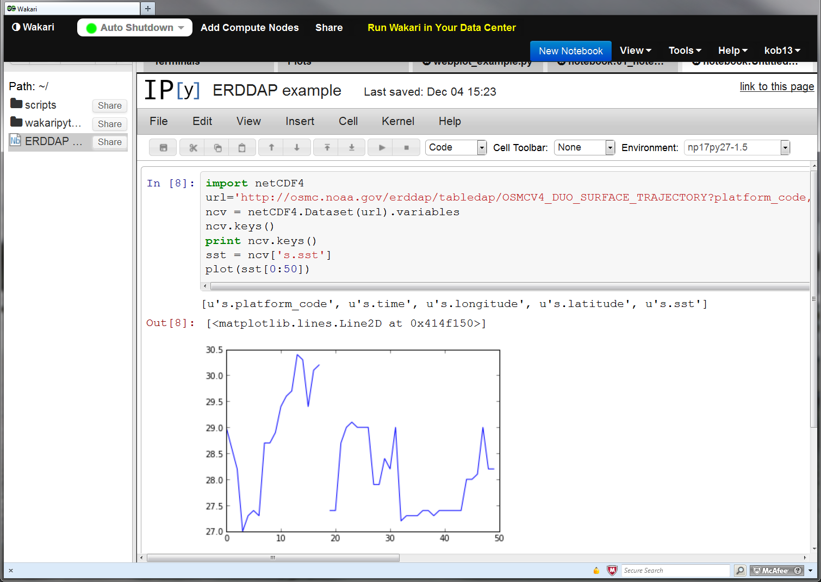
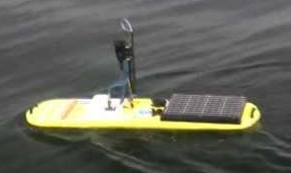
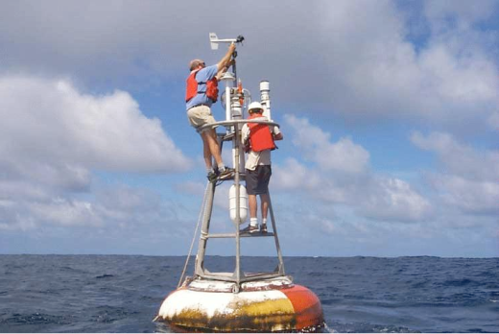
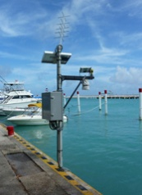
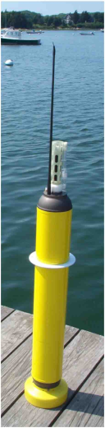
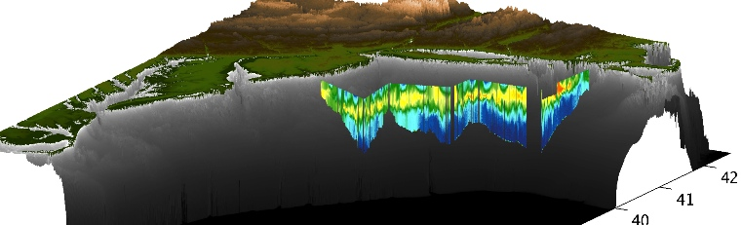
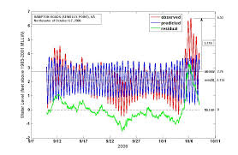
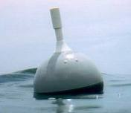
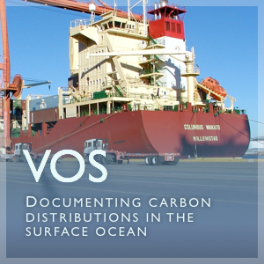
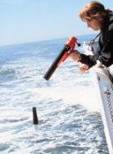
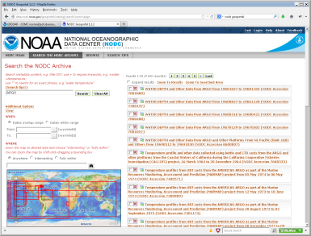
Integration strategy provides multiple access and discovery services for near real time data
GTS
NOAA/OAR/COD integration strategy will provide same services for delayed mode data from DACs
Real time
REST services via OSMC/ERDDAP
Live Access Server
Google Earth
iPython notebook
Metadata available through international standards
IOOS coastal modeling
Matlab™
Original metadata can be enhanced at this point, if necessary
Data flows directly into users’ applications
ESRI Geoportal
ICG-WIGOS V - JCOMM – Geneva - 25-28 Jan 16

Slide 8
Capacity Development Activities according to PANGEA concept
Partnership for New GEOSS Applications (PANGEA)
  Developed countries: bring expertise on data use, and observing platforms
  Developing countries: bring logistics for implementation of obs. System
  Socio-economic benefits of ocean observing systems at global and regional levels
PANGEA works to
  Provide in-region expert applications training to users and decision makers of ocean data
  Demonstrate practical socio-economic importance of ocean information to budget and policy officials
  Increase regional in-situ ocean observations for numerous cross cutting applications
ICG-WIGOS V - JCOMM – Geneva - 25-28 Jan 16

Slide 9
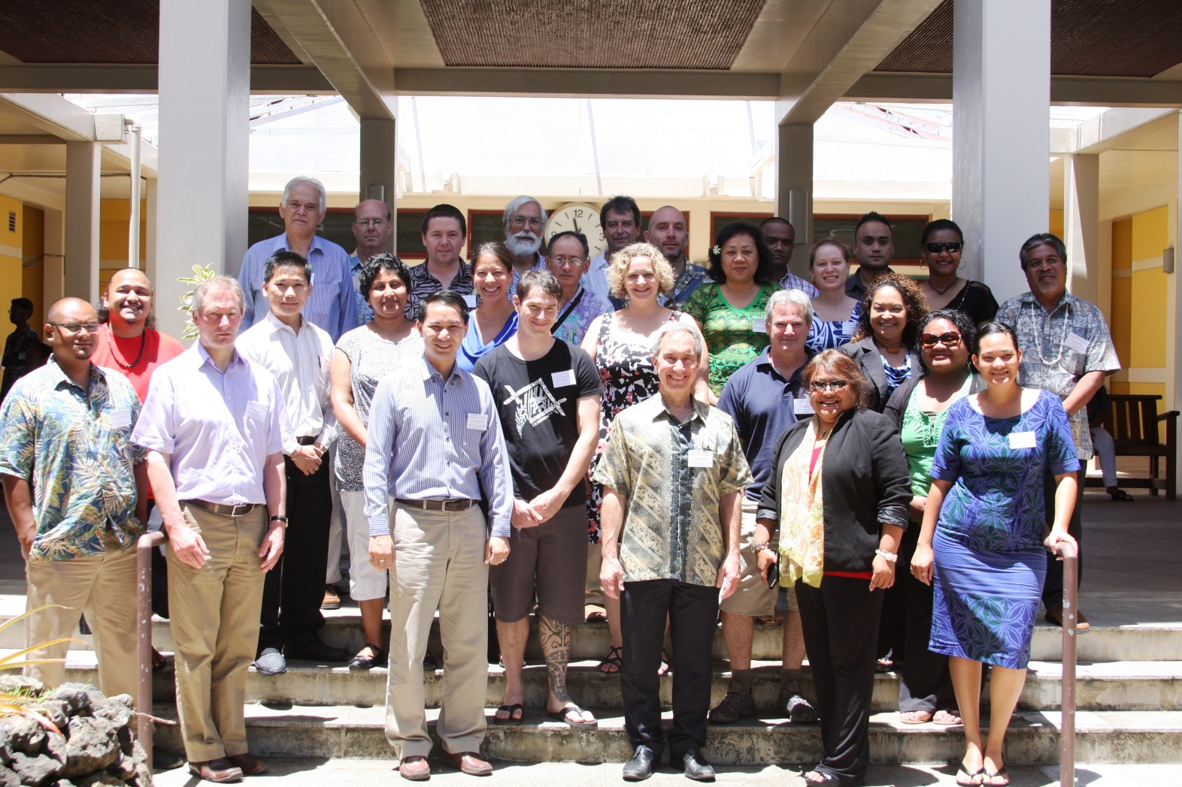
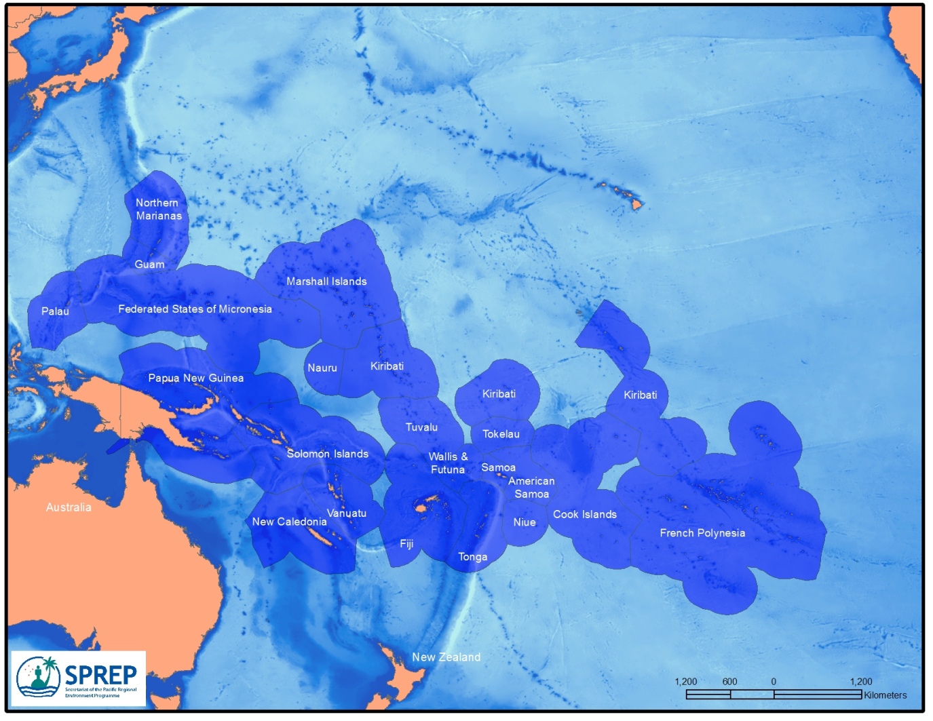
Capacity Development Activities according to PANGEA
First DBCP Pacific Islands Training Workshop on Ocean Observations and Data Applications (DBCP PI-1, 4-7 May 2015, Palau)
  Increase awareness of ocean processes, ocean observing, and data applications,
  Conceptualization of a Pacific Islands Ocean Observing System
ICG-WIGOS V - JCOMM – Geneva - 25-28 Jan 16
Notes:
GOALS OF THE PI-1 WORKSHOP:
● Begin to build capacity within the region to apply ocean observing data for enhanced predictive capability;
● Demonstrate the role of ocean observations for understanding and predicting regional weather, ocean state and climatology;
● Demonstrate the societal and economic benefits of delivering enhanced ocean observing system data for better informed decisions;
● Increase awareness of the importance of the ocean, scientific understanding and traditional knowledge, and how marine processes affect the lives of Pacific Islanders;
● Discuss the potential impacts of climate change on oceans;
● Learn practical implementation aspects of ocean observing systems;
● Explore the importance of marine modelling;
● Evaluate data gaps within the region and how they can be addressed;
● Encourage cooperation with and support for existing monitoring programmes such as the Argo programme and the Global Drifter Program; and
● Advance the design, coordination of a Pacific Islands Ocean Observing System.

Slide 10
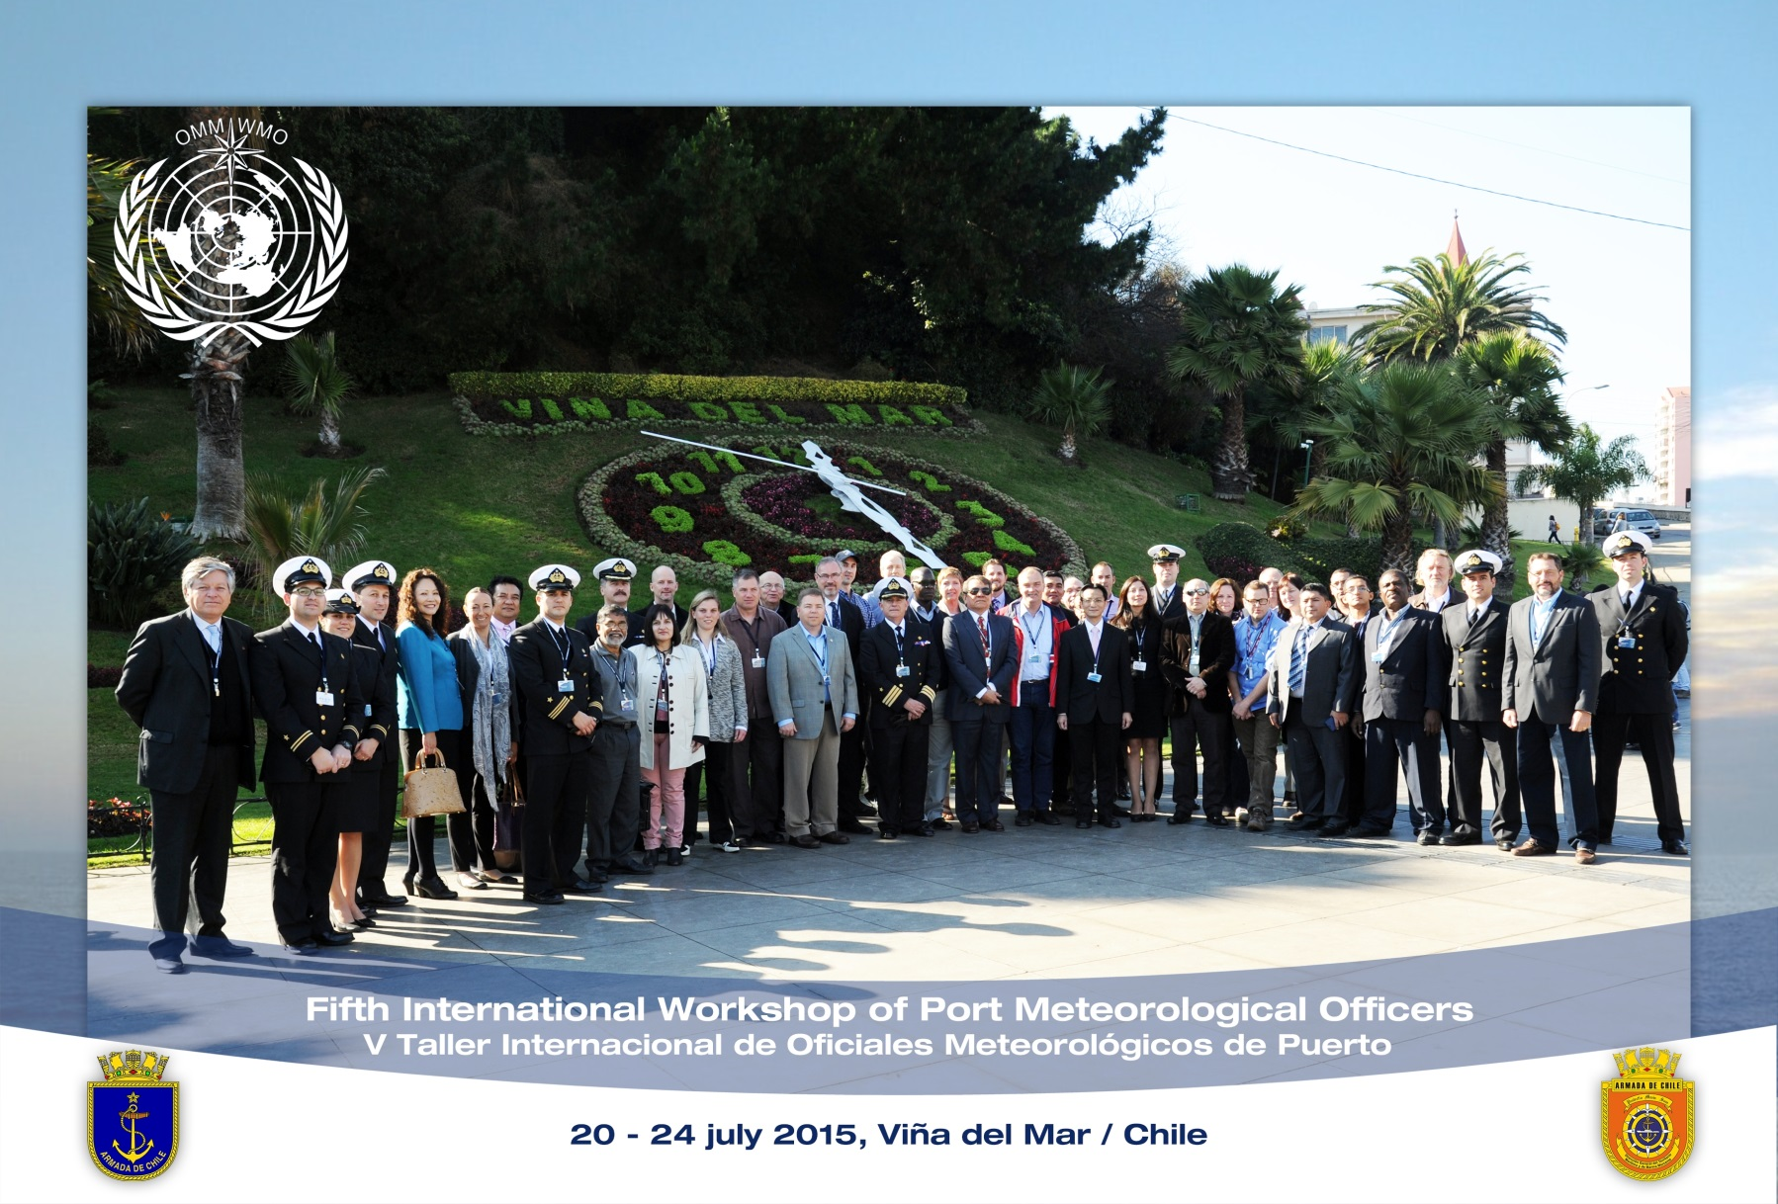
Capacity Development Activities
Fifth International Workshop of Port Meteorological Officers (PMO-5, 20-24 July 2015, Vina del Mar, Chile)
  promote global standards of service for the VOS Scheme
  provide information on the state of the art marine meteorological services by NMHSs relevant to PMOs
ICG-WIGOS V - JCOMM – Geneva - 25-28 Jan 16
Notes:
Great opportunity to strengthen relationships in a role, which relies heavily on international co-operation and is becoming more complex and requiring new skills such as computer and IT related skills, deploying drifters and floats, using e-logbooks, retrieving delayed mode data, installing AWS and providing information on marine meteorological services to shipping companies and port authorities.
There is also a demand from the developing countries to develop ocean observing programmes. Programmes relying on ships of opportunity are quite cost-effective, and can realistically be supported by those countries. Developing countries also have research vessel fleets that can be used for the deployment and servicing of ocean instruments, including tropical moorings. This was an opportunity to build partnership between developed countries who contribute expertise on ocean observing programme management and data use and developing countries that have valuable ship logistical resources.

Slide 11
Capacity Development Activities
Fourth DBCP Capacity Building Workshop for the North Pacific Ocean and its Marginal Seas (NPOM-4, 2-4 Nov 2015, Busan, ROK)
  Focus on ocean obs. Requirements for Typhoon prediction
  To use DBCP barometer upgrade scheme, DBCP-VOS drifter donation programme, SVPB drifter barometer upgrade scheme
  Recognizes importance of training on met/ocean observations requirements and met/ocean observing systems implementation
  Supports the establishment of the NPOMS Training Centre at the Busan National University
ICG-WIGOS V - JCOMM – Geneva - 25-28 Jan 16

Slide 12
Pilot Projects
SatCom/Iridium (completed)
Impact of Sea Level Prediction from drifter on NWP (completed)
Wave measurement evaluation and testing, and lost cost wave observation from drifters using GPS (underway)
ITU submarine cables proved promising and cost effective for tsunami monitoring
Gliders
ICG-WIGOS V - JCOMM – Geneva - 25-28 Jan 16
Notes:
Satcom/Iridium (completed)
Impact of SLP from drifter on NWP (completed)
Wave measurement evaluation and testing, and low cost wave observation from drifters using GPS (underway)
ITU submarine cables (e.g. for Tsunami monitoring) promising much more cost effective observing programme
Gliders

Slide 13
Contribution to WIGOS priority activities for Pre-Operational Phase (2016-2019)
WIGOS Regulatory Material, supplemented with necessary guidance material, focusing on providing Members with technical details required for the implementation
  Manual and Guide on the Global Observing System (GOS)
  CIMO Guide (Marine Observations Chapter)
  Manual and Guide to Marine Meteorological Services (VOS Scheme, Marine Climate Data System)
ICG-WIGOS V - JCOMM – Geneva - 25-28 Jan 16

Slide 14
Contribution to WIGOS priority activities for Pre-Operational Phase (2016-2019)
WIGOS Information Resource (WIR), including the OSCAR and SORT databases
  JCOMMOPS is contributing and developing Machine to Machine interface with OSCAR, and modernizing webpage.
  Metocean observing systems metadata collected routinely by JCOMMOPS need to be expanded to fully comply with WIGOS Metadata Standard, and WIGOS requirements (mandatory, optional, conditionnal) and implementation plan proposed by the TT on WIGOS Metadata.
ICG-WIGOS V - JCOMM – Geneva - 25-28 Jan 16

Slide 15
Contribution to WIGOS priority activities for Pre-Operational Phase (2016-2019)
SORT (Standards of Observation Reference Tool):
  JCOMM is cooperating with the IODE of the IOC to feed appropriate references of JCOMM standards and documents in the IODE ClearingHouse. A JCOMM Catalogue of Best Practices and Standards was developed and integrated in the IODE ClearingHouse.
  http://www.oceandatapractices.net/
ICG-WIGOS V - JCOMM – Geneva - 25-28 Jan 16

Slide 16
Contribution to WIGOS priority activities for Pre-Operational Phase (2016-2019)
WIGOS Data Quality Monitoring System (WDQMS)
  RSMC Exeter for quality monitoring of surface also as Real-Time Monitoring Centre (RTMC) for the VOSClim data
  Monitoring statistics of marine data routinely provided by NWP monitoring centres (UK Metoffice, ECMWF, Meteo France, NCEP)
  QC Tools are offered by Meteo France and widely used in JCOMM
  JCOMMOPS has put in place a fault management system & mechanism for providing feedback on quality information to platform operators
ICG-WIGOS V - JCOMM – Geneva - 25-28 Jan 16

Slide 17
Contribution to WIGOS priority activities for Pre-Operational Phase (2016-2019)
WIGOS Regional Centres
  --Regional Marine Instrument Centres (RIMCs)
  Provide calibration service, training on marine instrument practices, and assist for intercomparison activities
  Efforts need to be made to expand the network (current RMIC/China & RMIC/USA, more ?)
ICG-WIGOS V - JCOMM – Geneva - 25-28 Jan 16

Slide 18
Contribution to WIGOS priority activities for Pre-Operational Phase (2016-2019)
Regional and national coordination and governance mechanisms
  JCOMM working through Panels (DBCP, SOT, GLOSS, ...)
  Closer links with Regional Associations and GOOS Regional Alliances sought
ICG-WIGOS V - JCOMM – Geneva - 25-28 Jan 16

Slide 19
Challenges
Volunteers
HF Radar
Marine Met and Pole data – in-situ
Oceanographic data
“Unknown’s”
Notes:
SST, Salinity, acidification, other related Ph Ch2,

Slide 20
Thank you for your attention

