Slide 1
CHy Progress Toward WIGOS Implementation
Harry F. Lins
President, WMO Commission for Hydrology
ICG-WIGOS-5, Geneva, January, 2016
WMO; Climate and Water Department

Slide 2
Accomplishments since ICG-WIGOS-4
Informed Cg-17 of CHy proposal to develop WHOS as
the CHy contribution to WIGOS
Congress welcomed the effort and urged the president
of CHy to continue guiding WHOS to full implementation
Congress urged the promotion of WHOS among NHSs
and the hydrological community
Implemented Phase 1 of WHOS in August 2015
Map interface with links to those NHSs that make their near real-time and historical stage and discharge data available online

Slide 3
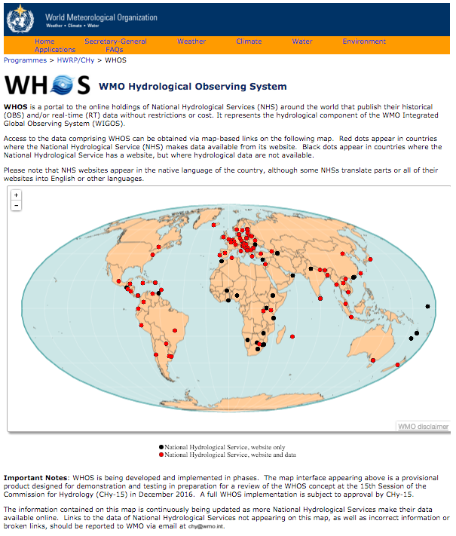
http://www.wmo.int/pages/prog/hwrp/chy/whos/index.php

Slide 4
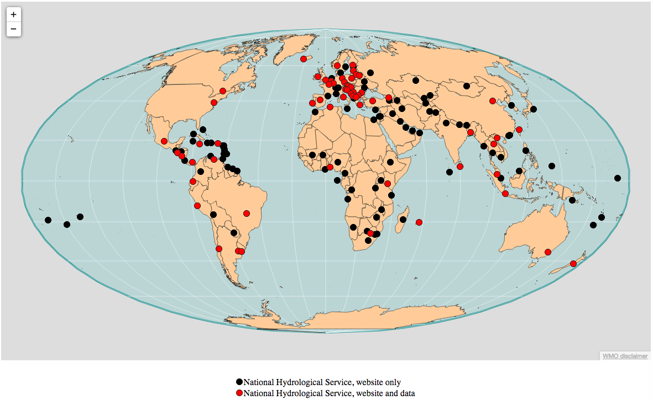
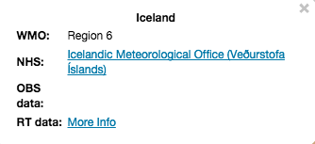
WMO Hydrological Observing System (WHOS)
Phase 1 -- WorldWide Map Portal

Slide 5
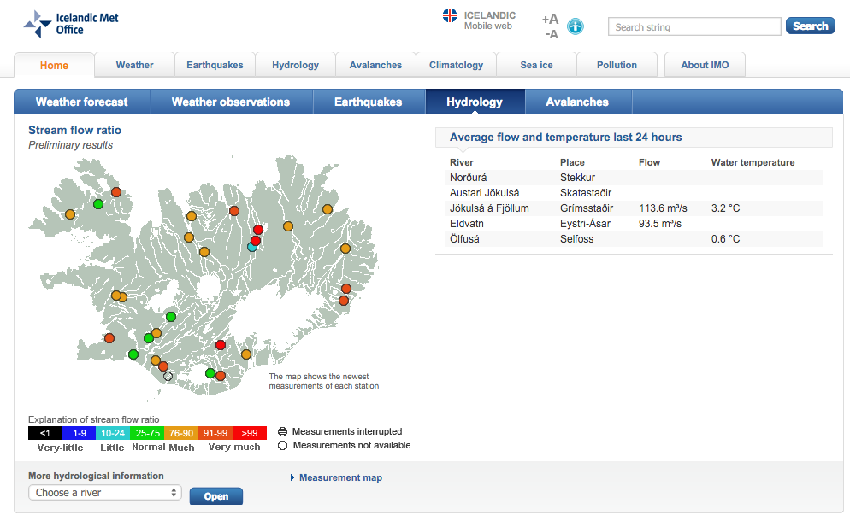
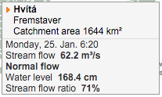

Slide 6
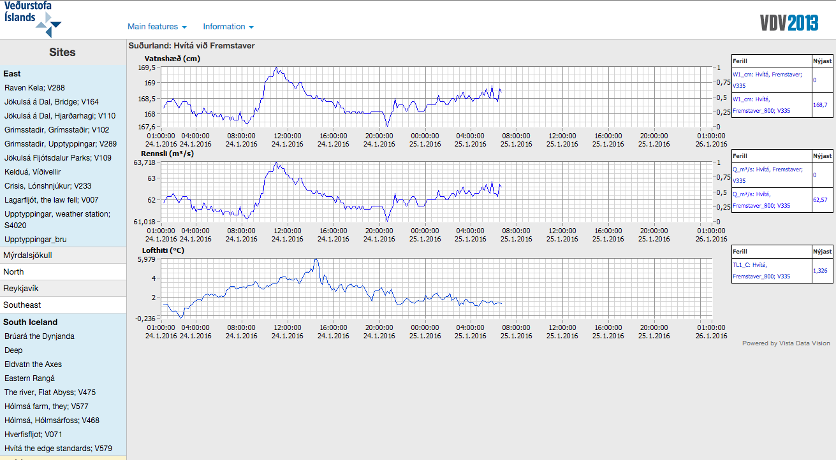

Slide 7
Plans for 2016
Continued develop of Phase II
A fully WIGOS-WIS compliant services-oriented framework linking hydrologic data providers and users through a hydrologic information system enabling data registration, data discovery, and data access.
Regional prototypes currently being developed for Arctic HYCOS, La Plata basin in South America, and . .
Beta version for CHy-15 review and endorsement (Nov 2016) Initial implementation for EC approval (June 2018)

Slide 8
Issues
No critical issues at this time, but . . .
The big unknown is how the Commission, at CHy-15, to all that has been proposed, developed, and implemented thus far, particularly with respect to the Phase II prototypes that will be presented during the session.
Concern is that as we move increasingly toward a WIS compliant interoperable system, NHSs will be strongly encouraged to move toward both WIGOS and WIS implementation, and many Services will find this difficult.

Slide 9
Thank you for your attention
Harry F. Lins
President, Commission for Hydrology
+1-571-218-5077
chy.president@gmail.com

