Slide 1
World Meteorological Organization Working together in weather, climate and water
WMO
ICG-WIGOS 5
Progress on WIGOS activities within CBS
Geneva, 25-28 February 2016
Dr. Jochen Dibbern
Chair, CBS OPAG-IOS

Slide 2
Content
Achievements and next steps within CBS
Challenges still to be addressed

Slide 3
Achievements and next steps
focus of the OPAG-IOS activities with regard to WIGOS implementation was given to
WIGOS Technical Regulations,
WIGOS Metadata, and Quality Management,
the development of the WIR,
WIGOS Principles an guidance for Observing System Network Design and several achievements under ET-SBO and ET-ABO
contribution of OPAG-IOS to the GOS related components of the different Key Activity Areas of the WIGOS Implementation Plan
contribution of Satellite Observations to all WIGOS component Observing Systems

Slide 4
IPET on WIGOS Framework Implementation Matters (Chair: Jochen Dibbern, Germany)
There is a close link between IPET-WIFI Subgroups and ICG-WIGOS Task Teams
The SG-Regulatory Material contributed to the new WIGOS Technical Regulations, the new WIGOS Manual and the significantly modified Manual on the GOS, all to come into effect from 1 July 2016. Further revisions of the Manual on the GOS will be synchronized with revisions of the WIGOS Manual, leading to the eventual phasing out of the Manual on the GOS.
It was proposed to establish a WIGOS Editorial Board under ICG-WIGOS to coordinate all activities for regular review and updating of the WIGOS regulatory material.
The SG-Metadata contributed to the development of the semantic standard for WIGOS Core Metadata

Slide 5
IPET on WIGOS Framework Implementation Matters (Chair: Jochen Dibbern, Germany)
During the development phase, the technical specification of OSCAR will be overseen by the IPET-WIFI in close collaboration with the Secretariat, new SG-OD, Chair: Simon Gilbert, UK, had its first meeting in July 2015
To further develop the RBON concept, there will be a Workshop with representatives from IPET-WIFI, GCOS, IPET-OSDE, RAs and Secretariat in May 2016.
A new scheme for WIGOS observing station identifiers has been proposed, which allows a globally unique identifier to be issued to a station or platform

Slide 6
IPET on Observing System Design and Evolution (Chair: John Eyre, UK)
Steps have been undertaken to monitor the implementation of the EGOS-IP. IPET-OSDE will actively promote the implementation process through a network of national focal points.
A high level document on the EGOS-IP, targeted at PRs has been developed.
The IPET will undertake steps towards developing a new vision for the global observing systems titled “Vision for WIGOS component Observing Systems in 2040”.
Observing Network Design
Observing System Network Design (OSND) principles have been included in the Manual on WIGOS
IPET-OSDE held two Workshops on Observing System Design. The guidance material, developed at these WS will be discussed at IPET-OSDE-2 and ICT-IOS-9 in April 2016 and then forwarded to WIGOS-PO to be included in the WIGOS Guide.

Slide 7
Expert Team on Surface-based Observing Systems (Chair: Stuart Goldstraw, UK)
A 2nd WIGOS workshop on data quality monitoring and incident management was held in December 2015 in Geneva, under ICG-WIGOS and chaired by ET-SBO.
The Expert Team worked in cooperation with IPET-WIFI SG-RM on draft regulations on AWS, Weather radar systems and radar wind profiler for inclusion in the Manual on the GOS. It is the aim to get approval by ICT-IOS-9 and CBS-XVI in 2016.
The Expert Team developed a proposal to establish a WMO inter-commission and inter-programme coordination group on weather radar systems under the joint management of CIMO and CBS. This proposal will be further examined by CIMO and CBS Management Group.

Slide 8
Expert Team on Aircraft-based Observations (Chair: Frank Grooters, Netherlands)
CBS-ET-ABO and CIMO-ETAO have combined meetings; more than 3500 aircraft from 39 airlines, under 11 national/regional programmes produce currently around 700.000 observations globally per day.
The ET developed several reports and guidance documents related to AMDAR (guidance material on implementation and operation, AMDAR impact and benefits).
Development of the Aircraft-Based Observations Programme (ABOP) Strategy and implementation Plans.
Development of AMDAR-RIP under way for all Regions except Region II.
Sub Group on WIGOS Regulatory Material drafted update material for the Guide to the GOS, on Aircraft Meteorological Stations, to be submitted to ICT-IOS-9 and CBS-XVI in 2016.

Slide 9
Expert Team on Satellite Systems (Chair: Jack Kaye, USA)
ET-SAT is providing advice from a satellite operator’s perspective,
consolidating the inputs from participating agencies and
the outcomes of the Coordination Group for Meteorological Satellites (CGMS) and
the Committee on Earth Observation Satellites (CEOS).
The Team developed a draft version of space based observations in 2040, and using the input from a workshop held at WMO Secretariat on 18-20 Nov 2015 the draft will be presented to the Consultative Meeting on High-Level Policy on Satellite Matters, 28-29 Jan 2016. The vision should be developed and finalized by 2018 under CBS responsibility.

Slide 10
IPET on Satellite Utilization and Products (Chair: Anthony Rea, Australia)
IPET-SUP addresses the users’ perspective, which is essential to promote the efficient use of satellite capabilities across all WMO Regions and Programme areas.
IPET-SUP will in 2016 focus working on the vision for the WIGOS component system for 2040, in close cooperation with IPET-OSDE.
In the context of WIGOS, the Team discussed and contributed to satellite performance monitoring, the WMO Satellite Data Dissemination Strategy, and the WIR/OSCAR Space.

Slide 11
Steering Group on Radio Frequency Coordination (Chair: Jose Arimatea de Sousa Brito, Brazil)
RFC is relevant to nearly all observing systems
Active and passive sensing
Used by in situ, surface based and space based remote sensing systems
SG-RFC is in the OPAG IOS
Input from all TCs & RAs (Focal points or focus groups)
Maintains guidance material that should be incorporated into the WIGOS manual & guides
The preparation for WRC-15 under SG-RFC was excellent, with positive outcome of the conference for WMO.
Because of its inter-disciplinary nature, CBS-MG will discuss, that SG-RFC should directly report to CBS-MG.

Slide 12
Rapporteur on Scientific Evaluation of Impact Studies undertaken by NWP Centres (Erik Andersson, ECMWF, and Yoshiaki Sato, Japan)
The Sixth Workshop on the Impact of Various Observing Systems on NWP will be held in Shanghai, China, May 10-13.
The second announcement will be issued before the end of January 2016, just after the 4th meeting (teleconference) of the SOC on 25 Jan 2016.
There is a large interest in the Workshop, there will be about 40 oral presentation and a poster session of similar size.

Slide 13
Challenges still to be addressed
Integration of IPET-WIFI activities into ICG-WIGOS
Pro: better use of resources and representation of other TCs in the work of the TT, no possibility of overlap/duplication of efforts
Con: would break the direct link with IPET-OSDE, SG-OD would need to replaced by a new ICG-WIOS TT on OSCAR development
WIGOS Editorial Board needed to ensure harmonization of all contributions to WIGOS regulatory material.
Formation of a WMO Weather Radar Coordination Team
Develop guidance material on RBON; workshop is planned to be held on 18-20 May 2016.

Slide 14
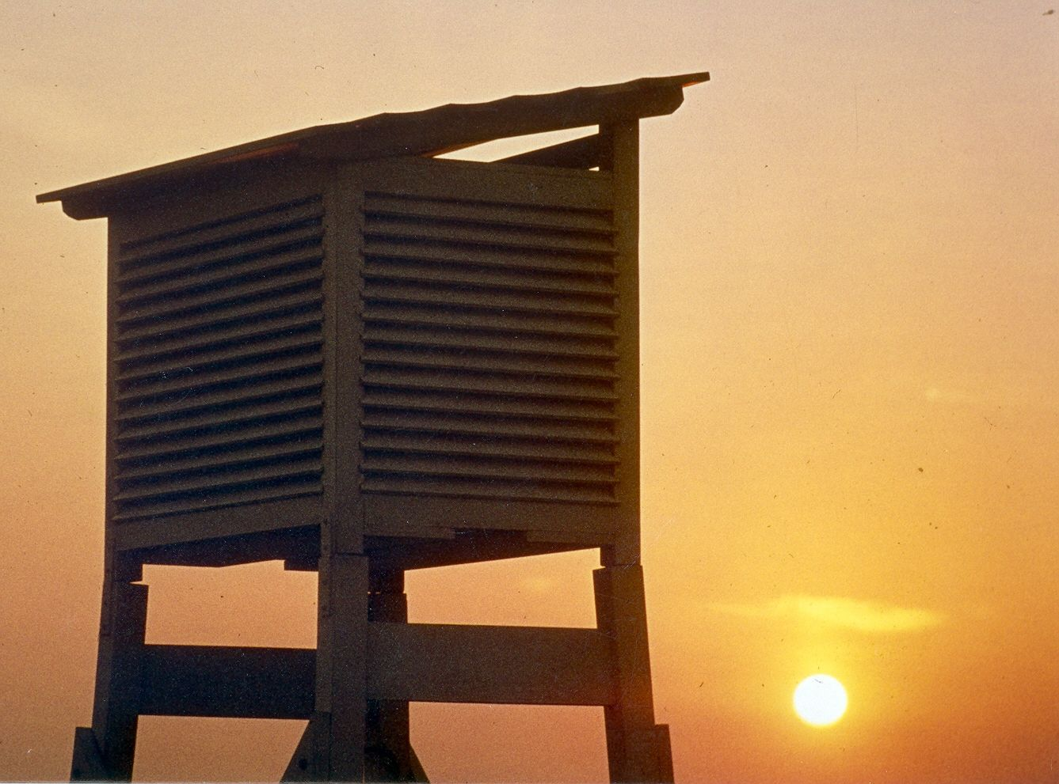
Thank you for your attention!

