Slide 1
Report to ICG-WIGOS-5 on Status and Perspectives from CAgM
Key Issues
In-situ observations : RG, GHG, SM, Phenology
Service implications : EW with NWPs / DS
- Crop status monitoring & prediction :
3) Capacity development & partnerships
- MetAgri & SMAPVEX16/AAFC, GEOGLAM, ISB,
- CIMO/CAS/CCl/CHy/CBS/JCOMM
25-28 Jan. 2016
Byong Lyol LEE
Commission for Agricultural Meteorology

Slide 2
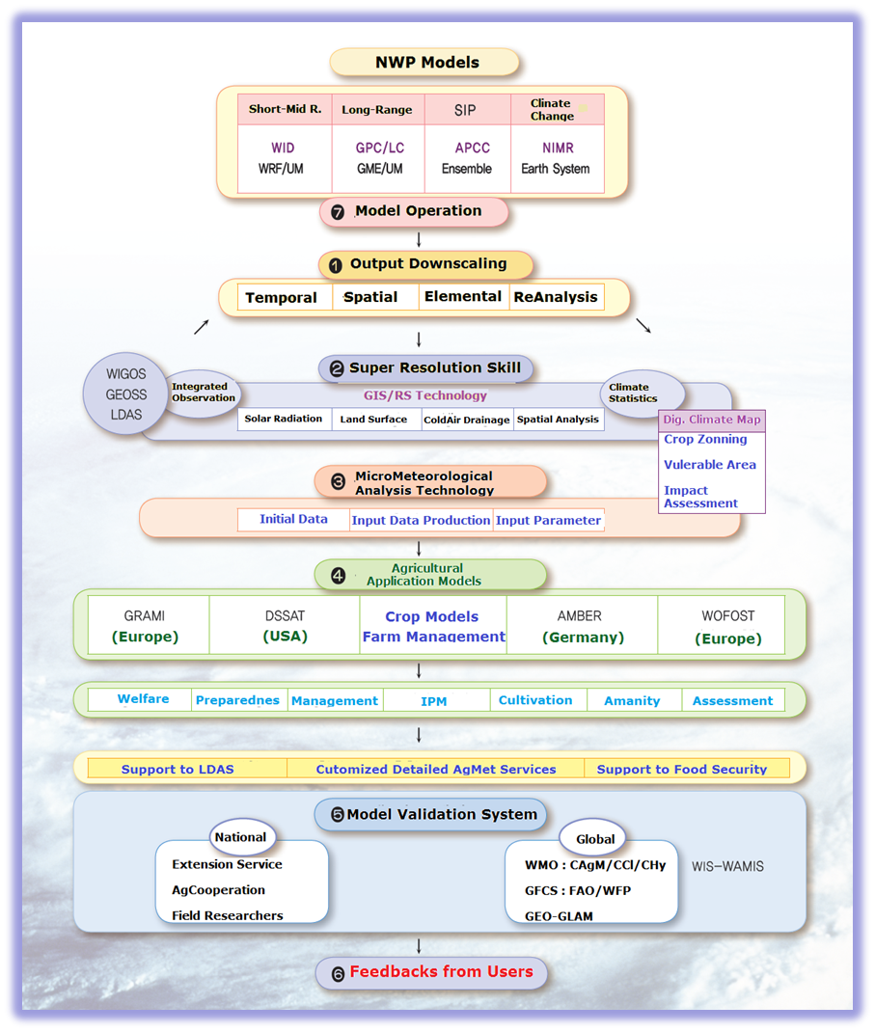
WIGOS
From now-casting
To climate change projection

Slide 3
WIGOS/S2S-based CAgM-GEOGLAM : World AgroMet Early-Warning & Outlook System
S2S
WWRP/THORPEX-WCRP
GAMOS
GDEWS
GLUMS
GWHAS
GAPON
Downscaling
AgModels
ICT platform
ChiNAMOS
NWPs based
In-situ based
RS based
CAMS
CMA
NUIST
Members
GAMOS
WIGOS
GEOGLAM
Crop Watch
JECAM

Slide 4
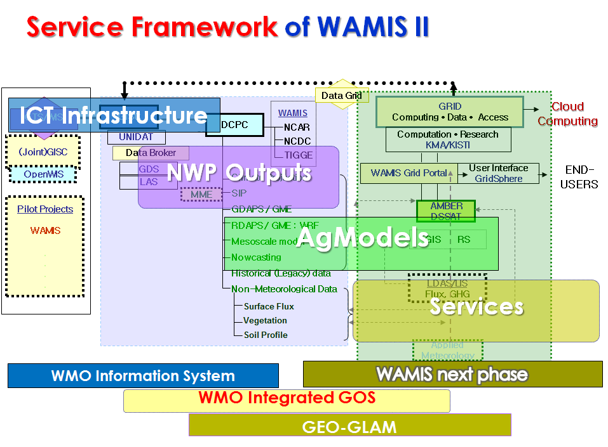
WAMIS II System Architecture

Slide 5
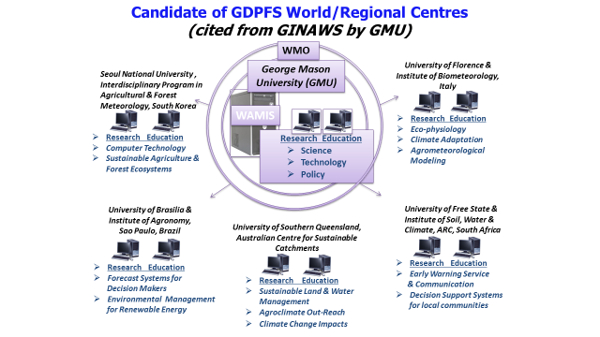
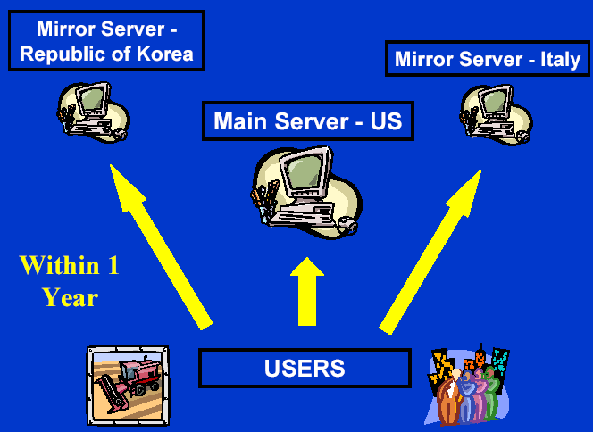
AgMet Platform : ICT Sharable Platform of WAMIS II
KISTI
Science DMZ
WAMIS
DWD
KMA
INMET
QMD
NCAR
NUIST
KMA-KISTI
Science DMZ
WAMIS
GISC
Seoul (KMA) : Offenbach (DWD)
Mutual Backup
DCPC
-WAMIS
GRID /
Cloud
DCPC
-GMC
WAMIS Portal
Australia, Brazil

Slide 6
Matrix of R-based framework from CAgM perspectives
GFCS | CAgM | Requirements | Objectives/Input | Activities/Deliverables
OBS |  | Ground truth/in-situ | Exp.Pj1– joint projects | GEOSS/GAPON/SMDP
 | GAMOS | Outlook/flux/phenology | O1-AI-5) Tr, O2-AI-6) Tw | S2S/RS based Outlook Sys
RMP |  | Mitig/Adapt/Sustain. | Exp.Pj2–Global Challenge | S2S/Downscaling
 | GAMPP | Global challenge research | O2-AI-5) Re, O4-A!-1) Pc | NWP based LCA tool
CSIS |  | Service platform | Exp.Pj3-ICT platform | Cloud/ScienceDMZ
 | WAMIS II | On-line, ICT infra, tools | O3-AI-2) Sv, O2-AI-2) Pf | Sharable ICT platform
UIP |  | Off-line interfaces | Exp.Pj4-Global Soc. Mtng | GIS-Online/CyberGIS
 | GFAMS | Expertise transfer | O1, O2 | Consultations
CD |  | Human/Infra/Instit/Proc. | All-Virtuous CD cycle | RTC/Global Campus
 | GCREAM | E/T/R, Think-tank | O1-AI-5) Tr, O2-AI-4) Ts | Graduate program
Coordinate | ICO/IPO | In/ex-ternal partners | O5-A!-3) Rs | GIAM ICO with GRIAM
Resources | Donors | Trust fund, in-kinds, .. | O4-A!-2) Rs | ICO/GRIAM, GCF/GCR
Governance | AGMP | FAO/WFP/GEO/GACSA .. | O5 | PAC/TAC, GFCS focal point
Note : Green Color – Key projects in AgFS Exemplar, Red Color – Global partners/programmes

Slide 7
WMO Structural Schematics with partnerships from CAgM Perspective

Slide 8
Summary (1/2)
1. Activities, outcomes, accomplishments in AGMP/CAgM since ICG-WIGOS-4
A. Soil Moisture Demonstration Project - 20 soil moisture sensors were installed in South Africa. There are currently being calibrated and then connected to WIGOS, WIS, and GTS. two intercomparison sites with 5 sensors were also installed in South Africa.
B. The MetAgri Operational Project embraced National Meteorological and Hydrological Services (NMHSs) and farmers and agricultural extension workers in 17 West African countries. Between 2012 and 2015, there were a total of 260 roving seminars with over 10,600 farmers. Over 4,500 rain gauges were given to farmers to teach them basic weather principles and to start to develop a supplemental observation network. In addition, several NMHSs reported successful partnerships and collaborations with local non-governmental organizations, government ministries and local farmer`s groups. These partnerships helped increase the visibility of meteorological services and led to increased requests for climate services.
C. A "Dialogue on Climate Services and Food Security" was just held in Rome from 18-19 Jan 2016. The Meeting was hosted by the World Food Programme and WMO and including representatives from many agricultural and food security organizations including FAO, Famine Early Warning System Network (FEWSNET), GEO, International Fund for International Development and many others.

Slide 9
Summary (2/2)
2. Planned or suggested activities for the coming year.
A. CAgM is exploring adding additional soil moisture sensors in Nigeria and Ethiopia.
B. A comparison of simple rain gauges will be completed by the WMO CIMO Center for Precipitation Intensity with support from CAgM will be completed in June 2016. Based on these results, the center will provide recommendations to CAgM on fabricating simple rain gauges.
C. CAgM will liaise with the relevant food security agencies to ensure that their station networks are connected to WIGOS, WIS, and GTS.
3. Issues & recommendations that need to be brought to ICG-WIGOS 5
A. Provide a better internal WMO liaison on observation issues especially on technical issues with the TCs. Preliminary discussions have already taken place.
B. Consideration of new GDPFS centres in Agricultural Meteorology, e.g. WAMIS II institutions as World AgroMeteorological Early Warning and Outlook Production Centres (WAMIS portal and DCPC)
C. More chances to demonstrate feasible scientific and technological applications for user community through pilot projects, e.g. S2S-based applications for Agriculture and Food Security.

Slide 10
Suggestions
1) Observation enhancements for emerging issues
- Phenology issue in terms of Big Data
e.g. App development for Crowd sourced/SNS data on global phenology monitoring,
- GHG issue through new partnerships with CAS
- together with enhanced soil moisture networks.
2) Service oriented implementations
- Early warning services on climate extremes, complemented by NWP outputs for
GFCS and DRR
- Crop status monitoring and predictions together with GEOGLAM and NWP for food
security issue
3) Strengthening of Reference stations into WIGOS implementation strategy
- in Space weather, Remote sensing, and Big data from crowd source/social media, which all requires reference data for quality managements

