Slide 1
ICG-WIGOS-5
GENEVA, SWITZERLAND, 25-28 JANUARY 2016
ICG-WIGOS >>> Our next challenges
Bertrand Calpini,
Co-Chair ICG-WIGOS, CIMO President

Slide 2
Finalizing (next ca. 3 years)
  The necessary guiding material

Slide 3
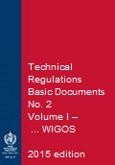
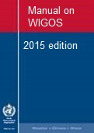
New WIGOS Regulatory Material
Members shall implement and manage their national observing systems in accordance with the provisions of the Technical Regulations, Volume I, Part I, and the Manual on WIGOS
Members shall continuously monitor the performance of their observing systems.
Members shall implement quality control for all observations for which they are responsible.
Members shall record, retain and make available internationally the observational metadata as specified in the Manual on WIGOS, section 2.5.
Notes:
Just to mention some of them as examples
See WIGOS Technical Regulations in: WMO-No. 1157 (Eng. version: http://library.wmo.int/pmb_ged/wmo_1157_en.pdf; Resolutions 25 and 26 respectively)

Slide 4
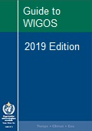
New WIGOS Guidance Material
more detailed information, best practices and procedures, explanation and examples on how to implement national observing systems …
WMO
Notes:
Request for sharing by Members those best practices, procedures to be used by others at the Regional / Global levels
The Guide should provide more detailed information, best practices and procedures, explanation and examples on how to implement standard and recommended practices and procedures specified in the Volume I, Part I – WIGOS of the WMO Technical Regulations (WMO-No. 49) and Manual on WIGOS into day-to-day operations.
The Guide is intended to be used by managers/supervisors and other technical staff of NMHSs responsible for planning, implementation, performance and operation of national observing systems/networks. These individuals are the target audience.

Slide 5
Finalizing (next ca. 3 years)
  The necessary guiding material
  The required Information Tools

Slide 6
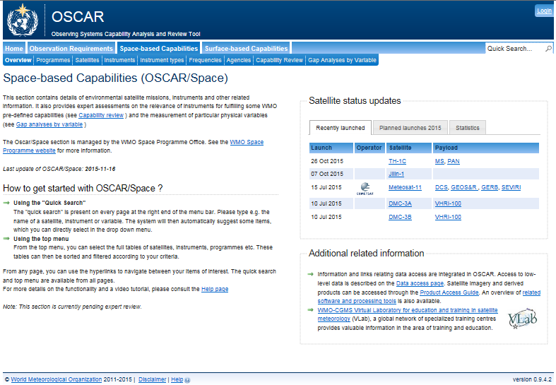
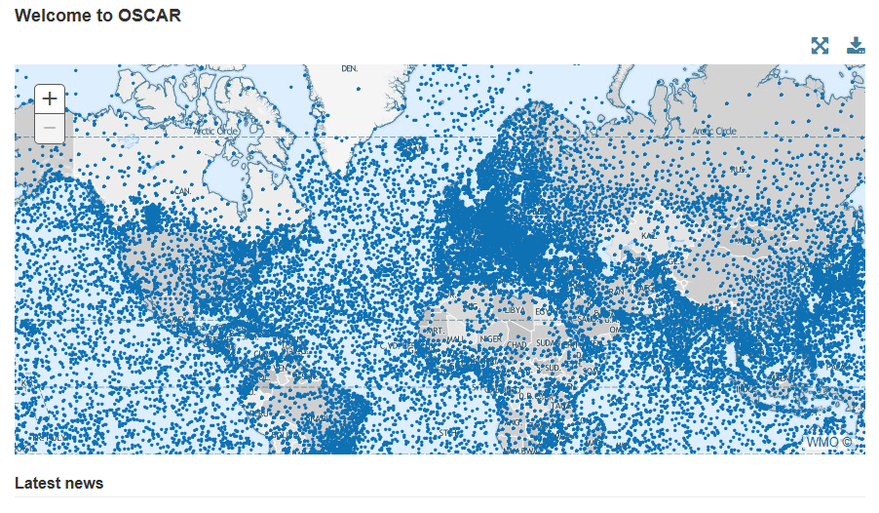
WIR Components
Portal
  General WIGOS information
  Basic documents
SORT
  WIGOS relevant Standards
  and best practices
OSCAR
  Archival and exchange
  of «observation metadata»
  Network design and planning
  Support for Rolling Requirements Review

Slide 7
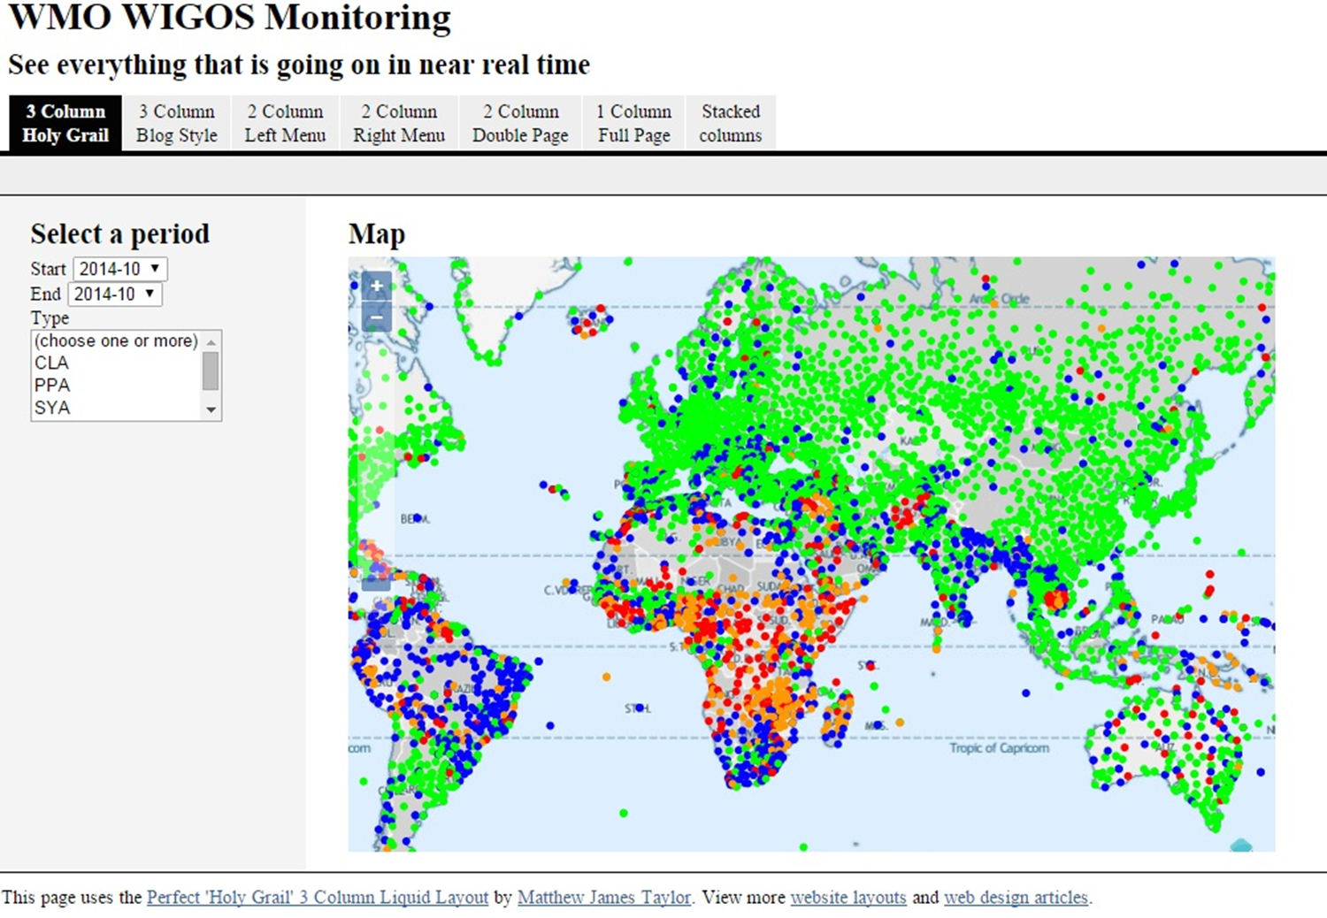
WIGOS Data Quality Monitoring System (WDQMS)
Notes:
A specific presentation by S. Goldstraw

Slide 8
Finalizing (next ca. 3 years)
  The necessary guiding material
  The required Information Tools
  The QA work with Partners

Slide 9
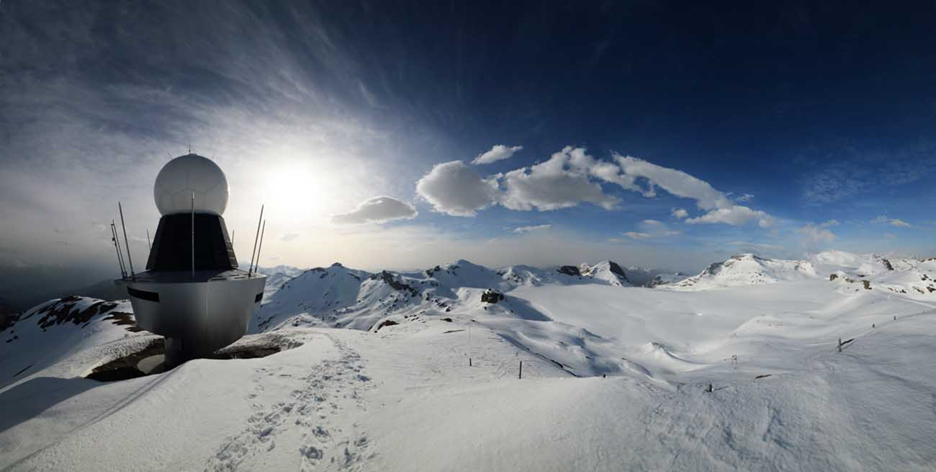
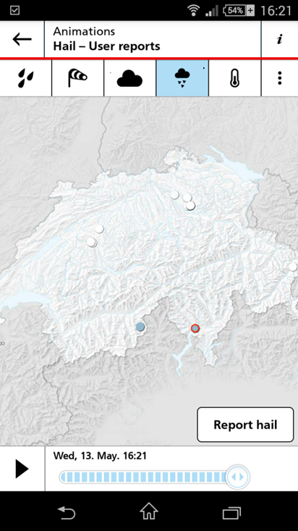
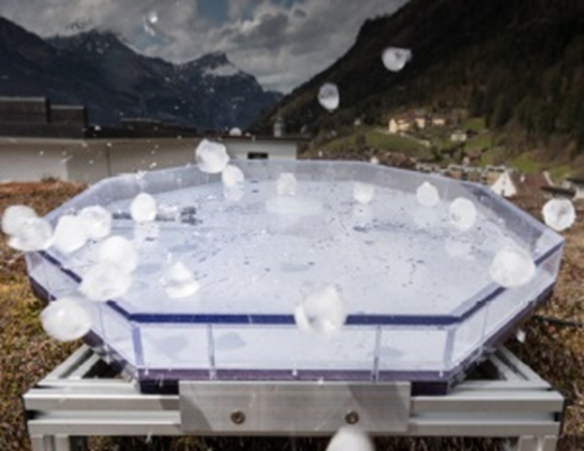
Partners / Crowdsourcing / Big Data
Remote sensing
+
In situ observation
+
crowdsourcing

Slide 10
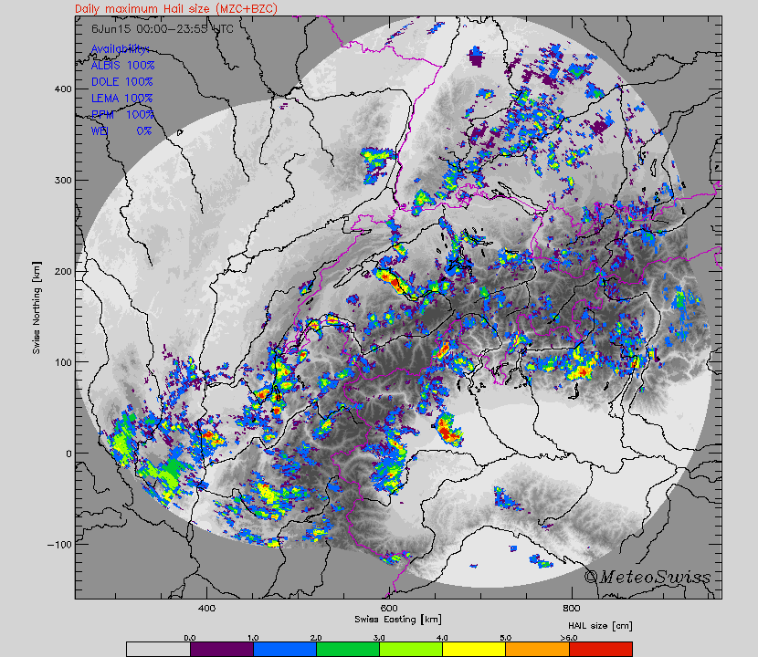
Maximum hail size - Radar
6 June 2015
A Hering et al.

Slide 11
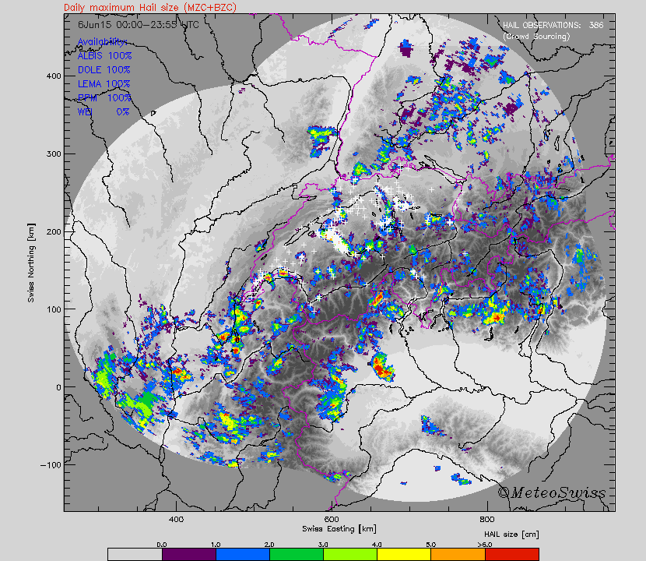
Hail reports - MeteoSwiss App
6 June 2015
Note: over lakes, mountains and abroad the chances to get reports are low.
A Hering et al.

Slide 12
Finalizing (next ca. 3 years)
  The necessary guiding material
  The required Information Tools
  The QA end-to-end processes
  The required WIGOS «Training»

Slide 13
Next Phase of WIGOS Implementation
Guidance from ICG-WIGOS
WMO RA VI WIGOS Workshop
(Belgrade, Serbia 24 - 27 November 2015)
Bertrand Calpini,
Deputy Director, MeteoSwiss
CIMO President & Co-Chair, ICG-WIGOS

Slide 14
Homework … from President RA VI
For your NMH what are the practical advantages when supporting OSCAR/surface ?
  the ONLY complete description of a station/platform (much more than VolA),
  visible from all users, national and international
  Allow to identify synergies nationally and across border
  And support the RRR process.
Notes:
More details will be discussed under SESSION 1 - Role of Members and NMHSs at the national WIGOS implementation, specifically in “Moving from the WIGOS Framework towards the Pre-operational Phase” by J. Dibbern

Slide 15
Finalizing (next ca. 3 years)
  The necessary guiding material
  The required Information Tools
  The QA end-to-end processes
  The required WIGOS «Training»
>>> leadership from all 8 TCs

Slide 16
Finalizing ... And Implementing (long term perspective)
  At the National Level

Slide 17
Develop a national implementation plan
Understand national needs and priorities
Understand WIGOS relevant WMO Tech Regs
Perform critical analysis of capabilities and gaps (systems, processes, people, networks, governance, issues of compliance)
Define expected outcomes and milestones for national implementation, define key performance indicators
Establish governance and key relationships
Notes:
More details will be discussed under SESSION 1 - Role of Members and NMHSs at the national WIGOS implementation, specifically in “Moving from the WIGOS Framework towards the Pre-operational Phase” by J. Dibbern

Slide 18
Finalizing ... And Implementing (long term perspective)
  At the National Level
  With the Regional WIGOS Centers

Slide 19
Finalizing ... And Implementing (long term perspective)
  At the National Level
  With the Regional WIGOS Centers
  At the Global Level

Slide 20
Conclusions
WIGOS has a strong and evolving foundation to
  Empower Members
    reinforce their national mandate
    and leadership in providing services to society
    design, evolve and sustain integrated observing systems that meet national needs
  Enable RAs
    support and evolve observing and service capacities with their Region
  Enable WMO to assist and guide Members, in context of all WMO priorities (DRR, GFCS, etc.)
Rep co-chair ICG WIGOS 2016, B. Calpini P CIMO
Notes:
Implementation will, like GOS, be an ongoing thing but the foundation that we build now:
will position WMO well to assist and guide members, in the context of all of the WMO priorities (including GFCS, DRR etc) and
will equip regional associations to assist and evolve observing and service capacities within their region;
Will empower Members to design, evolve and sustain the observing systems that best meet national needs, and provide national leadership on integrated observations with the global brand recognition of WMO

Slide 21
Finalizing ... And Implementing
  At the National Level
  With the Regional WIGOS Centers
  At the Global Level
>>> leadership from all 6 RAs

Slide 22
ICG-WIGOS >>> Our next challenges
>>> leadership from all 8 TCs
>>> leadership from all 6 RAs
>>> ICG WIGOS Governance

Slide 23
Thank you for your attention
www.wmo.int/wigos

