Slide 1
WIGOS /WIS – COTE D’IVOIRE
WIGOS IMPLEMENTATION ACTIVITIES IN COTE D’IVOIRE
Second meeting of the RA I Task Team on WIGOS
25 - 27 November 2014, Harare, Zimbabwe
AGUIA Aristide
WIGOS Focal Point in Côte d’Ivoire
aguia_aristide@yahoo.fr

Slide 2
OUTLINE
Introduction
CMS observation Network
CMS activities to implement WIGOS
Conclusion

Slide 3
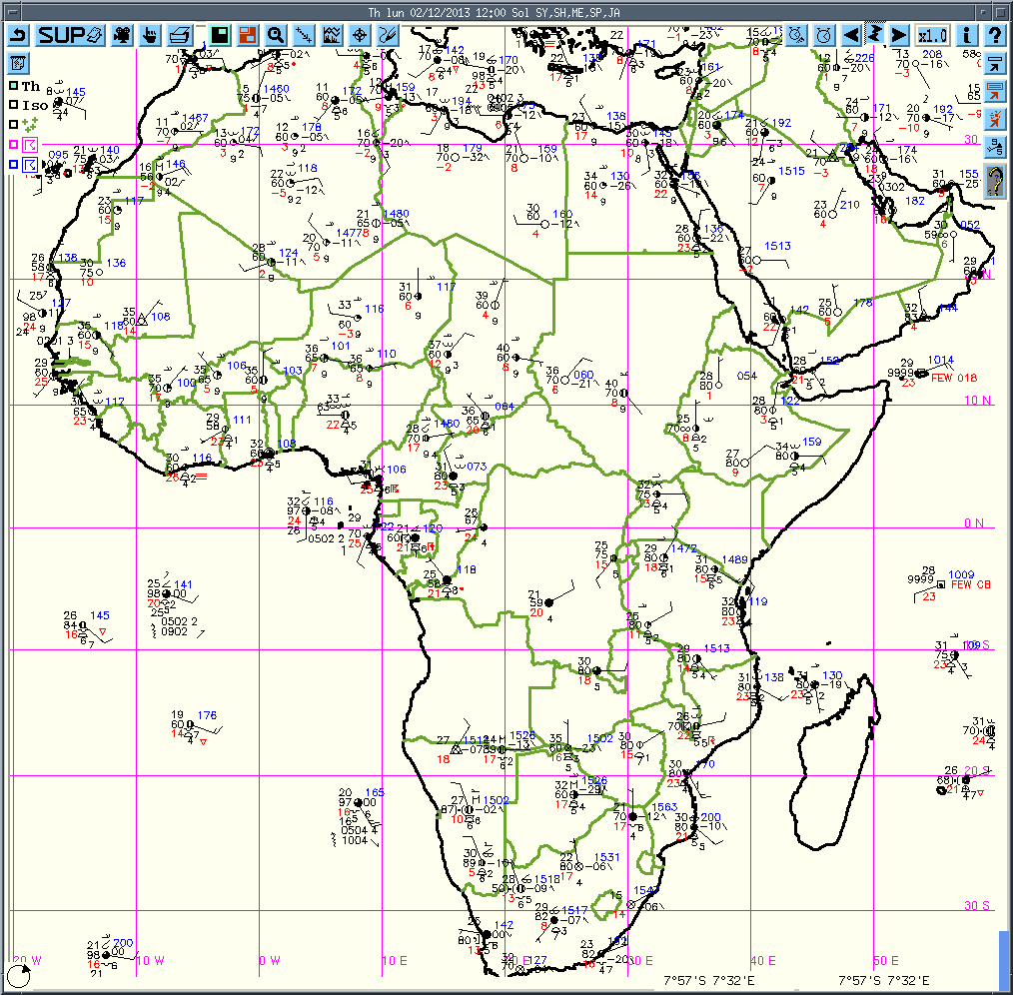
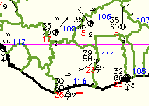
1. Introdution : Côte d’Ivoire Geographical location
. Côte d’Ivoire is in west Africa
bordered in the north by Mali and Burkina Faso, in the west by Guinea and Liberia, in the east by Ghana and in the south by Atlantic ocean

Slide 4
Introdution: SODEXAM organisation structure
Ministre des Transports
Directeur General
Directeur Général Adjoint chargé des opérations techniques
Directeur Général Adjoint chargé des Finances
Directeur de la Navigation Aérienne
Directeur de la Meteorologie Nationale (PR)
Dpt d’etude, de devellopemen et
Dpt de climat agro-météorologie.
Dpt. Metéo Gle et des transports

Slide 5
2. CMS observation Network
Type de stations | QTE | Automatic OR Manual | operational | silent
SYNOPTIC | 13 | 2 new AWS 11 Manual | 11 | 2
CLIMATOLOGICAL | 6 | Manuel | 2 | 4
RAINFALL | 183 | Manuel | 77 | 106

Slide 6
2. CMS observation Network
synoptic
climatology

Slide 7
3. CMS activities to implement WIGOS 3.1 atictivies carried out since the workshop
The report of the west africa workshop is sent to the ministry
A WIS focal point is nominated
WIGOS/WIS implementation working team is created whithin the CMS( hydrologist, agrometeolorogist, data base manager, telcom system administrtor, instrument technicien, rainfall network manger, synoptic meteorologist)
activities plan have been done by the team
the implementation strategy and an organization of Cote d’Ivoire ‘s WIGOS where defined (, national governance group and working group are created)

Slide 8
3.1 atictivies carried out since the workshop
8 key partners were identified in hydrolog, aeromet,environement,polution,oceanology domain)
They received an invitation letter to integrate their network in WIGOS (all patners nominated 3 represents 1 to integrate the Governance group and 2 in working group/1 for WIGOS,1 for WIS);
questionnaire were used, key questions are asked to get more information on their network (6 resent answer)
sensitization meetings have been held with patners, they accept to collaborate with CMS by integrating observation network
others patners are also idenfied by the team and by key partners

Slide 9
3.2 information on partners station
Key patners | domains | Station qty | Station position card
ASECNA | Synoptic, upper air | 1 AWS, 2 upper air | ok
CNRA | Agromet, rainfall | 27 agromet | ok
ANADER | agrometeoroly | Not yet answer
CRO | oceanology | 9 topograpgy level, 2 sea surface temp, 1 maregraphy,1 laboratory | ok
IHH | hydrology | 173 hydrology | ok
CIAPOL | air and water quality | 85 (salinity, temperature,) | no
MINISTRY AGRI | agrometerology | 1 sattilite image for agriculture | no
MINISTRY ENV | environment | Not yet answer

Slide 10
3.2.1 Partners 1: ASECNA
UPPER AIR
SYNOPTIC

Slide 11
3.2.2 Partners 2 : CNRA (Centre National de Recherche Agronomique)
agromet

Slide 12
3.2.2 Partners 3 : CRO(Centre de Recherche Océanologique)
topography
SST
maregraphy

Slide 13
Togother we will have
CMS
ASECNA
CNRA
CRO

Slide 14
3.4 other partners identified
Station owners
CIDT
IVOIRE COTON
FHB University
NA University
Water resource Direction
SAPH
Abidjan Hasbourg
San pedro Hasbourg
Data user who can help CMS
National program of Climate change (PNCC)
RCC
BNETD
Electricity company
Water distrution company
PETROCI
FIRCA

Slide 15
3.5 Future activities
To continue partners identification
To conduct a workshop (16 -17 december 2014 ) with all partners identified with WMO support (national problem, challenge and priorities will be identified)
The working and governance groups will be established during the workshop with clear mission
The WIGOS implementation plan will be built during the workshop (take account users need)
To visit all partners stations in january 2015 and propose a standard requirement to those have not
Send the plan to all climate sensitive ministries in Cote d’Ivoire
Hope to benefit a WIGOS pilot project in collaboration with WMO and ASECNA in 2015

Slide 16
4. CONLUSION
WIGOS implementation advance in Cote d’ivoire
All partners think that it is a opportunity for our country
But We need a best understanding on the WIS (mainly on acces and management to database)
it is good to implement WIS and WIGOS at same time

Slide 17
Thank You

