Slide 1
TASK TEAM ON WIGOS QUALITY MANAGEMENT (TT-WQM)

Slide 2
Topics:
Activities and discussions of the task team
Proposal for WIGOS Quality Monitoring System

Slide 3
Summary of activities of TT-WQM since ICG-WIGOS-3
Meeting TT-WQM-1 at WMO (Geneva), 17-20 June 2014:
Update of Terms of Reference,
Concept of the WIGOS Workshop on Observational Data Monitoring,
Future Work Programme and Action Plan
Email exchange concerning quality flags
Review of Manual on WIGOS and the WMO Technical Regulation (WMO no 49), Volume 1, Part 1 – WIGOS

Slide 4
Summary of activities of TT-WQM since ICG-WIGOS-3
Workshop on Quality Monitoring and Incident Management at WMO (Geneva) 10-12 December 2014 (chair Mr. Stuart Goldstraw, chair of ET-SBO).
Proposal: Development of the WIGOS Quality Monitoring System (WQMS)

Slide 5
Regulatory material and QM practices
Guidance material that should be considered:
Quality flags for data quality for the different observational networks
Emergency plans for gaps and errors in data:
  communication of missing data or defunct programs
  actions, that have to be taken in such cases
Introduction of statistical instruments for tests of inconsistent and erroneous data for all programs and for quality control of data (in order to describe the quality control of data outlined in the WIGOS manual, chapter 2.4.3.4)

Slide 6
Regulatory material and QM practices
Feedback loops are recommended between:
Observational data quality monitoring systems and data providers:
  (Near) real time,
  identify problems and take corrective actions,
  provide guidance material (“lessons learned”)
Observational data providers and the user community:
  In case, user expectations are not met,
  Make solutions available from members for members
  ICG-WIGOS should consider a recommendation about adding functionality for this area to the WIR.

Slide 7
Regulatory material and QM practices
Exchange about experience between communities:
GAW:
  regional calibration centres,
  audits,
  quality flags
EUCOS:
  clear assignment of responsibilities in case of missing or faulty data
  structured feedback loop for correction and resubmission of data
Concept of implementing WIGOS QM on regional and national level?

Slide 8
REVIEWED TERMS OF REFERENCE OF TT-WQM
The Task Team shall:
a) Examine current quality management practices and procedures being used by WMO observing systems, including those co-sponsored by the organization.
b) Report on QM practices and procedures used, with identification of areas for improvement.
c) Based on a review of the current practices in the observational data monitoring system, formulate a recommendation on the way forward, including suggestions on:
• modernisation of the monitoring system,
• near-real time reporting,
• quality evaluation leading to quality improvement,
• fault management with feedback mechanisms,
• extension of the observational data monitoring to non-weather areas (i.e. beyond the GOS), where appropriate and possible,
d) Undertake other activities related to WIGOS quality management as directed by ICG-WIGOS.
e) Report at least annually to the ICG-WIGOS on progress made.
f) Complete its tasks by December 2015.

Slide 9
Further comments:
Task team is not yet complete.
  Expert on satellite monitoring?
  Expert on hydrological observations?

Slide 10
Development of the WIGOS Quality Monitoring System
Long-term scope:
WQMS defined and implemented for all component observing systems.
Extension of scope step-wise.
Short to medium-term scope:
Update of the quality monitoring system of the WWW Programme and the GOS: Focus on surface-based sub-system and its monitoring by NWP centres.
QM of surface pressure, air temperature, wind, humidity and precipitation, includes:
    • Automatic distribution of monitoring reports to data providers, and
    • Automatic real-time/near-real-time practices and procedures for follow-up/corrective actions.

Slide 11
Deliverables
Long term:
The WIGOS Quality Monitoring System (WQMS) established with:
  WMO Lead Centres, Monitoring Centres and Regional Centres
  A fault management system/ reporting system for QM
Short to medium term:
A quality monitoring and fault management system in connection with ECMWF and perhaps other global NWP centres for GOS starting from selected pilots.

Slide 12
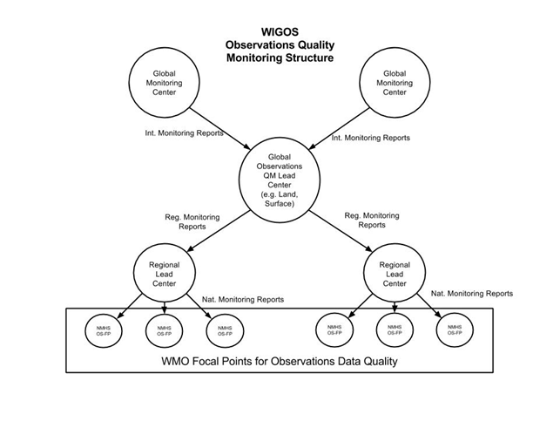

Slide 14
Tasks and Activities
Develop regulations/guidance on the WIGOS Global Quality Monitoring System (2016, TT-WRM)
Develop functional and technical specifications for a global Fault Management System (FMS) - 2015 [S.Klink, TT-WQM]
  Identify an off-the-shelf FMS that might be applied and assessed in the FMS pilots. (TT-WQM)

Slide 15
Tasks and Activities
Develop a proposal for the GOS Implementation of the WIGOS Global Quality Monitoring System (IPET-WIFI/SG-QM, ET-SBO)
GOS QM Pilots (SG-QM)
  Pilot (2015 - ECMWF, NCEP, others?) [R.Grumbine, D.Richardson]
    Participating NWP centres to agree on:
      i. Information to exchange;
      ii. Format for exchange;
      iii. Feasibility and commencement.
Integration of GCOS networks into EUMETNET monitoring system (2015) [S.Klink]

Slide 16
Tasks and Activities
GOS FMS Pilots (2015 - ET-SBO)
    2 regional pilot FMS in association with the NWP Quality Monitoring Pilot
Develop guidance on the GOS WIGOS Global Quality Monitoring System (SG-QM, SG-RM)
Produce report to ICG-WIGOS on GOS Quality Monitoring and Fault Management System pilots (2016 - TT-WQM)

