Slide 1
WIGOS from the CAS Perspective
Sandro Fuzzi
National Research Council, Italy
WMO: Research Dept.

Slide 2
Global Atmospheric Watch (GAW)
GAW is an observing system coordinated by WMO and guided by Scientific Advisory Groups (SAGs) and Expert Teams (ET)
Focus of GAW are air quality as well as climate, on urban, regional and global scales
Mainly a network(s) of ground-based stations, but also uses ship-, air-, and satellite-borne sensors
GAW is the atmospheric chemistry component of the Global Climate Observing System (GCOS)

Slide 3
Operational support functions
Try to minimise workload in the Secretariat
GAW has “outsourced” many central facilities:
World Calibration Centres
Central Calibration Laboratories
World Data Centres
GAW Station Information System (GAWSIS)
Thanks to our partners we have a sustainable system

Slide 4
GAW World Data Centres

Slide 5
GAWSIS
GAWSIS contains information on:
Stations
Measurement programmes at the stations
Hyperlinks to GAW World Data Centres for the various parameters measured
Information on collaborating networks
Contact persons
Maps of stations

Slide 6
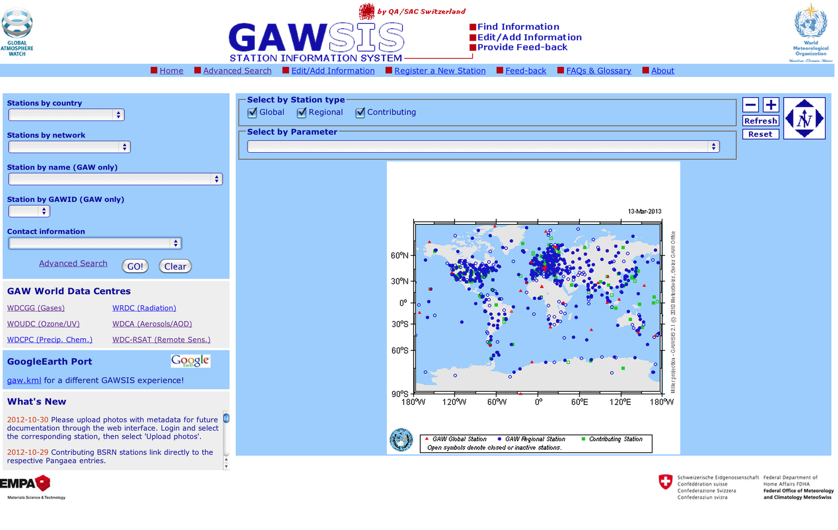
GAWSIS screen shot

Slide 7
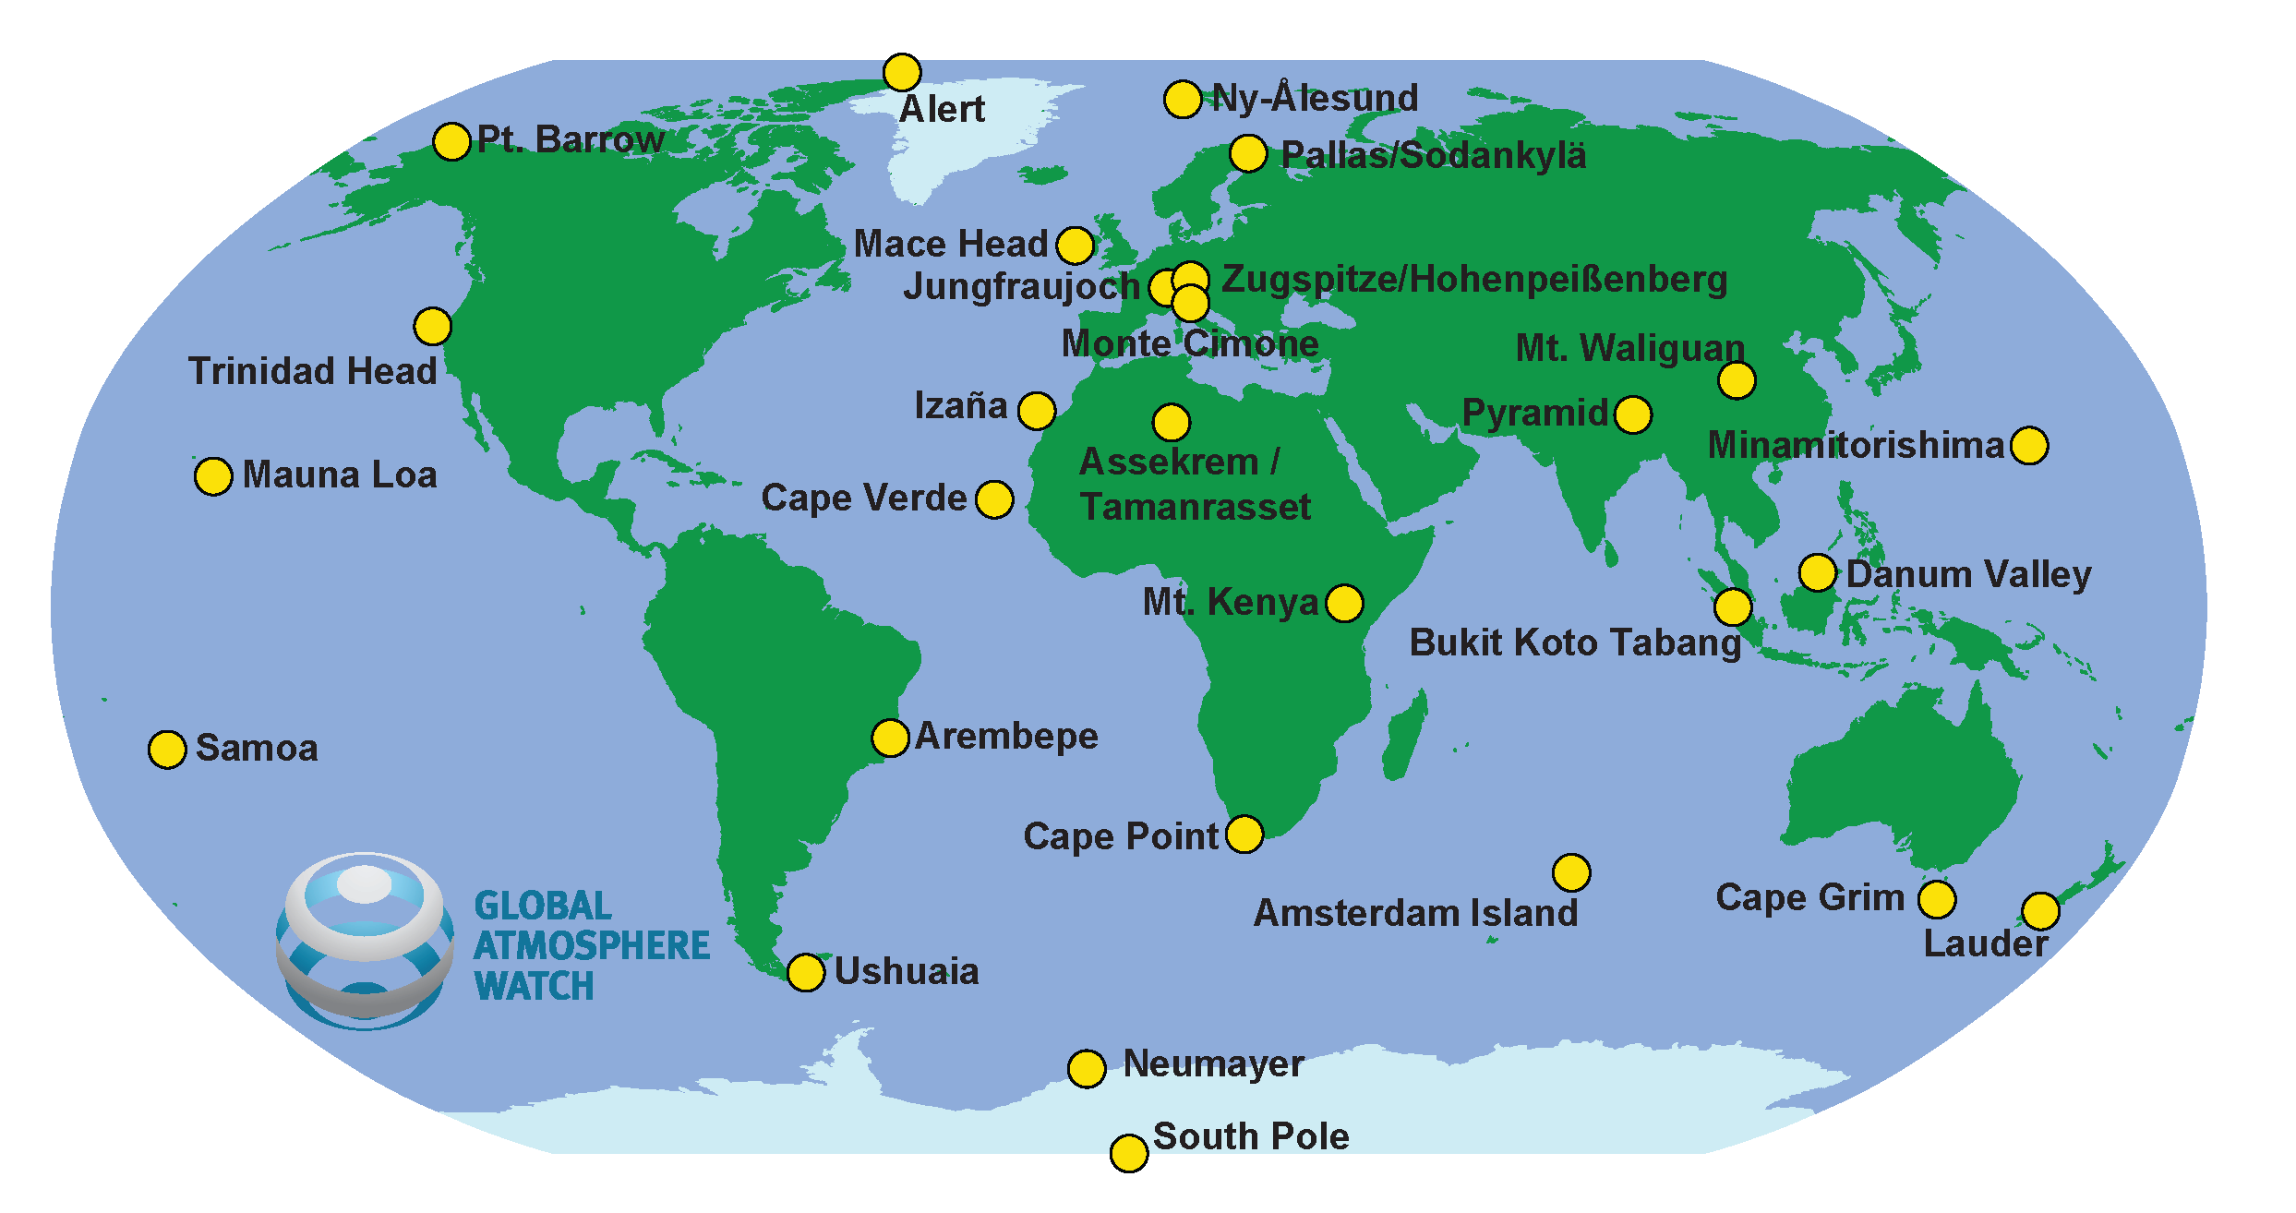
WMO
GAW Global Stations

Slide 8
Co-benefits between WIGOS and GAW
The Executive Council (EC-64) noted that the observing component of GAW is a key component of WIGOS and requested the GAW Programme in coordination with the ICG-WIGOS and Secretariat to address the need for a sustainable network in the WIGOS Implementation plan.
The GAW networks are not only managed by NMHSs but rely strongly on the contribution of other government agencies as well as academia.
Both NMHSs and participating research institutes will mutually benefit from improving access to information concerning atmospheric chemistry, related physical parameters, and meteorological measurements.

Slide 9
WIGOS Pilot Projects in GAW
WDC-PP:
Improvement of Interoperability of GAW World Data Centres with WIS and Establishment of Prototype Services to Facilitate User Access to GAW Data
Project aims:
Improve the possibility for machines to discover data archived at the individual WDCs
Improve the dissemination of data archived at the WDCs
Establish tailored services for the GAW global stations allowing them comfortable access to data and information products available from WDCs

Slide 10
WIGOS Pilot Projects in GAW
WDC-PP:
Overview:
This pilot will improve the interoperability of GAW WDCs with WIS and other clients (e.g., individual users, satellite community) by exposing ISO 19115-compliant metadata representations describing the data archived at each WDC.
GAWSIS ready to expose WMO Core Compliant metadata
Compliance tests still pending due to the lack of a compliance test mechanism
Several WDCs will do this on their own and others depend on GAWSIS for this
These metadata will be used to establish a prototype client (human/machine interface) through which data and metadata of a given station that are archived at different WDCs can be combined and retrieved with a single client.
The need for such a client has only partly been recognised by the WDCs

Slide 11
WIGOS Pilot Projects in GAW
GAW-IDOA
Improvement of Dissemination of Ozone (total column, profiles and surface) and Aerosol observations through the WIS
Project aims:
Improve dissemination of ozone (total column, profiles and surface) and aerosol observations through the WIS
for:
Ingestion into atmospheric models using data assimilation
Support improved forecasts of weather, surface UV and air quality
Verification of models

Slide 12
WIGOS Pilot Projects in GAW
GAW-IDOA:
Overview:
This PP will improve availability of ozone and Aerosol Optical Depth (AOD) and surface Particulate Matter (PM) observations to the user community and prepare documentation to help other communities make their observing practices compatible.
This PP combines activities already proposed by four advisory groups: SAG Ozone, SAG Aerosol, ET-NRT, ET-EGOS.
Progress:
A manual on submission of total ozone data to the GTS/WIS has been published as a GAW report
NMHSs with observations in Antarctica have been asked to provide total ozone data in NRT via GTS/WIS
AOD data from Precision Filter Radiometers are available in NRT (24h delay) from the WMO/GAW World Data Centre for Aerosols (WDCA), hosted at NILU, Norway. 24 stations deliver data in NRT.

Slide 13
WIGOS Pilot Projects in GAW
WDC-PP can be considered completed
Still some work to be done at each data centre in order to open up for machine to machine communication. This depends on each World Data Centre.
GAW-IDOA can be considered completed
A meeting was held in Garmisch-Partenkirchen in October 2009 about NRT delivery of reactive gases from GAW. An ftp server is set up at MOHp where stations can submit data. Data will be used for validation of models in MACC, MACC-II etc.
GAW Report no. 193 details how to submit total ozone data in NRT to the GTS. NMHSs have been asked to implement NRT delivery. Further progress now depends on the individual NMHSs and the other data providers.
AOD data available in NRT at the WDCA (NILU, Norway).

Slide 14
Task Team on Satellites
16th Congress recommended for GAW to set up an ad-hoc Task Team to review the needs for GAW regarding satellite measurements and the IGACO recommendations on these that date back to 2004.
Congress further recommended for this work to be done in coordination with the CBS Expert Team on Satellite Systems (ET-SAT) and the Expert Team on Evolution of the Global Observing Systems (ET-EGOS), the Committee on Earth Observation Satellites (CEOS) Atmospheric Composition Constellation group and the Coordination Group for Meteorological Satellites (CGMS) and also taking into consideration GCOS requirements and the vision for the GOS in 2025.

Slide 15
Task Team on Satellites
This Task Team has not been established yet due to lack of personnel and resources.
It would make sense to set up this team under the umbrella of WIGOS in close collaboration with staff in the OBS department.
CEOS should be involved and there are two CEOS reports that can serve as a starting point.

Slide 16
Volcanic ash: A possible WIGOS demo project?
A good example of a problem where one needs a combination of observations, modelling and operational forecasting
GAW can contribute with:
Lidars (EARLINET and others)
Ceilometers (deployed in hundreds of locations)
A limited number of lidars can be used to calibrate the ceilometers
Data from these sources can be very useful to the VAACs
ICAO has asked WMO to include volcanic ash in its GAW Programme
Need for harmonisation of retrieval algorithms and data formats
Need for NRT data delivery from stations that usually operate in research mode

Slide 17
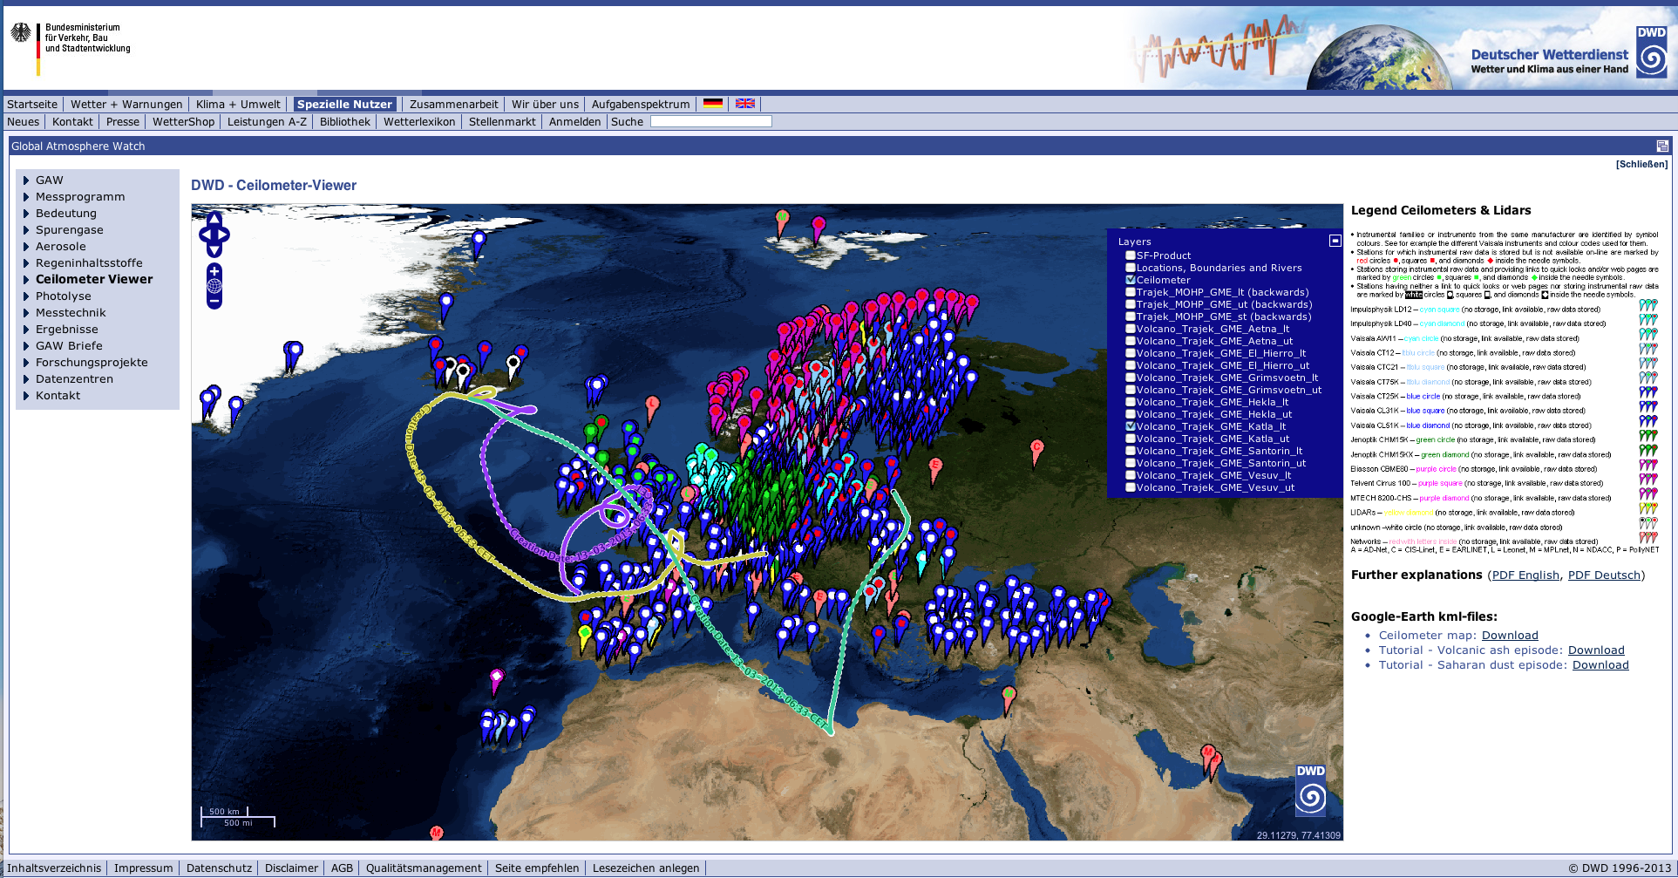
Ceilometers for volcanic ash detection
European ceilometer network with volcanic plume trajectories from Katla, Iceland.

Slide 18
Final considerations
The Commission for Atmospheric Sciences is actively involved in the implementation of WIGOS through its GAW observing program
The aspects of the GAW activity relevant to WIGOS have been outlined in this presentations and the achievements have been highlighted
The GAW Symposium 2013 is taking place in parallel to this meeting and new input should be expected concerning further WIGOS-related activities of GAW

Slide 19
Thank you for your attention
Sandro Fuzzi
Institute of Atmospheric Sciences and Climate
National Research Council
Bologna, Italy
s.fuzzi@isac.cnr.it

