Slide 1
GRIB Edition 3 Enrico Fucile
Inter-Program Expert Team on Data Representation Maintenance and Monitoring
IPET-DRMM
Geneva, 30 May – 3 June 2016

Slide 2
GRIB Edition 3 requirements
Harmonisation with OGC O&M ISO 19156.
More flexibility by introducing templates in each section and implementing a better separation of time, space, parameter, process and data in different sections.
Multiple bitmaps. The possibility to associate multiple bitmaps to a field.
Separation of data and metadata. It must be possible and efficient to list the content of the message without decoding the full dataset also for multi field data.
Redefine the term GRID as more objects which cannot be classified with the classical term of GRID need to be represented in GRIB.
A way to associate two fields in the same message.
The possibility to use different units for the same parameter.
Terms unique and available through the web registry codes.wmo.int
Ambiguity in the regulations and notes has to be eliminated as much as possible by introducing clear explanation and examples.

Slide 3
GRIB Edition 3 requirements
Harmonisation with OGC O&M ISO 19156.
More flexibility by introducing templates in each section and implementing a better separation of time, space, parameter, process and data in different sections.
Multiple bitmaps. The possibility to associate multiple bitmaps to a field.
Separation of data and metadata. It must be possible and efficient to list the content of the message without decoding the full dataset also for multi field data.
Redefine the term GRID as more objects which cannot be classified with the classical term of GRID need to be represented in GRIB.
A way to associate two fields in the same message.
The possibility to use different units for the same parameter.
Terms unique and available through the web registry codes.wmo.int
Ambiguity in the regulations and notes has to be eliminated as much as possible by introducing clear explanation and examples.

Slide 4
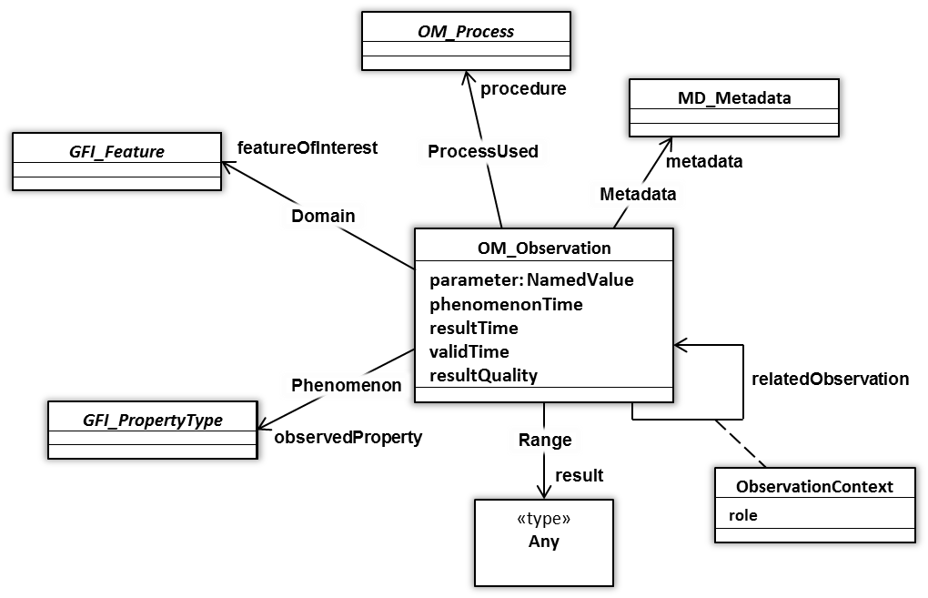
OGC O&M ISO19156 and GRIB 3
OM_Observation: an EVENT whose RESULT is an estimate of a value of some PROPERTY of some THING obtained using a specified PROCEDURE …
4

Slide 5
GRIB edition 3 model
Section 0
Indicator Section
Geospatial Representation In Binary
Binary representation of fields resulting from an observation or a numerical model simulation of an observable property in a geospatial and time domain.
Section 1
Originator Section
Section 2
Repetitions and Index Section
Section 3
Time Domain Section
Section 4
Horizontal Domain Section
Section 5
Vertical Domain Section
Based on ISO19156 in harmonisation with METCE
Section 6
Generating Process Section
repeated
Section 7
Observed Property Section
Section 8
Data Representation Section
Section 9
Overlay Section
Section 10
Data Section
Section 11
End Section

Slide 6
GRIB Edition 3 requirements
Harmonisation with OGC O&M ISO 19156.
More flexibility by introducing templates in each section and implementing a better separation of time, space, parameter, process and data in different sections.
Multiple bitmaps. The possibility to associate multiple bitmaps to a field.
Separation of data and metadata. It must be possible and efficient to list the content of the message without decoding the full dataset also for multi field data.
Redefine the term GRID as more objects which cannot be classified with the classical term of GRID need to be represented in GRIB.
A way to associate two fields in the same message.
The possibility to use different units for the same parameter.
Terms unique and available through the web registry codes.wmo.int
Ambiguity in the regulations and notes has to be eliminated as much as possible by introducing clear explanation and examples.

Slide 7
GRIB edition 3 – Overlay Section
Section 0
Indicator Section
Has a template to define different types of overlay
Bitmap is the simpler template with (0->missing, 1->present) associated to the domain points
Easy to define a n-bits overlay with a flag table providing meaning for each bit of the overlay values
Possible to design a template with multiple overlays. Not a very practical way of associating a field (out of scope).
Section 1
Originator Section
Section 2
Repetitions and Index Section
Section 3
Time Domain Section
Section 4
Horizontal Domain Section
Section 5
Vertical Domain Section
Section 6
Generating Process Section
repeated
Section 7
Observed Property Section
Section 8
Data Representation Section
Section 9
Overlay Section
Section 10
Data Section
Section 11
End Section

Slide 8
GRIB Edition 3 requirements
Harmonisation with OGC O&M ISO 19156.
More flexibility by introducing templates in each section and implementing a better separation of time, space, parameter, process and data in different sections.
Multiple bitmaps. The possibility to associate multiple bitmaps to a field.
Separation of data and metadata. It must be possible and efficient to list the content of the message without decoding the full dataset also for multi field data.
Redefine the term GRID as more objects which cannot be classified with the classical term of GRID need to be represented in GRIB.
A way to associate two fields in the same message.
The possibility to use different units for the same parameter.
Terms unique and available through the web registry codes.wmo.int
Ambiguity in the regulations and notes has to be eliminated as much as possible by introducing clear explanation and examples.

Slide 9
GRIB edition 3 – Repetitions and SUI
Section 0
Indicator Section
Aim is to provide an efficient way to access metadata without decoding data and to have an efficient way to code multiple fields in the same message.
Repeat full block of sections 3 to 10, no option to repeat only some sections.
A section can have a payload or refer to a section with a payload using the Section Unique Identifier (SUI).
Never repeat twice a section with a payload.
Repetitions and Index section has to provide the total number of repetitions and the total number of repetitions with payload for each section
Index is optional and is a complement to a more efficient direct access to the fields stored in the message. It should provide a list of offsets for the sections in a way that the software can make an index by jumping to the relevant sections, without parsing the full message. To be defined later as a set of templates. We can think to provide templates of indexing for vertical profiles, time series, members of ensemble system, different observed properties …
Section 1
Originator Section
Section 2
Repetitions and Index Section
Section 3
Time Domain Section
Section 4
Horizontal Domain Section
Section 5
Vertical Domain Section
Section 6
Generating Process Section
repeated
Section 7
Observed Property Section
Section 8
Data Representation Section
Section 9
Overlay Section
Section 10
Data Section
Section 11
End Section

Slide 10
GRIB Edition 3 requirements
Harmonisation with OGC O&M ISO 19156.
More flexibility by introducing templates in each section and implementing a better separation of time, space, parameter, process and data in different sections.
Multiple bitmaps. The possibility to associate multiple bitmaps to a field.
Separation of data and metadata. It must be possible and efficient to list the content of the message without decoding the full dataset also for multi field data.
Redefine the term GRID as more objects which cannot be classified with the classical term of GRID need to be represented in GRIB.
A way to associate two fields in the same message.
The possibility to use different units for the same parameter.
Terms unique and available through the web registry codes.wmo.int
Ambiguity in the regulations and notes has to be eliminated as much as possible by introducing clear explanation and examples.

Slide 11
GRIB edition 3 – Horizontal domain
Section 0
Indicator Section
GRID is a special case of Horizontal Domain realised with particular templates
In the new structure we can think to have one single point and by repetition of sections a vertical profile or a time series.
Some geometries may require external reference to a grid. This can be implemented in a template.
A template with a list of latitude/longitude points can be defined.
Section 1
Originator Section
Section 2
Repetitions and Index Section
Section 3
Time Domain Section
Section 4
Horizontal Domain Section
Section 5
Vertical Domain Section
Section 6
Generating Process Section
repeated
Section 7
Observed Property Section
Section 8
Data Representation Section
Section 9
Overlay Section
Section 10
Data Section
Section 11
End Section

Slide 12
GRIB Edition 3 requirements
Harmonisation with OGC O&M ISO 19156.
More flexibility by introducing templates in each section and implementing a better separation of time, space, parameter, process and data in different sections.
Multiple bitmaps. The possibility to associate multiple bitmaps to a field.
Separation of data and metadata. It must be possible and efficient to list the content of the message without decoding the full dataset also for multi field data.
Redefine the term GRID as more objects which cannot be classified with the classical term of GRID need to be represented in GRIB.
A way to associate two fields in the same message.
The possibility to use different units for the same parameter.
Terms unique and available through the web registry codes.wmo.int
Ambiguity in the regulations and notes has to be eliminated as much as possible by introducing clear explanation and examples.

Slide 13
GRIB edition 3 – Referencing fields
Repeated sections have a Section Unique Identifier (SUI) except Data Section (data section is the payload)
A unique identifier for a field is the sequence of the SUIs of its sections. This can be used within the message to reference a field uniquely.
A quality control variable can be defined by a template containing the parameter definitions and the SUI-OPS of the variable to which it refers.
Building a unique external reference to a field would require an extra element to make the key made with the SUIs globally unique.
It is possible to think of a single GRIB message with several orography fields defined on different horizontal domains (possibly a set of lat/lon points or a complex grid). A set of templates referring to external fields can be used in sections 3 to 9 to link to the individual field in the GRIB message. A way of providing a unique prefix identifier (probably a URI) has to be developed.
Section 0
Indicator Section
Section 1
Originator Section
Section 2
Repetitions and Index Section
Section 3
SUI-TDS Time Domain Section
Section 4
SUI-HDS Horizontal Domain Section
Section 5
SUI-VDS Vertical Domain Section
Section 6
SUI-GPS Generating Process Section
repeated
Section 7
SUI-OPS Observed Property Section
Section 8
SUI-DRS Data Representation Section
Section 9
SUI-OS Overlay Section
Section 10
Data Section
Section 11
End Section

Slide 14
GRIB Edition 3 requirements
Harmonisation with OGC O&M ISO 19156.
More flexibility by introducing templates in each section and implementing a better separation of time, space, parameter, process and data in different sections.
Multiple bitmaps. The possibility to associate multiple bitmaps to a field.
Separation of data and metadata. It must be possible and efficient to list the content of the message without decoding the full dataset also for multi field data.
Redefine the term GRID as more objects which cannot be classified with the classical term of GRID need to be represented in GRIB.
A way to associate two fields in the same message.
The possibility to use different units for the same parameter.
Terms unique and available through the web registry codes.wmo.int
Ambiguity in the regulations and notes has to be eliminated as much as possible by introducing clear explanation and examples.

Slide 15
GRIB edition 3 – Units
We need to provide guidance on the units, but we also need to provide flexibility.
Units cannot be completely free. We don’t want temperature to be expressed in metres.
We are specifically talking of the units of the observed property.
QUDT - Quantities, Units, Dimensions and Data Types Ontologies (qudt.org) is an excellent solution and has been discussed in the context of METCE several times. Very resources demanding in terms of implementation.
Proposed solution in a Simple Observed Property template is to provide a conversion scale factor and offset to compute the values in the units provided in the official table of parameters.
Observable Property Template 7.0 – Simple Observable Property
Byte No. Contents
8 Parameter Discipline (see Code table 7.1)
9 Parameter Category (see Code table 7.2)
10-11 Parameter Number (see Code table 7.3)
12-15 Units conversion scale factor (ucs) (see Note 1)
16-19 Units conversion offset (uco) (see Note 1)
Notes:
Units conversion scale factor (ucs) and offset (uco) shall be used to encode fields in units different from
the units reported in table 7.3. If the values encoded in the GRIB message are v_{e} , the values in the units provided
in table 7.2 shall be: v=ucs * v_{e}+ uco .

Slide 16
GRIB Edition 3 requirements
Harmonisation with OGC O&M ISO 19156.
More flexibility by introducing templates in each section and implementing a better separation of time, space, parameter, process and data in different sections.
Multiple bitmaps. The possibility to associate multiple bitmaps to a field.
Separation of data and metadata. It must be possible and efficient to list the content of the message without decoding the full dataset also for multi field data.
Redefine the term GRID as more objects which cannot be classified with the classical term of GRID need to be represented in GRIB.
A way to associate two fields in the same message.
The possibility to use different units for the same parameter.
Terms unique and available through the web registry codes.wmo.int
Ambiguity in the regulations and notes has to be eliminated as much as possible by introducing clear explanation and examples.

Slide 17
GRIB edition 3 – Unique name for terms
Reuse of terms is an important feature to be able to expose the semantics to other communities and to build the mapping with other community standards.
This will require do define a unique name for each term. Uniqueness has to be guaranteed within GRIB and the web registry codes.wmo.int will collect those terms and provide global unique identifiers.
Mapping with CF convention will require the definition of unique names and the mapping between the two standards.
Observable Property Template 7.0 – Simple Observable Property
Byte No. Unique Name Contents
8 parameterDiscipline Parameter Discipline (see Code table 7.1)
9 parameterCategory Parameter Category (see Code table 7.2)
10-11 parameterNumber Parameter Number (see Code table 7.3)
12-15 unitsConversionScaleFactor Units conversion scale factor (ucs) (see Note 1)
16-19 unitsConversionOffset Units conversion offset (uco) (see Note 1)

Slide 18
GRIB Edition 3 requirements
Harmonisation with OGC O&M ISO 19156.
More flexibility by introducing templates in each section and implementing a better separation of time, space, parameter, process and data in different sections.
Multiple bitmaps. The possibility to associate multiple bitmaps to a field.
Separation of data and metadata. It must be possible and efficient to list the content of the message without decoding the full dataset also for multi field data.
Redefine the term GRID as more objects which cannot be classified with the classical term of GRID need to be represented in GRIB.
A way to associate two fields in the same message.
The possibility to use different units for the same parameter.
Terms unique and available through the web registry codes.wmo.int
Ambiguity in the regulations and notes has to be eliminated as much as possible by introducing clear explanation and examples.

Slide 19
Change suggested
Replace “observable” with “observed” in all the relevant templates and sections.
Explicitly state that date and time are compliant with ISO8601:2004
Latitude, longitude regulations to be revised and moved to “horizontal domain section”
Unique name to be given to all the elements in GRIB. It has to be unique within GRIB standard and will be part of the codes registry where it will have a global unique identifier.

Slide 20
Thank you for your attention

